Slide 1
Create Request for Proposals (RFP)
DESCRIPTION
This guide will show Sourcing Event Buyers how to create a Request for Proposals (RFP).
OVERVIEW
The key steps in the process are below:
Navigate to Sourcing.
Select Create New Event.
Select the eRFP Template and complete the necessary fields.
Submit the Sourcing Event.
Business Process:
Navigate to Sourcing Module
Select Create New Event
Utilize the eRFP Template
Submit the Sourcing Event

Slide 2


Create Request for Proposals (RFP)
(Part 1 of 53)
INSTRUCTIONS
Click the Global Navigation Menu.
Note: University System of Georgia (USG) and GDOT users complete local logon and then proceed to Step 4.
Click Sourcing, Contracts & Supplier Management.

Slide 3

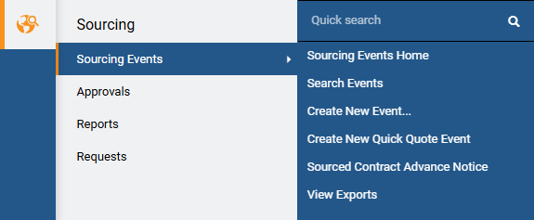
Create Request for Proposals (RFP)
(Part 2 of 53)
INSTRUCTIONS
Click Sign On.
Note: The system utilizes Single Sign-On (SSO) capabilities and no log in information is required.
Click Sourcing.
Click Sourcing Events.
Click Create New Event.
4
5
6

Slide 4
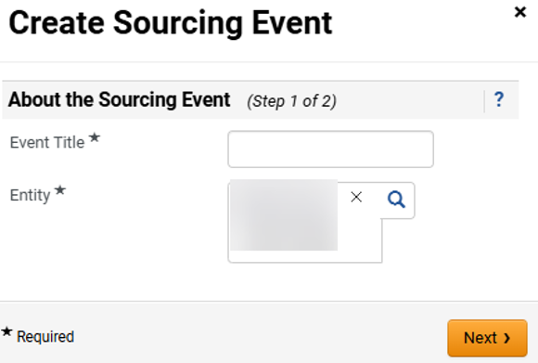
Create Request for Proposals (RFP)
(Part 3 of 53)
INSTRUCTIONS
Enter Event Title*.
Note: Including the State Entity Name in Event Title will assist in Sourcing Director event list as there is no column to display state entity’s name (e.g. UGA Consulting Services).
Review populated Entity*.
Click Next.
7
8
9

Slide 5
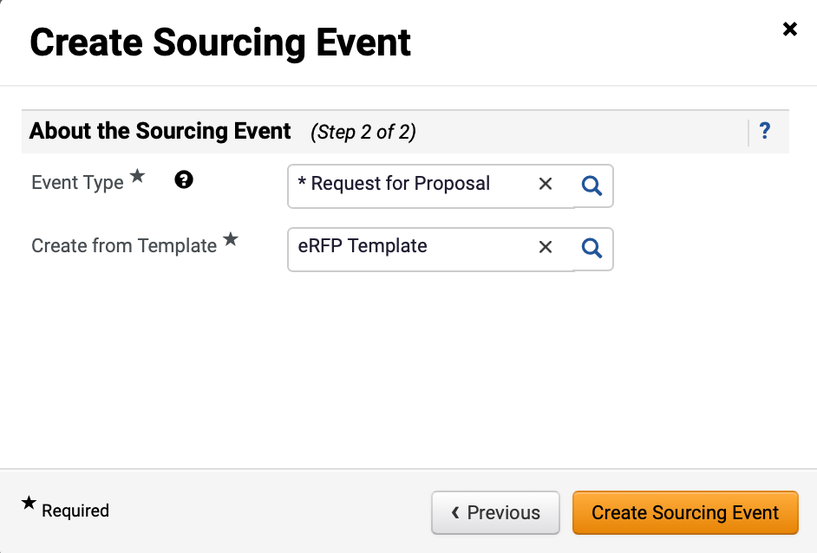
Create Request for Proposals (RFP)
(Part 4 of 53)
INSTRUCTIONS
Select Request for Proposal as the Event Type*.
Select eRFP Template for Create from Template*.
Note: eRFP Template will auto-populate in the Create from Template field once Request for Proposal is selected.
Click Create Sourcing Event.
10
11
12

Slide 6
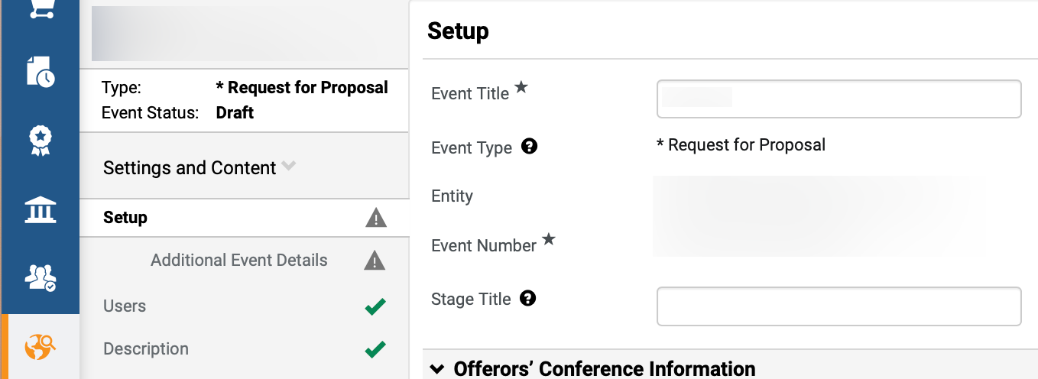
Create Request for Proposals (RFP)
(Part 5 of 53)
INSTRUCTIONS
Review populated Event information.
Enter Stage Title.
Note: Stage Title is used to distinguish different versions if an event goes to a second stage and beyond during the evaluation process, such as a round of cost negotiations. It is recommended to enter “Original Solicitation” as the Stage Title for all events during initial set-up. Stage Title and Event Title can be edited; however, the other fields are read-only.
13
14

Slide 7
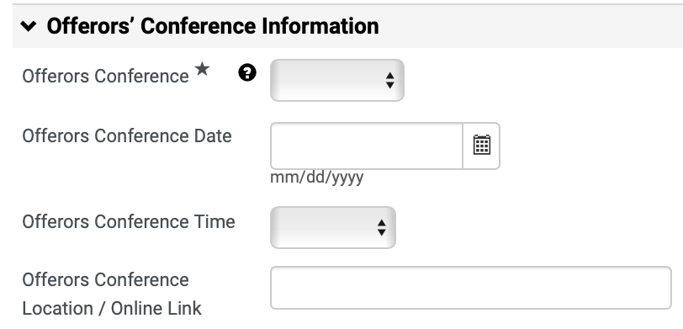
Create Request for Proposals (RFP)
(Part 6 of 53)
INSTRUCTIONS
Select Offerors Conference*.
Note: If Mandatory or Optional is selected, follow Steps 16 – 22 to complete the fields in this section. If Offerors Conference is N/A, skip to Step 23. This information is transmitted and displayed on the Georgia Procurement Registry (GPR) as part of the public notice. The Sourcing Event Buyer must also include offerors’ conference information by publishing SPD-SPR010 Bidders/Offerors’ Conference Announcement in the Buyers Attachment section.
Enter Offerors Conference Date.
Select Offerors Conference Time.
Enter Offerors Conference Location / Online Link.
Note: Indicate whether the conference will be held virtually, and if so, use the link option to provide the virtual meeting information.
15
16
17
18

Slide 8
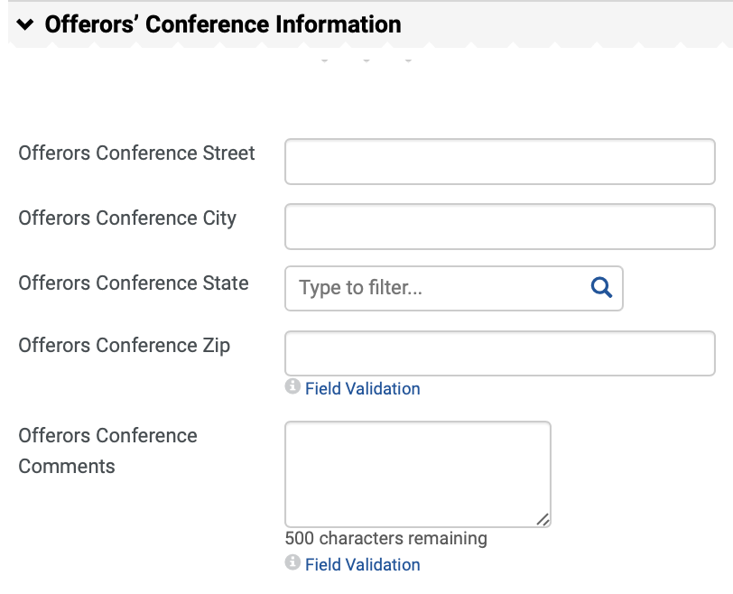
Create Request for Proposals (RFP)
(Part 7 of 53)
INSTRUCTIONS
Enter Offerors Conference Street and Offerors Conference City.
Select Offerors Conference State.
Note: Click magnifying glass to view more options.
Enter Offerors Conference Zip.
Enter Offerors Conference Comments.
19
20
21
22

Slide 9
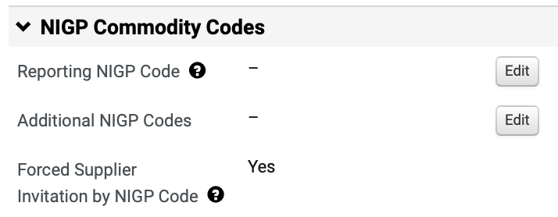
Create Request for Proposals (RFP)
(Part 8 of 53)
INSTRUCTIONS
Click Edit to add the Reporting NIGP Code.

Slide 10
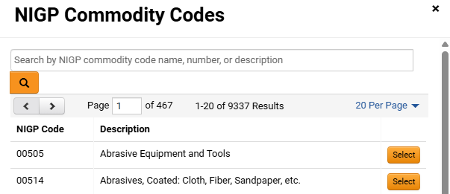
Create Request for Proposals (RFP)
(Part 9 of 53)
INSTRUCTIONS
Enter or search for the Commodity Code.
Note: Search by Name, Code or Description. Commodity Code can be removed by clicking Remove.
Click Select.
Note: If the event is limited to suppliers that were prequalified through an eRFP, then do not select any NIGP Commodity Codes. Instead, add the qualified suppliers to the event to be notified manually.
24
25

Slide 11
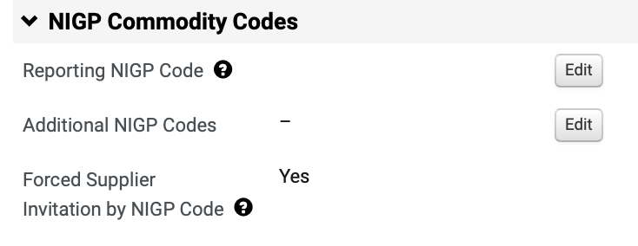
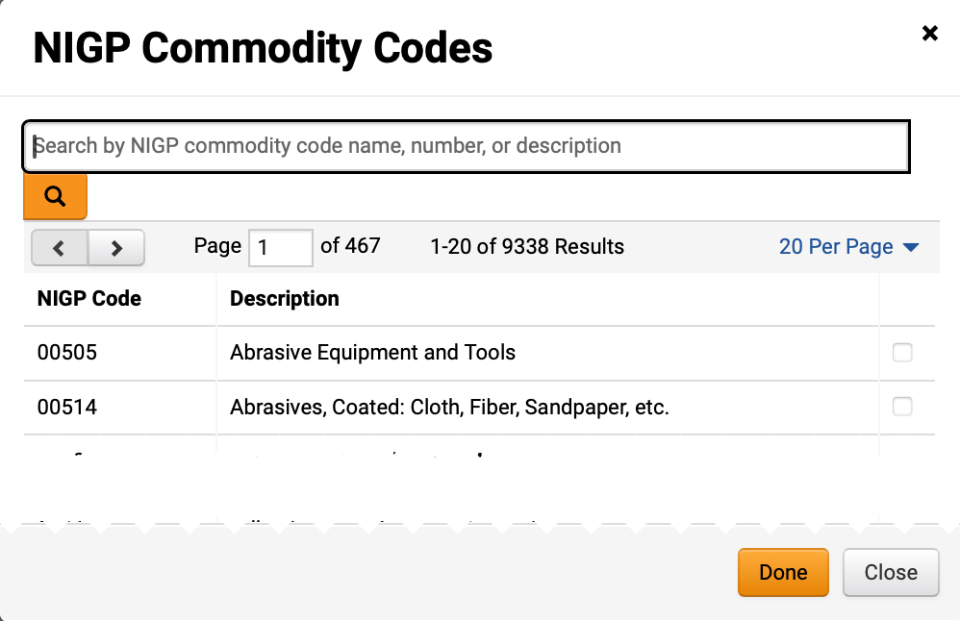
Create Request for Proposals (RFP)
(Part 10 of 53)
INSTRUCTIONS
Review added Reporting NIGP Code.
Click Edit to add Additional NIGP Commodity.
26
27
Check the NIGP Commodity Code box.
Note: Multiple codes can be selected.
Click Done.
28
29

Slide 12
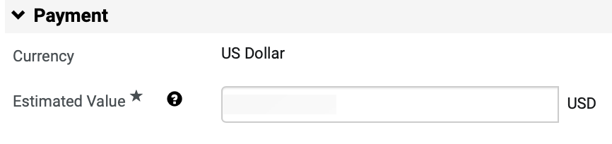
Create Request for Proposals (RFP)
(Part 11 of 53)
INSTRUCTIONS
Enter the Estimated Value for the event.
Note: The Estimated Value field is also used for DPA Approvals and NOIA/NOA protest period.

Slide 13
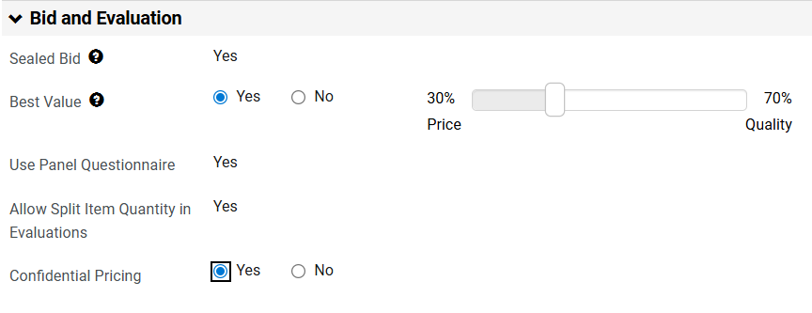
Create Request for Proposals (RFP)
(Part 12 of 53)
INSTRUCTIONS
Select checkbox for Best Value and drag slider bar to match the RFP percentage weight.
Note: Best Value defaults to No. By selecting Yes, an additional field to select Price and Quality will display.
Select checkbox for Confidential Pricing.
Note: Confidential Pricing conceals suppliers’ price line item responses from panelists; however, the sourcing event buyer will be able to view all pricing. The Sealed Bid, Use Panel Questionnaire, and Allow Split Item Quantity in Evaluations fields in this section are read-only based on the template selection. Sealed Bid ensures supplier responses remain confidential to the Sourcing Event Buyer until after the event closes.
31
32

Slide 14
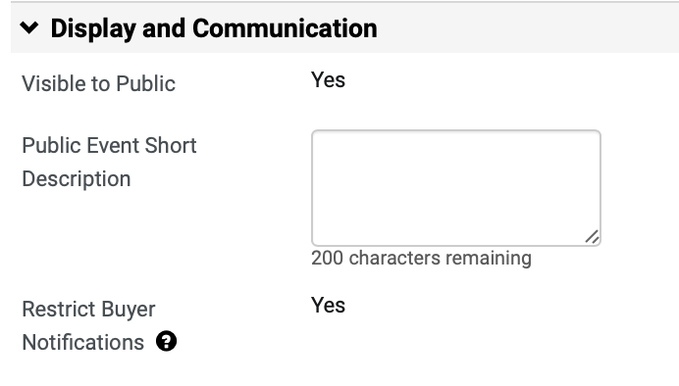
Create Request for Proposals (RFP)
(Part 13 of 53)
INSTRUCTIONS
Enter Public Event Short Description (Optional).
Note: The Public Event Short Description will be displayed on the GA@WORK Marketplace. It is highly recommended to include the state entity’s full name in the description. Restrict Buyer Notification is set to Yes so that only the Sourcing Event Buyer will receive event related notifications.

Slide 15
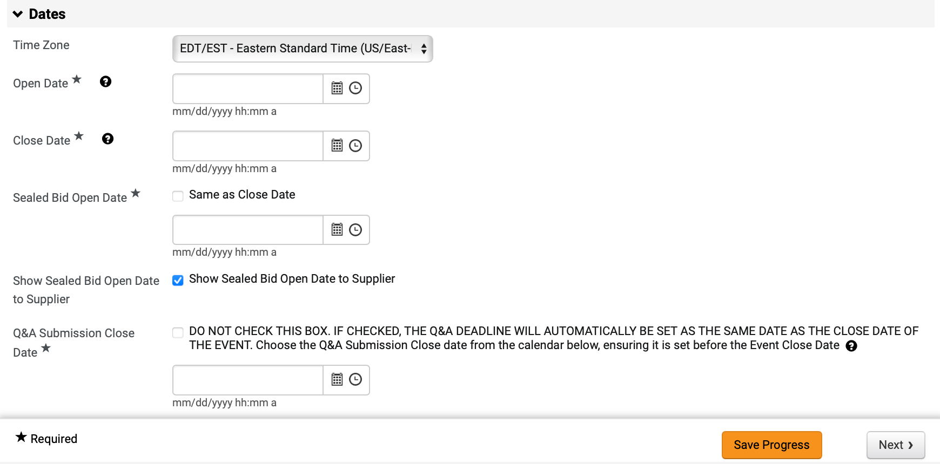
Create Request for Proposals (RFP)
(Part 14 of 53)
INSTRUCTIONS
Select Time Zone (Optional).
Note: Verify Time Zone is set to Eastern Standard Time.
Enter Open Date* and Close Date*.
Select Sealed Bid Open Date*.
Note: Same as Close Date checkbox is auto-populated. If unselecting Same as Close Date checkbox, the Sealed Bid Open Date field is visible.
Select Show Sealed Bid Open Date to Supplier.
Note: Show Sealed Bid Open Date to Supplier checkbox is auto-populated.
Enter Q&A Submission Close Date*.
Note: If clicking the checkbox, the date field does not need to be populated and will automatically be set as the same date as the close date of the event.
Click Save Progress and Next.
34
35
36
37
38
39

Slide 16
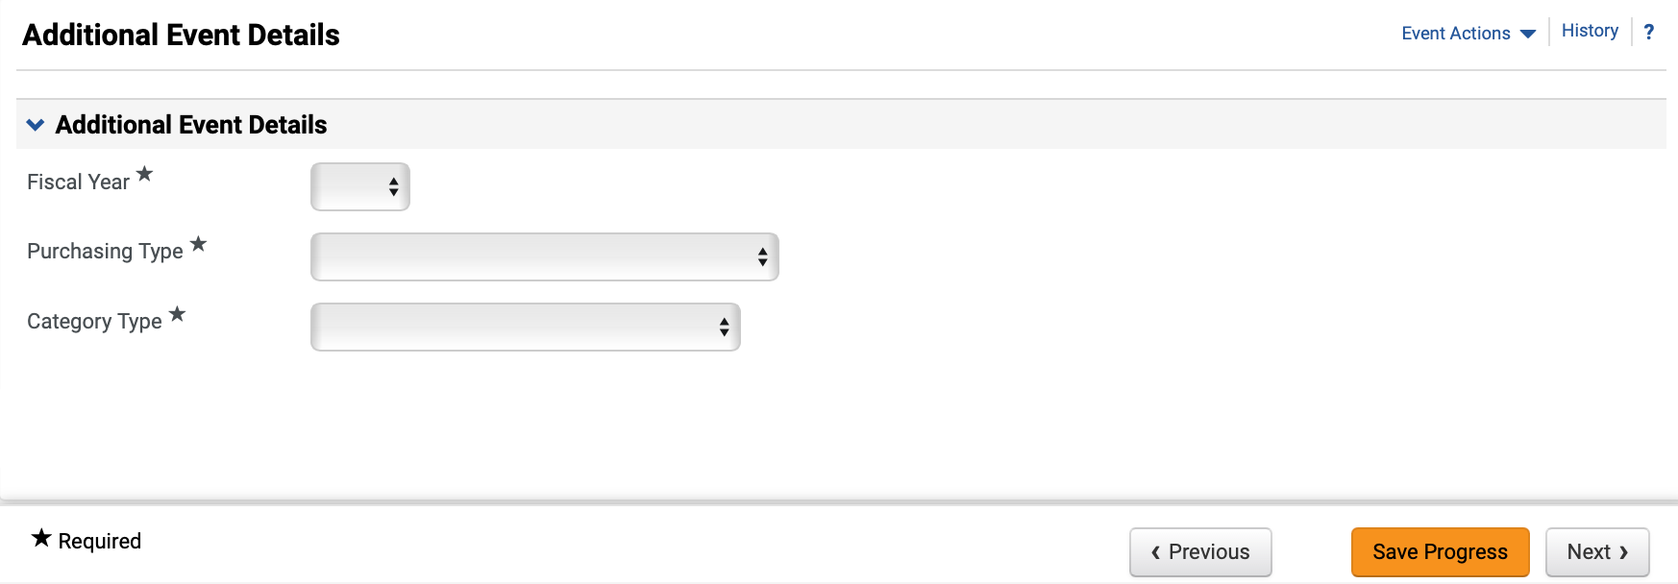
Create Request for Proposals (RFP)
(Part 15 of 53)
INSTRUCTIONS
Select the Fiscal Year* the event will be awarded.
Select Purchasing Type* and Category Type*.
Click Next.
40
41
42

Slide 17
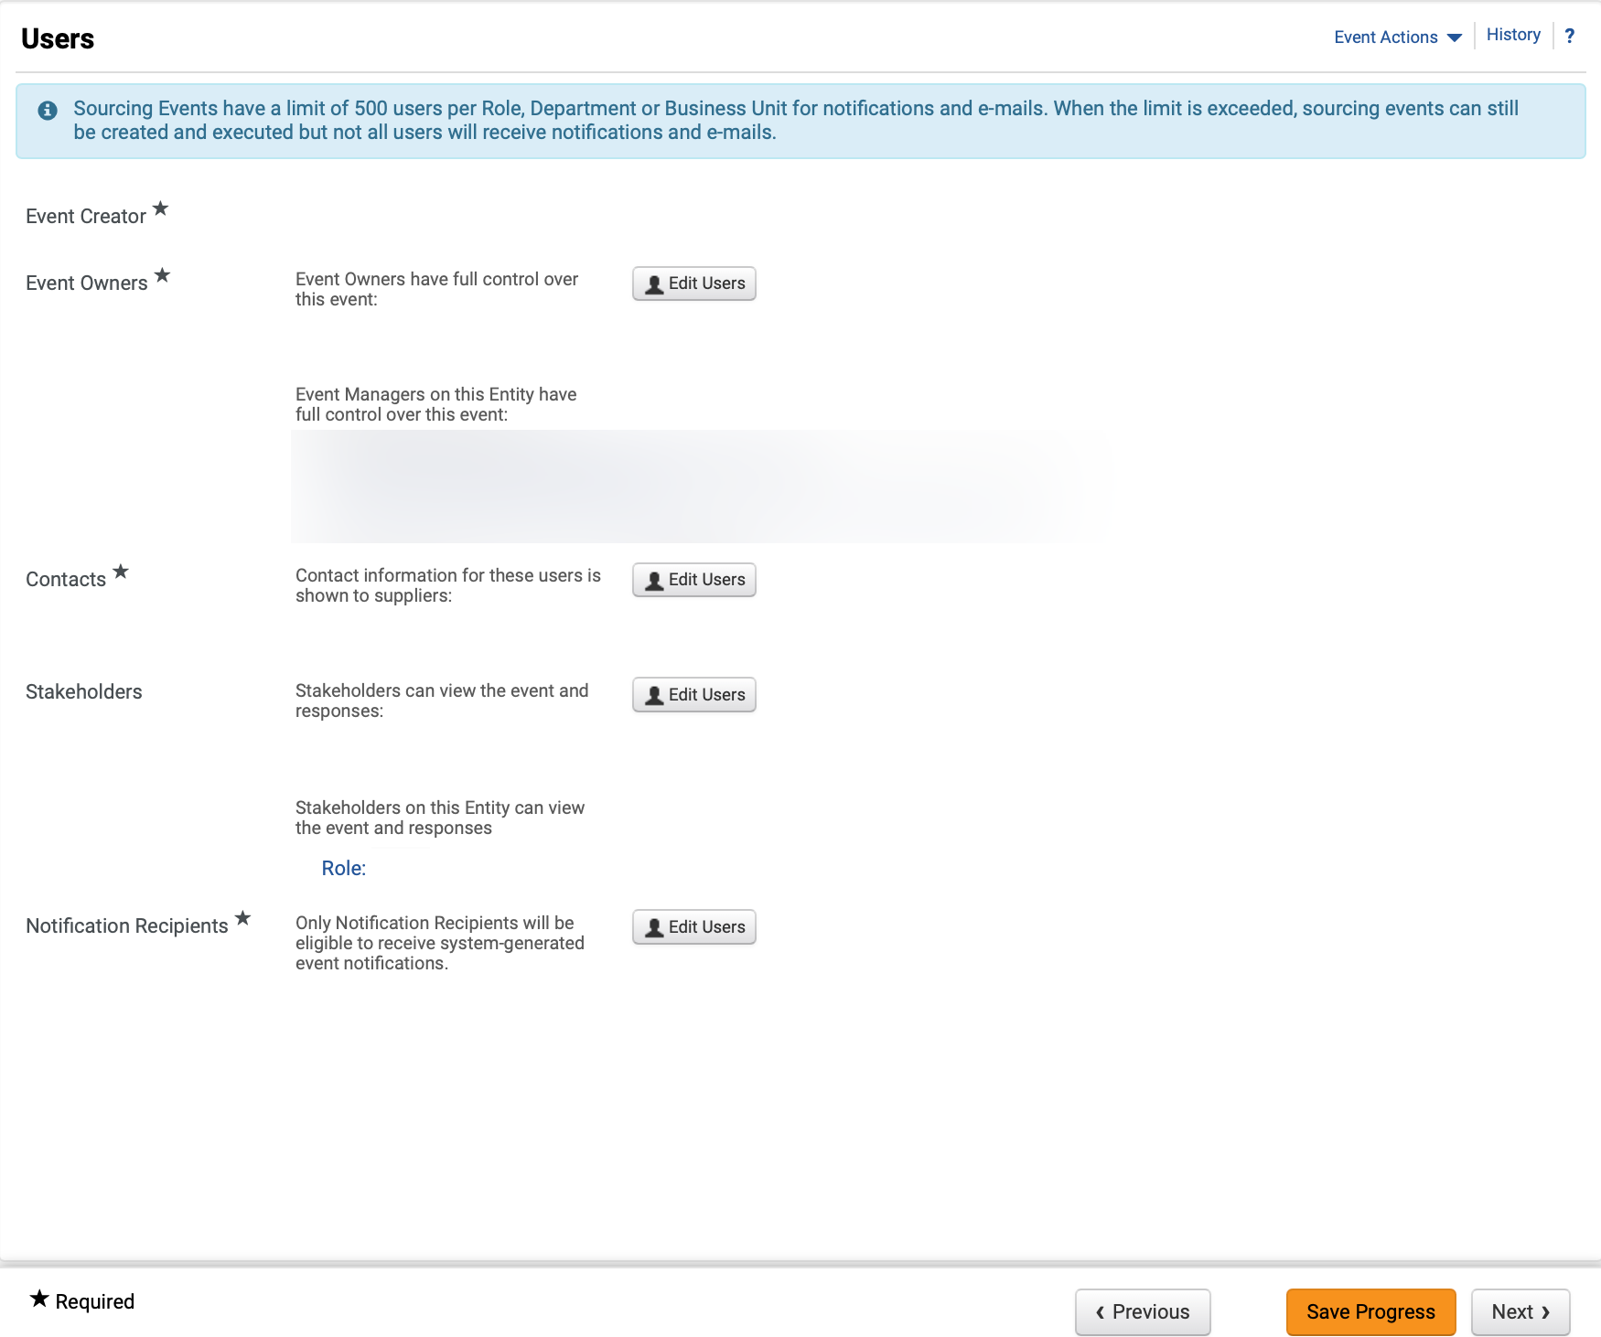
Create Request for Proposals (RFP)
(Part 16 of 53)
INSTRUCTIONS
Review Event Owners*, Contacts* and Notification Recipients*.
Note: Click Edit Users to update any of the editable fields. Review Managing Administrators, Stakeholders and Contract Managers Job Aid for further details.
Click Next.
43
44

Slide 18
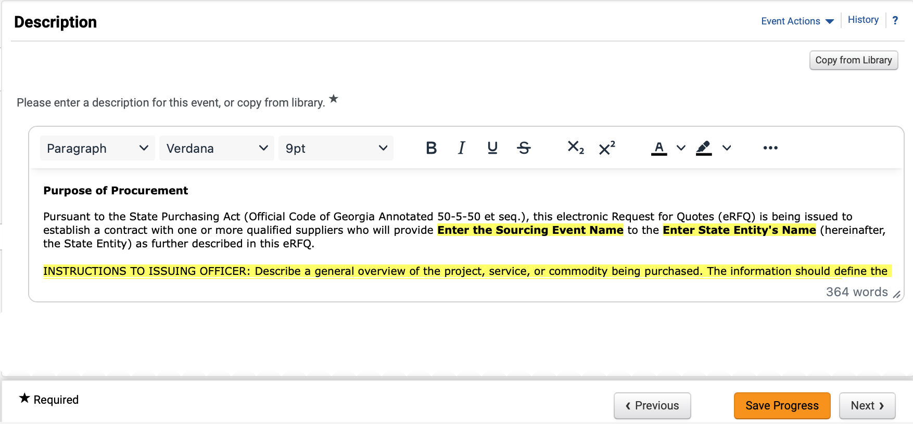
Create Request for Proposals (RFP)
(Part 17 of 53)
INSTRUCTIONS
Review and edit Description*.
Note: Remove instructions when editing Description. To remove yellow highlighting, select the text and click the Paint Bucket to change the background color. To Copy from Library, follow Steps 46 – 49, or skip to Step 50 to add Stage Description.
To Copy Description from Library, click Copy from Library.
Note: Click magnifying glass to display more options.

Slide 19
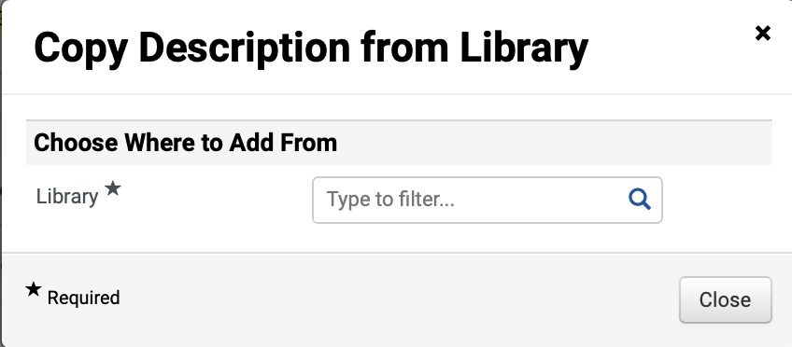
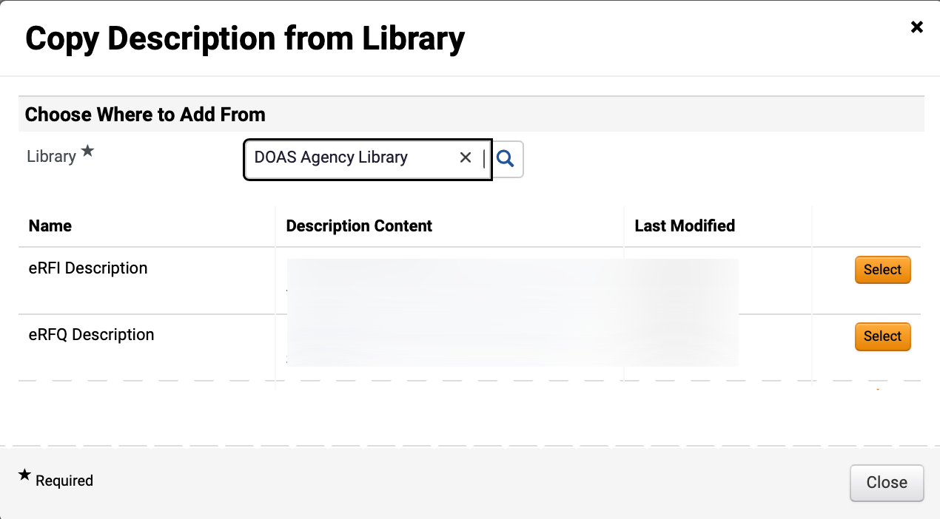
Create Request for Proposals (RFP)
(Part 18 of 53)
INSTRUCTIONS
Select Library*.
Note: Click magnifying glass to display more options.
Click Select to add Description Content.

Slide 20
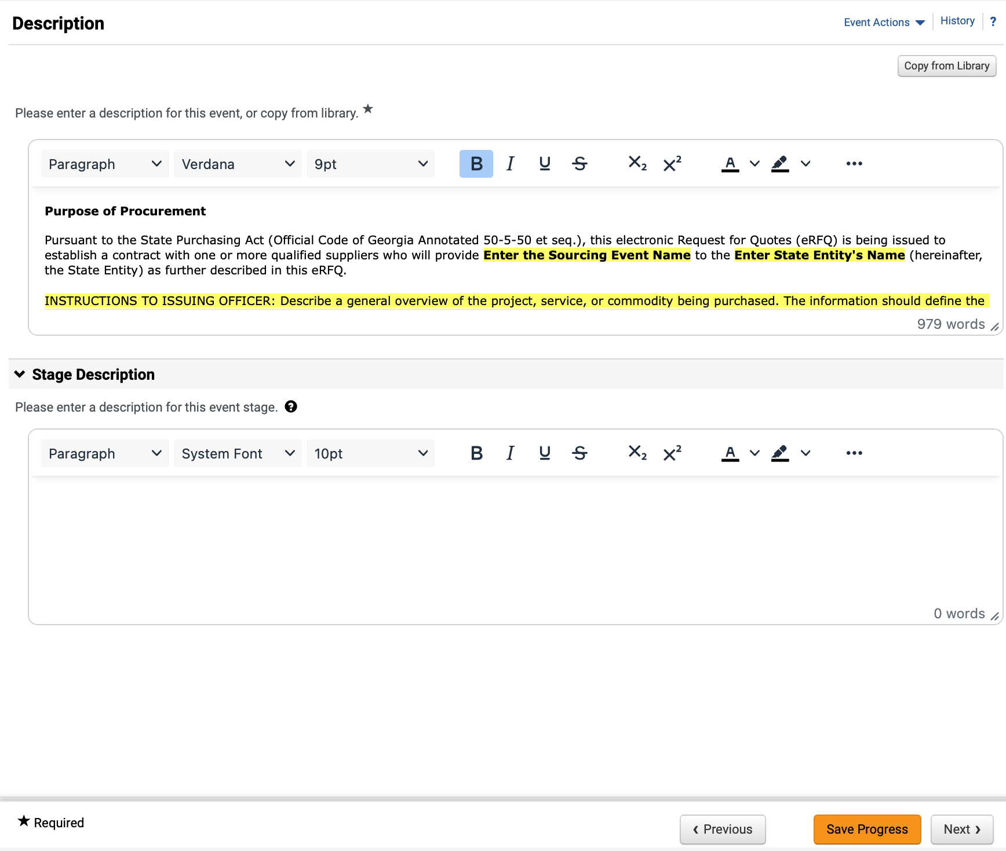
Create Request for Proposals (RFP)
(Part 19 of 53)
INSTRUCTIONS
Review added Description.
Enter Stage Description (Optional).
Note: Populate this field only if there is a stage included in the event.
Click Save Progress and Next.
49
50
51

Slide 21
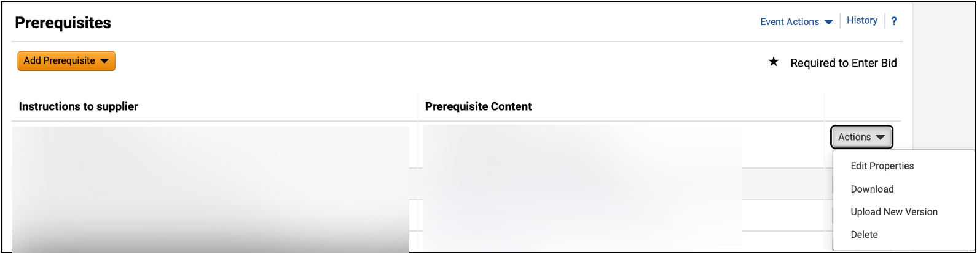
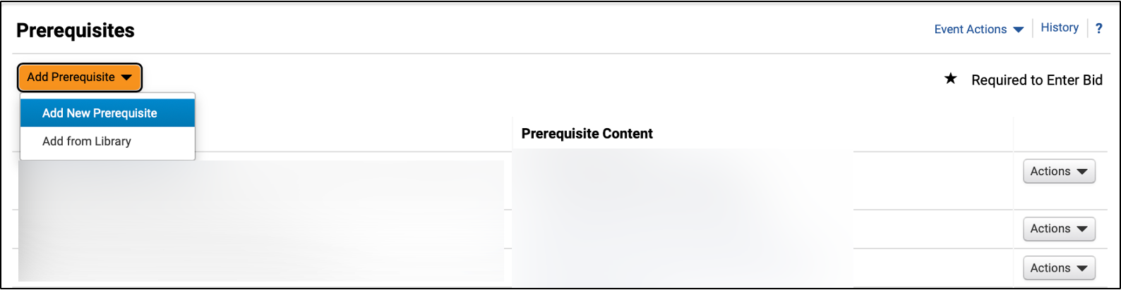
Create Request for Proposals (RFP)
(Part 20 of 53)
INSTRUCTIONS
Click Actions to edit or delete a Prerequisite (Optional).
Note: All template populated Prerequisites should be reviewed by Sourcing Event Buyers to ensure language and attachments are correct in accordance with what they are sourcing.
Click Add Prerequisite (Optional).
Note: If selecting Add New Prerequisite, follow Steps 54 – 69 and then skip to Step 77 to Add Attachment. If selecting Add from Library, follow Steps 70 – 76.
Select Add New Prerequisite.
53
54

Slide 22
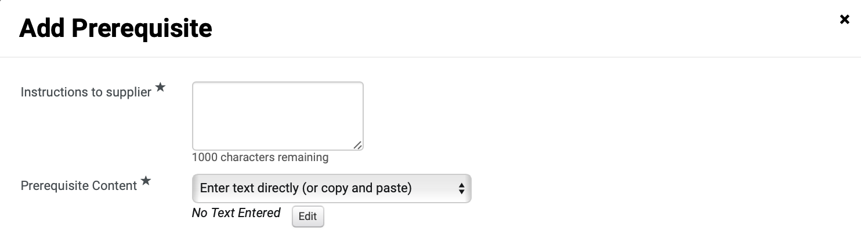
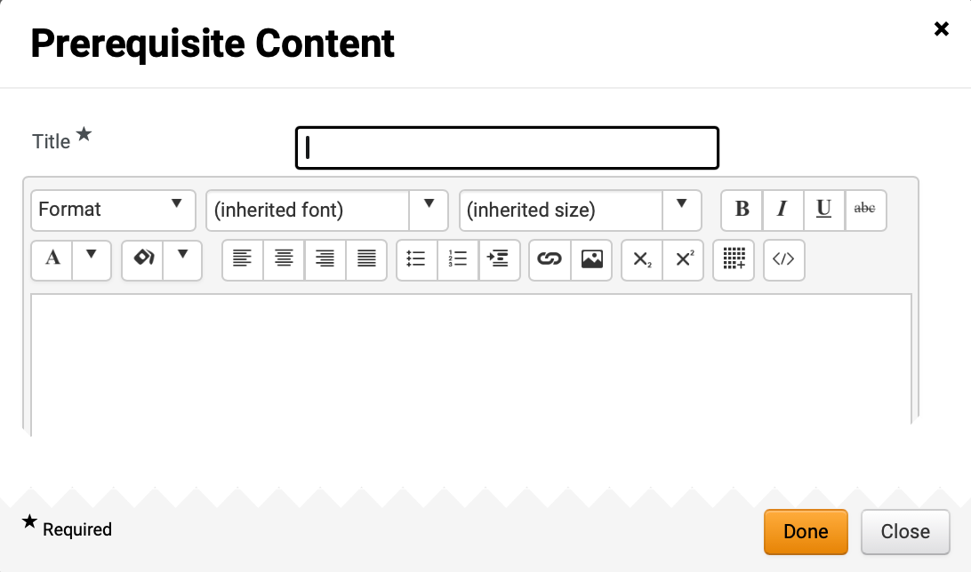
Create Request for Proposals (RFP)
(Part 21 of 53)
INSTRUCTIONS
Enter Instructions to supplier*.
Select Prerequisite Content*.
Note: If selecting Enter text directly, follow Steps 57 – 60, skip to Steps 68 - 69, and skip to Step 76. To Attach File, skip to Step 61.
Click Edit.
55
56
57
Enter Title*.
Enter Prerequisite Content.
Click Done.
58
59
60

Slide 23
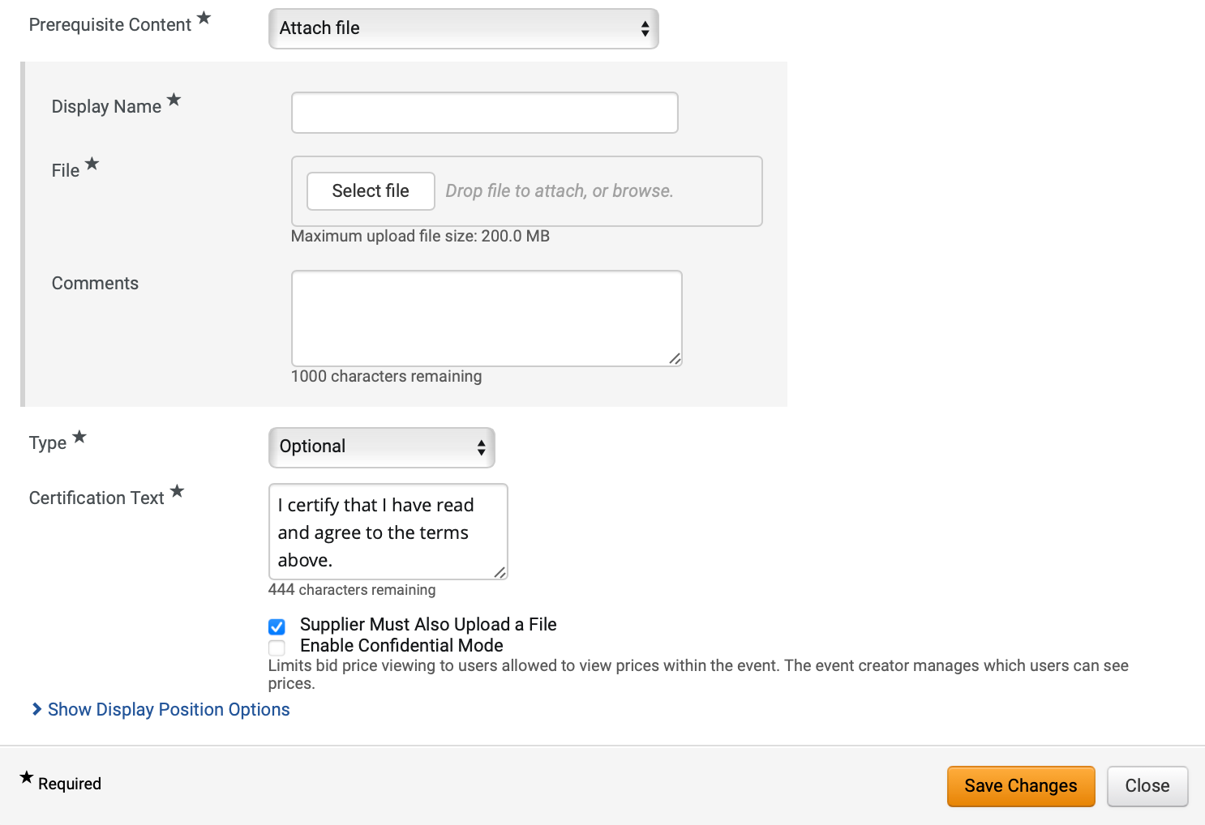
Create Request for Proposals (RFP)
(Part 22 of 53)
INSTRUCTIONS
If attaching file, enter Display Name*.
Click Select file to attach File*.
Enter Comments (Optional).
Select Type*.
Enter Certification Text*.
Note: Certification Text will auto-populate but can be edited.
Click Supplier Must Also Upload a File checkbox (Optional).
Note: If checked, Enable Confidential Mode option will display.
Click Show Display Position Options.
61
62
63
64
65
67
66

Slide 24
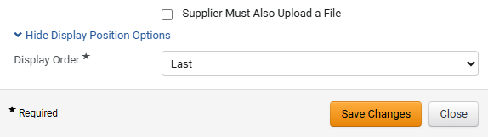
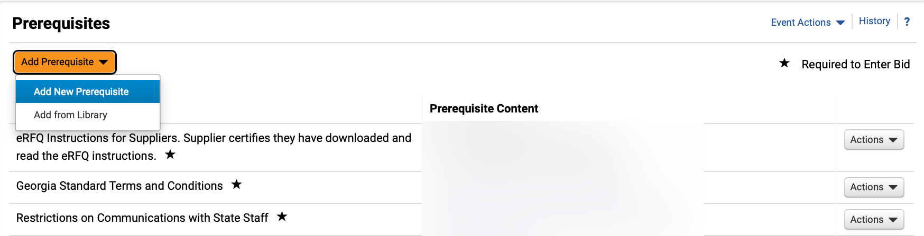
Create Request for Proposals (RFP)
(Part 23 of 53)
INSTRUCTIONS
Select Display Order*.
Click Save Changes.
Note: Repeat the steps above to add additional custom prerequisites.
68
69
Click Add Prerequisite.
Select Add from Library.
70
71

Slide 25
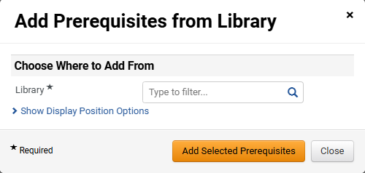
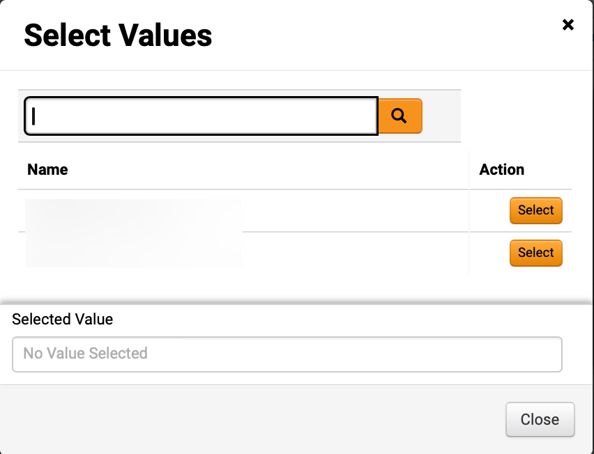
Create Request for Proposals (RFP)
(Part 24 of 53)
INSTRUCTIONS
Click magnifying glass to select Library*.
Note: If selecting Library from dropdown, skip to Step 74.
Click Select for the desired library.

Slide 26
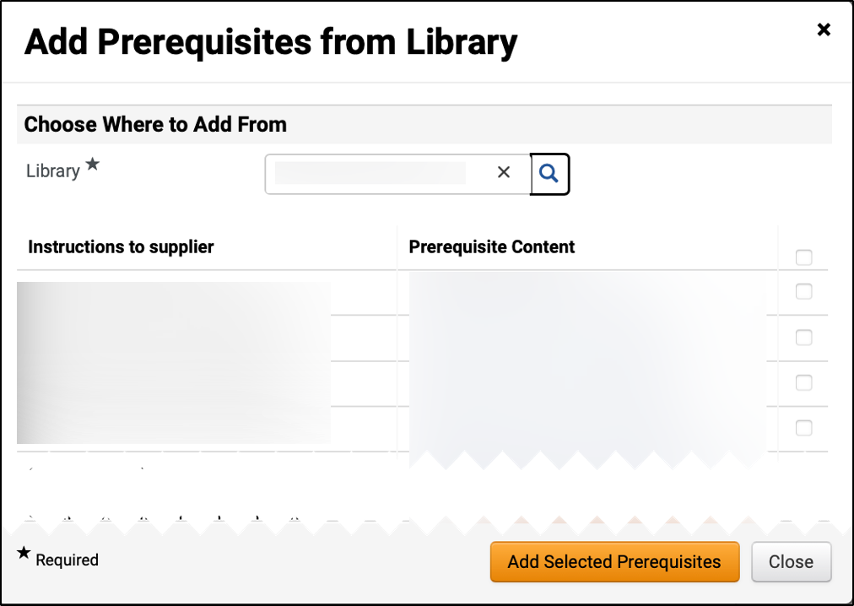
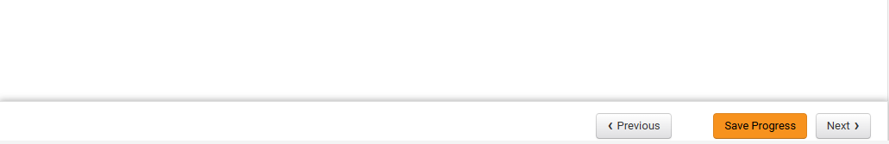
Create Request for Proposals (RFP)
(Part 25 of 53)
INSTRUCTIONS
Check Prerequisite box.
Note: Multiple Prerequisites can be selected.
Click Add Selected Prerequisites.
74
75
Click Save Progress and Next.
76

Slide 27
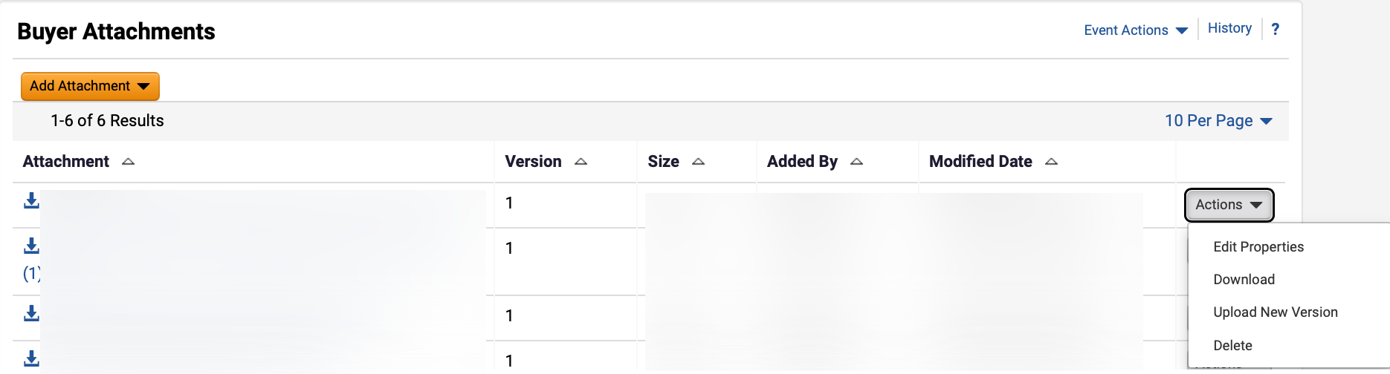
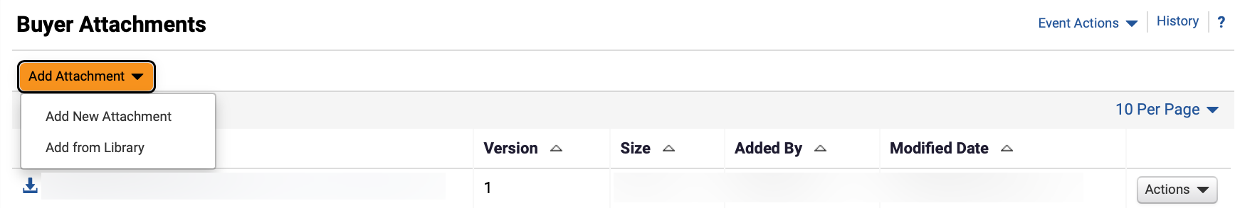
Create Request for Proposals (RFP)
(Part 26 of 53)
INSTRUCTIONS
Click Actions to edit or delete an attachment (Optional).
Click Add Attachment.
Note: Follow Steps 79 – 92 and skip to Step 97 if adding Buyer Attachments or skip to Step 93 to Add from Library. Following your organization's guidance, upload any relevant files to the event. If no files to add, skip to Step 98.
Select Add New Attachment.
78
79

Slide 28
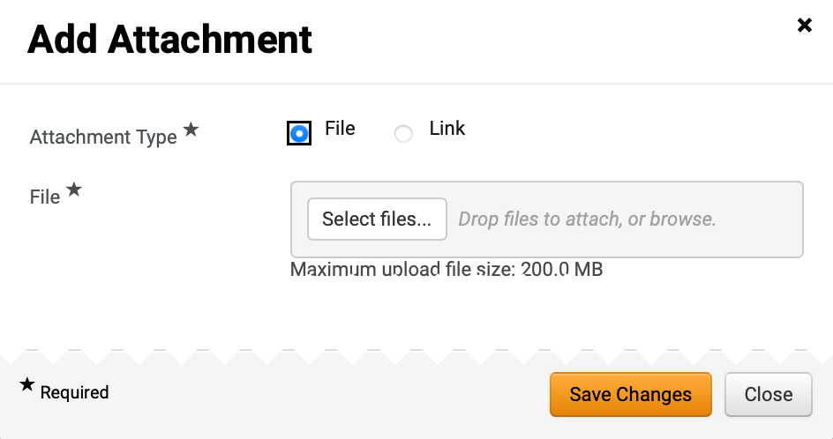

Create Request for Proposals (RFP)
(Part 27 of 53)
INSTRUCTIONS
Select Attachment Type*.
Note: If selecting File, follow Steps 81 – 87 then skip to Step 98. If selecting Link, skip to Step 88.
Click Select files… to upload File*.
89
81
Select the applicable File from local computer.
Click Open.
82
83

Slide 29
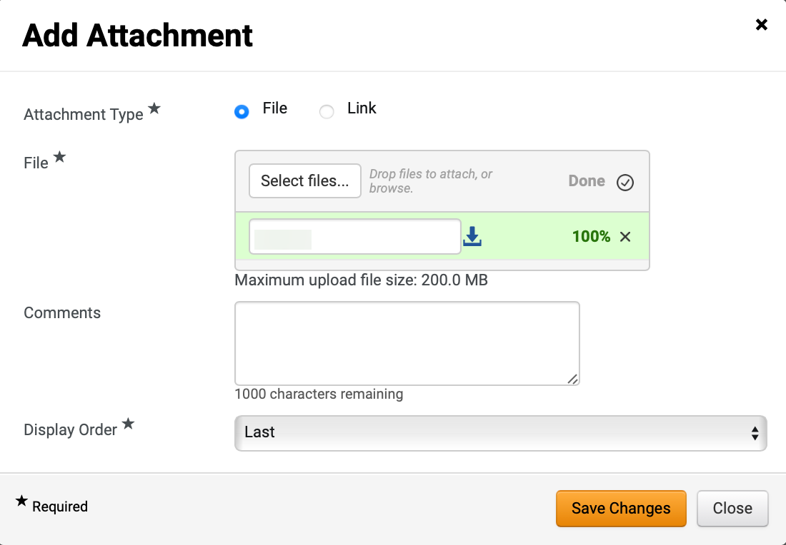
Create Request for Proposals (RFP)
(Part 28 of 53)
INSTRUCTIONS
Confirm that the uploaded File* was added.
Enter Comments (Optional).
Select Display Order*.
Click Save Changes.
Note: Skip to Step 99 to Add Question.
84
85
86
87

Slide 30
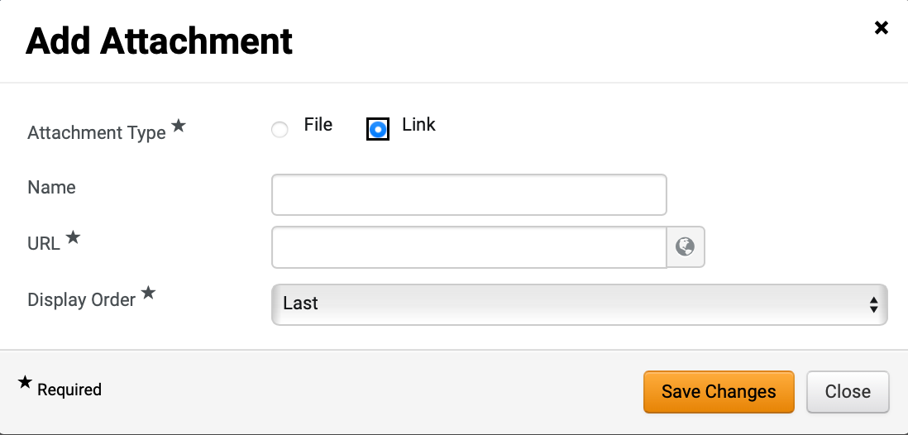
Create Request for Proposals (RFP)
(Part 29 of 53)
INSTRUCTIONS
Select Link as Attachment Type*.
Enter Name.
Enter URL*.
Select Display Order*.
Click Save Changes.
88
89
90
91
92
To Add Attachment from Library, select Add from Library.

Slide 31
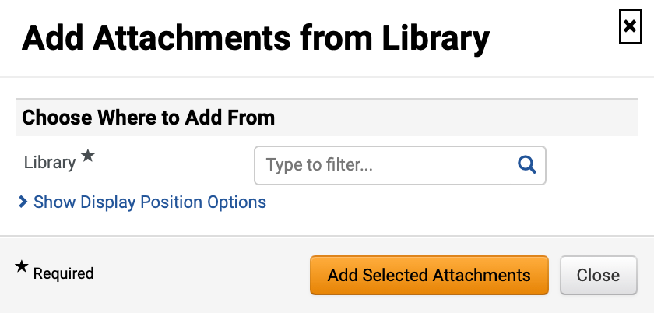
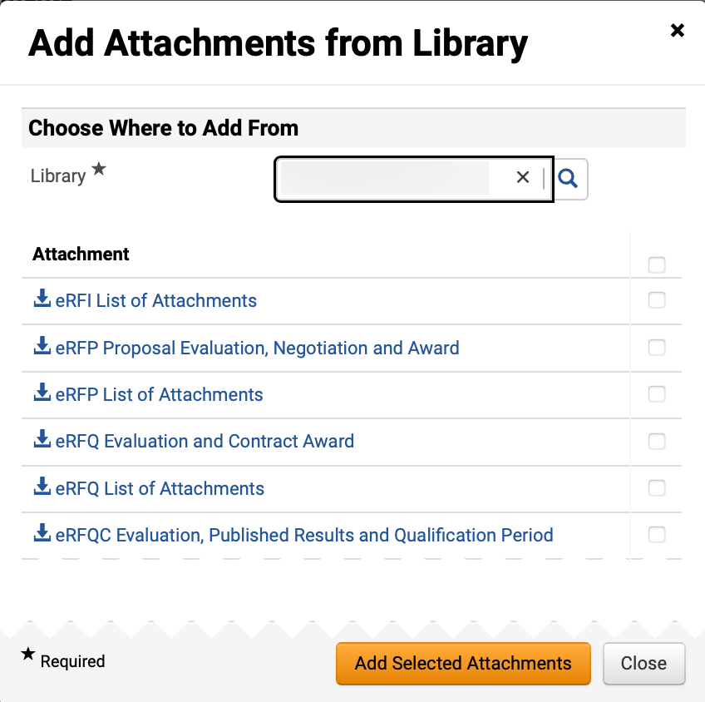
Create Request for Proposals (RFP)
(Part 30 of 53)
INSTRUCTIONS
Select Library*.
Note: Use magnifying glass to search for Library.
Check box to Add Attachments.
Note: Multiple Attachments can be selected.
Click Add Selected Attachments.
95
96

Slide 32
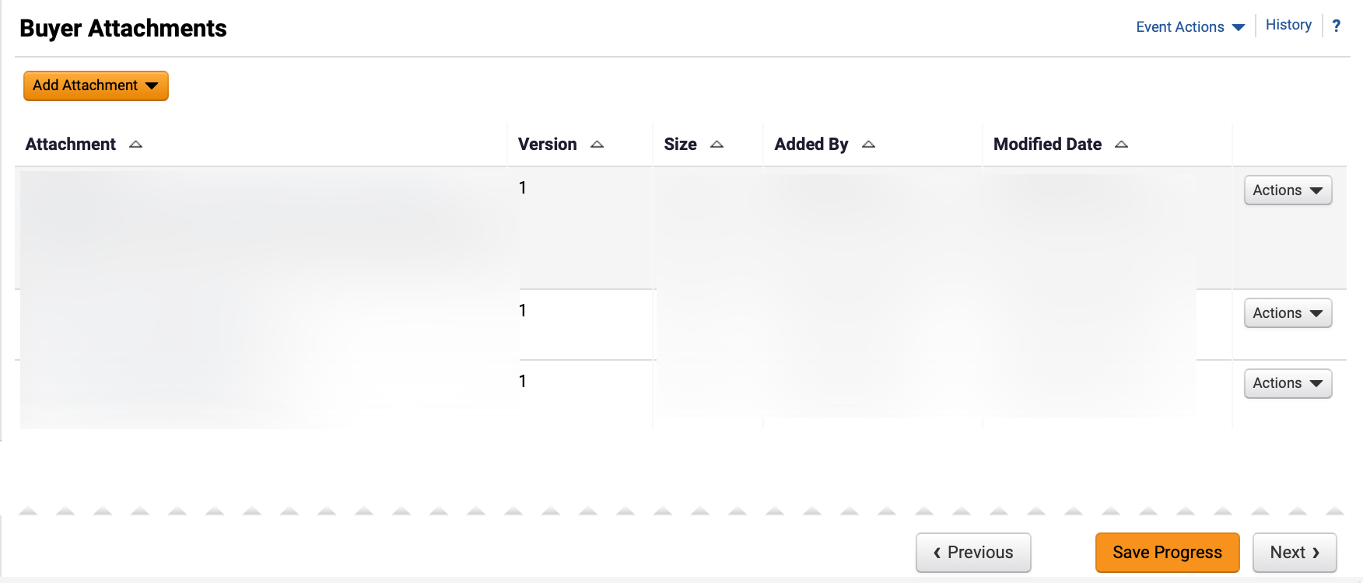
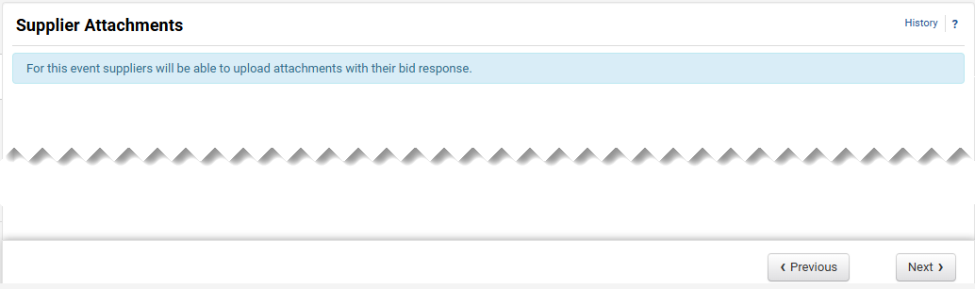
Create Request for Proposals (RFP)
(Part 31 of 53)
INSTRUCTIONS
Review Buyer Attachments.
Click Next.
97
98
Click Next.
Note: All event types are set up to allow suppliers to upload attachments.

Slide 33
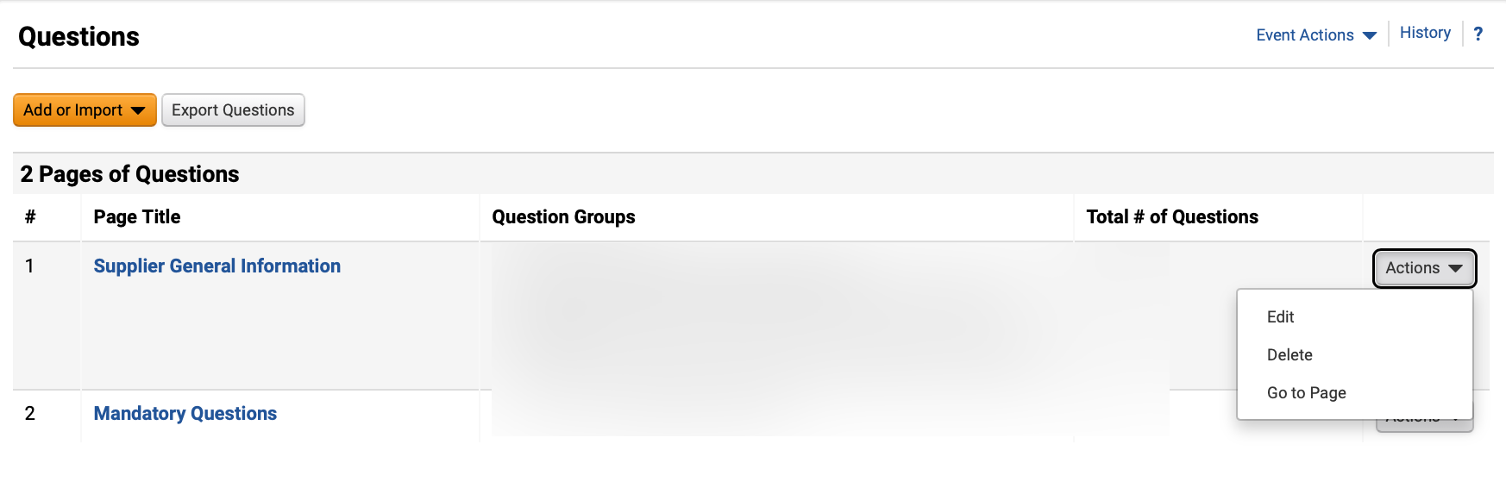
Create Request for Proposals (RFP)
(Part 32 of 53)
INSTRUCTIONS
To Edit or Delete prepopulated question
groups, click Actions (Optional).
Click Page Title hyperlink to view questions.
Note: Review the chart to learn more about Event Questions.
100
101

Slide 34
Create Request for Proposals (RFP)
(Part 33 of 53)
INSTRUCTIONS
Event Questions
Description
Add New Question
Enter a custom question.
Add from Library
Select standard questions.
Import from File
Upload previously prepared questions.
Question Page
Questions can be organized into separate pages. The RFP Template includes four pre-populated question pages:
Supplier General Information
Mandatory Requirements
Mandatory Scored Questions
Additional Scored questions
Question Group
Within each page, questions can be further grouped into sections with titles based on user-defined criteria. Instructions for each group can also be entered.
Block Questions with Supplier Profile Content
Questions from Supplier Profile Content can be added in groups.
Note: Users can organize their questions and groups freely.
Options:
Group questions in sections under a single page.
Place each group on a separate page.
Have all questions in a single page without groups.

Slide 35
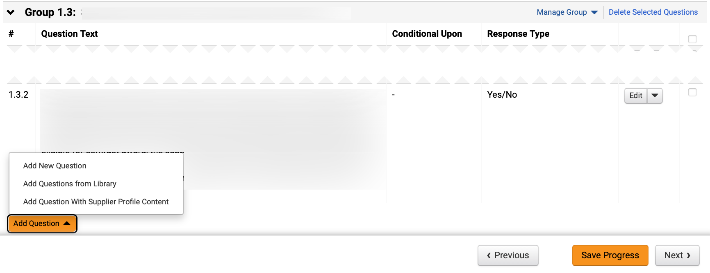
Create Request for Proposals (RFP)
(Part 34 of 53)
INSTRUCTIONS
Click Add Question.
To add a custom question, select Add New Question.
Note: To Add New Question, follow Steps 104 – 109 and skip to Step 116. To Add Questions from Library, follow Steps 110 – 116.
103
102

Slide 36
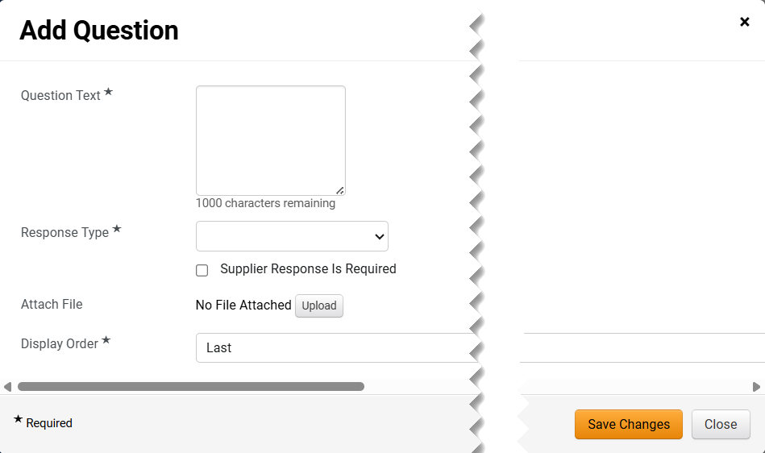
Create Request for Proposals (RFP)
(Part 35 of 53)
INSTRUCTIONS
Enter Question Text*.
Select Response Type*.
Note: Additional fields may display depending on Response Type selected.
Click Supplier Response is Required checkbox (Optional).
Click Upload to Attach File (Optional).
Select Display Order*.
Click Save Changes.
104
105
106
107
108
109

Slide 37
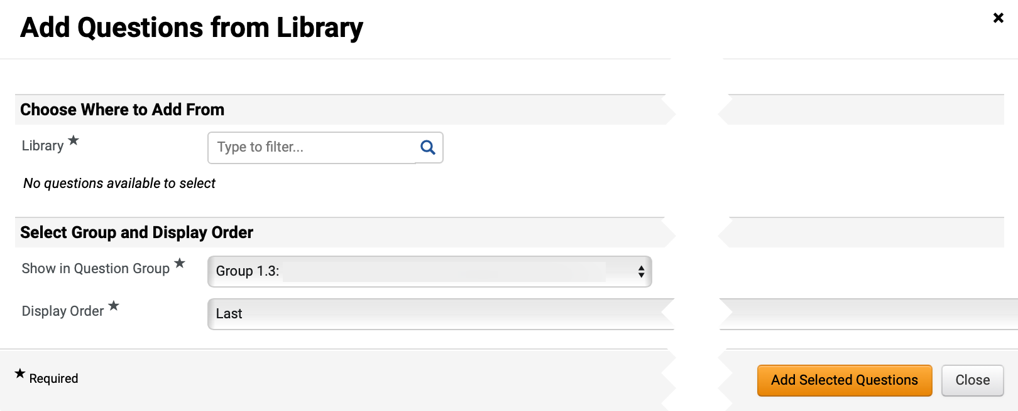
Create Request for Proposals (RFP)
(Part 36 of 53)
INSTRUCTIONS
Select Add Question from Library.
Note: To Add Questions from Library, follow Steps 111 – 116.
Select Library*.
Note: Use magnifying glass to search.

Slide 38
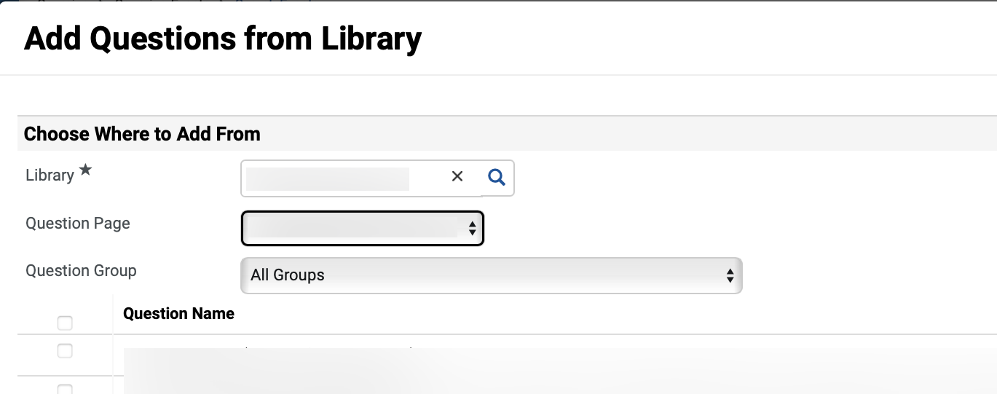
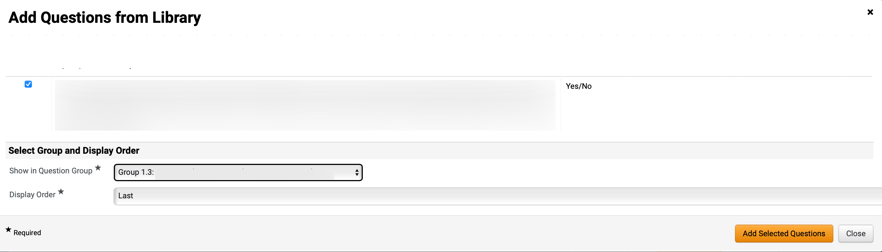
Create Request for Proposals (RFP)
(Part 37 of 53)
INSTRUCTIONS
Select Question Page and Question Group.
Note: Question Group can be filtered by All Groups or an individual Question Group.
Check applicable Question Name box(s)
112
113
Select Show in Question Group* and preferred Display Order*.
Click Add Selected Questions.
114
115

Slide 39
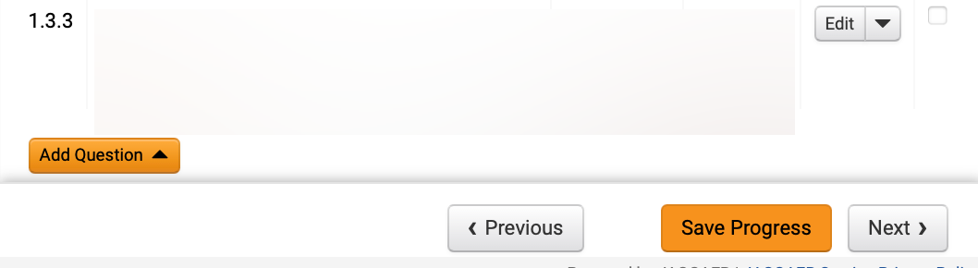
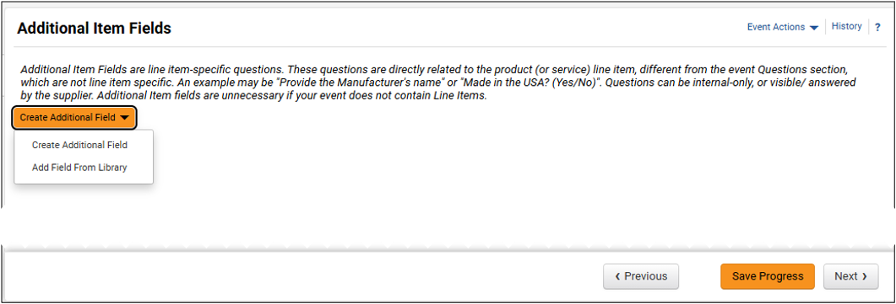
Create Request for Proposals (RFP)
(Part 38 of 53)
INSTRUCTIONS
Review added Question and click Next.
Click Create Additional Field (Optional) and select Create Additional Field to create a custom question.
Note: If selecting Create Additional Field, follow Steps 118 – 124 and skip to Step 130. If selecting Add Field From Library, skip to Step 125.

Slide 40
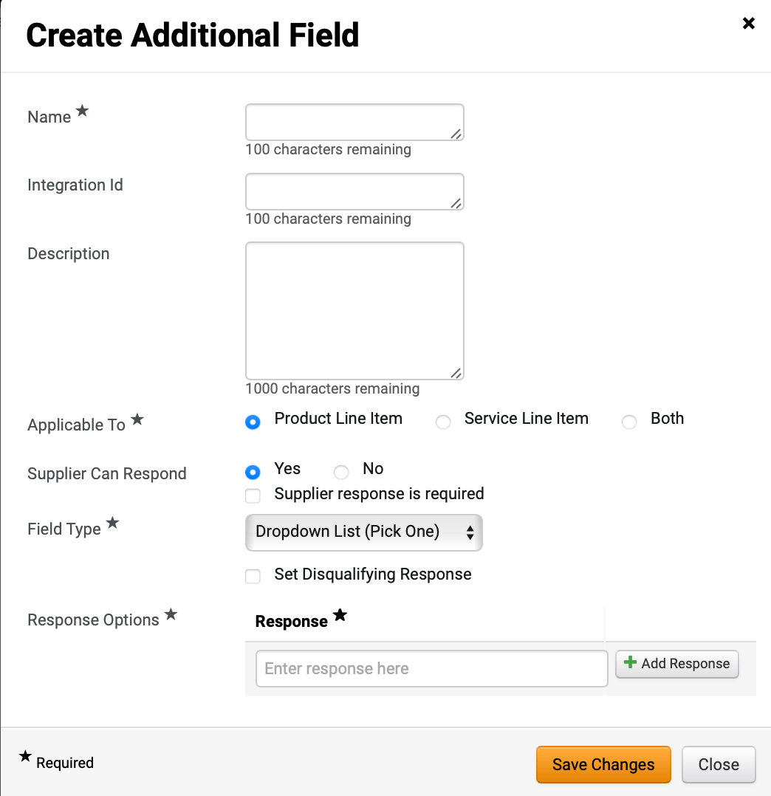
Create Request for Proposals (RFP)
(Part 39 of 53)
INSTRUCTIONS
Enter Name*.
Enter Description (Optional).
Check the Applicable To* box.
Check Supplier Can Respond box.
Note: If selecting Yes, an option to click Supplier response is required checkbox displays.
Select Field Type*.
Note: Response Option displays only based on Field Type selected. An option to Set Disqualifying Response may display.
Enter Response* and click Add Response.
Click Save Changes.
118
119
120
121
122
123
124

Slide 41
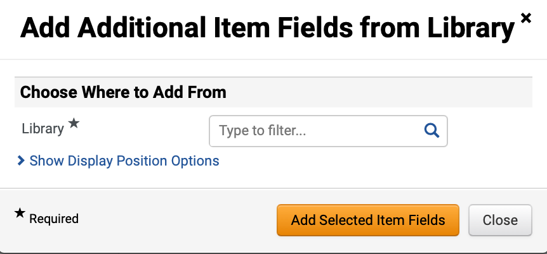
Create Request for Proposals (RFP)
(Part 40 of 53)
INSTRUCTIONS
Select Add Field from Library.
Select Library*.
Note: Once Library is selected, additional fields will display.

Slide 42

Create Request for Proposals (RFP)
(Part 41 of 53)
INSTRUCTIONS
Check the Additional Item Fields, if applicable.
Click Add Selected Item Fields.
127
128

Slide 43

Create Request for Proposals (RFP)
(Part 42 of 53)
INSTRUCTIONS
Review added Additional Item Fields.
Click Save Progress and Next.
129
130

Slide 44

Create Request for Proposals (RFP)
(Part 43 of 53)
INSTRUCTIONS
Select the applicable Items tab.
Note: If the solicitation includes both products and services, add items for both tabs following the same steps. If using a template to create the event, content will be pre-populated but can be edited or deleted.
Click Add Product Line Item.
Select Add New Item.
Note: To Add New Item, follow Steps 134 – 135 and skip to Step 143. If selecting Add Item from Library, skip to Step 136.
131
132
133

Slide 45

Create Request for Proposals (RFP)
(Part 44 of 53)
INSTRUCTIONS
Enter Product Line Item information.
Note: Check the Unit Price is Required box to ensure suppliers do not leave the price line blank as it will prevent contract award.
Click Save Changes.
134
135

Slide 46

Create Request for Proposals (RFP)
(Part 45 of 53)
INSTRUCTIONS
To Add Item from Library, click Add Product Line Item.
Select Add Item from Library.
136
137
Select Library*.
Note: Once Library is selected, additional fields will display.

Slide 47

Create Request for Proposals (RFP)
(Part 46 of 53)
INSTRUCTIONS
Check applicable Product Line Items box(s) in Product Line Items Group.
Note: Multiple Product Line Items can be selected.
Select Show in Item Group*.
Select Display Order*.
Click Add Selected Items.
139
140
141
142

Slide 48

Create Request for Proposals (RFP)
(Part 47 of 53)
INSTRUCTIONS
Review added Items.
Click Next.
143
144

Slide 49

Create Request for Proposals (RFP)
(Part 48 of 53)
INSTRUCTIONS
Review added Suppliers.
Note: From the Suppliers Invited by Commodity Code tab view which registered suppliers will receive an email notification based on the NIGP Commodity Codes selected in the Setup section. If the tab is blank, return to the Setup section and select the appropriate NIGP Commodity Codes.
To invite additional suppliers, click the Add Suppliers to Event tab.
146
145

Slide 50

Create Request for Proposals (RFP)
(Part 49 of 53)
INSTRUCTIONS
Enter Supplier Name in Quick search to search for Suppliers.
Click Add to Event.
Note: An Added confirmation icon will display.
Click Manually Invite Suppliers (Optional).
Note: To Manually Invite Suppliers, follow Steps 149 – 154 or skip to Step 155.
Select Add Supplier to Event.
Note: If adding several suppliers, select Get Import Template.
149
147
150
148

Slide 51


Create Request for Proposals (RFP)
(Part 50 of 53)
INSTRUCTIONS
Enter Supplier Name*.
Enter Sales or Corporate Contact Name (Optional).
Enter Email*.
Click Save or Save and Add Another.
151
152
153
154
Review added Supplier.

Slide 52


Create Request for Proposals (RFP)
(Part 51 of 53)
INSTRUCTIONS
Click Save Progress and Next.
Review Progress for each section.
Note: Click the Section hyperlink to return to a section for editing.
Click Submit.
157
158

Slide 53


Create Request for Proposals (RFP)
(Part 52 of 53)
INSTRUCTIONS
Review Event Submitted summary page.
Note: If there is workflow surrounding the event, approval steps can be viewed by clicking View Approval Steps.
Click Return to My Event hyperlink.
Click Tools.
Select Approvals.
161
162

Slide 54


Create Request for Proposals (RFP)
(Part 53 of 53)
INSTRUCTIONS
Review Sourcing Event Approval Workflow and make changes as applicable.
You have successfully created a Request for Proposals (RFP).

