Slide 1
Price Match Option for
Request for Quotes
DESCRIPTION
This guide will show Sourcing Event Buyers how to use the Price Match Option for Request for Quotes only.
Note: Review Section 3.5.5.1.6 of the GPM for policy information.
​
OVERVIEW
The key steps in the process are below:
Access the Sourcing module.
Select Event (Create New or event in Draft Status).
Conduct evaluation and tag Supplier to next stage.
Submit Price Match Option for Request for Quote.
Business Process:
Access Sourcing Module
Create New Event
Conduct Evaluation and Tag Supplier to Next stage
Submit Price Match Option for RFQ

Slide 2


Price Match Option for Request for Quotes (Part 1 of 24)
INSTRUCTIONS
Click the Global Navigation Menu.
Note: University System of Georgia (USG) users complete local log on and then proceed to Step 4.
Click Sourcing, Contracts & Supplier Management.

Slide 3

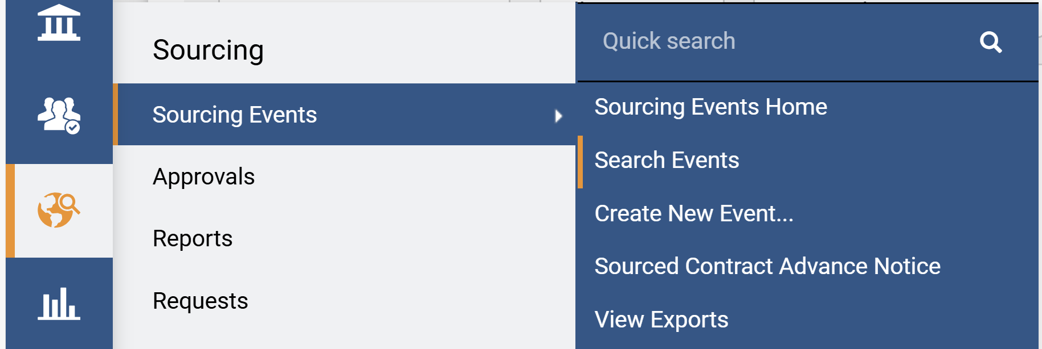
Price Match Option for Request for Quotes (Part 2 of 24)
INSTRUCTIONS
Click Sign On.
Note: The system utilizes Single Sign-On (SSO) capabilities
and no log in information is required.
To add Price Match Questions to a Sourcing Event, access the Sourcing module.
Click Sourcing Events.
Click Search Events.
5
6
4

Slide 4
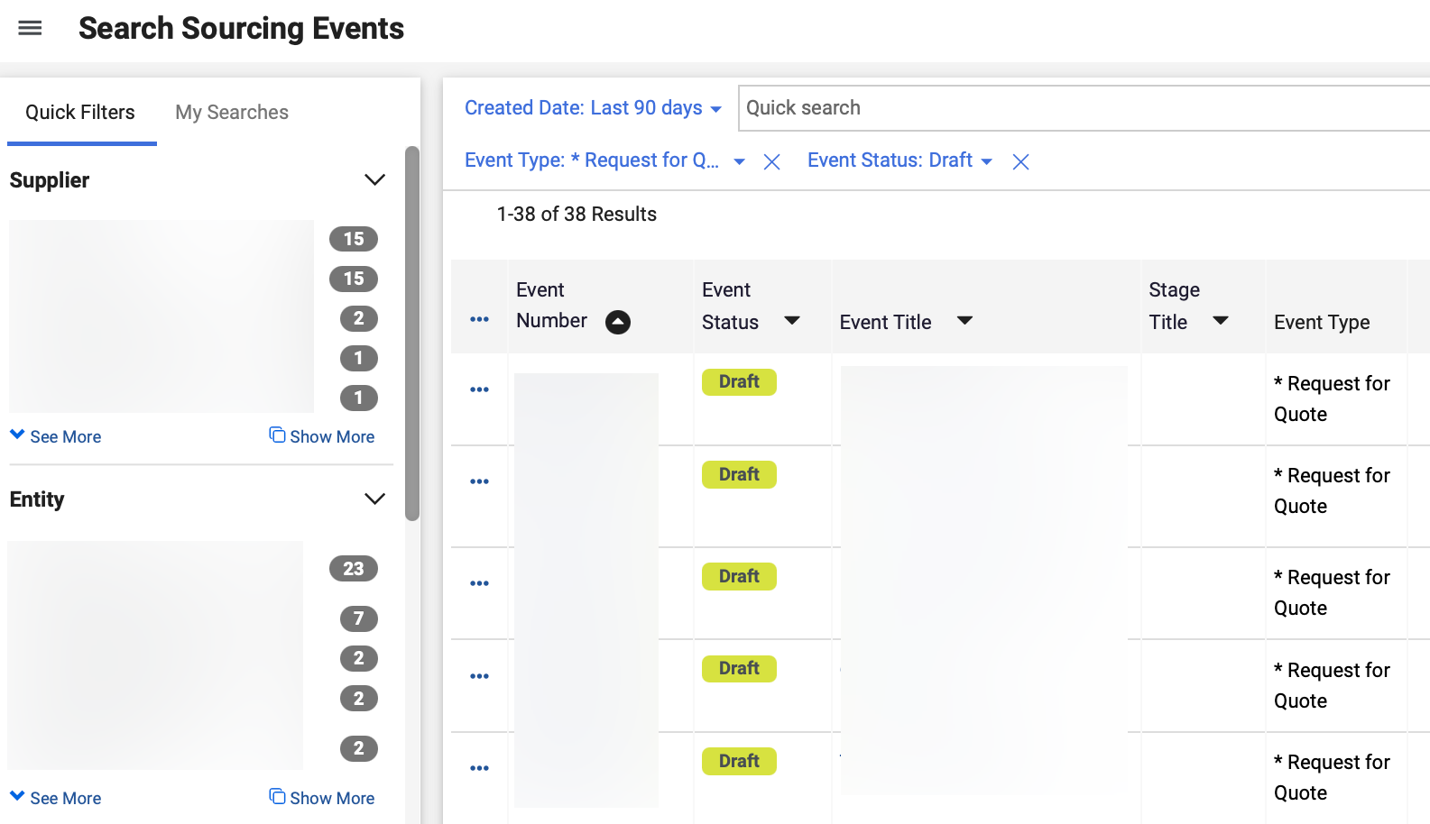
Price Match Option for Request for Quotes (Part 3 of 24)
INSTRUCTIONS
Click Event Number hyperlink
Note: Create a new Sourcing Event or select a Sourcing Event in Draft.

Slide 5
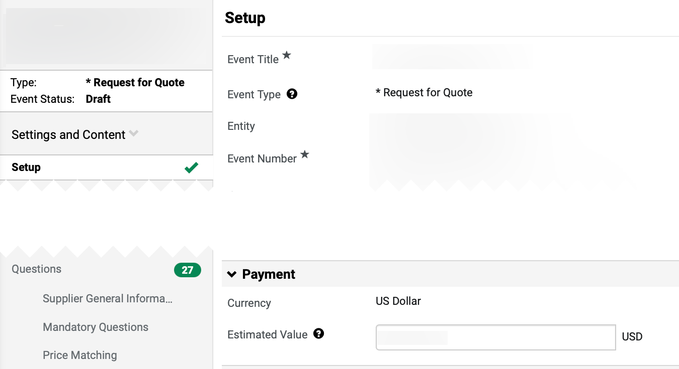
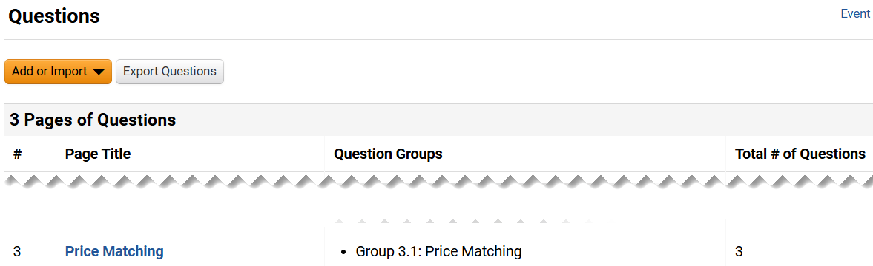
Price Match Option for Request for Quotes (Part 4 of 24)
INSTRUCTIONS
Click Questions.
Click Price Matching.
Note: Price Matching Questions are added based on the template selected. If no Price Matching Questions are available, follow steps 10-13 to add them to the Questions section.

Slide 6
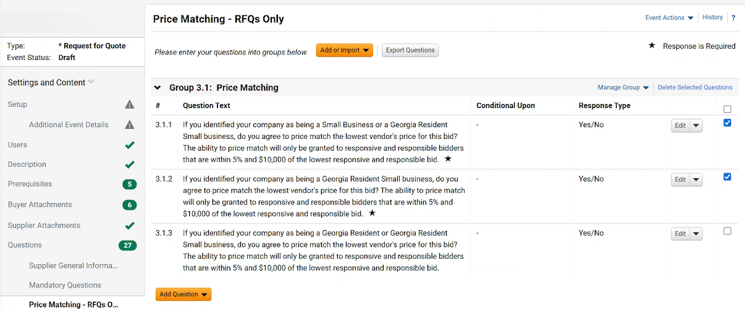
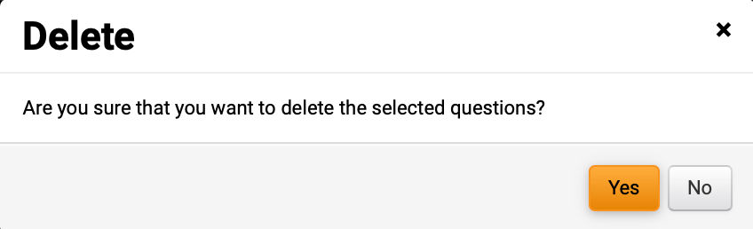
Price Match Option for Request for Quotes (Part 5 of 24)
INSTRUCTIONS
To delete Questions, click checkbox.
Note: Delete the questions per the policy requirements.
Click Delete Selected Questions.
11
10
Click Yes.

Slide 7
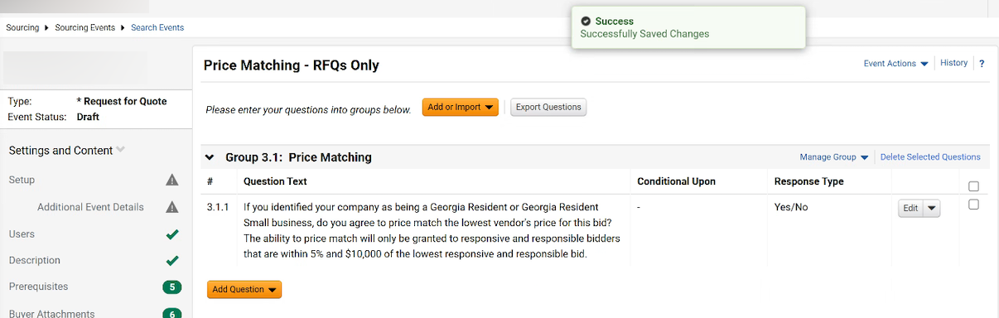
Price Match Option for Request for Quotes (Part 6 of 24)
INSTRUCTIONS
Review Successfully Saved Changes notification.

Slide 8
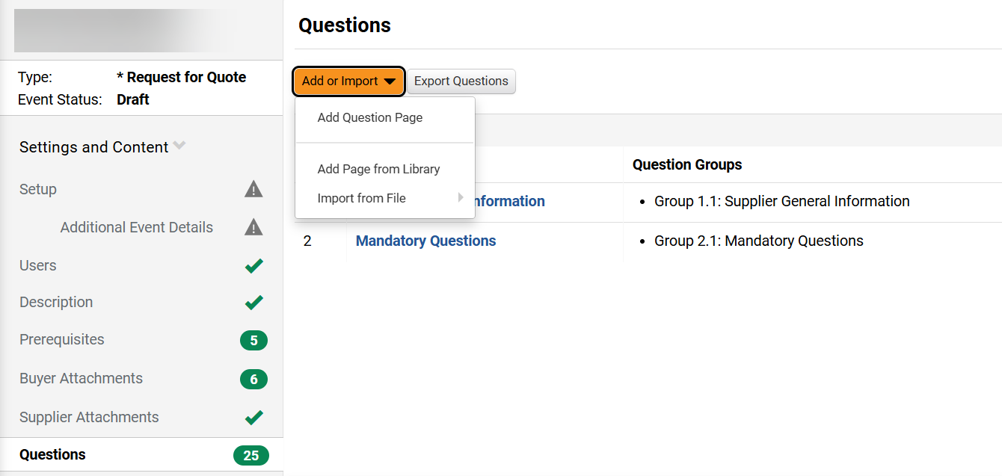
Price Match Option for Request for Quotes (Part 7 of 24)
INSTRUCTIONS
To add Price Matching Questions, click Questions.
Click Add or Import.
Click Add Page from Library.
15
16

Slide 9
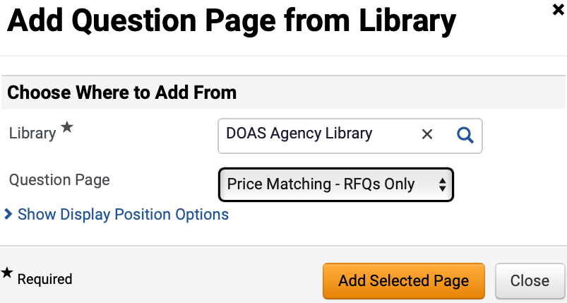
Price Match Option for Request for Quotes (Part 8 of 24)
INSTRUCTIONS
Select DOAS Agency Library as Library*.
Note: Complete all required fields marked with a black star *.
Select Price Matching – RFQs Only for Question Page as Question Page.
Click Add Selected Page.
17
18
19
To delete Questions, click checkbox.
Note: Delete the questions per the policy requirements.
Click Delete Selected Questions.
21
20

Slide 10




Price Match Option for Request for Quotes (Part 9 of 24)
PROCESS
Review the following steps before moving to step 23 (Price Match Question –Q&A board)
Finalize Event
The Sourcing Event Buyer creates the RFQ.
Submit and Approve
Sourcing Event Buyer submits the RFQ for approval and approval workflow is initiated. Approvers review and approve the RFQ.
Event Opens
The event is open and suppliers’ invitation is released.
Suppliers Respond
Suppliers submit bids.

Slide 11



Price Match Option for Request for Quotes (Part 10 of 24)
PROCESS
Event Closes
No further responses are allowed in the sourcing event.
Sourcing Event Buyer completes the Administrative Review
The Sourcing Event Buyer reviews the provided information from all suppliers.
Review If Suppliers Meets Criteria
The Sourcing Event Buyer must review and determine if the price match policy is satisfied and, if so, invite the suppliers to revise the bid. The Sourcing Event Buyer must confirm the supplier's willingness to price match the lowest bid before creating a new stage of the sourcing event. Please contact spdpolicy@doas.ga.gov for assistance.

Slide 12
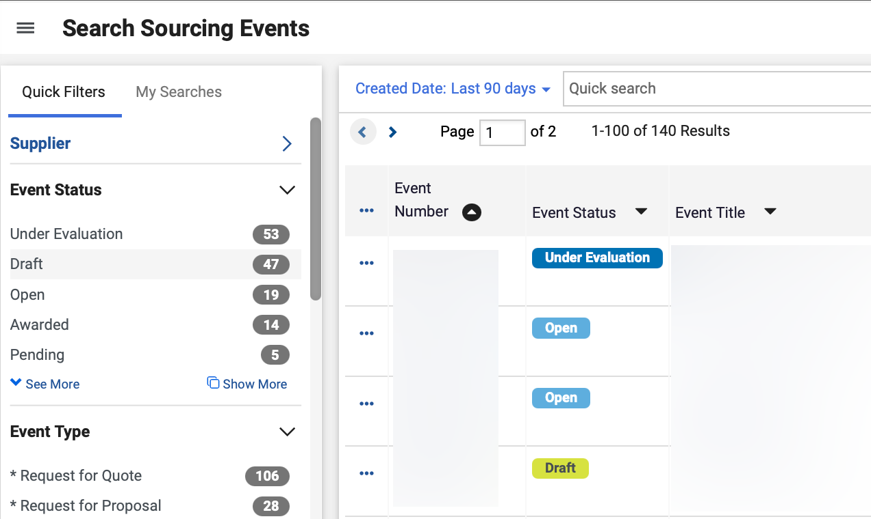
Price Match Option for Request for Quotes (Part 11 of 24)
INSTRUCTIONS
To submit Price Match questions, access the
Sourcing module.
Click Sourcing Events.
Click Search Events.
24
25
23
Click the Event Number hyperlink.
Note: Use Filters to ensure the Event Status is Under Evaluation and the Event Type is Request for Quote.

Slide 13
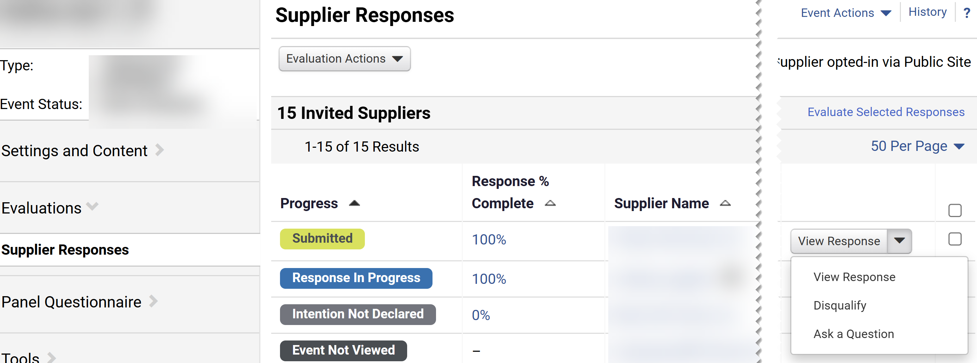
Price Match Option for Request for Quotes (Part 12 of 24)
INSTRUCTIONS
Click Supplier Responses.
Click Show Menu (Down Arrow).
Note: Select the Supplier that meets the Price Match criteria.
Click Ask a Question.
Note: Suggestion question to supplier: You indicated that you were willing to price match the lowest bid provided it is within 5% up to $10,000 of the lowest responsive and responsible bid. The lowest bid is (Buyer to enter amount). Are you willing to price match the lowest bid?
27
28
29

Slide 14
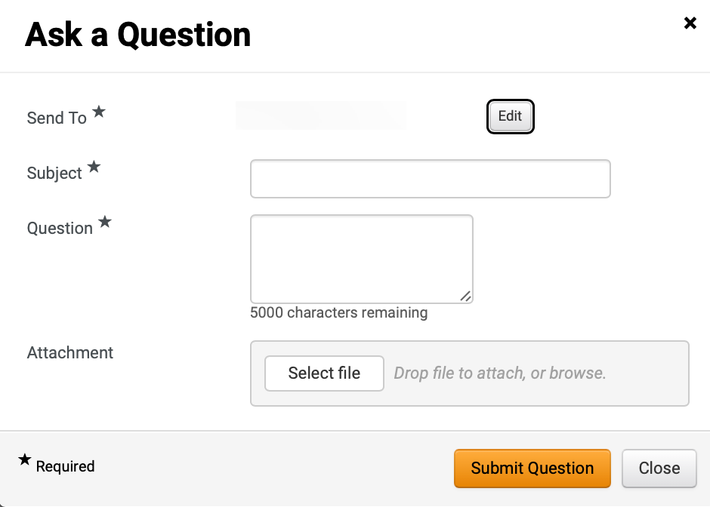
Price Match Option for Request for Quotes (Part 13 of 24)
INSTRUCTIONS
The Send To* field will auto-populate with Supplier name.
Enter Subject*.
Enter Question*.
Click Select file to add Attachment (Optional).
Click Submit Question.
30
31
32
33
34

Slide 15
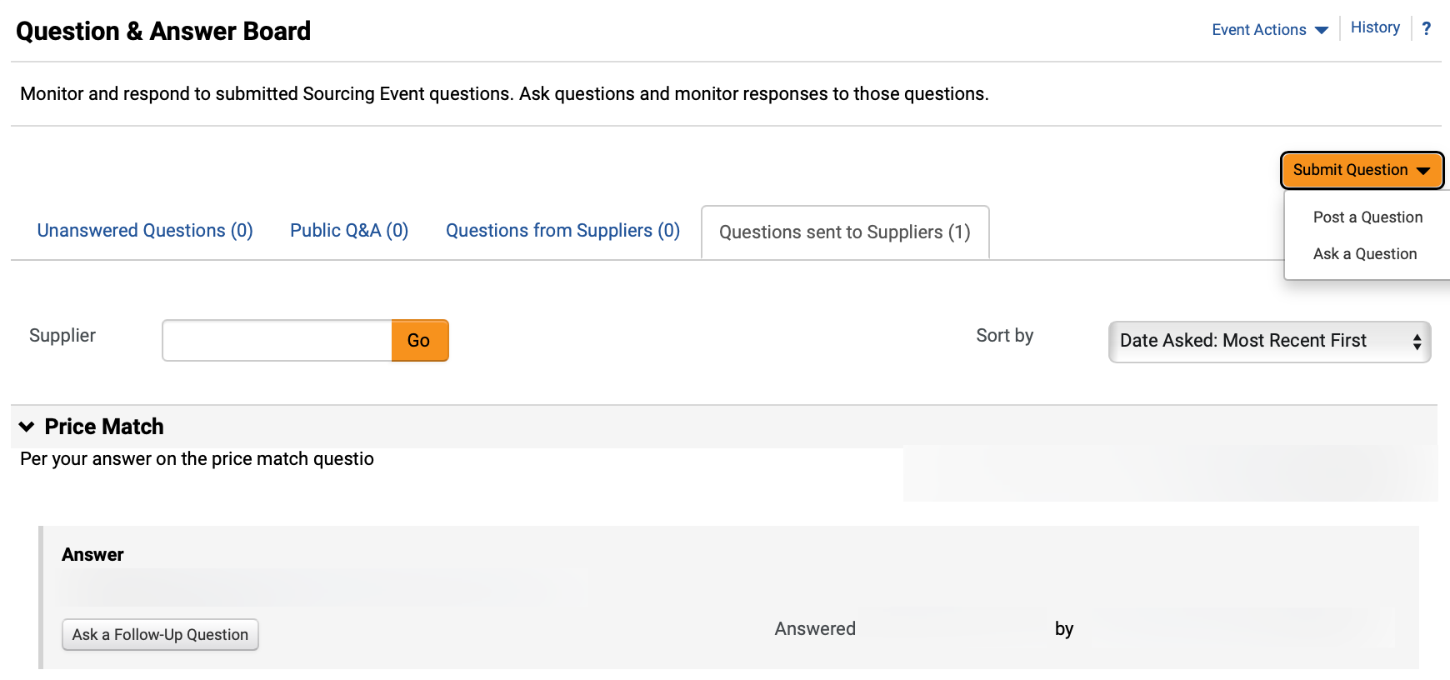
Price Match Option for Request for Quotes (Part 14 of 24)
INSTRUCTIONS
Click Questions sent to Suppliers to review Posted Questions and Answers.

Slide 16
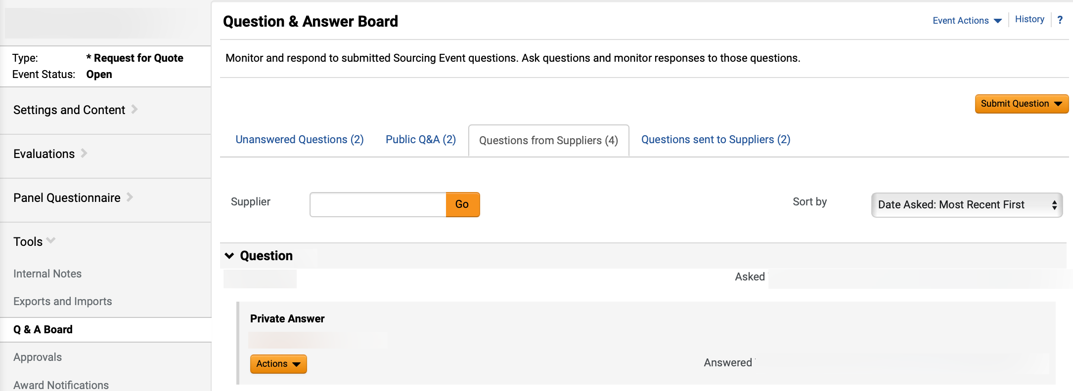
Price Match Option for Request for Quotes (Part 15 of 24)
INSTRUCTIONS
Click Questions sent to Suppliers to review Answer.
Note: To move to the next step, supplier must answer that they would like to move forward with the Price Match option.

Slide 17
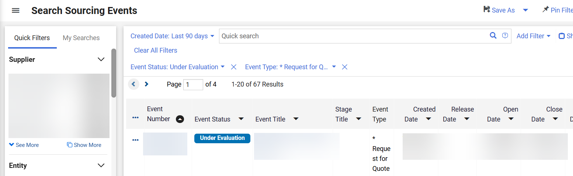
Price Match Option for Request for Quotes (Part 16 of 24)
INSTRUCTIONS
To add Next Stage, access the Sourcing module.
Click Sourcing Events.
Click Search Events.
38
39
37
Click Event Number hyperlink
Note: The previously created and reviewed Sourcing Event must be in Under Evaluation for the Buyer to add a New Stage.

Slide 18
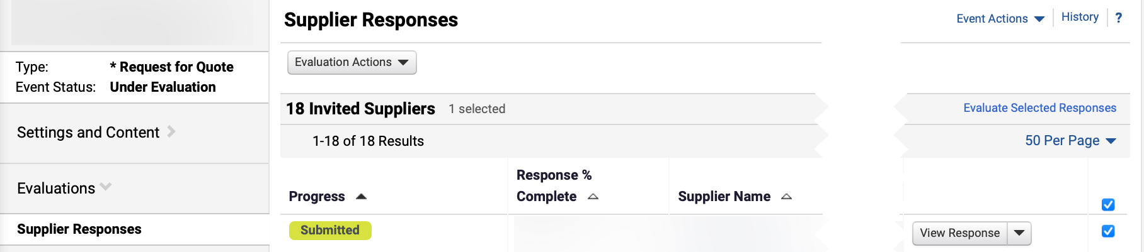
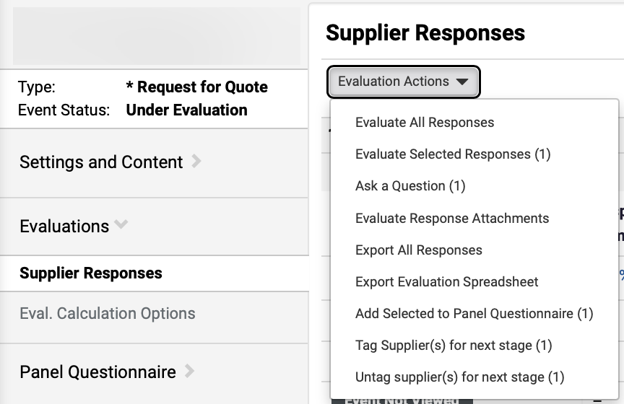
Price Match Option for Request for Quotes (Part 17 of 24)
INSTRUCTIONS
Click Evaluations.
Select Supplier Responses.
Click checkbox to select Supplier.
41
43
42
Click Evaluation Actions.
Select Tag Supplier(s) for next stage.
Note: The number of selected Suppliers will display in brackets.
44
45

Slide 19
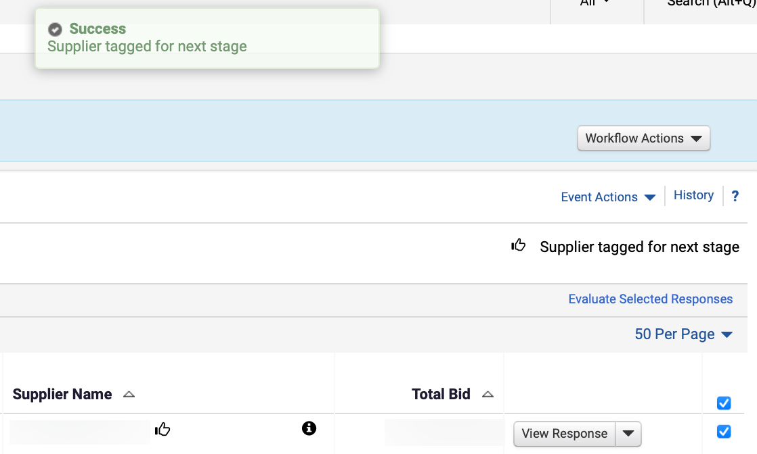
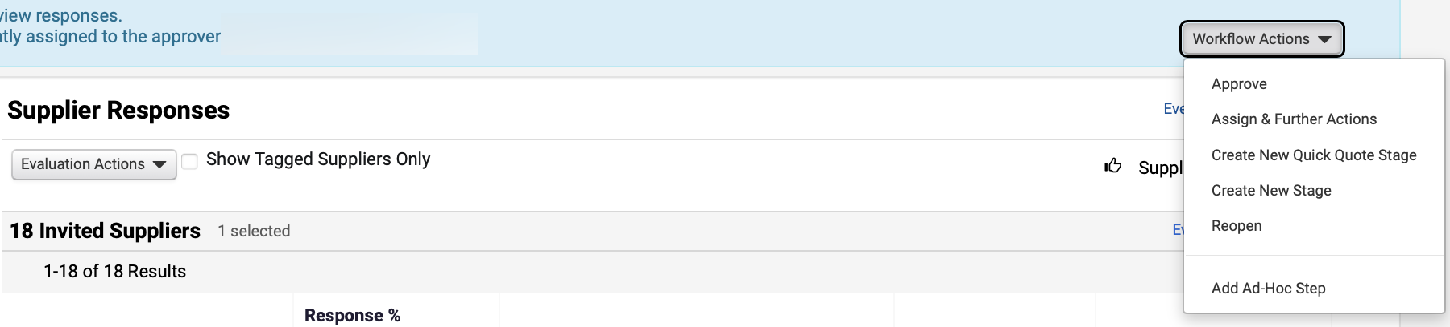
Price Match Option for Request for Quotes (Part 18 of 24)
INSTRUCTIONS
Review Success notification and Supplier tagged for next stage confirmation.
Click Workflow Actions.
Select Create New Stage.
47
48

Slide 20
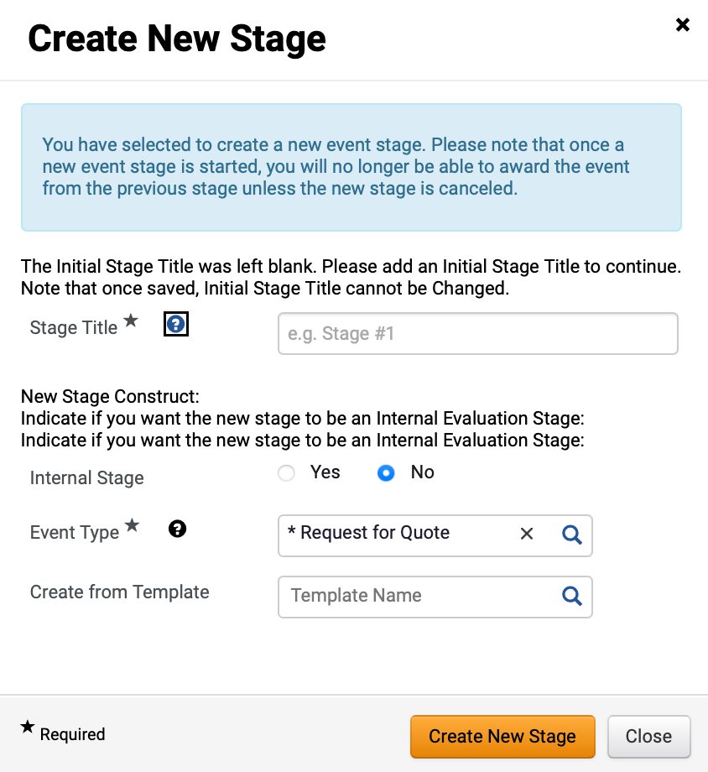
Price Match Option for Request for Quotes (Part 19 of 24)
INSTRUCTIONS
Enter Stage Title*.
Select No for Internal Stage.
The Event Type* will auto-populate to Request for Quote.
Select Create from Template (Optional).
Click Create New Stage.
49
50
51
52
53

Slide 21
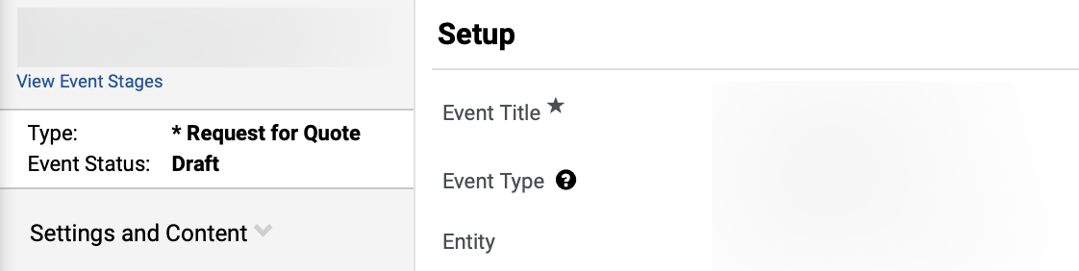
Price Match Option for Request for Quotes (Part 20 of 24)
INSTRUCTIONS
Review Event Status displayed as Draft.

Slide 22
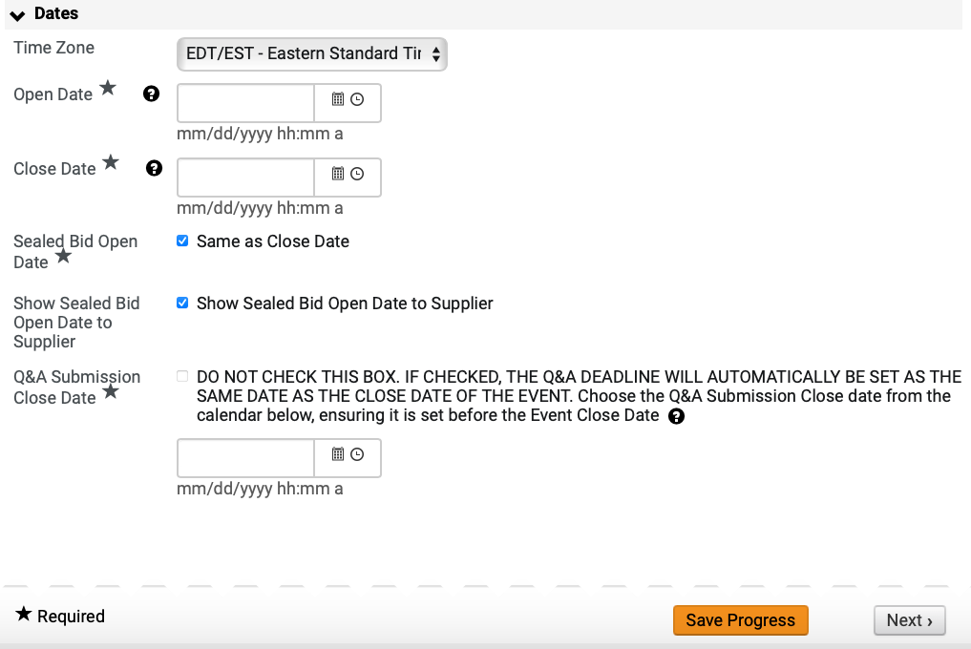
Price Match Option for Request for Quotes (Part 21 of 24)
INSTRUCTIONS
Select Time Zone.
Select Open Date*.
Select Close Date*.
Select Sealed Bid Open Date*.
Select Show Sealed Bid Open Date to Supplier.
Select Q&A Submission Close Date*.
Note: Do not click the Q&A Submission Close Date* checkbox, otherwise the Q&A Deadline will set as the close date of the event. Ensure the Q&A Submission Close Date is set before the Event Close Date.
Click Save Progress.
55
56
57
58
59
60
61

Slide 23

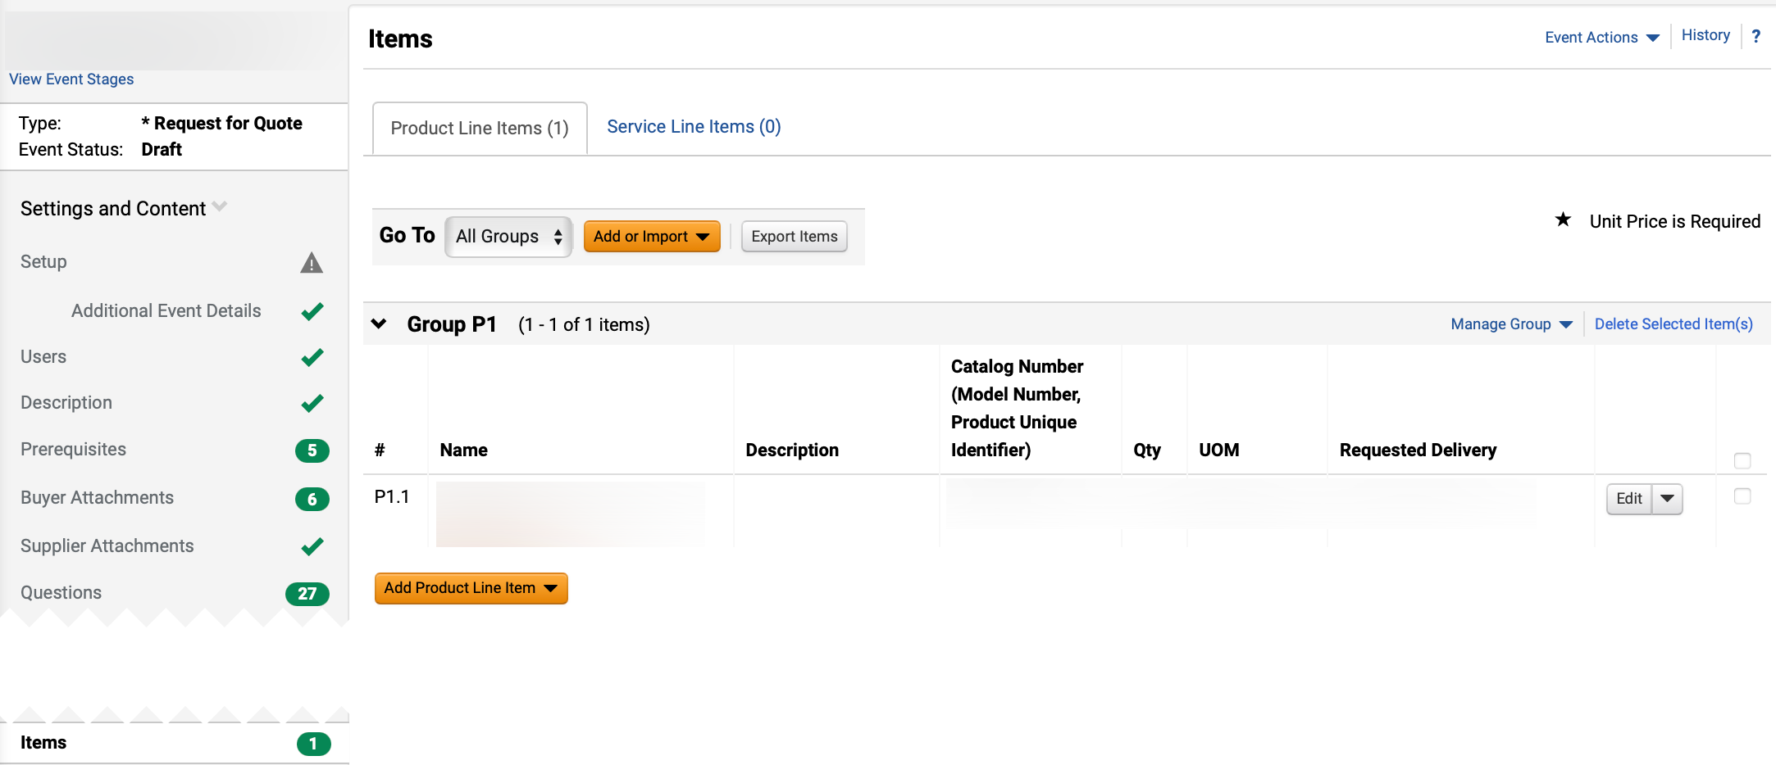
Price Match Option for Request for Quotes (Part 22 of 24)
INSTRUCTIONS
Review Successfully Saved Changes notification.
Click Items.
Review Event Items.
64
63

Slide 24
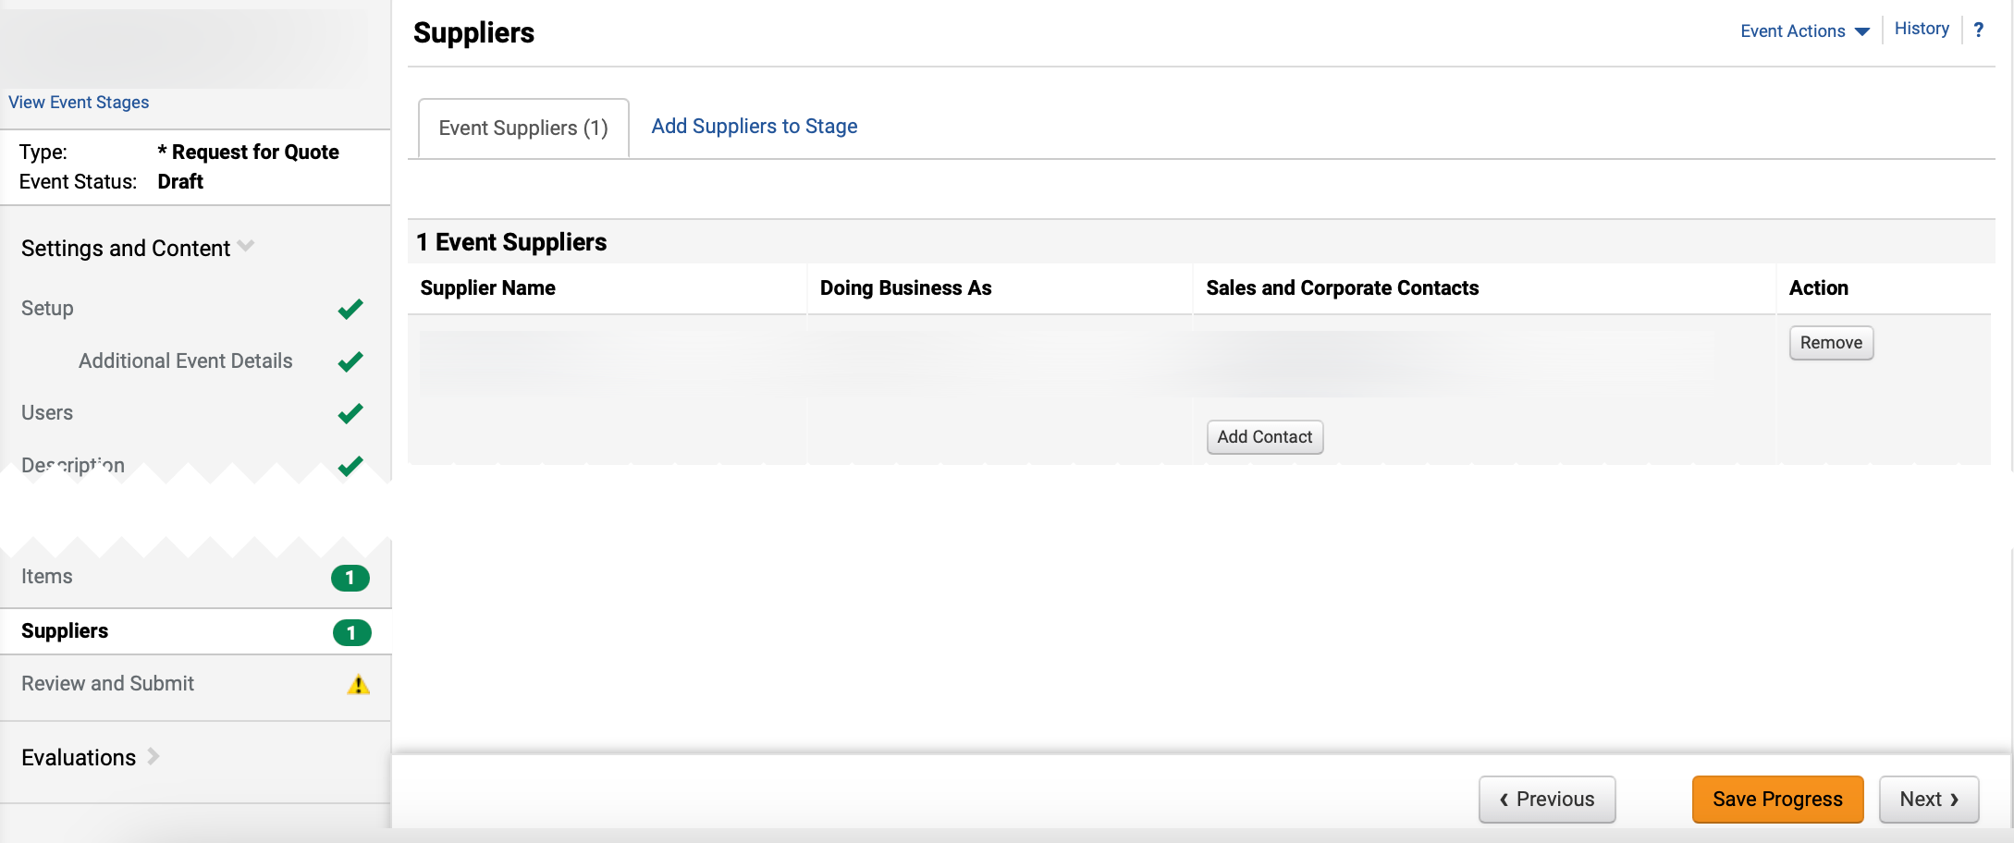
Price Match Option for Request for Quotes (Part 23 of 24)
INSTRUCTIONS
Click Suppliers.
Review Event Suppliers.
Note: Select Event Supplier(s) that agreed to Price Match only.
66
65

Slide 25
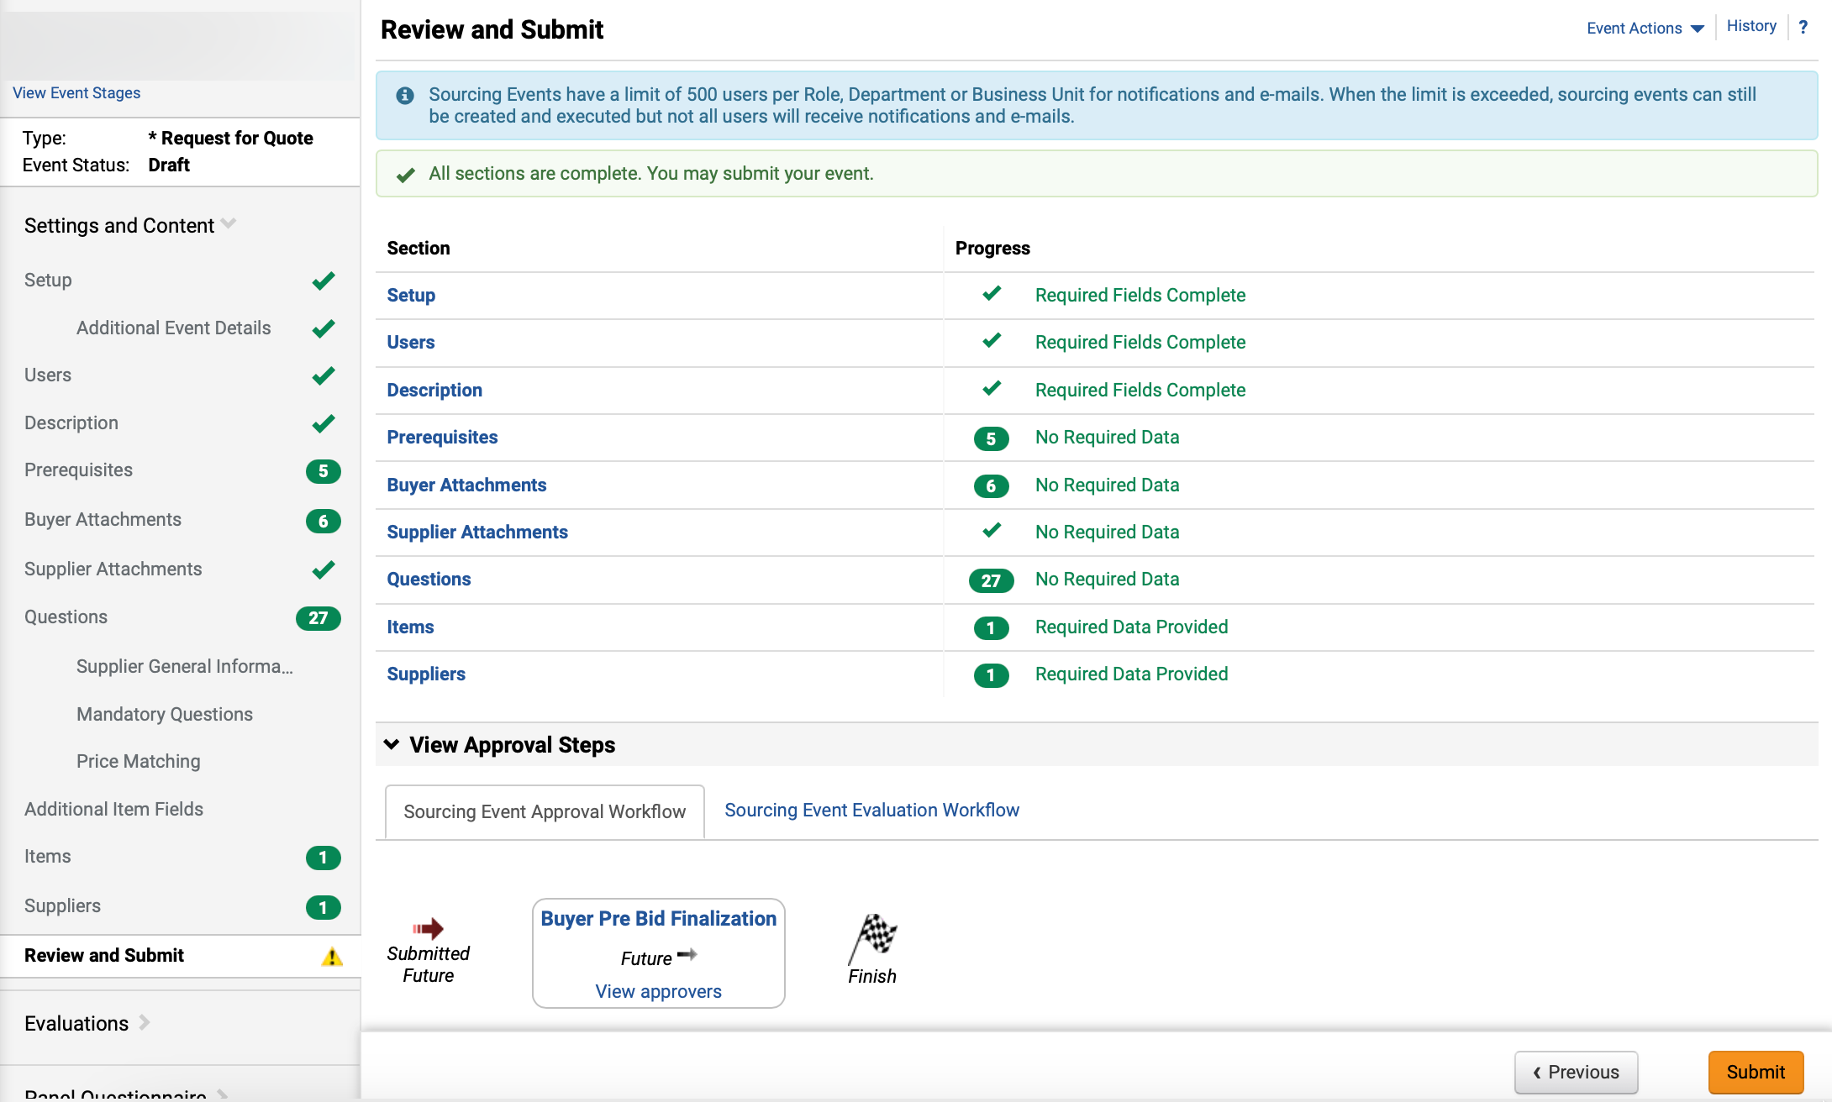

Price Match Option for Request for Quotes (Part 24 of 24)
INSTRUCTIONS
Click Review and Submit.
Review Approval Workflow.
Click Submit.
Note: The stage will be released to the selected supplier(s) based on the open date and time selected. At that time, an email will be sent to the invited supplier(s). Once the event closes, the buyer will be able to access the revised cost submissions and proceed with the award process in accordance with the ward process in accordance with Price Match Policy.
67
68
69
You have successfully reviewed how to price match for request for quotes.

