Slide 1
Approve a Sourcing Event Request
DESCRIPTION
This guide will show the Sourcing Event Buyer, CUPOs and Agency Admin APO how to Approve a Sourcing Event Request.
OVERVIEW
The key steps in the process are below:
Login to GA@WORK.
Click Sourcing, Contracts, and Supplier Management App.
Review approval workflows.
Click Approve and Complete.
Business Process:
Click Sourcing, Contracts, & Supplier Management
Click Approve & Complete
Login to GA@WORK
Review Approval Workflows

Slide 2


Approve a Sourcing Event Request (1 of 7)
INSTRUCTIONS
Click the Global Navigation Menu.
Note: University System of Georgia (USG) users complete local logon and then proceed to Step 4.
Click Sourcing, Contracts & Supplier Management.
--

Slide 3

Approve a Sourcing Event Request (2 of 7)
INSTRUCTIONS
Click Sign On.
Note: The system utilizes Single Sign-On (SSO) capabilities and no log in information is required.

Slide 4
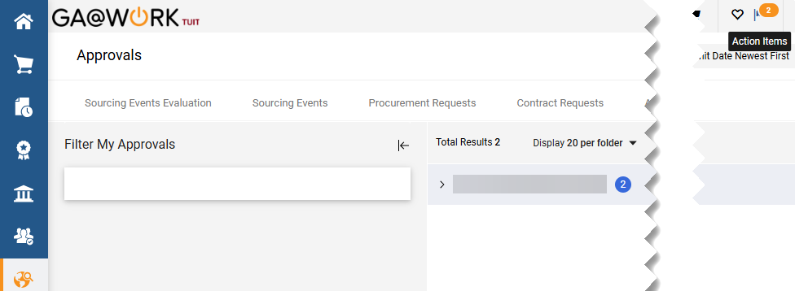
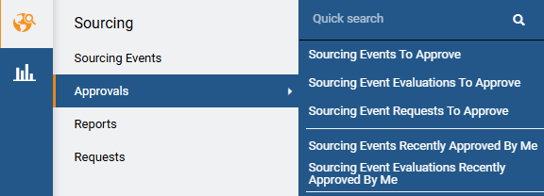

Approve a Sourcing Event Request (3 of 7)
INSTRUCTIONS
There are two ways to access Sourcing Event Requests to Approve. Click Notifications in the top-right corner or click the notification Flag in your Action Items queue.
Alternatively, click the Sourcing module.
Select Approvals.
Select Search Sourcing Event Requests to Approve.
4
5
6

Slide 5

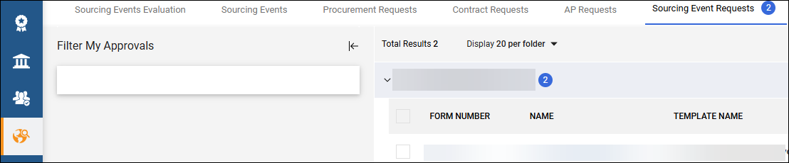


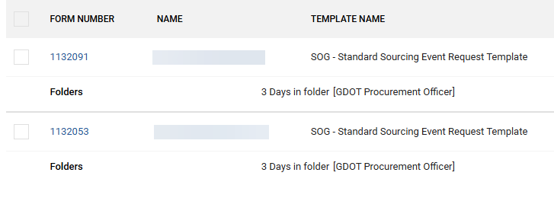
Approve a Sourcing Event Request (4 of 7)
INSTRUCTIONS
Use the Filter My Approvals arrow to search for Sourcing Event Requests.
͏Total Results will show the number of Total Sourcing Events Requests for approval.
Select Search Sourcing Event Requests.
10
Select the Form Number or Name for approvals awaiting action.

Slide 6
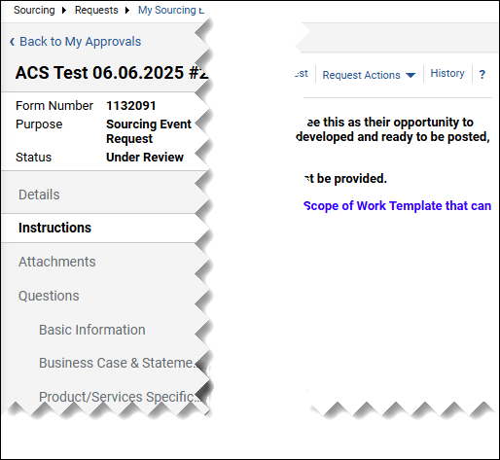
Approve a Sourcing Event Request (5 of 7)
INSTRUCTIONS
Review all sections of the Form Number.

Slide 7
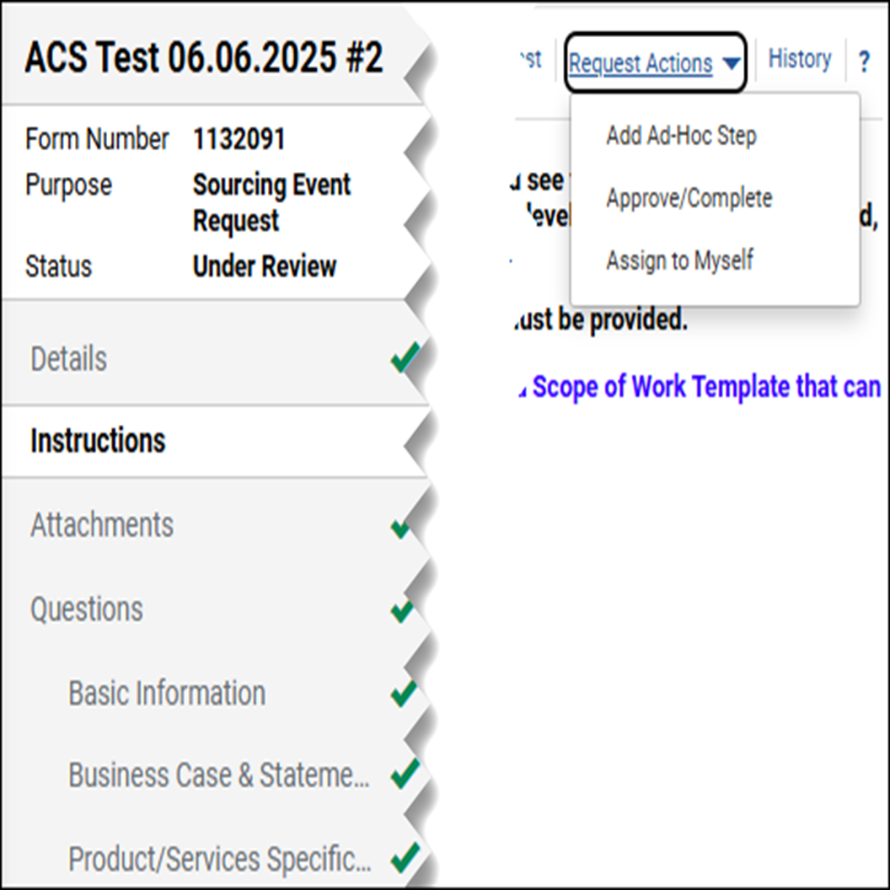
Approve a Sourcing Event Request (6 of 7)
INSTRUCTIONS
Click Request Actions.
Select Approve/Complete.
Note: To Assign to Self, skip to Step 15.
13
14

Slide 8

Approve a Sourcing Event Request (7 of 7)
INSTRUCTIONS
Click Request Actions.
Select Assign to Myself.
Note: You may assign the Sourcing Event to yourself. Assign to Myself actions include Ad Hoc, Reject, Send/Back and Approve.
15
16
You have successfully Approved a Sourcing Event Request.

