Slide 1
How to Withdraw a Bid
DESCRIPTION
This guide will show Suppliers How to Withdraw a Bid in GA@WORK Marketplace for Suppliers.
Note: To learn how to register or review the public bids portal information, review the job aids for those processes.
OVERVIEW
The key steps in the process are below:
Access Sourcing Event.
Select Withdraw the Bid.
The Bid is withdrawn.
Business Process:
Access Sourcing Event
Select Withdraw the Bid
The Bid is withdrawn

Slide 2
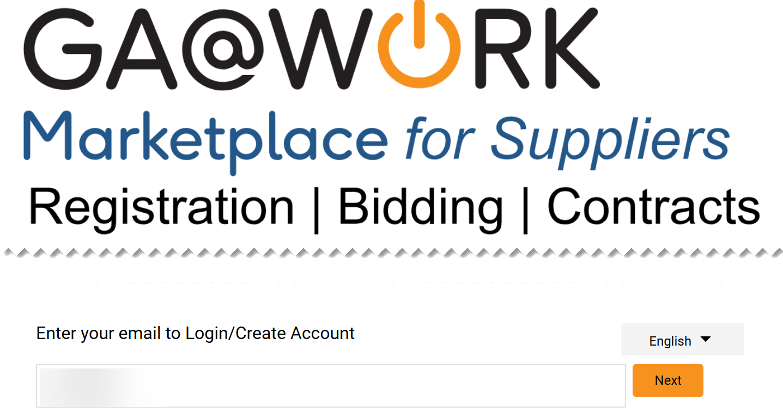
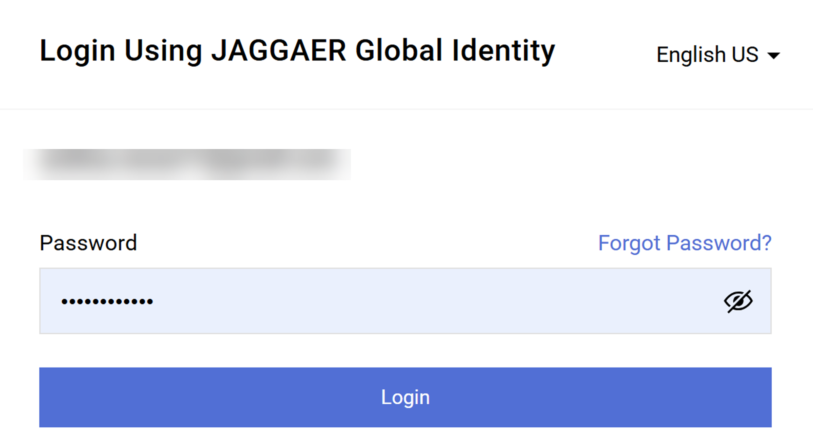
How to Withdraw a Bid (Part 1 of 13)
INSTRUCTIONS
Enter your Email to Login.
Click Next.
1
2
Enter your Password.
Click Login.
3
4

Slide 3
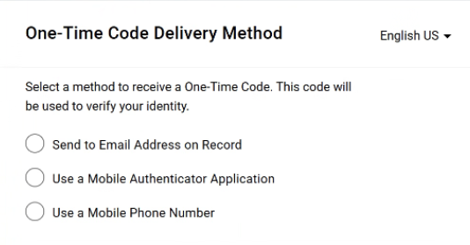
How to Withdraw a Bid (Part 2 of 13)
INSTRUCTIONS
Select a method to receive a One-Time Code.
Note: Only one method can be selected to receive the code. Follow steps 6 – 10 if selecting Send to Email Address on Record. Skip to 11 – 15 if selecting Use a Mobile Authenticator Application or skip to step 16 - 22 if selecting Use a Mobile Phone Number. Once completed, skip to step 23.

Slide 4
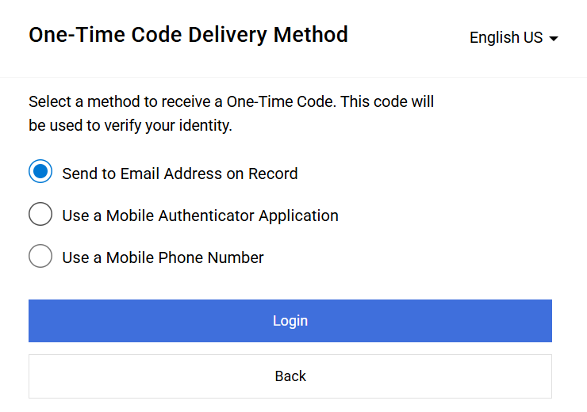
How to Withdraw a Bid (Part 3 of 13)
INSTRUCTIONS
Select Send to Email Address on Record.
Click Login
6
7

Slide 5
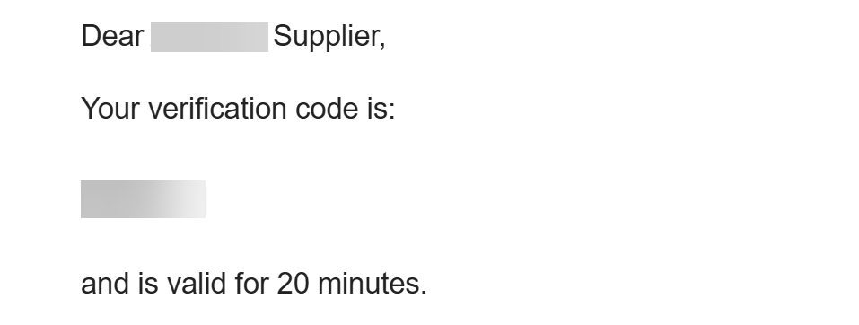
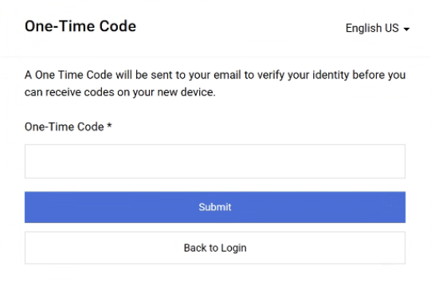
How to Withdraw a Bid (Part 4 of 13)
INSTRUCTIONS
Receive and make note of the One-Time Code.
Note: The verification code is only valid for 20 minutes.
In GA@WORK Marketplace, enter your One-Time Code*.
Note: Complete all required fields marked with a black star*.
Click Submit.
Note: Skip to Step 24 to continue.
9
10

Slide 6
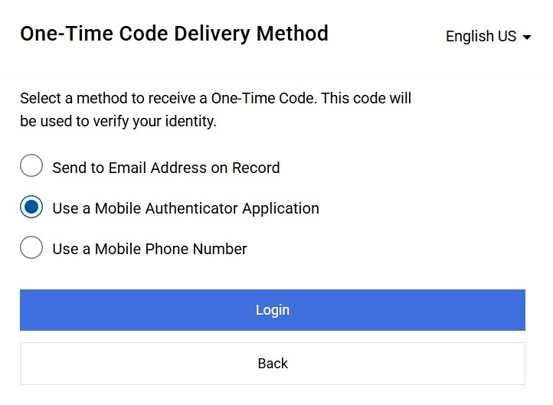
How to Withdraw a Bid (Part 5 of 13)
INSTRUCTIONS
Select Use a Mobile Authenticator Application.
Click Login.
11
12

Slide 7
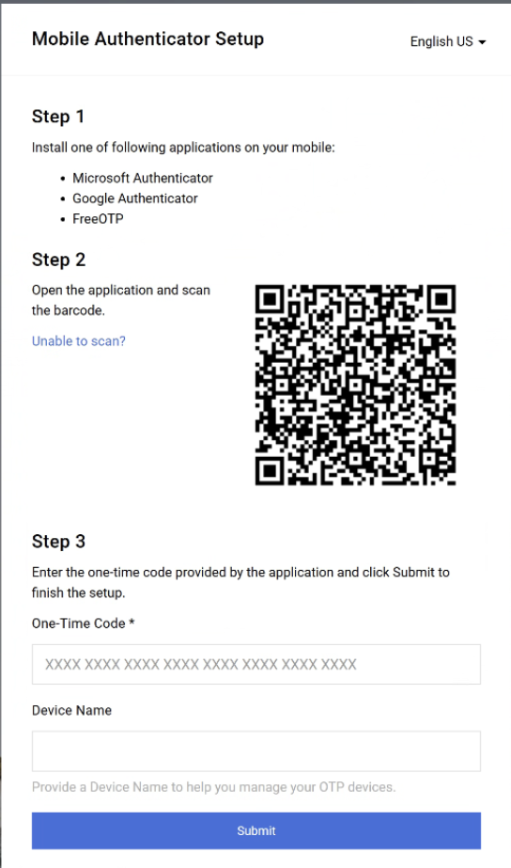
How to Withdraw a Bid (Part 6 of 13)
INSTRUCTIONS
Enter One-Time Code*.
Enter Device Name (optional).
Click Submit.
Note: Skip to step 23.
13
14
15

Slide 8
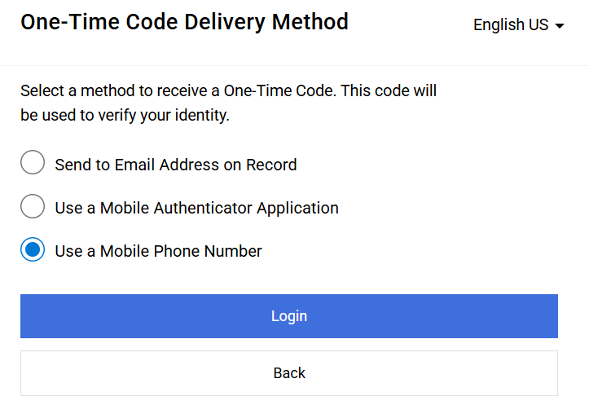
How to Withdraw a Bid (Part 7 of 13)
INSTRUCTIONS
Select Use a Mobile Phone Number.
Click Login.
16
17

Slide 9
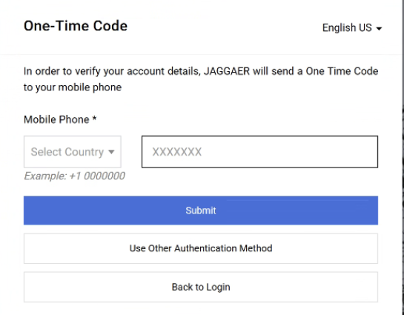
How to Withdraw a Bid (Part 8 of 13)
INSTRUCTIONS
Enter Mobile Phone*.
Click Submit.
18
19

Slide 10
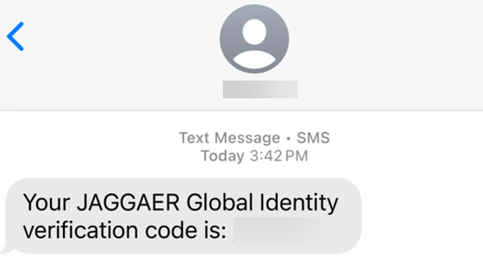
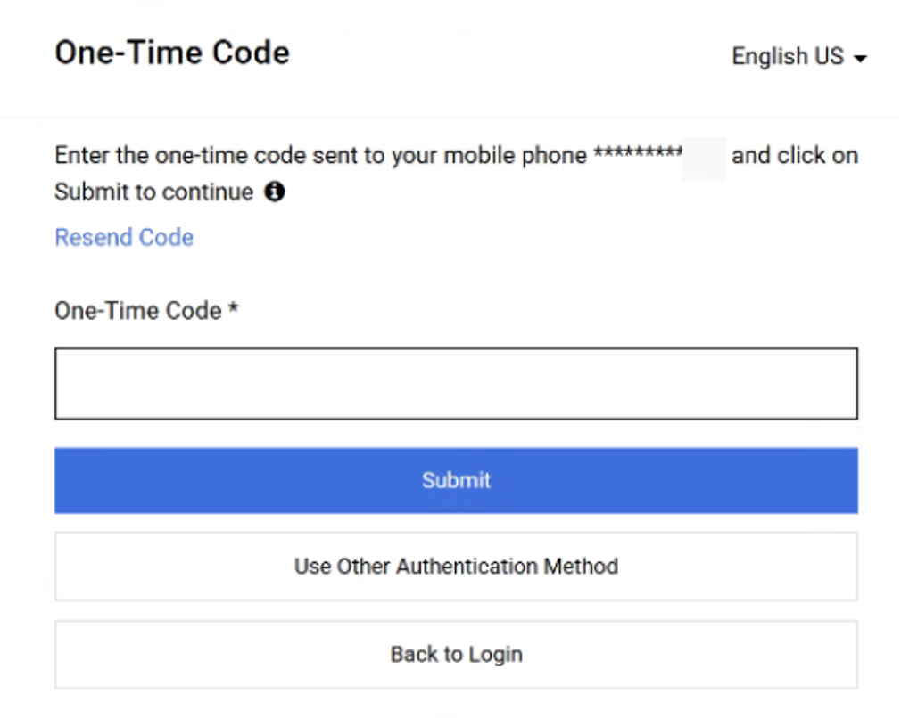
How to Withdraw a Bid (Part 9 of 13)
INSTRUCTIONS
Review Verification Code sent to Mobile Phone.
Note: Message will be received from JAGGAER Global Identity.
In GA@WORK Marketplace, enter your One-Time Code*.
Click Submit.
Note: Skip to step 23.
21
22

Slide 11
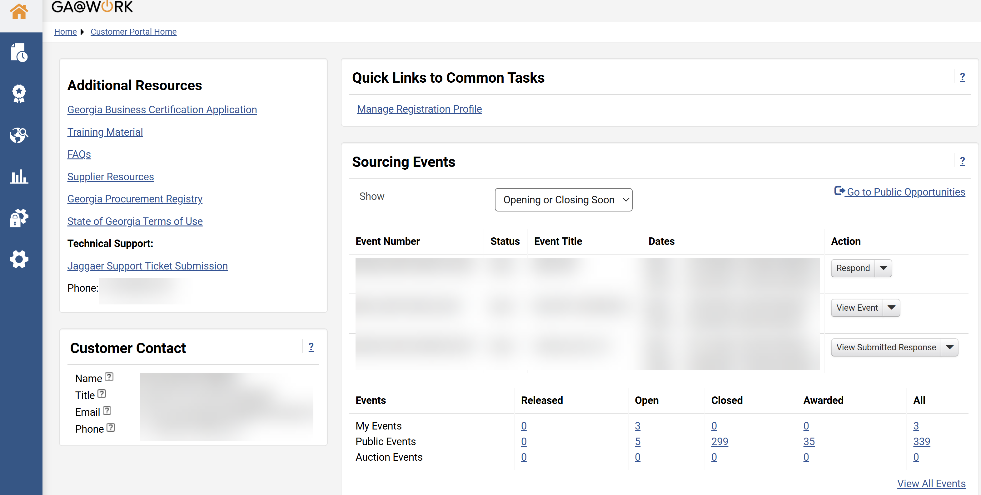
How to Withdraw a Bid (Part 10 of 13)
INSTRUCTIONS
View your Homepage.

Slide 12
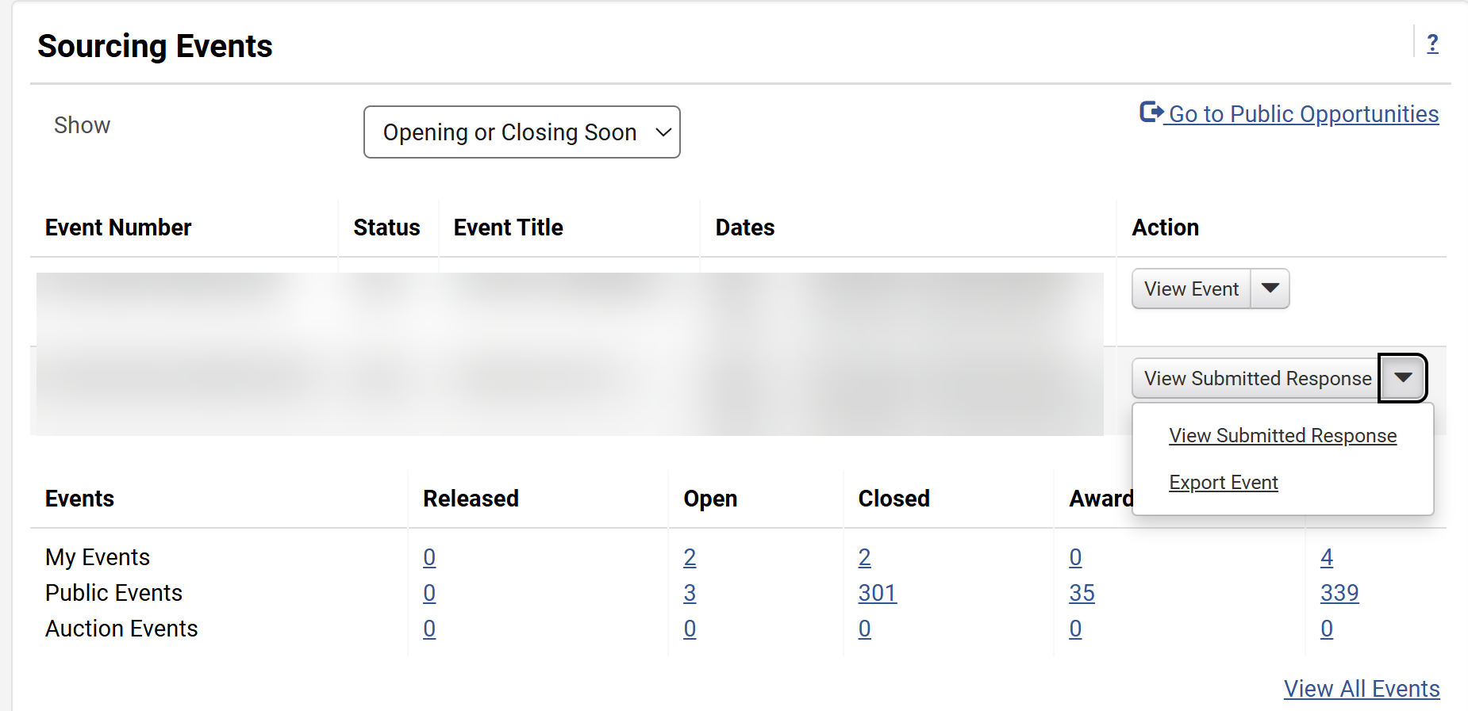
How to Withdraw a Bid (Part 11 of 13)
INSTRUCTIONS
Click View Submitted Reponses.
Note: Suppliers can also click on Open under My Events.
Select View Submitted Reponses.
24
25

Slide 13
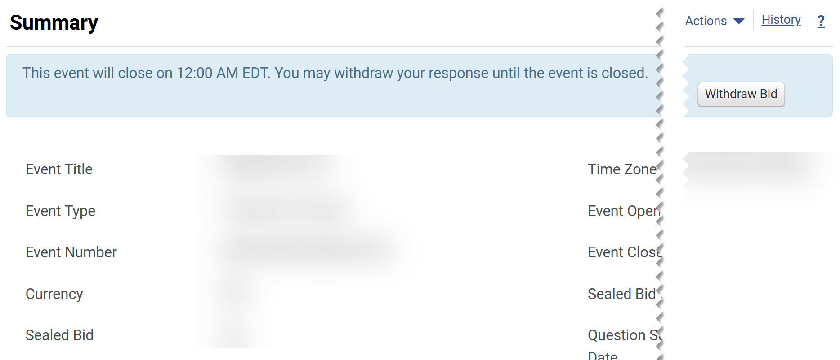
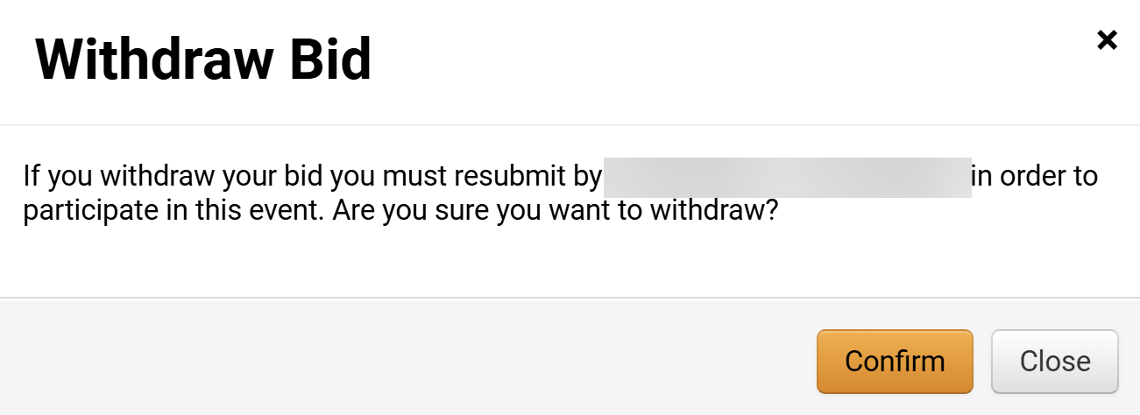
How to Withdraw a Bid (Part 12 of 13)
INSTRUCTIONS
Click Withdraw Bid.
Click Confirm.

Slide 14
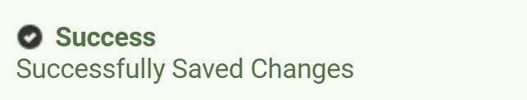

How to Withdraw a Bid (Part 13 of 13)
INSTRUCTIONS
Review the Success message.
Note: Review the Revise and Resubmit a Bid job aid for steps to resubmit the Bid.
You have successfully reviewed how to withdraw a bid.

