Slide 1
Respond to Sourcing Events
DESCRIPTION
This guide will show Suppliers how to Respond to Sourcing Events in GA@WORK Marketplace for Suppliers.
Note: To learn how to register or review the public bids portal information, review the job aids for those processes.
OVERVIEW
The key steps in the process are below:
Access Participation Email or Public Opportunities.
Access Sourcing Events.
Enter Sourcing Events information.
Submit Sourcing Event Bid Response.
Business Process:
Access Participation Email or Public Opportunities
Access Sourcing Event
Enter Sourcing Event Information
Submit Sourcing Event Bid Response

Slide 2
Respond to Sourcing Events
(Part 1 of 42)
INSTRUCTIONS
To access the Sourcing Event, follow one of the entry point information below, then skip to Step 31 to complete the Sourcing Event Bid Response information.
Access Point | Step Information
 | ​
 | ​
Email Link Invitation
2 - 7 (slides 3- 5)
GPR public interface Event Search
8 - 11 (slides 6- 7)
JAGGAER Supplier Network
12 - 21 (slides 8-12)
Public opportunity in GA@WORK Supplier Marketplace
22 - 30 (slides 13-16)

Slide 3
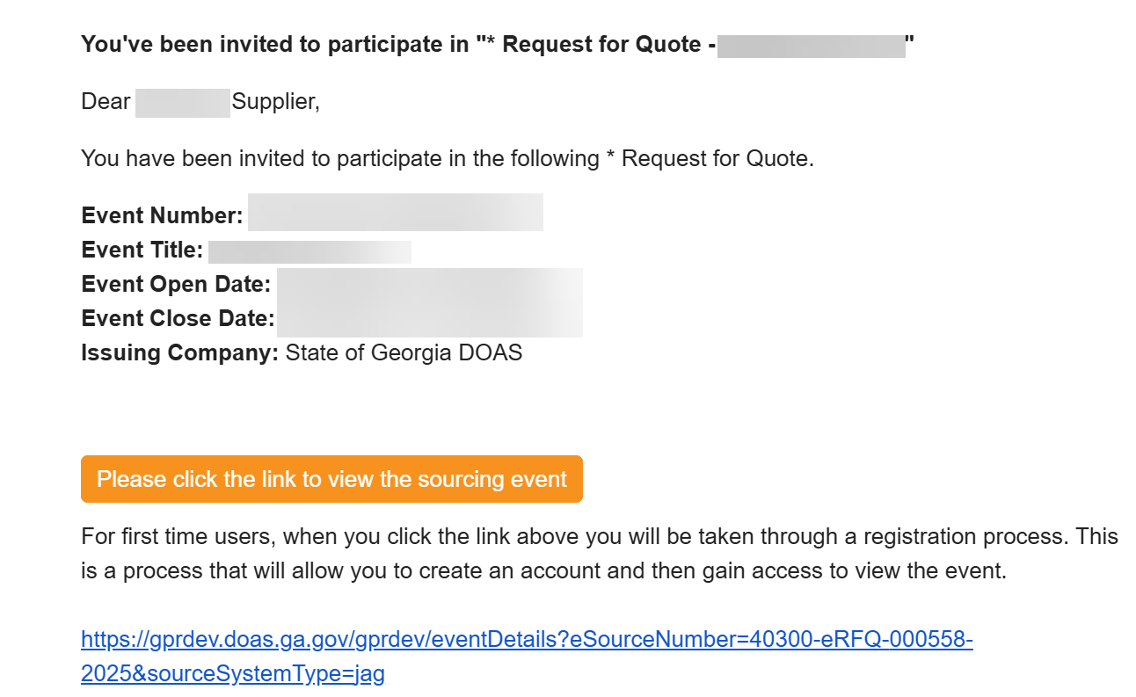
Respond to Sourcing Events
(Part 2 of 42)
INSTRUCTIONS
To access via email link invitation, click Please click the link to view the sourcing event.
Note: Suppliers are invited via email based on the commodity codes selected during registration. Follow steps 3-7 (log in steps), then skip to step 31 (yes I intend to bid) for bidding process.

Slide 4
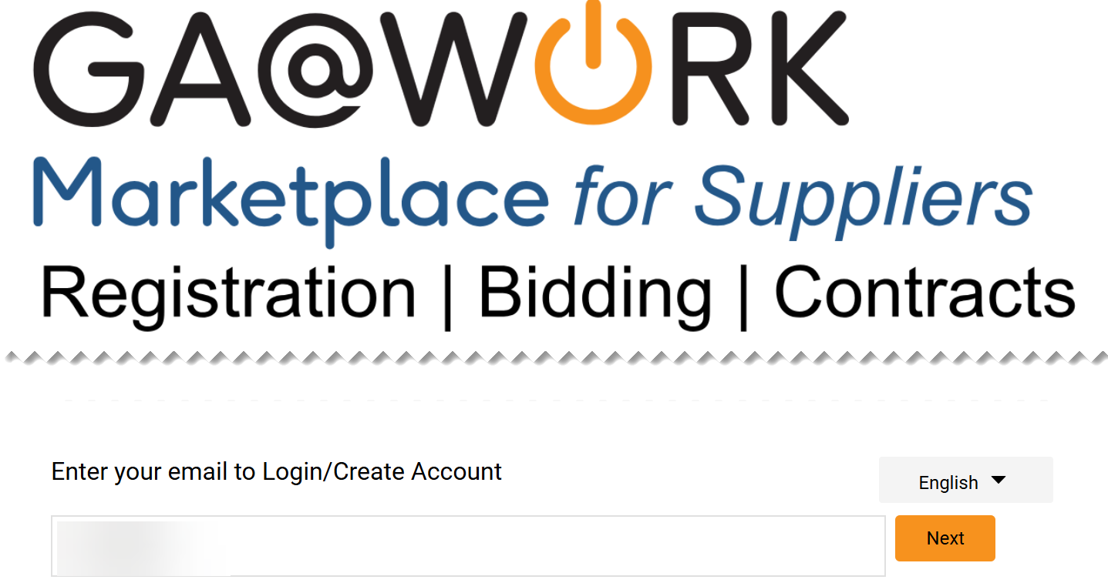
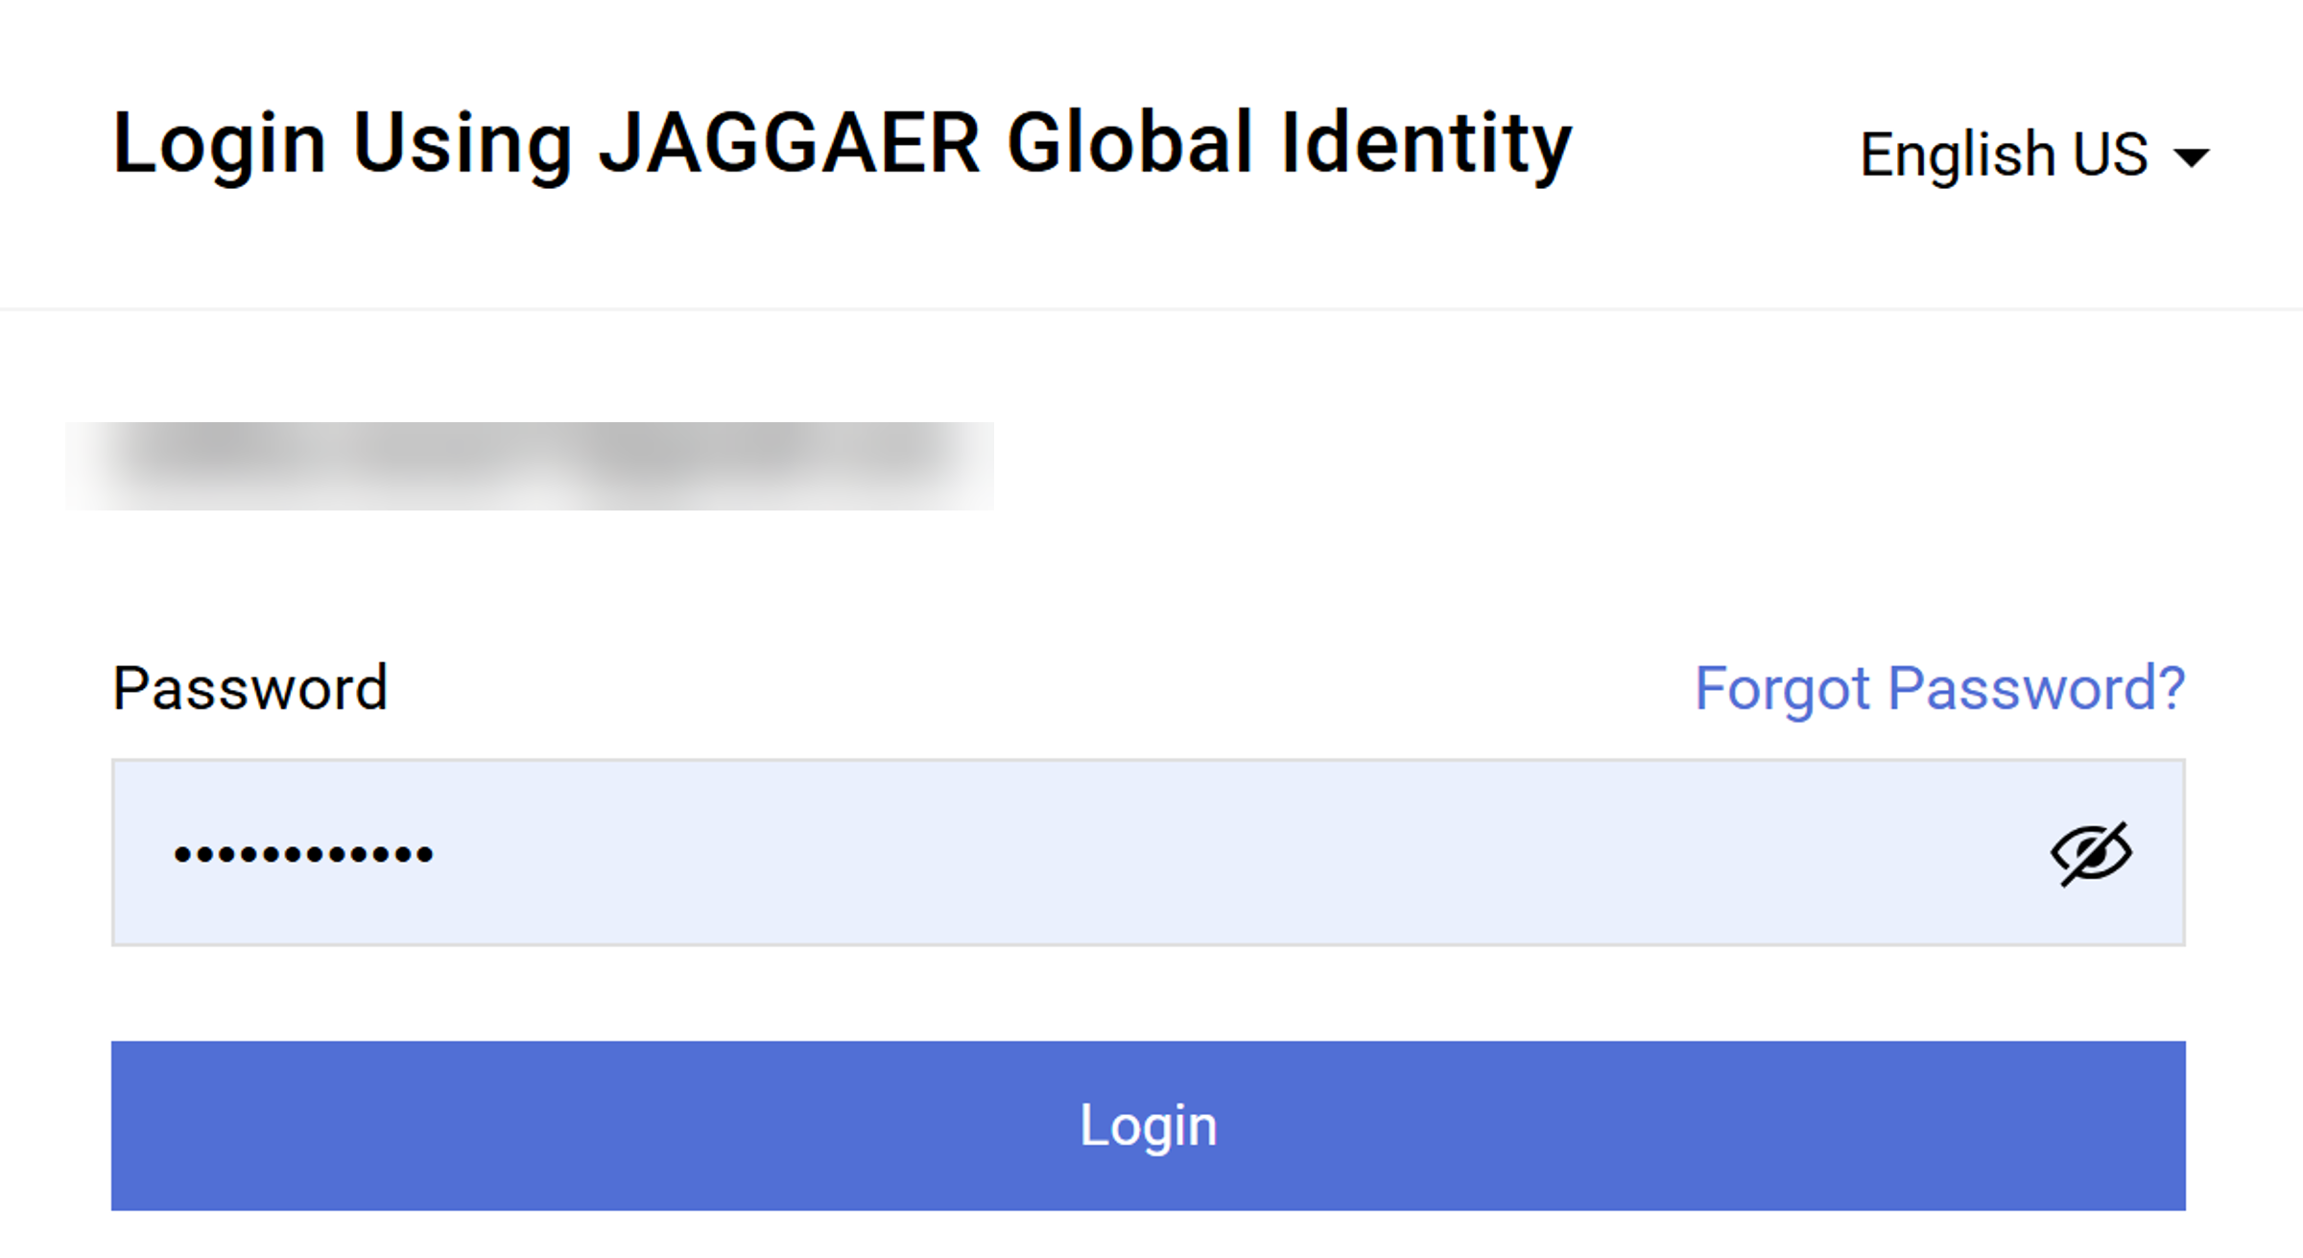
Respond to Sourcing Events
(Part 3 of 42)
INSTRUCTIONS
Enter your Email to Login.
Click Next.
3
4
Enter your Password.
Click Login.
5
6

Slide 5
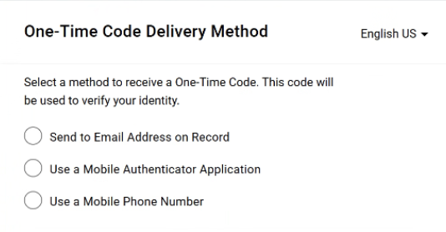
Respond to Sourcing Events
(Part 4 of 42)
INSTRUCTIONS
Select a method to receive a One-Time Code.
Note: For detail instructions on each One-Time Code Delivery Method, review the job aid Log in to the GA@WORK Marketplace for Suppliers. Skip to step 31 (Yes, I intend to bid) to continue with the bidding process.

Slide 6
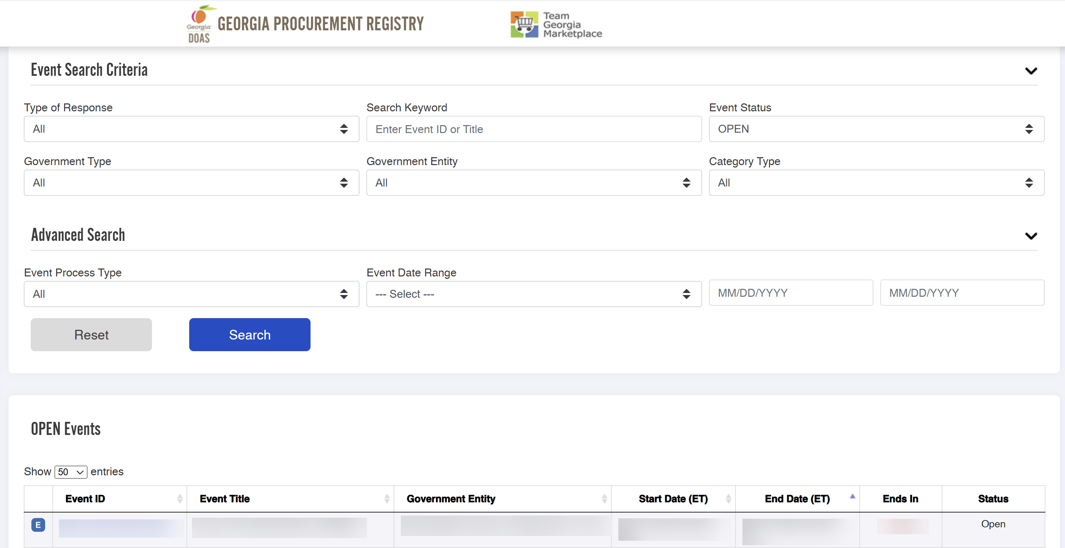
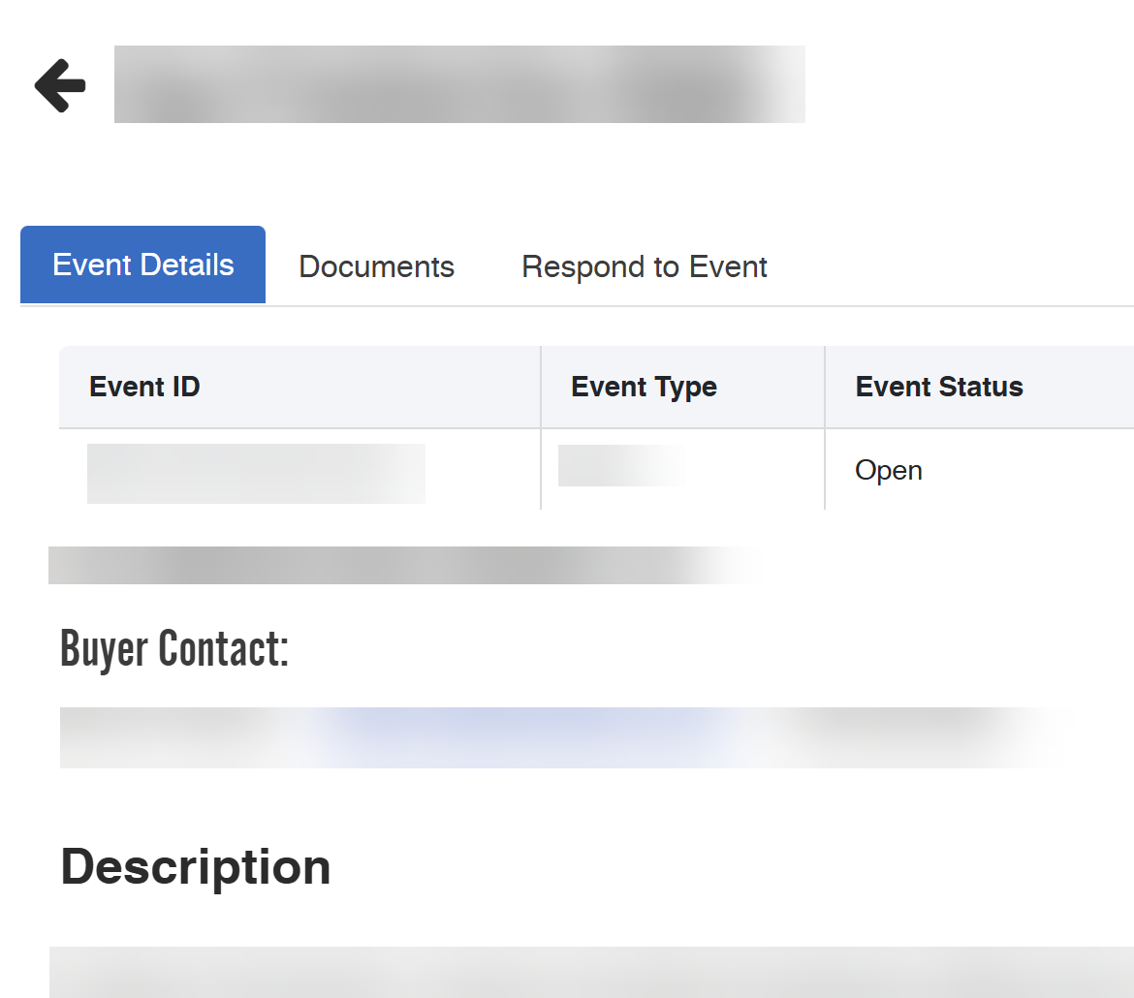
Respond to Sourcing Events
(Part 5 of 42)
INSTRUCTIONS
To access via GPR public interface Event Search, click Event ID.
Note: Open Events are displayed. It is possible to use the Event Search Criteria for filtering options. Follow steps 3-7 (log in steps), then skip to step 31 (yes I intend to bid) for bidding process.
Click Respond to Event.

Slide 7
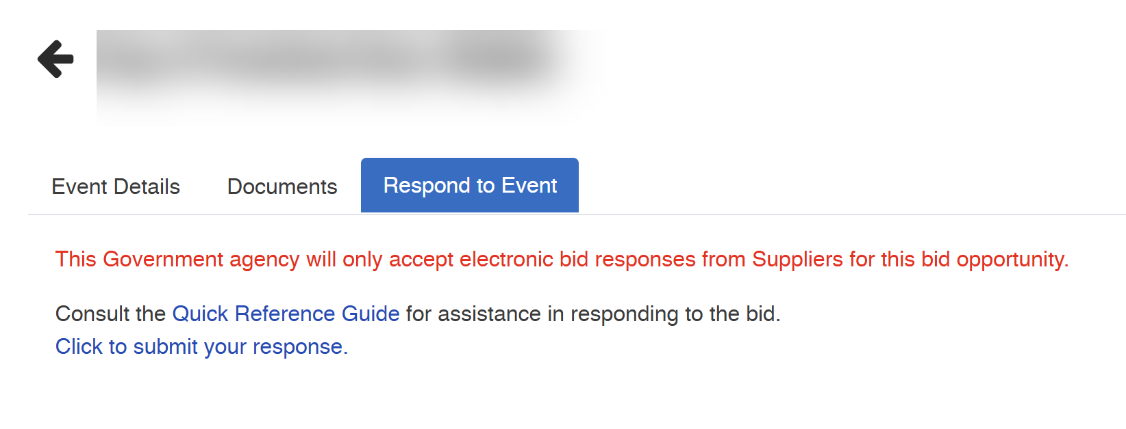
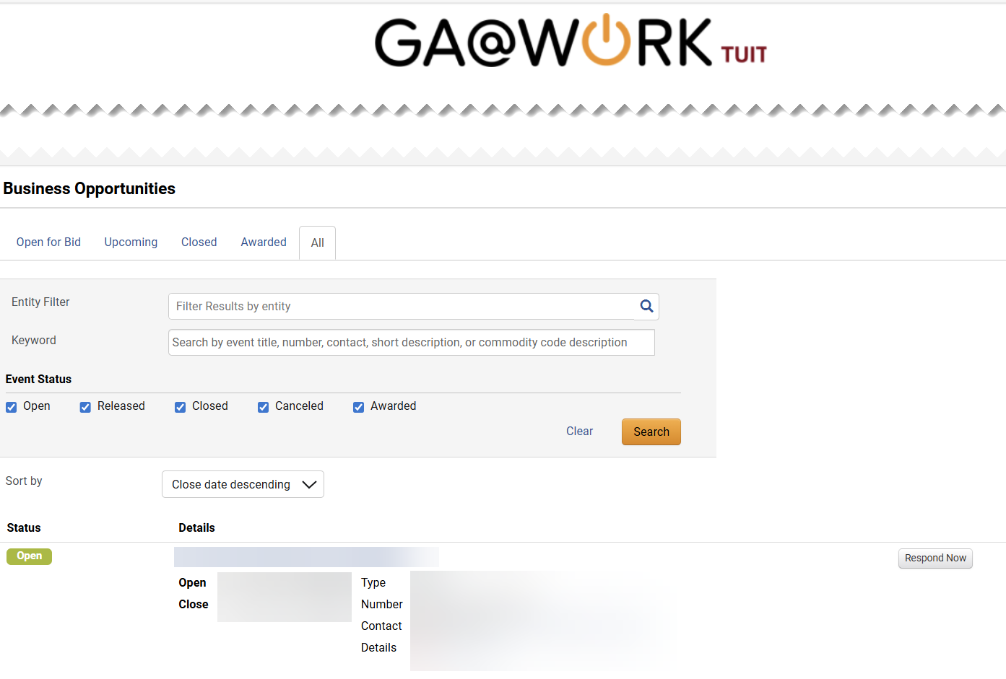
Respond to Sourcing Events
(Part 6 of 42)
INSTRUCTIONS
Select Click to submit your response.
Click Respond Now.
Note: Skip to Step 31 (Yes, I intend to bid) to continue with the bidding process.

Slide 8
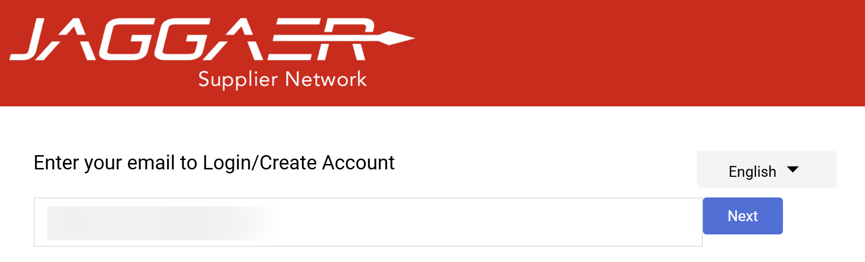
Respond to Sourcing Events
(Part 7 of 42)
INSTRUCTIONS
To access via JAGGAER Supplier Network, Enter your email to Login.
Click Next.
Note: Follow Steps 12 – 21, then skip to Step 31 (Yes, I intend to bid) for bidding process.
12
13
Enter your Password.
Click Login.
14
15

Slide 9
Respond to Sourcing Events
(Part 8 of 42)
INSTRUCTIONS
Select a method to receive a One-Time Code.
Note: For detail instructions on each One-Time Code Delivery Method, review the job aid Log in to the GA@WORK Marketplace for Suppliers.

Slide 10
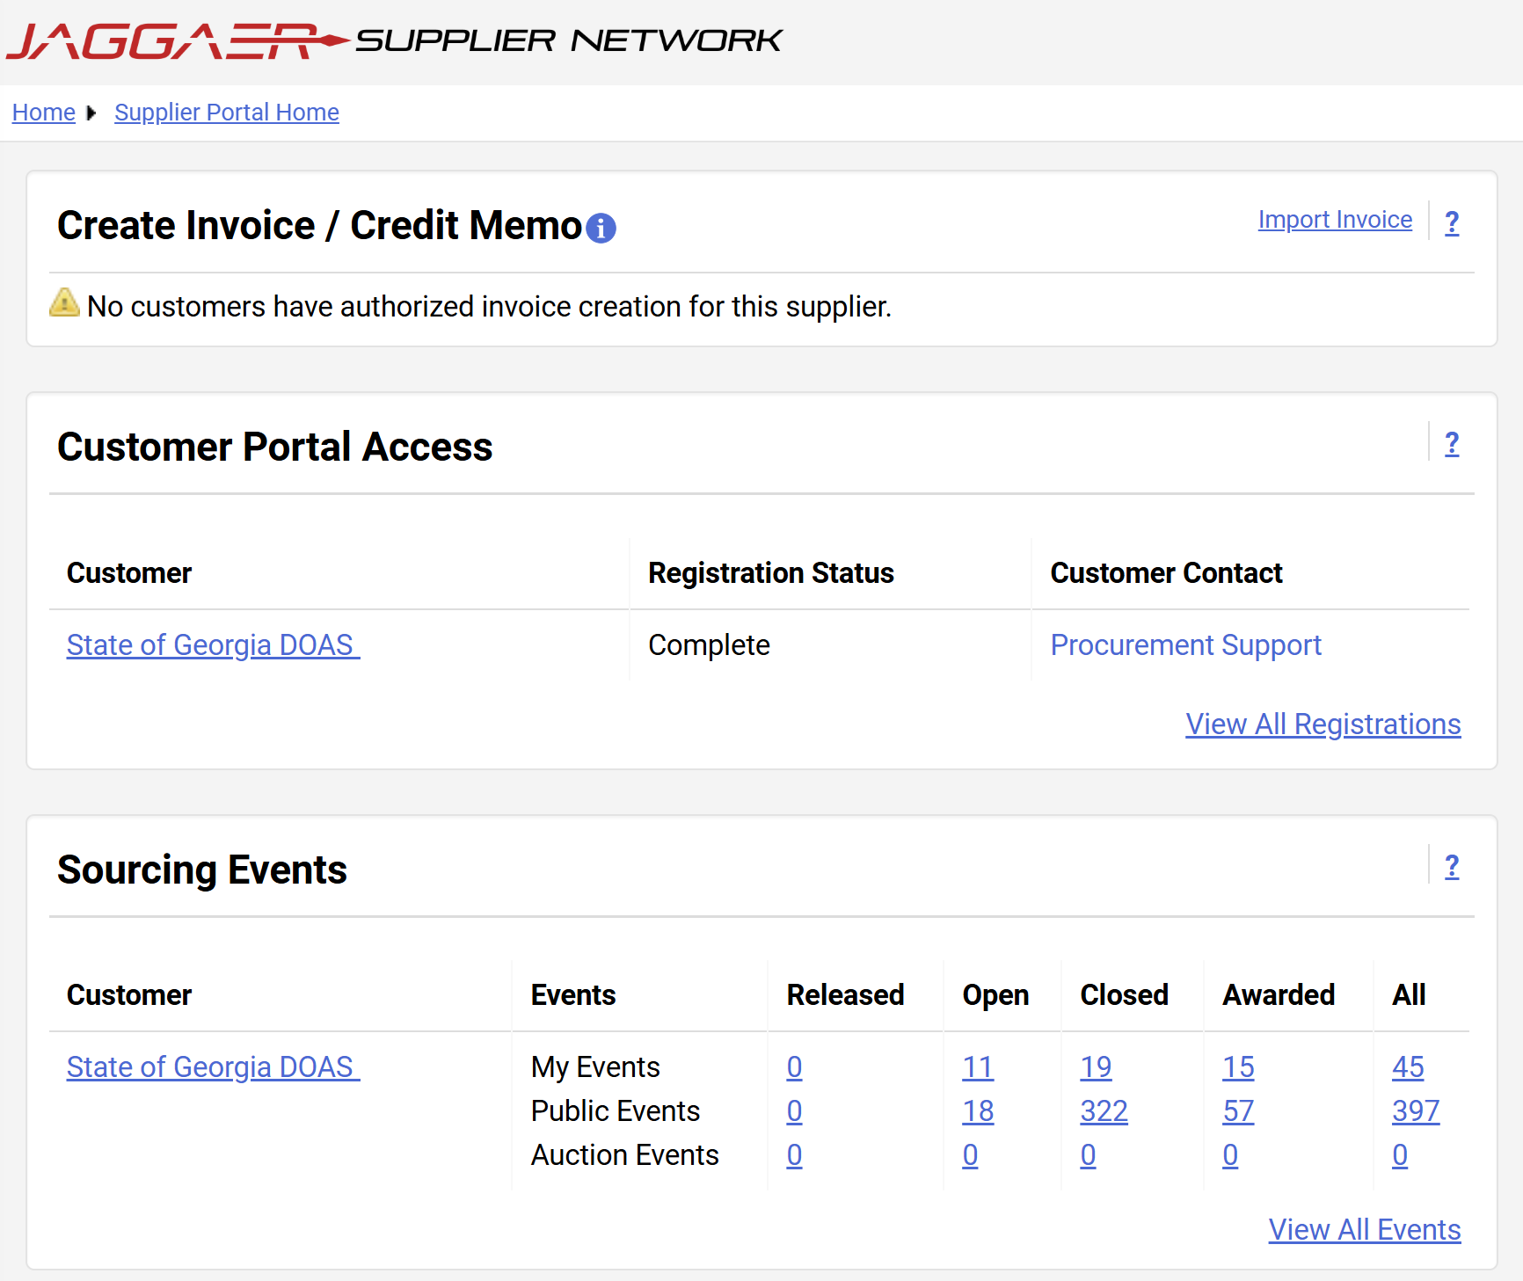
Respond to Sourcing Events
(Part 9 of 42)
INSTRUCTIONS
For Sourcing Events section, click State of Georgia DOAS.

Slide 11
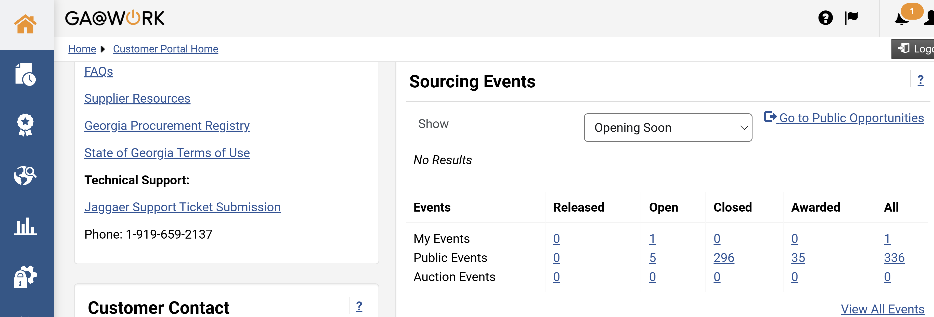
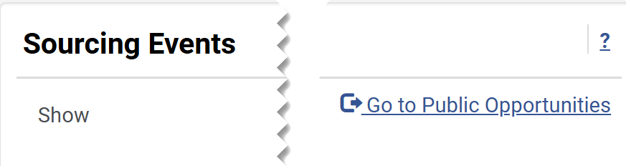
Respond to Sourcing Events
(Part 10 of 42)
INSTRUCTIONS
For public opportunities, your Homepage is displayed.
Click Go to Public Opportunities.

Slide 12
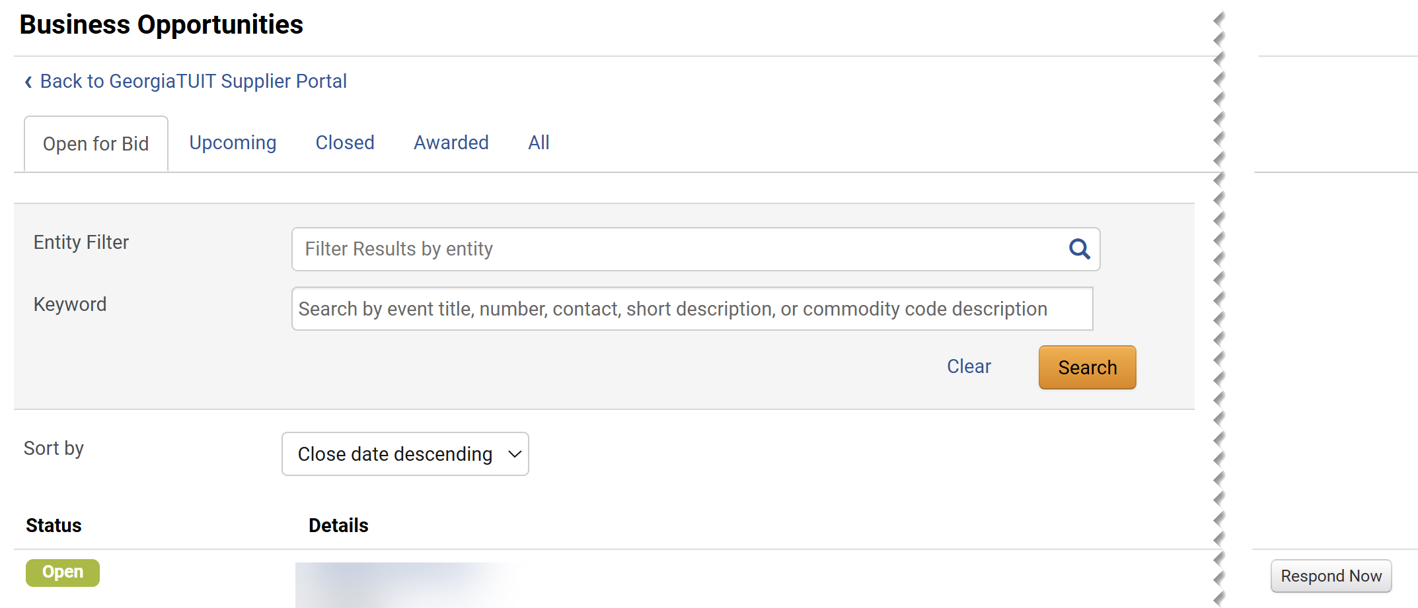
Respond to Sourcing Events
(Part 11 of 42)
INSTRUCTIONS
Select the Tabs for quick filter options to view Business Opportunities.
Note: The default display is Open for Bid. Click on each tab to display results.
Click Respond Now to access the Bid.
Note: Skip to Step 31 (Yes, I intend to bid) to continue with the bidding process.
20
21

Slide 13
Respond to Sourcing Events
(Part 12 of 42)
INSTRUCTIONS
To access via Public opportunity in GA@WORK Supplier Marketplace, Enter your email to Login.
Click Next.
Note: Follow Steps 22 - 30 (log in steps), then skip to Step 31 (Yes, I intend to bid) for bidding process.
22
23

Slide 14
Respond to Sourcing Events
(Part 13 of 42)
INSTRUCTIONS
Enter your Password.
Click Login.
24
25
Select a method to receive a One-Time Code.
Note: For detail instructions on each One-Time Code Delivery Method, review the job aid Log in to the GA@WORK Marketplace for Suppliers.

Slide 15
Respond to Sourcing Events
(Part 14 of 42)
INSTRUCTIONS
For public opportunities, your Homepage is displayed.
Click Go to Public Opportunities.

Slide 16
Respond to Sourcing Events
(Part 15 of 42)
INSTRUCTIONS
Select the Tabs for quick filter options to view Business Opportunities.
Note: The default display is Open for Bid. Click on each tab to display results.
Click Respond Now to access the Bid.
29
30

Slide 17
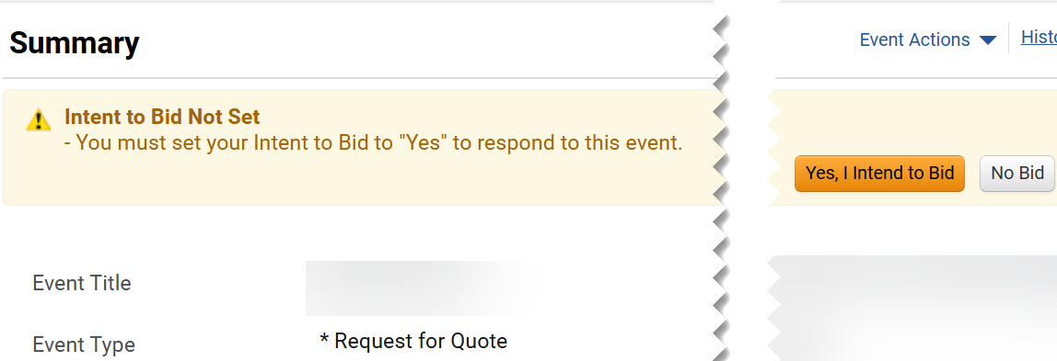
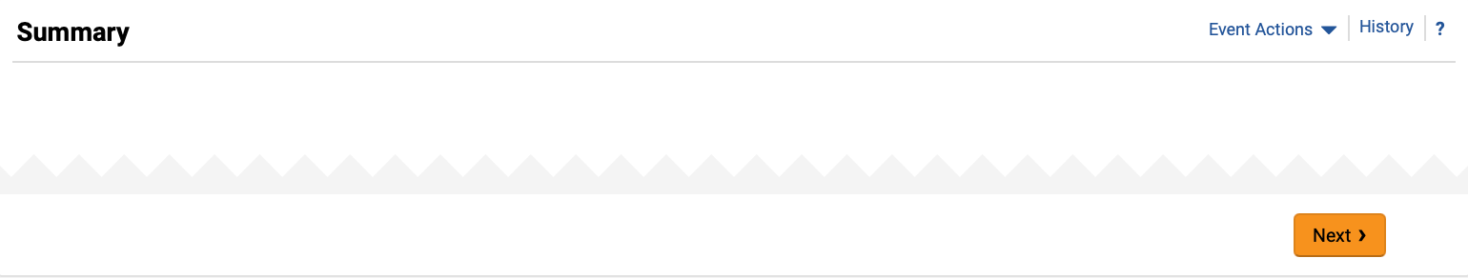
Respond to Sourcing Events
(Part 16 of 42)
INSTRUCTIONS
Click Yes, I Intend to Bid.
Note: This step is required to answer the Sourcing Event. The same steps apply to Public Opportunities or Invited Events.
Click Next.

Slide 18
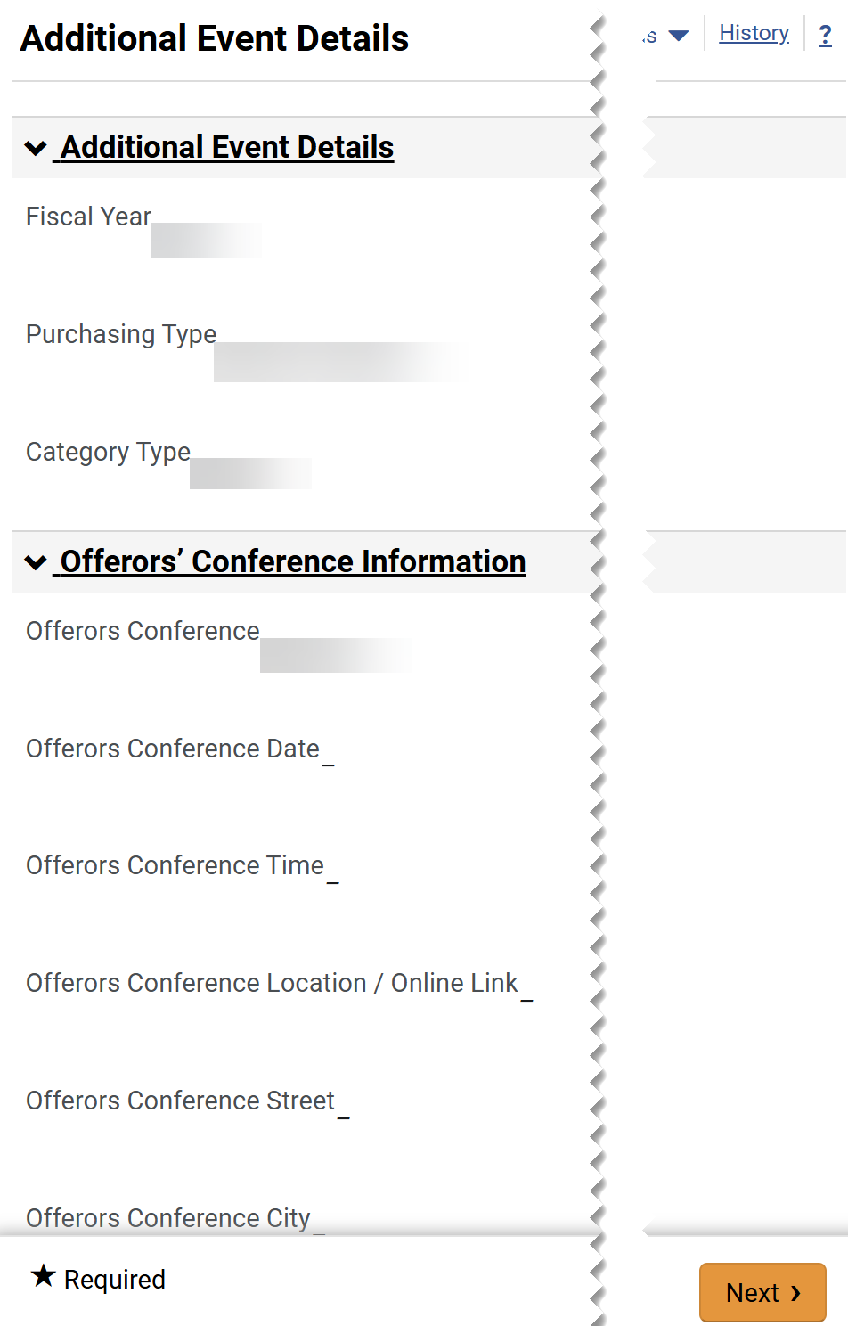
Respond to Sourcing Events
(Part 17 of 42)
INSTRUCTIONS
Review Additional Event Details.
Note: Information displayed is read-only with details about the Event.
Click Next.
33
34

Slide 19
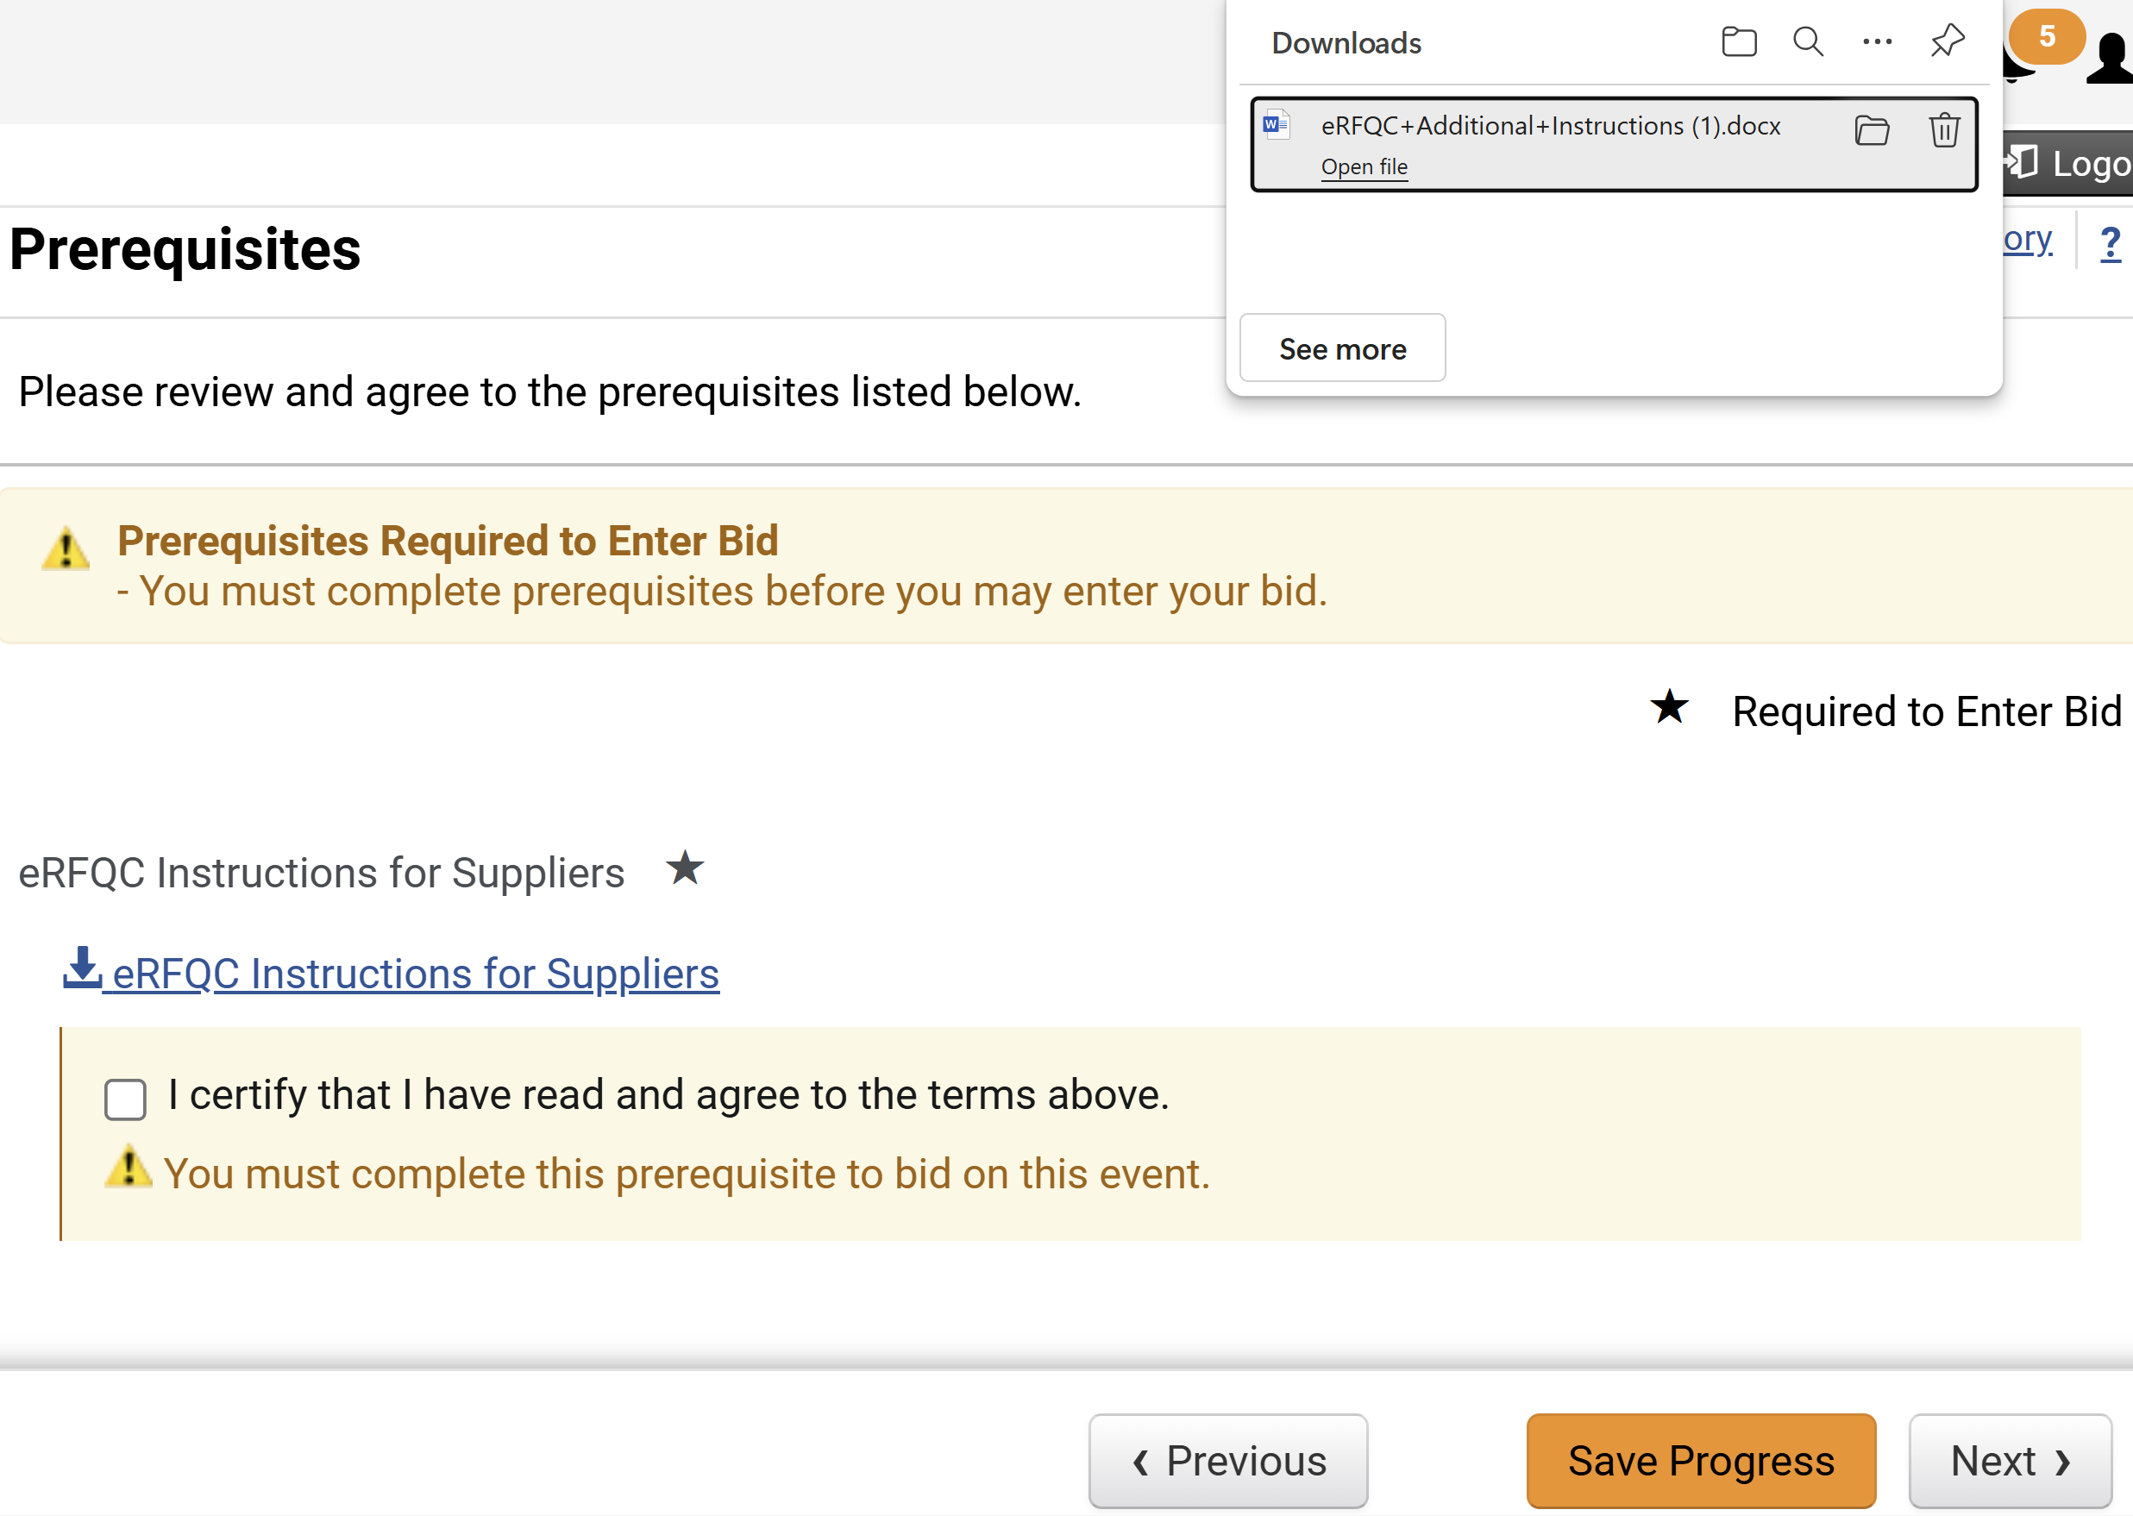
Respond to Sourcing Events
(Part 18 of 42)
INSTRUCTIONS
Download the Prerequisite.
Note: Read the downloaded file before the Certify step.
Certify the Prerequisites.
Note: Prerequisites might vary based on the Event type.
Click Save Progress.
35
36
37

Slide 20
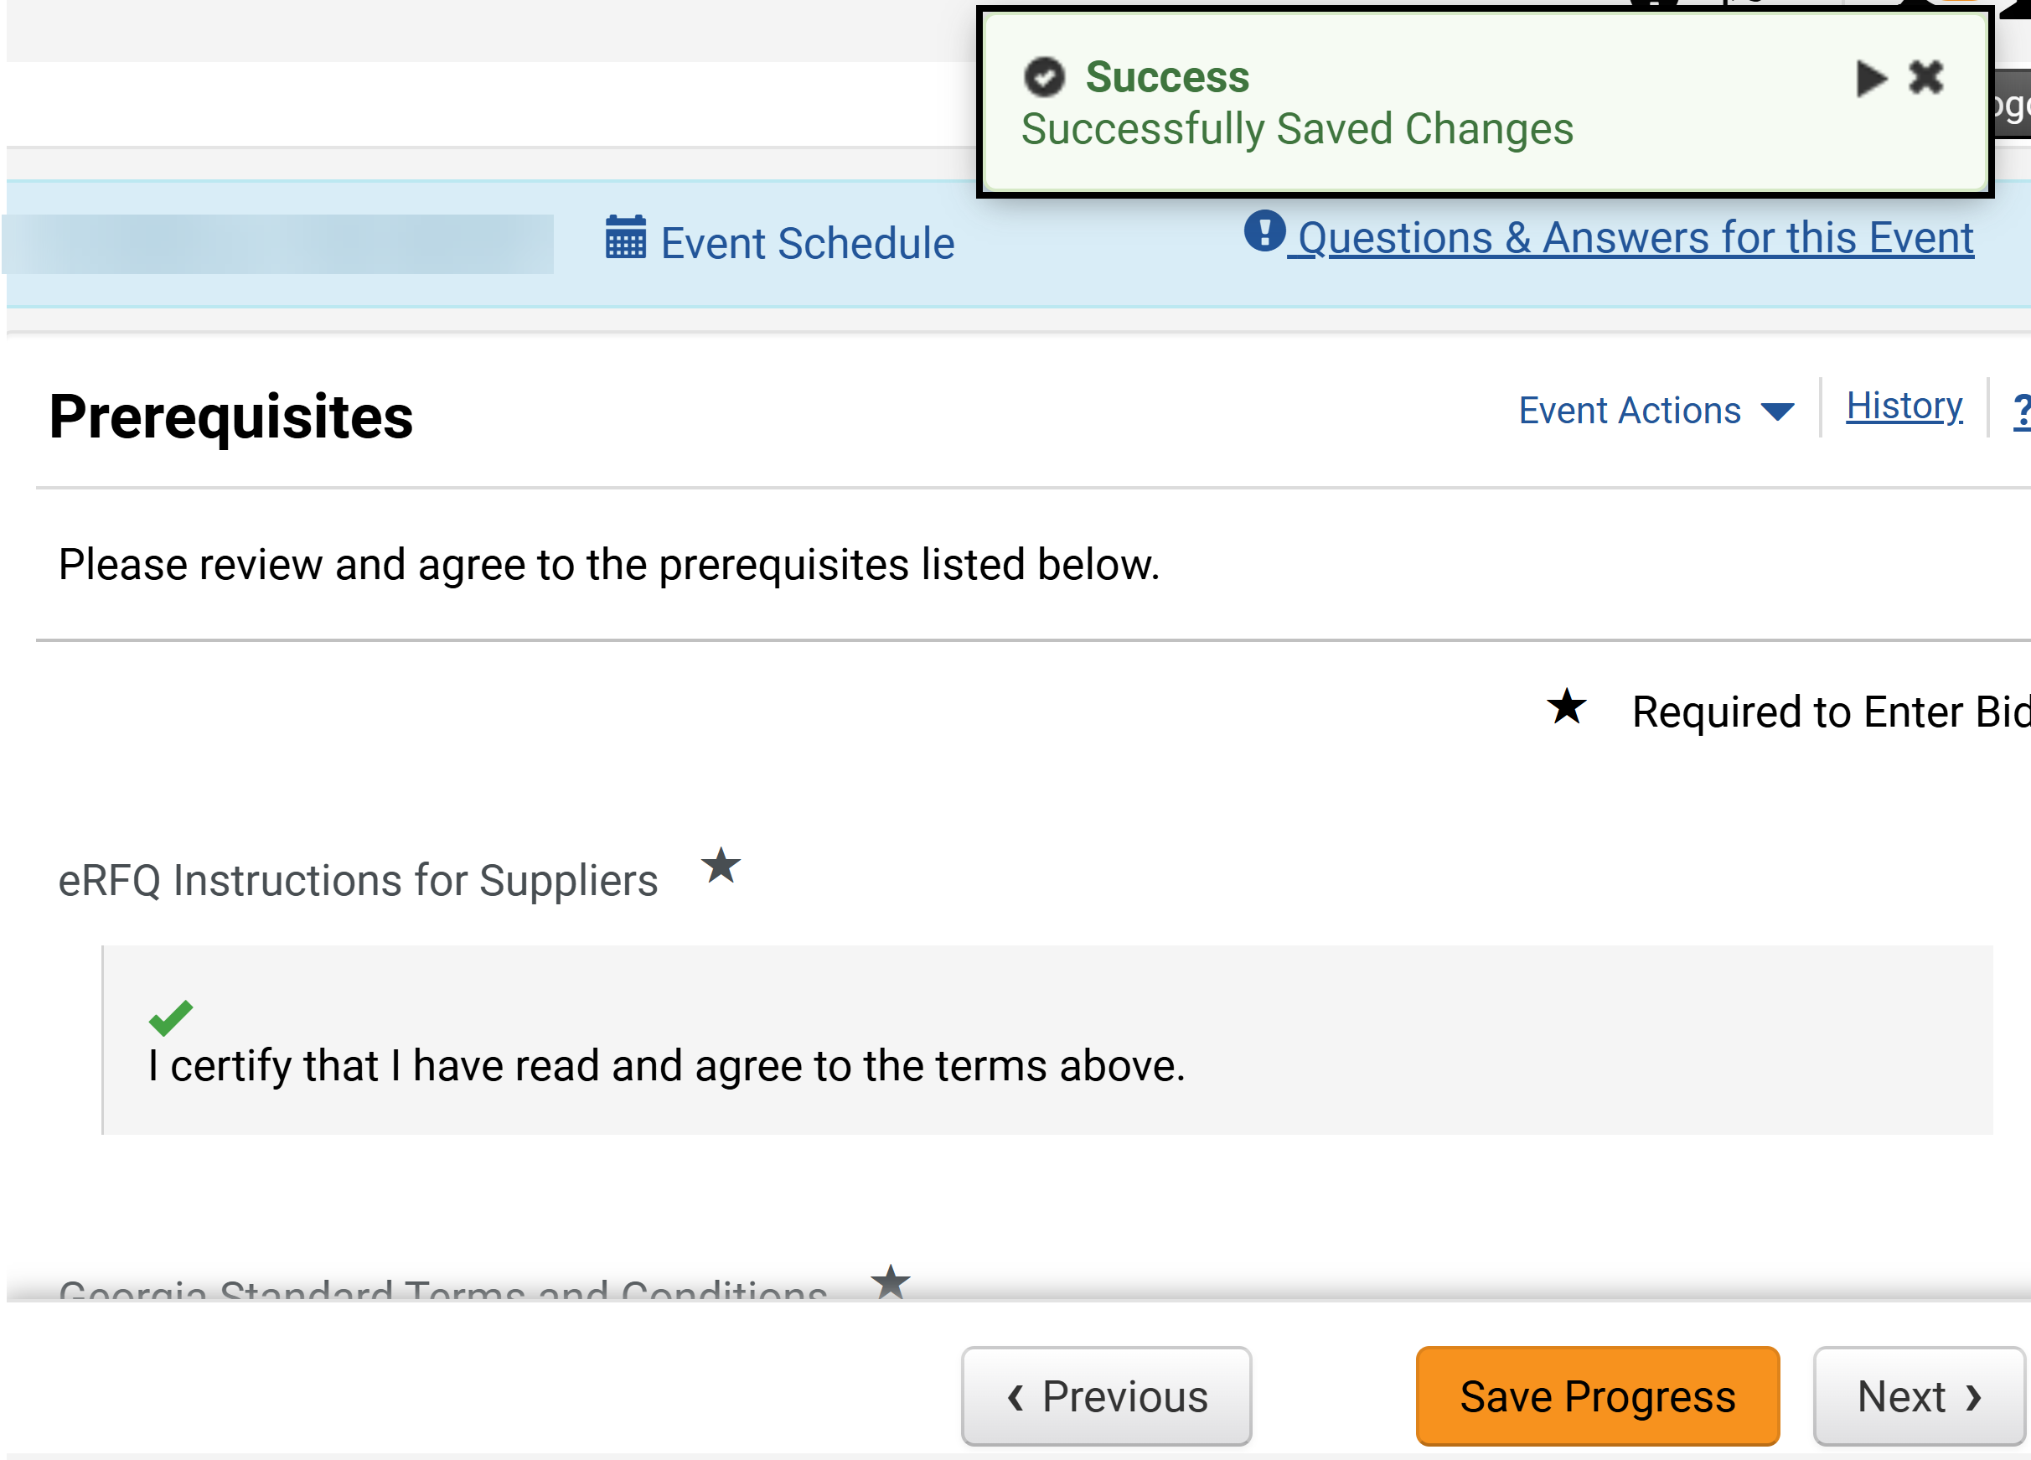
Respond to Sourcing Events
(Part 19 of 42)
INSTRUCTIONS
Review the Success Message.
Click Next.
38
39

Slide 21
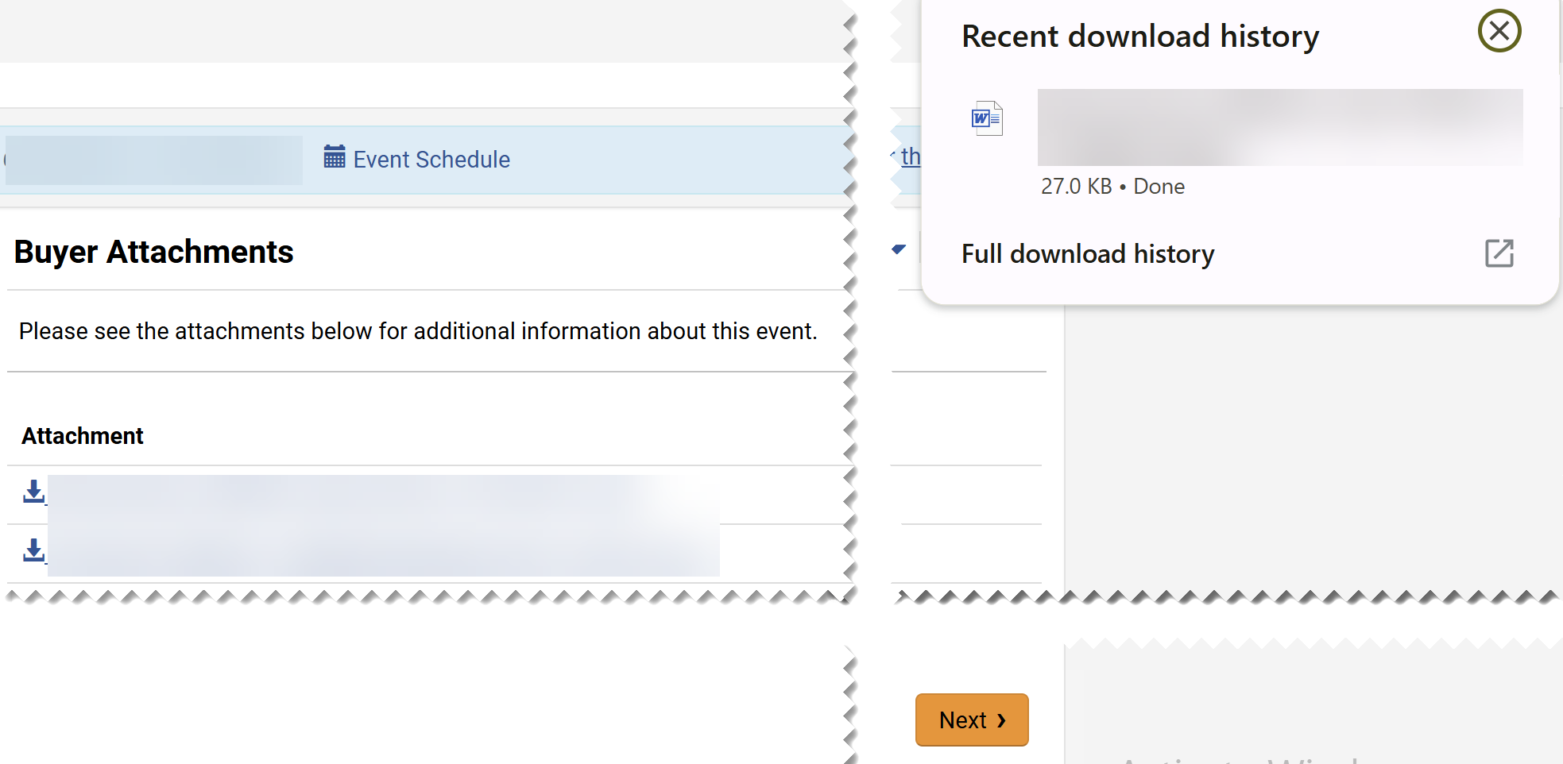
Respond to Sourcing Events
(Part 20 of 42)
INSTRUCTIONS
Review Buyer Attachments.
Click the Attachment hyperlink to download.
Note: Download all the documents, as they contain crucial information for meeting the Event requirements, such as details on how to answer the event questions, documents required, etc.
40
41
Click the Downloaded Document to review.
Click Next.
42
43

Slide 22
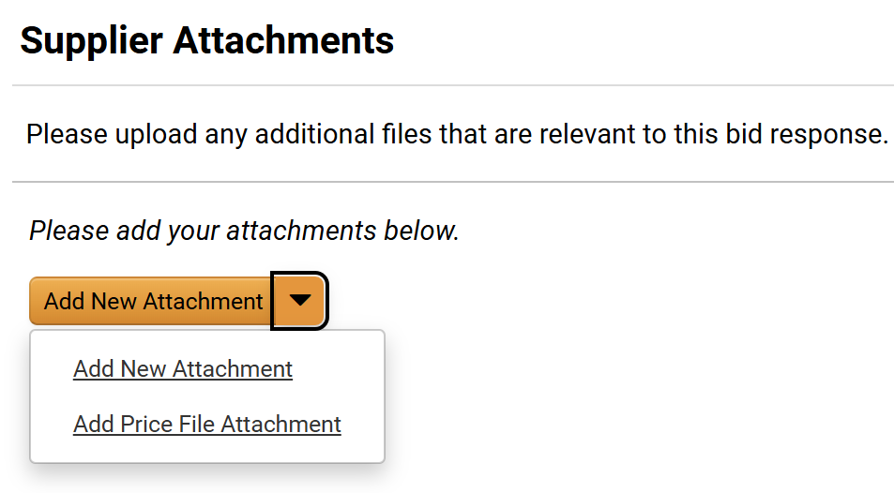
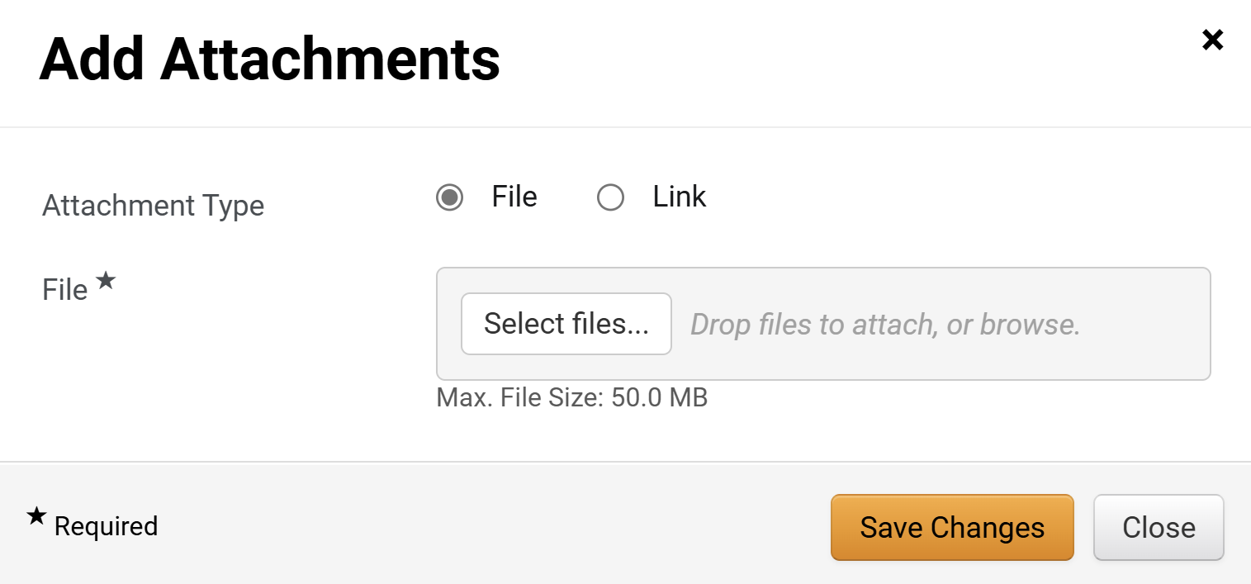
Respond to Sourcing Events
(Part 21 of 42)
INSTRUCTIONS
Click Add New Attachment.
Note: Include Supplier Attachments relevant to the Event. The process to upload attachments is the same for New Attachment or Price File Attachment. If no attachments are added, click Next and skip to step 54.
Select Attachment Type as File or Link.
Note: For the purposes of this guide, we will select File. If Attachment Type is Link skip to step 50 - 53.
Click Select Files for File*.
Note: Complete all required fields marked with a black star*.
45
46

Slide 23
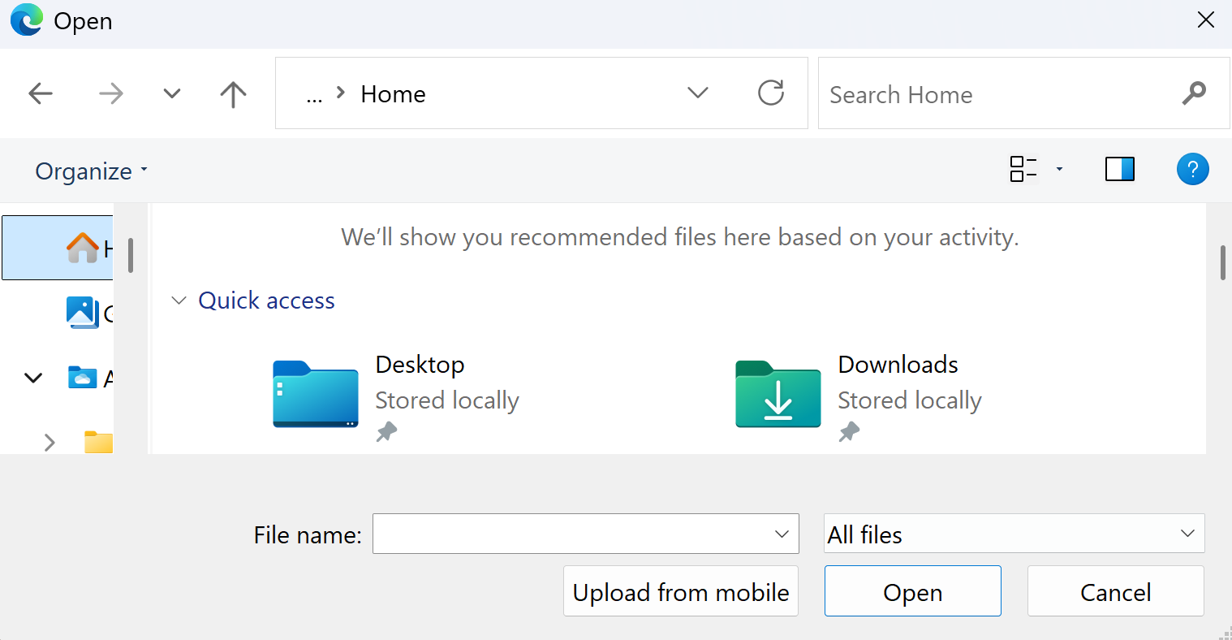
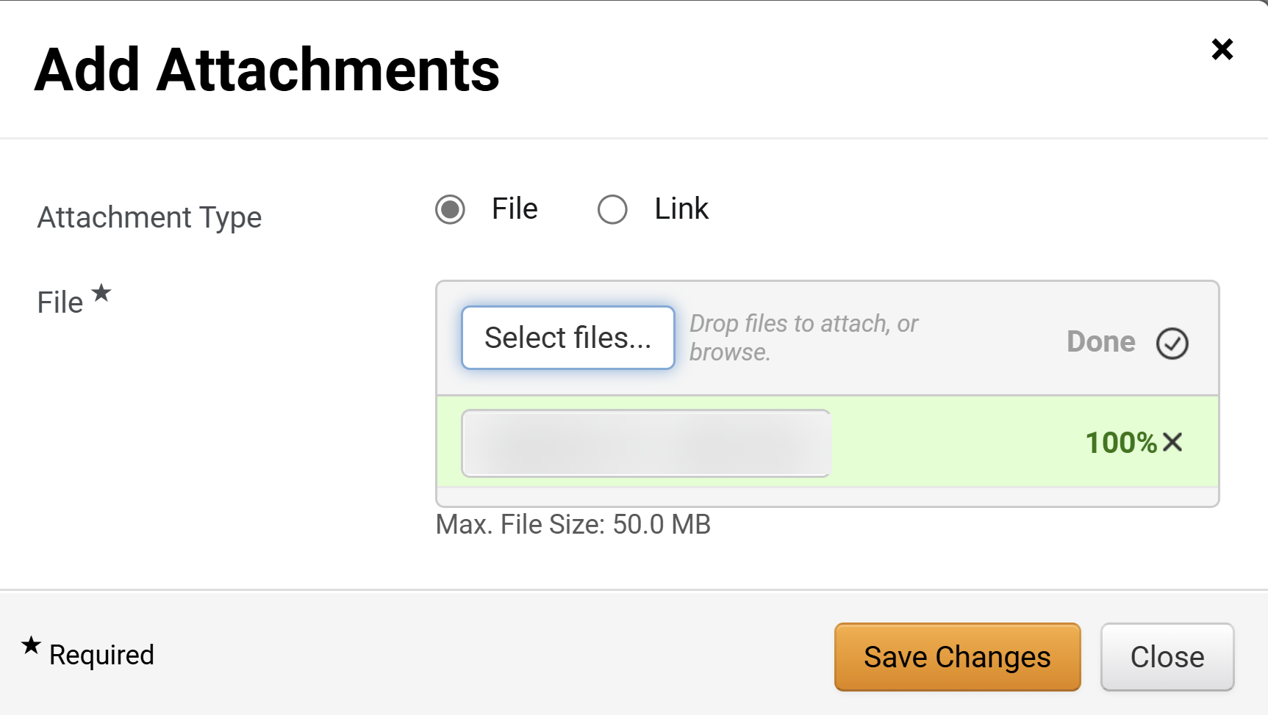
Respond to Sourcing Events
(Part 22 of 42)
INSTRUCTIONS
Select the applicable File from your computer.
Click Open.
47
48
Click Save Changes.

Slide 24
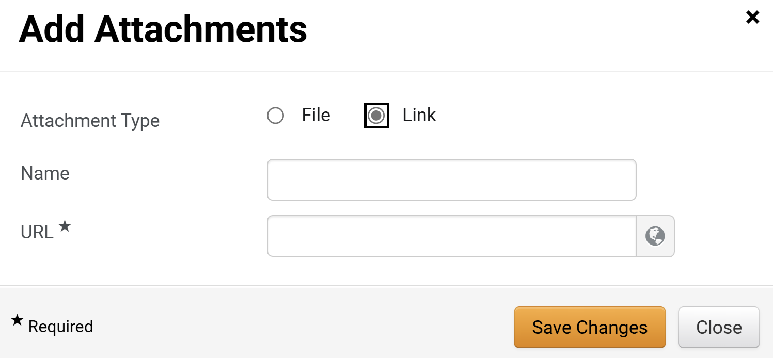
Respond to Sourcing Events
(Part 23 of 42)
INSTRUCTIONS
If attaching a link, select Link for the Attachment Type.
Enter a Name.
Enter the URL*.
Click Save Changes.
50
51
52
53

Slide 25
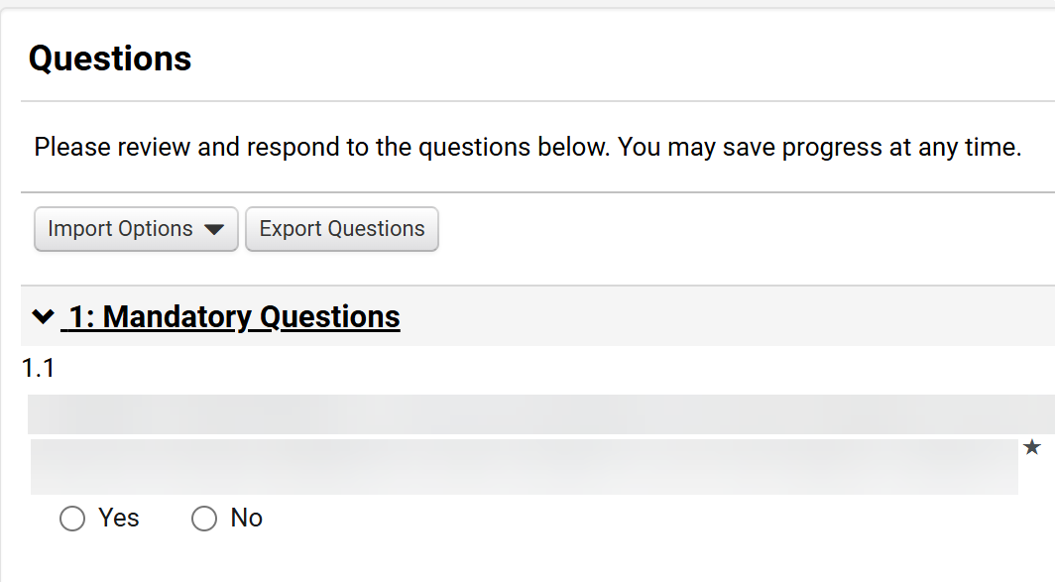
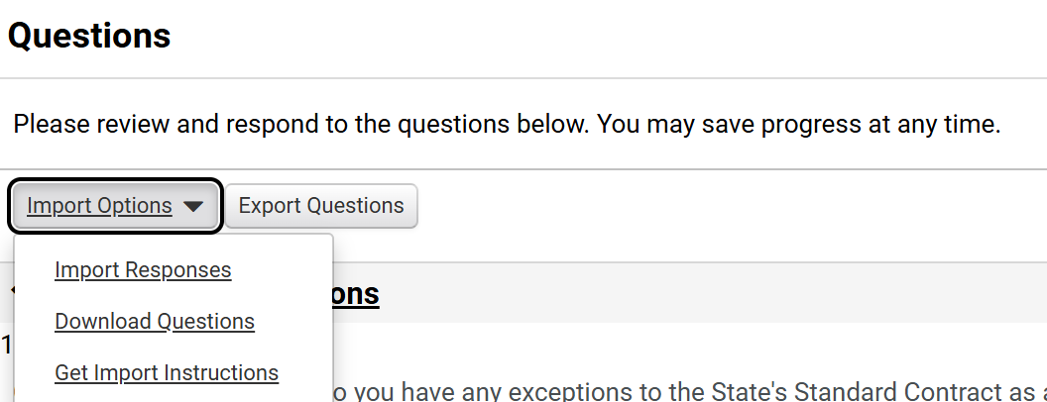
Respond to Sourcing Events
(Part 24 of 42)
INSTRUCTIONS
Answer Questions.
Note: Questions might vary based on the Sourcing Event. Based on the answer, additional questions may be displayed. If Import Options is selected, follow steps 55 - 79; otherwise, skip to step 80.
Click Import Options.
Select Download Questions.
55
56

Slide 26
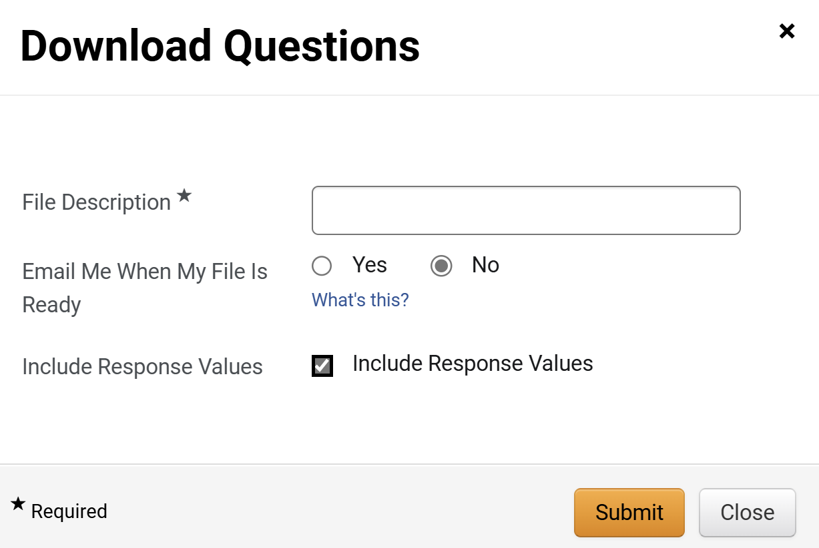
Respond to Sourcing Events
(Part 25 of 42)
INSTRUCTIONS
Enter a File Description*.
Select Email Me When My File Is Ready.
Select Include Response Values.
Click Submit.
57
58
59
60

Slide 27
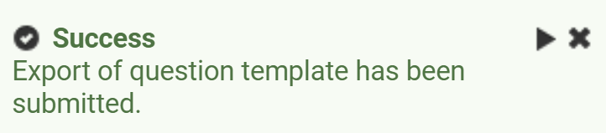
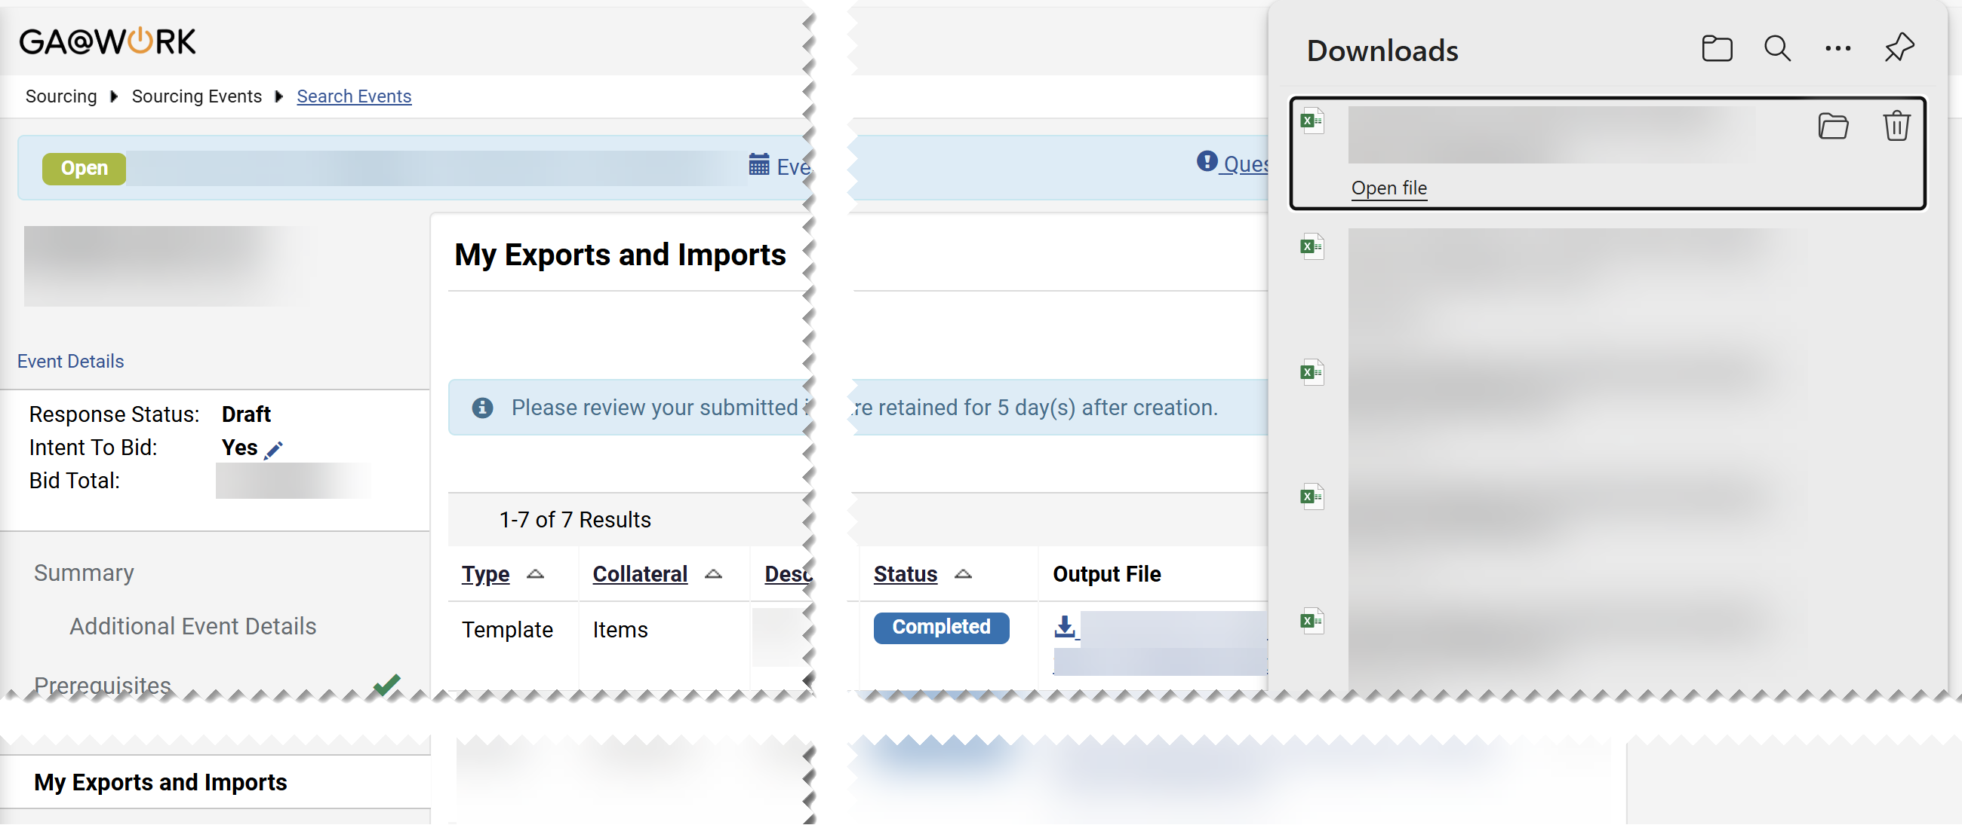
Respond to Sourcing Events
(Part 26 of 42)
INSTRUCTIONS
Review the Success message.
Click My Exports and Imports.

Slide 28
Respond to Sourcing Events
(Part 27 of 42)
INSTRUCTIONS
Click the Output File hyperlink.
Click Downloaded File.
64
63

Slide 29
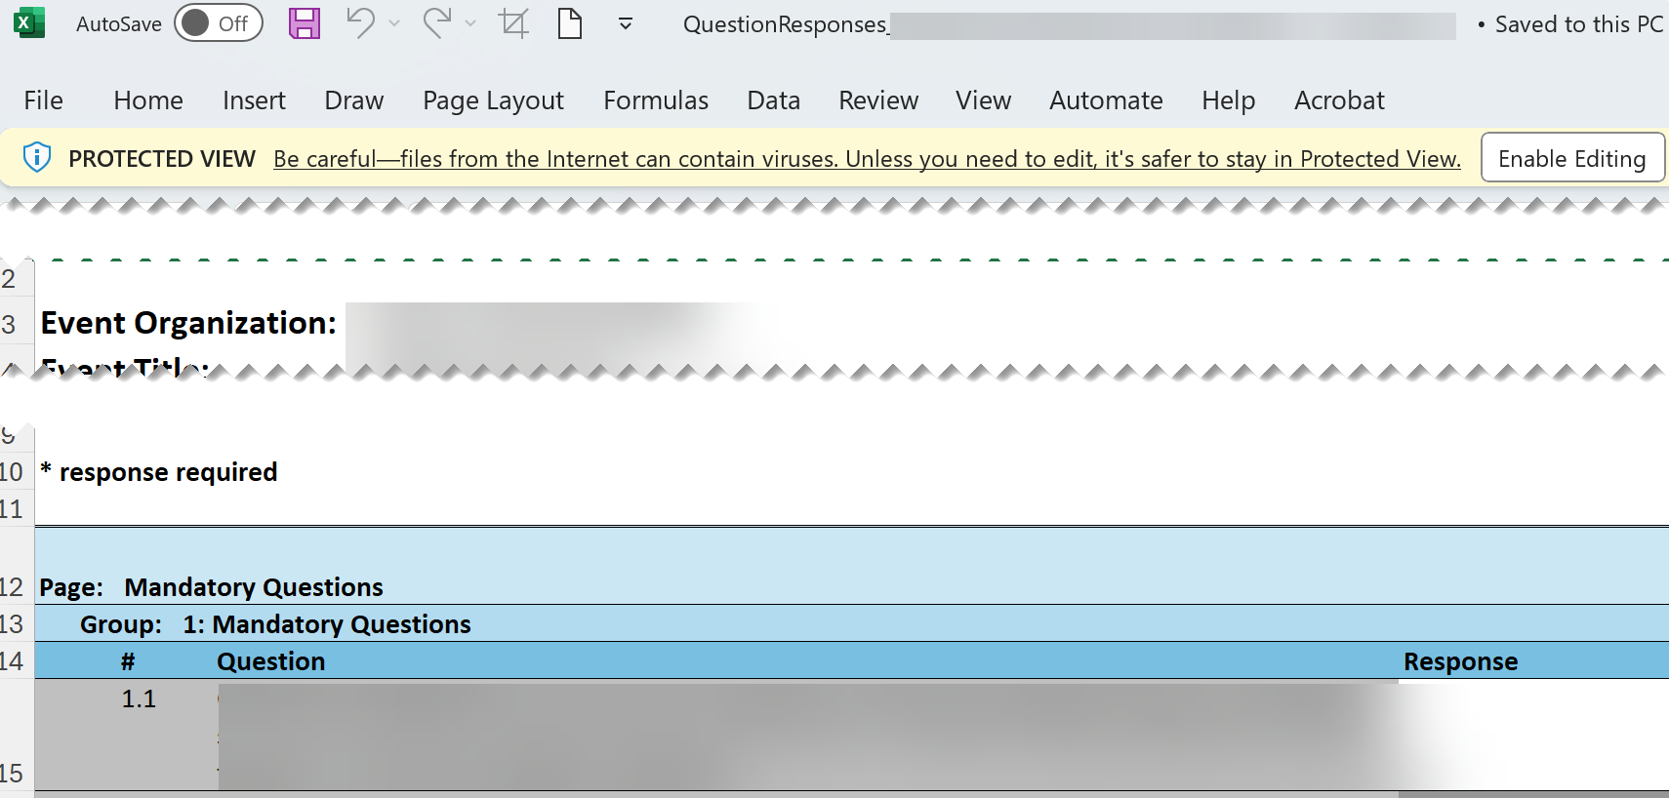
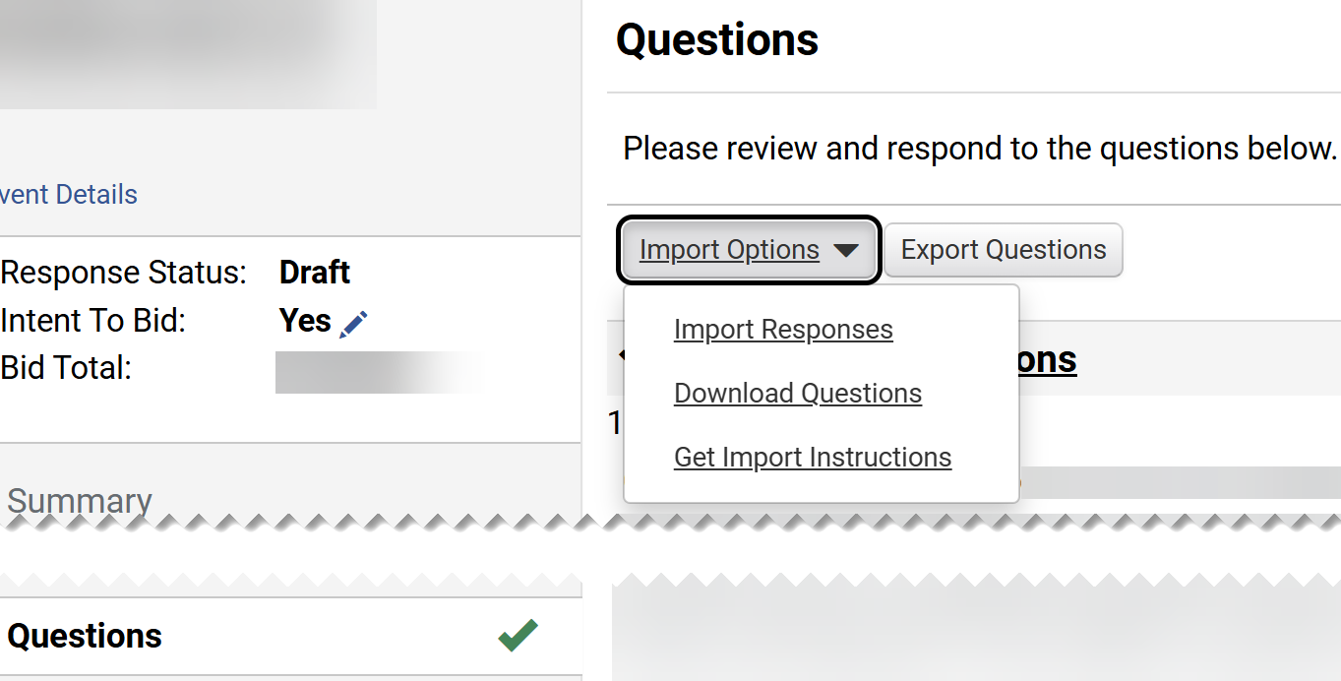
Respond to Sourcing Events
(Part 28 of 42)
INSTRUCTIONS
Click Enable Editing.
Answer Question.
Save File.
67
65
66
Click Questions.
Click Import Options.
Click Import Responses.
69
70
68

Slide 30
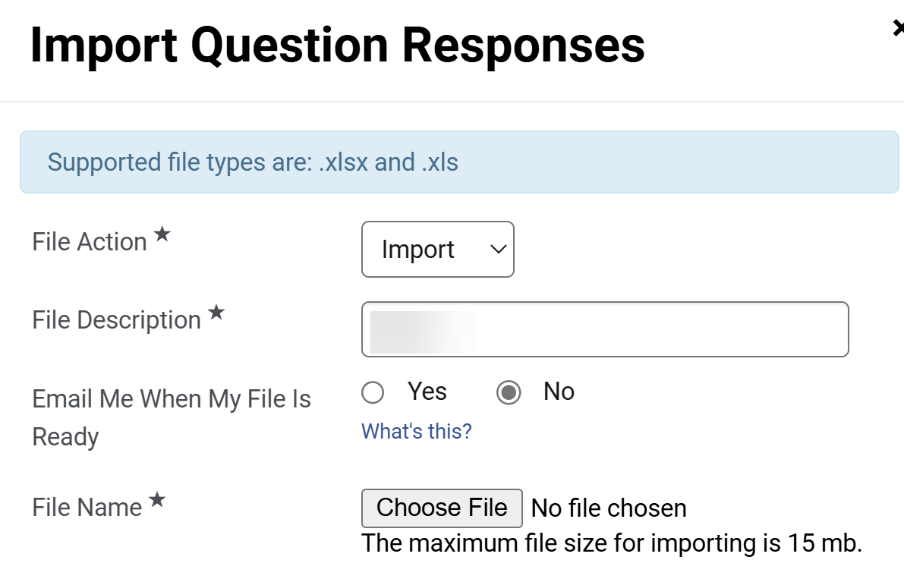
Respond to Sourcing Events
(Part 29 of 42)
INSTRUCTIONS
Select File Action*.
Enter File Description*.
Select Email Me When My File Is Ready.
Click Choose File for File Name*.
71
72
73
74

Slide 31
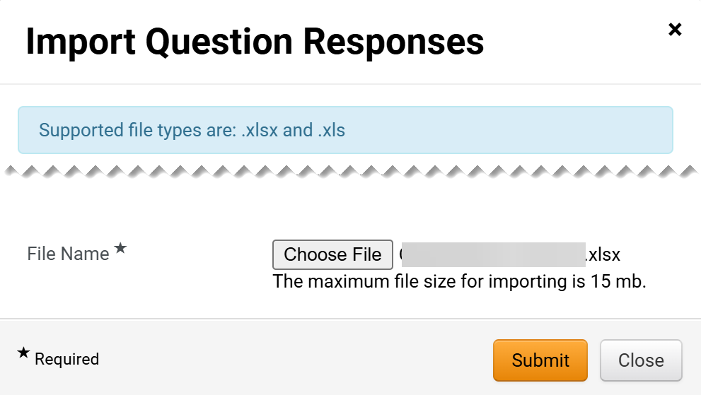
Respond to Sourcing Events
(Part 30 of 42)
INSTRUCTIONS
Select the applicable File from your computer.
Click Open.
75
76
Review File is loaded.
Note: The file loaded should be either .xlsx or .xls.
Click Submit.
77
78

Slide 32
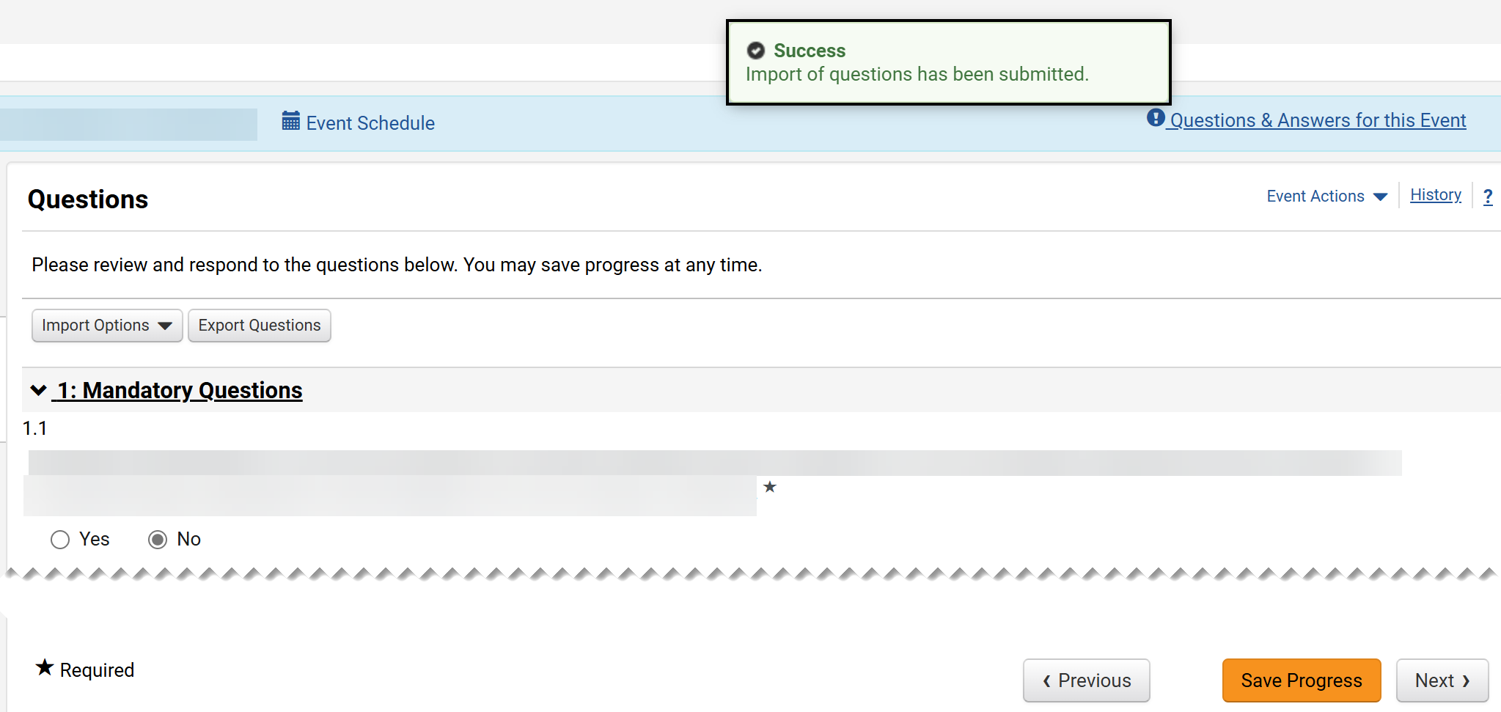
Respond to Sourcing Events
(Part 31 of 42)
INSTRUCTIONS
Review the Success message.
Note: The Questions will display answers from the imported file. Since attachments are not supported via the import, any required files must be added directly in GA@WORK Marketplace for Suppliers.
Click Next.
79
80

Slide 33
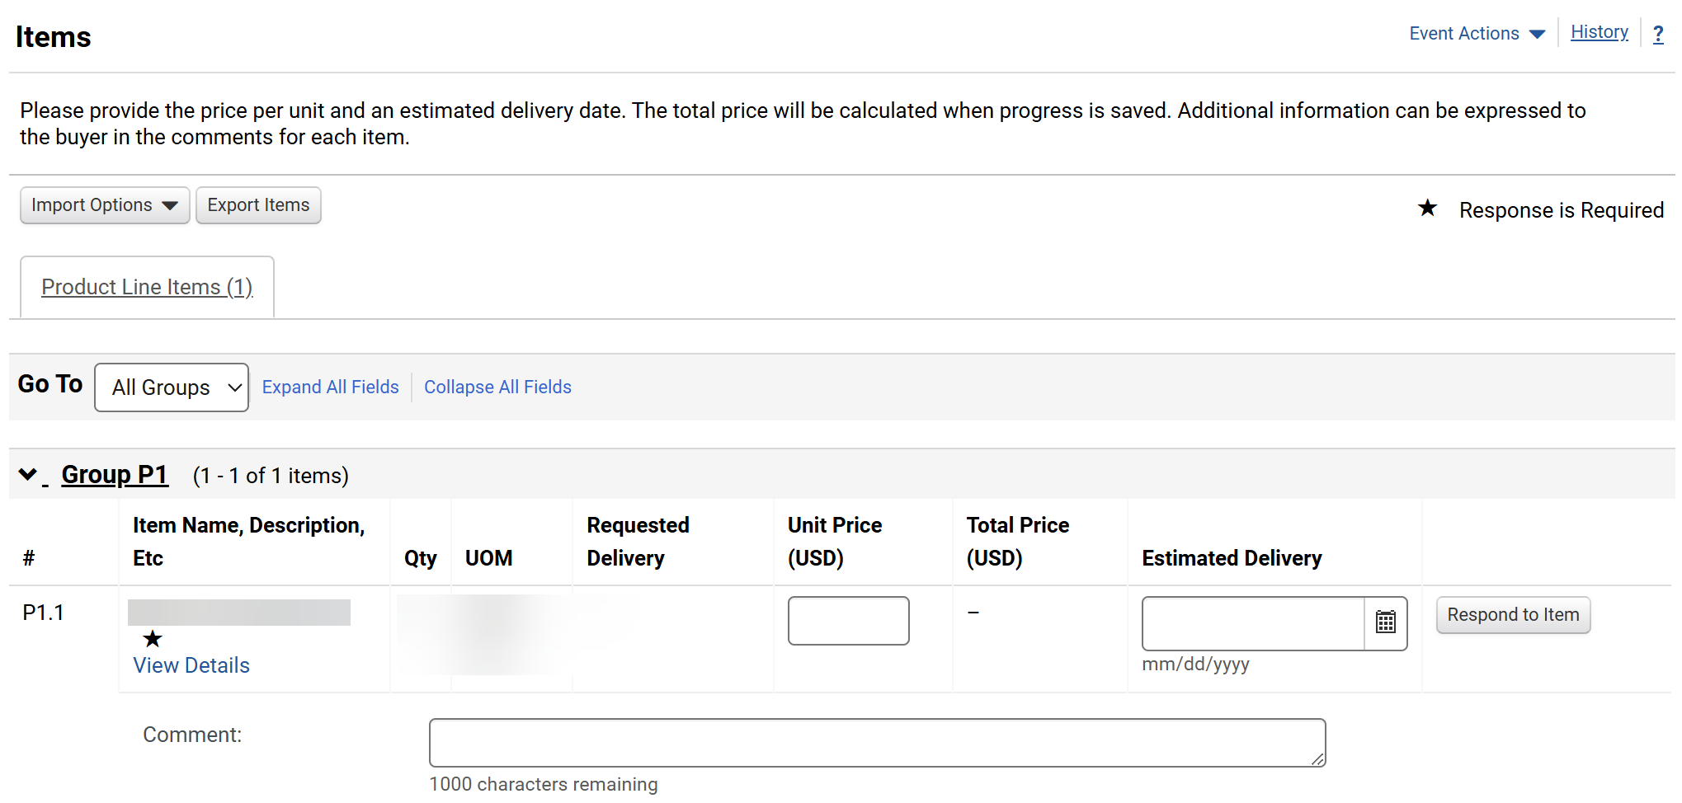
Respond to Sourcing Events
(Part 32 of 42)
INSTRUCTIONS
Enter a Unit Price.
Enter an Estimated Delivery date.
Enter a Comment, if applicable.
Note: Items might vary based on the Sourcing Event. If Import Options is selected, follow steps 84 - 110 ; otherwise, skip to step 111.
81
82
83

Slide 34
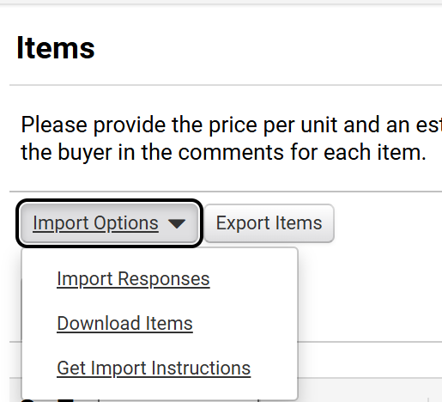
Respond to Sourcing Events
(Part 33 of 42)
INSTRUCTIONS
Click Import Options.
Select Download Items.
84
85

Slide 35
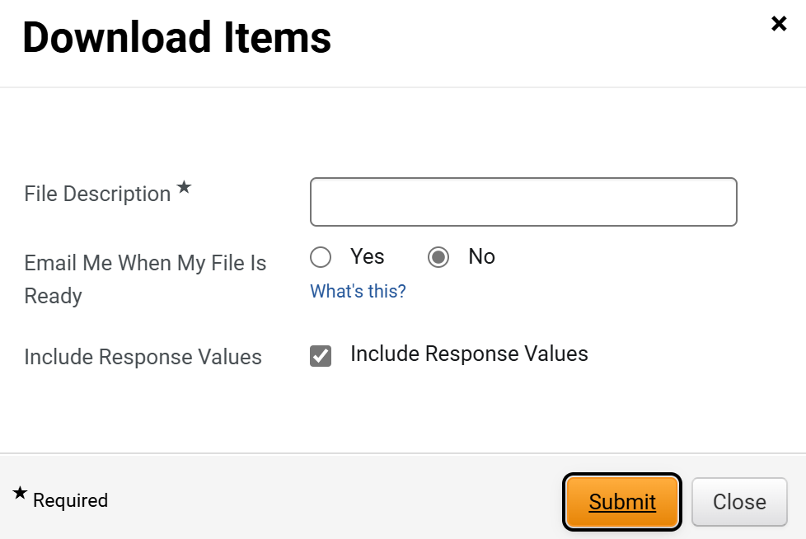
Respond to Sourcing Events
(Part 34 of 42)
INSTRUCTIONS
Enter a File Description*.
Select Email Me When My File Is Ready.
Select Include Response Values.
Click Submit.
86
87
88
89

Slide 36
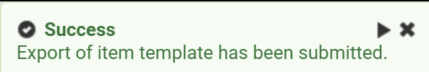
Respond to Sourcing Events
(Part 35 of 42)
INSTRUCTIONS
Review the Success message.
Click My Exports and Imports tab.

Slide 37
Respond to Sourcing Events
(Part 36 of 42)
INSTRUCTIONS
Click Output File hyperlink.
Click Downloaded File.
92
93

Slide 38
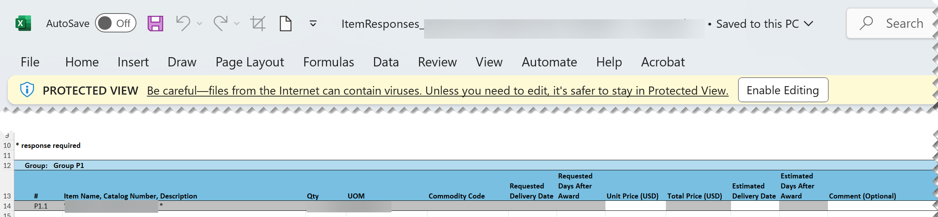
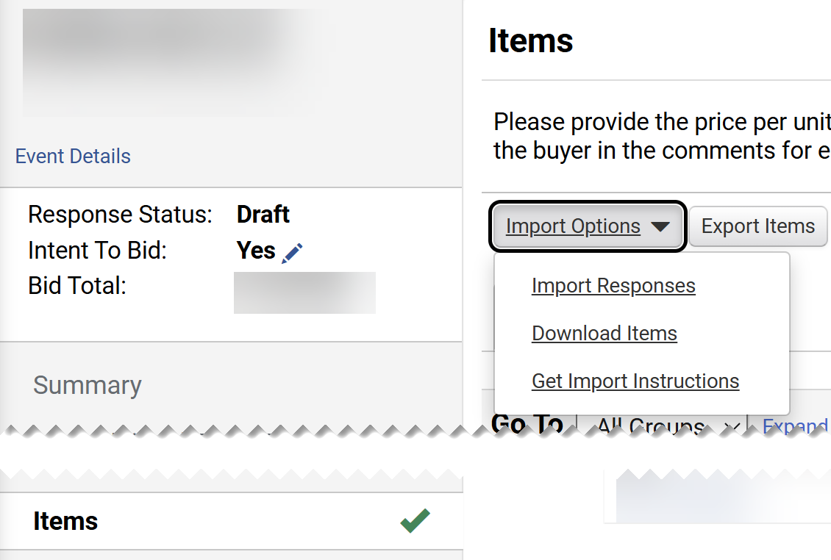
Respond to Sourcing Events
(Part 37 of 42)
INSTRUCTIONS
Click Enable Editing.
Enter a Unit Price.
Enter an Estimated Delivery date.
Enter a Comment, as applicable.
Save File.
98
94
95
96
97
Click Items tab.
Click Import Options.
Click Import Responses.
100
101
99

Slide 39
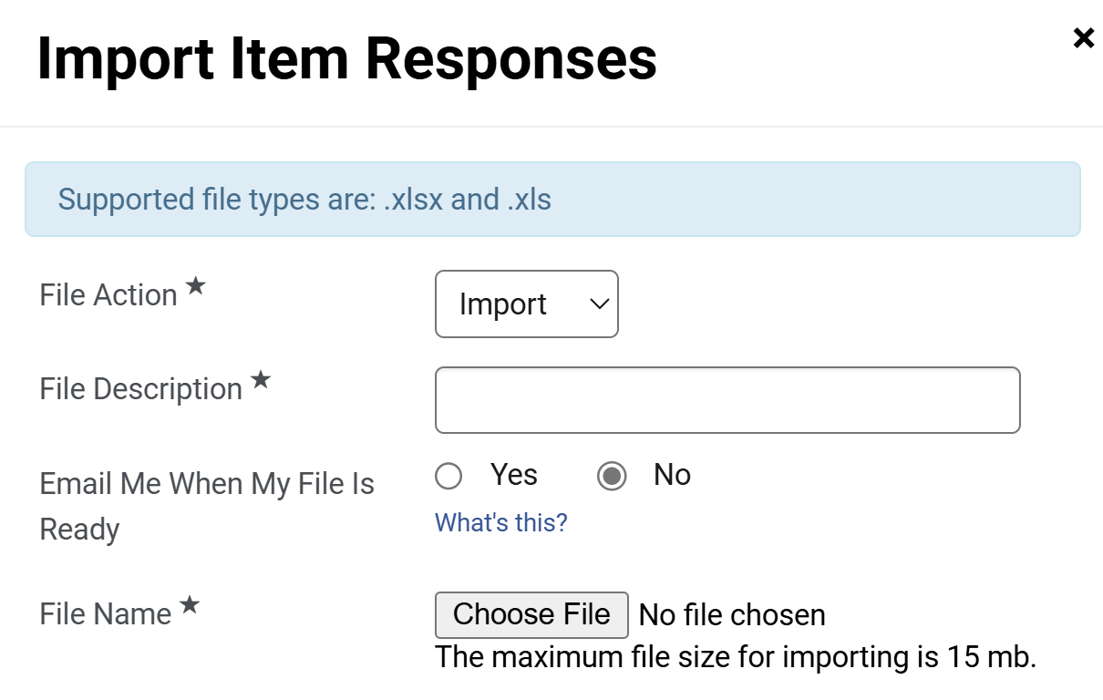
Respond to Sourcing Events
(Part 38 of 42)
INSTRUCTIONS
Select File Action*.
Enter File Description*.
Select Email Me When My File Is Ready.
Click Choose File for File Name*.
102
103
104
105

Slide 40
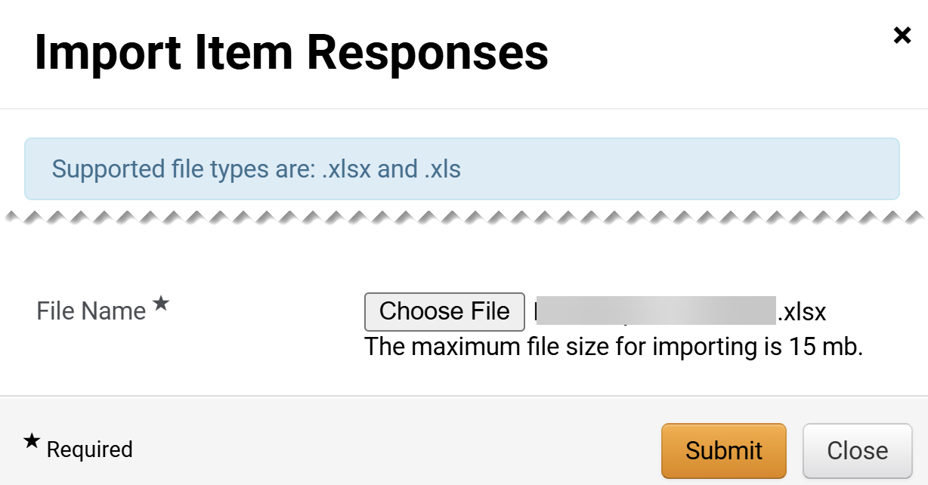
Respond to Sourcing Events
(Part 39 of 42)
INSTRUCTIONS
Select the applicable File from your computer.
Click Open.
106
107
Review File is loaded.
Note: The file loaded should be either .xlsx or .xls.
Click Submit.
108
109

Slide 41
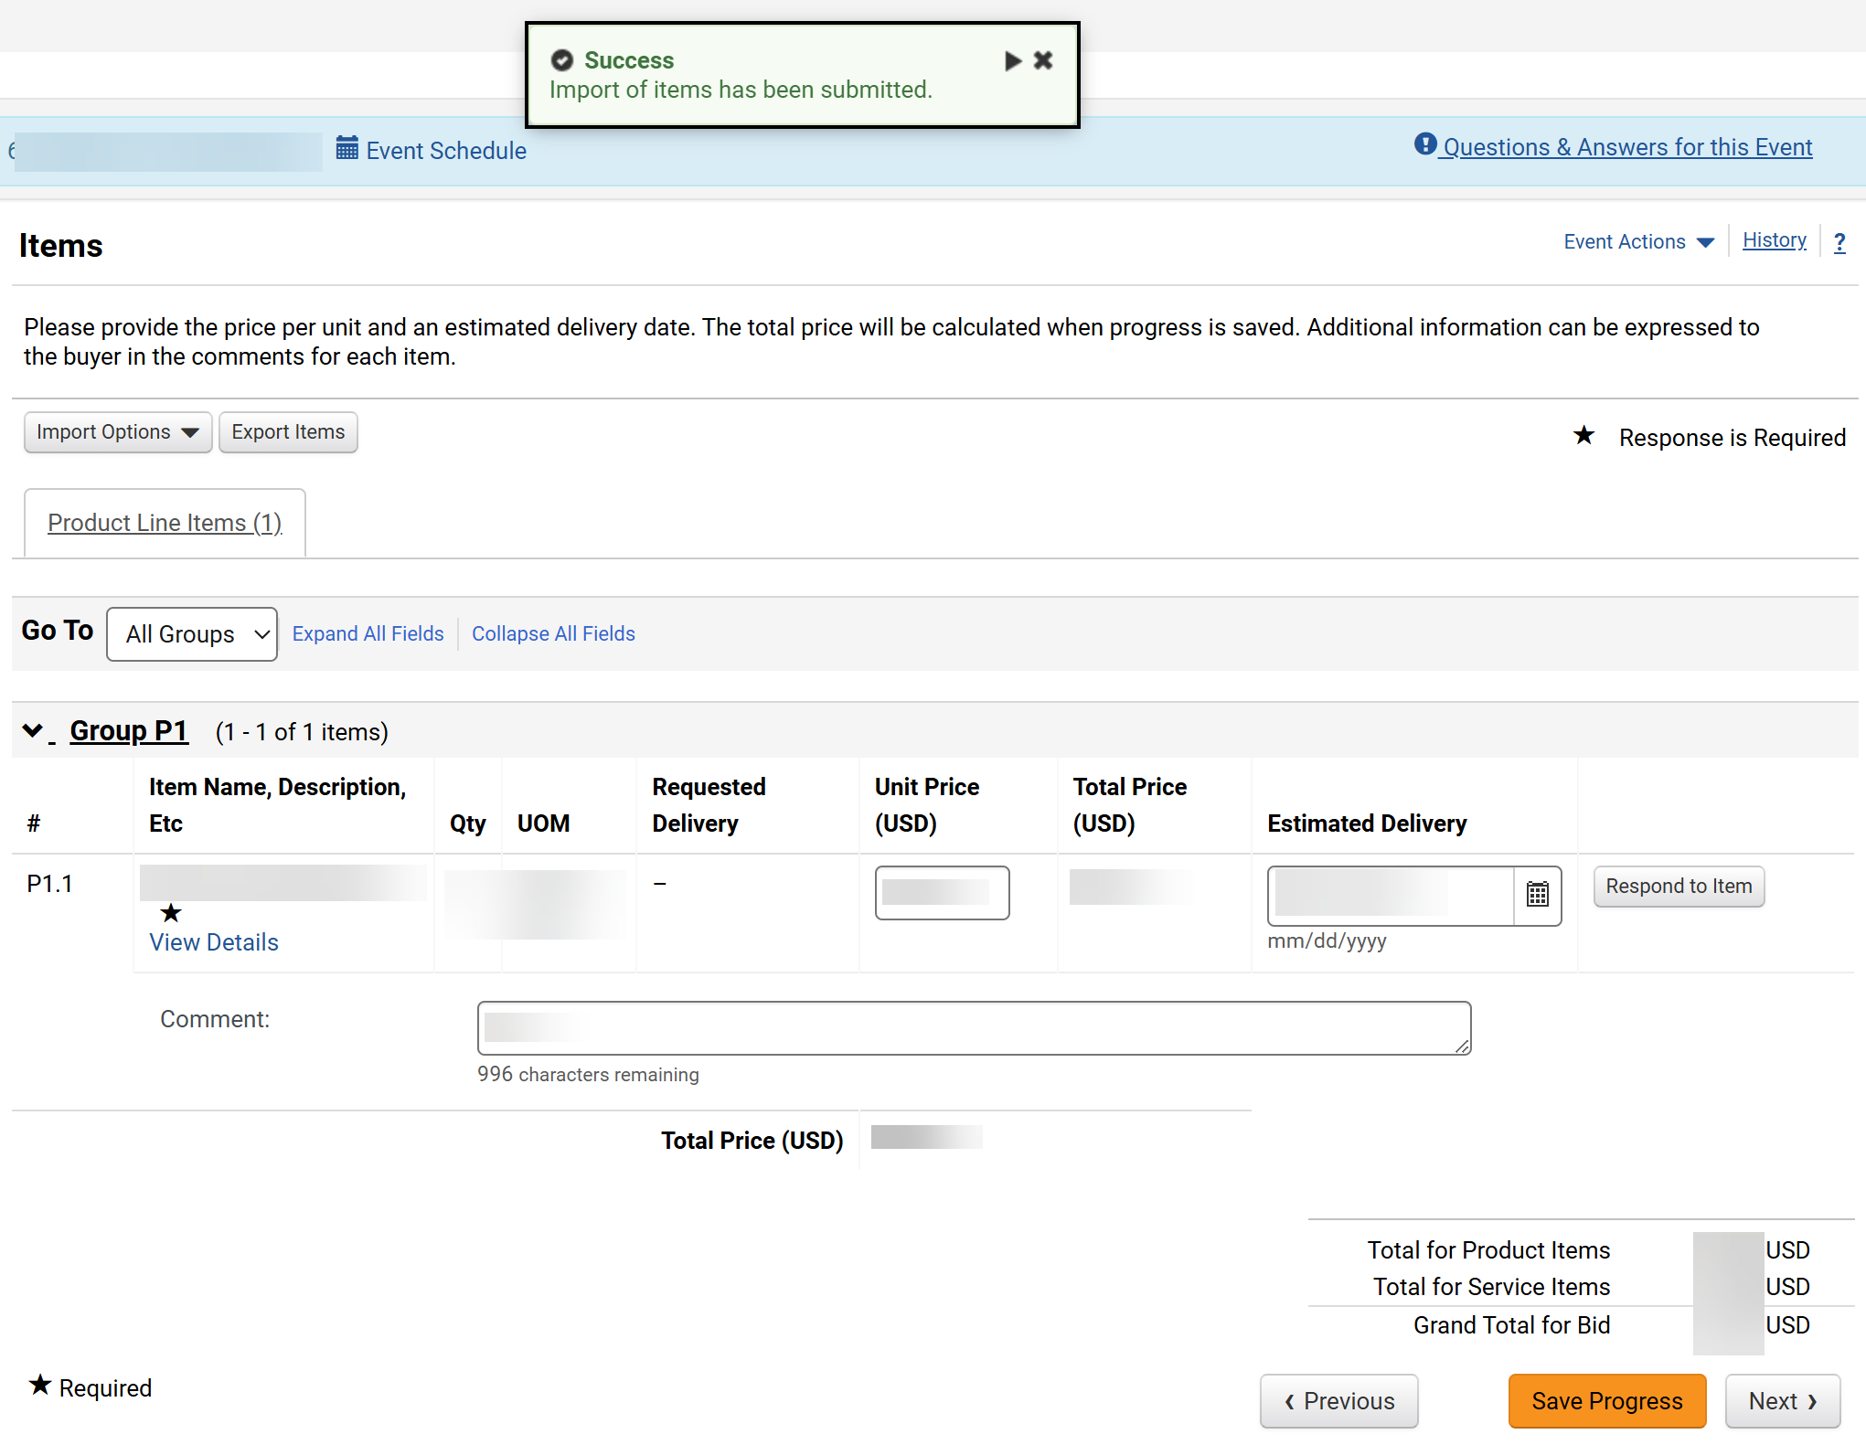
Respond to Sourcing Events
(Part 40 of 42)
INSTRUCTIONS
Review the Success message.
Note: The Items will display answers from the imported file.
Click Next.
110
111

Slide 42
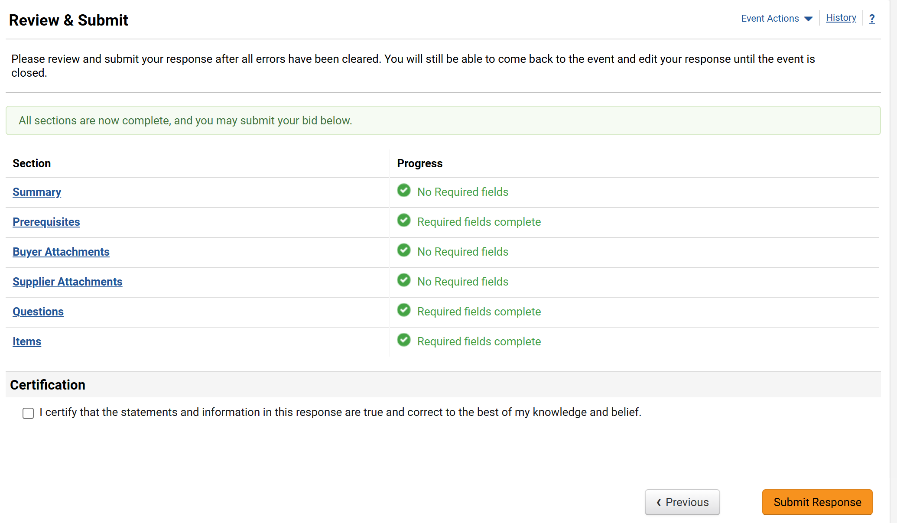
Respond to Sourcing Events
(Part 41 of 42)
INSTRUCTIONS
Review the Sections.
Note: Before certifying the Sourcing Event, ensure the Progress is green and completed for each Section.
Check the Certification box.
Click Submit Response
112
113
114

Slide 43
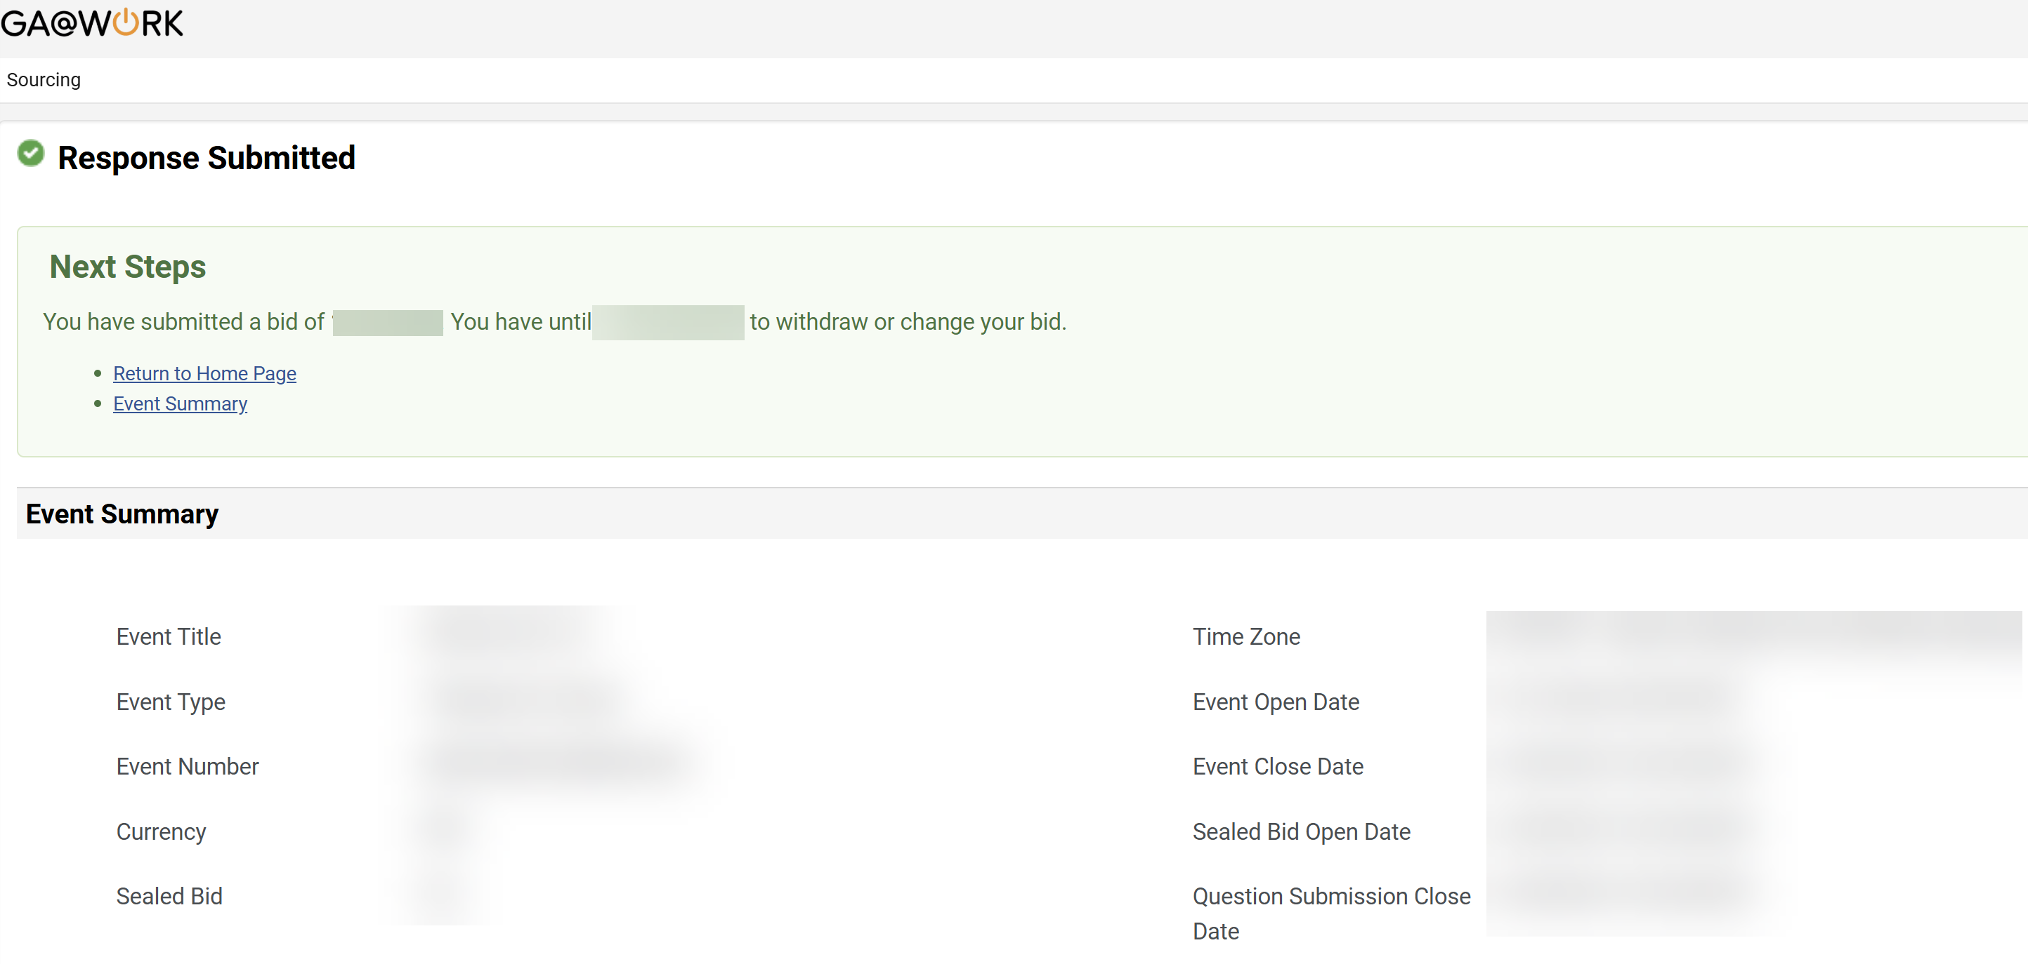

Respond to Sourcing Events
(Part 42 of 42)
INSTRUCTIONS
Review the Success message.
Note: It is possible to make changes/withdraw the bid based on the information on the Sourcing Event.
You have successfully responded to a Sourcing Event.
You have successfully Ad-Hoc Routed a Contract for Approval.

