Slide 1
Review GA@WORK
Marketplace Supplier ID
DESCRIPTION
This guide will show Suppliers how to Review the GA@WORK Marketplace Supplier ID.
Note: Prior registration as a supplier is required to complete the steps in this guide.
OVERVIEW
The key steps in the process are below:
Access GA@WORK Marketplace.
Access Manage Registration Profile.
Review Supplier ID.
Business Process:
Access Supplier Portal
Review Supplier ID
Access Manage Registration Profile

Slide 2
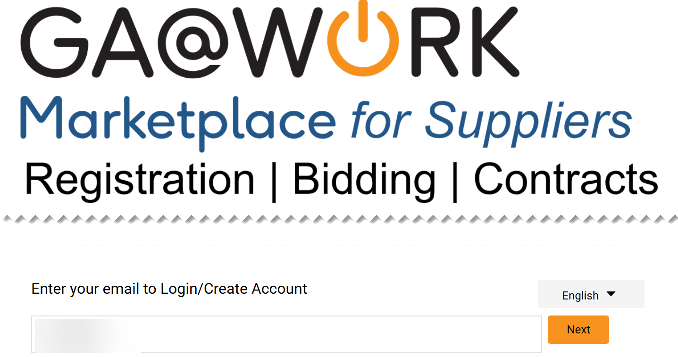
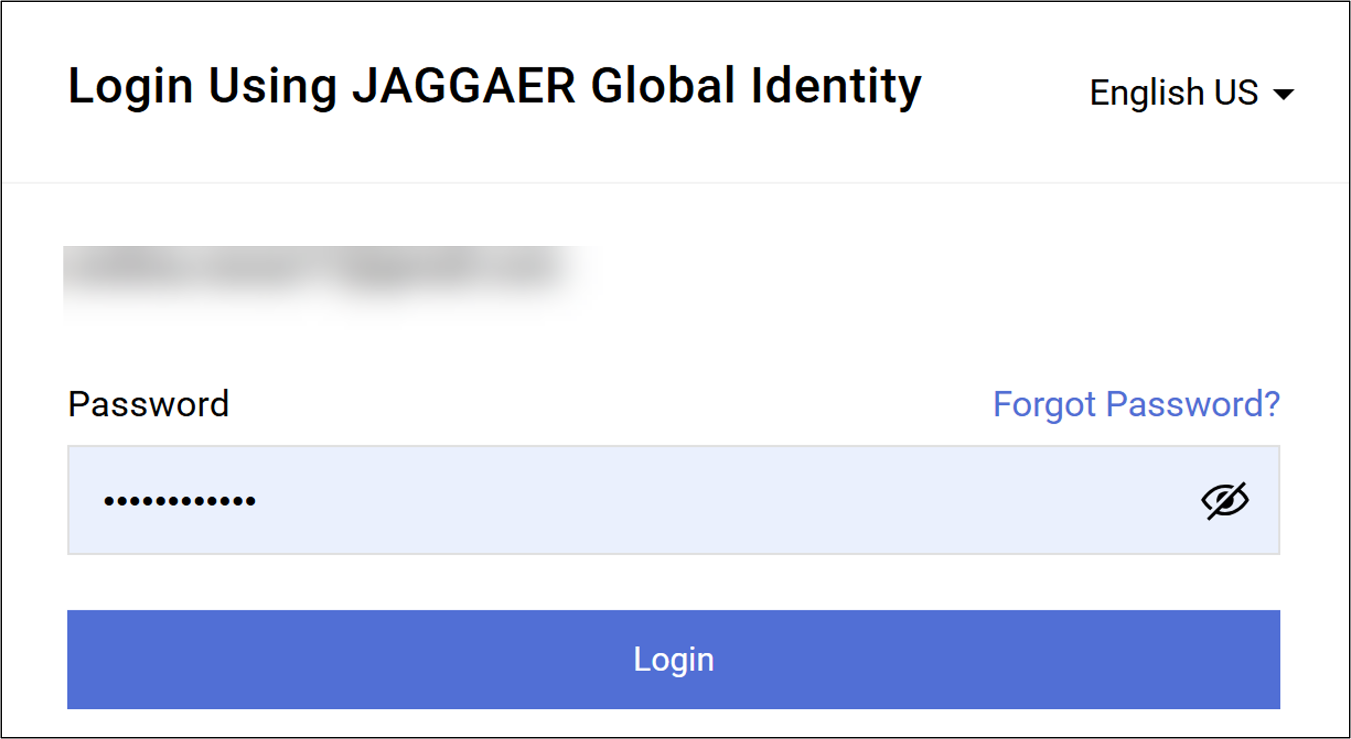
Review GA@WORK Marketplace Supplier ID (Part 1 of 11)
INSTRUCTIONS
Enter your email to Log in.
Click Next.
1
2
Enter your Password.
Click Login.
3
4

Slide 3
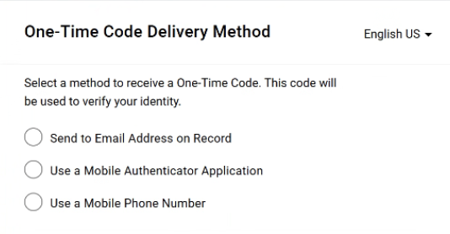
Review GA@WORK Marketplace Supplier ID (Part 2 of 11)
INSTRUCTIONS
Select a One-Time Code Delivery Method.
Note: Only one method can be selected to receive the code. Follow steps 6 – 10 if selecting Send to Email Address on Record. Skip to 11 – 15 if selecting Use a Mobile Authenticator Application or skip to step 16 - 23 if selecting Use a Mobile Phone Number. Once completed, skip to step 24.

Slide 4
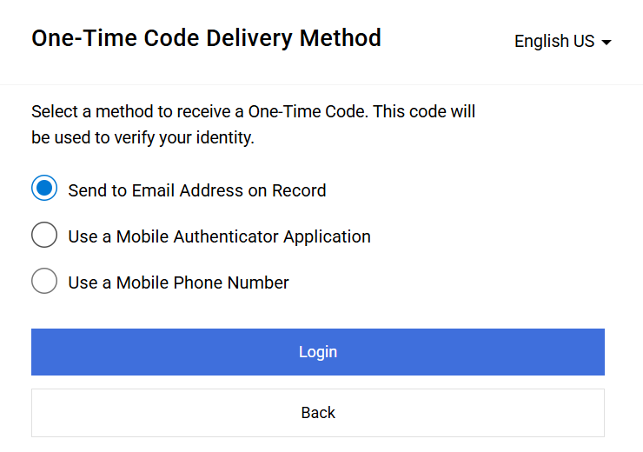
Review GA@WORK Marketplace Supplier ID (Part 3 of 11)
INSTRUCTIONS
Select Send to Email Address on Record.
Click Login.
6
7

Slide 5
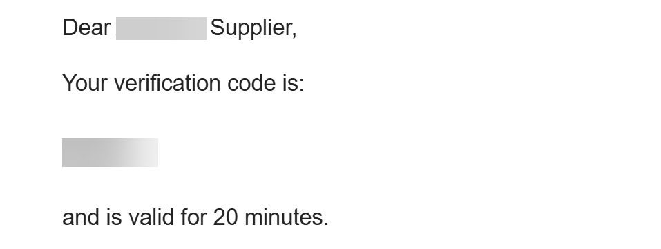
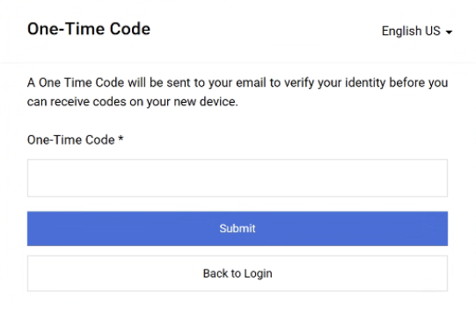
Review GA@WORK Marketplace Supplier ID (Part 4 of 11)
INSTRUCTIONS
Receive and make note of the One-Time Code.
Note: The verification code is only valid for 20 minutes.
In GA@WORK Marketplace, enter your One-Time Code*.
Note: Complete all required fields marked with a black star*.
Click Submit.
Note: Skip to Step 24 to continue.
9
10

Slide 6
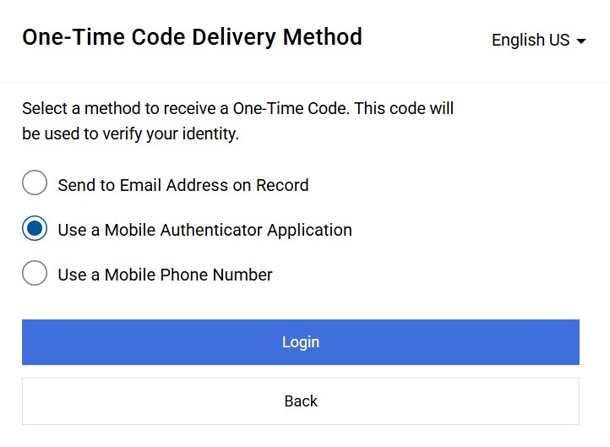
Review GA@WORK Marketplace Supplier ID (Part 5 of 11)
INSTRUCTIONS
Select Use a Mobile Authenticator Application.
Click Login.
11
12

Slide 7
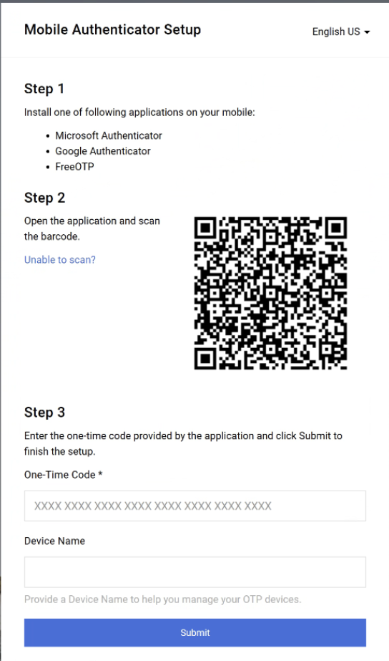
Review GA@WORK Marketplace Supplier ID (Part 6 of 11)
INSTRUCTIONS
Enter One-Time Code*.
Enter Device Name (optional).
Click Submit.
Note: Skip to step 24.
13
14
15

Slide 8
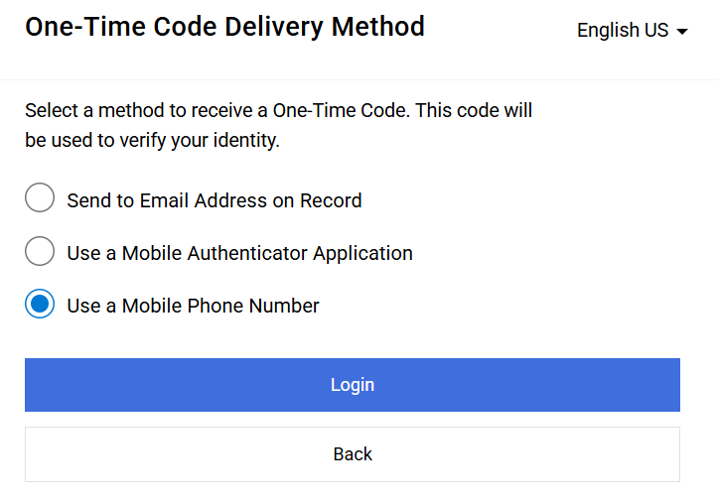
Review GA@WORK Marketplace Supplier ID (Part 7 of 11)
INSTRUCTIONS
Select Use a Mobile Phone Number.
Click Login.
16
17

Slide 9
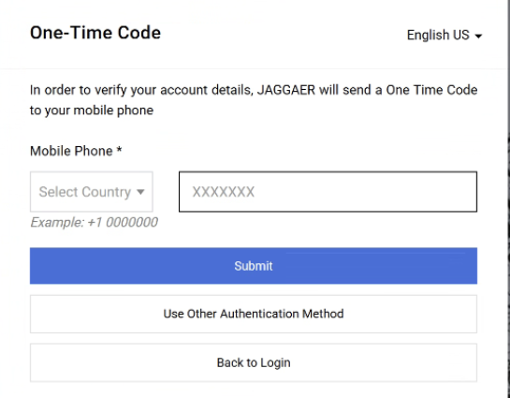
Review GA@WORK Marketplace Supplier ID (Part 8 of 11)
INSTRUCTIONS
Select Country*.
Enter Mobile Phone*.
Click Submit.
18
19
20

Slide 10
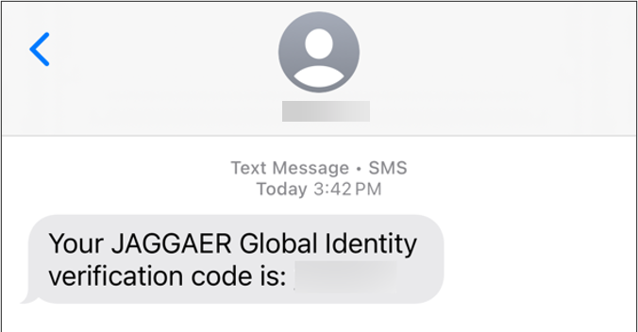
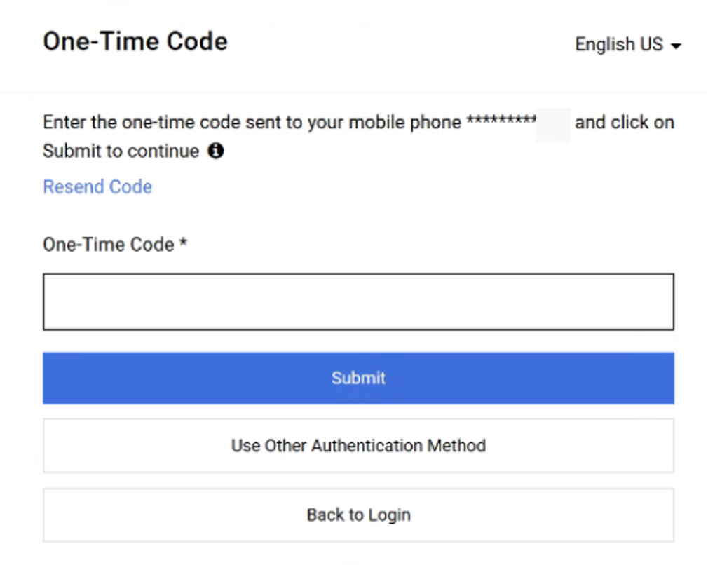
Review GA@WORK Marketplace Supplier ID (Part 9 of 11)
INSTRUCTIONS
Review Verification Code sent to Mobile Phone.
Note: Message received will come from JAGGAER Global Identity.
In GA@WORK Marketplace, enter your One-Time Code*.
Click Submit.
Note: Skip to step 24.
22
23

Slide 11
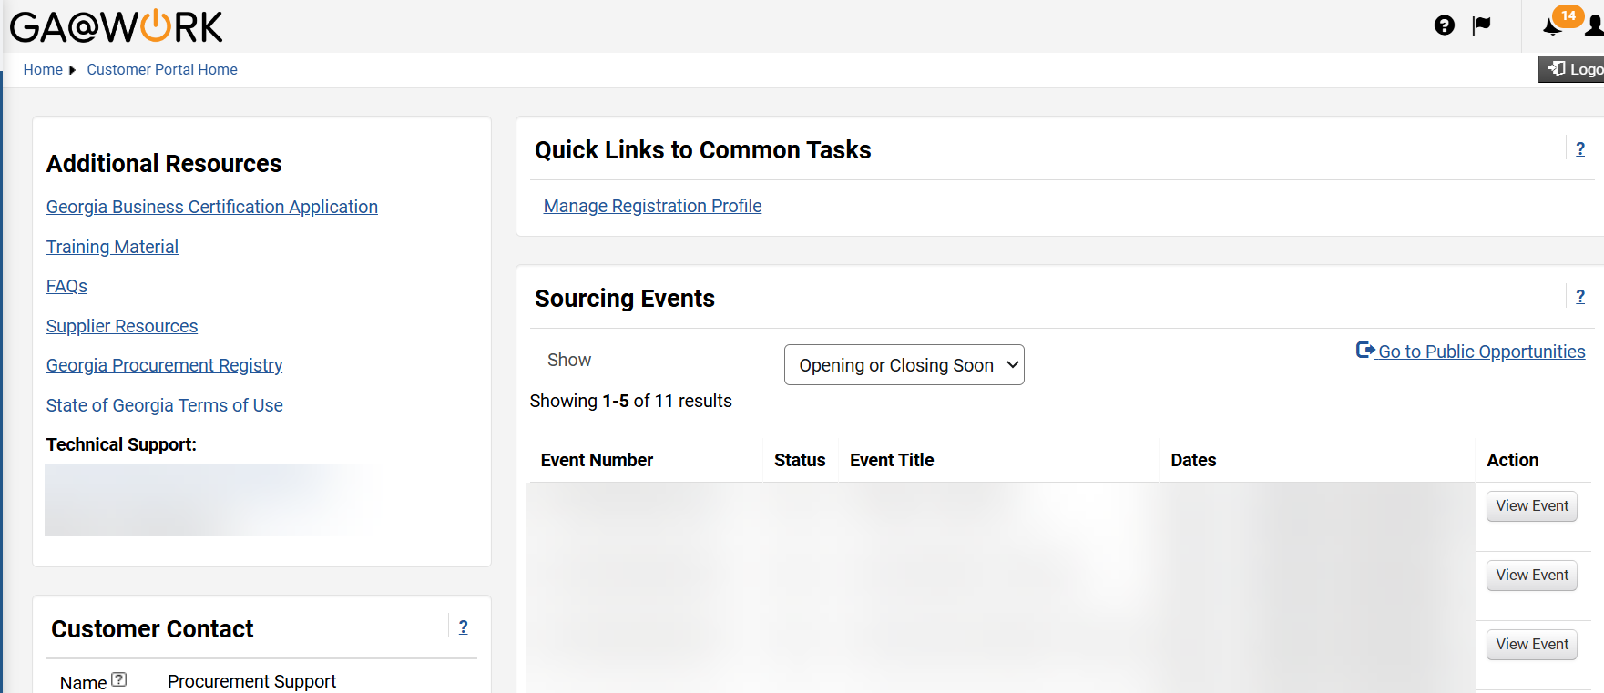
Review GA@WORK Marketplace Supplier ID (Part 10 of 11)
INSTRUCTIONS
Your GA@WORK Marketplace Homepage is displayed, click Manage Registration Profile.
24

Slide 12
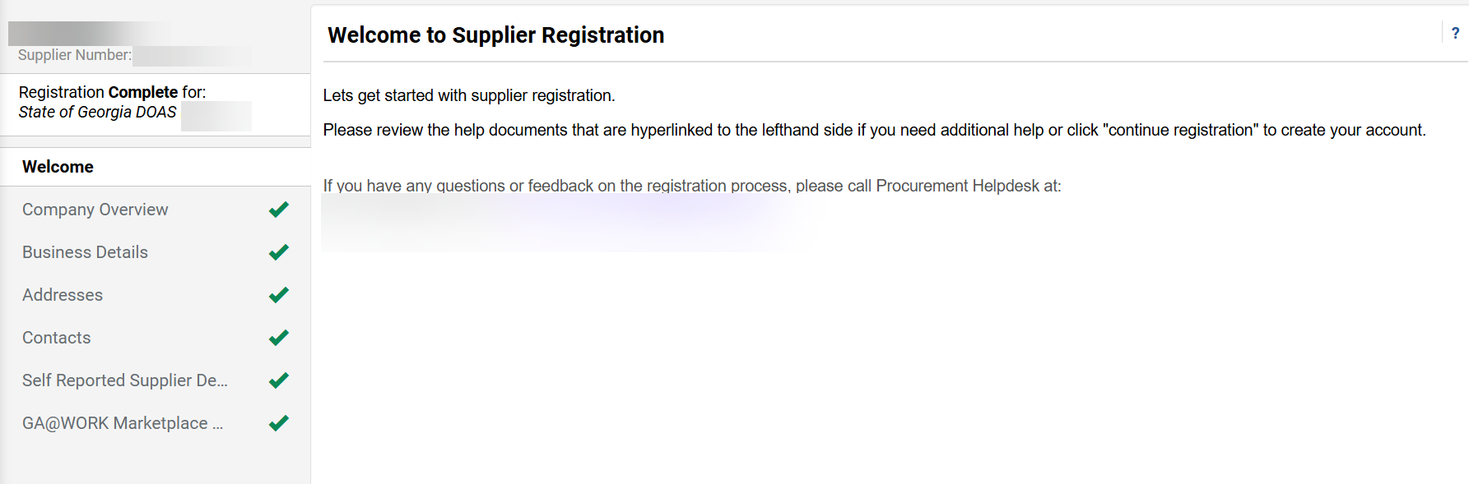
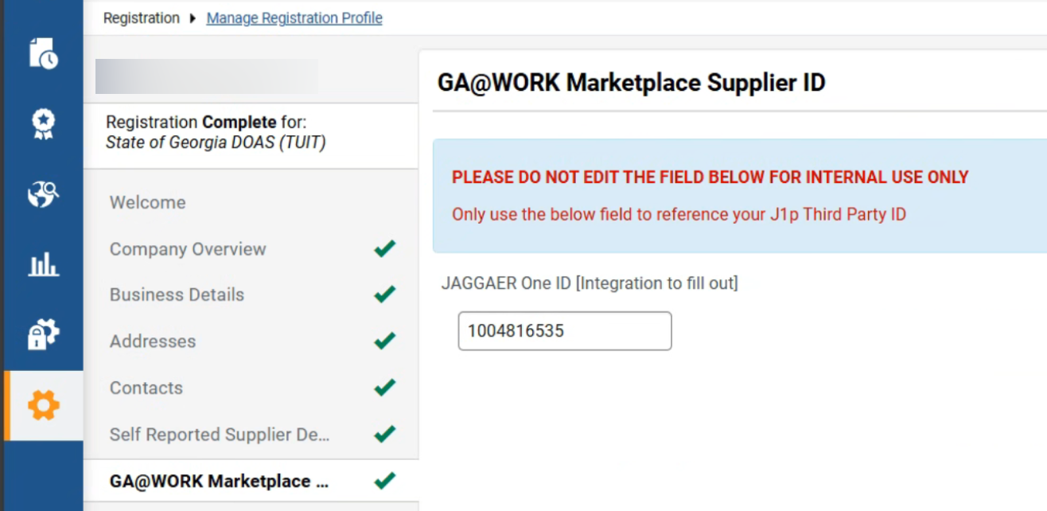

Review GA@WORK Marketplace Supplier ID (Part 11 of 11)
INSTRUCTIONS
Click GA@WORK Marketplace Supplier ID.
Note: The Supplier Number on the top left could be a different number, and it is not the correct number to choose.
25
Review Supplier ID.
Note: Do not edit or remove the Supplier ID field.
26
You have successfully reviewed the GA@WORK Marketplace Supplier ID.

