Slide 1
Revise and Resubmit a Bid
DESCRIPTION
This guide will show Suppliers How to Revise and Resubmit a Bid in GA@WORK Marketplace for Suppliers.
Note: To learn how to register or review the public bids portal information, review the job aids for those processes.
OVERVIEW
The key steps in the process are below:
Access the Sourcing Event.
Revise Sourcing Event Information.
Save changes to the Sourcing Event.
The Sourcing Event is revised.
Business Process:
Access Sourcing Event
Revise Sourcing Event Information
Save changes to Sourcing Event
The Sourcing Event is Revised

Slide 2
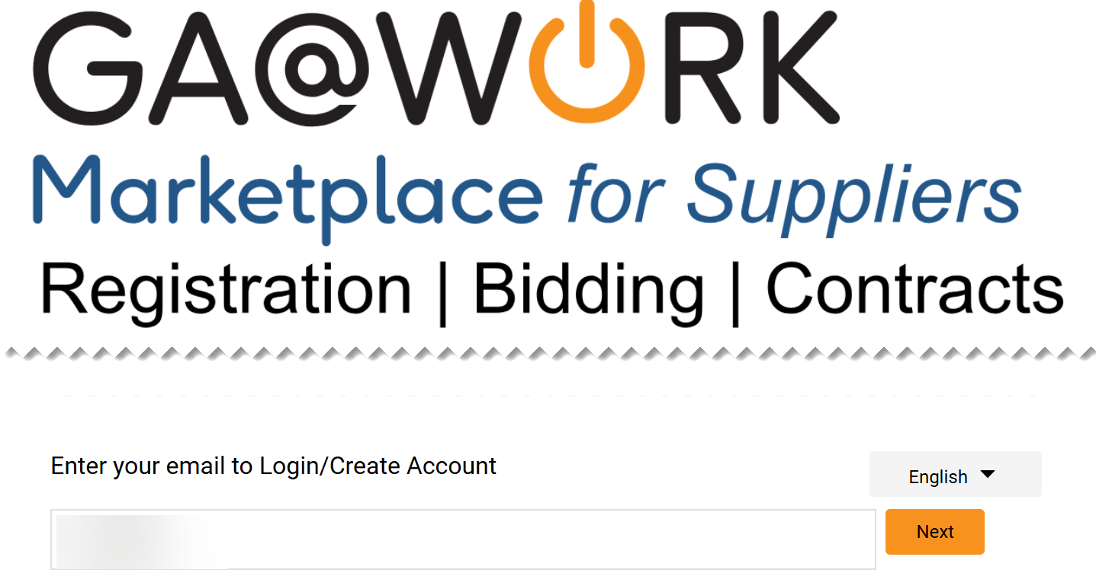
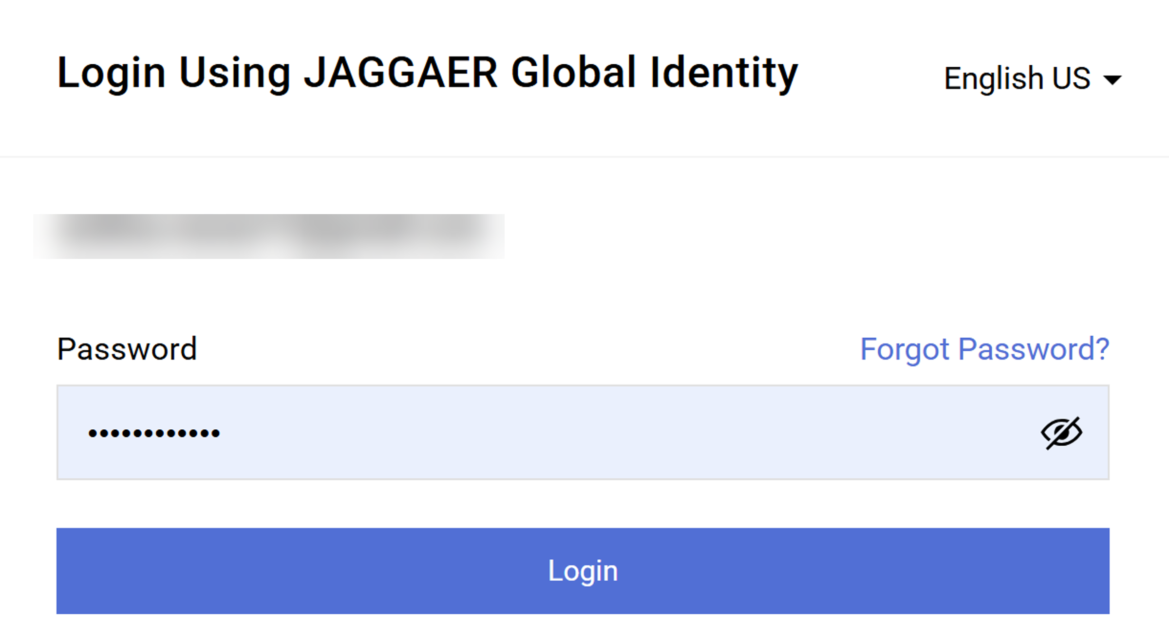
Revise and Resubmit a Bid (Part 1 of 31)
INSTRUCTIONS
Enter your email to login.
Click Next.
1
2
Enter your Password.
Click Login.
3
4

Slide 3
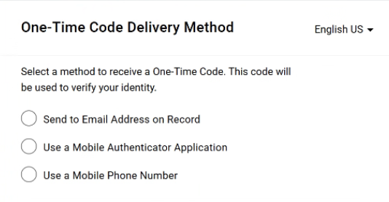
Revise and Resubmit a Bid (Part 2 of 31)
INSTRUCTIONS
Select a method to receive a One-Time Code.
Note: Only one method can be selected to receive the code. Follow steps 6 – 10 if selecting Send to Email Address on Record. Skip to 11 – 15 if selecting Use a Mobile Authenticator Application or skip to step 16 - 22 if selecting Use a Mobile Phone Number. Once completed, skip to step 23.

Slide 4
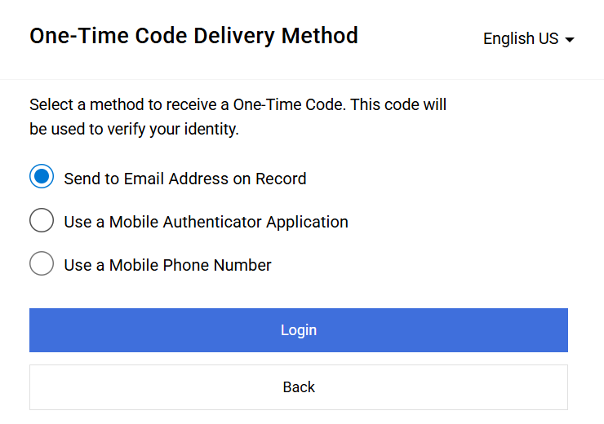
Revise and Resubmit a Bid (Part 3 of 31)
INSTRUCTIONS
Select Send to Email Address on Record.
Click Login
6
7

Slide 5
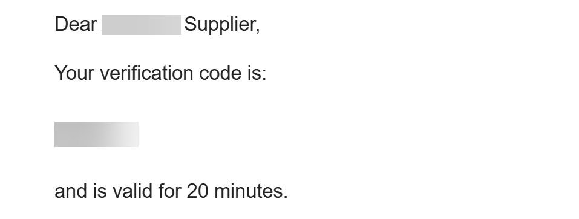
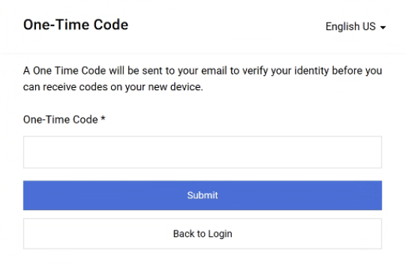
Revise and Resubmit a Bid (Part 4 of 31)
INSTRUCTIONS
Receive and make note of the One-Time Code.
Note: The verification code is only valid for 20 minutes.
In GA@WORK Marketplace, enter your One-Time Code*.
Note: Complete all required fields marked with a black star*.
Click Submit.
Note: Skip to Step 24 to continue.
9
10

Slide 6
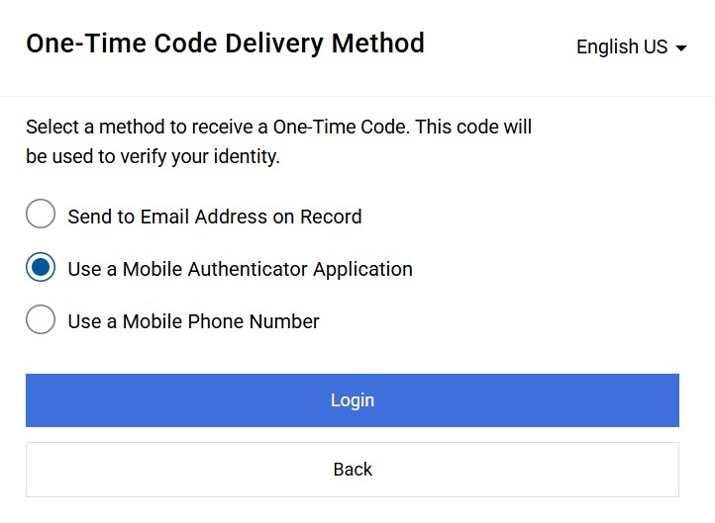
Revise and Resubmit a Bid (Part 5 of 31)
INSTRUCTIONS
Select Use a Mobile Authenticator Application.
Click Login.
11
12

Slide 7
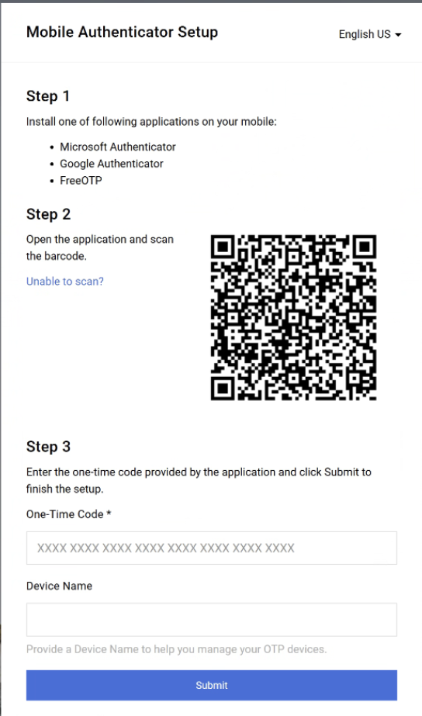
Revise and Resubmit a Bid (Part 6 of 31)
INSTRUCTIONS
Enter One-Time Code*.
Enter Device Name (optional).
Click Submit.
Note: Skip to step 23.
13
14
15

Slide 8
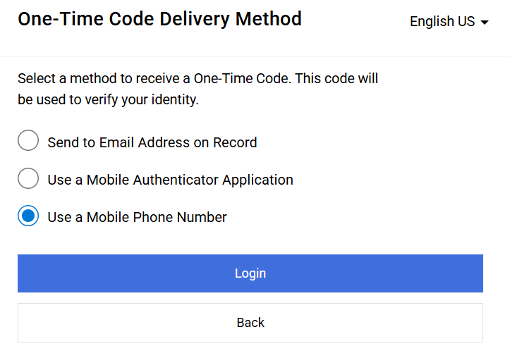
Revise and Resubmit a Bid (Part 7 of 31)
INSTRUCTIONS
Select Use a Mobile Phone Number.
Click Login.
16
17

Slide 9
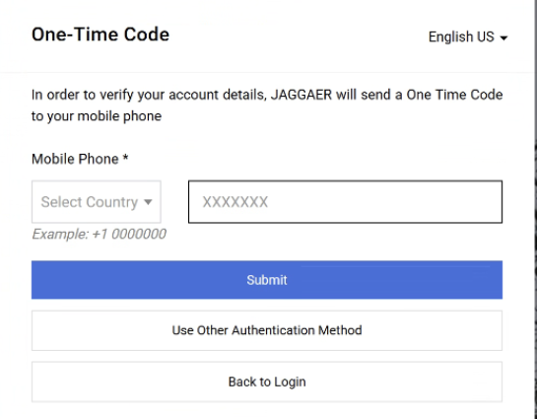
Revise and Resubmit a Bid (Part 8 of 31)
INSTRUCTIONS
Enter Mobile Phone*.
Click Submit.
18
19

Slide 10
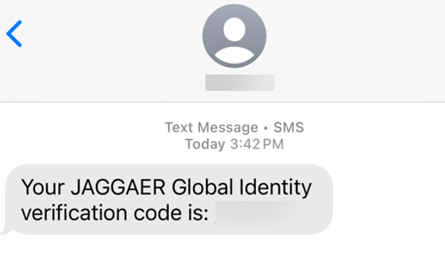
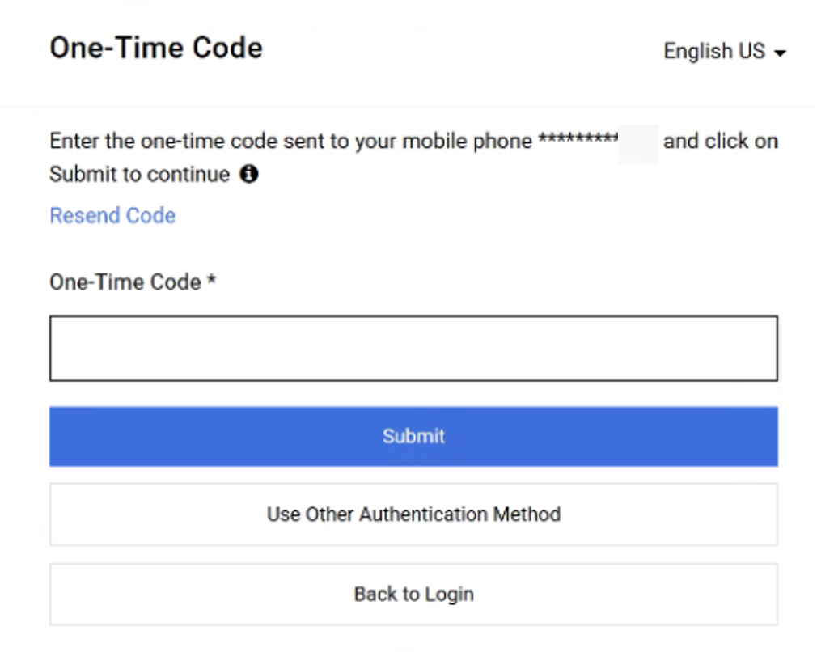
Revise and Resubmit a Bid (Part 9 of 31)
INSTRUCTIONS
Review Verification Code sent to Mobile Phone.
Note: Message will be received from JAGGAER Global Identity.
In GA@WORK Marketplace, enter your One-Time Code*.
Click Submit.
Note: Skip to step 23.
21
22

Slide 11
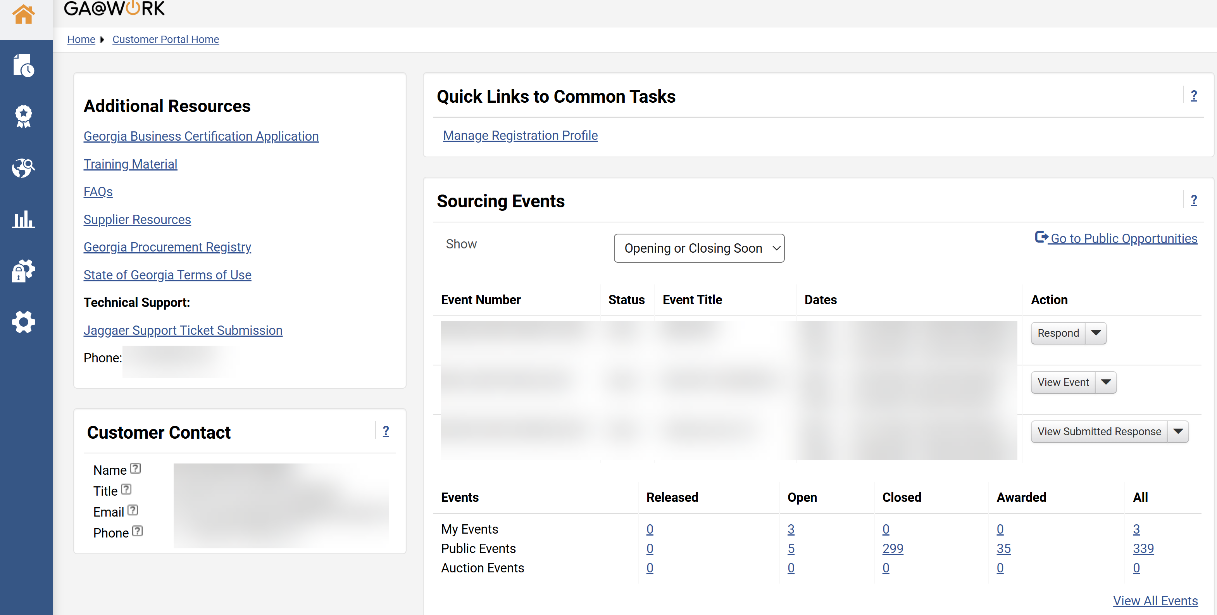
Revise and Resubmit a Bid (Part 10 of 31)
INSTRUCTIONS
View your Homepage.

Slide 12
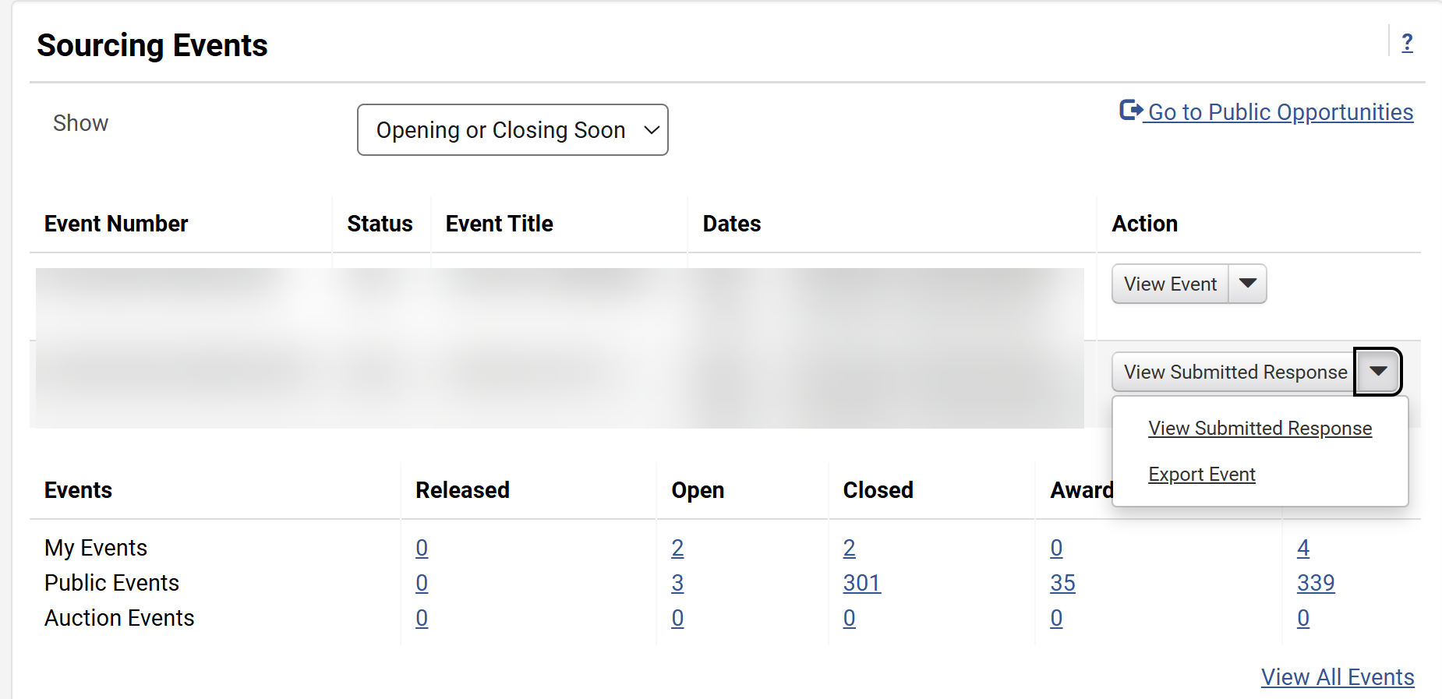
Revise and Resubmit a Bid (Part 11 of 31)
INSTRUCTIONS
Click View Submitted Reponses.
Note: Suppliers can also click on Open under My Events.
Click View Submitted Reponses.
Note: Suppliers can review the submitted bid and make the required changes in any of the bid sections, as shown on this job aid.
24
25

Slide 13
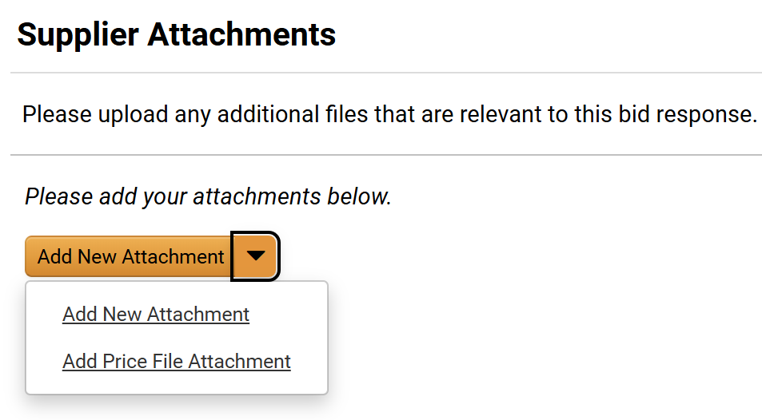
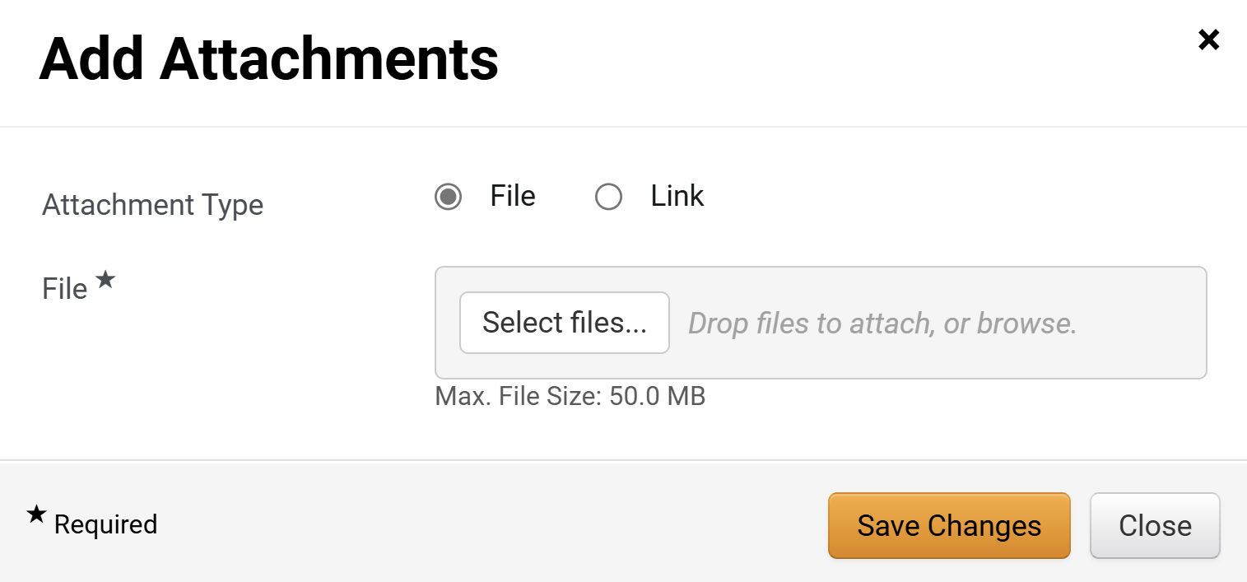
Revise and Resubmit a Bid (Part 12 of 31)
INSTRUCTIONS
Click Add Attachments.
Note: Suppliers can add additional Supplier Attachments relevant to the Event. The process to upload attachments is the same for New Attachment or Price File Attachment. If no attachments are added, click Next and skip to step 36.
Select Attachment Type as File or Link.
Note: For the purposes of this guide, we will select File. If Attachment Type is Link skip to step 32.
Click Select Files… to attach the file.
27
28

Slide 14

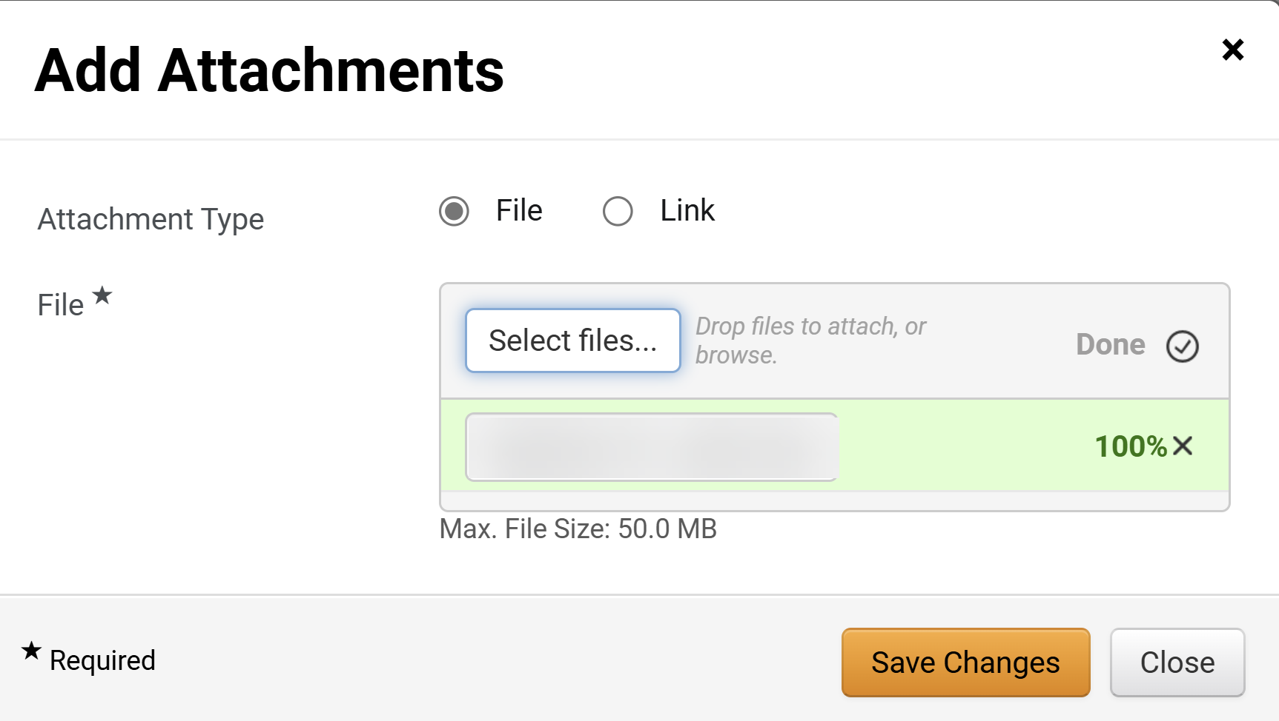
Revise and Resubmit a Bid (Part 13 of 31)
INSTRUCTIONS
Select the applicable File from your computer.
Click Open.
29
30
Click Save Changes.

Slide 15
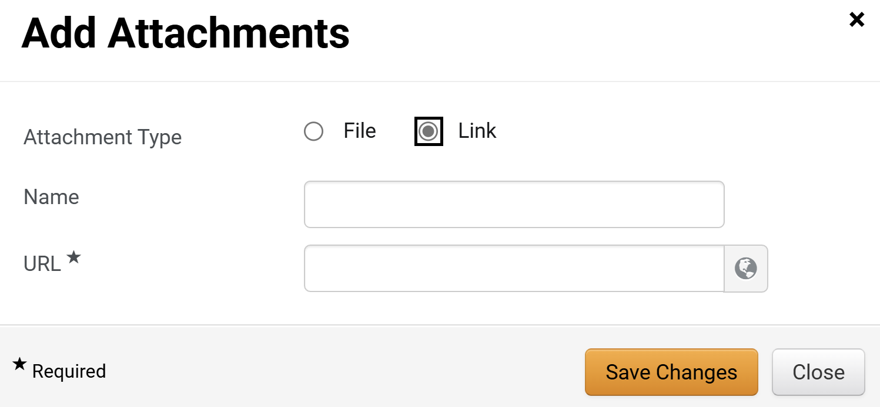
Revise and Resubmit a Bid (Part 14 of 31)
INSTRUCTIONS
If attaching a link, select Link for the Attachment Type.
Enter a Name.
Enter the URL*.
Click Save Changes.
32
33
34
35

Slide 16
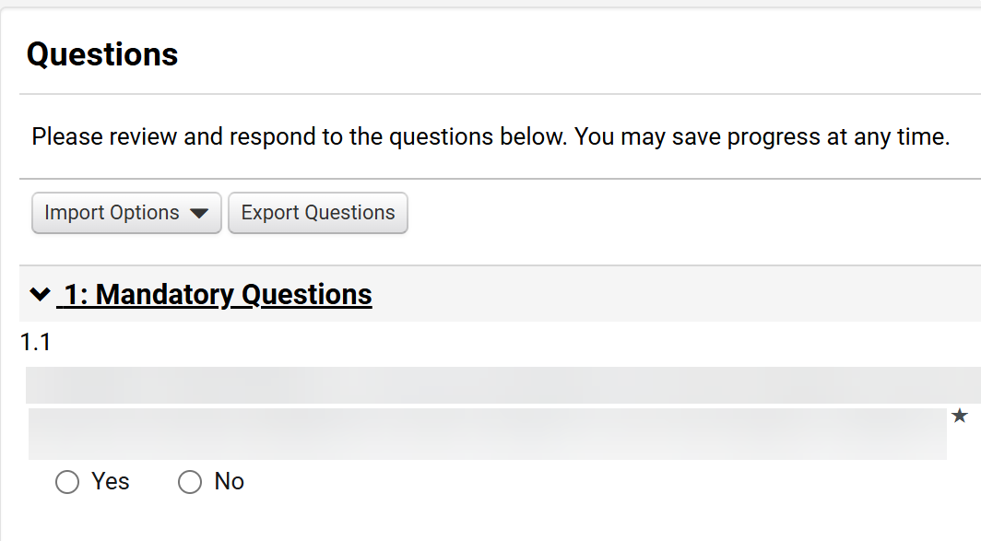
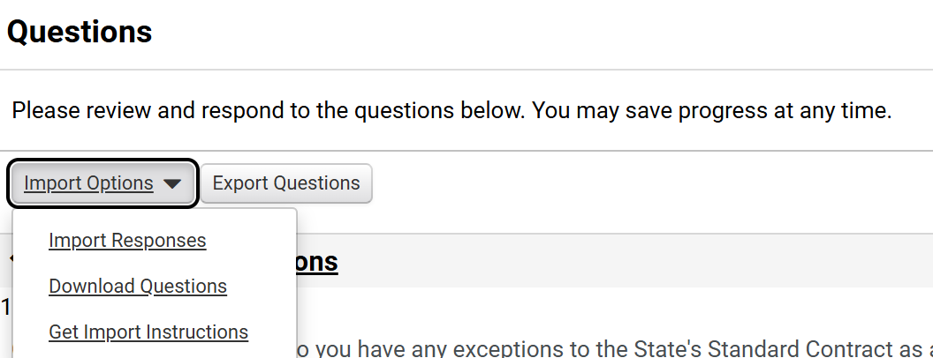
Revise and Resubmit a Bid (Part 15 of 31)
INSTRUCTIONS
Answer the Questions.
Note: Answers to Questions can be edited. Questions might vary based on the Sourcing Event. Based on the answer, additional questions may be displayed. If Import Options is selected, follow steps X-X; otherwise, skip to step X (Next).
Click Import Options.
Click Download Questions.
37
38

Slide 17
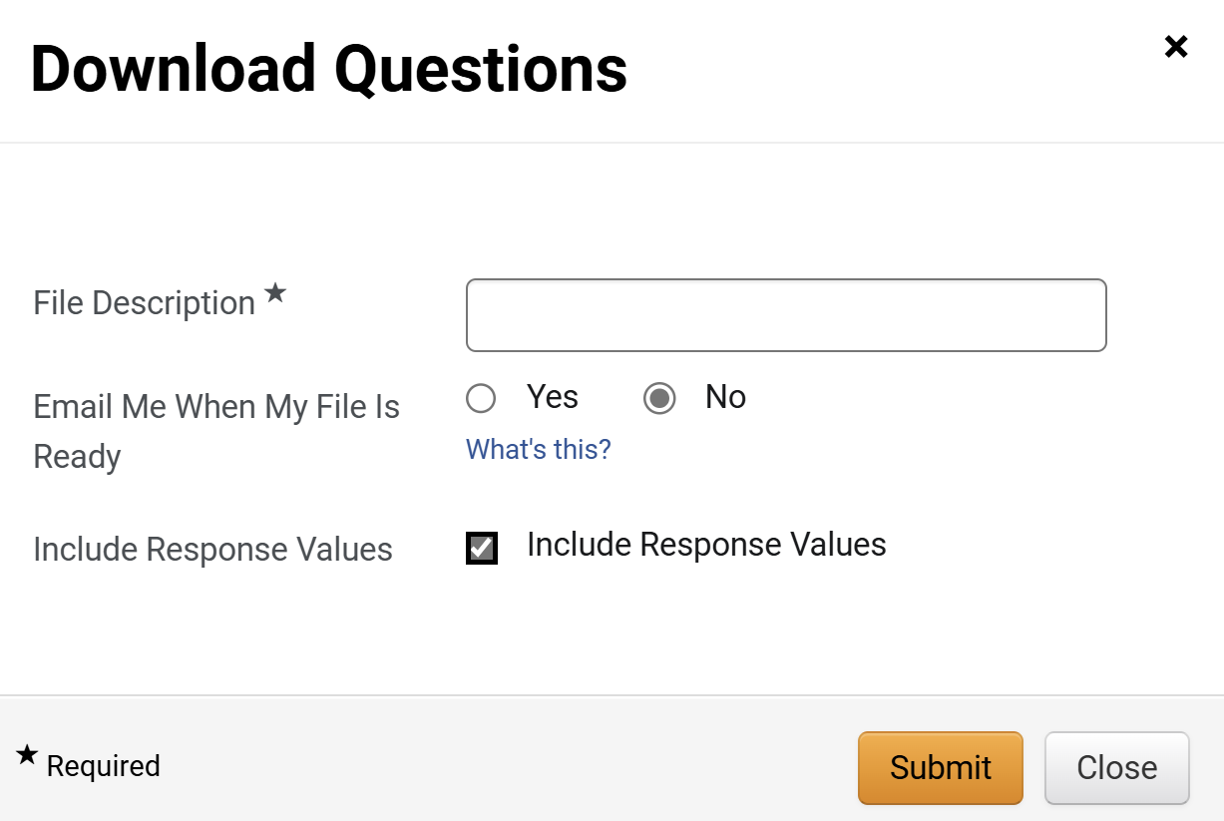
Revise and Resubmit a Bid (Part 16 of 31)
INSTRUCTIONS
Enter a File Description*.
Select an option for Email Me When My File Is Ready.
Check Include Response Values.
Click Submit.
39
40
41
42

Slide 18
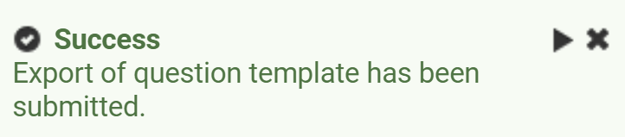
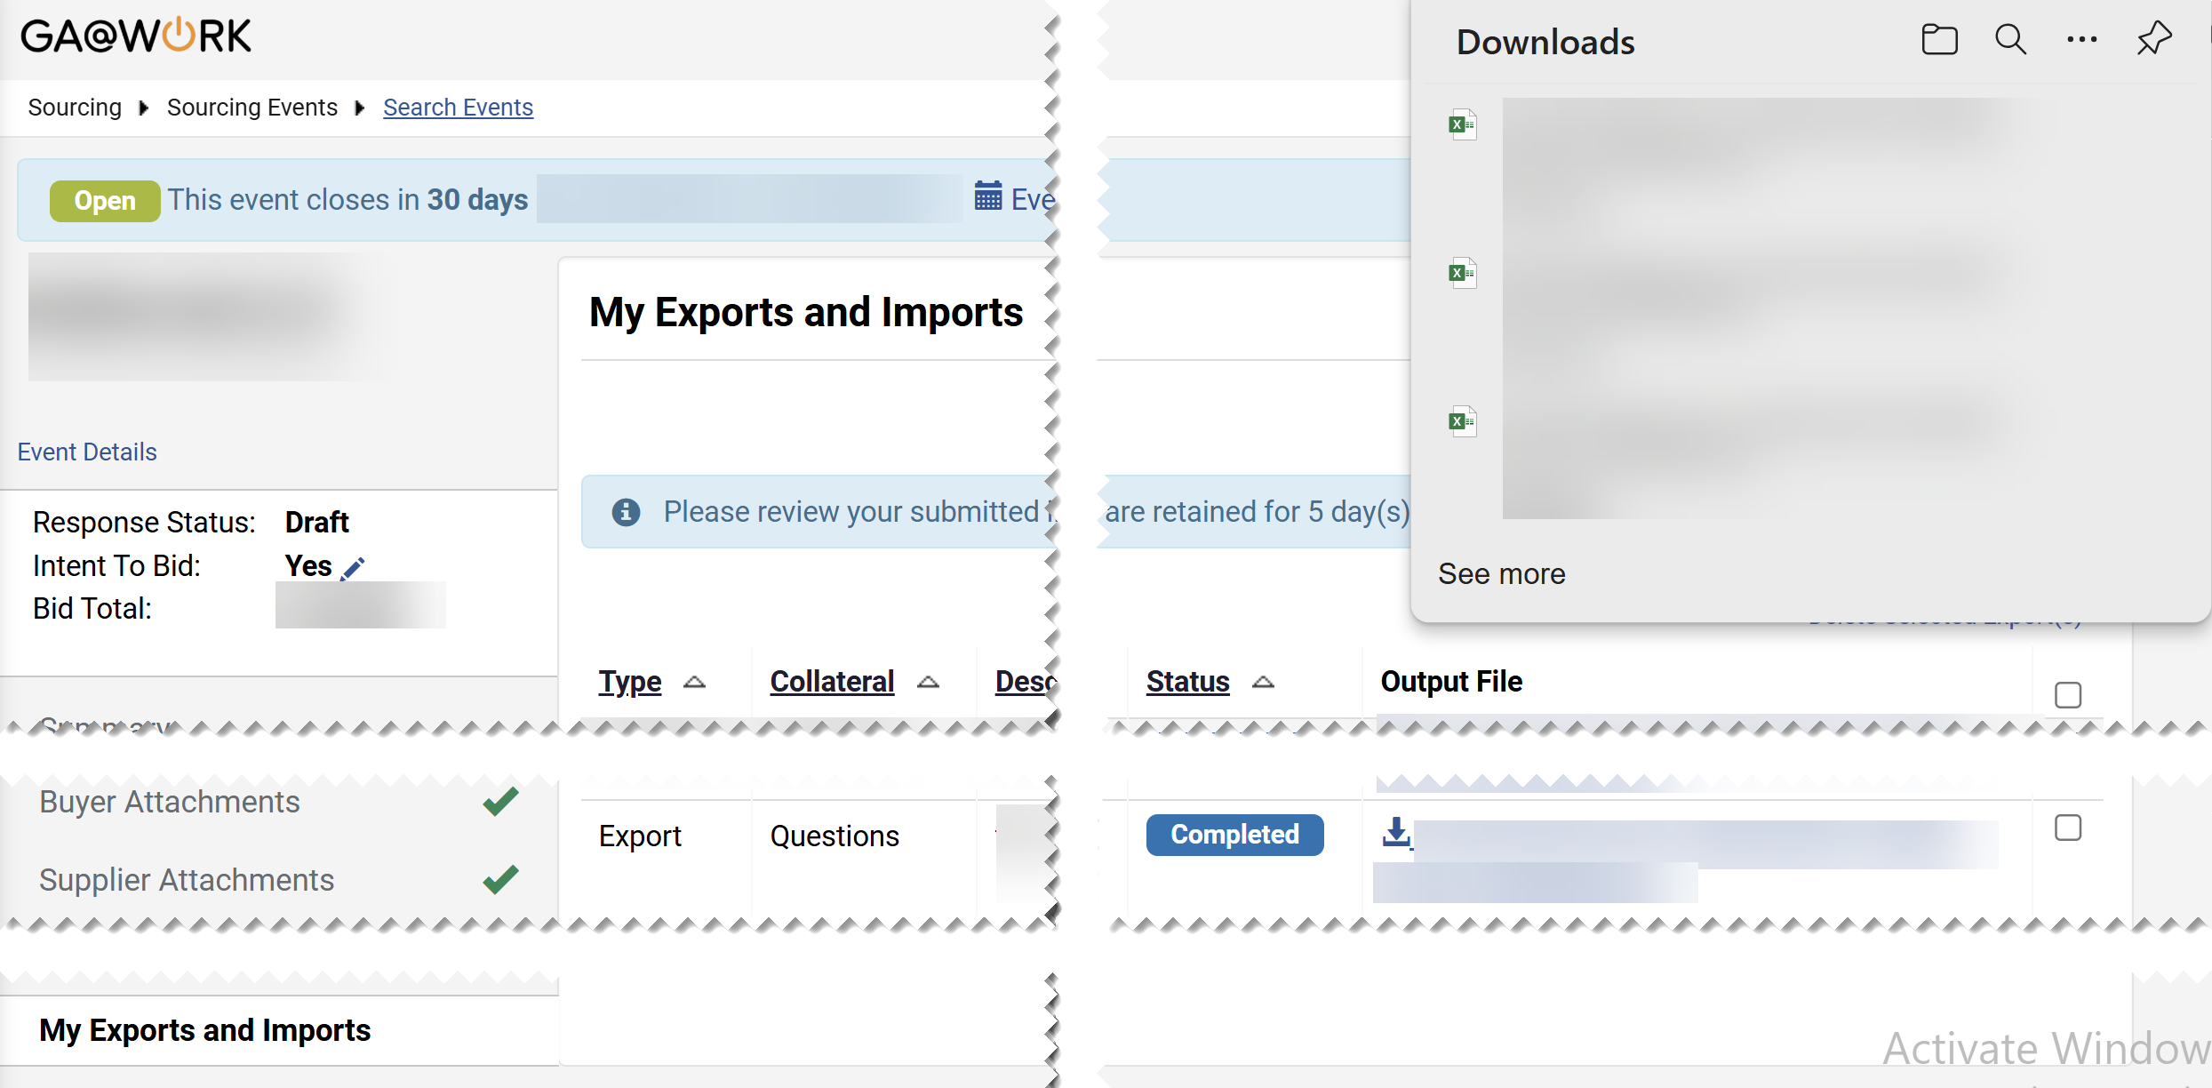
Revise and Resubmit a Bid (Part 17 of 31)
INSTRUCTIONS
Review the Success message.
Click My Exports and Imports tab.

Slide 19
Revise and Resubmit a Bid (Part 18 of 31)
INSTRUCTIONS
Click Output File hyperlink.
Click Downloaded File.
46
45

Slide 20
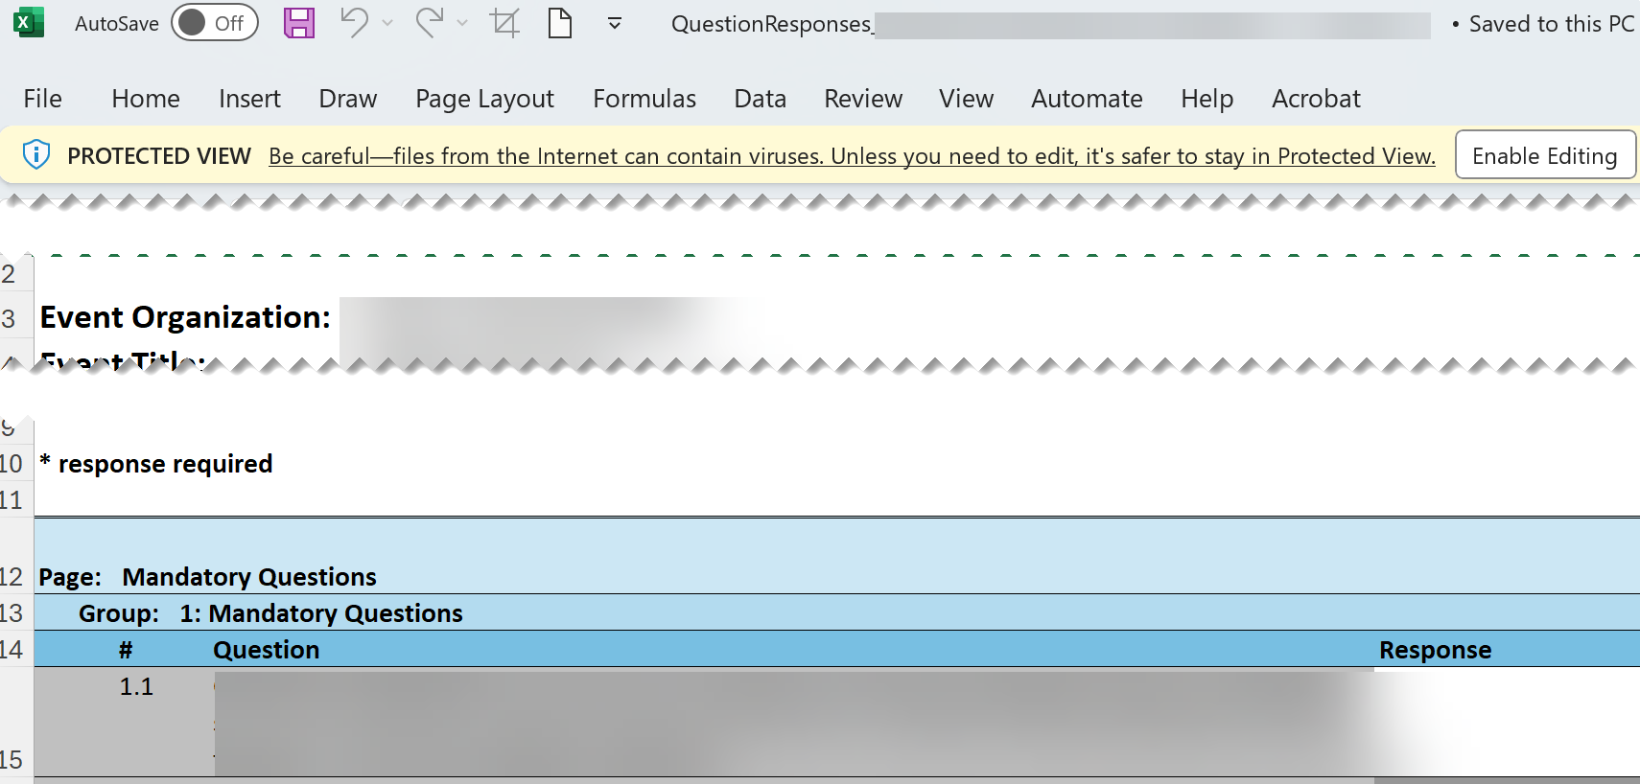
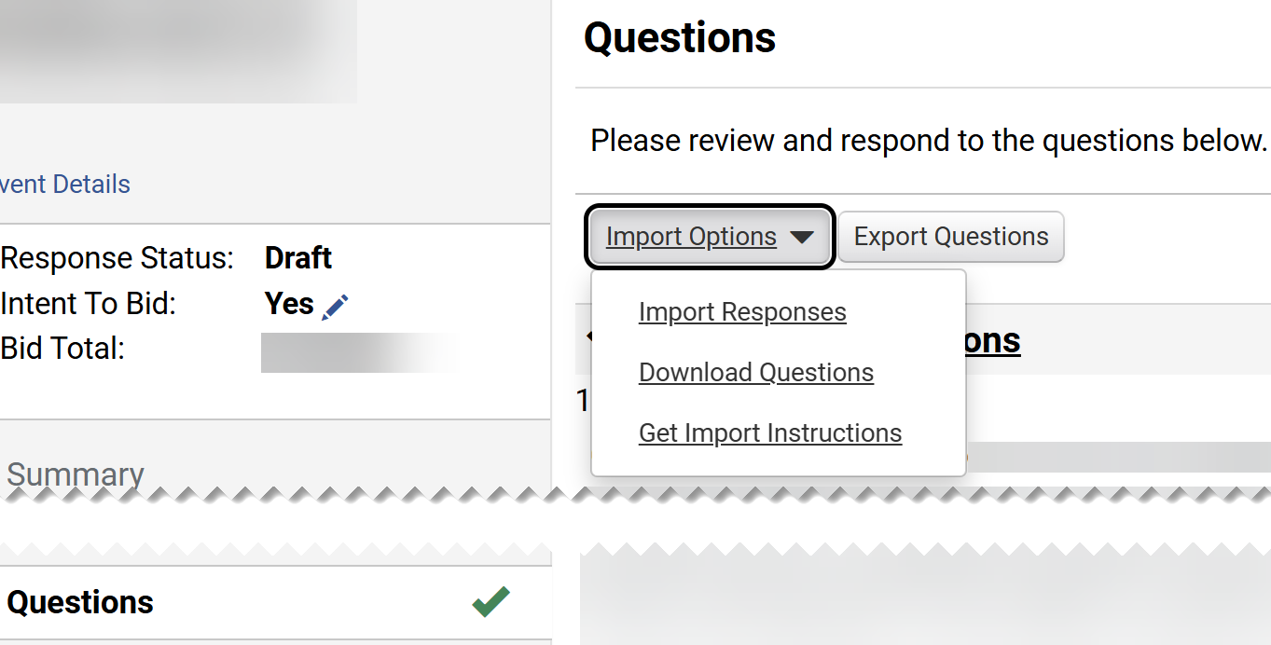
Revise and Resubmit a Bid (Part 19 of 31)
INSTRUCTIONS
Click Enable Editing.
Answer Question.
Save File.
49
47
48
Select the Questions tab.
Click Import Options.
Click Import Responses.
51
52
50

Slide 21
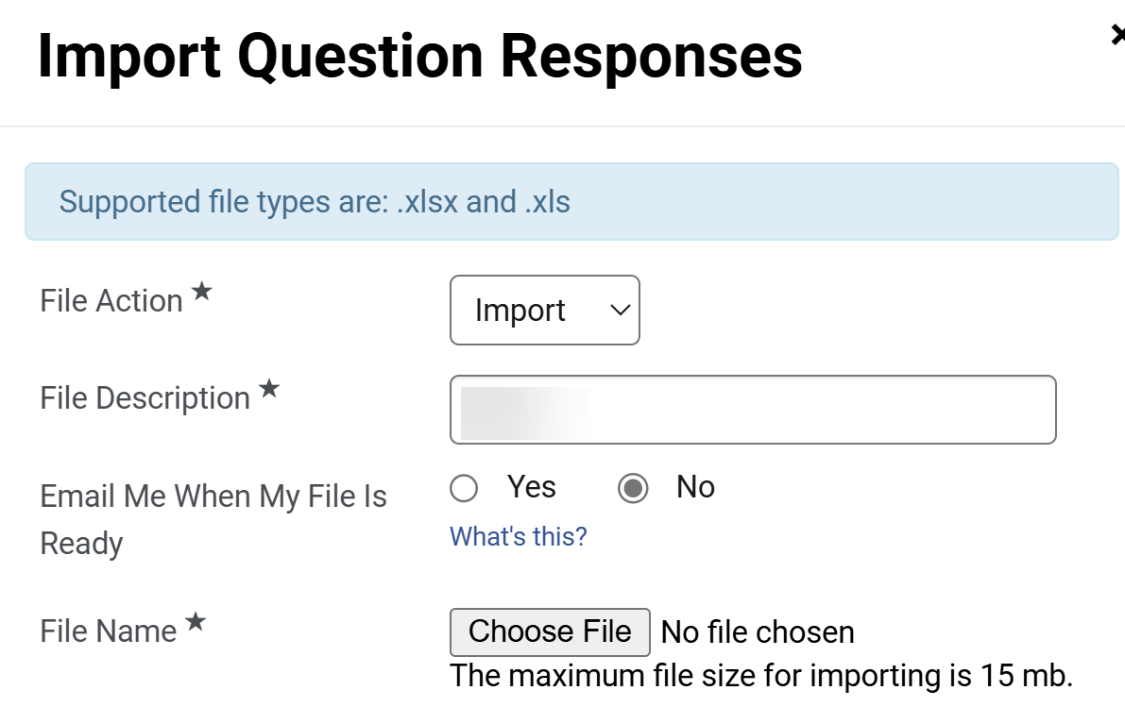
Revise and Resubmit a Bid (Part 20 of 31)
INSTRUCTIONS
Select File Action*.
Enter a File Description*.
Select an option for Email Me When My File Is Ready.
Click Choose File for File Name*.
53
54
55
56

Slide 22
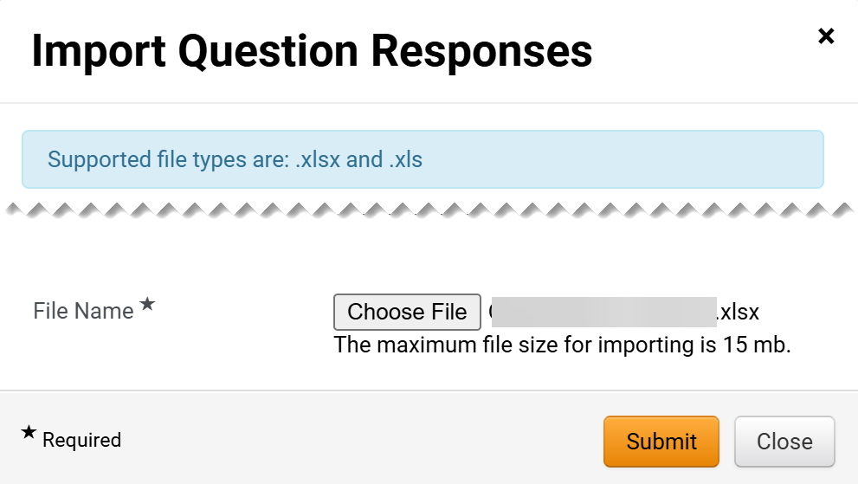
Revise and Resubmit a Bid (Part 21 of 31)
INSTRUCTIONS
Select the applicable File from your computer.
Click Open.
57
58
Verify the File is loaded.
Note: The file loaded should be either .xlsx or .xls.
Click Submit.
59
60

Slide 23
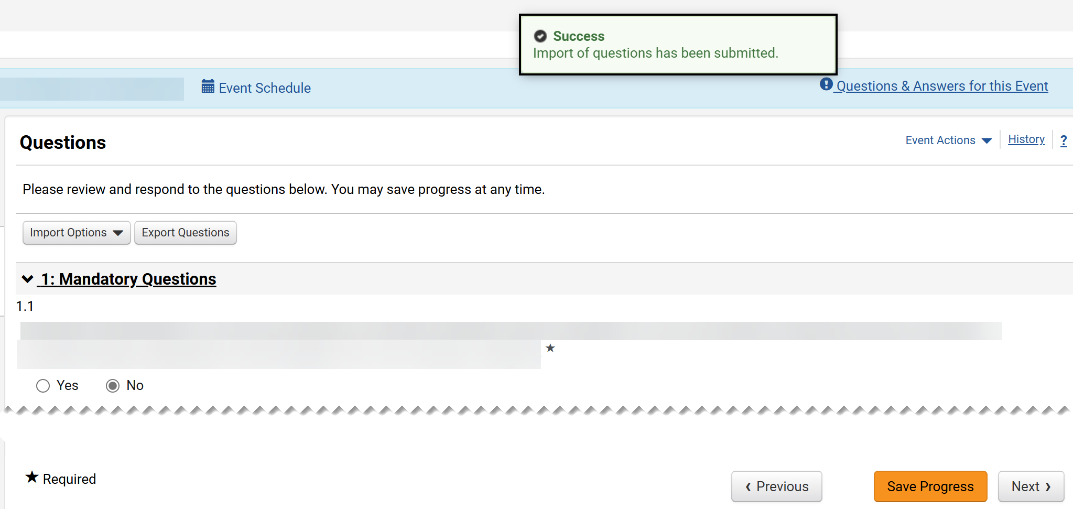
Revise and Resubmit a Bid (Part 22 of 31)
INSTRUCTIONS
Review the Success message.
Note: The Questions will display answers from the imported file. Since attachments are not supported via the import, any required files must be added directly in GA@WORK Marketplace for Suppliers.
Click Save Progress.
Click Next.
61
62
63

Slide 24
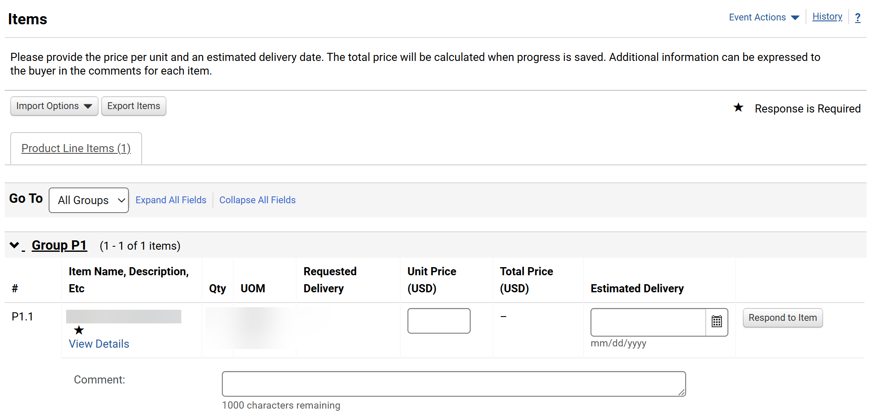
Revise and Resubmit a Bid (Part 23 of 31)
INSTRUCTIONS
Enter a Unit Price.
Enter an Estimated Delivery date.
Enter a Comment (Optional).
Note: Items might vary based on the Sourcing Event. If Import Options is selected, follow steps X-X; otherwise, skip to step X (Next).
64
65
66

Slide 25
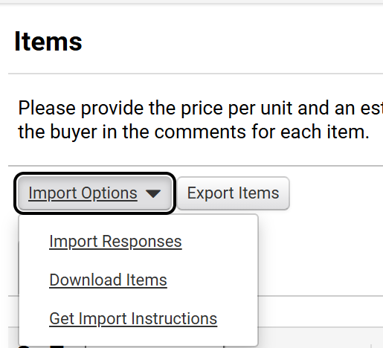
Revise and Resubmit a Bid (Part 24 of 31)
INSTRUCTIONS
Click Import Options.
Select Download Items.
67
68

Slide 26
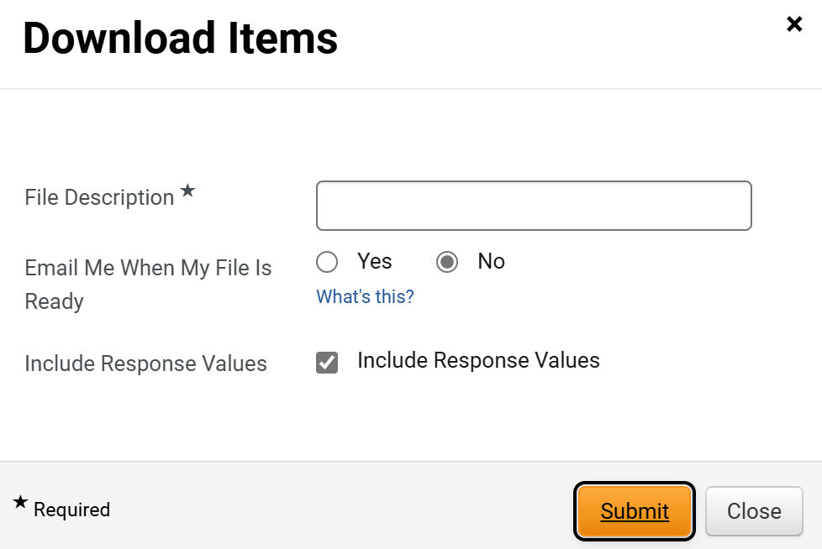
Revise and Resubmit a Bid (Part 25 of 31)
INSTRUCTIONS
Enter a File Description*.
Select an option for Email Me When My File Is Ready.
Select Include Response Values.
Click Submit.
69
70
71
72

Slide 27
Revise and Resubmit a Bid (Part 26 of 31)
INSTRUCTIONS
Review the Success message.
Click My Exports and Imports tab.

Slide 28
Revise and Resubmit a Bid (Part 27 of 31)
INSTRUCTIONS
Click Output File hyperlink.
Click Downloaded File.
76
75

Slide 29
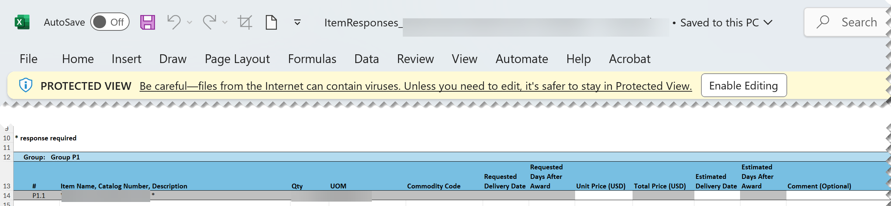
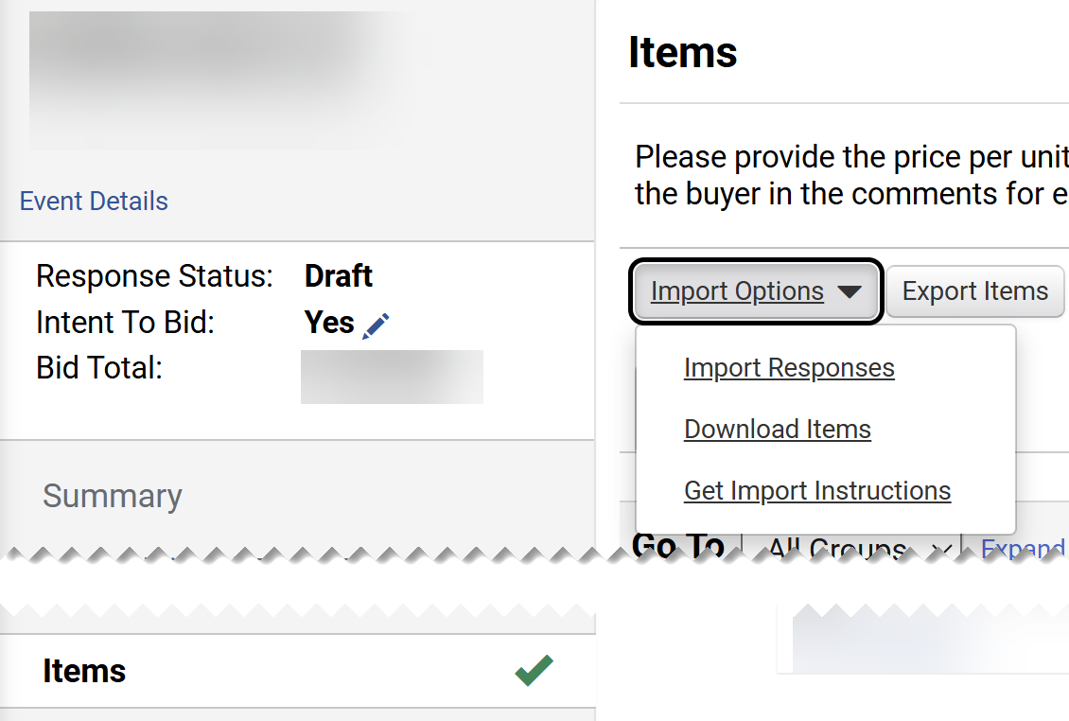
Revise and Resubmit a Bid (Part 28 of 31)
INSTRUCTIONS
Click Enable Editing.
Enter a Unit Price.
Enter an Estimated Delivery date.
Enter a Comment (Optional).
Save File.
81
77
78
79
80
Select the Items tab.
Click Import Options.
Click Import Responses.
83
84
82

Slide 30
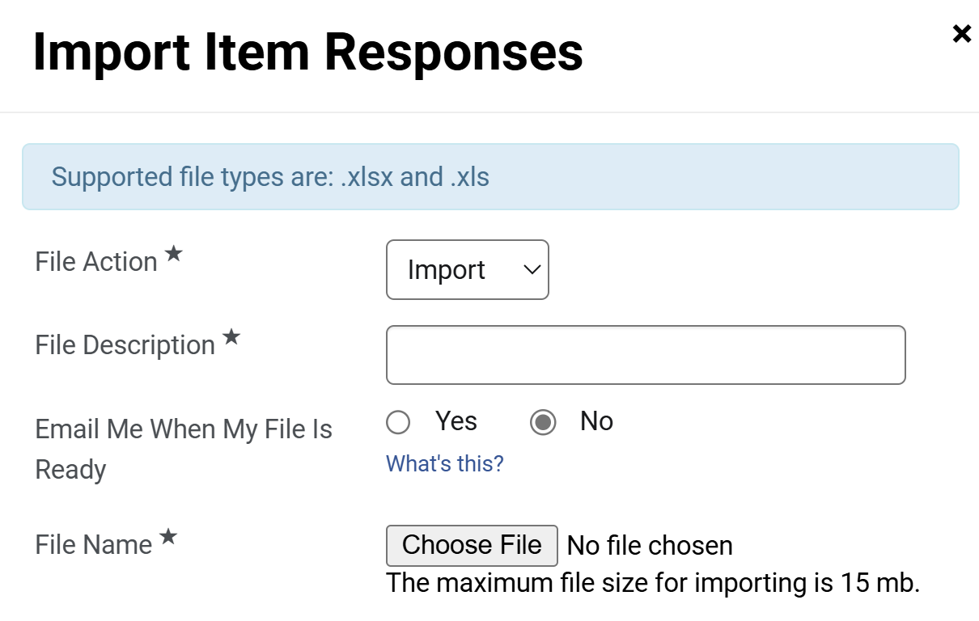
Revise and Resubmit a Bid (Part 29 of 31)
INSTRUCTIONS
Select a File Action*.
Enter a File Description*.
Select an option for Email Me When My File Is Ready.
Click Choose File for File Name*.
85
86
87
88

Slide 31
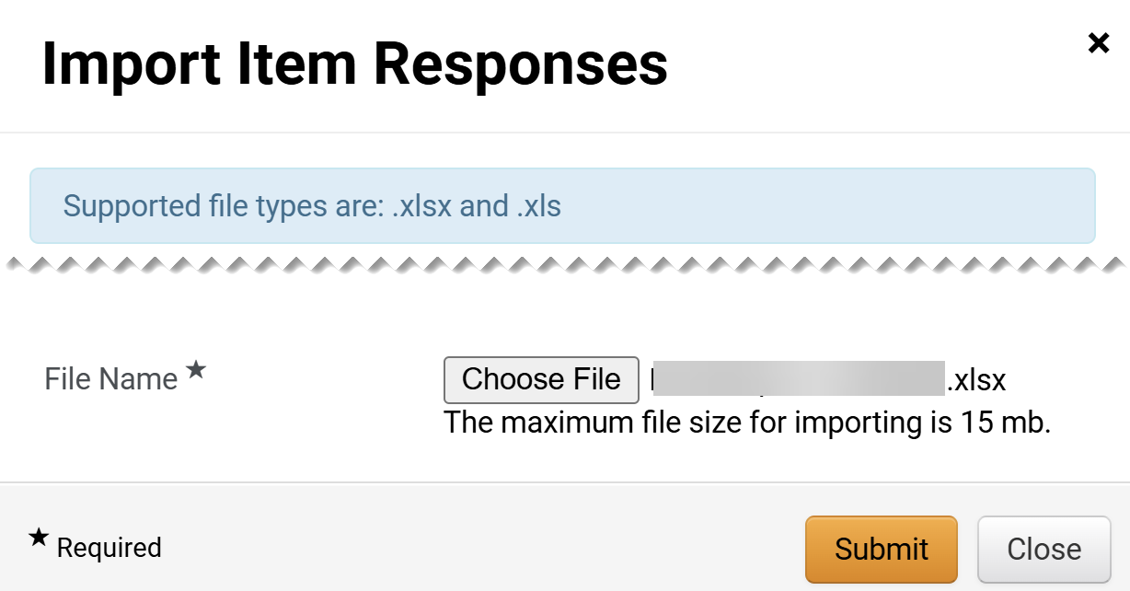
Revise and Resubmit a Bid (Part 30 of 31)
INSTRUCTIONS
Select the applicable File from your computer.
Click Open.
89
90
Verify the File is loaded.
Note: The file loaded should be either .xlsx or .xls.
Click Submit.
91
92

Slide 32
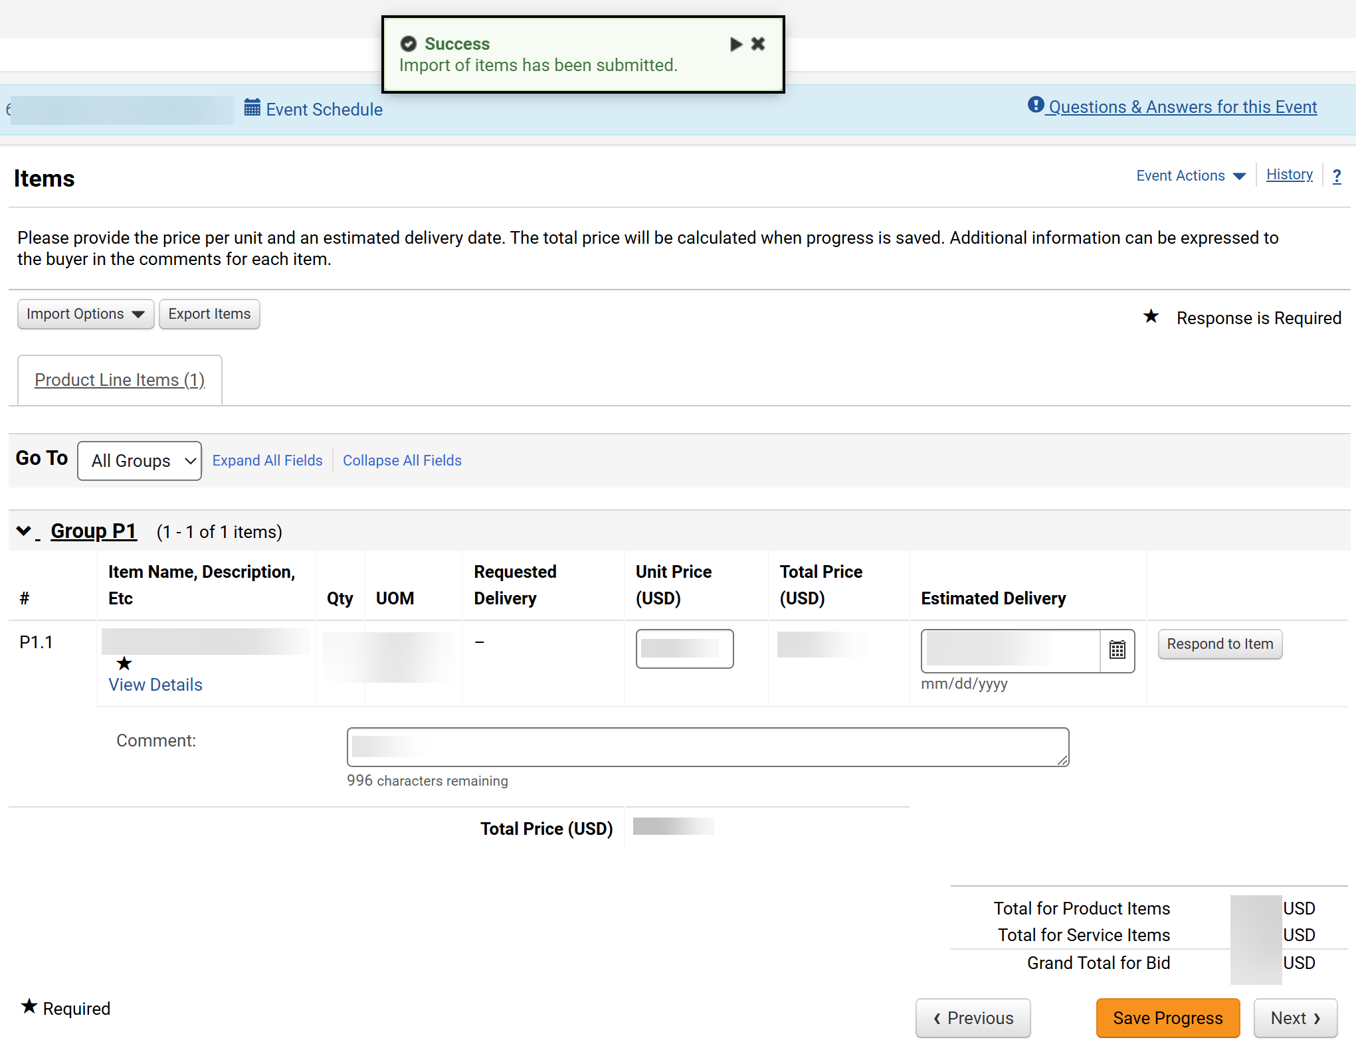

Revise and Resubmit a Bid (Part 31 of 31)
INSTRUCTIONS
Review the Success message.
Note: The Items will display answers from the imported file.
Click Save Progress.
93
94
You have successfully revised and resubmitted a bid .

