Slide 1
Export Event Reports
DESCRIPTION
This guide will show a Supplier how to Export Event Reports in GA@WORK Marketplace for Suppliers.
OVERVIEW
The key steps in the process are below:
Access the GA@WORK Marketplace for Suppliers.
Access Sourcing.
Search Report.
Report is exported in GA@WORK Marketplace for Suppliers.
Business Process:
Access Supplier Portal
Access Sourcing
Search Report
Report is Exported

Slide 2
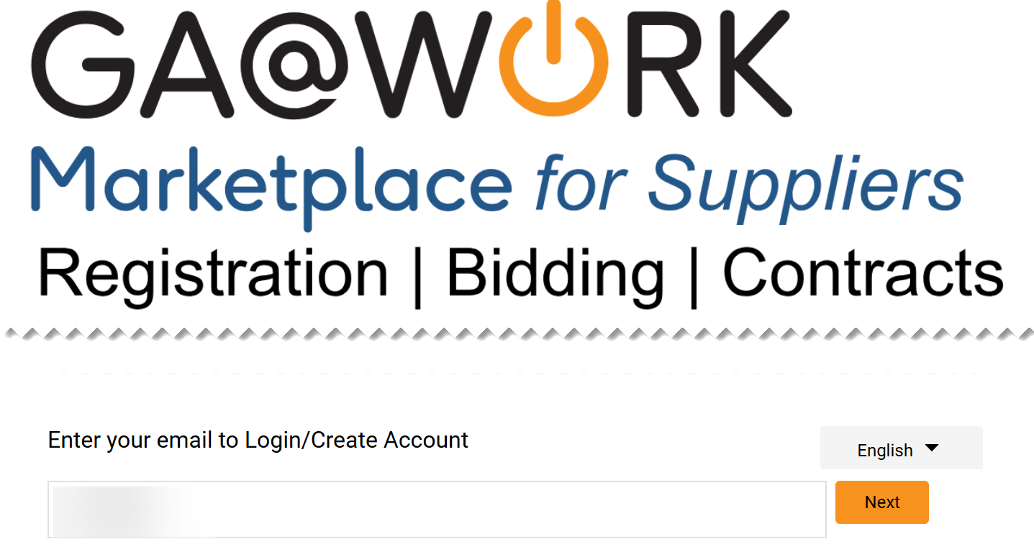
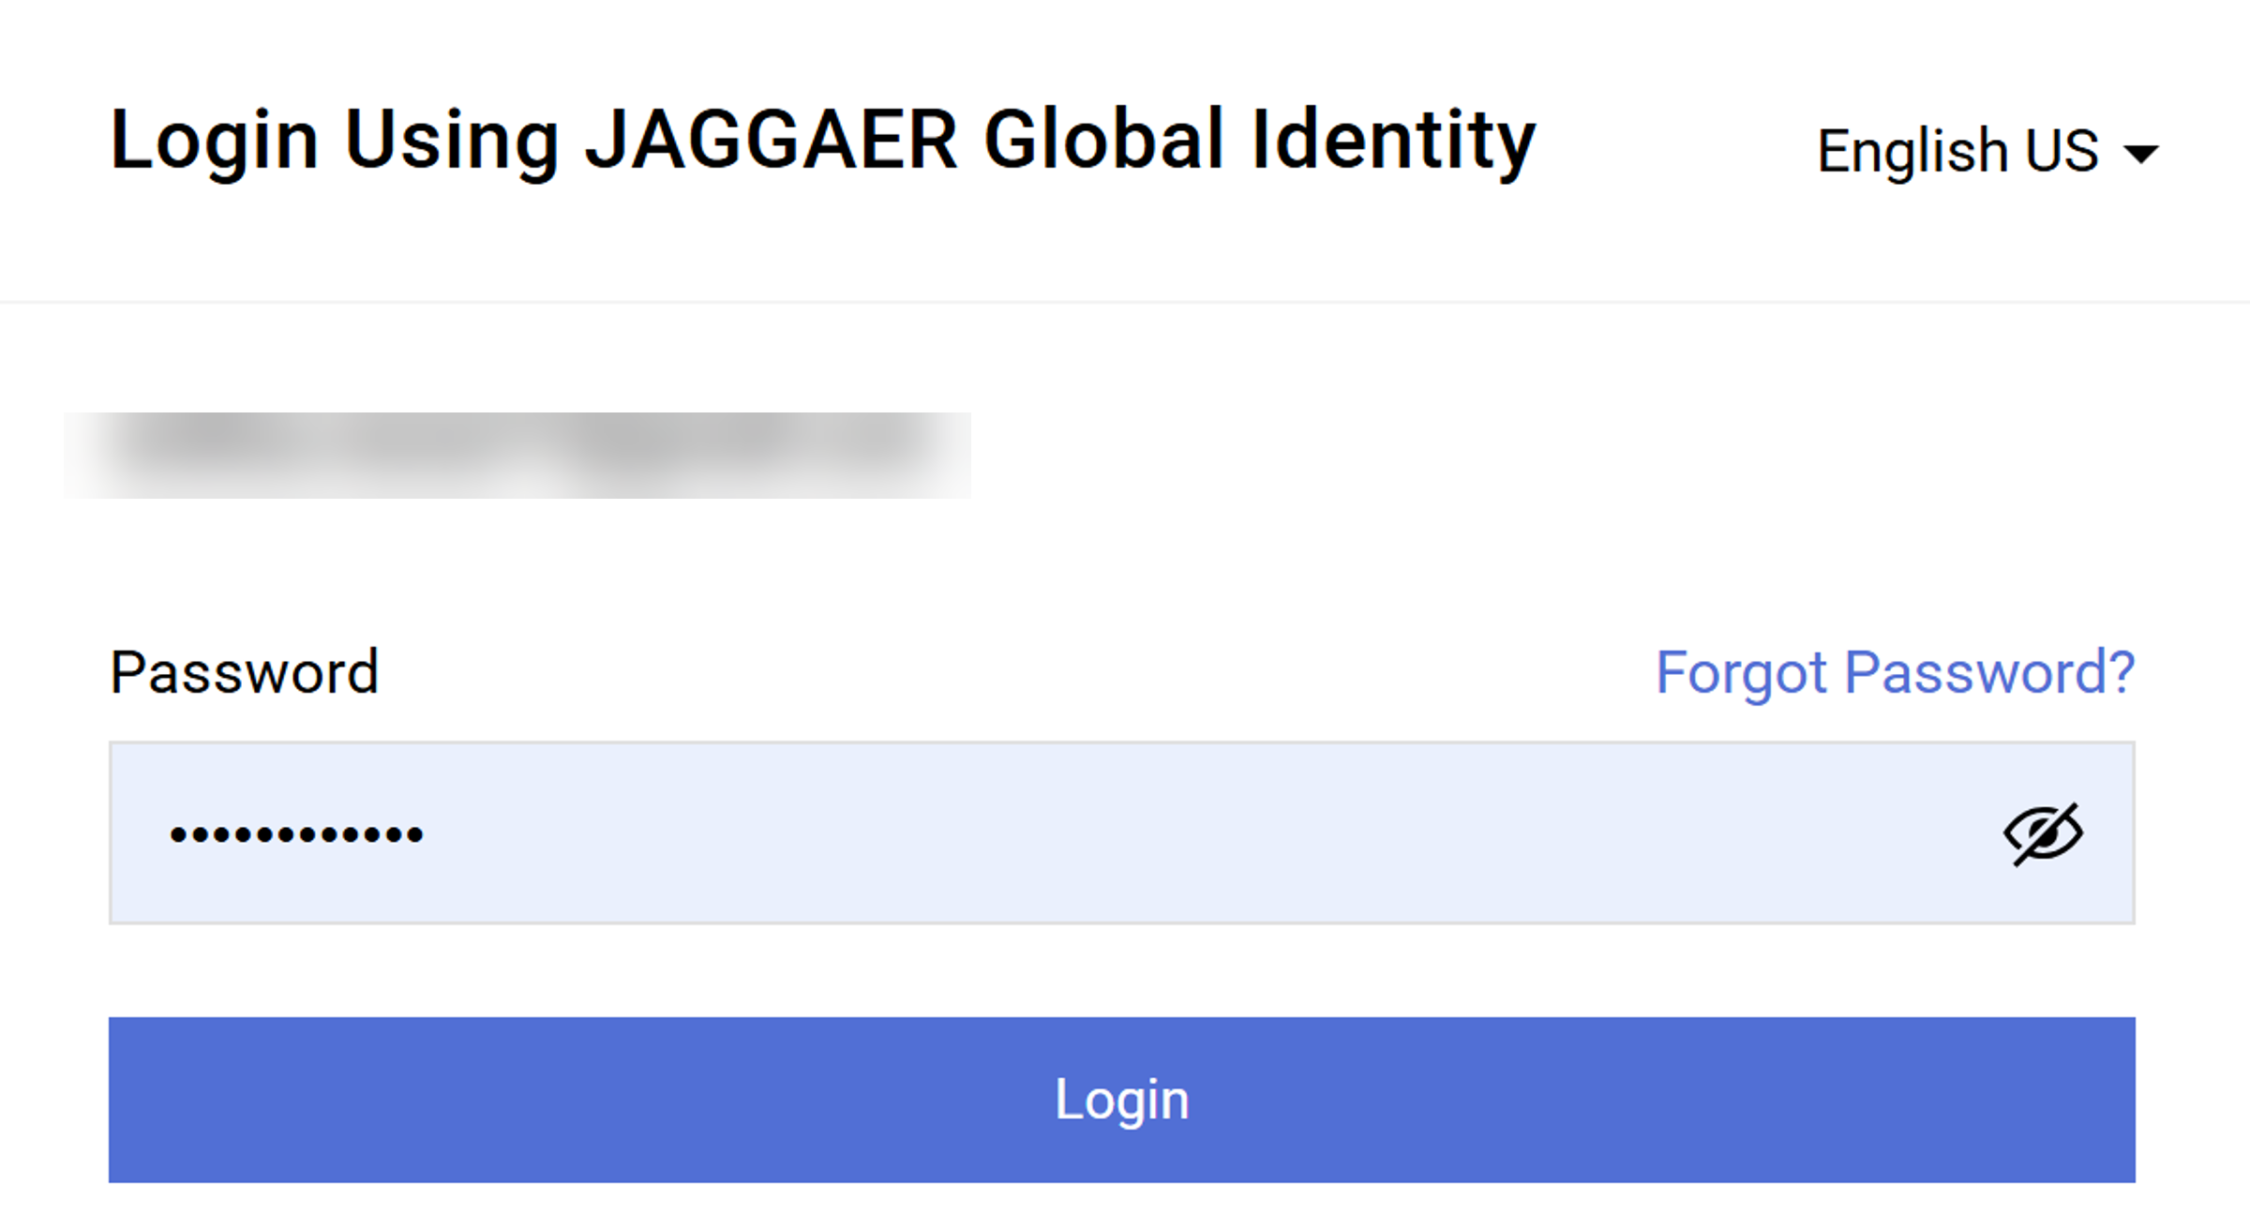
Export Event Reports (Part 1 of 18)
INSTRUCTIONS
Open GA@WORK Marketplace and enter your email to login.
Note: To log in supplier must have started the registration process in GA@WORK Marketplace for Suppliers.
Click Next.
1
2
Enter Password.
Click Login.
3
4

Slide 3
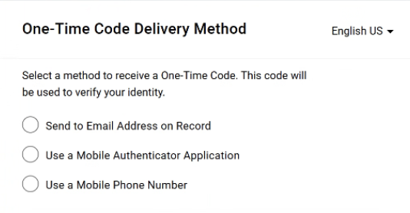
Export Event Reports (Part 2 of 18)
INSTRUCTIONS
Select a method to receive a One-Time Code.
Note: Only one method can be selected to receive the code. Follow steps 6 – 10 if selecting Send to Email Address on Record. Skip to 11 – 15 if selecting Use a Mobile Authenticator Application or skip to step 16 - 22 if selecting Use a Mobile Phone Number. Once completed, skip to step 23.

Slide 4
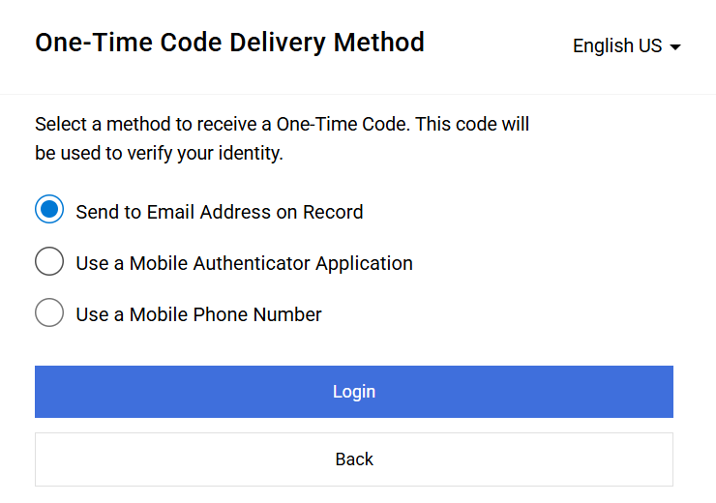
Export Event Reports (Part 3 of 18)
INSTRUCTIONS
Select Send to Email Address on Record.
Click Login
6
7

Slide 5
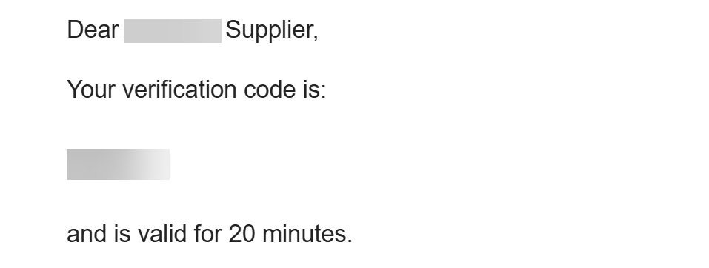
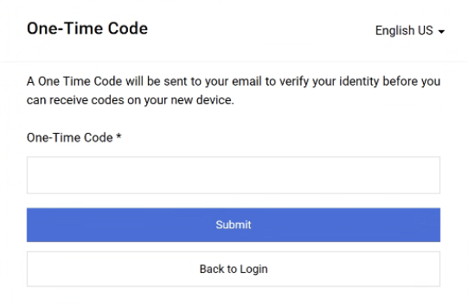
Export Event Reports (Part 4 of 18)
INSTRUCTIONS
Receive and make note of the One-Time Code.
Note: The verification code is only valid for 20 minutes.
In GA@WORK Marketplace, enter your One-Time Code*.
Note: Complete all required fields marked with a black star*.
Click Submit.
Note: Skip to Step 24 to continue.
9
10

Slide 6
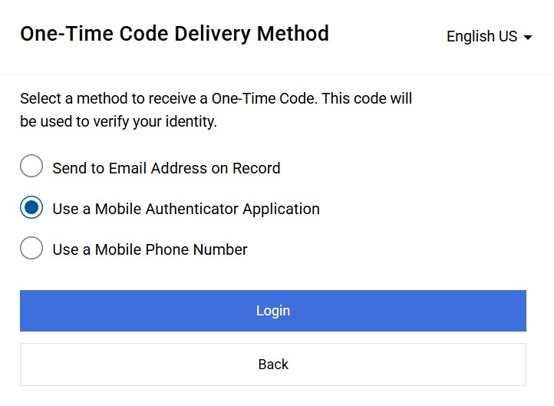
Export Event Reports (Part 5 of 18)
INSTRUCTIONS
Select Use a Mobile Authenticator Application.
Click Login.
11
12

Slide 7
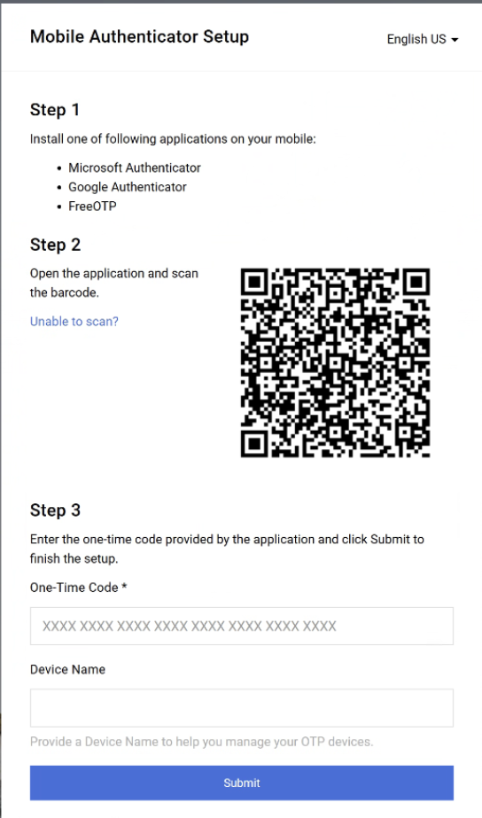
Export Event Reports (Part 6 of 18)
INSTRUCTIONS
Enter One-Time Code*.
Enter Device Name (optional).
Click Submit.
Note: Skip to step 23.
13
14
15

Slide 8
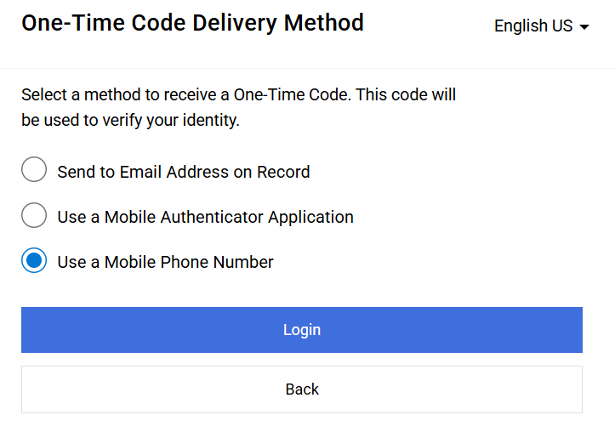
Export Event Reports (Part 7 of 18)
INSTRUCTIONS
Select Use a Mobile Phone Number.
Click Login.
16
17

Slide 9
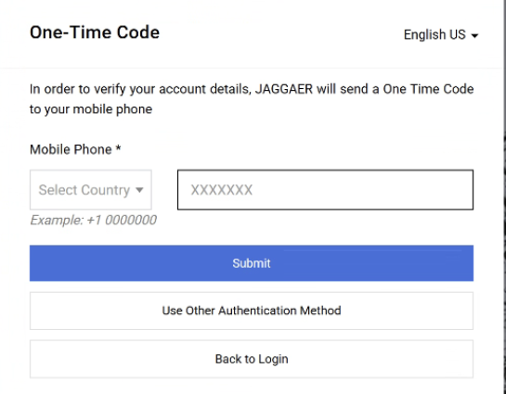
Export Event Reports (Part 8 of 18)
INSTRUCTIONS
Enter Mobile Phone*.
Click Submit.
18
19

Slide 10
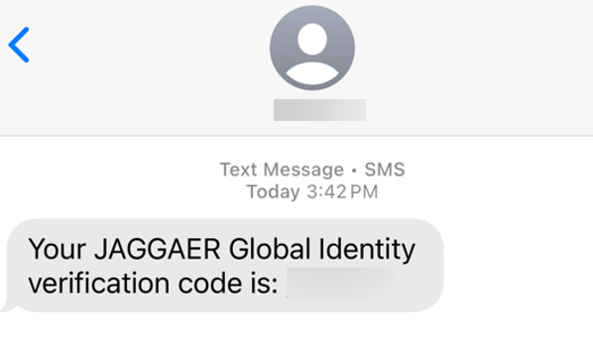
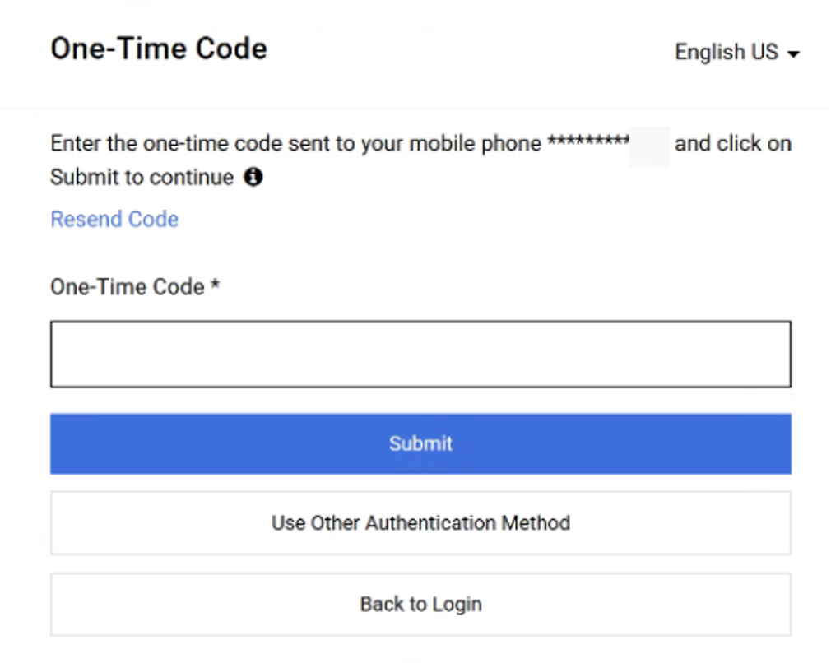
Export Event Reports (Part 9 of 18)
INSTRUCTIONS
Review Verification Code sent to Mobile Phone.
Note: Message will be received from JAGGAER Global Identity.
In GA@WORK Marketplace, enter your One-Time Code*.
Click Submit.
Note: Skip to step 23.
21
22

Slide 11
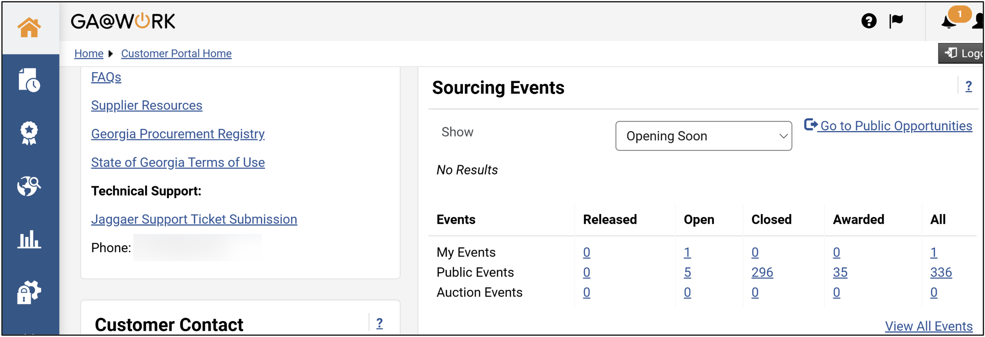
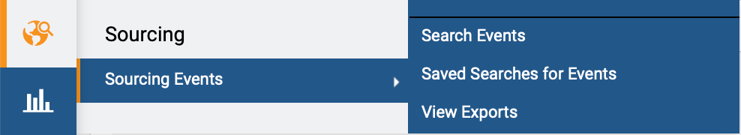
Export Event Reports (Part 10 of 18)
INSTRUCTIONS
The Homepage is displayed.
Access the Sourcing module.
Click Sourcing Events.
Click Search Events.
24
26
25

Slide 12
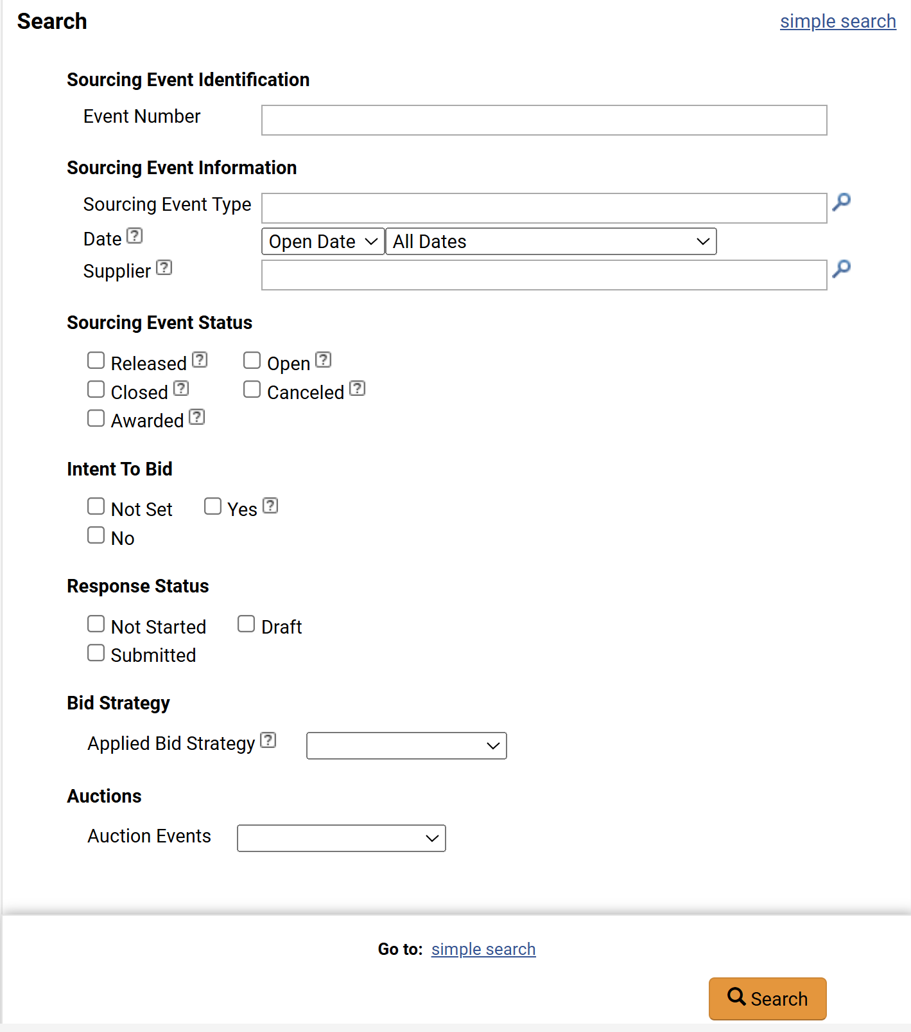
Export Event Reports (Part 11 of 18)
INSTRUCTIONS
Use the Filters, as applicable, to search for Sourcing Events.
Note: Enter in field or use magnifying glass to search.
Click Search.
27
28

Slide 13
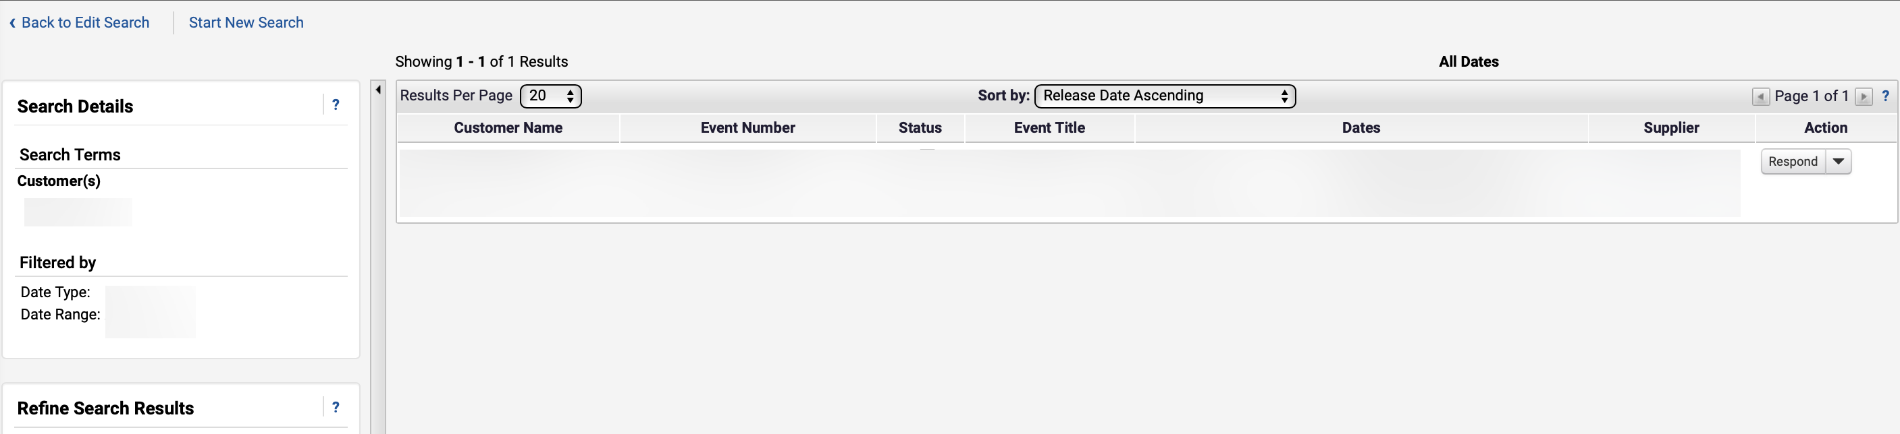
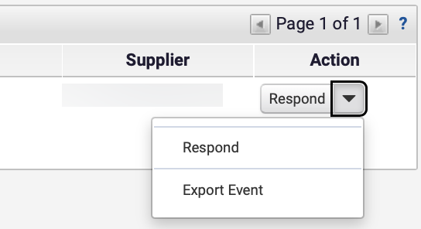
Export Event Reports (Part 12 of 18)
INSTRUCTIONS
Review the Search Results.
Note: Conducting an Advanced Search and Simple Search will populate the same screen.
Click Respond.
Click Export Event.
30
31

Slide 14
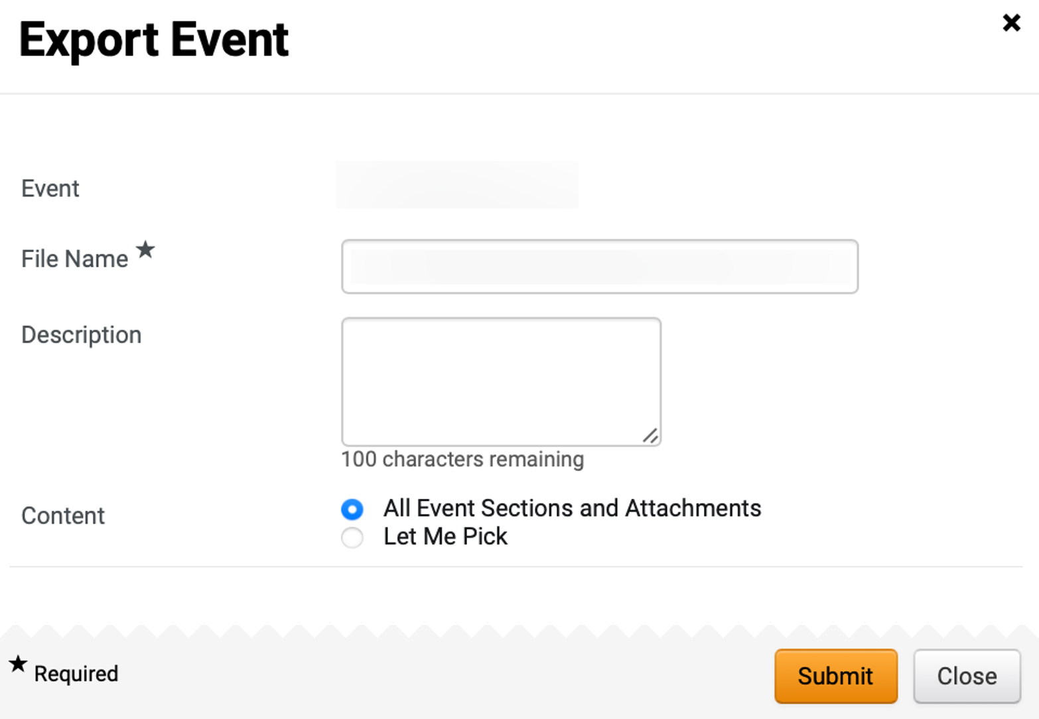
Export Event Reports (Part 13 of 18)
INSTRUCTIONS
Enter a File Name*.
Note: Event field will auto-populate and cannot be edited.
Enter a Description.
Check the All Event Sections and Attachments box.
Note: Follow steps 35 - 38 or skip to step 39 if selecting Let Me Pick to attach specific Event Sections.
32
33
34

Slide 15
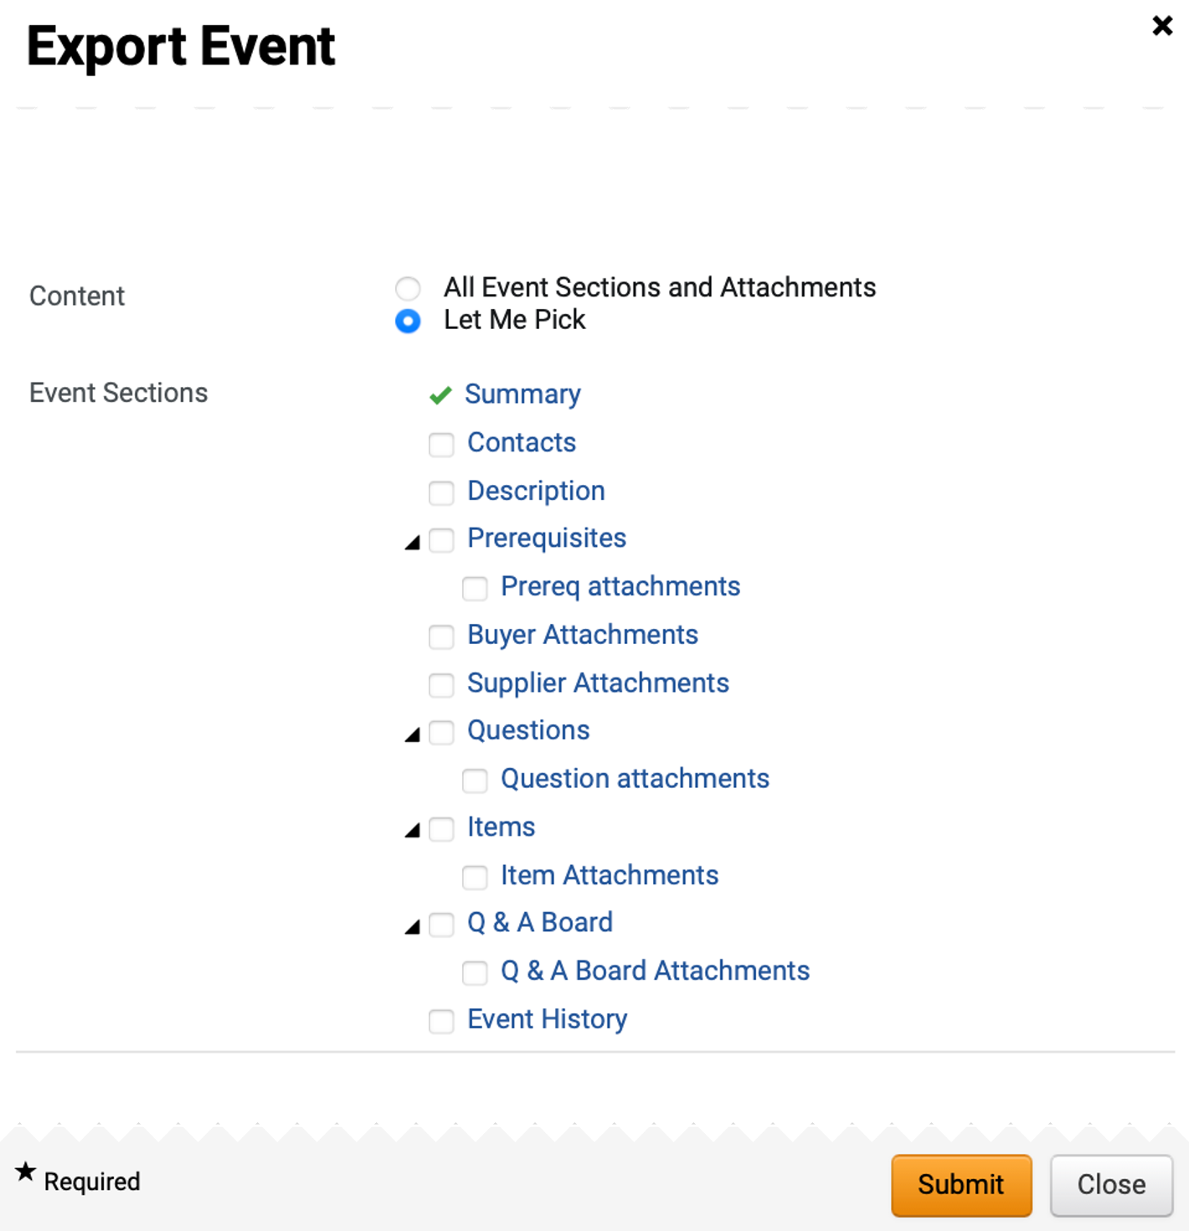
Export Event Reports (Part 14 of 18)
INSTRUCTIONS
Check Let Me Pick box.
Check applicable Event Sections attachments.
Note: Multiple Event Sections can be selected.
35
36

Slide 16
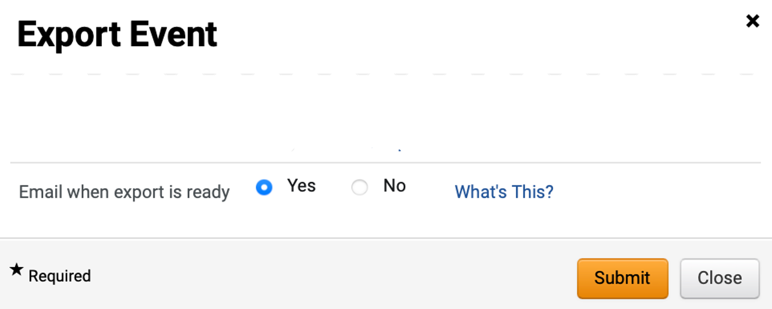
Export Event Reports (Part 15 of 18)
INSTRUCTIONS
Select Email when export is ready.
Click Submit.
37
38

Slide 17
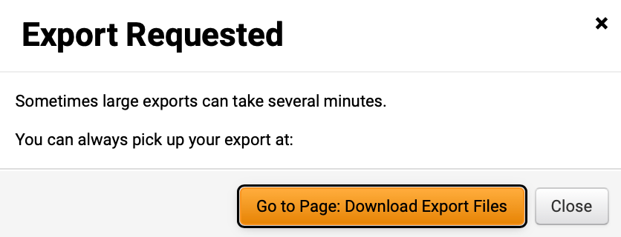
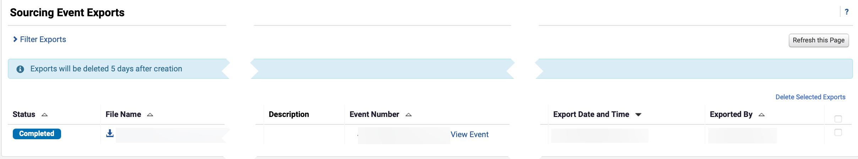
Export Event Reports (Part 16 of 18)
INSTRUCTIONS
Click Go to Page: Download Export Files.
Note: Follow steps 43 - 48 to access Export in View Exports.
Review Sourcing Event Completed Status.
Click the File Name hyperlink to download document.
Note: Click View Event hyperlink to view event details.
41
18

Slide 18
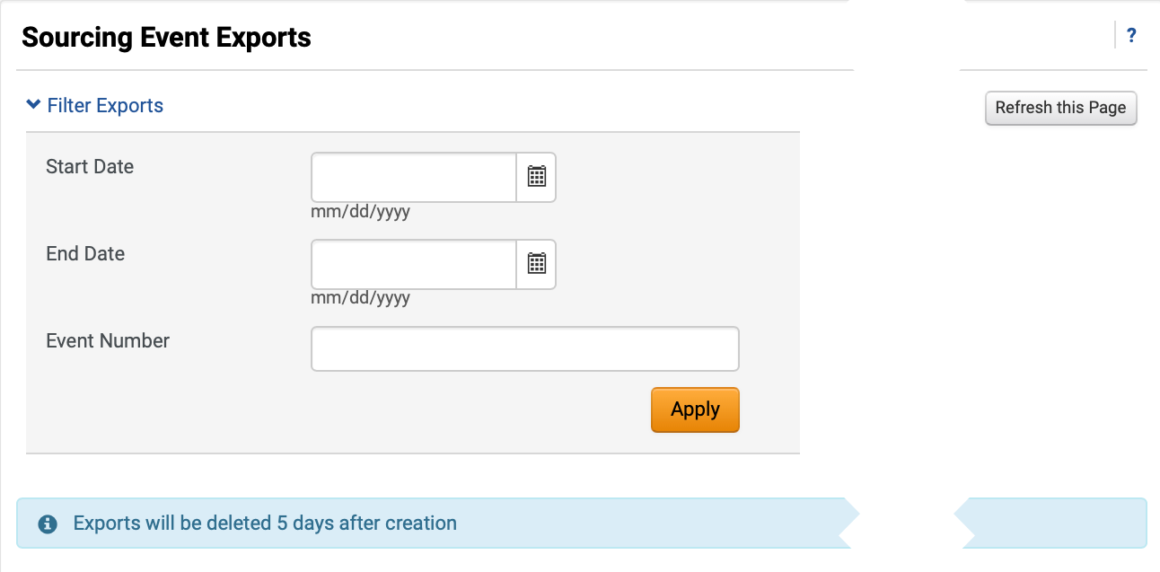
Export Event Reports (Part 17 of 18)
INSTRUCTIONS
Access the Sourcing module.
Click Sourcing Events.
Click View Exports.
43
44
45
Use the Filters to search for Sourcing Event Exports.
Click Apply.
Note: Exports will be deleted five days after creation.
46
47

Slide 19

Export Event Reports (Part 18 of 18)
INSTRUCTIONS
Review Sourcing Event Exports.
Note: Click View Event hyperlink to view Event details.
You have successfully Exported a Report in JAGGAER Supplier Portal.

