Slide 1
Add/Update Supplier Contacts & Users (GA@WORK Marketplace for Suppliers)
DESCRIPTION
This guide will show a Supplier how to Add/Update Supplier Contacts and Users in GA@WORK Marketplace for Suppliers
OVERVIEW
The key steps in the process are below:
Access the GA@WORK Marketplace for Suppliers.
Access Contacts.
Add/Update Supplier Contact/User.
Contact/User is Added/Updated in GA@WORK Marketplace for Suppliers.
Business Process:
Access GA@WORK Marketplace for Suppliers
Access Contacts
Add/Update Supplier Contact/User Information
Contact/User is Added/Updated

Slide 2
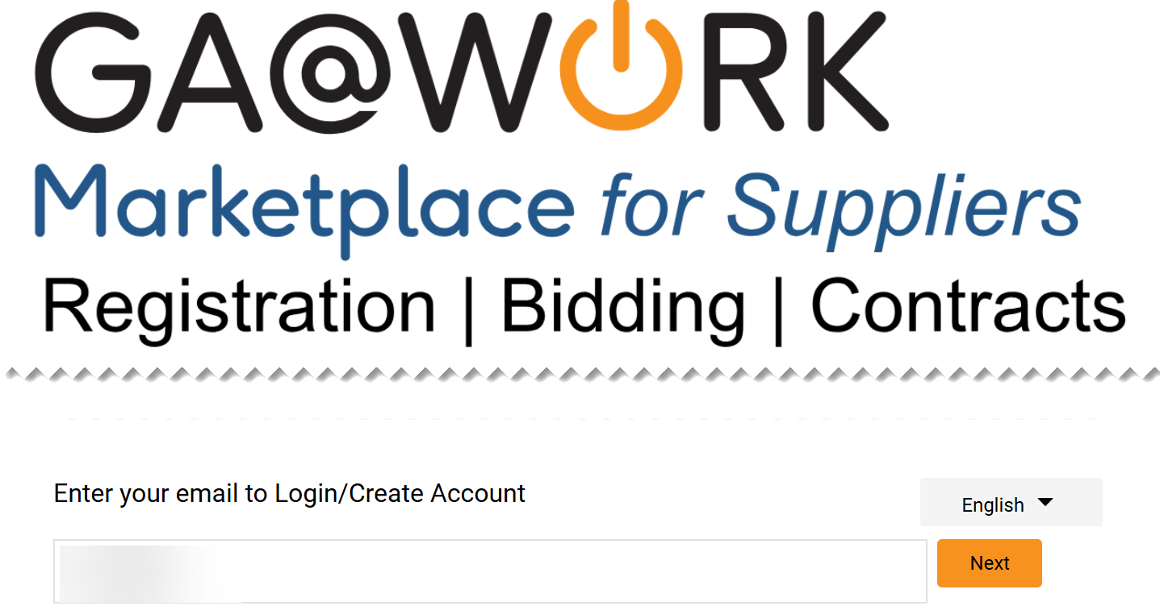
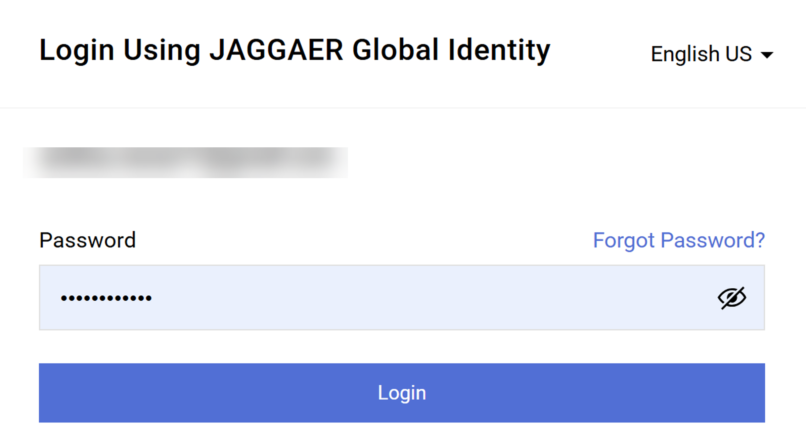
Add/Update Supplier Contacts and Users (Part 1 of 18)
INSTRUCTIONS
Open GA@WORK Marketplace and enter your email to Log in.
Note: To log in, a supplier must have completed the registration process in GA@WORK Marketplace for Suppliers.
Click Next.
1
2
Enter your Password.
Click Login.
3
4

Slide 3
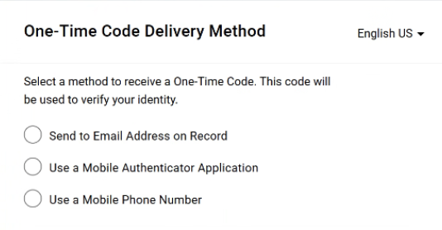
Add/Update Supplier Contacts and Users (Part 2 of 18)
INSTRUCTIONS
Select a method to receive a One-Time Code.
Note: Only one method can be selected to receive the code. Follow steps 6 – 10 if selecting Send to Email Address on Record. Skip to 11 – 15 if selecting Use a Mobile Authenticator Application or skip to step 16 - 22 if selecting Use a Mobile Phone Number. Once completed, skip to step 23.

Slide 4
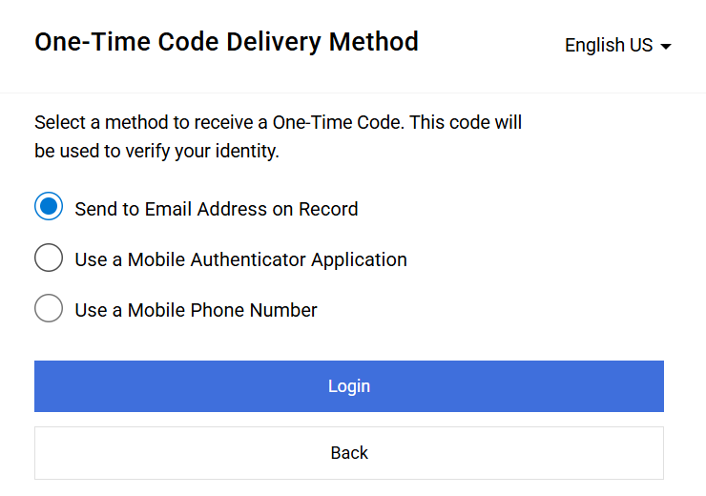
Add/Update Supplier Contacts and Users
(Part 3 of 18)
INSTRUCTIONS
Select Send to Email Address on Record.
Click Login
6
7

Slide 5
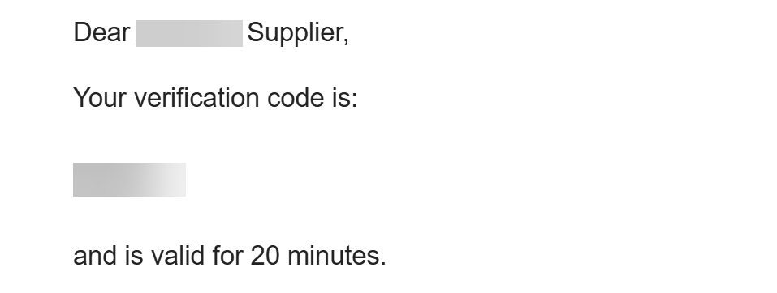
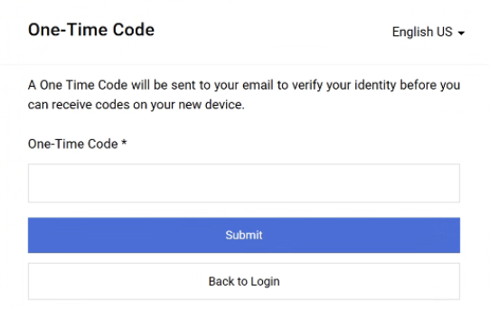
Add/Update Supplier Contacts and Users
(Part 4 of 18)
INSTRUCTIONS
Receive and make note of the One-Time Code.
Note: The verification code is only valid for 20 minutes.
In GA@WORK Marketplace, enter your One-Time Code*.
Note: Complete all required fields marked with a black star*.
Click Submit.
Note: Skip to Step 24 to continue.
9
10

Slide 6
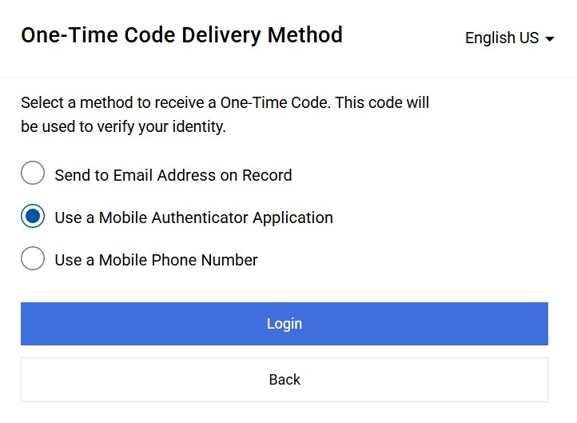
Add/Update Supplier Contacts and Users
(Part 5 of 18)
INSTRUCTIONS
Select Use a Mobile Authenticator Application.
Click Login.
11
12

Slide 7
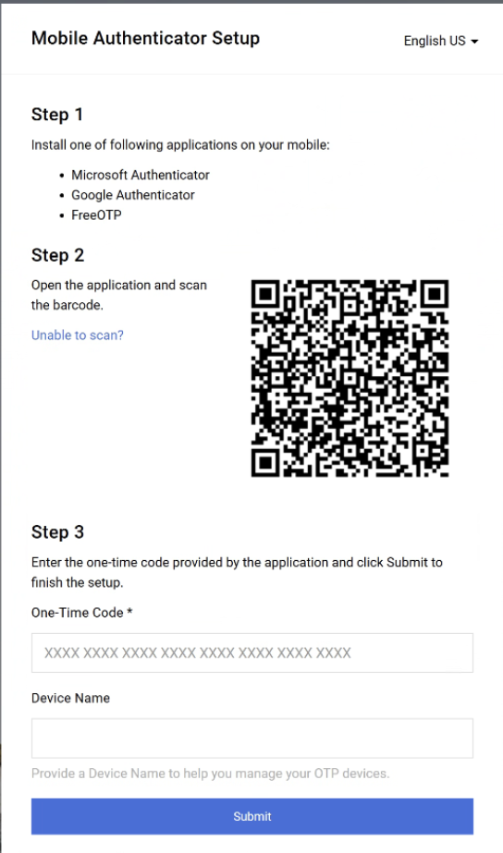
Add/Update Supplier Contacts and Users
(Part 6 of 18)
INSTRUCTIONS
Enter One-Time Code*.
Enter Device Name (optional).
Click Submit.
Note: Skip to step 23.
13
14
15

Slide 8
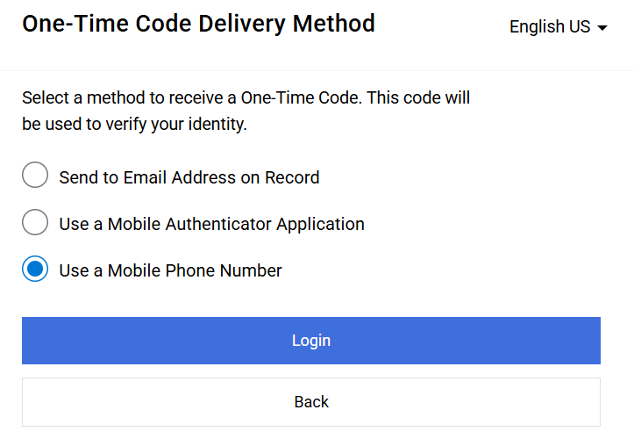
Add/Update Supplier Contacts and Users
(Part 7 of 18)
INSTRUCTIONS
Select Use a Mobile Phone Number.
Click Login.
16
17

Slide 9
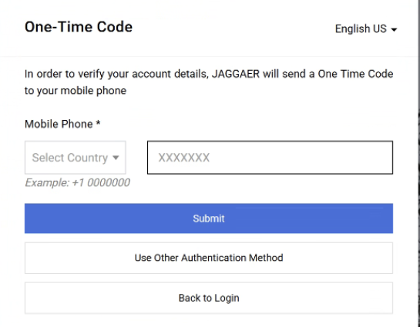
Add/Update Supplier Contacts and Users
(Part 8 of 18)
INSTRUCTIONS
Enter Mobile Phone*.
Click Submit.
18
19

Slide 10
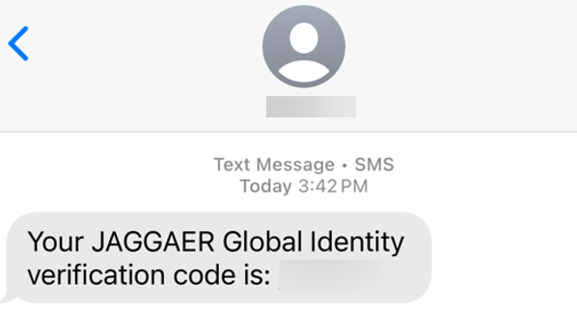
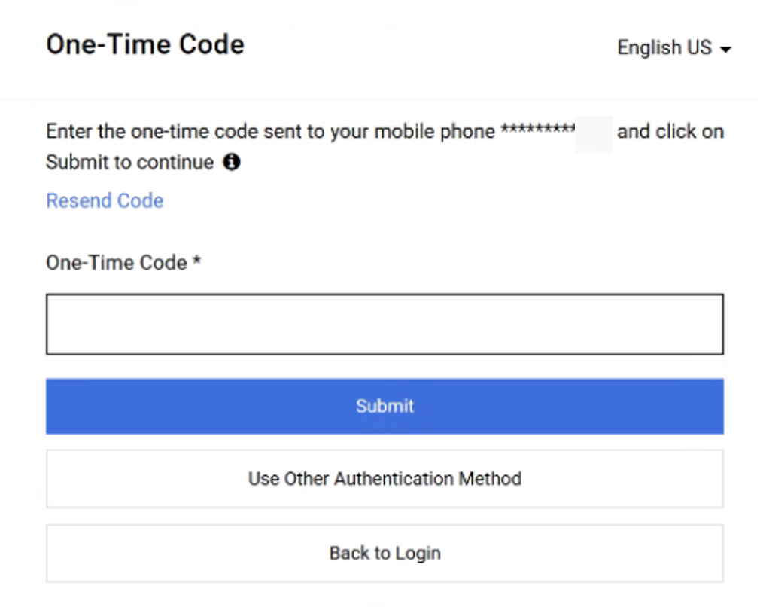
Add/Update Supplier Contacts and Users
(Part 9 of 18)
INSTRUCTIONS
Review Verification Code sent to Mobile Phone.
Note: Message will be received from JAGGAER Global Identity.
In GA@WORK Marketplace, enter your One-Time Code*.
Click Submit.
Note: Skip to step 23.
21
22

Slide 11
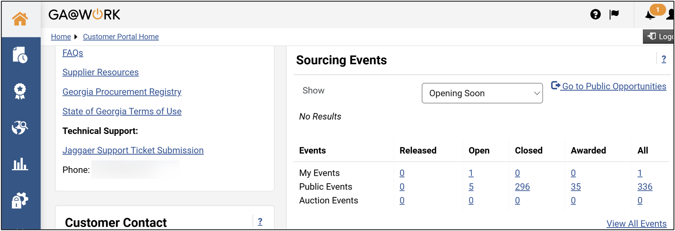
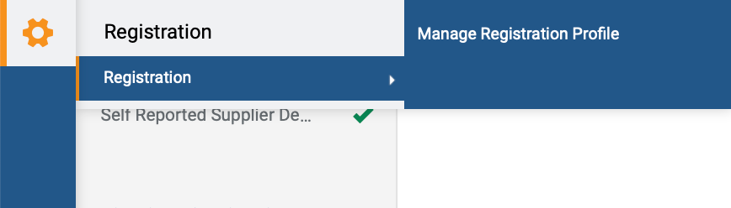
Add/Update Supplier Contacts and Users (Part 10 of 18)
INSTRUCTIONS
The Homepage is displayed.
Access the Registration module.
Click Registration.
Click Manage Registration Profile.
Note: It is also possible to access the registration via the Homepage then click Manage Registration Profile.
24
26
25

Slide 12
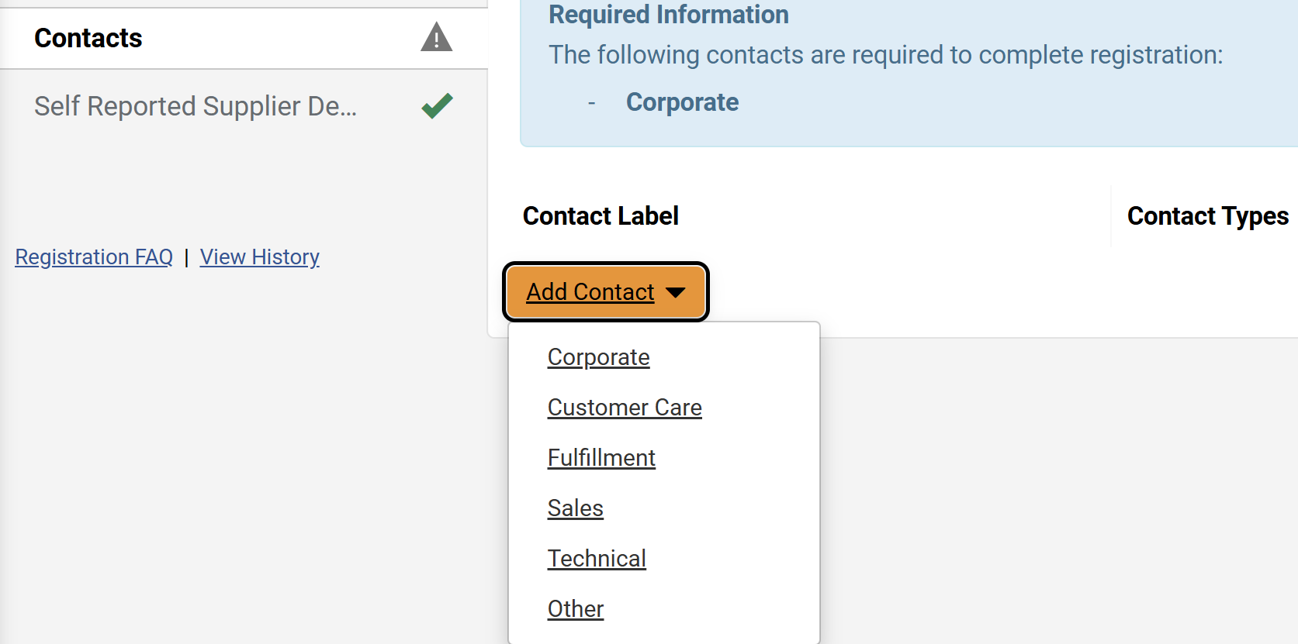
Add/Update Supplier Contacts and Users (Part 11 of 18)
INSTRUCTIONS
Click Contacts.
Note: Contacts will display the Incomplete icon until a Corporate Contact is added.
Click Add Contact.
Select Contact Type.
27
28
29

Slide 13
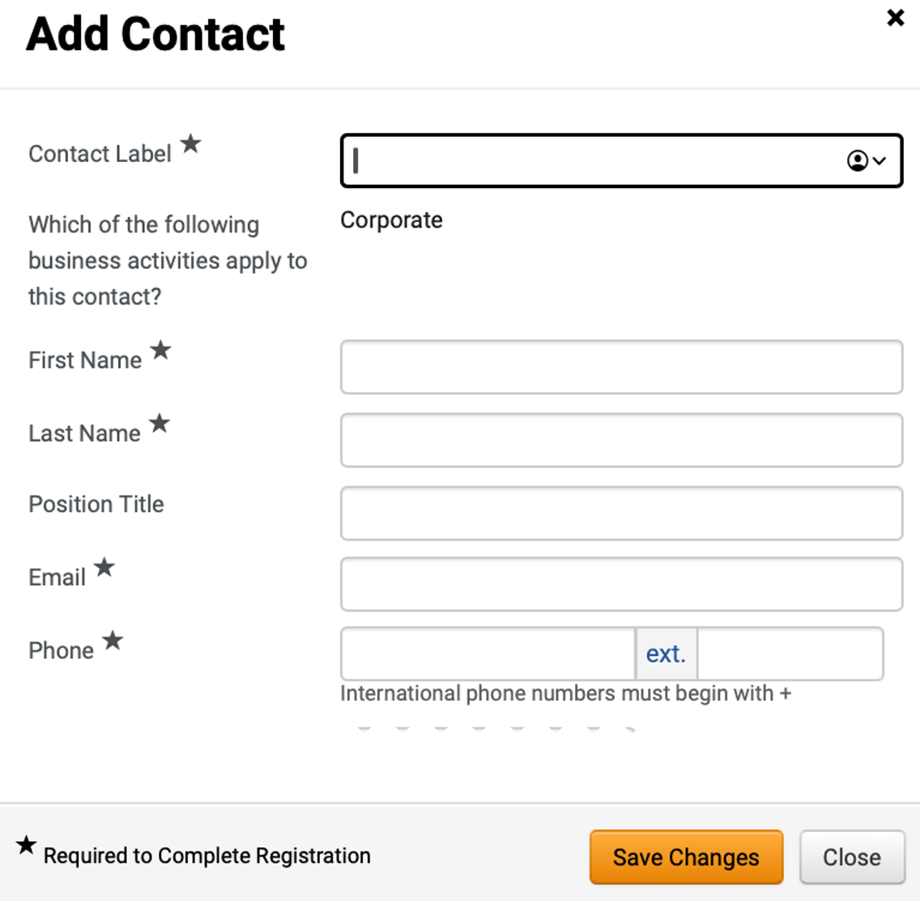
Add/Update Supplier Contacts and Users (Part 12 of 18)
INSTRUCTIONS
Enter Contact Label*.
Note: Which of the following business activities apply to this contact? will auto-populate with the selected Contact Type.
Enter First Name*
Enter Last Name*.
Enter Position Title (optional).
Enter Email*.
Enter Phone*.
Click Save Changes.
30
31
32
33
34
35
36

Slide 14
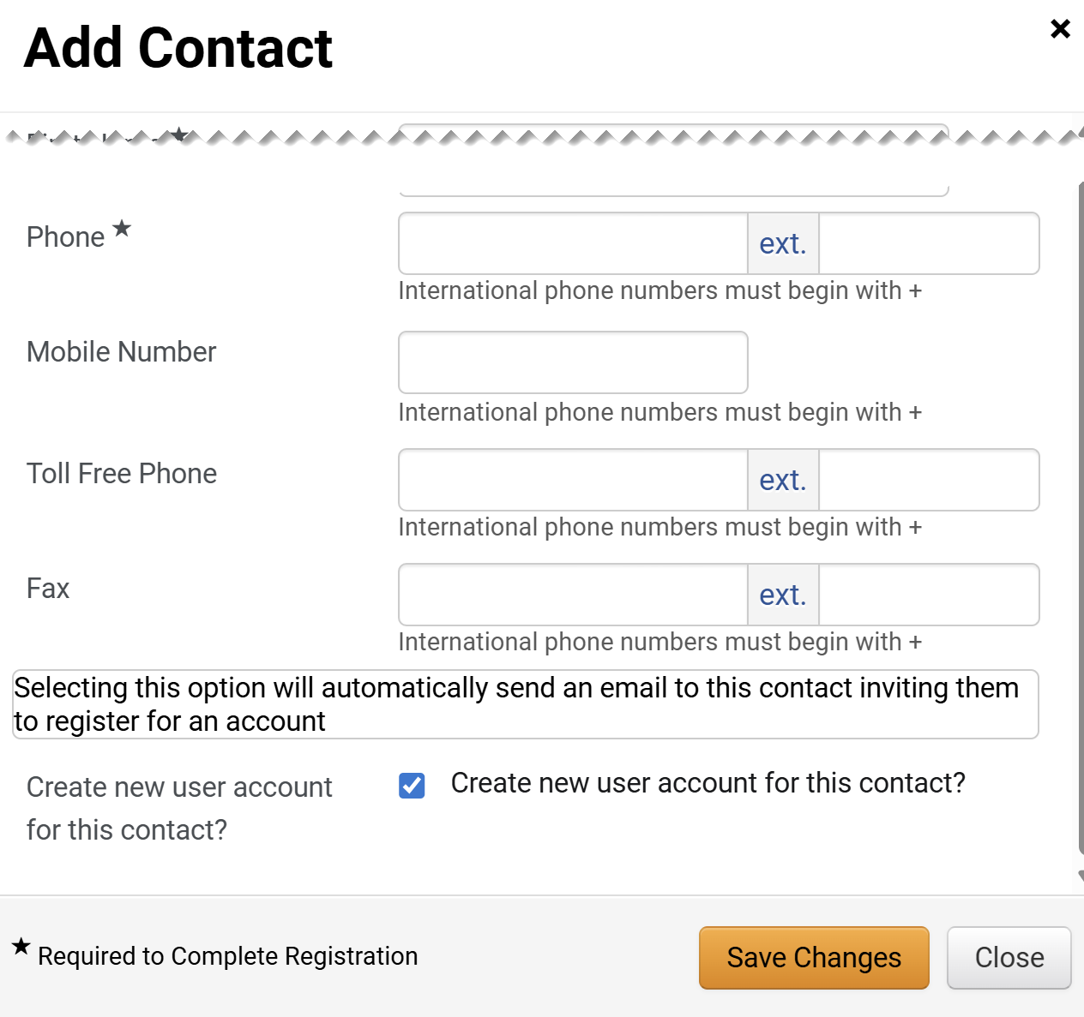
Add/Update Supplier Contacts and Users (Part 13 of 18)
INSTRUCTIONS
Enter Phone*.
Enter Mobile Number (optional).
Enter Toll Free Phone (optional).
Enter Fax (optional).
Check the Create new user account for this contact? box.
Note: This is only applicable if Corporate is selected as the Contact Type. If selected, an email inviting the contact to register for an account will be automatically sent to set up login credentials for the contact.
Click Save Changes.
37
38
39
40
41
18

Slide 15
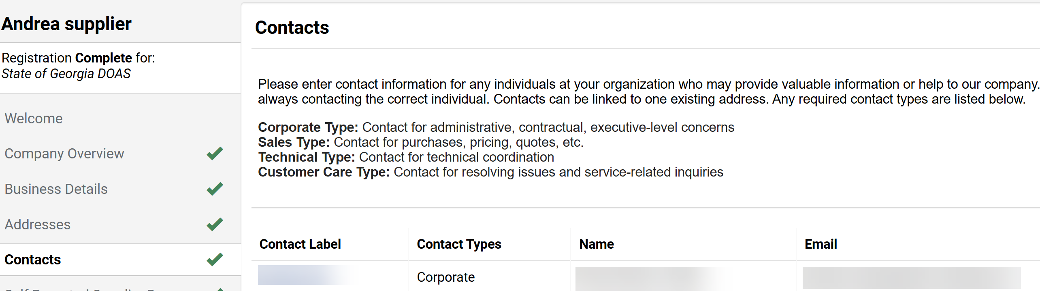
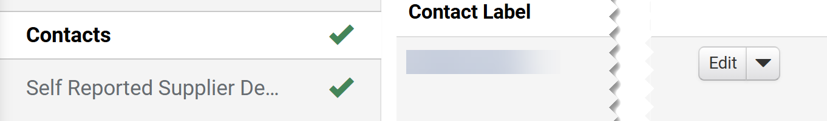
Add/Update Supplier Contacts and Users (Part 14 of 18)
INSTRUCTIONS
Review the Added Contact.
Note: Follow steps 27 – 41 to create other Contact Types. Also, once the Corporate Contact is added, the Complete Checkmark is visible.
Click the Contact Label hyperlink .
Note: Clicking Edit will also open editable fields.

Slide 16
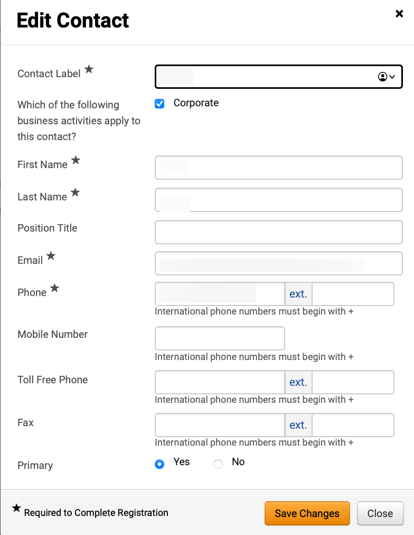
Add/Update Supplier Contacts and Users (Part 15 of 18)
INSTRUCTIONS
Review Contact fields and make changes.
Note: Contact fields will auto-populate with current information.
Click Save Changes.
45
46

Slide 17
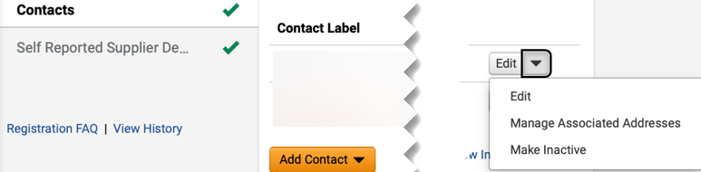
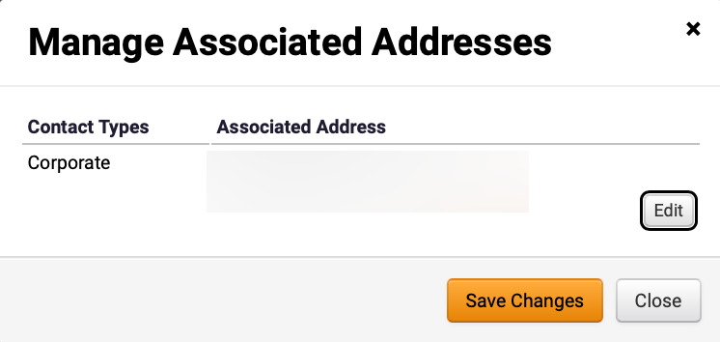
Add/Update Supplier Contacts and Users (Part 16 of 18)
INSTRUCTIONS
Click Show Menu.
Select Manage Associated Addresses.
47
48
Click Edit.

Slide 18
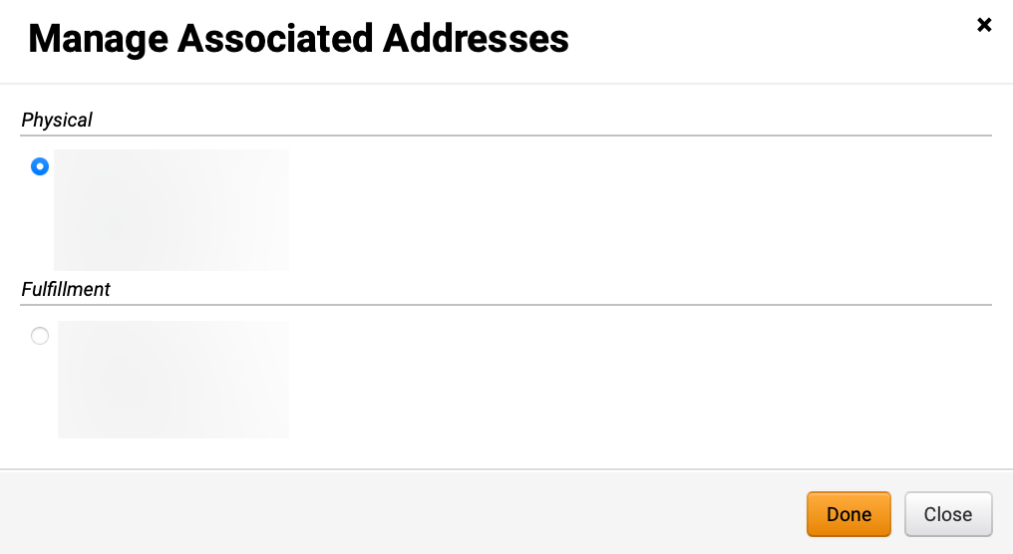
Add/Update Supplier Contacts and Users (Part 17 of 18)
INSTRUCTIONS
Select an option for Address.
Click Done.
50
51

Slide 19
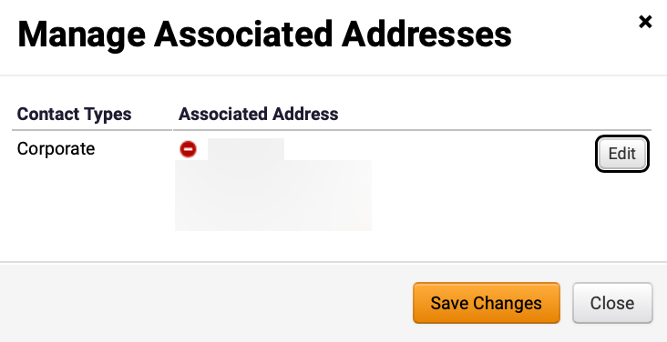


Add/Update Supplier Contacts and Users (Part 18 of 18)
INSTRUCTIONS
Review Associated Address.
Note: Clicking on the Red Remove will remove the associated Address. To manage Addresses, click the Addresses tab.
Click Save Changes.
52
53
Review Success notification.
You have successfully Added/Updated a Supplier Contact.

