Slide 1
View Historical Bid Responses
DESCRIPTION
This guide will show a Supplier how to View Historical Bid Responses in GA@WORK Marketplace for Suppliers, Supplier Portal.
OVERVIEW
The key steps in the process are below:
Access the GA@WORK Marketplace for Suppliers.
Seach Sourcing Events.
Apply Sourcing Event Filters.
The Historical Bid Responses are displayed.
Business Process:
Access Supplier Portal
Search Sourcing Events
Apply Sourcing Event Filters
Historical Bid Responses Displayed

Slide 2
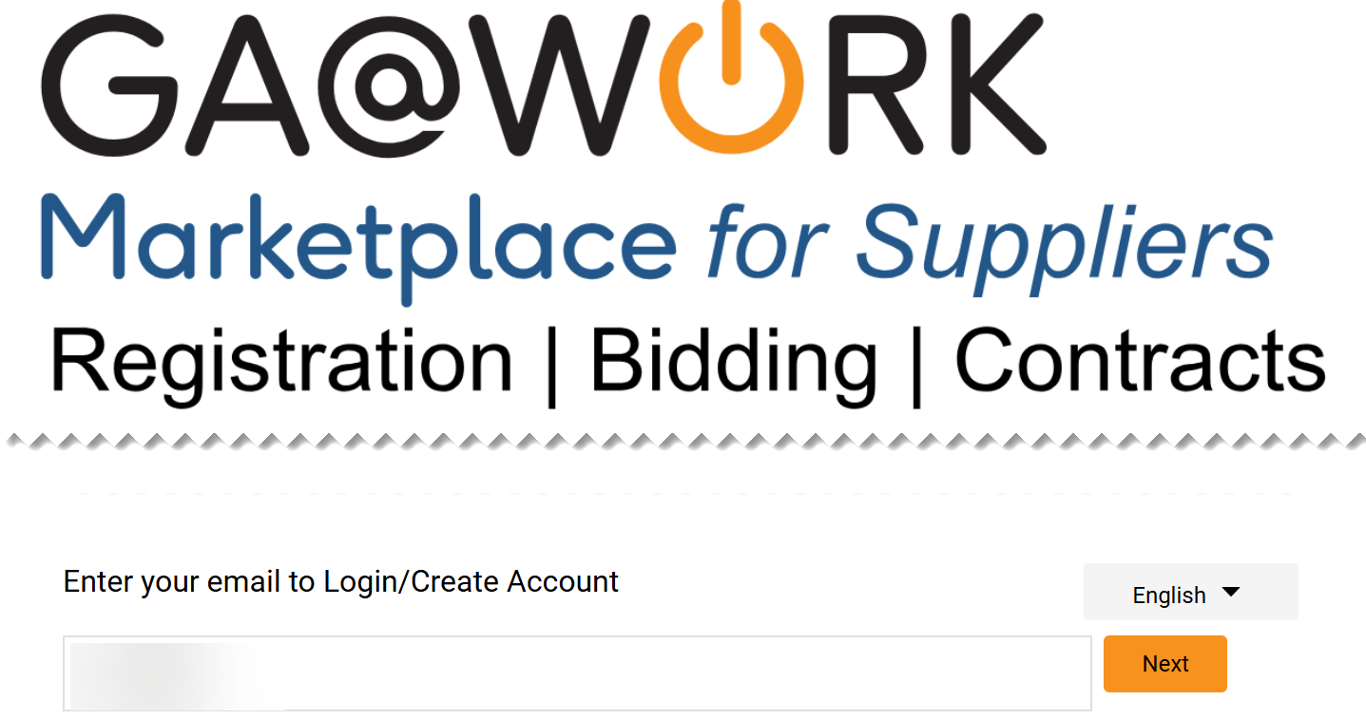
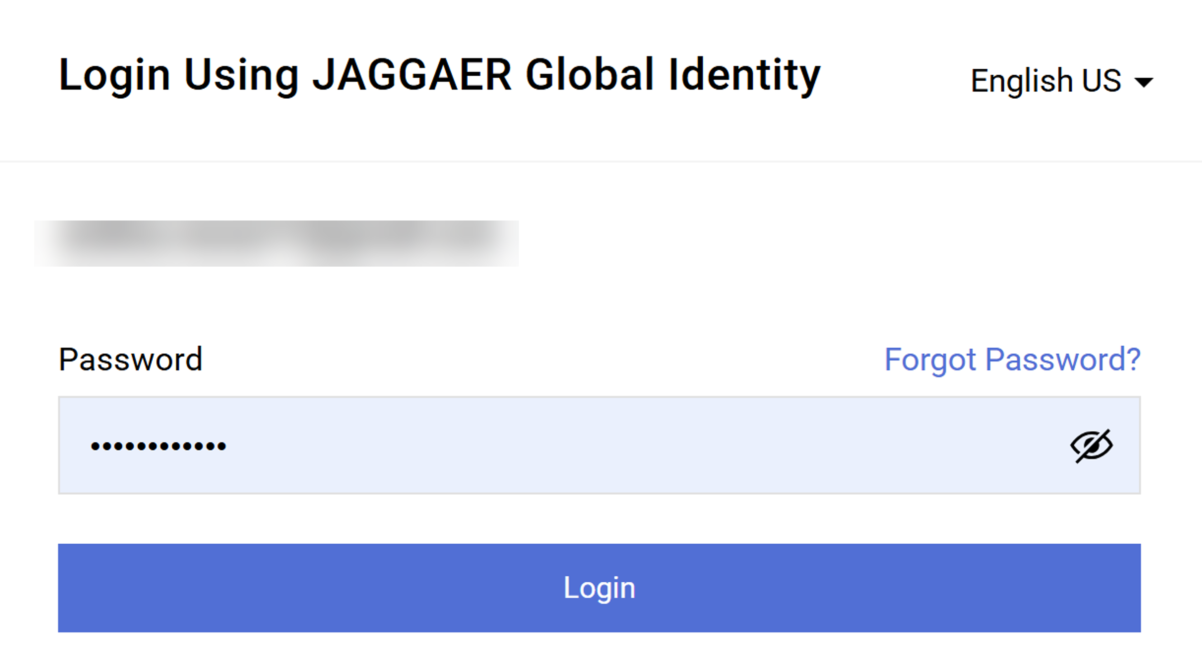
View Historical Bid Responses
(Part 1 of 12)
INSTRUCTIONS
Open GA@WORK Marketplace and enter your email to login.
Note: To log in supplier must have started the registration process in GA@WORK Marketplace for Suppliers.
Click Next.
1
2
Enter your Password.
Click Login.
3
4

Slide 3
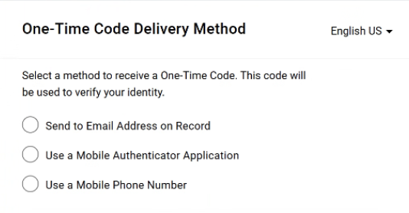
View Historical Bid Responses
(Part 2 of 12)
INSTRUCTIONS
Select a method to receive a One-Time Code.
Note: Only one method can be selected to receive the code. Follow steps 6 – 10 if selecting Send to Email Address on Record. Skip to 11 – 15 if selecting Use a Mobile Authenticator Application or skip to step 16 - 22 if selecting Use a Mobile Phone Number. Once completed, skip to step 23.

Slide 4
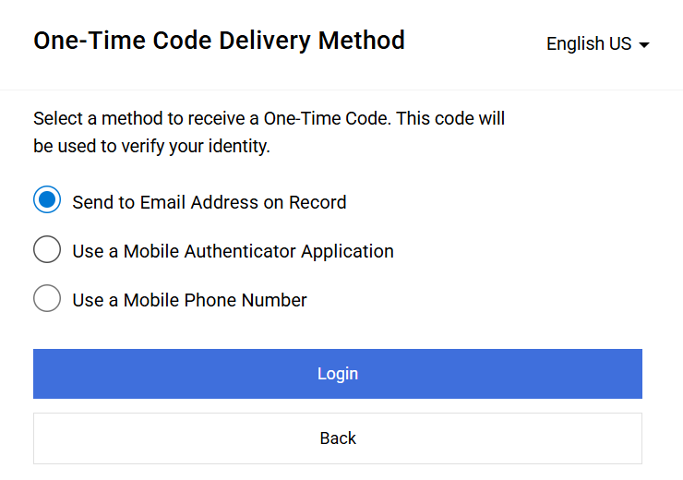
View Historical Bid Responses (Part 3 of 12)
INSTRUCTIONS
Select Send to Email Address on Record.
Click Login
6
7

Slide 5
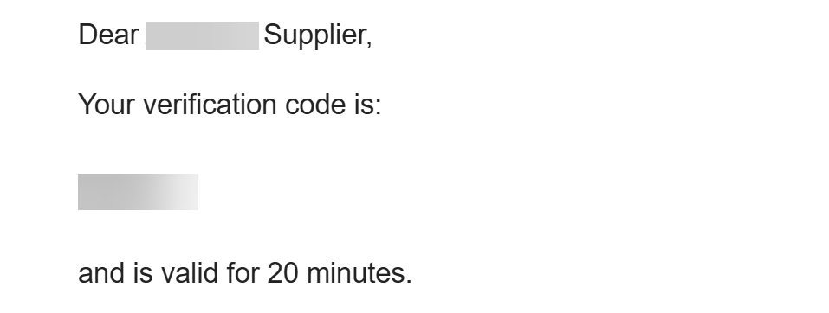
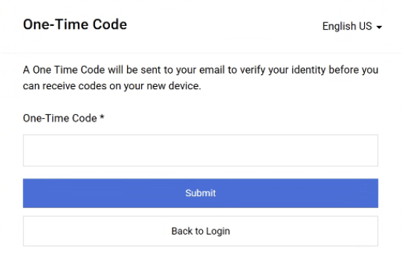
View Historical Bid Responses (Part 4 of 12)
INSTRUCTIONS
Receive and make note of the One-Time Code.
Note: The verification code is only valid for 20 minutes.
In GA@WORK Marketplace, enter your One-Time Code*.
Note: Complete all required fields marked with a black star*.
Click Submit.
Note: Skip to Step 24 to continue.
9
10

Slide 6
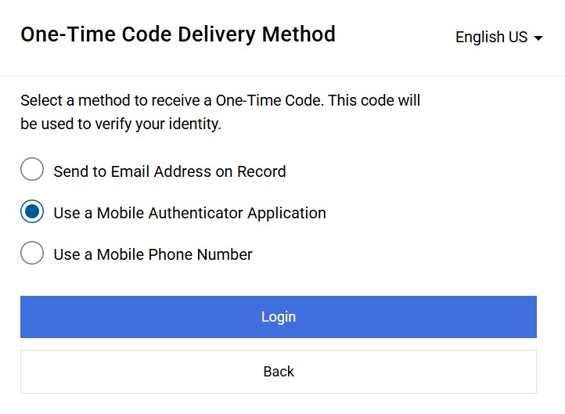
View Historical Bid Responses (Part 5 of 12)
INSTRUCTIONS
Select Use a Mobile Authenticator Application.
Click Login.
11
12

Slide 7
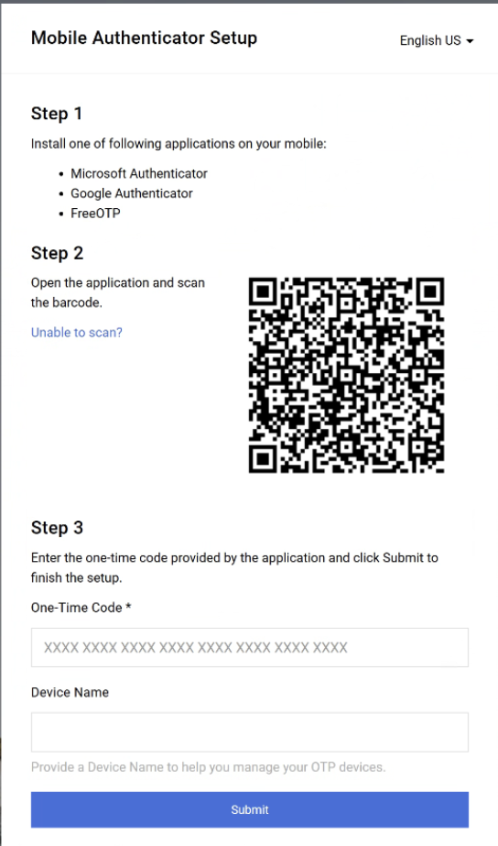
View Historical Bid Responses (Part 6 of 12)
INSTRUCTIONS
Enter One-Time Code*.
Enter Device Name (optional).
Click Submit.
Note: Skip to step 23.
13
14
15

Slide 8
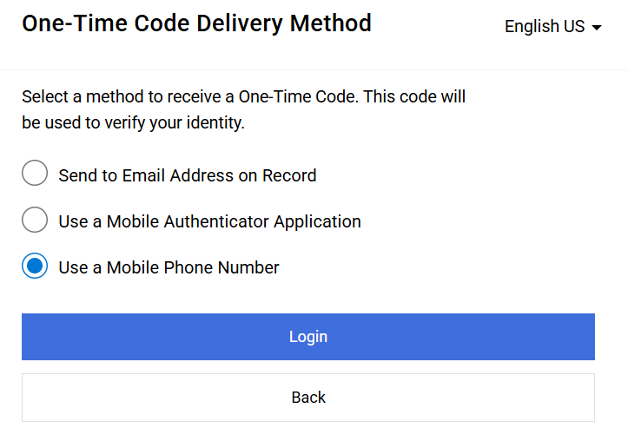
View Historical Bid Responses (Part 7 of 12)
INSTRUCTIONS
Select Use a Mobile Phone Number.
Click Login.
16
17

Slide 9
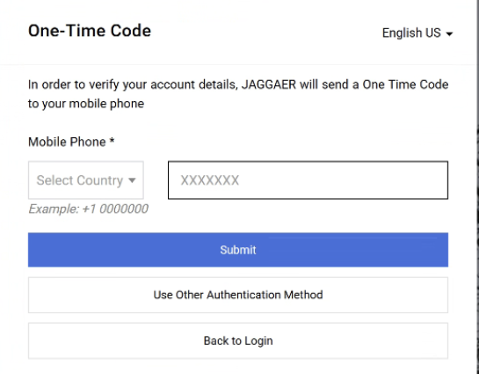
View Historical Bid Responses (Part 8 of 12)
INSTRUCTIONS
Enter Mobile Phone*.
Click Submit.
18
19

Slide 10
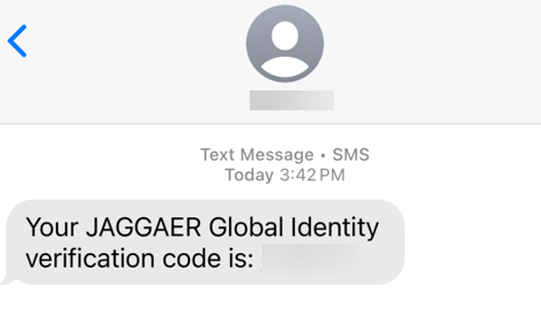
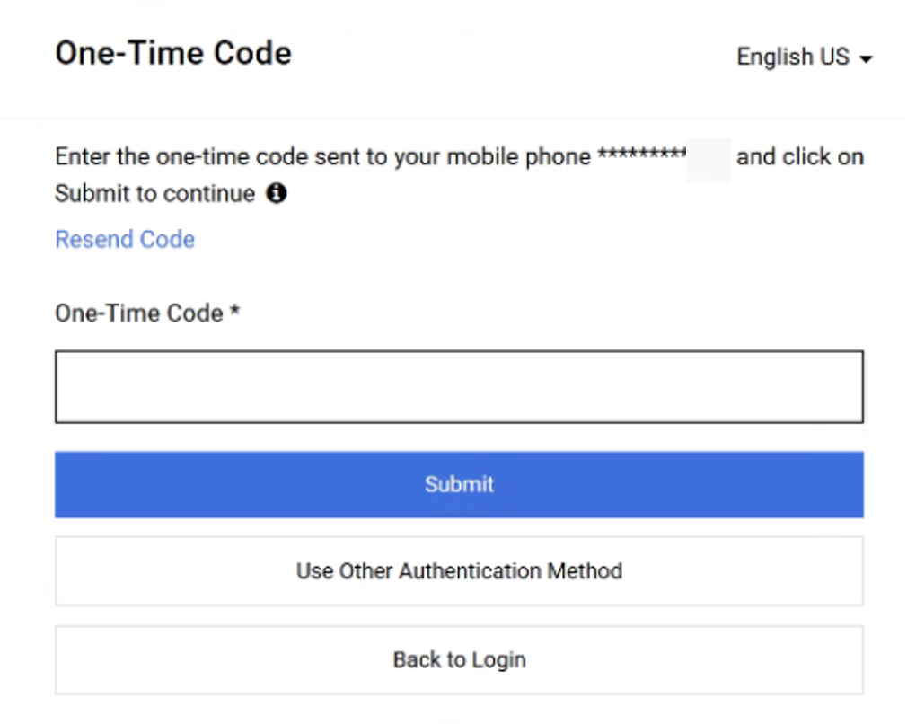
View Historical Bid Responses
(Part 9 of 42)
INSTRUCTIONS
Review Verification Code sent to Mobile Phone.
Note: Message will be received from JAGGAER Global Identity.
In GA@WORK Marketplace, enter your One-Time Code*.
Click Submit.
Note: Skip to step 23.
21
22

Slide 11
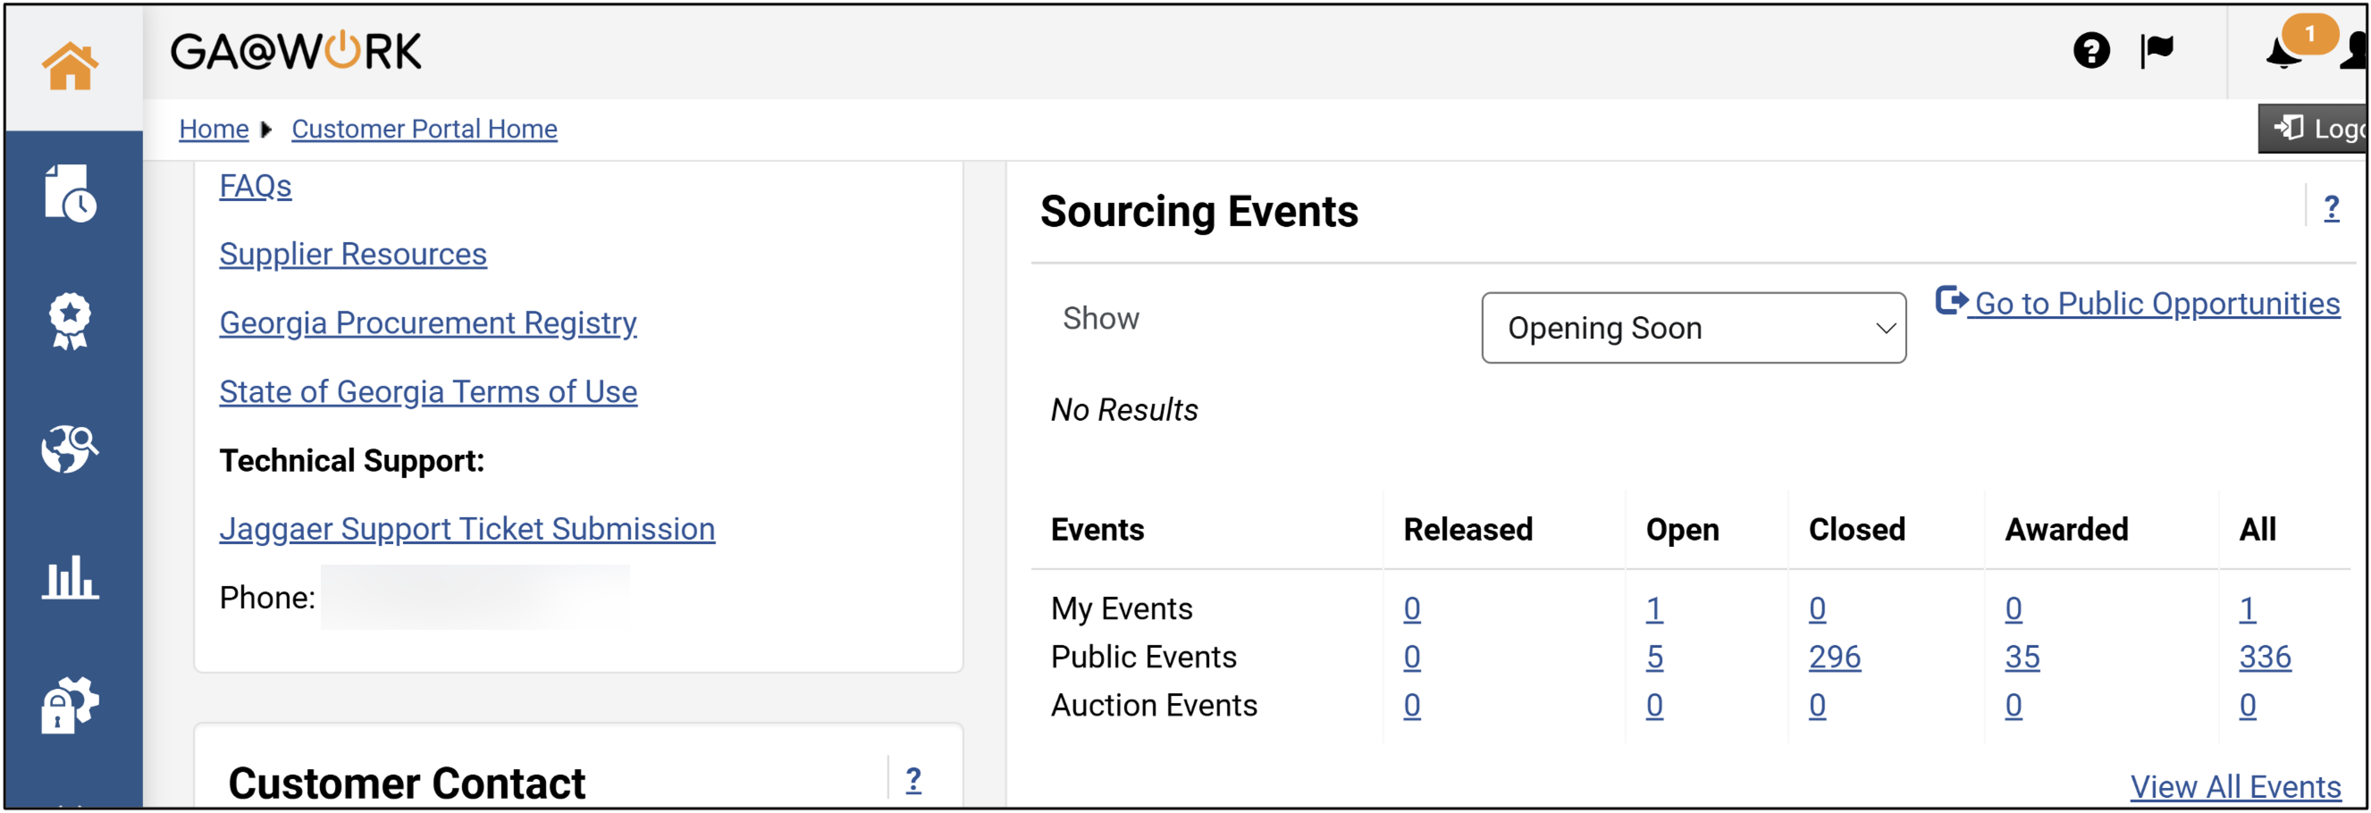
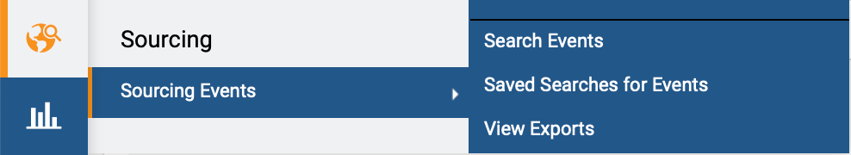
View Historical Bid Responses (Part 10 of 12)
INSTRUCTIONS
View your Homepage.
Access the Sourcing module.
Click Sourcing Events.
Click Search Events.
24
26
25

Slide 12
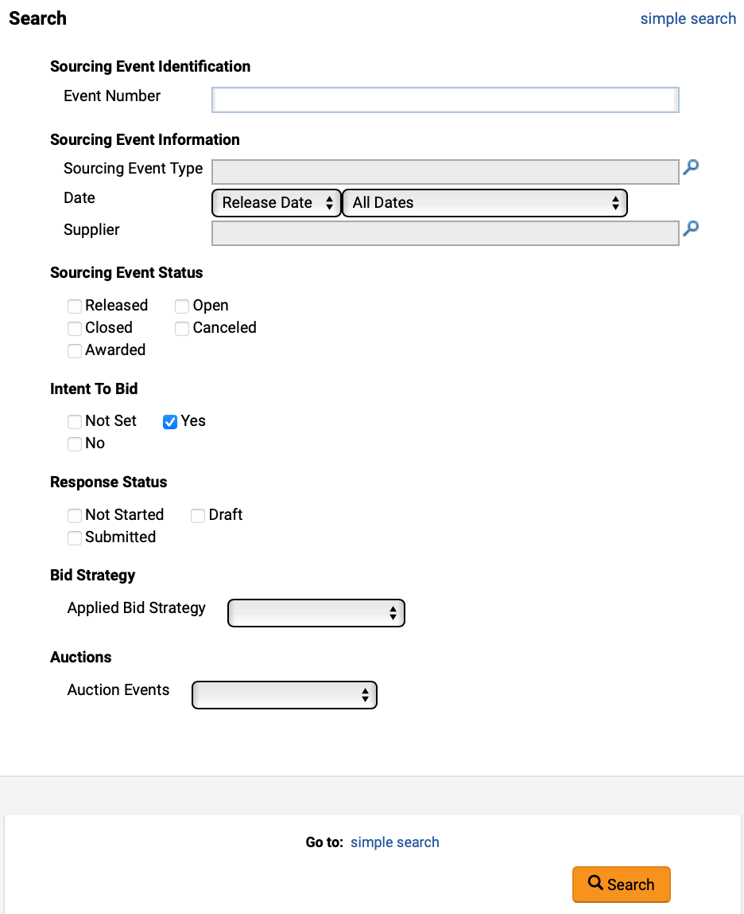
View Historical Bid Responses (Part 11 of 12)
INSTRUCTIONS
Use the Filters to search for Sourcing Events.
Note: Type in the field or use the magnifying glass to search.
Select Yes for Intent to Bid.
Click Search.
27
28
29

Slide 13
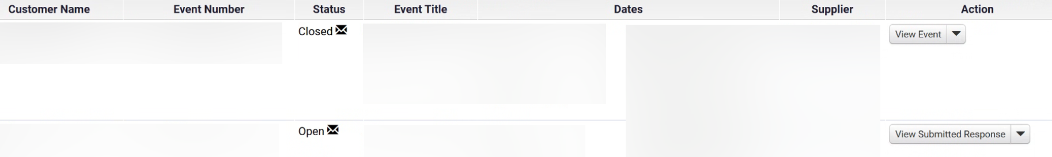

View Historical Bid Responses (Part 12 of 12)
INSTRUCTIONS
Review Search Results.
Click Action to access the Bid.
Note: The Action will depend on the Bid Status.
30
31
You have successfully Viewed Historical Bid Responses.

