Slide 1
Clause Library
DESCRIPTION
This guide will show the Agency Librarian or State Librarian how to manage the Clause Library.
OVERVIEW
The key steps in the process are below:
Access the Contracts module.
Click Clause Library.
Add a Clause.
Complete the Clause.
Business Process:
Access Contracts Module
Click Libraries
Add Clause
Complete Clause

Slide 2
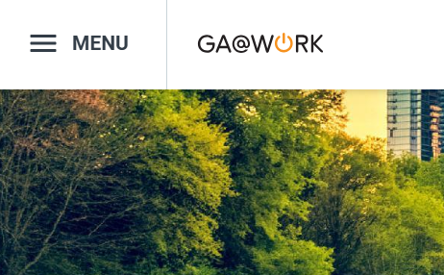

Clause Library (Part 1 of 19)
INSTRUCTIONS
Click the Global Navigation Menu.
Note: University System of Georgia (USG) users complete local logon and then proceed to Step 4.
Click Sourcing, Contracts & Supplier Management.

Slide 3

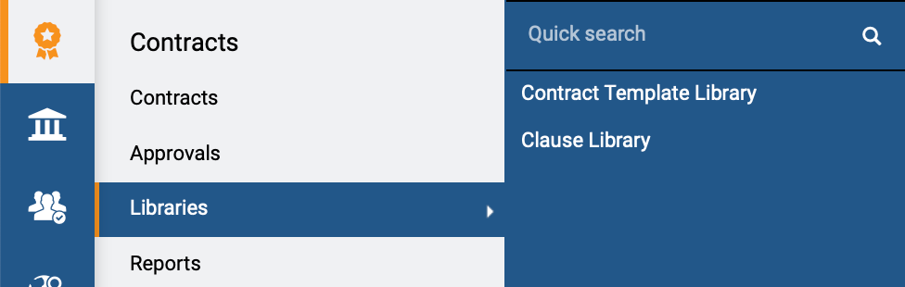
Clause Library (Part 2 of 19)
INSTRUCTIONS
Click Sign On.
Note: The system utilizes Single Sign-On (SSO) capabilities
and no log in information is required.
Access the Contracts module.
Click Libraries.
Click Clause Library.
4
6
5

Slide 4
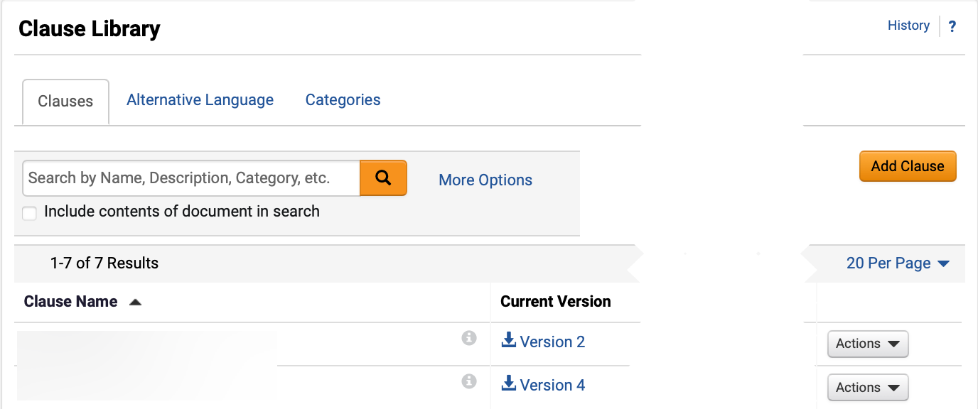
Clause Library (Part 3 of 19)
INSTRUCTIONS
Click Add Clause.

Slide 5
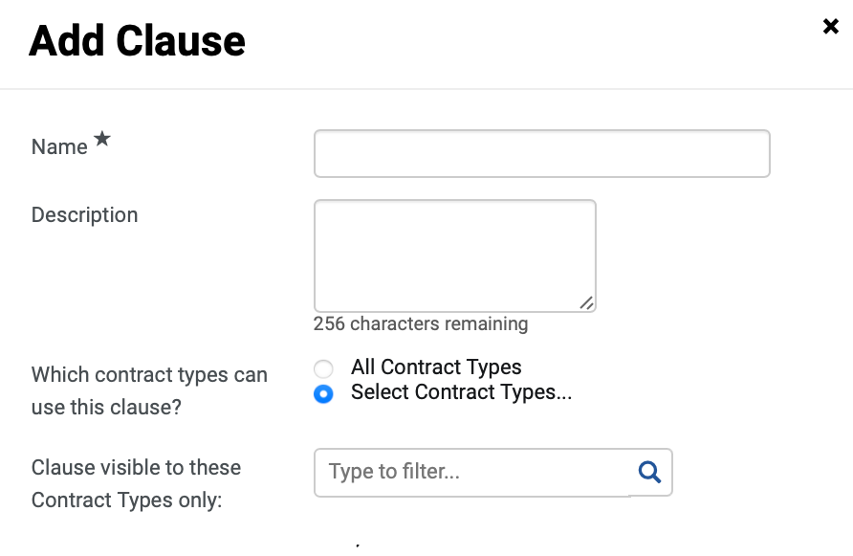
Clause Library (Part 4 of 19)
INSTRUCTIONS
Enter a Name*.
Note: Complete all required fields marked with a black star*.
Enter a Description (optional).
Select Which contract types can use this clause?.
Note: Click Select Contract Types… to filter clauses visible to specific Contract Types only.
Select an option for Clause visible to these Contract Types only.
Note: Use the magnifying glass to search and add multiple Contract Types.
8
9
10
11

Slide 6
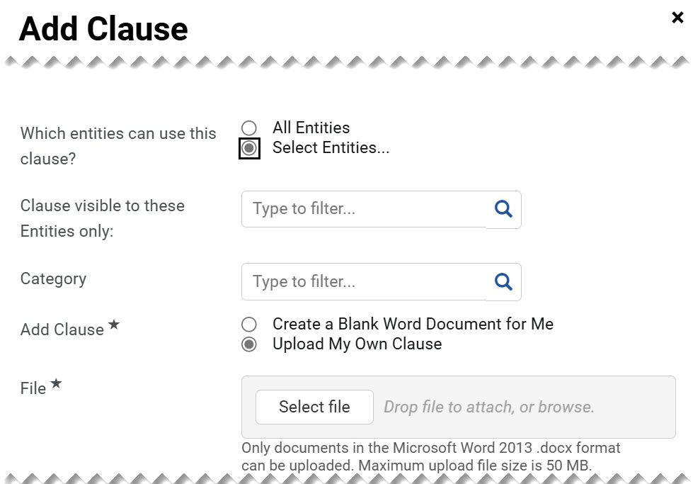
Clause Library (Part 5 of 19)
INSTRUCTIONS
Select an option for Which entities can use this clause?.
Note: Click Select Entities… to filter clauses visible to specific Contract Entities only.
Select an option for Clause visible to these Entities only.
Note: Use the magnifying glass to search and add Entities.
Select a Category (optional).
Note: Enter in the field or use the magnifying glass to search.
Select an option for Add Clause*.
Note: Follow steps 16 – 19 to Upload My Own Clause. If Create a Blank Word Document for Me is selected, skip to step 20.
Select the applicable File*.
12
13
14
15
16

Slide 7

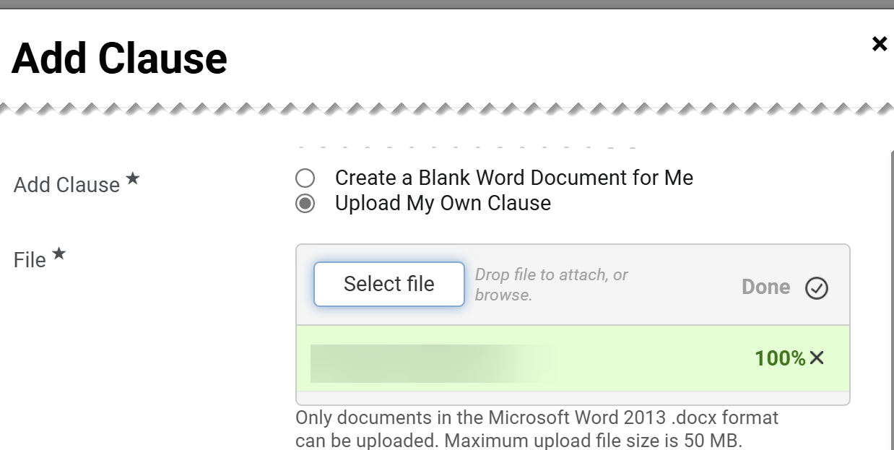
Clause Library (Part 6 of 19)
INSTRUCTIONS
Select a File from local computer.
Click Open.
Note: The file will open in Microsoft Word. Make changes to the document and save it where you can find it to upload.
17
18
Confirm that the uploaded File* is visible.

Slide 8
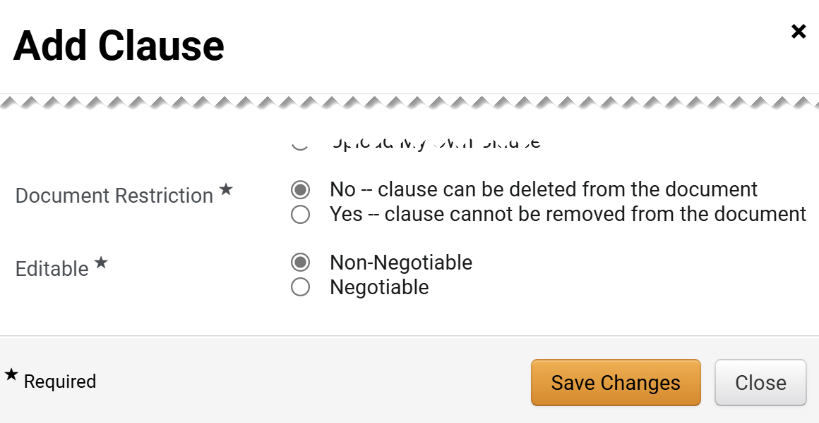
Clause Library (Part 7 of 19)
INSTRUCTIONS
Select an option for Document Restriction*.
Select an option for Editable*.
Click Save Changes.
20
21
22

Slide 9
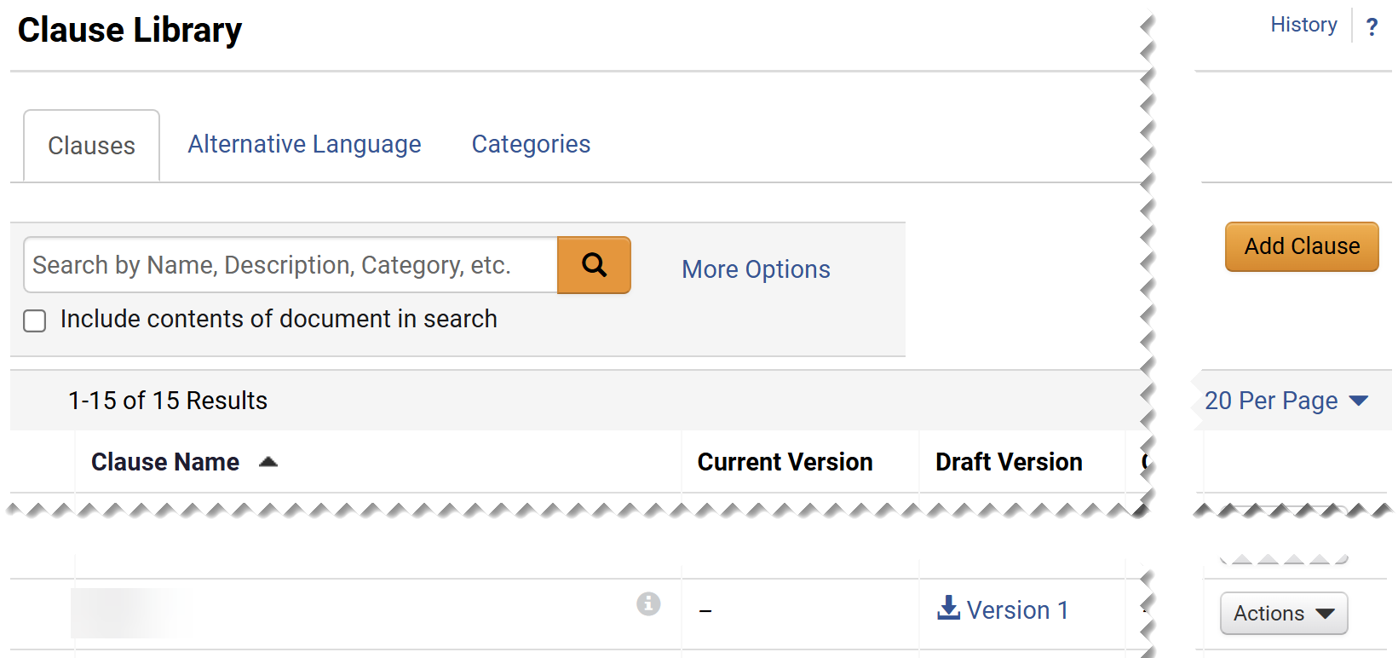
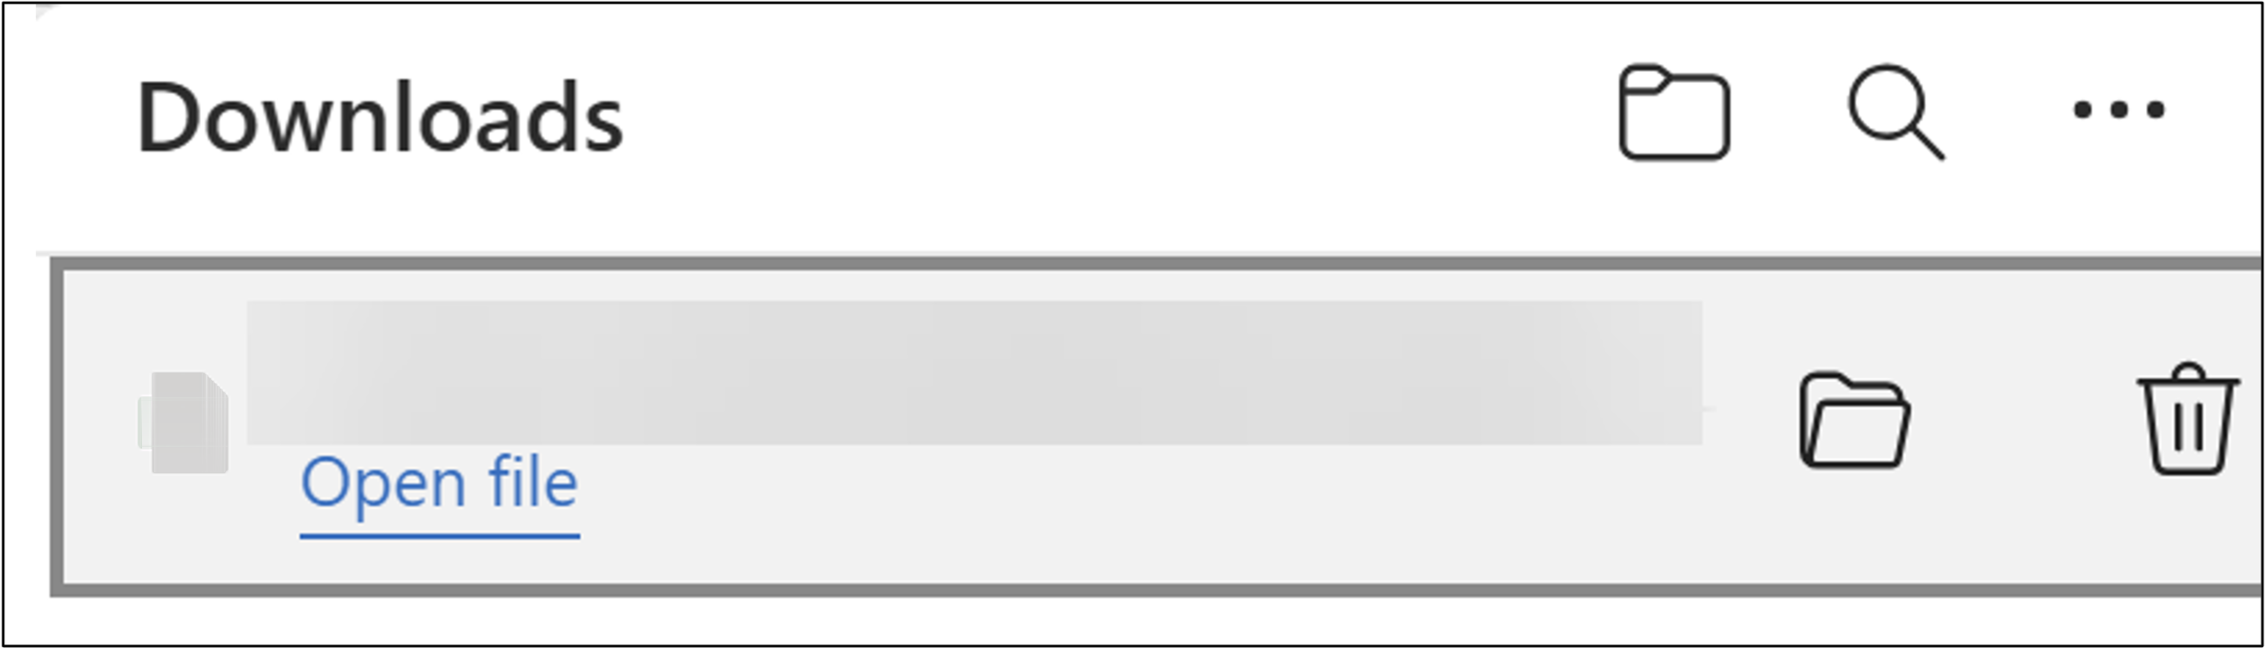
Clause Library (Part 8 of 19)
INSTRUCTIONS
Click the Clause Draft Version hyperlink.
Click Open File.
Note: The file will open in Microsoft Word. Enable making changes to the document.

Slide 10
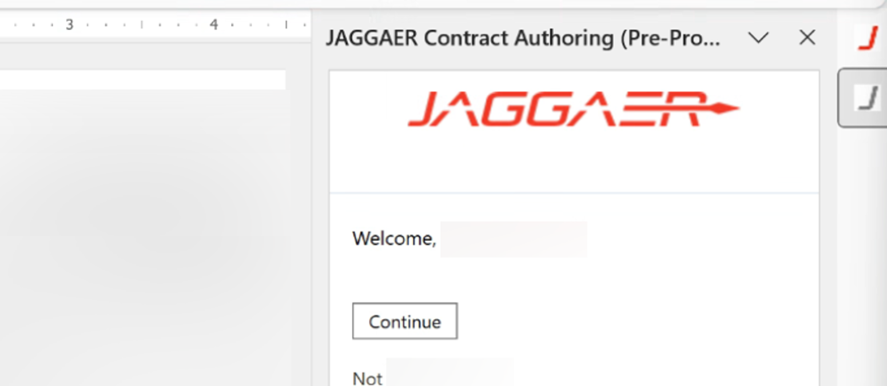
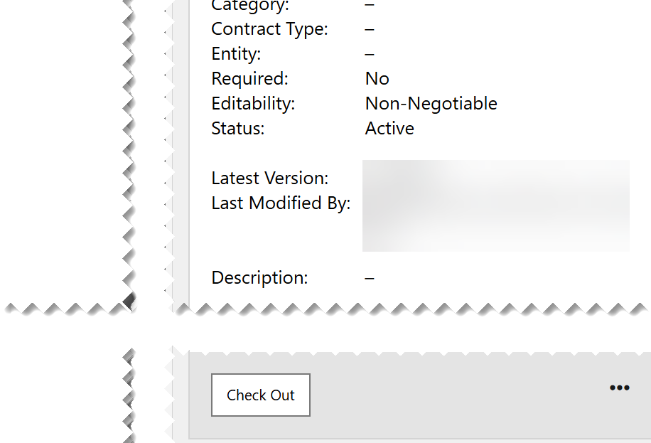
Clause Library (Part 9 of 19)
INSTRUCTIONS
Click JAGGAER.
Click Continue.
25
26
Click Check Out.

Slide 11
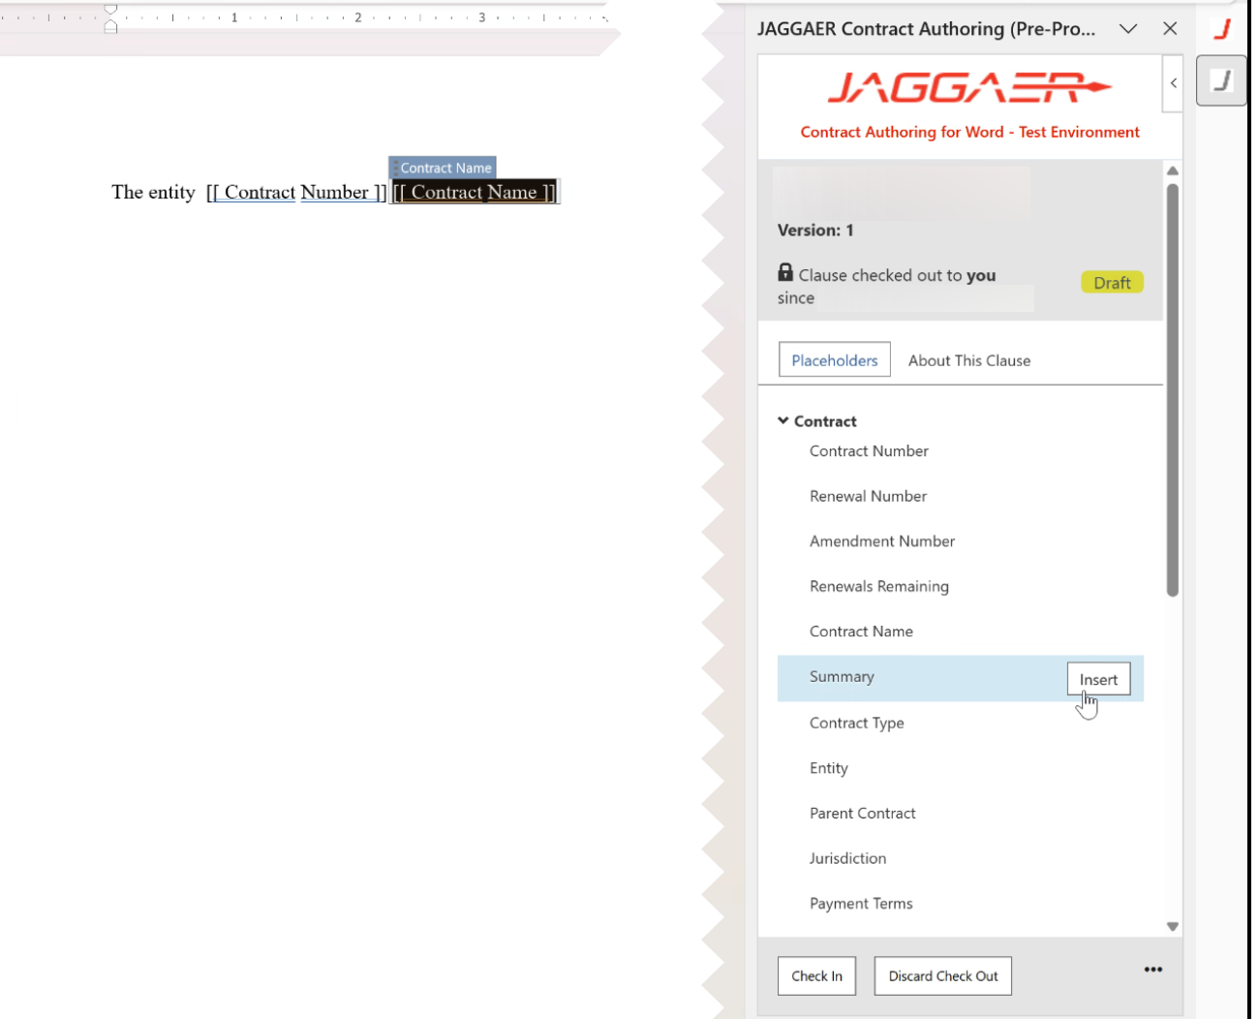
Clause Library (Part 10 of 19)
INSTRUCTIONS
Click Insert.
Note: Selecting Insert will bring the information over from the system and populate it in the Clause once selected within a contract.
Click Check In.
28
29

Slide 12
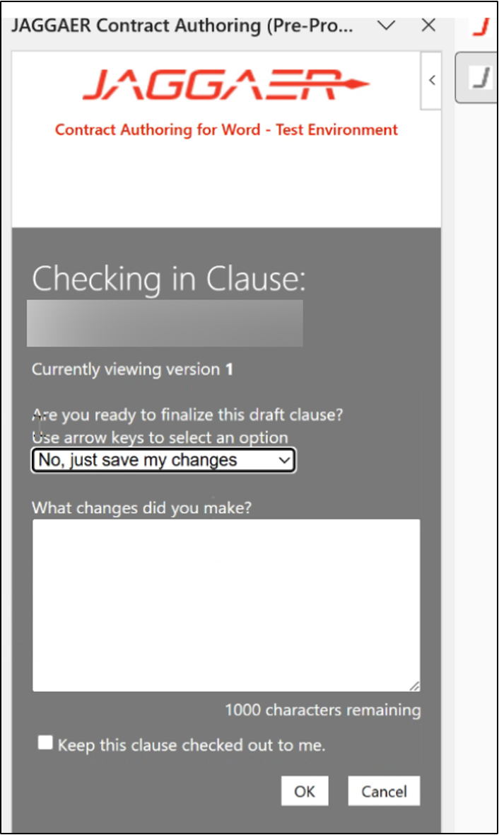
Clause Library (Part 11 of 19)
INSTRUCTIONS
Select an option for Are you ready to finalize this draft clause?.
Note: Selecting Yes, save and finalize now will finalize a clause.
Enter What changes did you make? (optional).
Click OK.
30
31
32

Slide 13
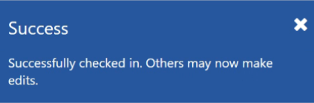
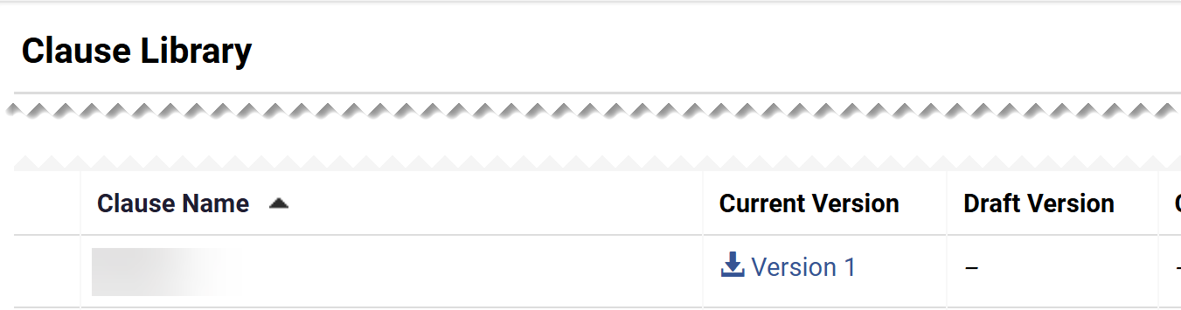
Clause Library (Part 12 of 19)
INSTRUCTIONS
Review the Success notification.
Note: Don’t save to desktop. Document will reflect changes made once opened in step 34. Draft can also be finalized through JAGGAER Add-In in Microsoft Word.
Confirm that the published Clause Name is the Current Version.
Note: Current Version number will change.

Slide 14
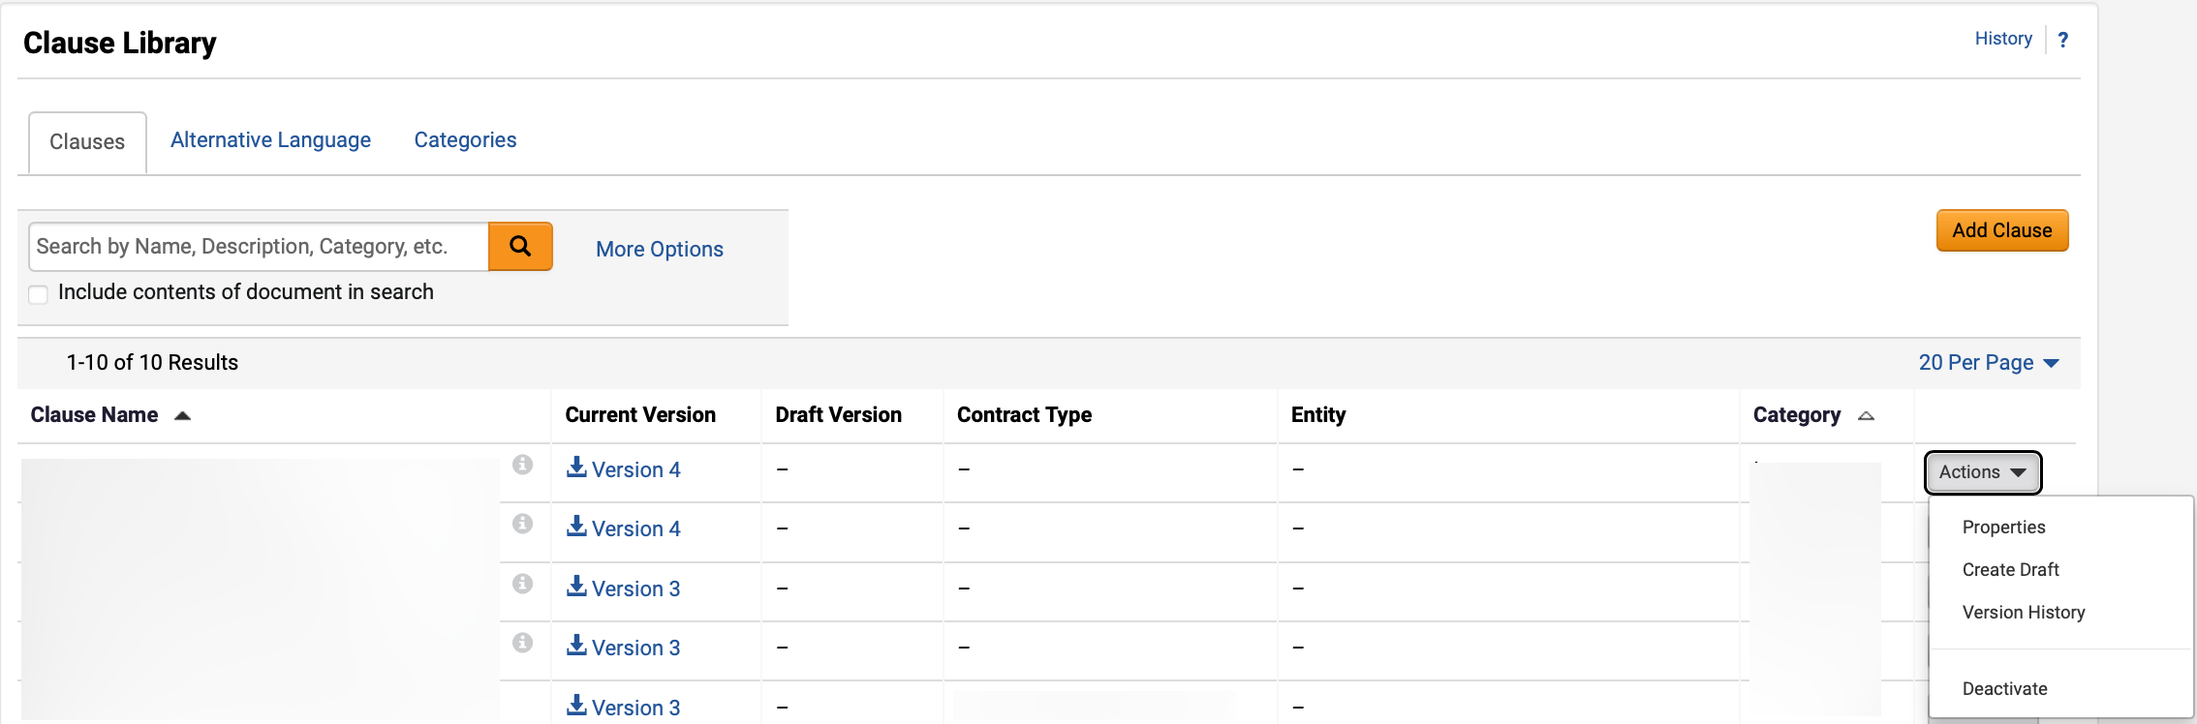
Clause Library (Part 13 of 19)
INSTRUCTIONS
Use the Clause Library table to learn more about each field in the section.
 | ​
Clause Library Field
Description
Actions
Open clause actions.
Actions > Properties
Able to edit clause properties; name, description, which contract types and entities can use the clause, document restriction, and editable fields.
Actions > Create Draft
Able to create draft version of the document.
Actions > Version History
Able to view and download version history of the document, view effective date, last modified date, changed by, comments, and compare clause sections.
Actions > Deactivate
Able to deactivate clause.
Action > Finalize Draft
Able to select to finalize the clause. Only visible once a draft has been created.

Slide 15
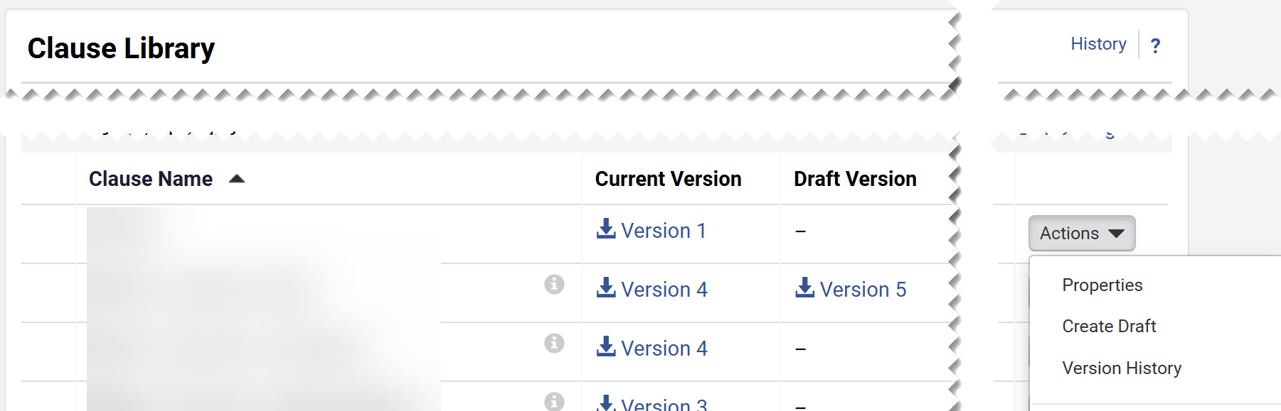
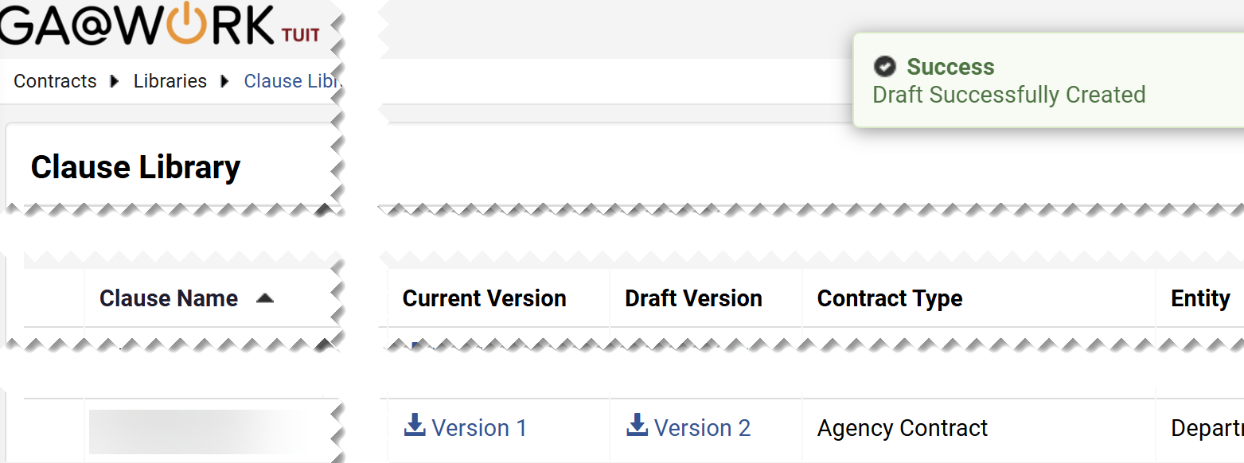
Clause Library (Part 14 of 19)
INSTRUCTIONS
Click Create Draft in the Actions menu.
Click the Draft Version link.

Slide 16
Clause Library (Part 15 of 19)
INSTRUCTIONS
Click Open File.
Note: The file will open in Microsoft Word. Enable making changes to the document.

Slide 17
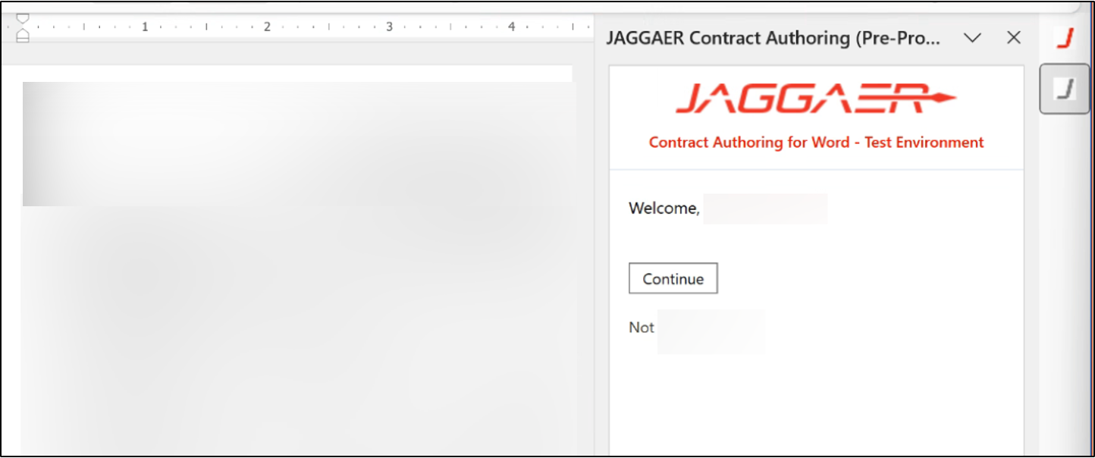
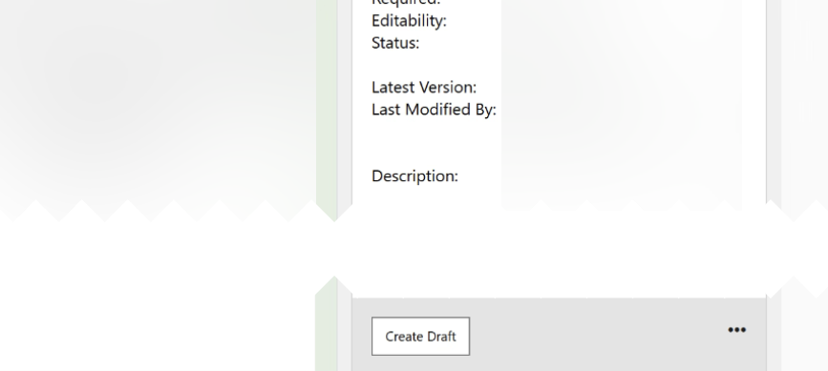
Clause Library (Part 16 of 19)
INSTRUCTIONS
Click JAGGAER.
Click Continue.
39
40
Click Create Draft.

Slide 18
Clause Library (Part 17 of 19)
INSTRUCTIONS
Click Insert.
Note: Selecting Insert will bring the information over from the system and will be filled in the Clause once selected within a contract.
Click Check In.
42
43

Slide 19
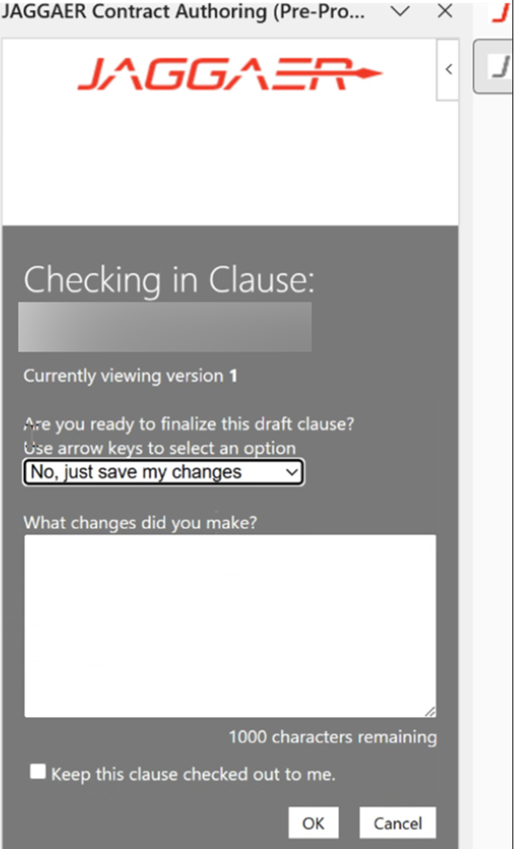
Clause Library (Part 18 of 19)
INSTRUCTIONS
Select an option for Are you ready to finalize this draft clause?.
Note: Selecting Yes, save, and finalize now will finalize a clause.
Enter What changes did you make? (optional).
Click OK.
44
45
46

Slide 20
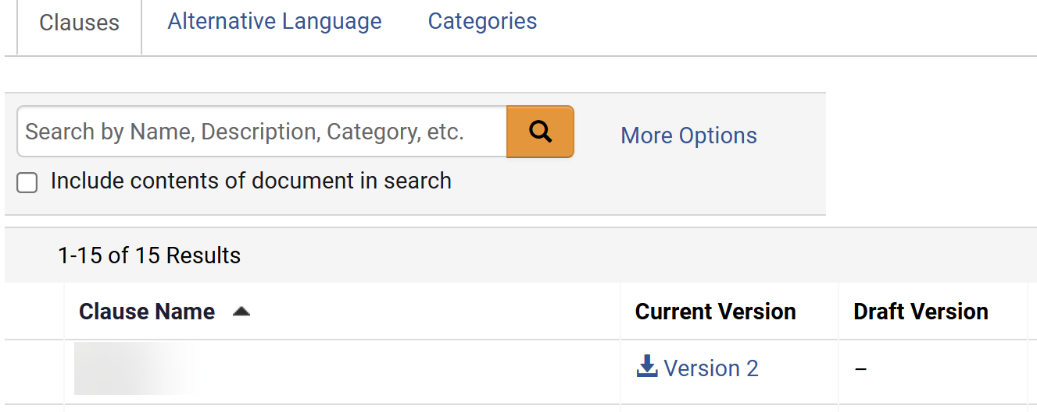

Clause Library (Part 19 of 19)
INSTRUCTIONS
Review the Success notification.
Note: Don’t save to desktop. Document will reflect changes made once opened in step 48. Draft can also be finalized through JAGGAER Add-In in Microsoft Word.
Confirm that the published Clause Name is the Current Version.
Note: The Current Version number will change.
You have successfully managed a Clause Library.

