Slide 1
Contract
Communications and Notifications
DESCRIPTION
This guide will show the Contract Administrator how to manage Contract Communications and Notifications.
OVERVIEW
The key steps in the process are below:
Access the Contracts module.
Search Contracts.
Add Communications and Notifications.
Action Complete.
Business Process:
Access Contracts Module
Search Contracts
Add Communications and Notifications
Action Complete
Disclaimer: Due to regular system updates, the screens and features in GA@WORK may differ slightly from those shown in this job aid. For questions or assistance, please contact the Help Desk.

Slide 2


Contract Communications and Notifications - Communications (Part 1 of 10)
INSTRUCTIONS
Click the Global Navigation Menu.
Note: University System of Georgia (USG) users complete local logon and then proceed to Step 4.
Click Sourcing, Contracts & Supplier Management.
Notes:
Link for USG log in: <insert link>
For log in issues, users should go to Agency Super User first. Call Help Desk if needed. T1 should know (have a list) log in selections to advise user of correct selection to make.
If the app, Sourcing, Contracts & Supplier Management, is not in the list of apps, click on the Add Apps button at the bottom, find the Sourcing, Contracts, & Supplier Management app, then click on the + to add it to your list of Apps.

Slide 3

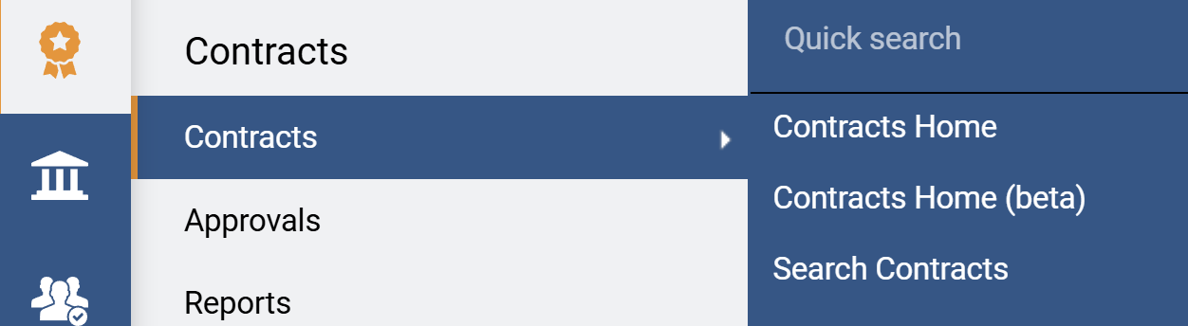
Contract Communications and Notifications - Communications (Part 2 of 10)
INSTRUCTIONS
Click Sign On.
Note: The system utilizes Single Sign-On (SSO) capabilities
and no log in information is required.
To review communication, click the Contracts module.
Click Contracts.
Click Search Contracts.
4
5
6
Notes:
Clicking Sign on will take the user out of GA@WORK and into the GA@WORK Marketplace.
Click on Contracts, then Search Contracts.

Slide 4
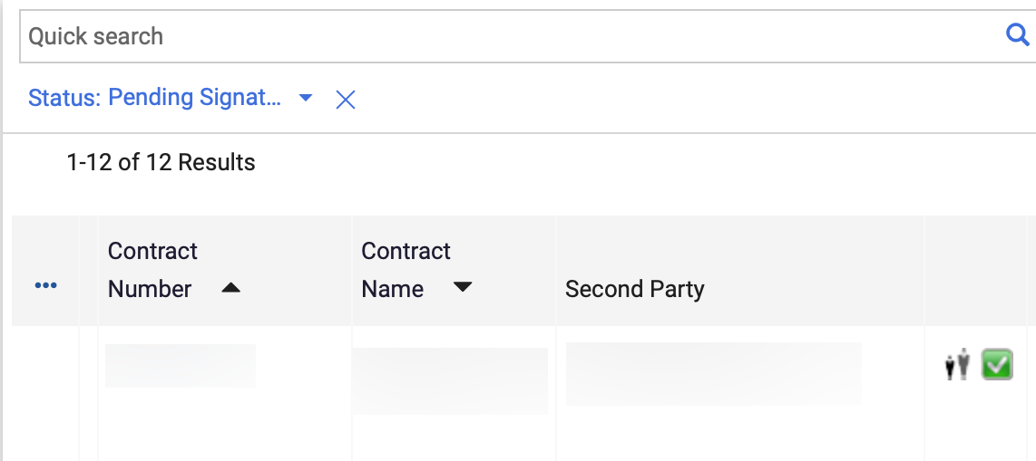
Contract Communications and Notifications - Communications (Part 3 of 10)
INSTRUCTIONS
Click the applicable Contract Number.
Note: Use the Quick Search and Filters to find the contract.
Notes:
Use Quick Search and Filters to find the desired contract.
Click on the Contract Number hyperlink.

Slide 5
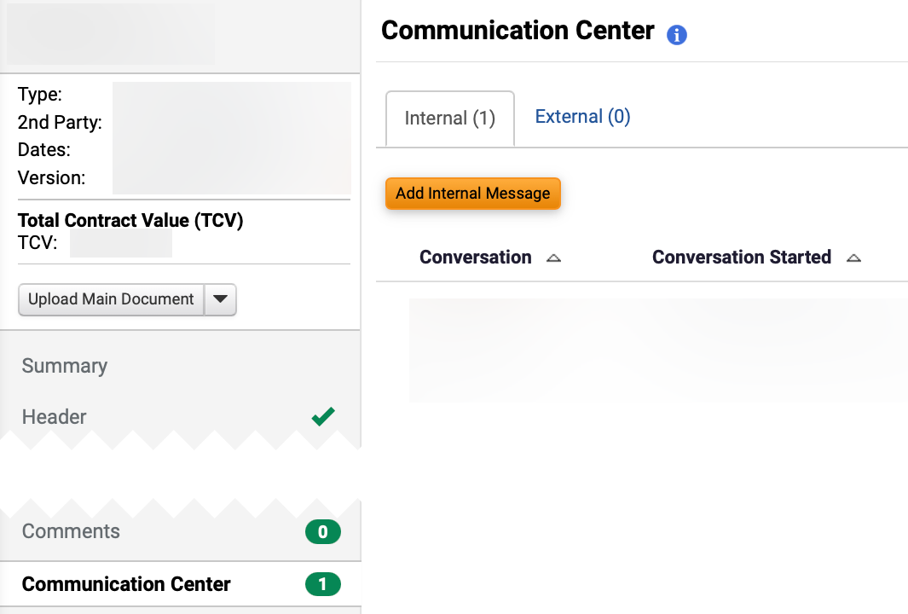
Contract Communications and Notifications - Communications (Part 4 of 10)
INSTRUCTIONS
Click Communication Center.
Select Internal.
Note: Click anywhere on the Conversation field to open the most recent Internal Message. Follow steps 16 - 23 to Start External Communication.
Click Add Internal Message.
9
10
8
Notes:
From the left contract menu, click on Communication Center.
To send an internal message, click on the Internal tab and then the Add Internal Message button.

Slide 6
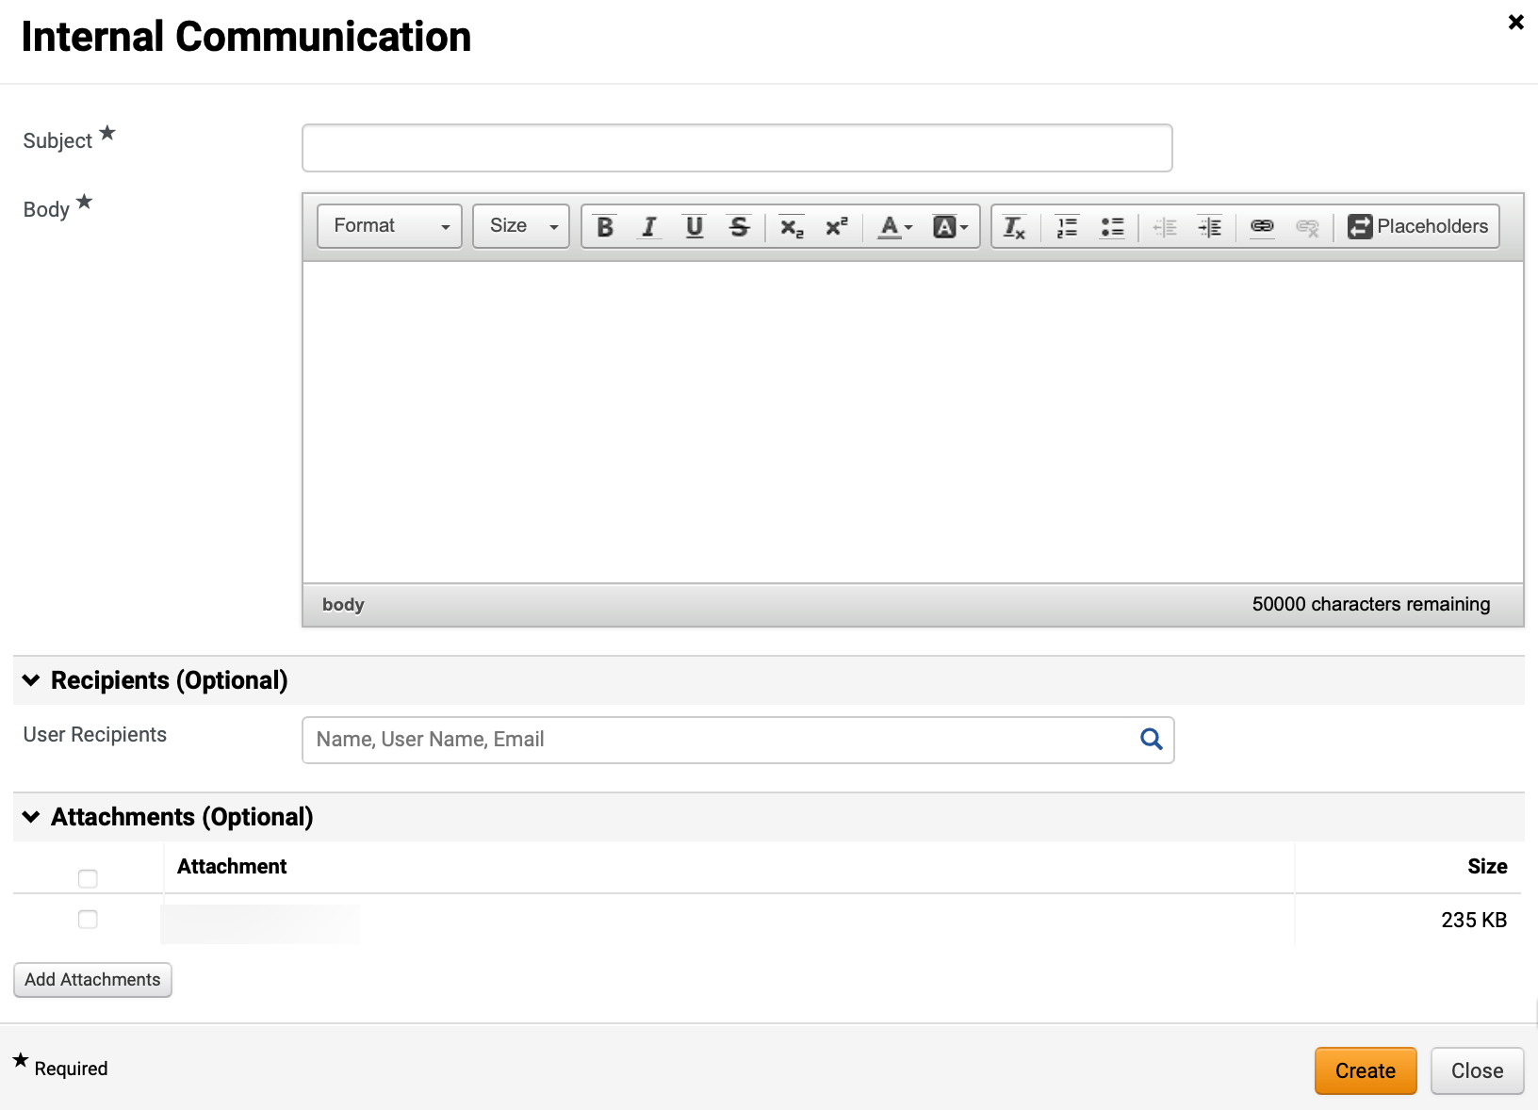
Contract Communications and Notifications - Communications (Part 5 of 10)
INSTRUCTIONS
Enter a Subject*.
Note: Complete all required fields marked with a black star *.
Enter desired information in Body*.
Select applicable User Recipients.
Click Add Attachments, as applicable.
Click Create.
11
12
13
14
15
Notes:
Enter a Subject, type in the body of the message.
Under Recipients users to receive the email can be selected.
This message can also include Attachments from the contract. Click on Attachments, then check the box next to the attachment to include with the email.

Slide 7
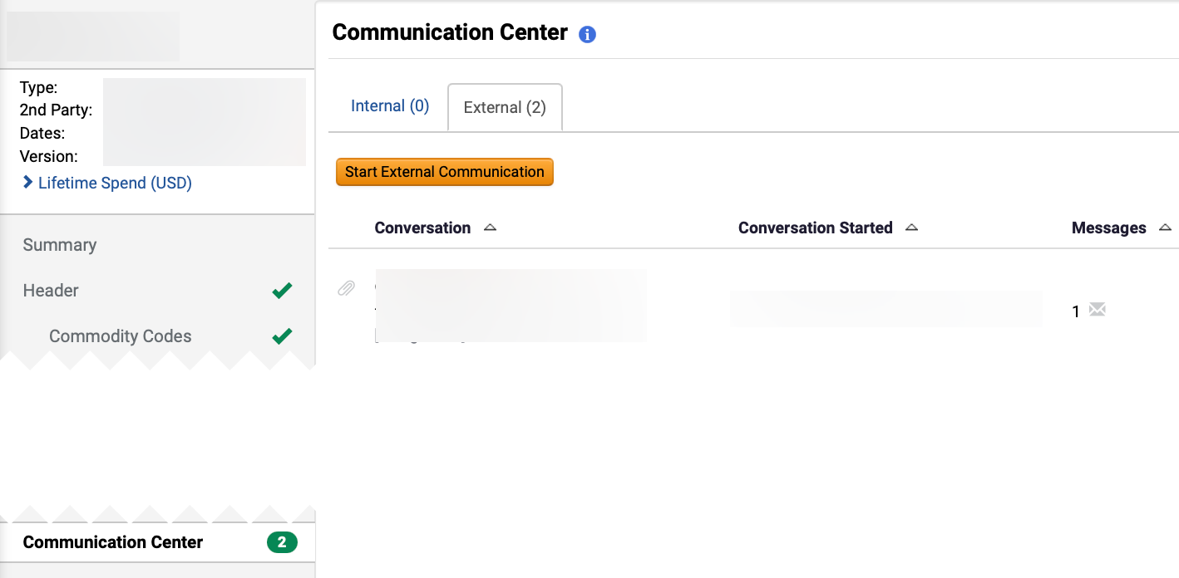
Contract Communications and Notifications - Communications (Part 6 of 10)
INSTRUCTIONS
Click Communication Center.
Select External.
Note: Click anywhere on the Conversation field to open most recent External Message.
Click Start External Communication.
17
18
16
Notes:
The same can be done for external users in the same was as internal users.
Click on the External tab, click on Start External Communication.

Slide 8
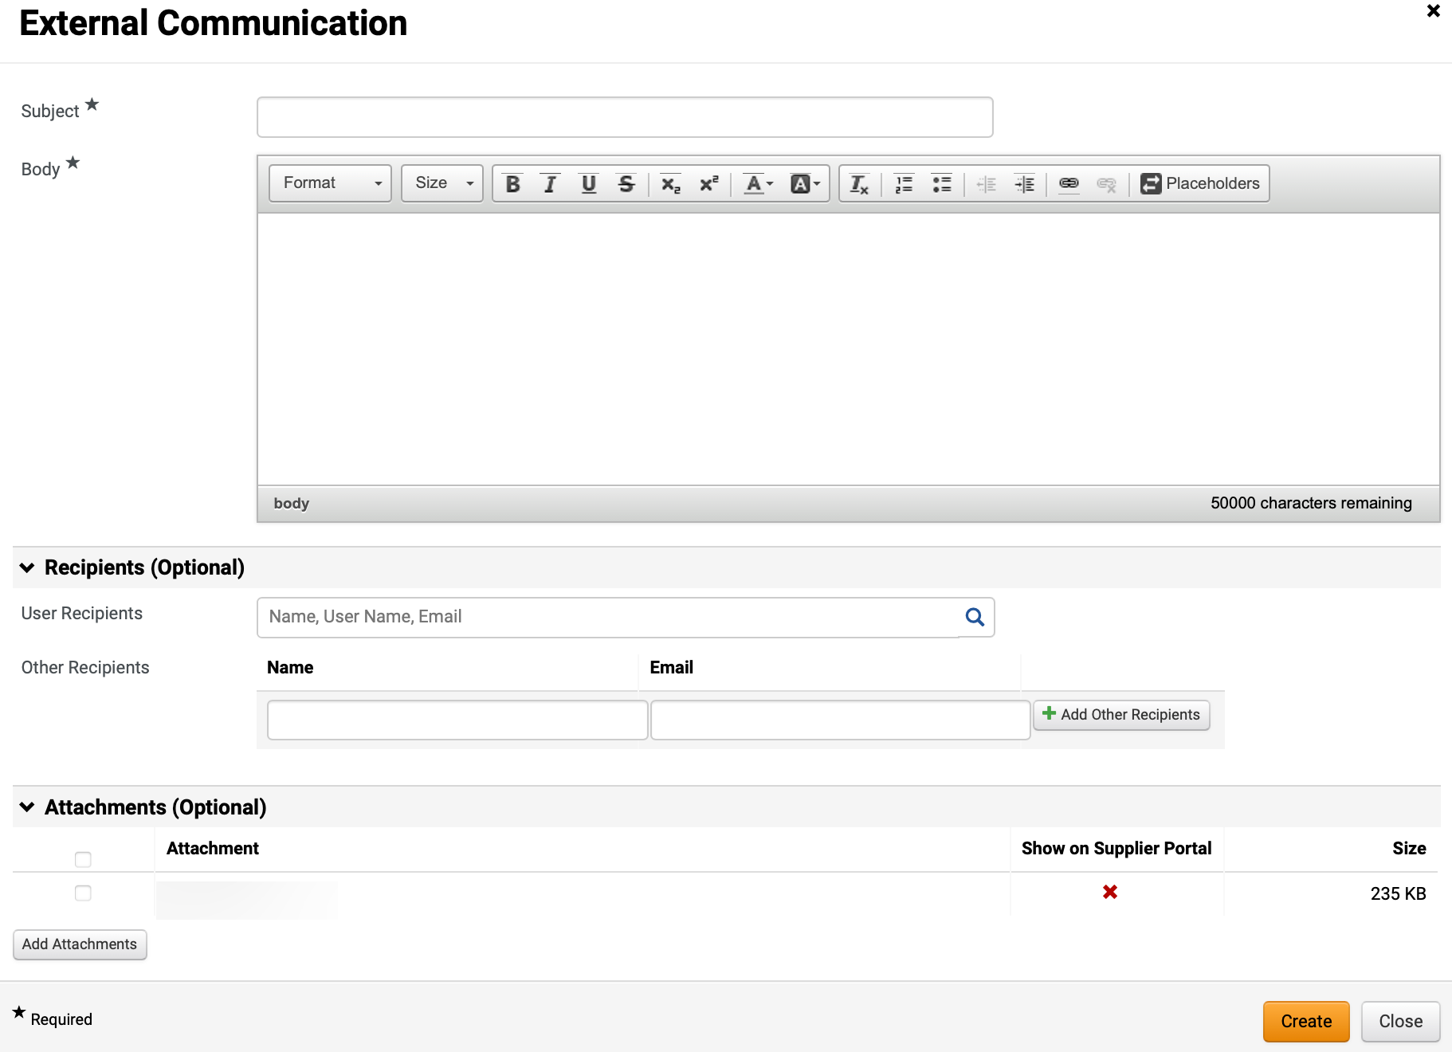
Contract Communications and Notifications - Communications (Part 7 of 10)
INSTRUCTIONS
Enter a Subject*.
Enter a Body*.
Select applicable User Recipients and Other Recipients (optional).
Select Add Attachments, as applicable.
Click Create.
19
20
21
22
23
Notes:
Enter the subject, the body, and recipient information.
Check any attachments from the contract that need to be included.
Click Create.

Slide 9
Contract Communications and Notifications - Communications (Part 8 of 10)
INSTRUCTIONS
Click Conversation Center.
Note: Click anywhere on the Conversation field to open most recent message.
Review Internal and External Communication.
25
24
Notes:
Email communication can be reviewed by going back to the Communication Center from the left contract menu and then clicking on either the Internal or External tab.
Double-click on a communication to open it to review the communication.

Slide 10
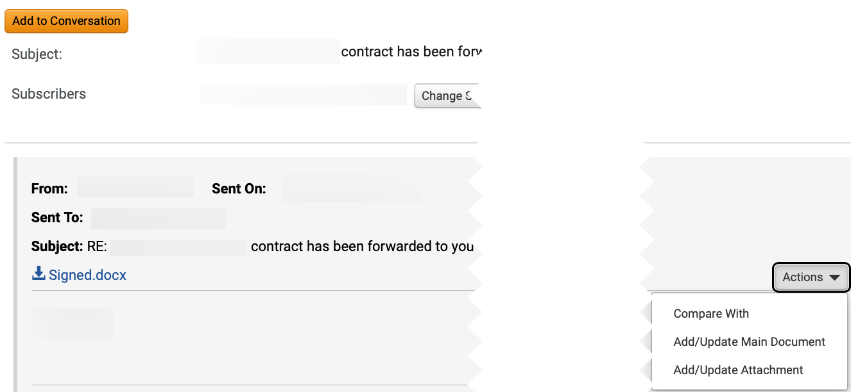
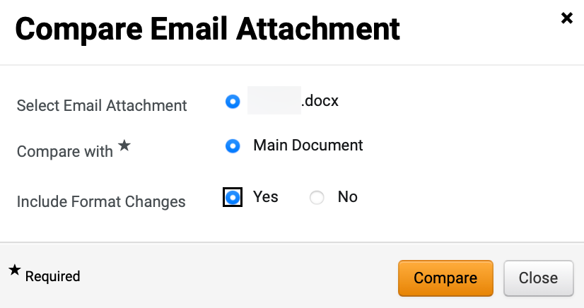
Contract Communications and Notifications - Communications (Part 9 of 10)
INSTRUCTIONS
Click Actions.
Click Compare With.
26
27
Select Yes for Include Format Changes.
Note: Select Email Attachment and Compare with* fields will auto-populate.
Click Compare.
28
29
Notes:
If the email contained an attachment for the recipient to review and make changes to, then a comparison can be made with the attachment the recipient was sent and the attachment the recipient sent back.
From the Actions menu, select Compare With.

Slide 11
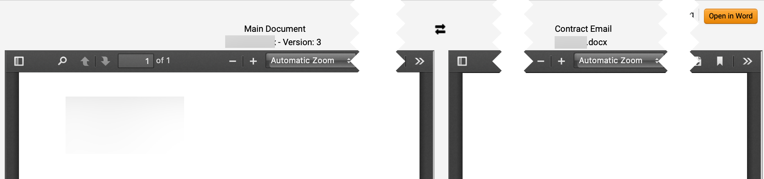
Contract Communications and Notifications - Communications (Part 10 of 10)
INSTRUCTIONS
Review the document changes.
Note: Compare browser window will open. Click Open in Word to open file in Microsoft Word. Review and close the Compare browser window.
You have successfully reviewed Contract Communications. Continue to the next section for Notifications.
Notes:
A Compare browser window will open. Open the file in Word. When complete, close the compare browser window.

Slide 12
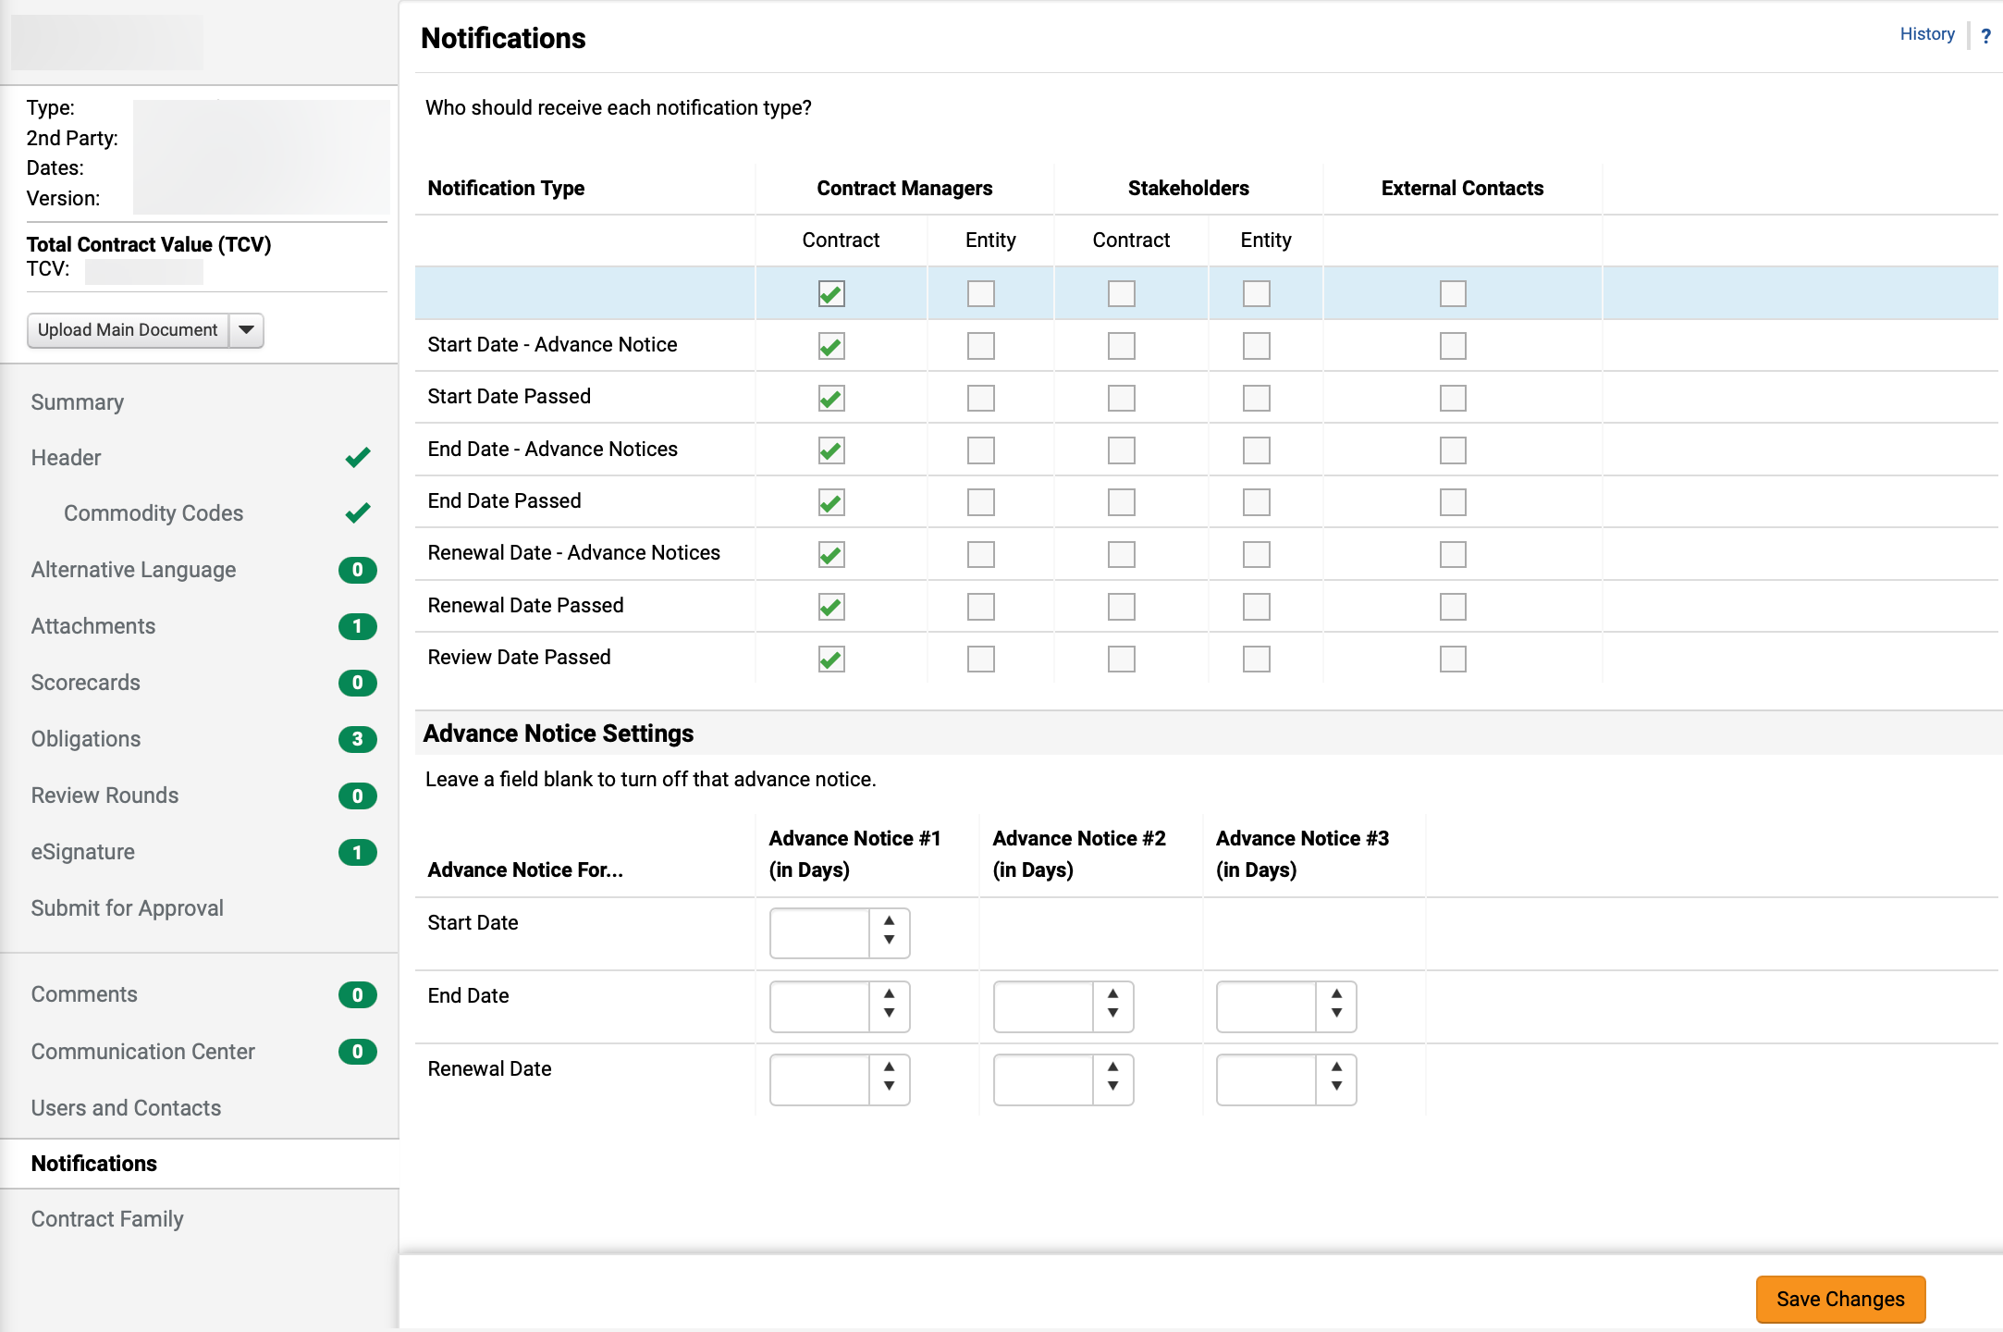
Contract Communications and Notifications - Notifications (Part 1 of 1)
INSTRUCTIONS
To review notifications, click Notifications.
Check applicable recipients under Notification Type.
Note: Click the checkbox under the stakeholder group to select the checkbox in the entire column.
Select the applicable Advance Notice Settings.
Click Save Changes.
2
3
1
4
You have successfully reviewed Notifications.

