Slide 1
Create and Manage
Contract Obligations
DESCRIPTION
This guide will show the Contract Administrator how to Create and Manage Contract Obligations.
OVERVIEW
The key steps in the process are below:
Access the Contracts module.
Search Contracts.
Add Obligations.
Click Mark as Complete.
Business Process:
Access Contracts Module
Search Contracts
Add
Obligations
Click Mark as Complete
Disclaimer: Due to regular system updates, the screens and features in GA@WORK may differ slightly from those shown in this job aid. For questions or assistance, please contact the Help Desk.

Slide 2


Create and Manage Contract Obligations
(Part 1 of 15)
INSTRUCTIONS
Click the Global Navigation Menu.
Note: University System of Georgia (USG) users complete local logon and then proceed to Step 4.
Click Sourcing, Contracts & Supplier Management.

Slide 3

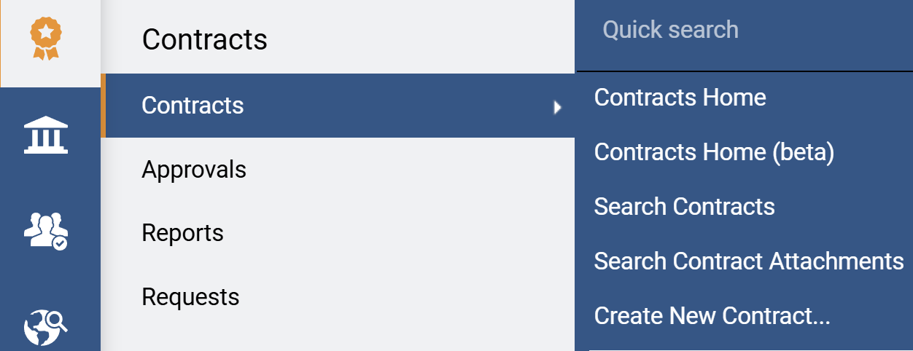
Create and Manage Contract Obligations
(Part 2 of 15)
INSTRUCTIONS
Click Sign On.
Note: The system utilizes Single Sign-On (SSO) capabilities
and no log in information is required.
To add an Obligation, access the Contracts module.
Click Contracts.
Click Search Contracts.
4
5
6

Slide 4
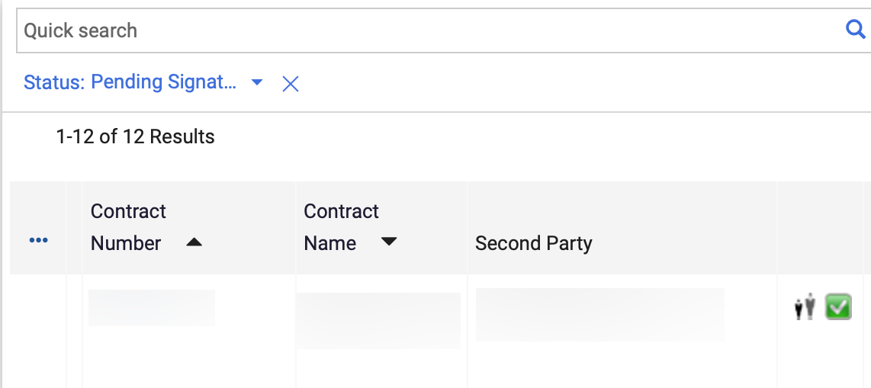
Create and Manage Contract Obligations
(Part 3 of 15)
INSTRUCTIONS
Click the Contract Number.
Note: Use the Quick Search and Filters to find the contract.

Slide 5
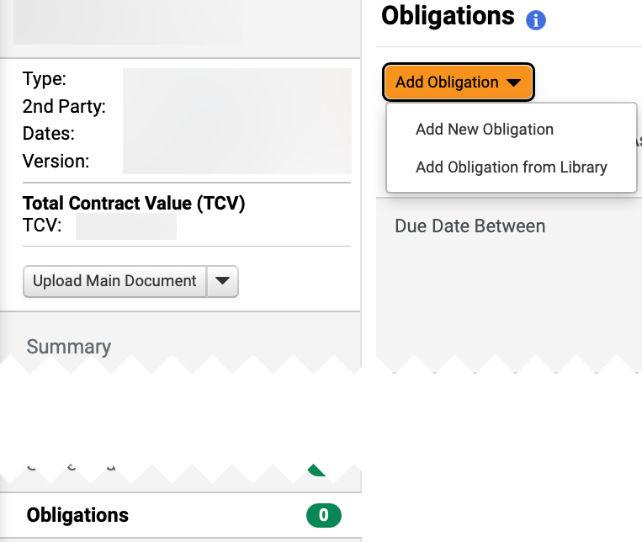
Create and Manage Contract Obligations
(Part 4 of 15)
INSTRUCTIONS
Click Obligations.
Click Add Obligation.
Click Add New Obligation.
Note: Select Add Obligation from Library to choose existing Obligation.
9
10
8

Slide 6
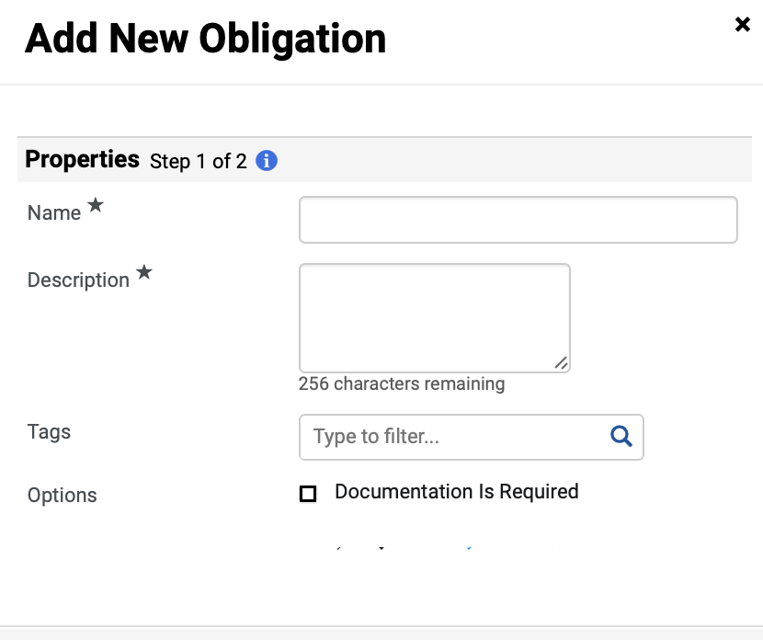
Create and Manage Contract Obligations
(Part 5 of 15)
INSTRUCTIONS
Enter a Name*.
Note: Complete all required fields marked with a black star *.
Enter a Description*.
Select the applicable Tags.
Note: Enter in the field or use the magnifying glass to search.
Check Documentation is Required next to Options, if applicable.
11
12
13
14

Slide 7
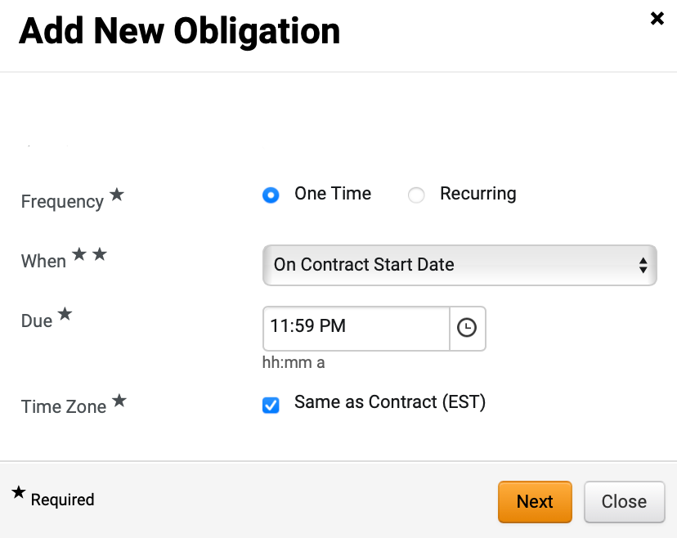
Create and Manage Contract Obligations
(Part 6 of 15)
INSTRUCTIONS
Select an option for Frequency*.
Note: If One Time is selected, continue to Step 16. If Recurring is selected, skip to Step 20.
Select When**.
Select an option for Due*.
Check Same as Contract (EST), if applicable for Time Zone*.
Click Next.
15
16
17
18
19

Slide 8
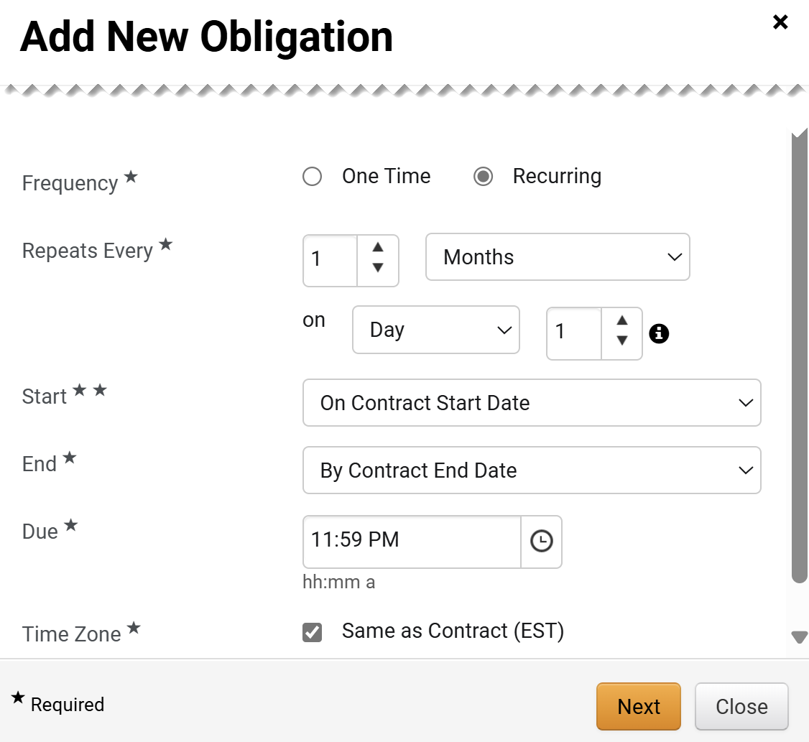
Create and Manage Contract Obligations
(Part 7 of 15)
INSTRUCTIONS
Select an option for Repeats every*.
Select Start**.
Select End*.
Select an option for Due*.
Check Same as Contract (EST), if applicable for Time Zone*.
Click Next.
20
21
22
23
24
25

Slide 9
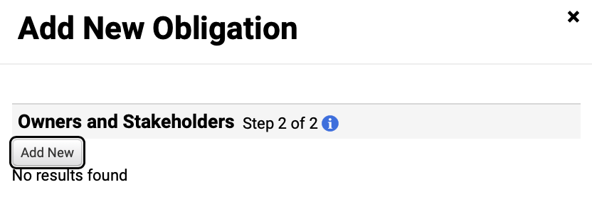
Create and Manage Contract Obligations
(Part 8 of 15)
INSTRUCTIONS
Click Add New.

Slide 10
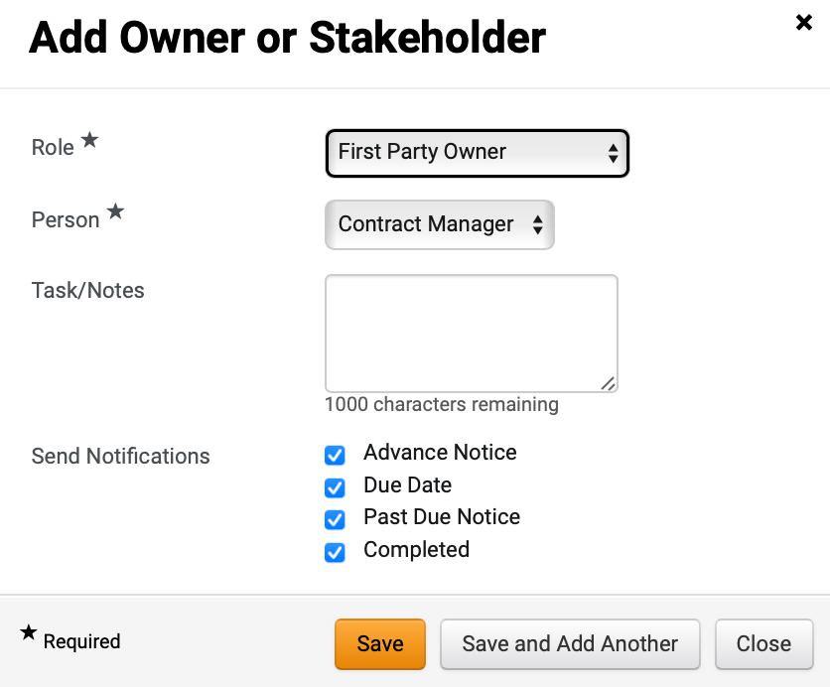
Create and Manage Contract Obligations
(Part 9 of 15)
INSTRUCTIONS
Select a Role*.
Select a Person*.
Enter Task/Notes.
Check options for Send Notifications, as applicable.
Click Save.
Note: Click Save and Add Another to add multiple Owners or Stakeholders.
27
28
29
30
31

Slide 11
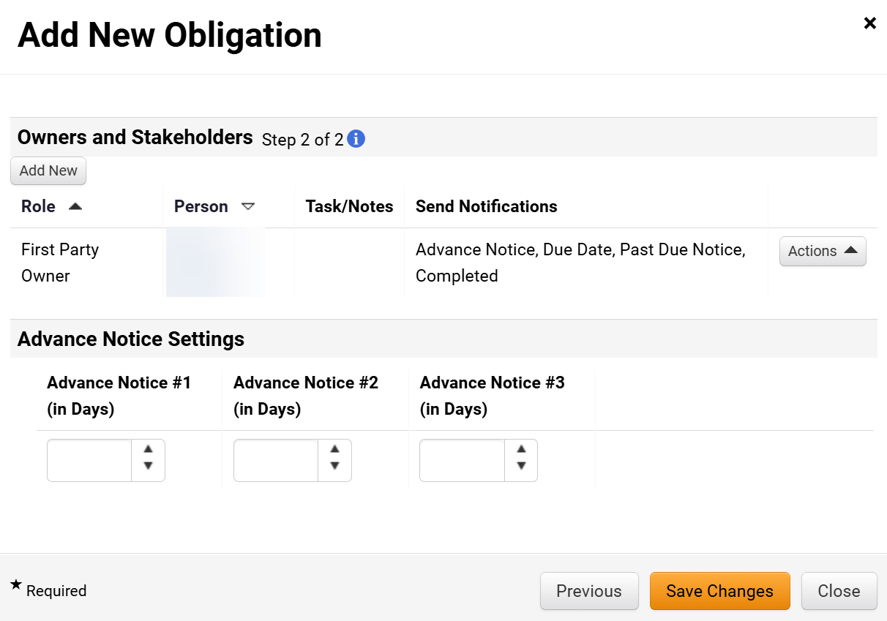
Create and Manage Contract Obligations
(Part 10 of 15)
INSTRUCTIONS
Select Advance Notice (in Days) #1, #2, and #3, as applicable.
Click Save Changes.
32
33

Slide 12

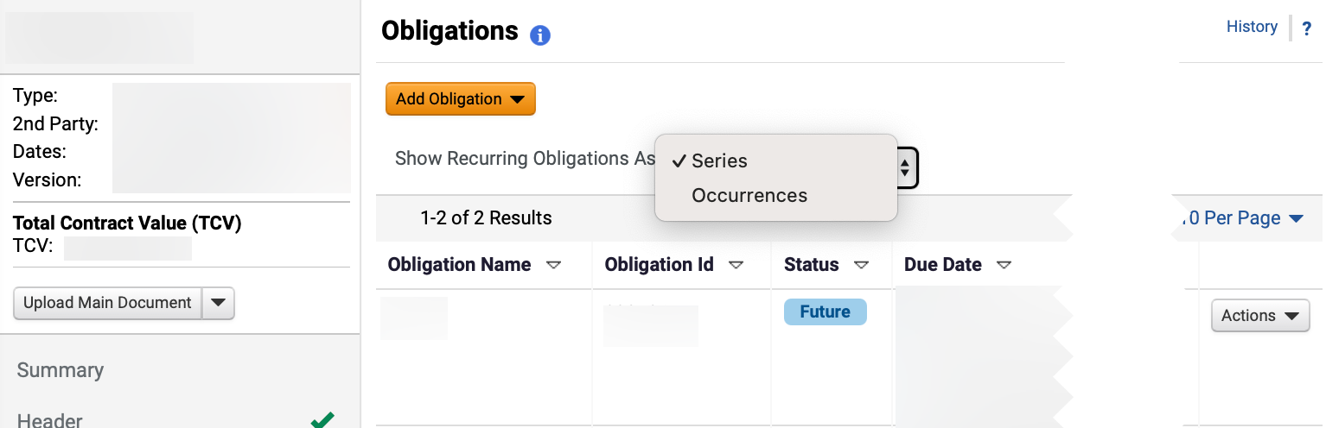
Create and Manage Contract Obligations
(Part 11 of 15)
INSTRUCTIONS
Review the notification that the Obligation has been successfully added notification.
Select Series for Show Recurring Obligation As.
Review the Obligation.
35
36

Slide 13
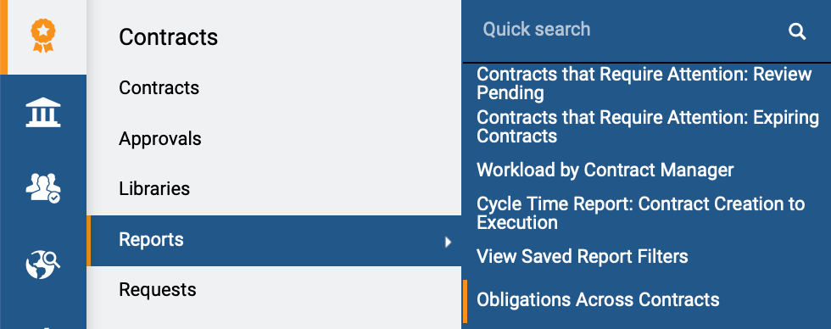
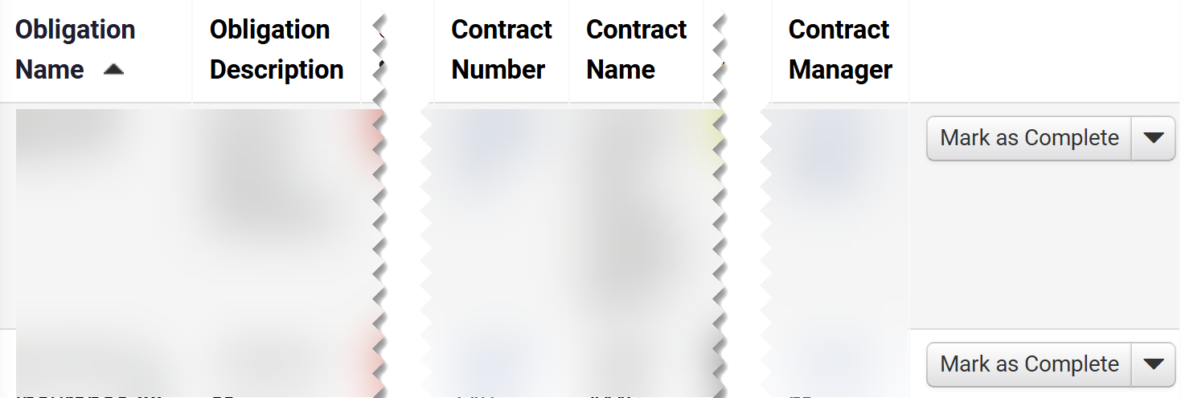
Create and Manage Contract Obligations
(Part 12 of 15)
INSTRUCTIONS
To manage an Obligation, click Reports.
Note: Follow Steps 38 - 45 to Mark as Complete.
Click Obligations Across Contracts.
37
38
Click Mark as Complete.
Note: If an Obligation is included for a supplier or an internal user without contract capabilities, the Contract Administrator must mark the contract obligation as complete.

Slide 14
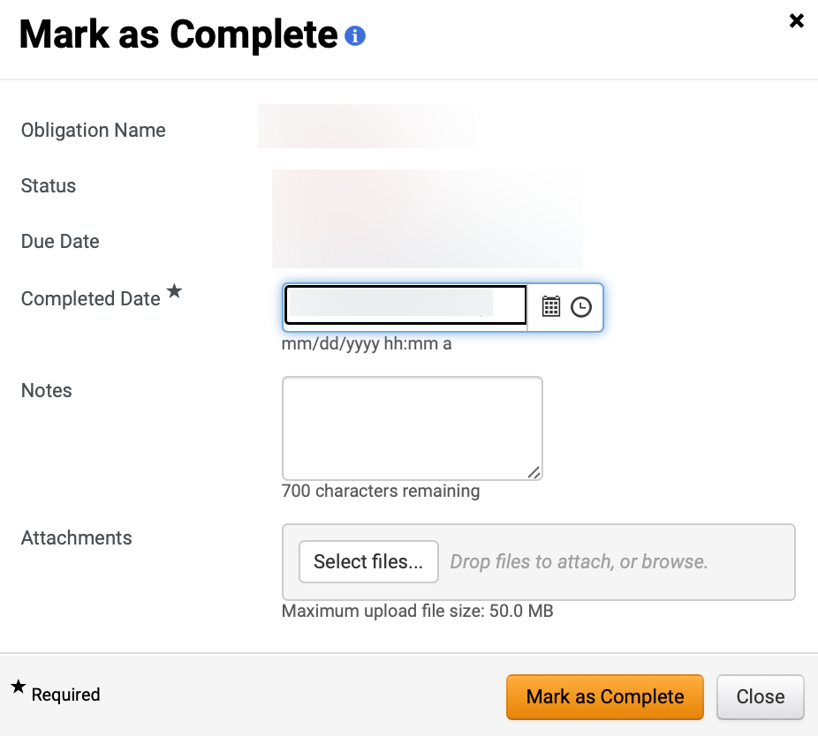
Create and Manage Contract Obligations
(Part 13 of 15)
INSTRUCTIONS
Select a Completed Date*.
Note: Completed Date* will auto-populate but can be edited.
Enter Notes, as applicable.
Click Select files… to include Attachments, as applicable.
40
41
42

Slide 15
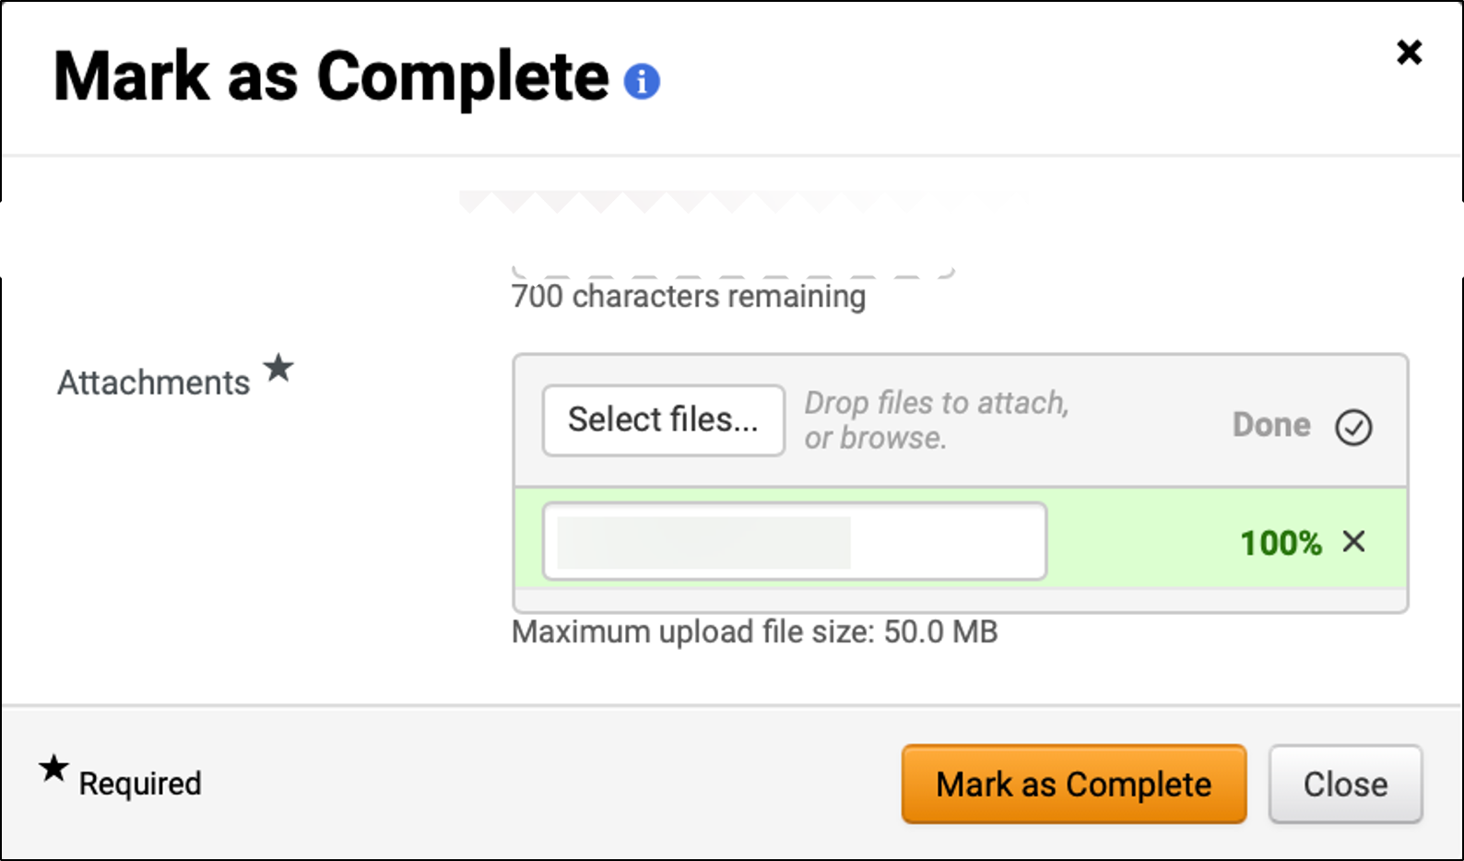
Create and Manage Contract Obligations
(Part 14 of 15)
INSTRUCTIONS
Review uploaded Attachment*.
Click Mark as Complete.
Note: Obligation will be removed from Obligations Across Contracts Report once marked as complete.
43
44
To review a completed Obligation, access the Contracts module.
Click Contracts.
Click Search Contracts.
45
46
47

Slide 16
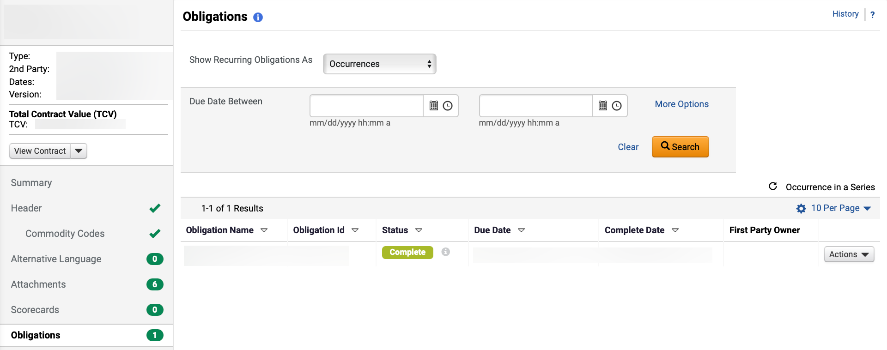

Create and Manage Contract Obligations
(Part 15 of 15)
INSTRUCTIONS
Click the Contract Number.
Note: Use the Quick Search and Filters to find the contract.
Click Obligations.
Review Complete Obligation.
50
49
You have successfully created and managed Contract Obligations.

