Slide 1
Create User with Panelist Role
(Technical Evaluator)
DESCRIPTION
This guide will show APO or designee how to Create User with Panelist Role (Technical Evaluator).
OVERVIEW
The key steps in the process are below:
Access the Admin module.
Create User and add Panelist Role.
Access the Sourcing Module.
Add Panelist to sourcing event.
Note: The process is only to create a New User that currently does not exist with a panelist role in GA@WORK Marketplace.
Business Process:
Access the Admin module
Create User and add Panelist Role
Access the Sourcing Module
Add Panelist to Sourcing event
Disclaimer: Due to regular system updates, the screens and features in GA@WORK may differ slightly from those shown in this job aid. For questions or assistance, please contact the Help Desk.

Slide 2
Create User with Panelist Role (Technical Evaluator) (Part 1 of 13)
INSTRUCTIONS
Review how to create technical evaluator and then add as Panelist in a sourcing event in the table below.
Step | Description | Step Information
 |  | ​
Create a new user
The APO or designated buyer can create a new user with limited capabilities/ role to be added to a sourcing event.
5 - 25
Add the user to a sourcing event
The user is visible and can be added as a panelist to any sourcing event.
26 - 41

Slide 3


Create User with Panelist Role (Technical Evaluator) (Part 2 of 13)
INSTRUCTIONS
Click the Global Navigation Menu.
Note: University System of Georgia (USG) users complete local logon and then proceed to Step 5.
Click Sourcing, Contracts & Supplier Management.

Slide 4

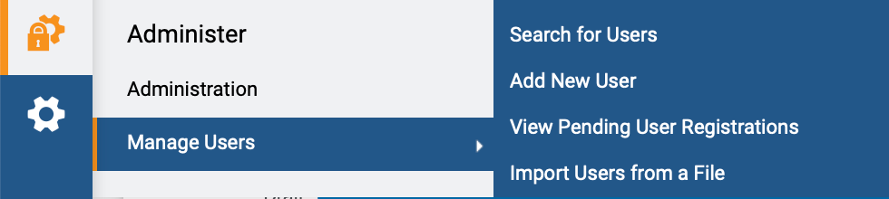
Create User with Panelist Role (Technical Evaluator) (Part 3 of 13)
INSTRUCTIONS
Click Sign On.
Note: The system utilizes Single Sign-On (SSO) capabilities
and no log in information is required.
To add a new user, access the Administer module.
Click Manage Users.
Click Add New User.
5
7
6

Slide 5
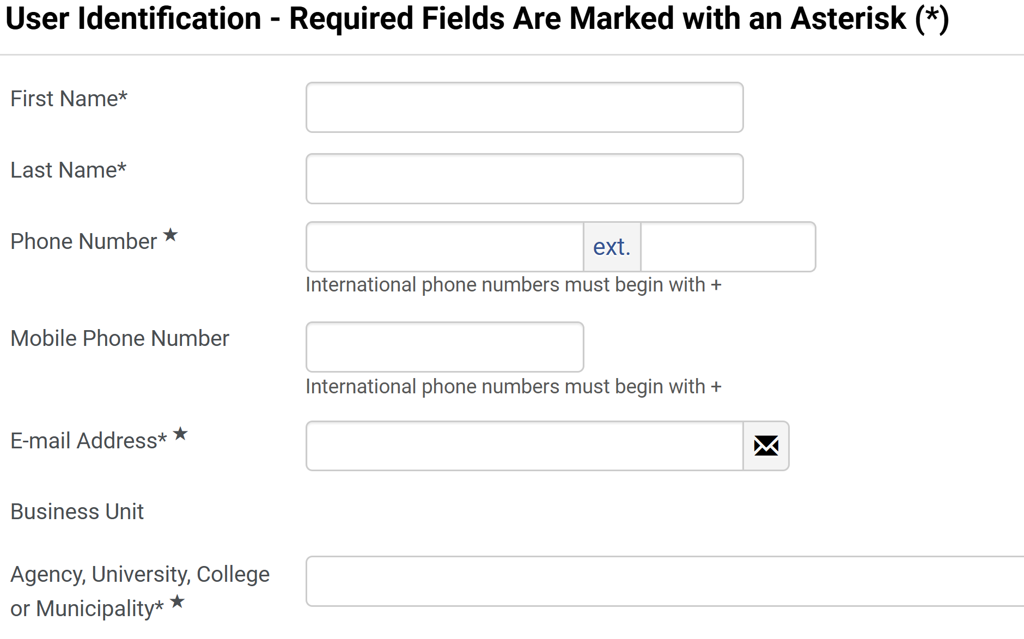
Create User with Panelist Role (Technical Evaluator) (Part 4 of 13)
INSTRUCTIONS
Enter First Name*.
Note: Complete all required fields marked with a black star *.
Enter Last Name*.
Enter Phone Number*.
Enter E-mail Address*.
Review auto-populated Business Unit.
Select Agency, University, College or Municipality*.
Note: Scroll to the bottom of the list and select the last option, as it matches the Business Unit.
8
9
10
10
11
12
13

Slide 6
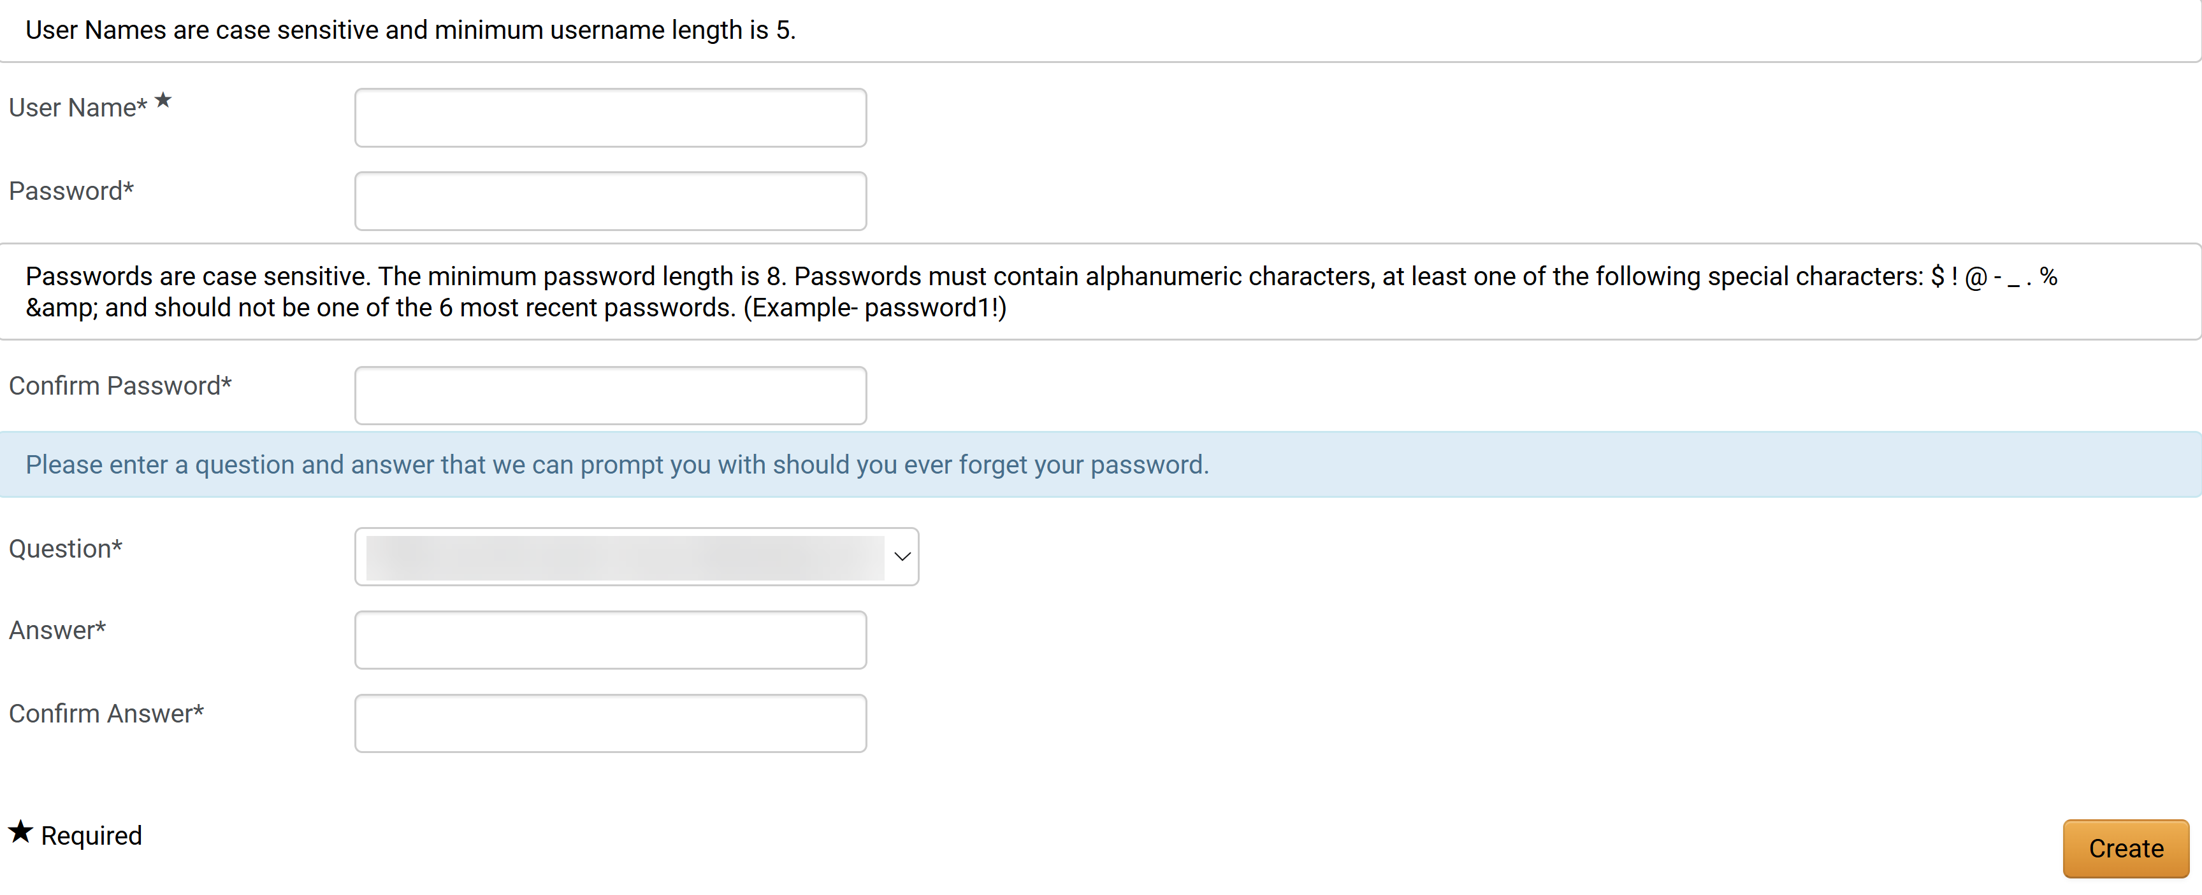
Create User with Panelist Role (Technical Evaluator) (Part 5 of 13)
INSTRUCTIONS
Enter User Name*.
Note: User Name is case sensitive and minimum length is 5.
Enter Password*.
Enter Confirm Password*.
Click Create.
14
15
16
17

Slide 7
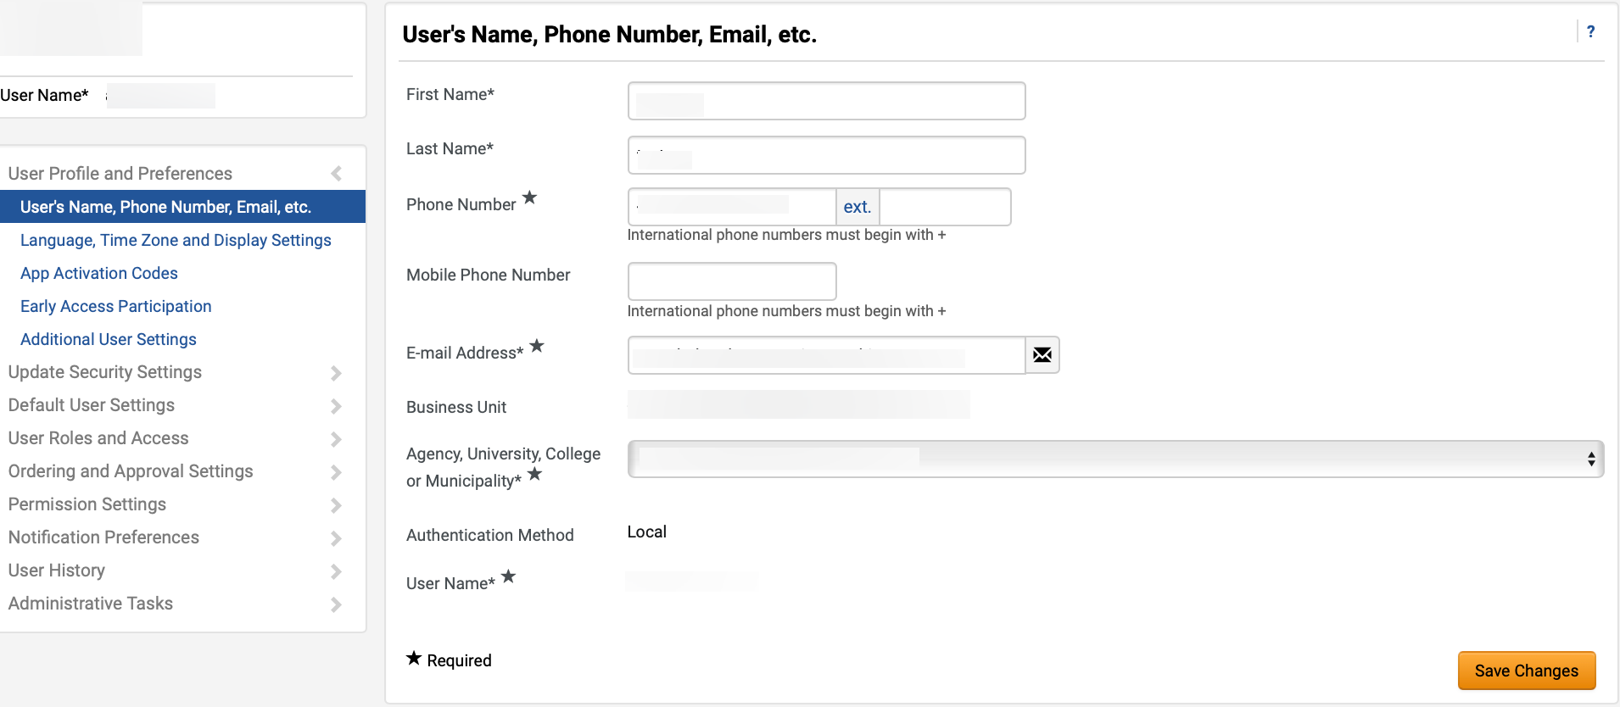
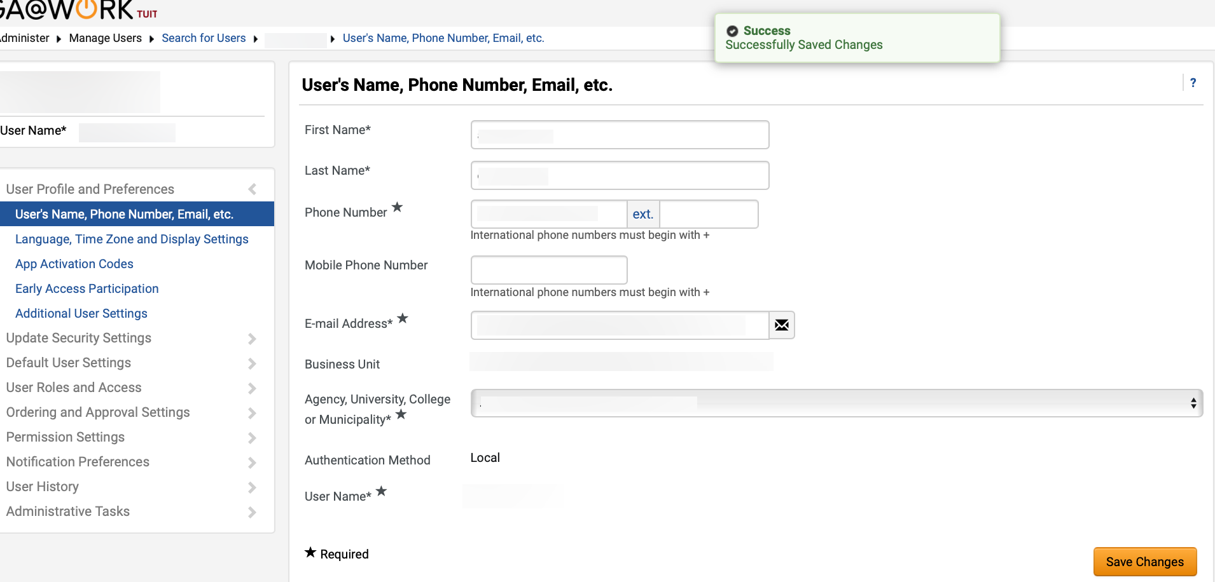
Create User with Panelist Role (Technical Evaluator) (Part 6 of 13)
INSTRUCTIONS
Review populated User fields.
Note: First Name, Last Name, Phone Number, Mobile Phone Number, E-mail Address, and Agency, University, College or Municipality fields can be edited.
Click Save Changes.
18
19
Review the Successfully Saved Changes notification.

Slide 8
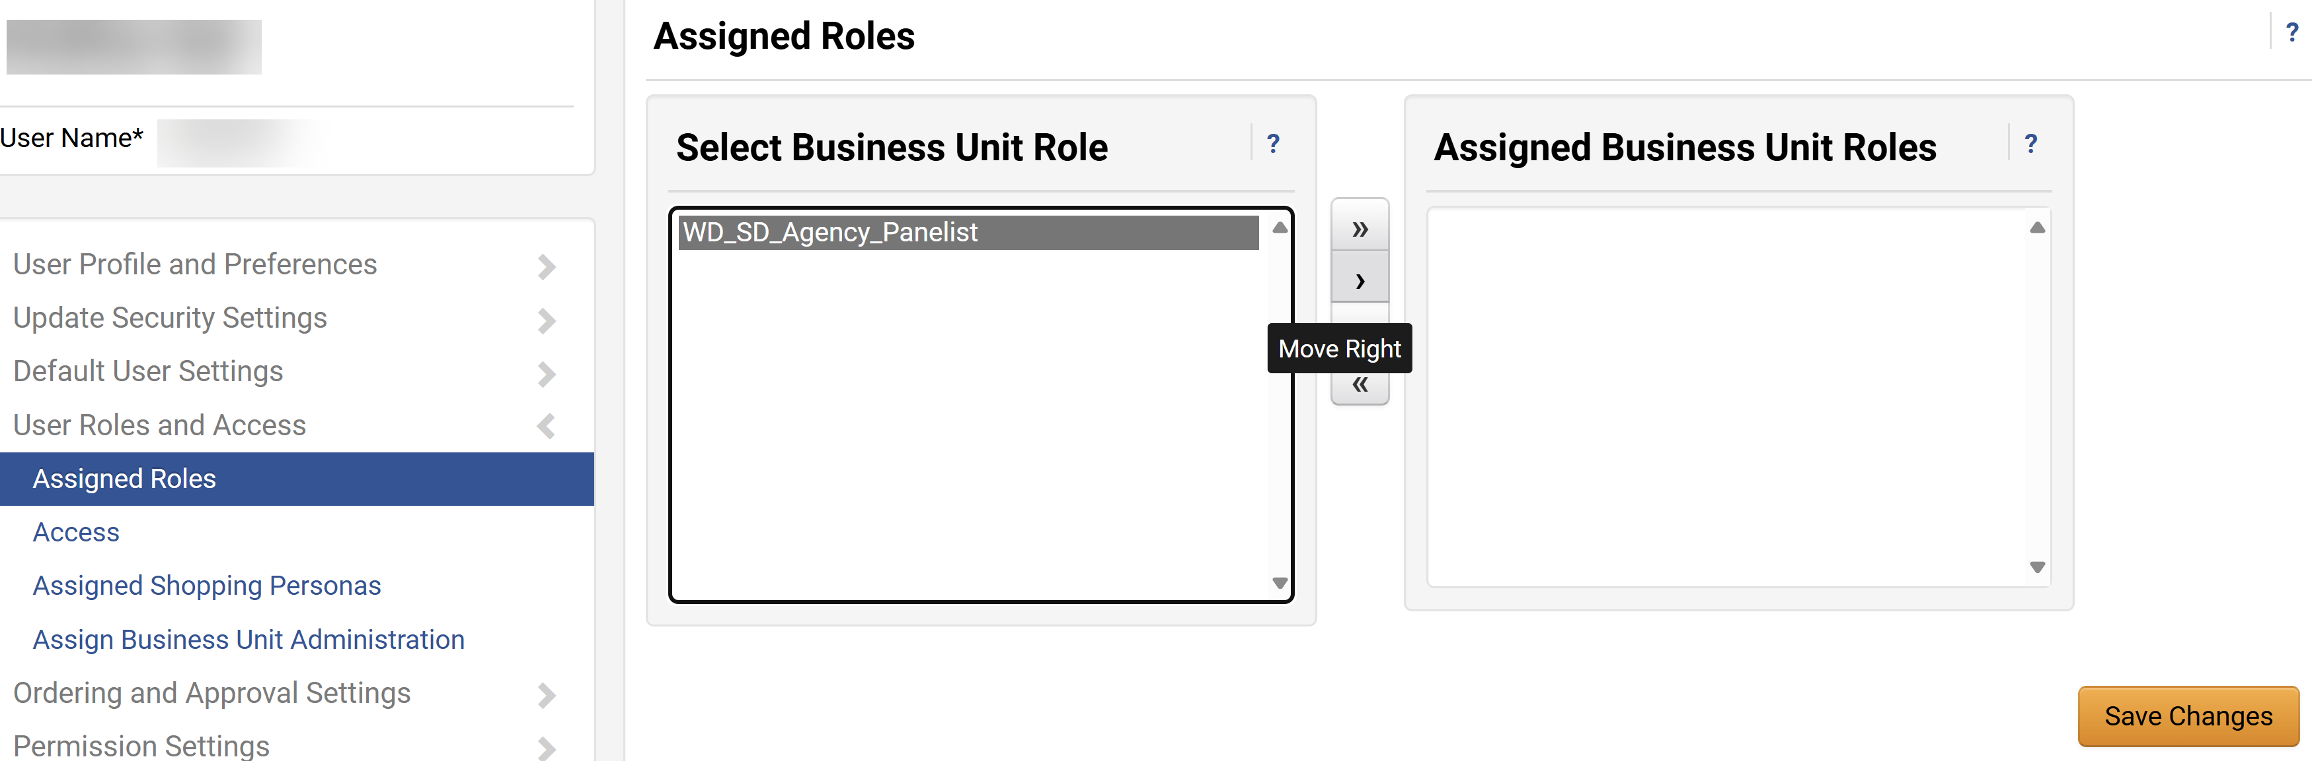
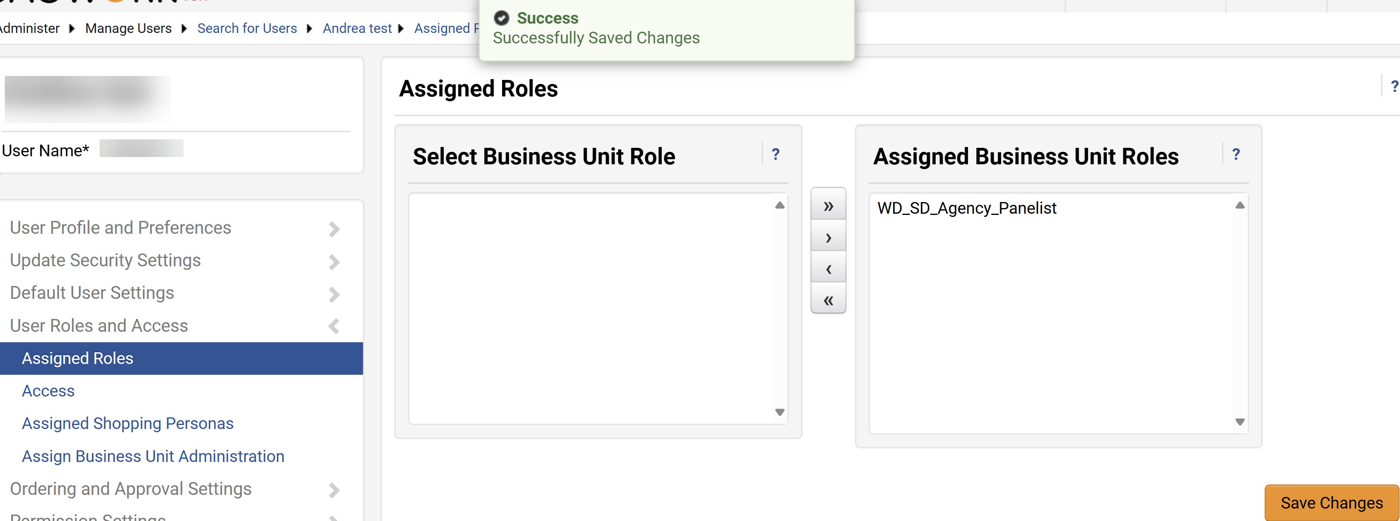
Create User with Panelist Role (Technical Evaluator) (Part 7 of 13)
INSTRUCTIONS
Click Assigned Roles.
Select Business Unit Role.
Click Move Right.
22
23
21
Review Assigned Business Unit Roles.
Click Save Changes.
Note: Once the user is successfully created, the APO or their designee is responsible for sending an email with GA@WORK Marketplace link, username, and password to the new panelist user outside the system.
24
25

Slide 9
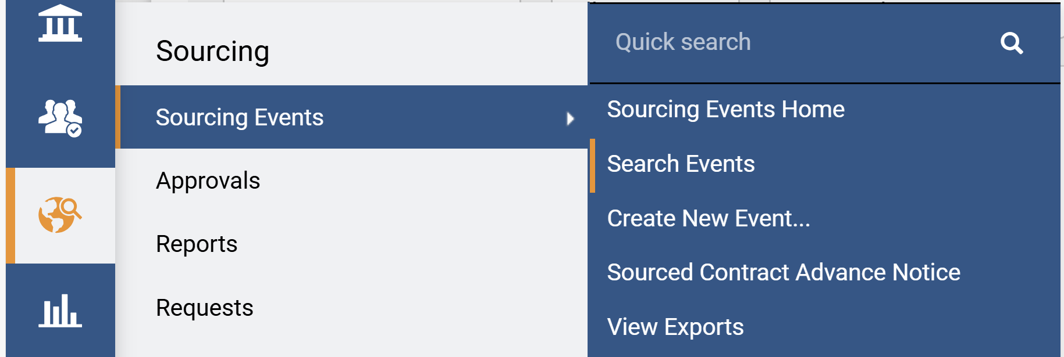
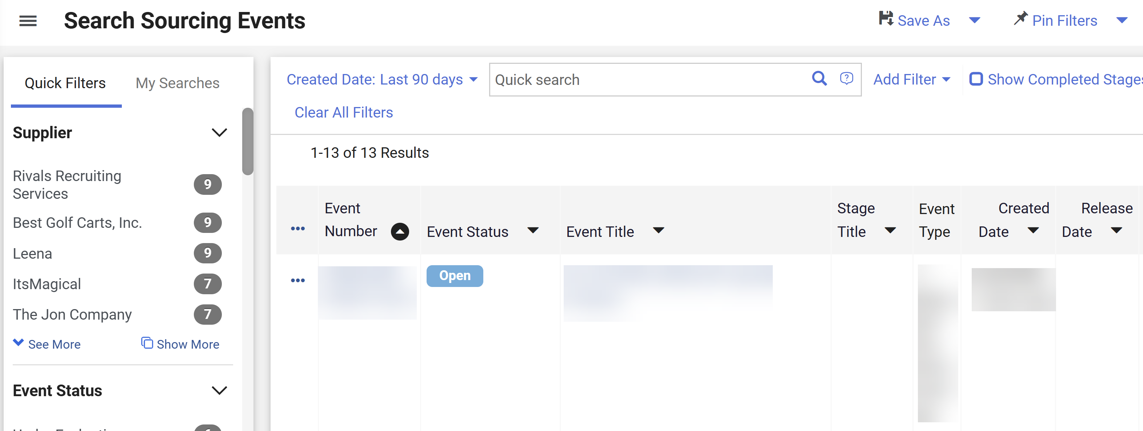
Create User with Panelist Role (Technical Evaluator) (Part 8 of 13)
INSTRUCTIONS
To add a Panelist, access the Sourcing module.
Click Sourcing Events.
Click Search Events.
27
28
26
Select the Event Number hyperlink.
Note: Use Filters to find the Sourcing Event.

Slide 10
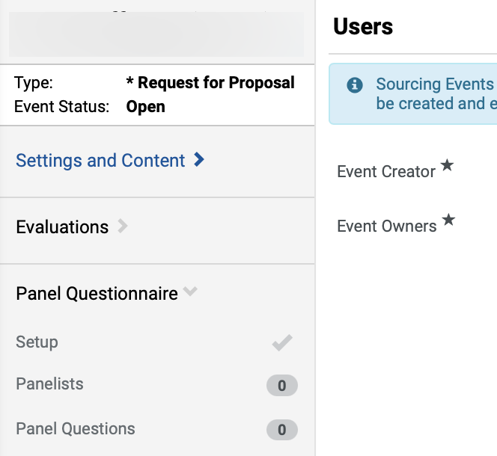
Create User with Panelist Role (Technical Evaluator) (Part 9 of 13)
INSTRUCTIONS
To add Panelists, click Panel Questionnaire.
Select Panelists.
30
31

Slide 11
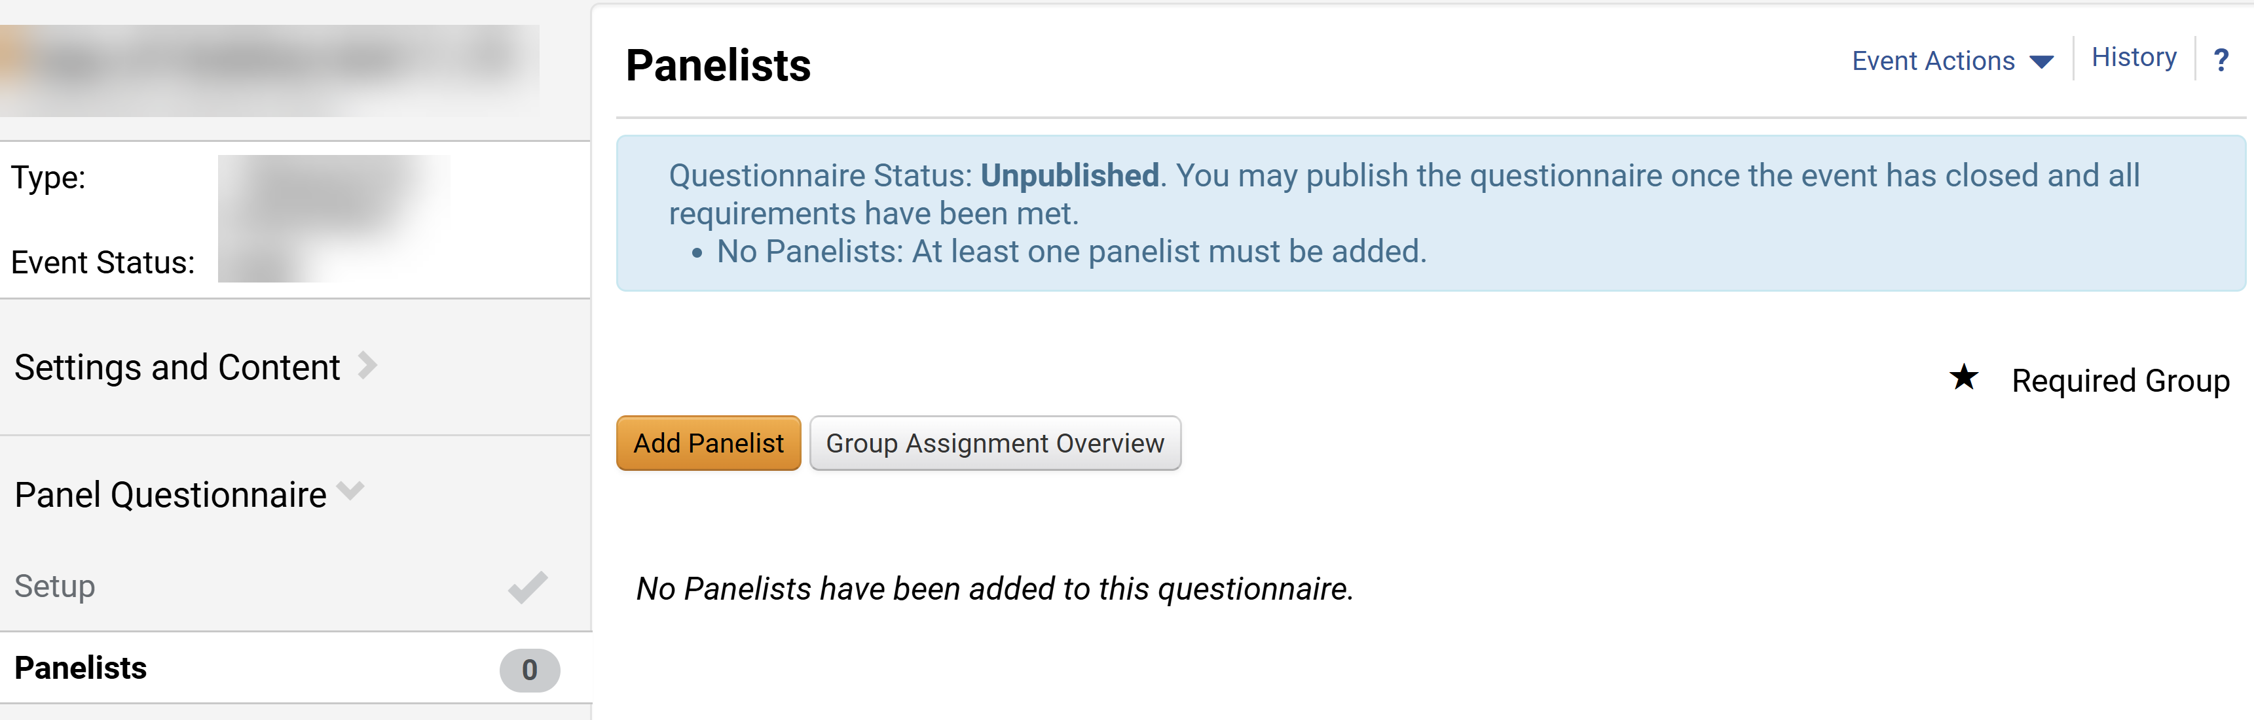
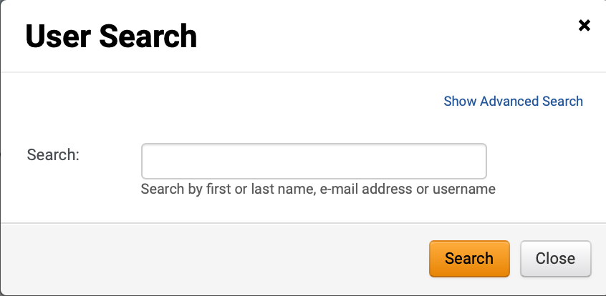
Create User with Panelist Role (Technical Evaluator) (Part 10 of 13)
INSTRUCTIONS
Click Add Panelist.
Enter Search criteria.
Note: Follow step 35 – 36 if selecting Show Advanced Search.
Click Search.
33
34

Slide 12
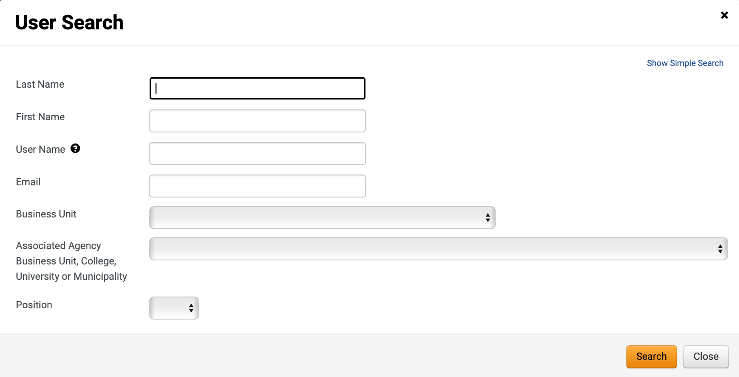
Create User with Panelist Role (Technical Evaluator) (Part 11 of 13)
INSTRUCTIONS
Use User Search filters.
Click Search.
35
36

Slide 13
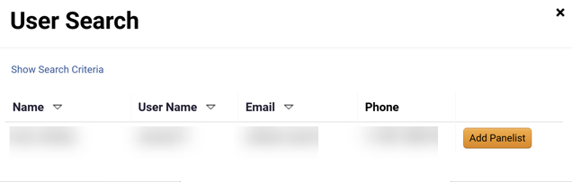
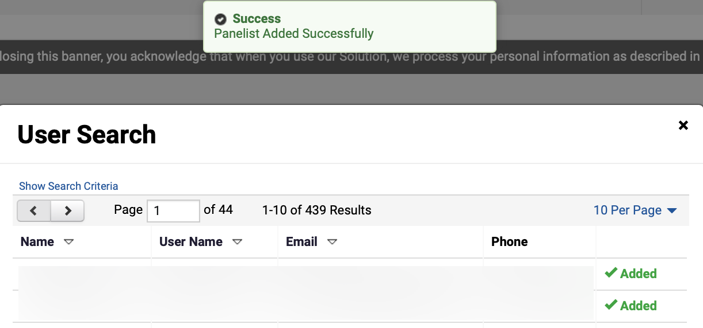
Create User with Panelist Role (Technical Evaluator) (Part 12 of 13)
INSTRUCTIONS
Click Add Panelist.
Review Panelist Added Successfully notification.
Review Added status.
38
39

Slide 14
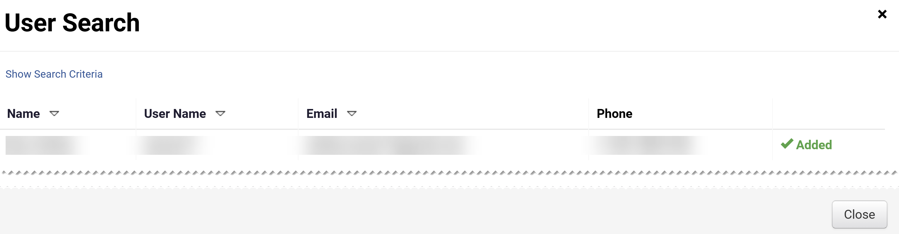
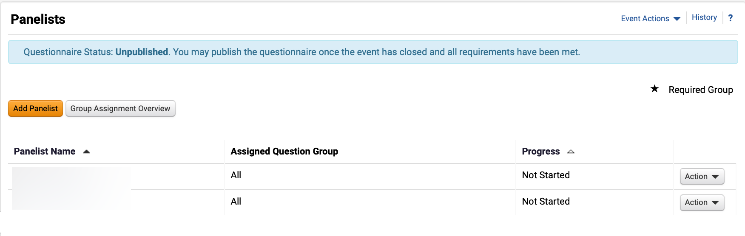

Create User with Panelist Role (Technical Evaluator) (Part 13 of 13)
INSTRUCTIONS
Click Close.
Review added Panelists.
You have successfully Created User with Panelist Role (Technical Evaluator).

