Slide 1
Manage & Finalize (Evaluate) Sourcing Event Using Panel Questionnaire
DESCRIPTION
This guide will show Sourcing Event Buyers how to Manage and Finalize Sourcing Event Using Panel Questionnaire. The Panel Questionnaire facilitates technical scoring for RFPs and scored RFQCs. Panelist will also learn how to respond to Panel Questionnaire.
OVERVIEW
The key steps in the process are below:
Sourcing Event Buyer adds Panelist.
Sourcing Event Buyer adds Questionnaire.
Panelist responds to the Questionnaire.
Sourcing Event Buyer Finalizes Sourcing Event.
Note: If you are a Sourcing Event Buyer, follow Steps 1-50. If you are a Panelist, skip to Slide 19.
Business Process:
Sourcing Event Buyer adds Panelist
Sourcing Event Buyer adds Questionnaire
Panelist Responds to the Questionnaire
Sourcing Event Buyer Finalizes Sourcing Event
Disclaimer: Due to regular system updates, the screens and features in GA@WORK may differ slightly from those shown in this job aid. For questions or assistance, please contact the Help Desk.

Slide 2
Manage & Finalize (Evaluate) Sourcing Event Using Panel Questionnaire
INSTRUCTIONS
Review Role and follow the steps in the table below to access the Steps.
Note: Click on the Role hyperlink to access each section.
Role | Description | Step Information
 |  | ​
Sourcing Event Buyer
Publish a Panel Questionnaire
Steps 2 – 50
(slides 3– 18)
Panelist
Complete and Submit Panel Questionnaire
Steps 1 – 47
(slides 19– 35)
Sourcing Event Buyer
Finalize Sourcing Event Using Panel Questionnaire
Step 1
(slides 36– 37)

Slide 3


Publish a Panel Questionnaire
(Part 1 of 16)
INSTRUCTIONS
Click the Global Navigation Menu.
Note: University System of Georgia (USG) and GDOT users complete local logon and then proceed to Step 4.
Click Sourcing, Contracts & Supplier Management.
Sourcing Event Buyer

Slide 4

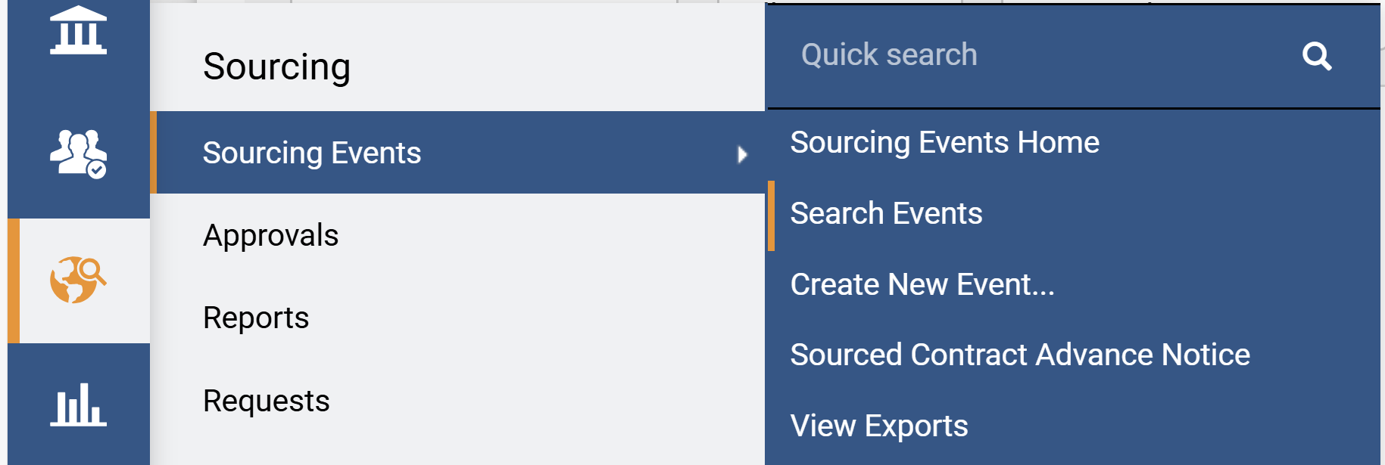
Publish a Panel Questionnaire
(Part 2 of 16)
INSTRUCTIONS
Click Sign On.
Note: The system utilizes Single Sign-On (SSO) capabilities
and no log in information is required.
Access the Sourcing module.
Click Sourcing Events.
Click Search Events.
5
6
4
Sourcing Event Buyer

Slide 5
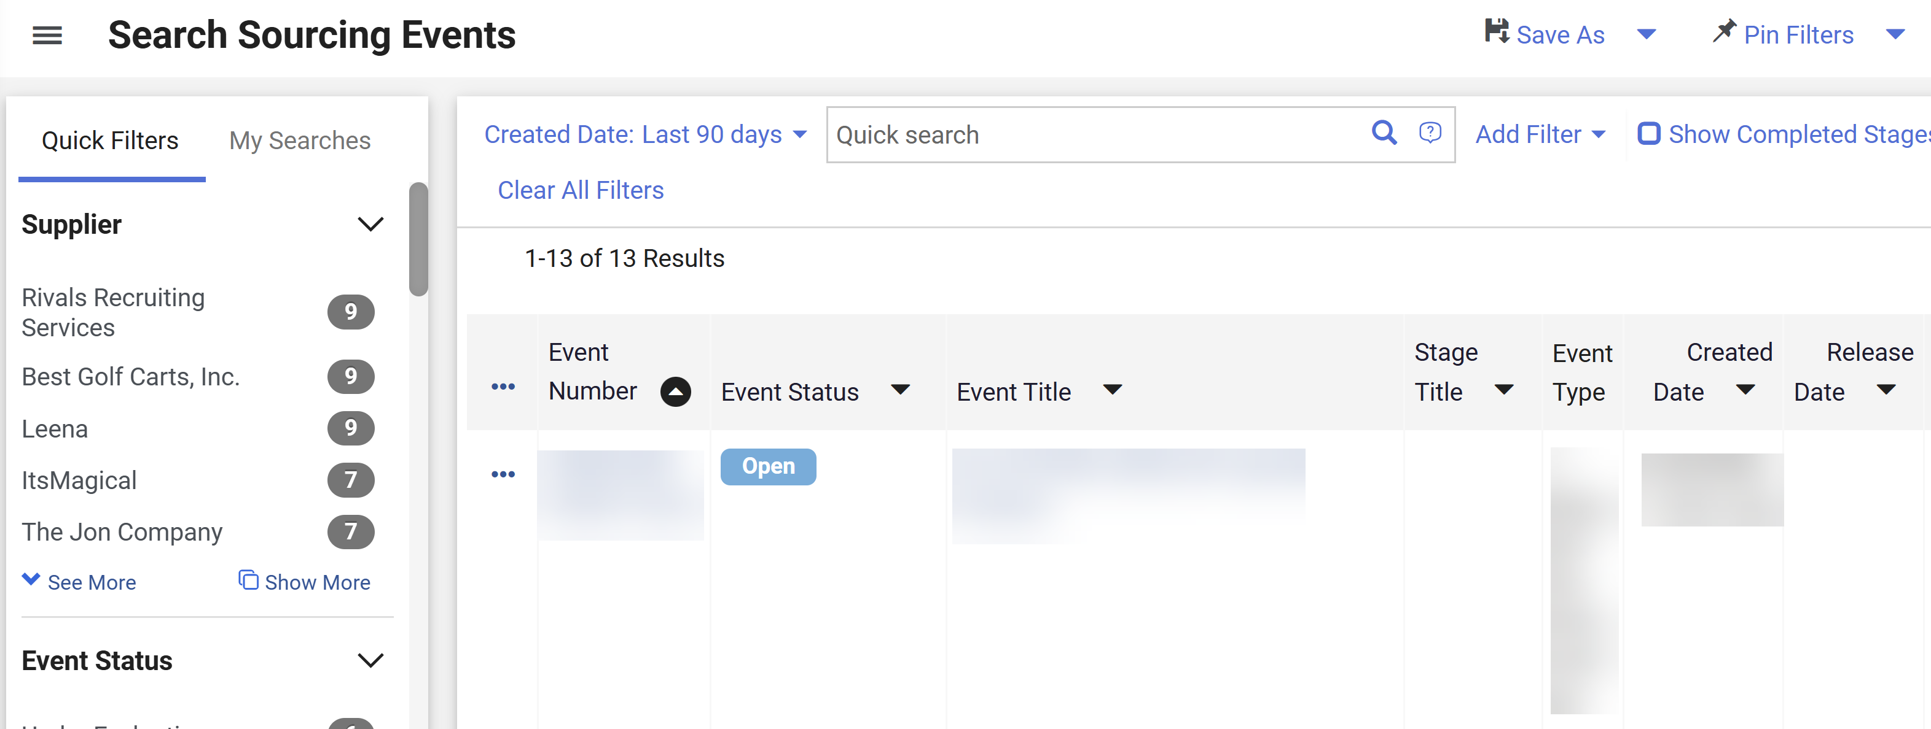
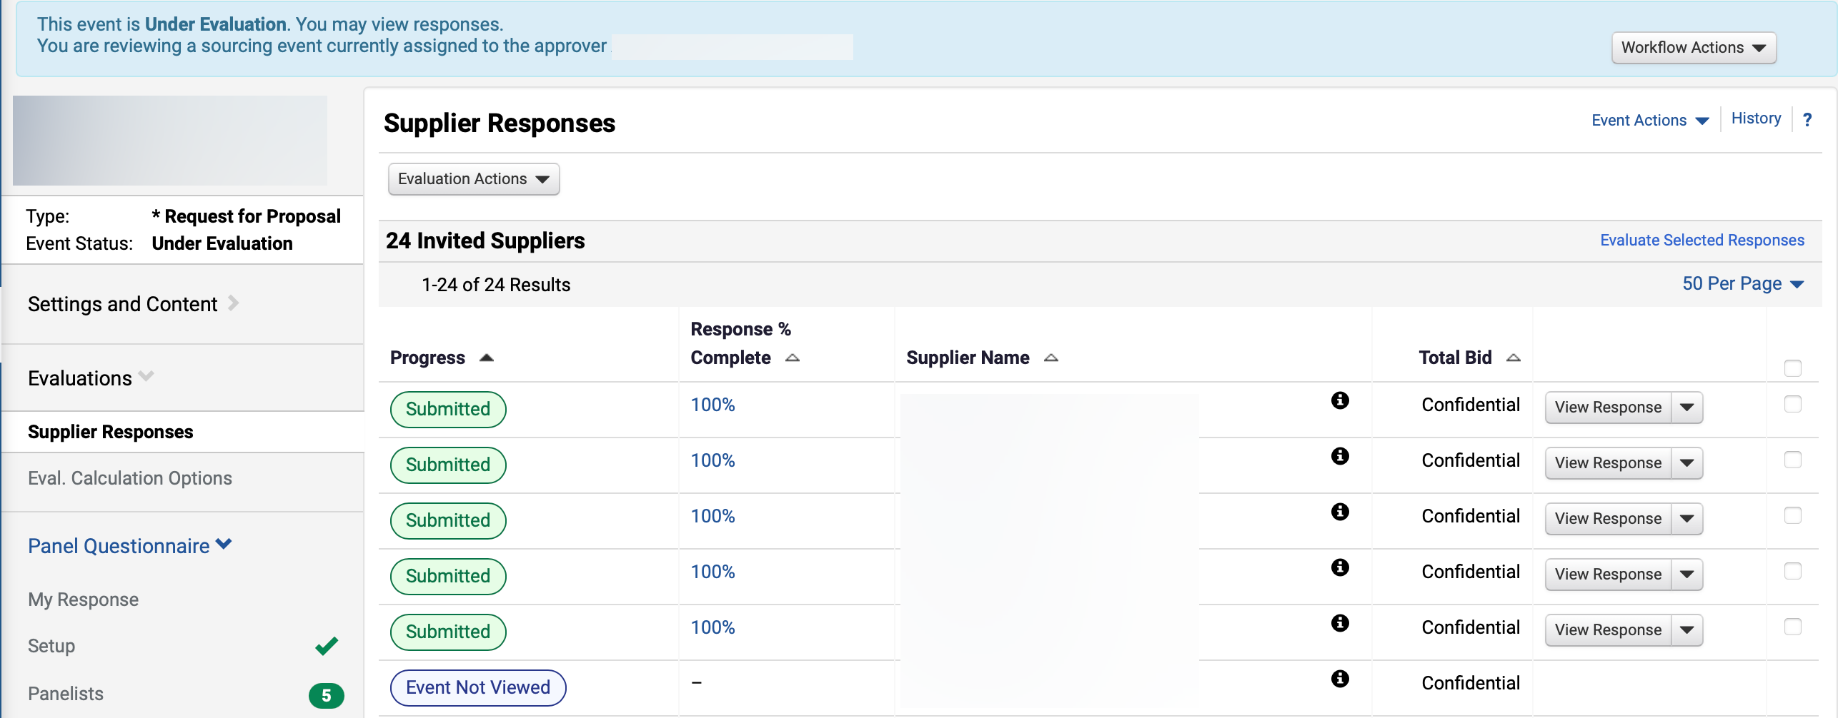
Publish a Panel Questionnaire
(Part 3 of 16)
INSTRUCTIONS
Use Filters to find the Sourcing Event.
Click the Event Number hyperlink.
7
8
Review Supplier Responses.
Click Panel Questionnaire.
Click Setup.
9
10
11
Sourcing Event Buyer

Slide 6
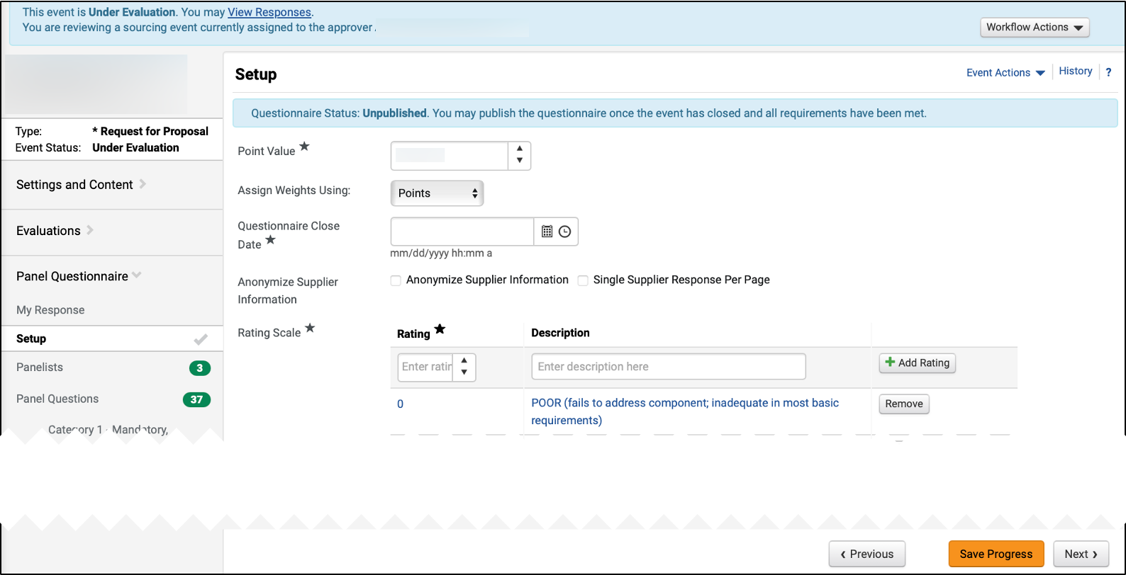
Publish a Panel Questionnaire
(Part 4 of 16)
INSTRUCTIONS
Select Point Value* and enter total number of available technical points. For Assign Weights Using, select Points.
Enter Questionnaire Close Date*.
Note: This date controls the deadline for panelists to complete technical scoring and may be extended by the Sourcing Event Buyer as needed.
Select Anonymize Supplier Information (Optional).
Note: Rating Scale is set up by DOAS as per policy. Anonymizing supplier information is not recommended by DOAS.
Click Save Progress.
Click Panelists.
12
13
14
16
15
Sourcing Event Buyer

Slide 7
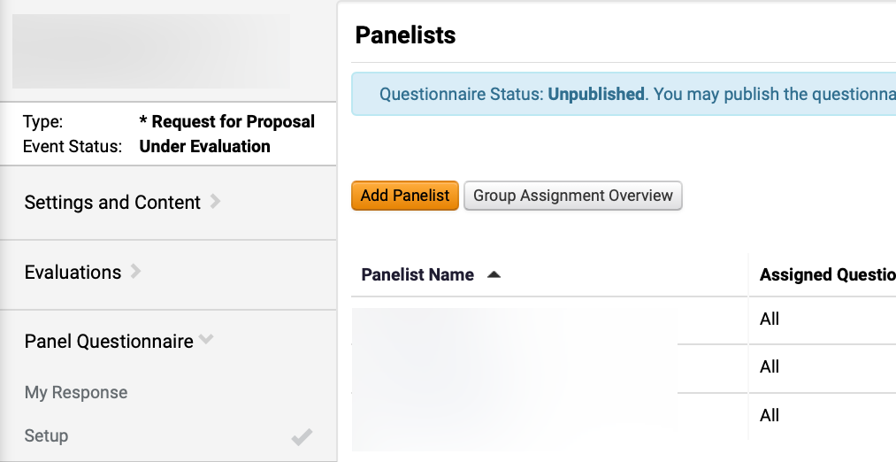
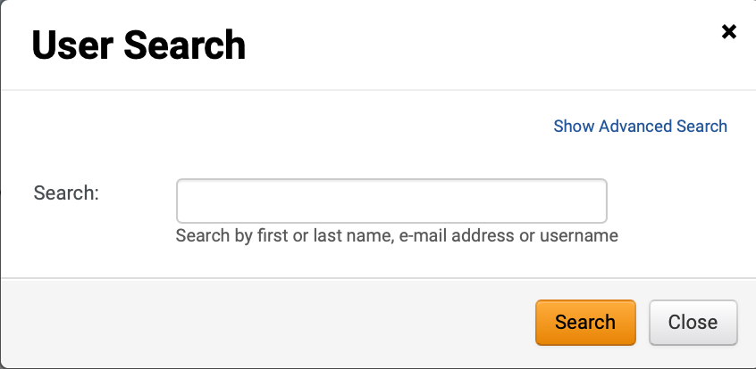
Publish a Panel Questionnaire
(Part 5 of 16)
INSTRUCTIONS
Click Add Panelist.
Note: If a technical panelist is required, reference Job Aid: Create a User with Panelist Role (Technical Evaluator).
Enter to Search.
Note: Follow Step 19 – 25 if selecting Show Advanced Search.
Click Search.
18
19
Sourcing Event Buyer

Slide 8
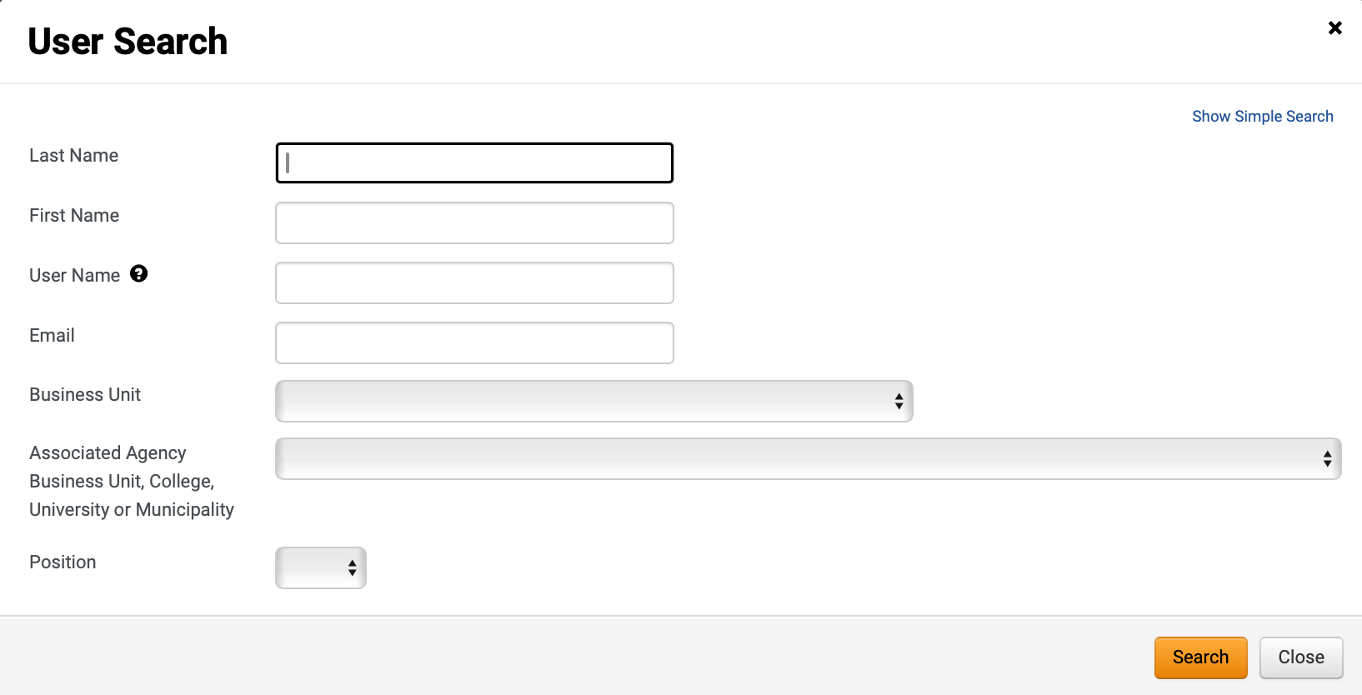
Publish a Panel Questionnaire
(Part 6 of 16)
INSTRUCTIONS
Use User Search filters.
Click Search.
20
21
Sourcing Event Buyer

Slide 9
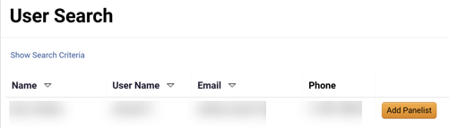
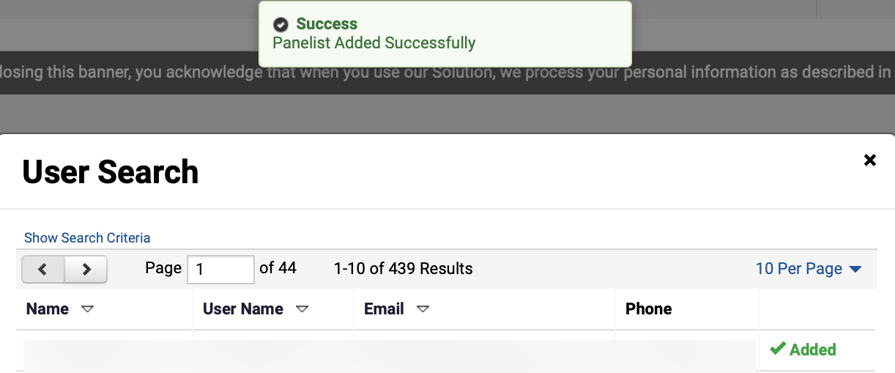
Publish a Panel Questionnaire
(Part 7 of 16)
INSTRUCTIONS
Click Add Panelist.
Review Panelist Added Successfully notification.
Review Added status.
23
24
Sourcing Event Buyer

Slide 10
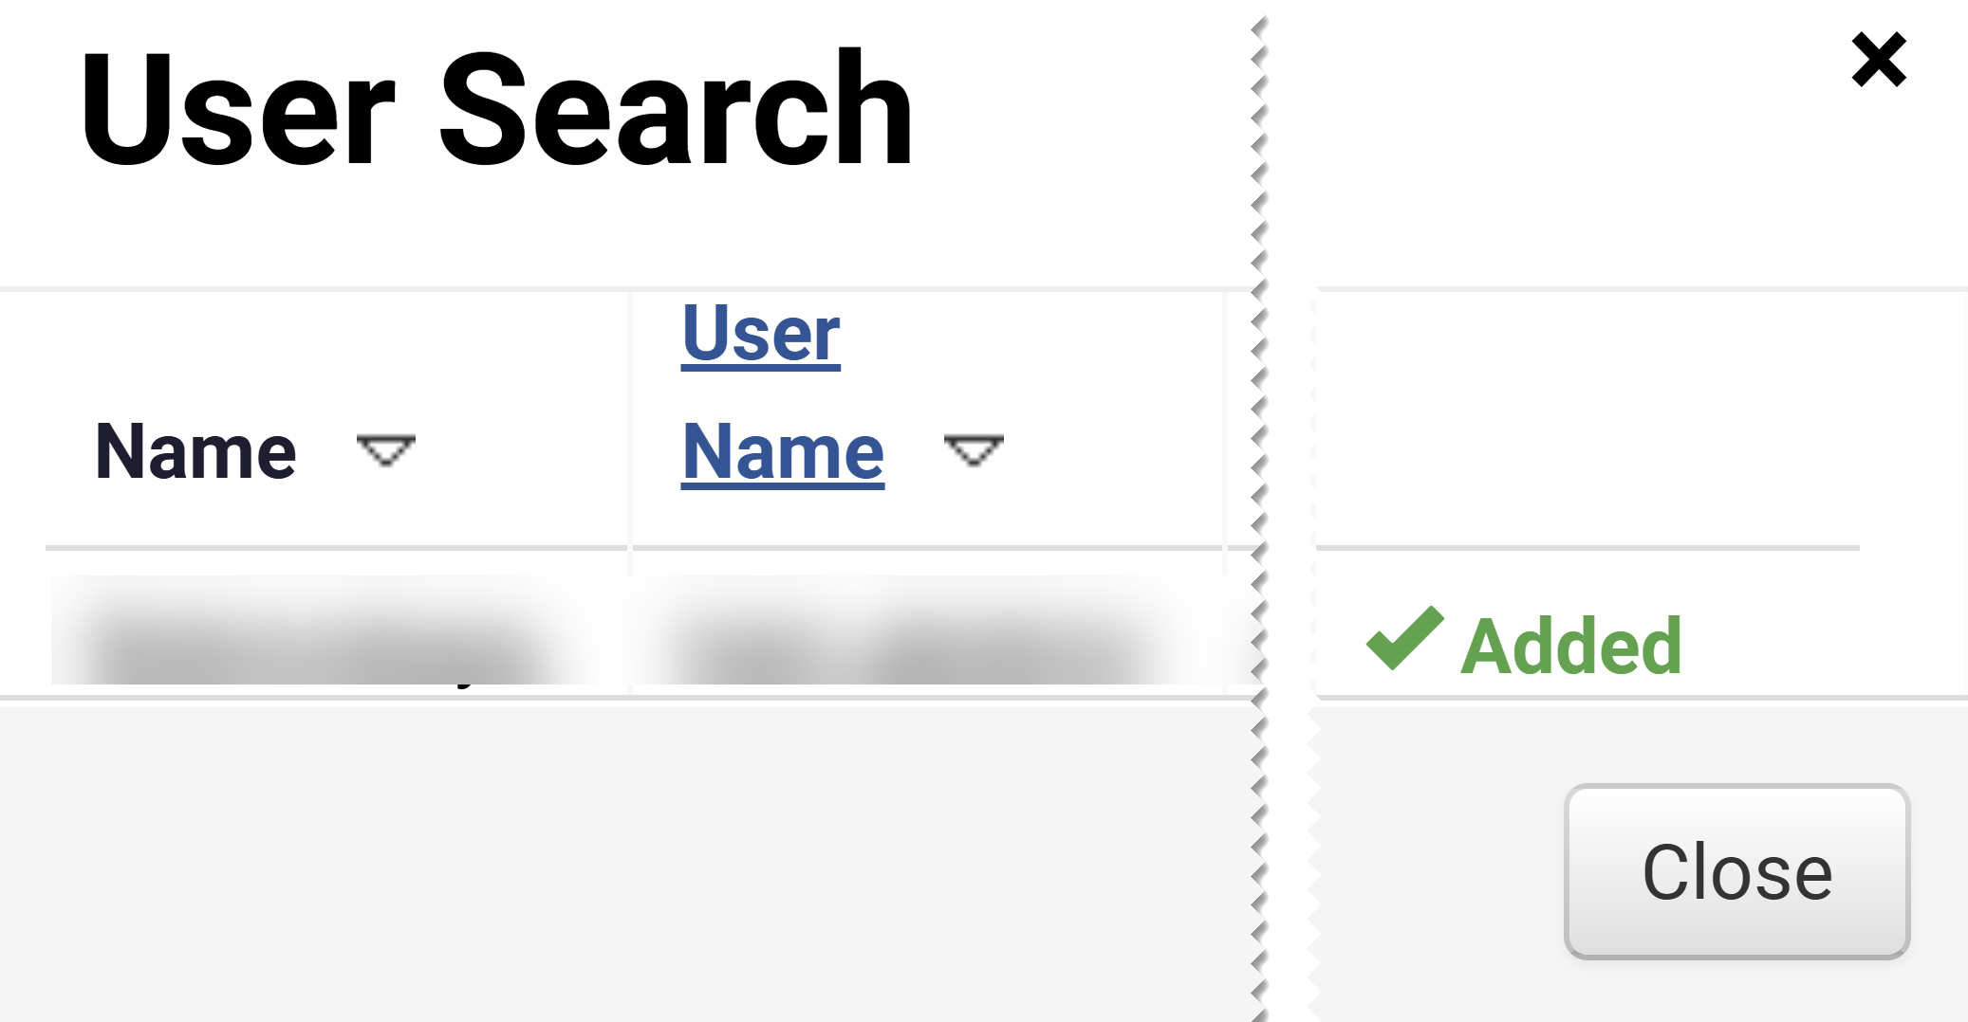
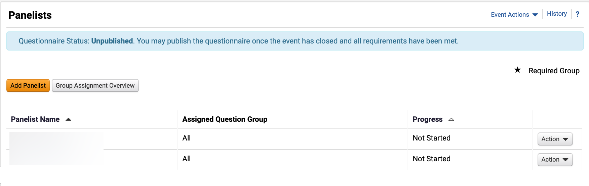
Publish a Panel Questionnaire
(Part 8 of 16)
INSTRUCTIONS
Click Close.
Review added Panelists.
Sourcing Event Buyer

Slide 11
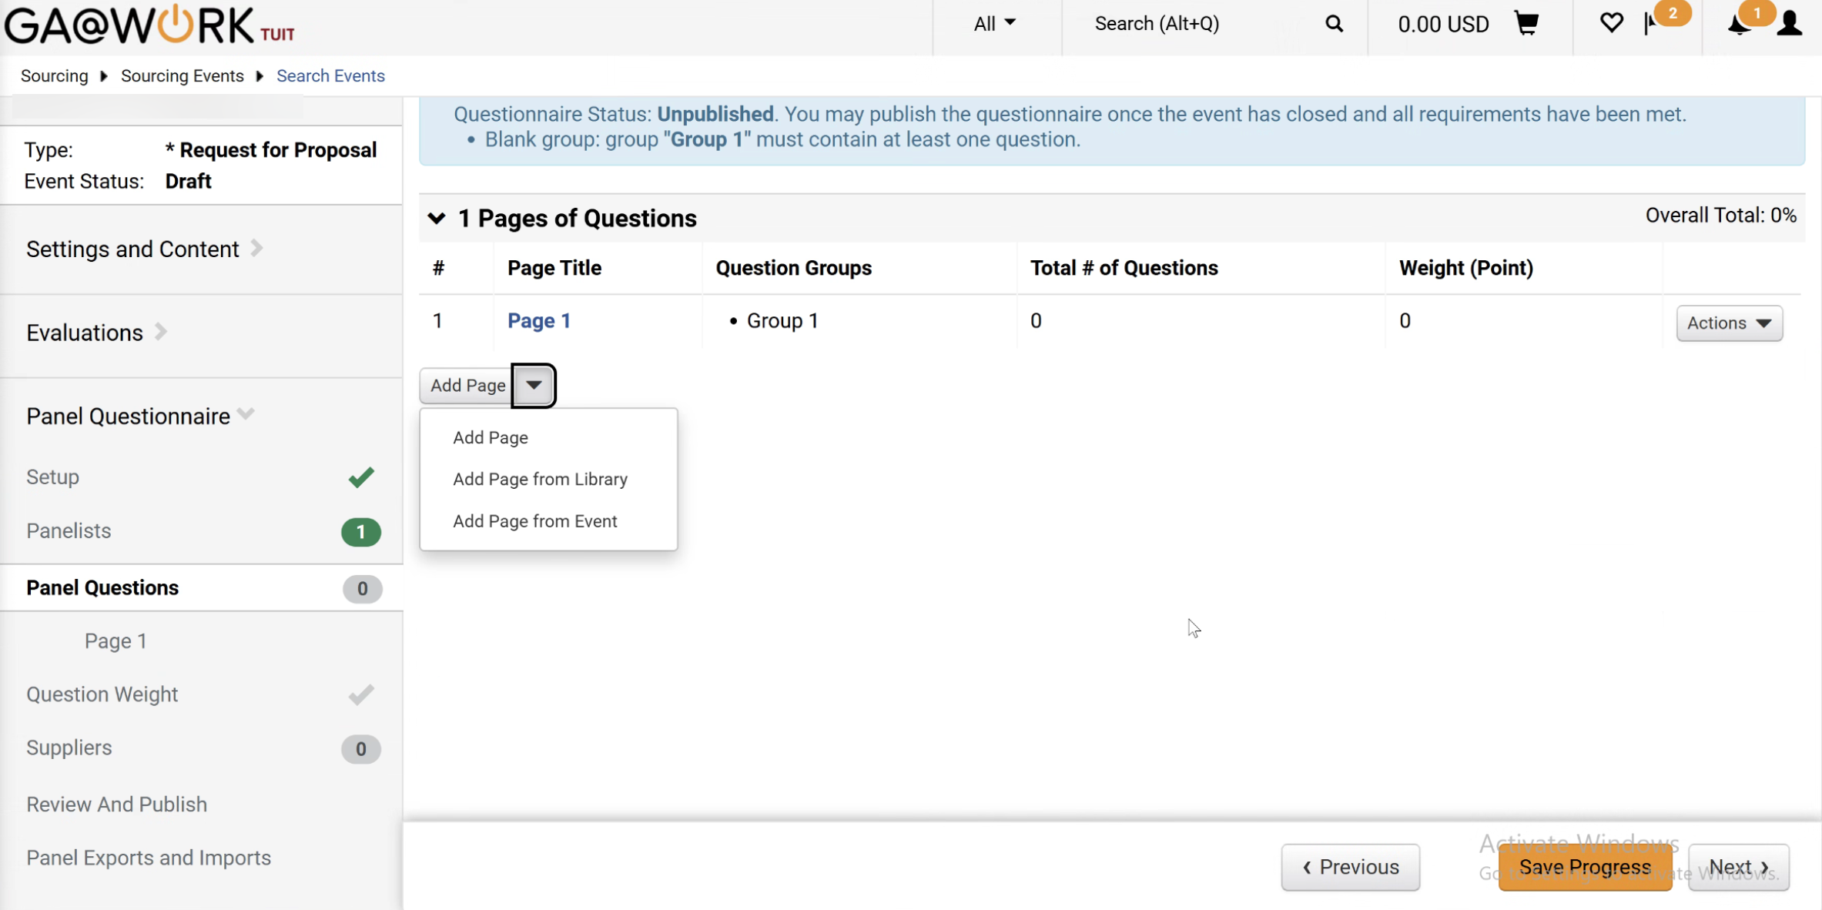
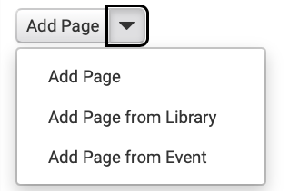
Publish a Panel Questionnaire
(Part 9 of 16)
INSTRUCTIONS
Click Panel Questions.
Click Add Page arrow.
Select Add Page from Event.
Note: Selecting Add Page from Event is the preferred method. To Add Page or Add Page from Library, consult with SPD and revisit the Event Questions.
28
29
Sourcing Event Buyer

Slide 12
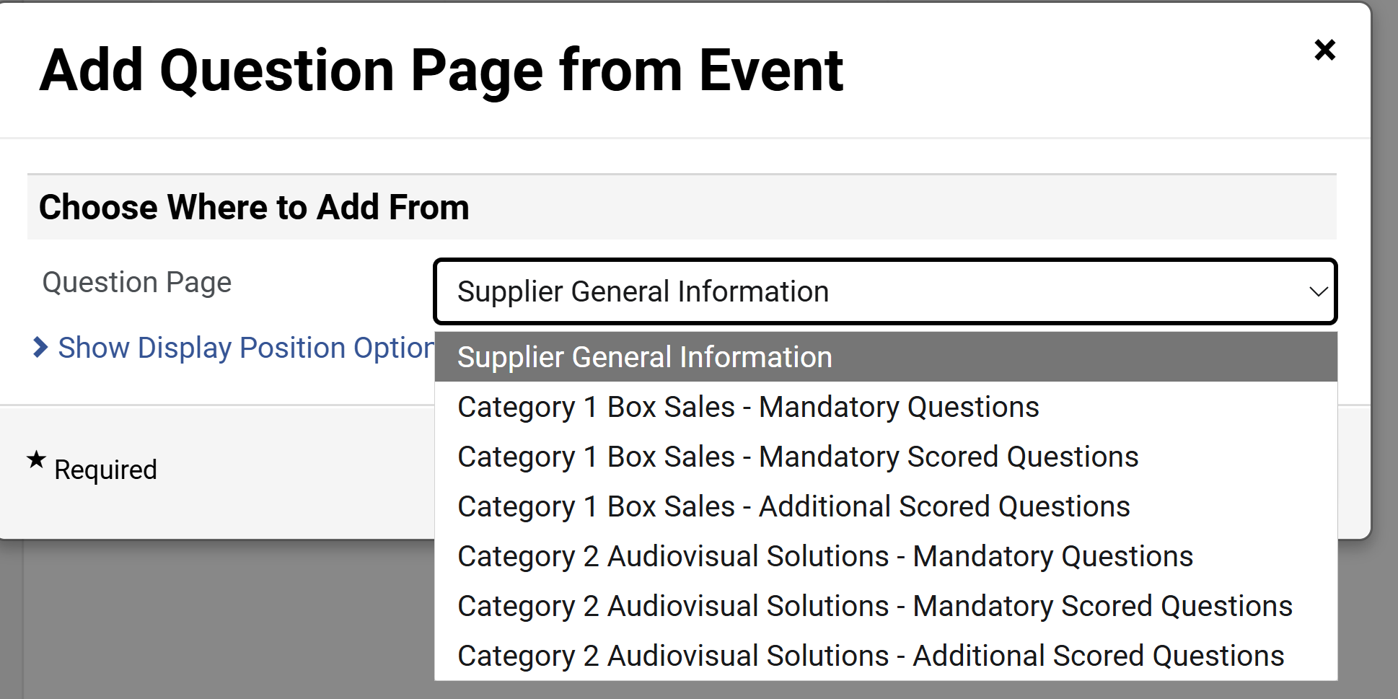
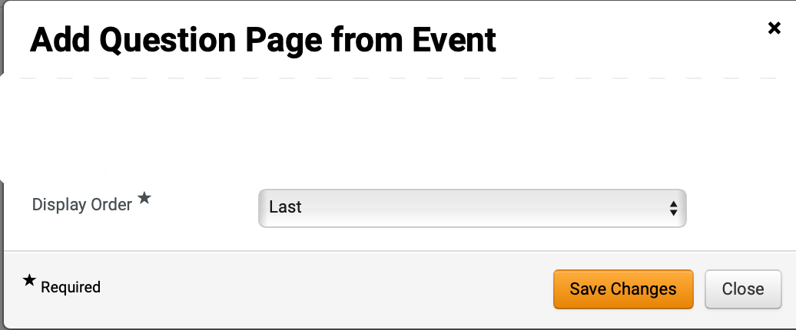
Publish a Panel Questionnaire
(Part 10 of 16)
INSTRUCTIONS
Select Question Page.
Note: Sourcing Event Buyer adds the applicable questions for scoring to the Questionnaire.
Select Display Order*.
Click Save Changes.
31
32
Sourcing Event Buyer

Slide 13
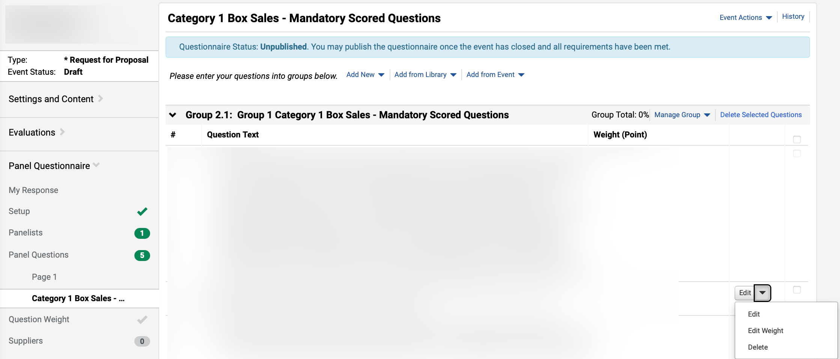
Publish a Panel Questionnaire
(Part 11 of 16)
INSTRUCTIONS
Review Question Page.
Note: Click Edit to edit Question Text, Edit Weight, or Delete a Question.
Sourcing Event Buyer

Slide 14
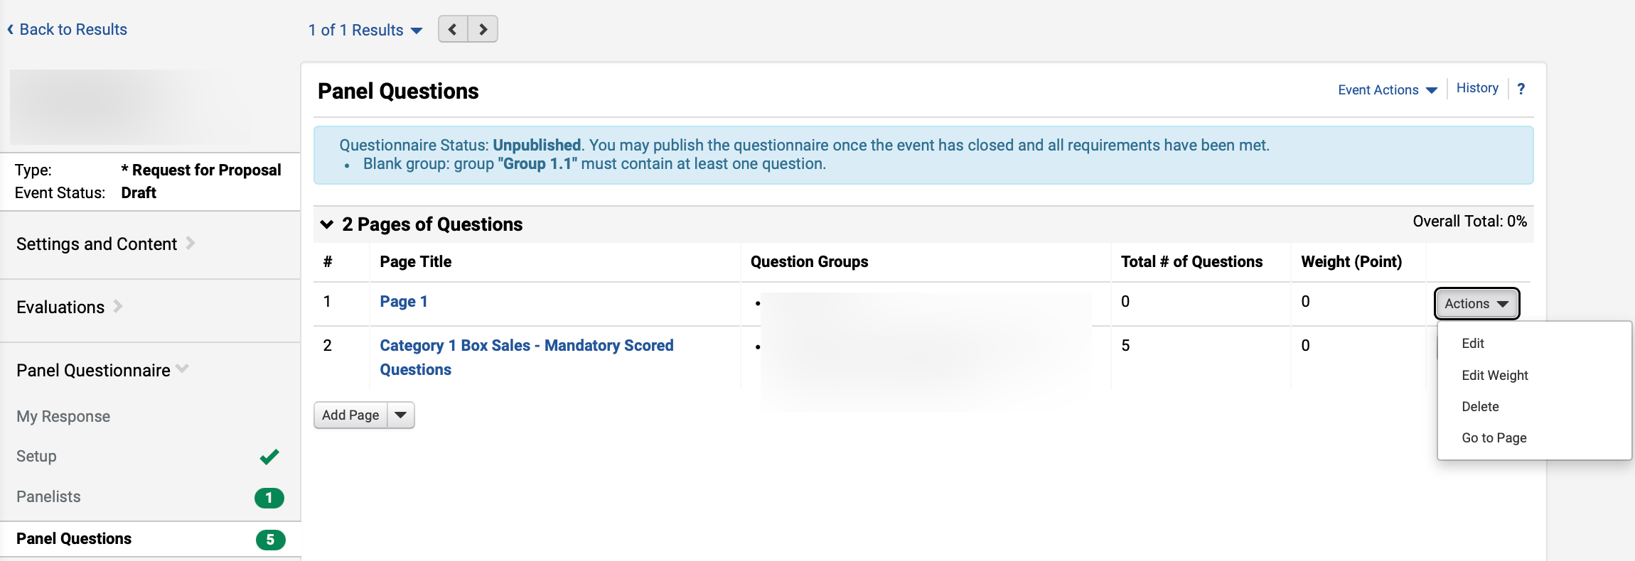
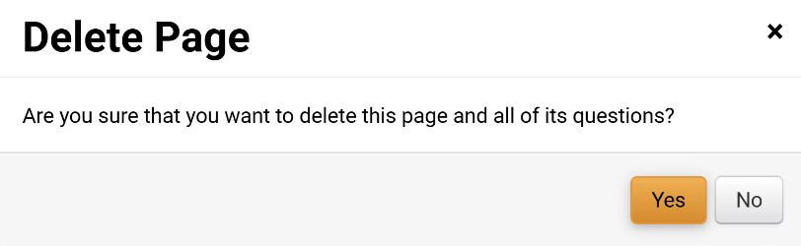
Publish a Panel Questionnaire
(Part 12 of 16)
INSTRUCTIONS
Click Panel Questions.
To delete Page 1, click Actions.
Note: System added Page 1 needs to be deleted before adding Question Weight.
Select Delete.
35
36
34
Click Yes.
Sourcing Event Buyer

Slide 15
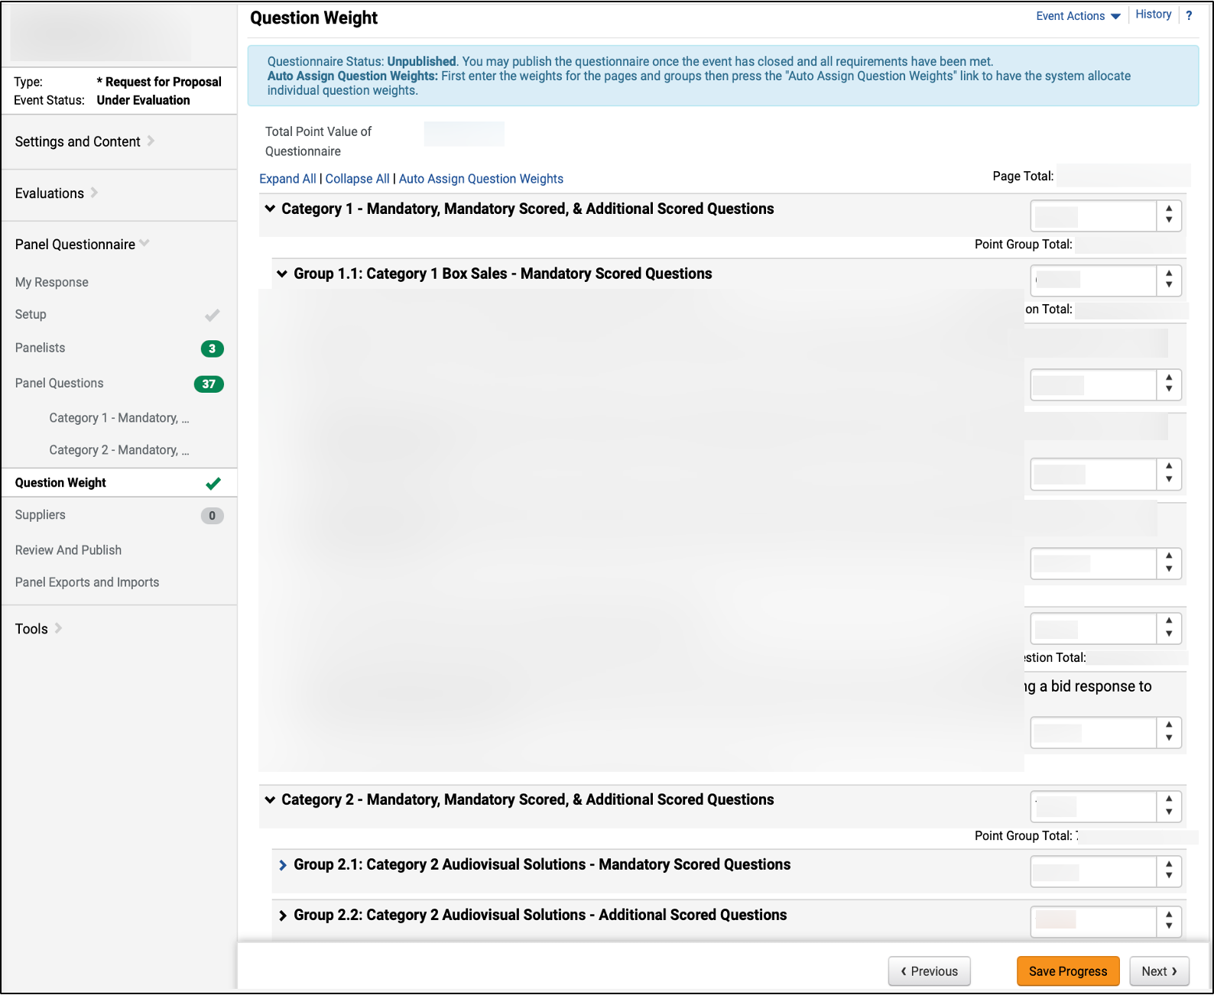
Publish a Panel Questionnaire
(Part 13 of 16)
INSTRUCTIONS
Click Question Weight.
Enter Question Weight for each Question Page and Question Group.
Note: Click arrow to display Category Questions in each Question Group.
Click Save Progress.
Click Suppliers.
39
38
41
40
Sourcing Event Buyer

Slide 16
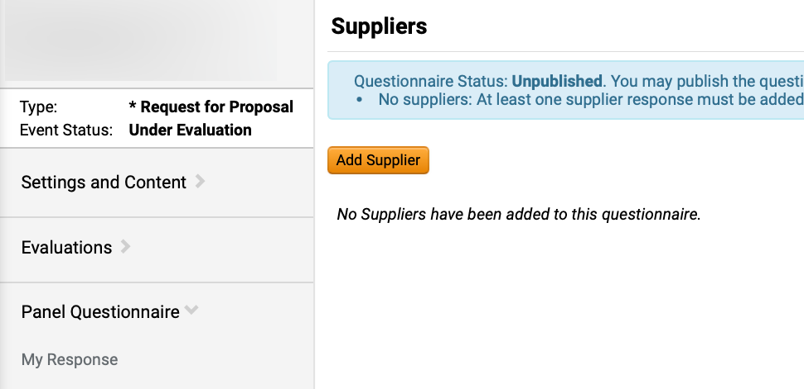
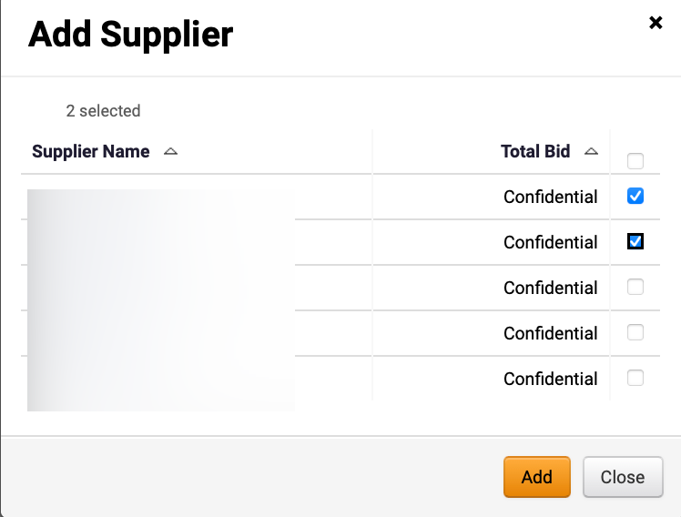
Publish a Panel Questionnaire
(Part 14 of 16)
INSTRUCTIONS
Click Add Supplier.
Click checkbox next to the Supplier Name to Add Supplier.
Note: Multiple Suppliers can be added.
Click Add.
43
44
Sourcing Event Buyer

Slide 17
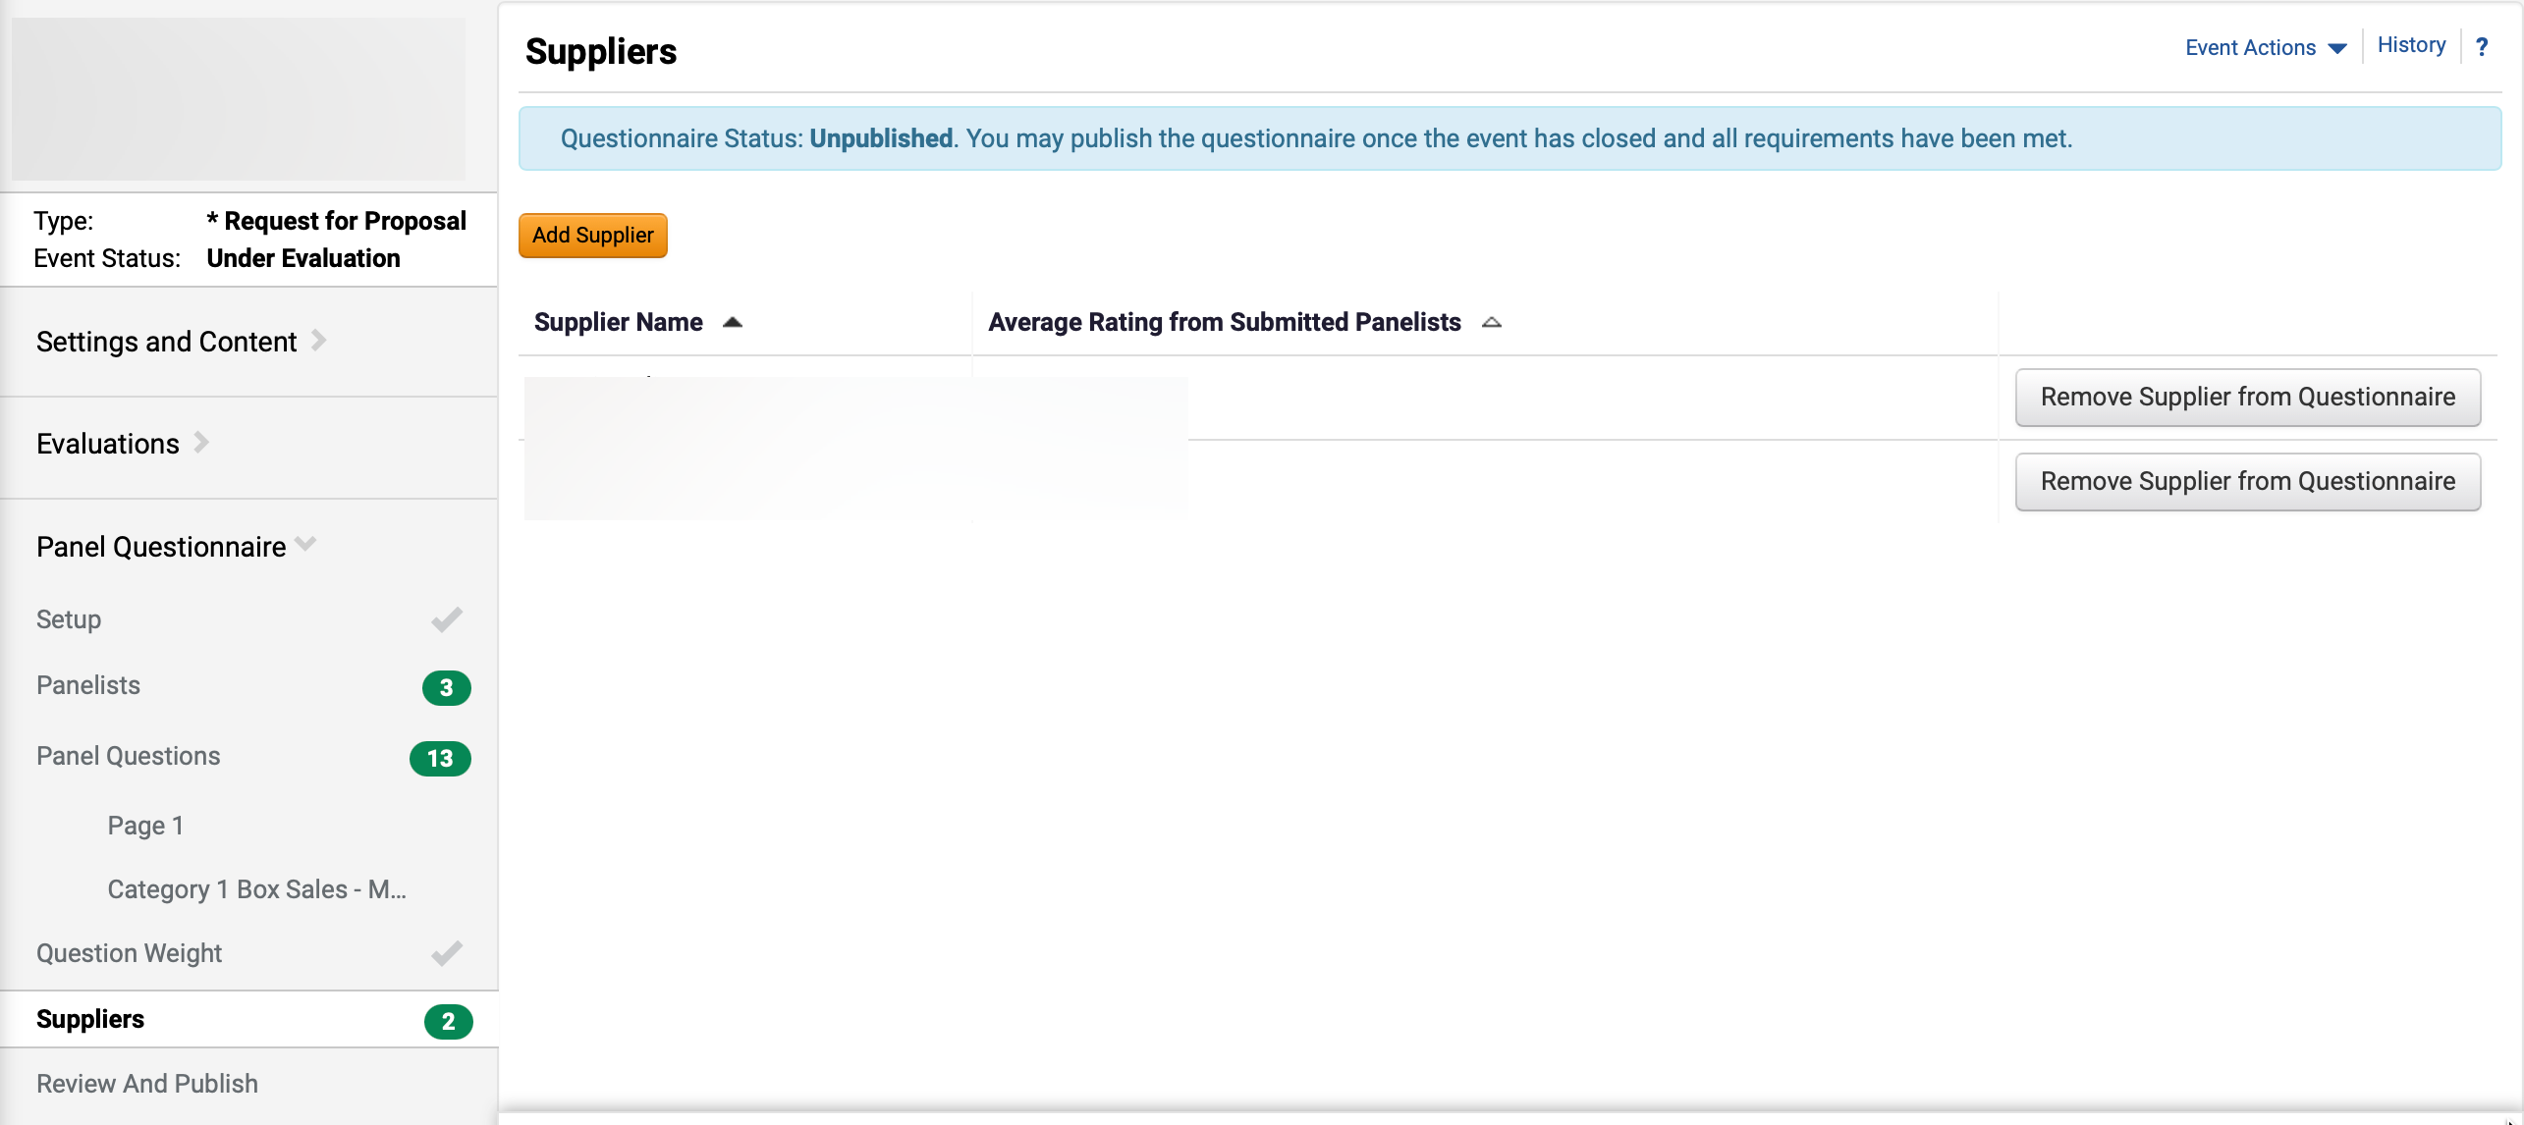
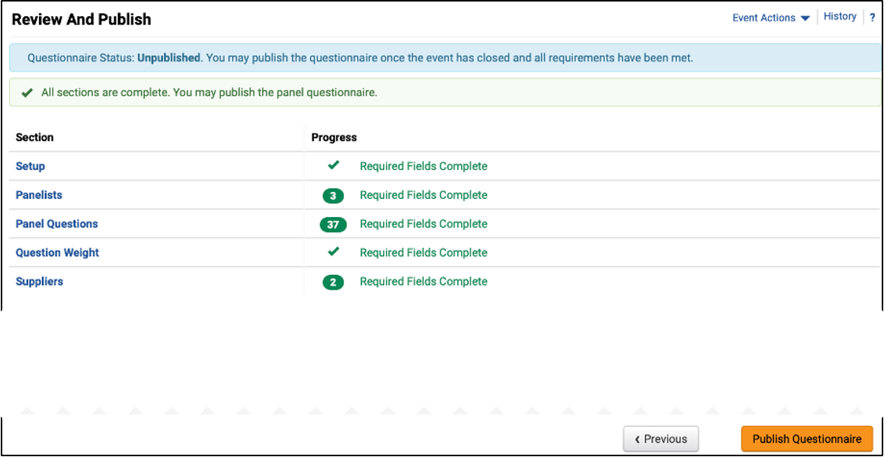
Publish a Panel Questionnaire
(Part 15 of 16)
INSTRUCTIONS
Verify added Suppliers.
Click Review and Publish.
45
46
Review Panel Questionnaire progress.
Click Publish Questionnaire.
47
48
Sourcing Event Buyer

Slide 18
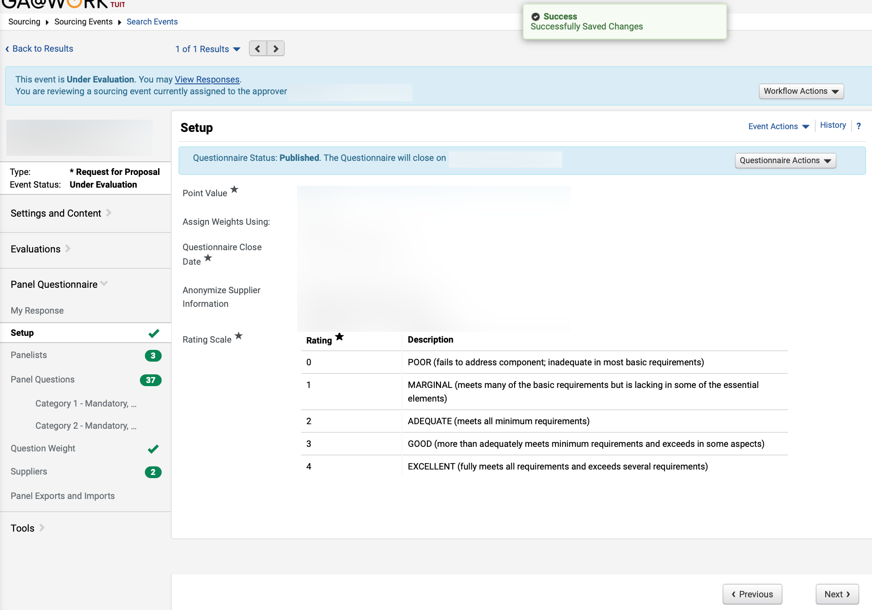
Publish a Panel Questionnaire
(Part 16 of 16)
INSTRUCTIONS
Review Successfully Saved Changes notification.
Review Questionnaire Status: Published.
49
50
Sourcing Event Buyer

Slide 19
Complete and Submit Panel Questionnaire
(Part 1 of 17)
INSTRUCTIONS
Review Action and follow the steps in the table below to access the Questionnaire.
Action | Description | Step Information
 |  | ​
Access Questionnaire via email
Preferred method for local panelists. Applies to all USG, DOT and state agencies without procurement roles.
Step 2
(slide 20)
Access Questionnaire via notification
Applies to all SSO users.
Steps 3 – 6
(slide 21)
Access Questionnaire via Search
Applies to all SSO users.
Steps 7 – 13
(slides 22– 24)
Panelist

Slide 20
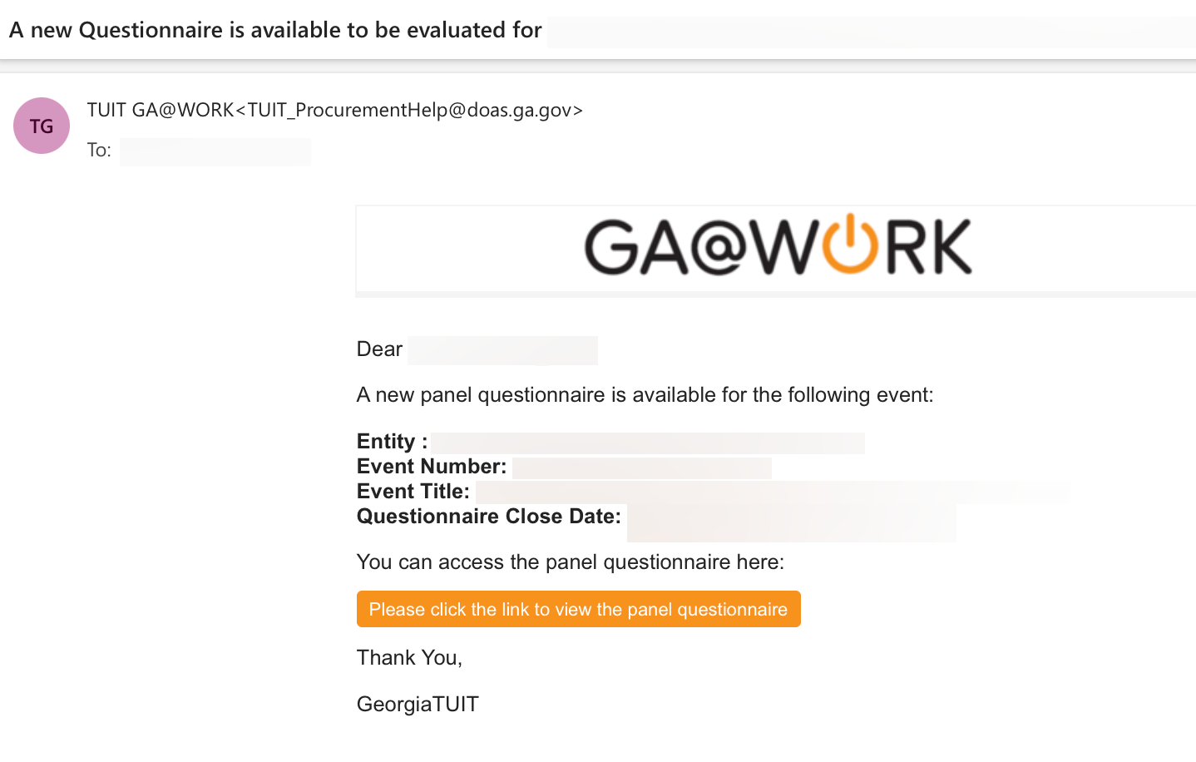
Complete and Submit Panel Questionnaire
(Part 2 of 17)
INSTRUCTIONS
A Panelist can access the Questionnaire multiple ways. If accessing Questionnaire via email, click Please click the link to view the panel questionnaire hyperlink.
Note: Accessing the Questionnaire via email is the preferred method for local users. If accessing via email skip to Step 15 to continue to Review Action or skip to Step 7 if accessing Questionnaire via the Sourcing module.
Panelist

Slide 21
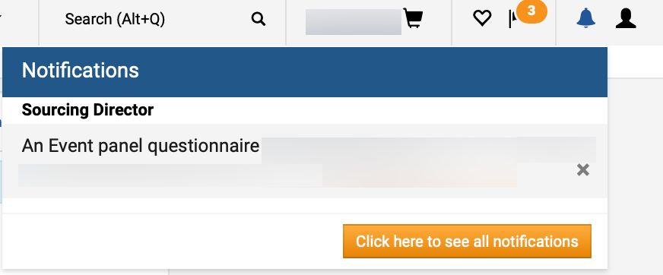
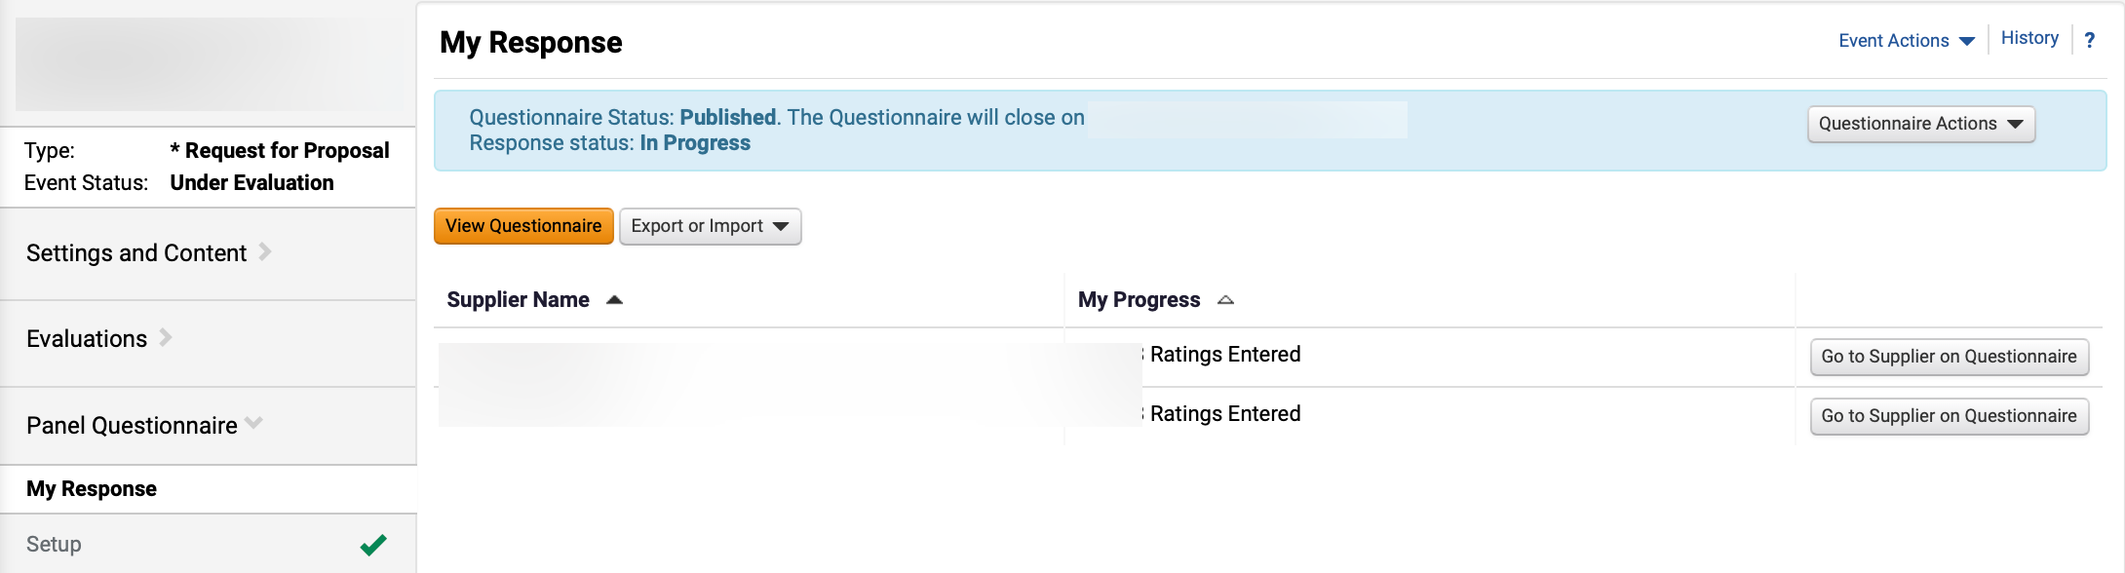
Complete and Submit Panel Questionnaire
(Part 3 of 17)
INSTRUCTIONS
To access Questionnaire via notification, click the Notification Bell icon.
Note: If accessing Questionnaire via notification, follow Steps 4 – 6 and skip to Step 15.
Click Notification.
3
4
Review My Response section.
Click Evaluations.
6
5
Panelist

Slide 22
Complete and Submit Panel Questionnaire
(Part 4 of 17)
INSTRUCTIONS
To access Questionnaire via module search, click the Global Navigation Menu.
Note: University System of Georgia (USG) and GDOT users complete local logon and then proceed to Step 10.
Click Sourcing, Contracts & Supplier Management.
Panelist

Slide 23
Complete and Submit Panel Questionnaire
(Part 5 of 17)
INSTRUCTIONS
Click Sign On.
Note: The system utilizes Single Sign-On (SSO) capabilities
and no log in information is required.
As a Panelist, access the Sourcing module.
Note: If accessing Panel Questionnaire via Sourcing module, follow Steps 11 – 47.
Click Sourcing Events.
Click Search Events.
11
12
10
Panelist

Slide 24
Complete and Submit Panel Questionnaire
(Part 6 of 17)
INSTRUCTIONS
Click the Event Number hyperlink.
Note: Use Filters to find the Sourcing Event. A previously set-up event RFP or RFQC is required, and the status must be draft, open, or in evaluation.
Review Action and follow the steps in the table below to View Questionnaire or Export Questionnaire.
Action | Description | Step Information
 |  | ​
View Questionnaire
Answer Questionnaire via View Questionnaire
Steps 15-25
(slides 25 – 27)
Export Questionnaire
Export Questionnaire to download Questionnaire file
Steps 26 – 47
(slides 28 – 35)
Panelist

Slide 25
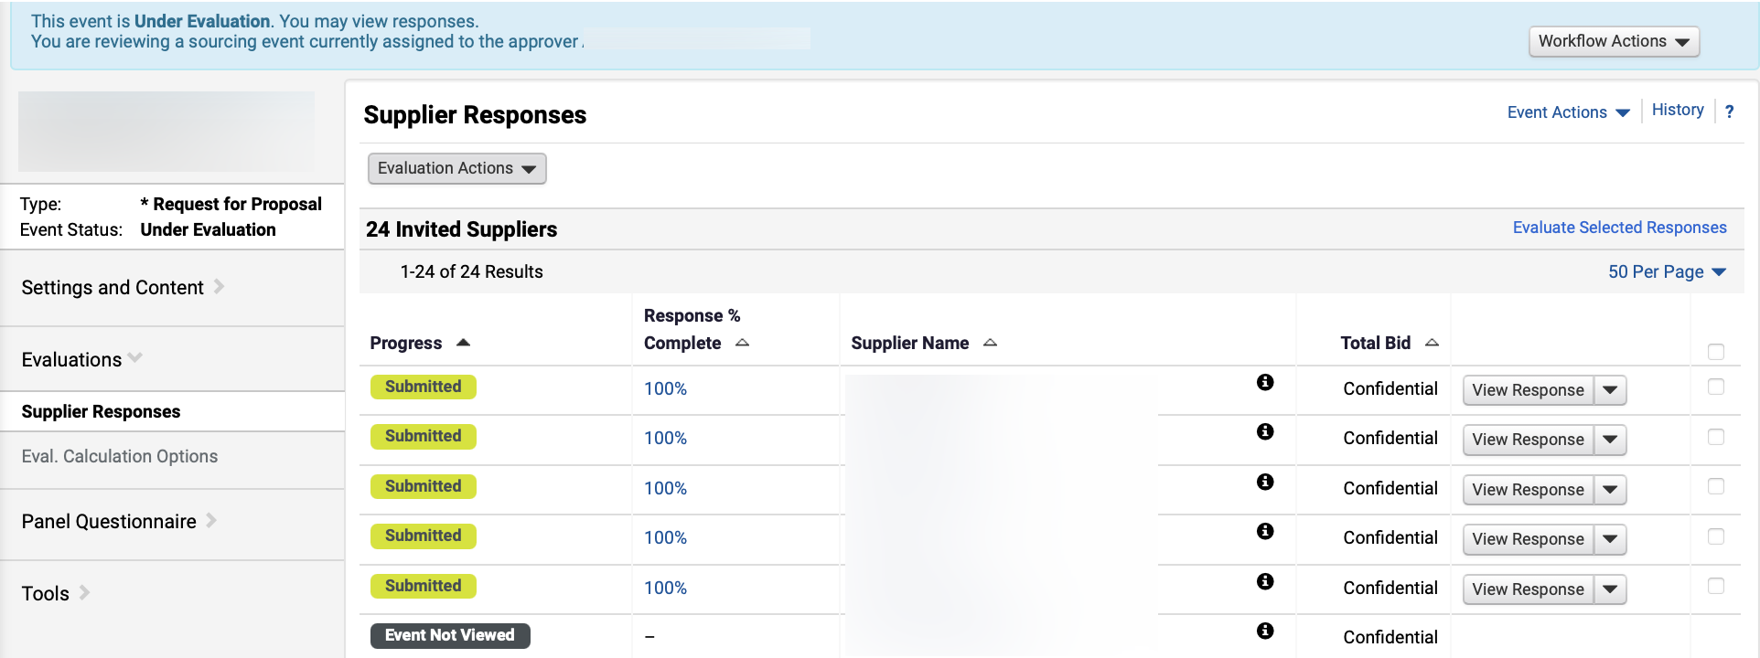
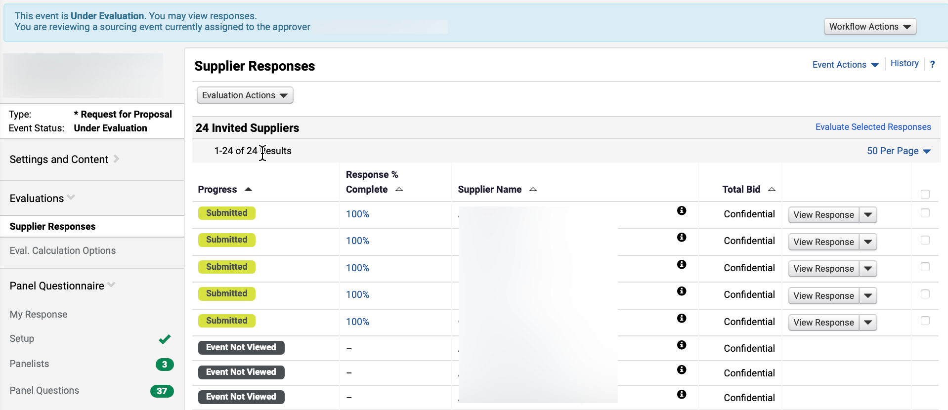
Complete and Submit Panel Questionnaire
(Part 7 of 17)
INSTRUCTIONS
To view questionnaire, click Supplier Responses.
Review Supplier Responses.
16
15
Click Panel Questionnaire to answer the questionnaire.
Select My Response.
18
17
Panelist

Slide 26
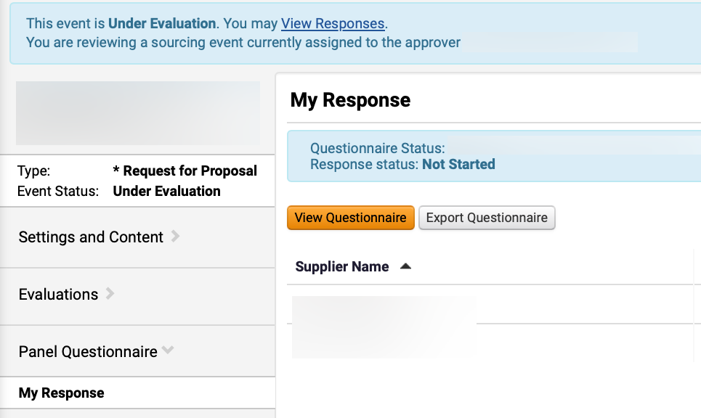
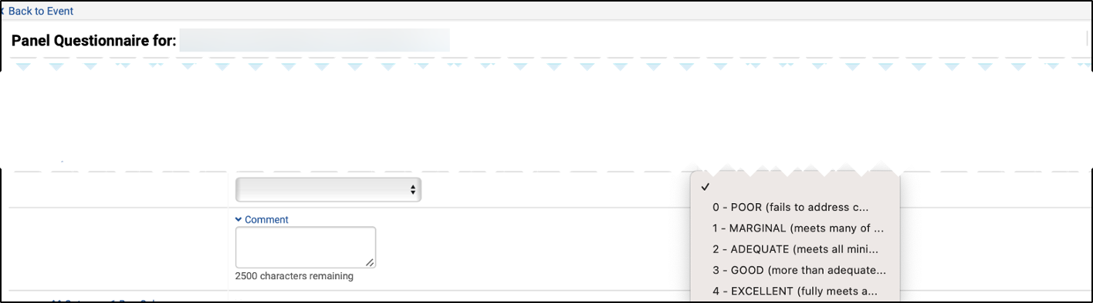
Complete and Submit Panel Questionnaire
(Part 8 of 17)
INSTRUCTIONS
Click View Questionnaire.
Select a Supplier Rating from 0 to 4.
Select Comment hyperlink (required per DOAS policy).
Enter Comment.
21
20
22
Panelist

Slide 27
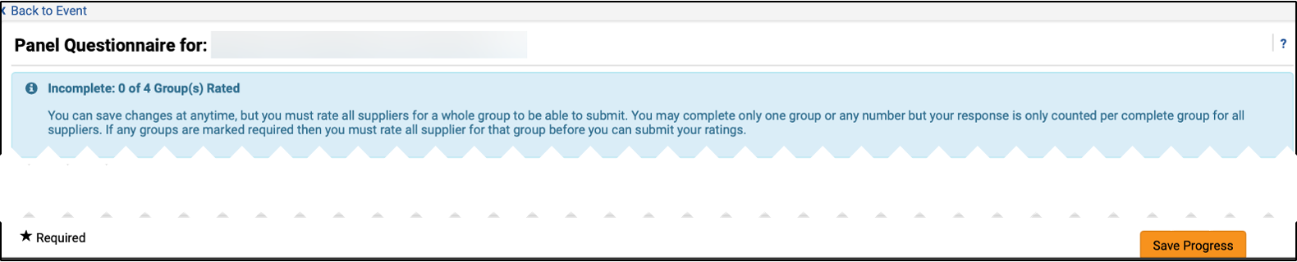
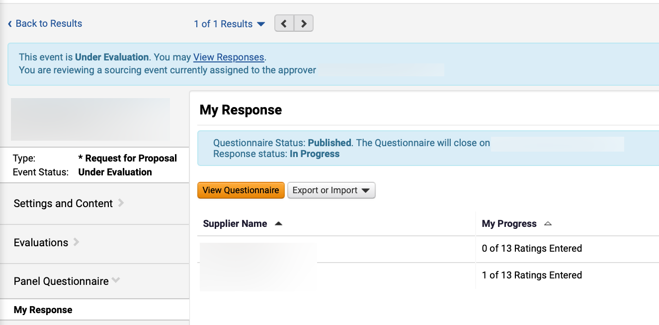
Complete and Submit Panel Questionnaire
(Part 9 of 17)
INSTRUCTIONS
Click Save Progress.
Click Back to Event hyperlink.
24
23
Review My Progress.
Note: Saved Rating will display.
Panelist

Slide 28
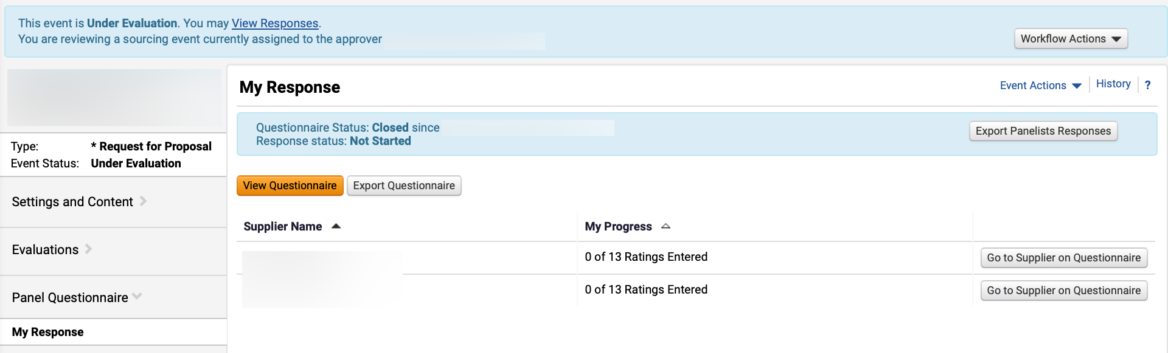
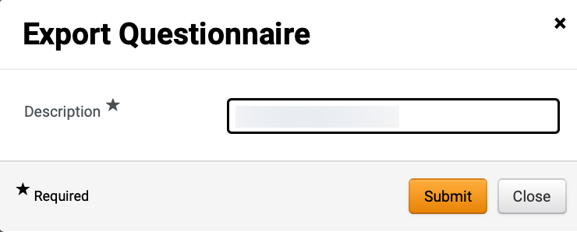
Complete and Submit Panel Questionnaire
(Part 10 of 17)
INSTRUCTIONS
To export questionnaire, click Export Questionnaire.
Enter Description*.
Click Submit.
27
28
Panelist

Slide 29
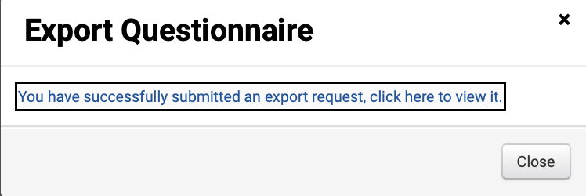
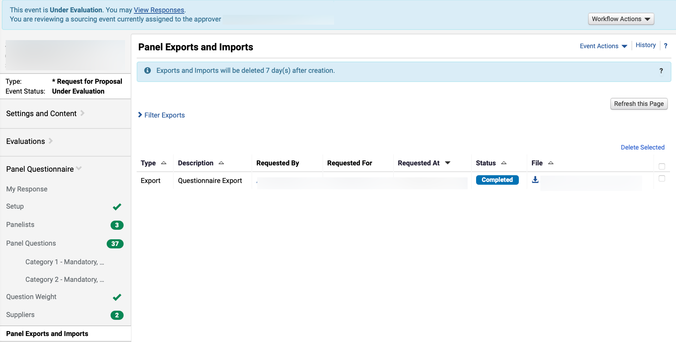
Complete and Submit Panel Questionnaire
(Part 11 of 17)
INSTRUCTIONS
Click You have successfully submitted an export request, click here to view it hyperlink.
Review Exported Questionnaire.
Note: Click Panel Exports and Imports to view all Exports.
To download Questionnaire, click File hyperlink.
30
31
Panelist

Slide 30
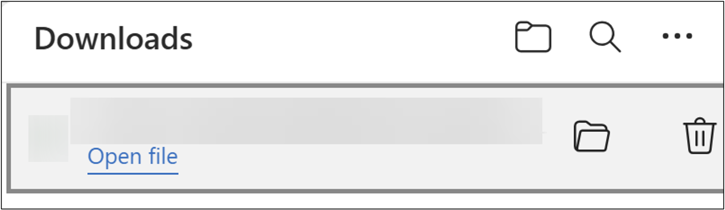
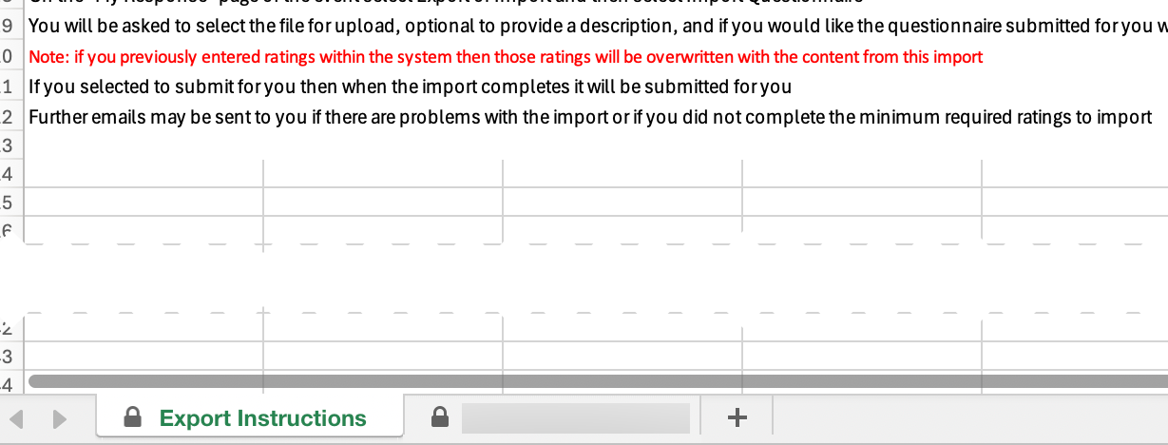
Complete and Submit Panel Questionnaire
(Part 12 of 17)
INSTRUCTIONS
Click Open file.
Note: The document will open as a Microsoft Excel document. This is a protected document.
Review Export Instructions.
Click File tab.
33
34
Panelist

Slide 31
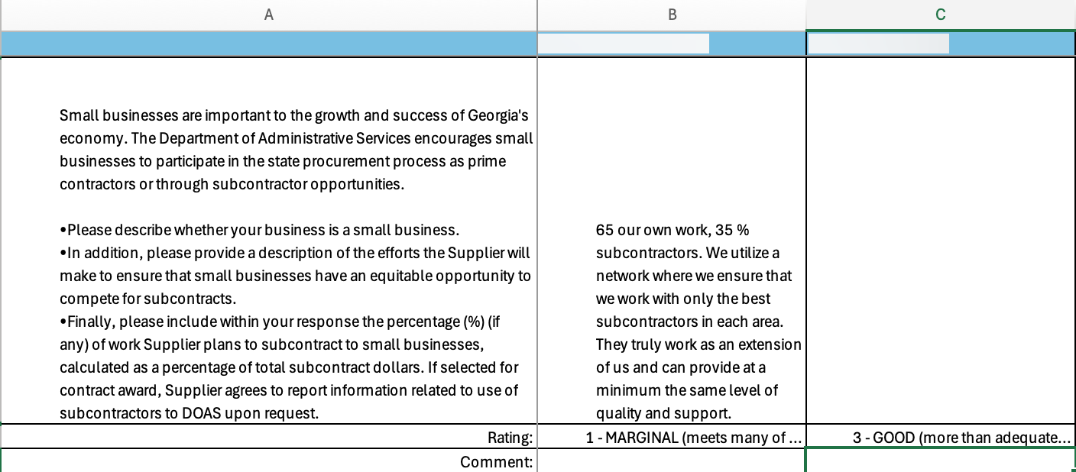
Complete and Submit Panel Questionnaire
(Part 13 of 17)
INSTRUCTIONS
Select Ratings.
Note: Only the Rating and Comment fields can be edited, all other rows are locked.
Enter Comments.
35
36
Panelist

Slide 32
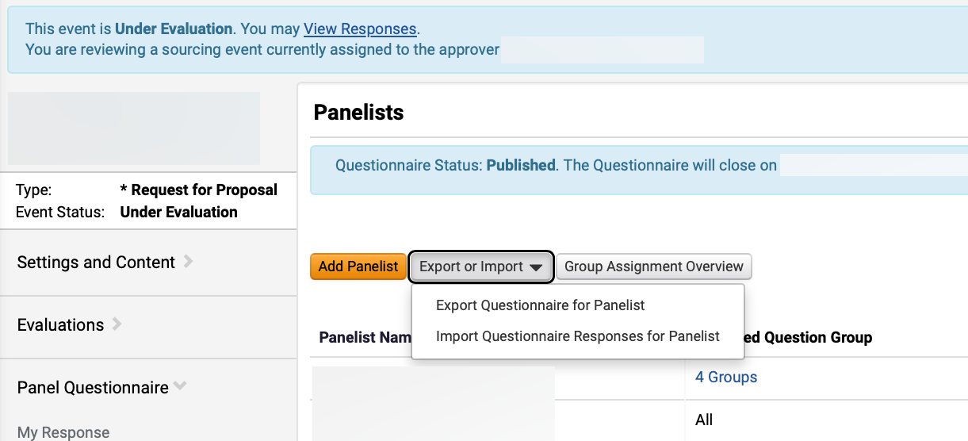
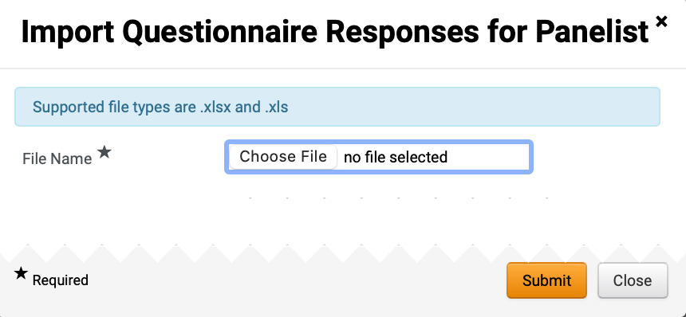
Complete and Submit Panel Questionnaire
(Part 14 of 17)
INSTRUCTIONS
Click Export or Import.
Select Import.
37
38
Click Choose File to add File Name*.
Note: Supported file types are .xlsx and .xls only.
Panelist

Slide 33
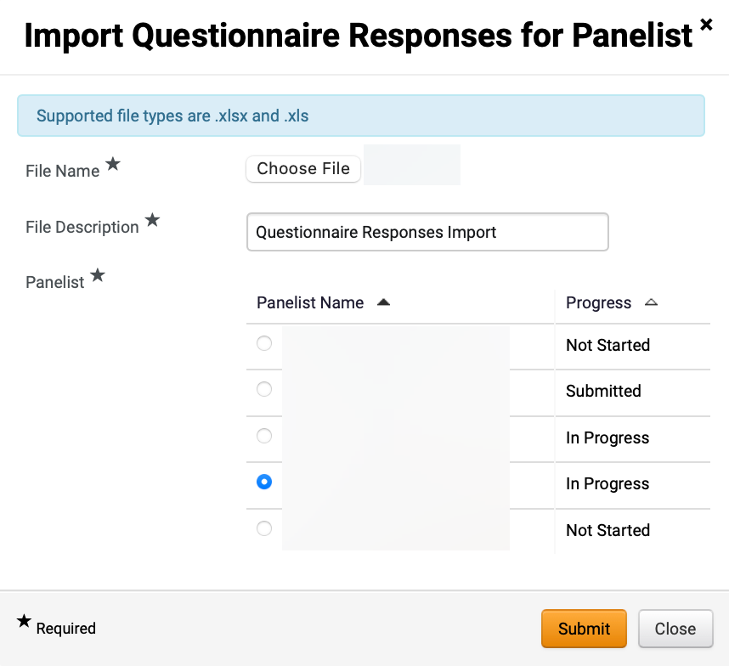
Complete and Submit Panel Questionnaire
(Part 15 of 17)
INSTRUCTIONS
Review uploaded File Name*.
Review File Description*.
Note: File Description will auto-populate but can be edited.
Check the Panelist Name box, as applicable.
Click Submit.
40
41
42
43
Panelist

Slide 34
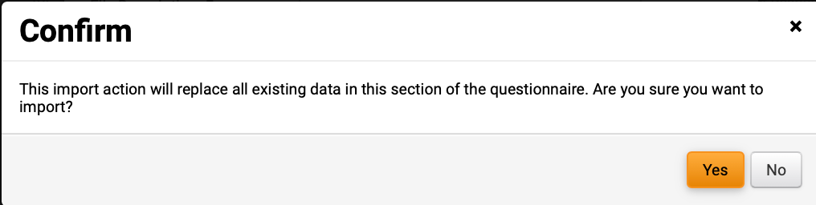
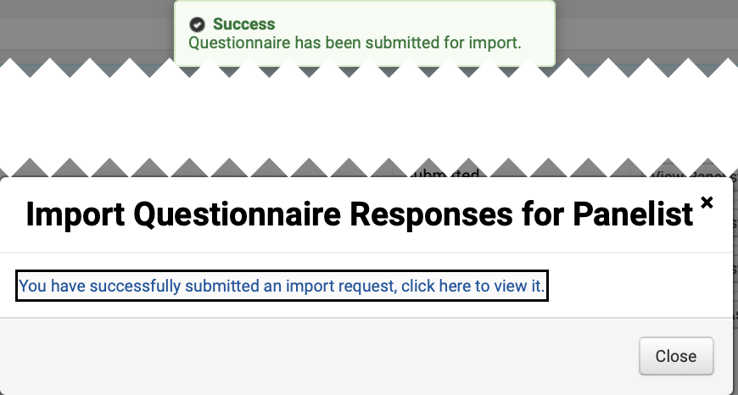
Complete and Submit Panel Questionnaire
(Part 16 of 17)
INSTRUCTIONS
Click Yes.
Review Success notification.
Click hyperlink to review Questionnaire Import Request.
45
46
Panelist

Slide 35
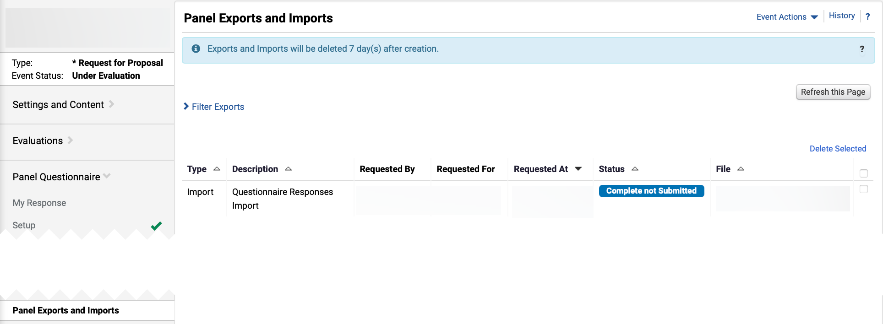
Complete and Submit Panel Questionnaire
(Part 17 of 17)
INSTRUCTIONS
Review Questionnaire Responses Import.
Panelist

Slide 36



Finalize Sourcing Event Using Panel Questionnaire (Part 1 of 2)
PROCESS
As a Sourcing Event Buyer, review the following steps for process flow information.
Download Questionnaire
The Sourcing Event Buyer downloads the Questionnaire.
Review Ratings and Comments
The Sourcing Event Buyer reviews the ratings and comments on the Questionnaire.
Schedule Validation Meeting
The Sourcing Event Buyer schedules the validation meeting as per policy requirements. See GPM 5.6.3.2.1. Technical Evaluation Process.
Sourcing Event Buyer

Slide 37



Finalize Sourcing Event Using Panel Questionnaire (Part 2 of 2)
PROCESS
Conduct Validation Meeting
The Sourcing Event Buyer conducts the validation meeting and reviews the ratings and comments. If the Sourcing Event Buyer opens the Questionnaire (recommended), then the Panelist can change the ratings in real-time.
Follow Job Aids for Next Steps
Follow Job Aids for Negotiations, Awarding Event, and Create a Contract from a Sourcing Event for next steps.
Sourcing Event Buyer
You have successfully managed and finalized the Sourcing Event using Panel Questionnaire.

