Slide 1
Create an Assignment
DESCRIPTION
This guide will show the State Purchasing Division Contract Pricing and Analysis Team Manager or designee How to Create an Assignment for statewide contract quarterly sales reports.
OVERVIEW
The key steps in the process are below:
Search and select View Integration System.
Select the Integration System and click OK.
Click More Actions and select Integration, select Launch/Schedule.
Select the Integration Criteria, the year and the quarter.
Click OK.
Business Process:
Select View Integration System.
Select the Integration QSR.
Select the Integration criteria.
Click OK.

Slide 2
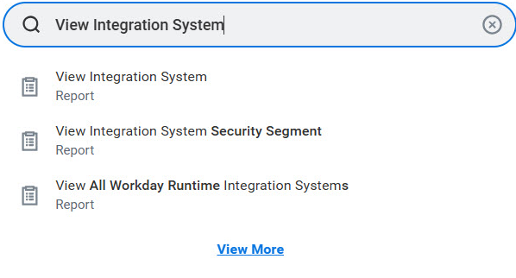
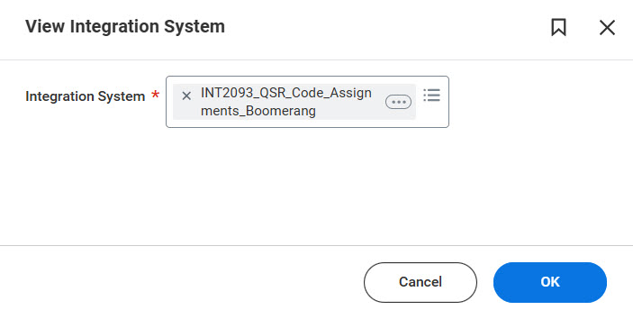
Create an Assignment (Part 1 of 3)
INSTRUCTIONS
Search View Integration System.
Click View Integration System report.
1
2
Select the Integration System*.
Click OK.
3
4

Slide 3
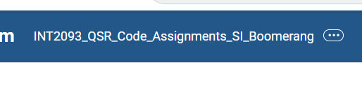

Create an Assignment (Part 2 of 3)
INSTRUCTIONS
Click Related Actions (…).
Click Integration.
Select Launch/Schedule.
6
7

Slide 4
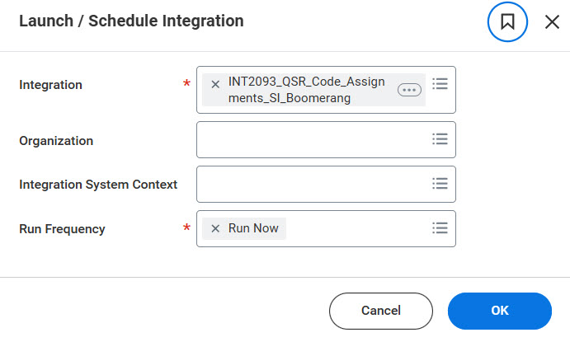
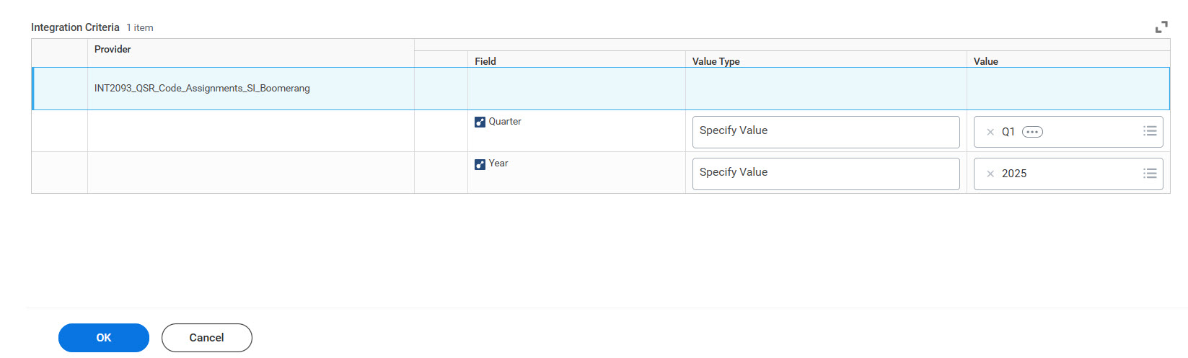

Create an Assignment (Part 3 of 3)
INSTRUCTIONS
Verify the Integration* and Run Frequency*.
Note: This will auto-populate.
Click OK.
8
9
Select the Integration Criteria, the year and the quarter.
Click OK.
10
11
You have successfully created an assignment.

