Slide 1
Quarterly Sales Report (QSR)
Admin Fee - How to Pay
DESCRIPTION
This guide will show a Contract Supplier (DOAS statewide contracts) how to pay the Quarterly Sales Report (QSR) Administrative Fee.
OVERVIEW
The key steps in the process are below:
Access the Invoice Email with remittance information in your inbox and click the link to access ePAS.
Select the Invoice(s) to pay and click Next.
Review the Invoice(s) and click Proceed to Checkout.
Select how you wish to pay and the Payment Method.
Enter the Credit Card information, check the Acknowledgement and click Pay Amount.
View the Confirmation of payment.
Business Process:
Access the Invoice email with Remittance
Pay the QSR Admin Fee
View the Confirmation of Payment

Slide 2
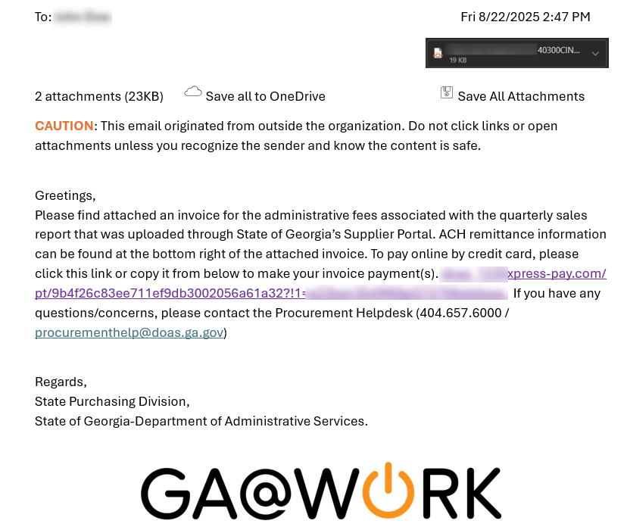
Quarterly Sales Report (QSR) Admin Fee - How to Pay (Part 1 of 6)
INSTRUCTIONS
Access the Invoice Email with remittance information in your inbox and click the link to access ePAS.

Slide 3
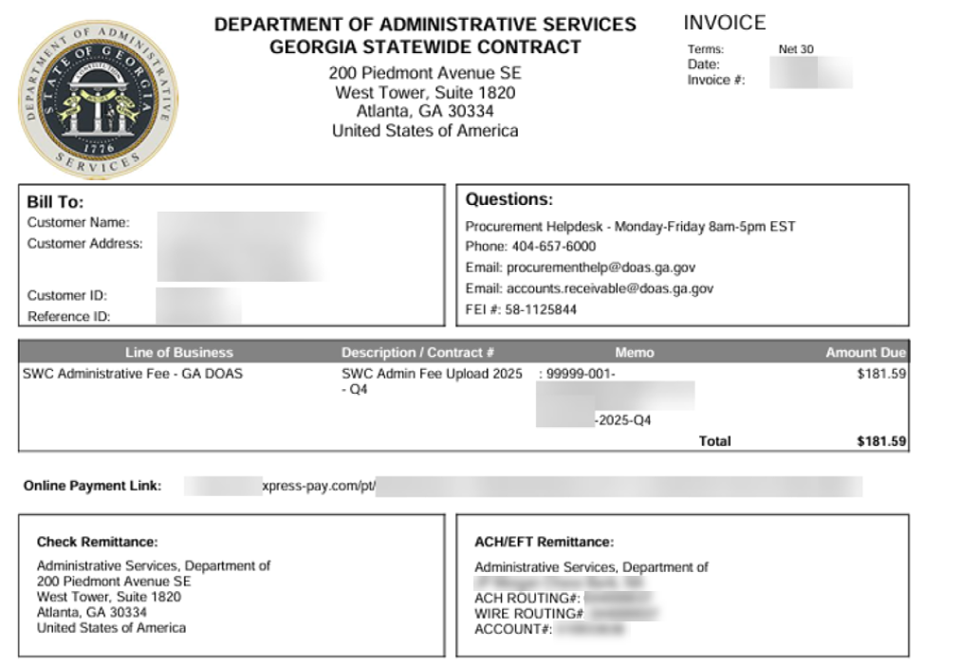
Quarterly Sales Report (QSR) Admin Fee - How to Pay (Part 2 of 6)
INSTRUCTIONS
The Invoice PDF is attached to the email. The bottom of the Invoice displays how to Pay Admin Fees with a Check Remittance or with an ACH/EFT Remittance, if desired.
ACH/EFT is preferred method of payment. If you require assistance with completing the form, contact DOAS Fiscal Services Phone: 404-657-9410 or by Email: fiscalservices@doas.ga.gov.

Slide 4
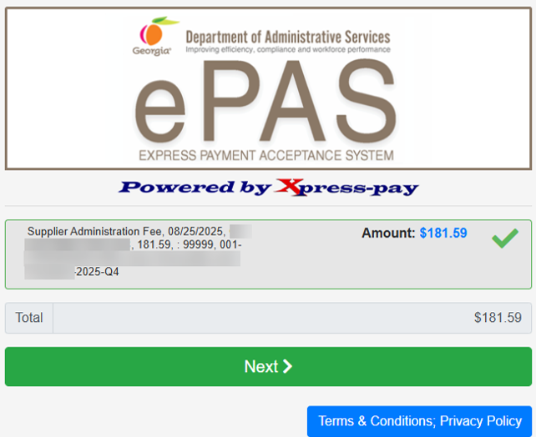
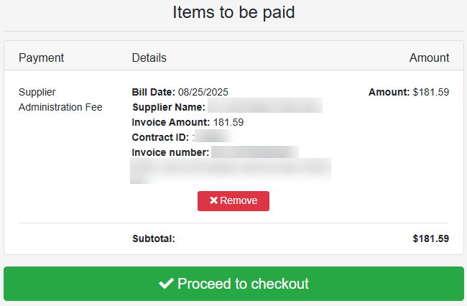
Quarterly Sales Report (QSR) Admin Fee - How to Pay (Part 3 of 6)
INSTRUCTIONS
Select the Invoice(s) to pay.
Click Next.
2
3
Review the Invoice for accuracy and click Proceed to Checkout.
Note: Click Remove for the item(s), if necessary.

Slide 5
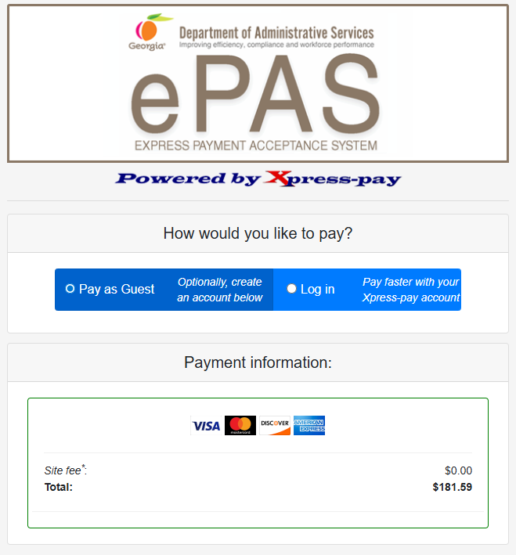
Quarterly Sales Report (QSR) Admin Fee - How to Pay (Part 4 of 6)
INSTRUCTIONS
Select Pay as Guest or Log in through your Xpress-pay account.
Select the Card Type (Visa, MasterCard, Discover or American Express).
5
6

Slide 6
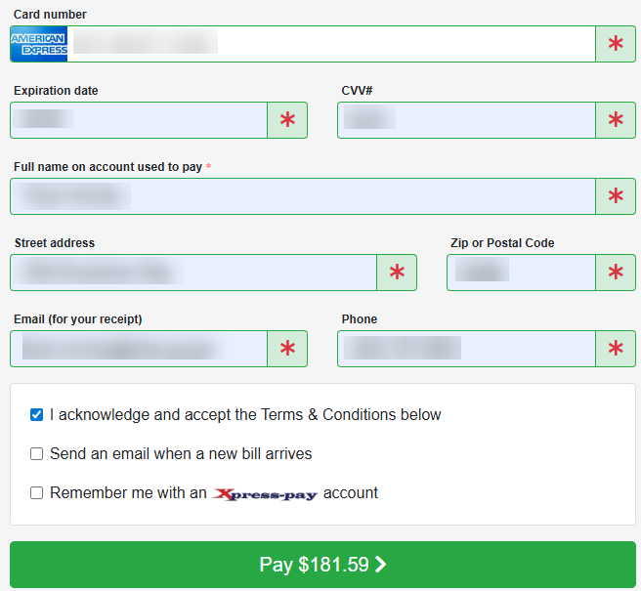
Quarterly Sales Report (QSR) Admin Fee - How to Pay (Part 5 of 6)
INSTRUCTIONS
Enter Card number*.
Enter Expiration date* and CVV#*.
Enter Full name on account used to pay*.
Enter Street address* and Zip or Postal Code*.
Enter Email (for your receipt)* and Phone*.
Check I acknowledge and accept the Terms & Conditions below.
Click Pay $Amount.
7
8
9
10
11
12
13

Slide 7
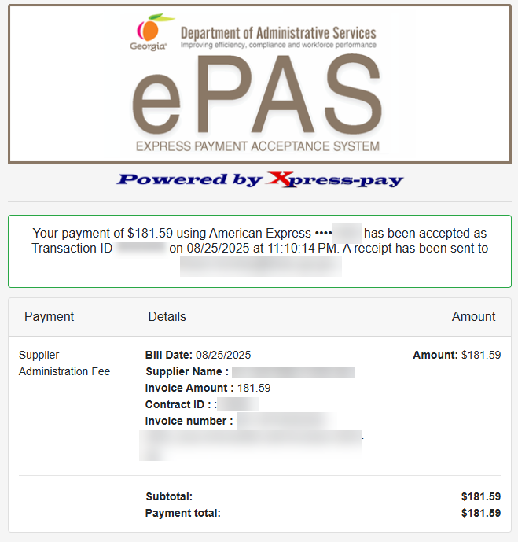
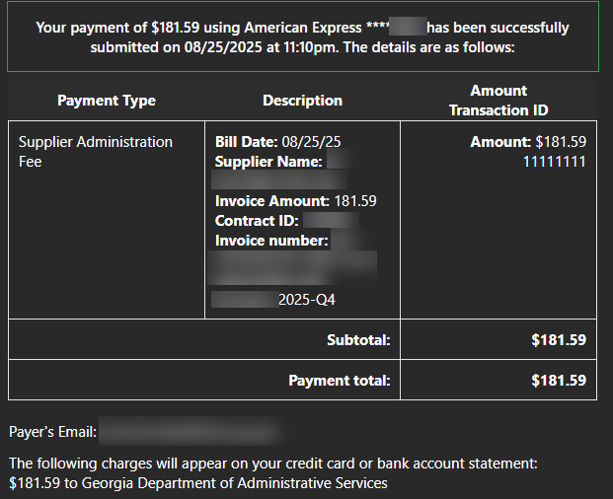

Quarterly Sales Report (QSR) Admin Fee - How to Pay (Part 6 of 6)
INSTRUCTIONS
View the Confirmation of Payment.
Note: The Supplier also receives a confirmation email.
You have successfully paid the quarterly sales report (QSR) admin fee.

