Slide 1
Supplier Quarterly Sales Report Upload Process (GA@WORK Supplier Management)
This guide will show a Contract Supplier (DOAS statewide contract) how to Upload a Quarterly Sales Report (QSR) via the GA@WORK Supplier Management.
OVERVIEW
The key steps in the process are below:
Access the automated Quarterly Sales Reporting email and click the link to access GA@WORK.
Select Native Login.
Enter your credentials and click Sign In.
Enter QSR Search in the search field and select the task.
Enter the required* fields and additional information. Then, click OK.
Add Attachments, click OK and click Create.
Enter Email Id’s*, Total Sales* and click OK.
Business Process:
Access the QSR automated email
QSR Upload Process
Pay the QSR Admin Fee
Disclaimer: Due to regular system updates, the screens and features in GA@WORK may differ slightly from those shown in this job aid. For questions or assistance, please contact the Help Desk.

Slide 2
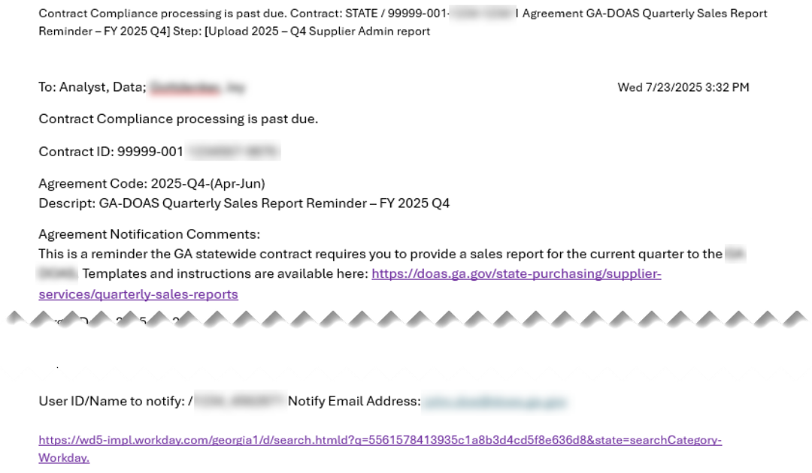
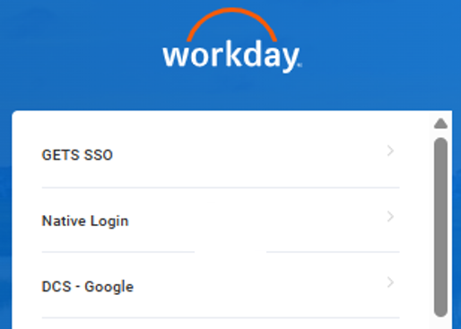
Supplier Quarterly Sales Report (QSR) Upload Process (GA@WORK Supplier Mgmt.) (Part 1 of 7)
INSTRUCTIONS
Access the automated email for Quarterly Sales Reporting in your inbox and click the link to access GA@WORK.
Click Native Login.

Slide 3
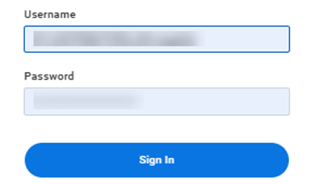
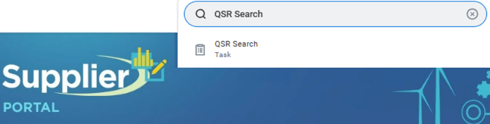
Supplier Quarterly Sales Report (QSR) Upload Process (GA@WORK Supplier Mgmt.) (Part 2 of 7)
INSTRUCTIONS
Enter your Username.
Enter your Password.
Click Sign In.
3
4
5
Enter QSR Search in the Search field.
Select the QSR Search task.
6
7

Slide 4
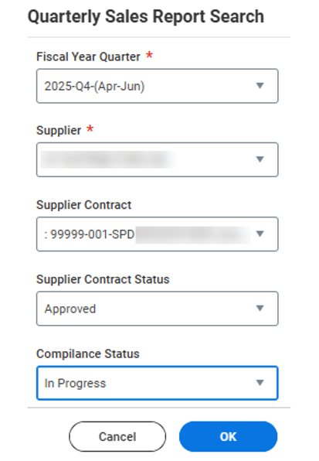
Supplier Quarterly Sales Report (QSR) Upload Process (GA@WORK Supplier Mgmt.) (Part 3 of 7)
INSTRUCTIONS
Select a Fiscal Year Quarter*.
Select a Supplier*.
Select the applicable Supplier Contract.
Select Supplier Contract Status as Approved.
Select Compliance Status as In Progress.
Click OK.
8
9
10
11
12
13

Slide 5
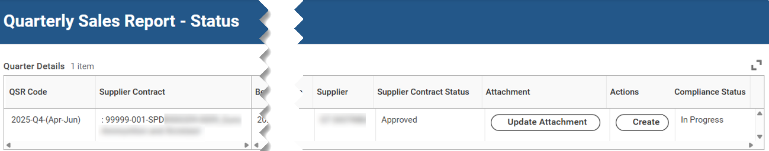
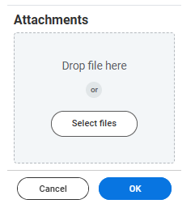
Supplier Quarterly Sales Report (QSR) Upload Process (GA@WORK Supplier Mgmt.) (Part 4 of 7)
INSTRUCTIONS
Verify Quarter Sale Report Status information is accurate and click Update Attachment.
Click Select files or Drop file here.

Slide 6
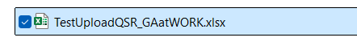
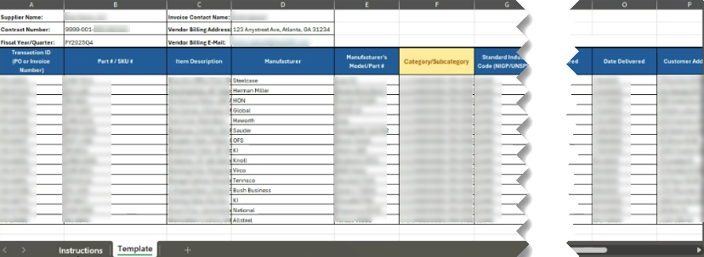
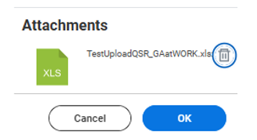
Supplier Quarterly Sales Report (QSR) Upload Process (GA@WORK Supplier Mgmt.) (Part 5 of 7)
INSTRUCTIONS
Select the desired file.
Note: You must attach the appropriate template for the
QSR to upload properly (see example below).
Click OK.

Slide 7
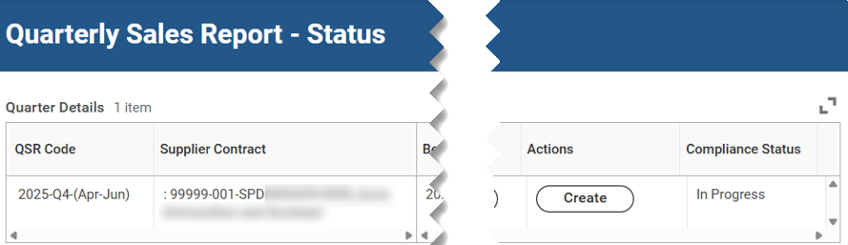
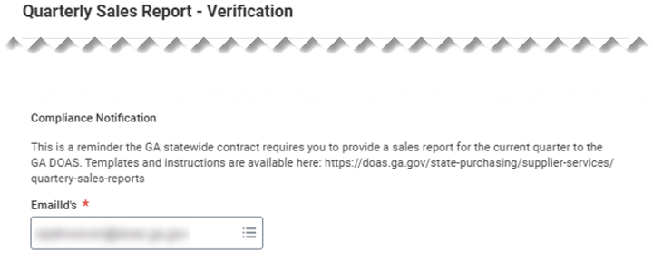
Supplier Quarterly Sales Report (QSR) Upload Process (GA@WORK Supplier Mgmt.) (Part 6 of 7)
INSTRUCTIONS
Click Create.
Select EmailId’s*.
Note: Multiple email addresses may be chosen based on the existing Georgia DOAS SPD maintained lists. If the email does not exist, a Pop-Up Note (see below) appears to instruct the person submitting.

Slide 8
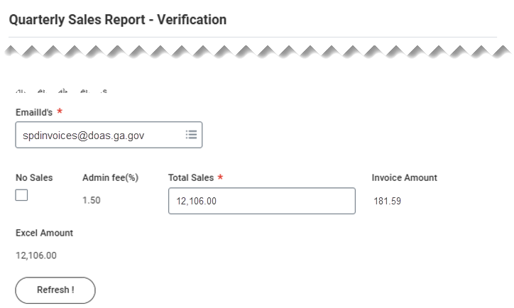
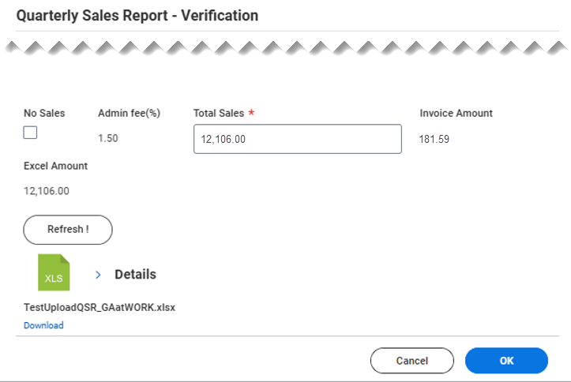

Supplier Quarterly Sales Report (QSR) Upload Process (GA@WORK Supplier Mgmt.) (Part 7 of 7)
INSTRUCTIONS
Enter the Total Sales*.
Note: This figure should match the Excel Amount. It is used
to calculate the administrative fee and must align with
supporting data. An error generates if it does not match.
Click OK.
You have successfully uploaded a quarterly sales report (QSR) via the GA@WORK Supplier Management.

