Slide 1
Cancel P-Card
Prior Approval Request
DESCRIPTION
This guide will show Cardholders how to Locate and Cancel ‘In Progress’ P-Card Prior Approval Requests regardless of whether the cardholder or someone on their behalf created the request.
Note: Optional steps provided for requesting a resolution update to 'Canceled' for unwanted Approved Requests.
OVERVIEW
The key steps in the process are below:
Select either the CRPROC – PCARD – My P-Card Prior Approval Requests report or the CRPROC – PCARD – Requests Submitted On My Behalf report.
Click Related Actions (…) next to the desired ‘In Progress’ Request.
Hover over Request, then click Cancel.
Click Submit.
Confirm Request document status updates to Canceled.
Cancel unwanted Approved Requests, as applicable.
Business Process:
Run P-Card Prior Approval Request Report
Select & Cancel ‘In Progress’ Prior Approval Request
Confirm Request Status Updates to ‘Canceled’

Slide 2
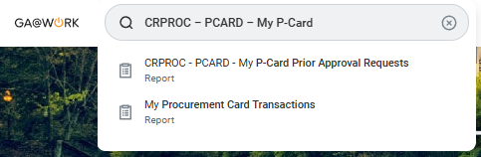
Cancel P-Card Prior Approval Request (Part 1 of 5)
INSTRUCTIONS
If you are the Cardholder or Request Initiator and need to locate and cancel requests you created, enter CRPROC – PCARD – My P-Card in the Search field.
Note: Skip to Step 5 if you are a Cardholder and need to locate and cancel requests created by others on your behalf.
Select CRPROC – PCARD – My P-Card Prior Approval Requests report.
1
2

Slide 3
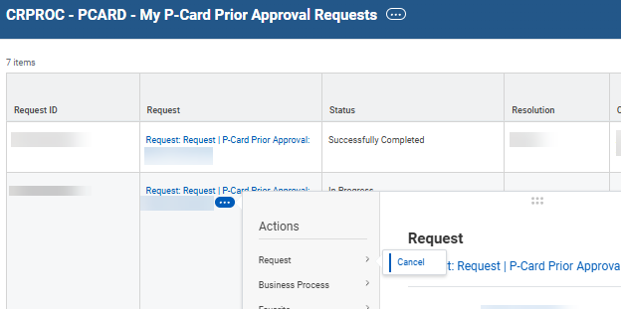
Cancel P-Card Prior Approval Request (Part 2 of 5)
INSTRUCTIONS
Click Related Actions (…) for the applicable Request.
Note: Verify the Request Status is ‘In Progress’.
Hover over Request and click Cancel.
Note: Skip to Step 9.
3
4

Slide 4

Cancel P-Card Prior Approval Request (Part 3 of 5)
INSTRUCTIONS
If you are the Cardholder and need to locate and cancel requests created by others on your behalf, enter CRPROC – PCARD – Requests in the Search field.
Select CRPROC – PCARD – Requests Submitted On My Behalf report.
5
6

Slide 5
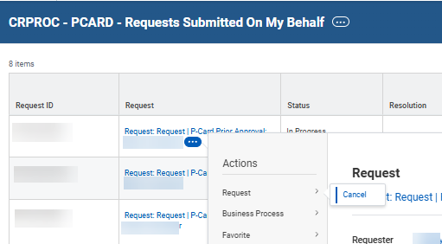
Cancel P-Card Prior Approval Request (Part 4 of 5)
INSTRUCTIONS
Click Related Actions (…) for the applicable Request.
Note: Verify the Request Status is ‘In Progress’.
Hover over Request and click Cancel.
7
8

Slide 6
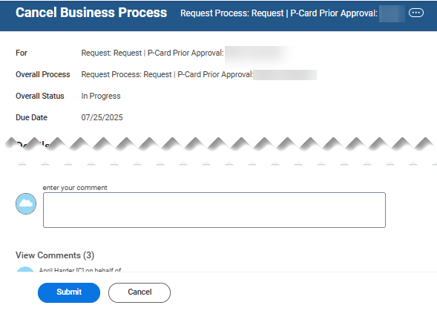
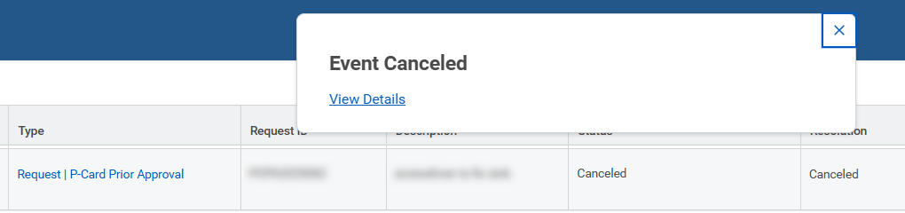
Cancel P-Card Prior Approval Request (Part 5 of 5)
INSTRUCTIONS
Review the ‘In Progress’ Request, and enter your comments, as applicable.
Click Submit.
Note: To discontinue Cancel action, click Cancel.
9
10
View the confirmation of Event Canceled which displays in the report status. Note: Click View Details, optional. The link provides details of the request canceled along with further confirmation of cancelation.

Slide 7
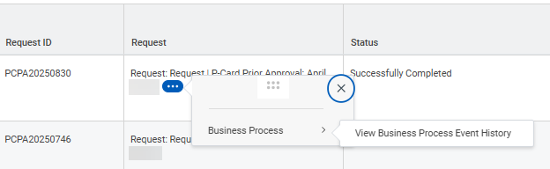
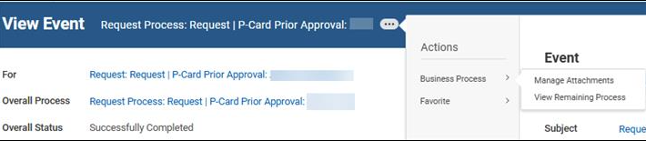
Close Unwanted P-Card Prior Approval Request (Part 1 of 2)
INSTRUCTIONS
If you need to Close an Approved Request that is no longer needed, use the following steps. Once a Request status reflects ‘Successfully Completed’, the Cancel option is no longer available.
It is encouraged that cardholders click Related Actions (…).
Hover over Business Process and click Manage Attachments.
2
3

Slide 8
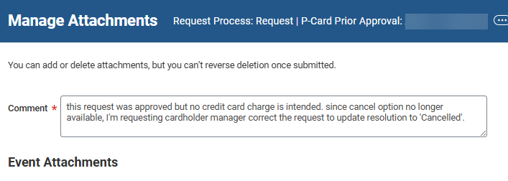


Close Unwanted P-Card Prior Approval Request (Part 2 of 2)
INSTRUCTIONS
Enter a Comment* on the Request. It is recommended that you send an email to notify the cardholder’s manager of the need for updating the request resolution to ‘Cancelled’.
Note: An attachment is not required.
Click OK.
You have successfully canceled both ‘In Progress’ and 'Successfully Completed' P-Card Prior Approval Requests.

