Slide 1
Find and Edit Credit Card for Credit Card Admins
DESCRIPTION
Credit Cards are added and maintained through a bank file that loads daily. This guide will show SAO & DOAS Credit Card Administrators how to find and manually edit credit cards, when necessary.
OVERVIEW
The key steps in the process are below:
Enter CRPROC – PCARD – Find Credit Cards in the Search field.
Click CRPROC – PCARD – Find Credit Cards report.
Enter desired Search Parameters and click OK.
Click Related Actions (…) for specific Credit Card in Credit Card column.
Click Edit within the Credit Card Action.
Edit Credit Card Account information.
Click OK.
Business Process:
Select Report
Identify & Select Credit Card to Edit
Edit Credit Card Account Information
Click OK

Slide 2

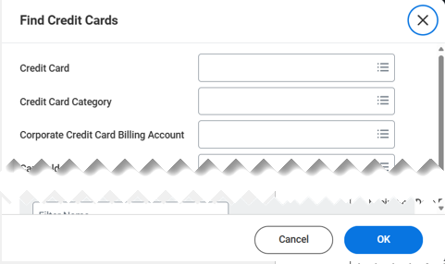
Find and Edit Credit Cards (Part 1 of 4)
INSTRUCTIONS
Enter CRPROC – PCARD - Find Credit Cards in the Search field.
Click the CRPROC – PCARD - Find Credit Cards report.
1
2
Enter desired Search Parameters.
Click OK.
3
4

Slide 3
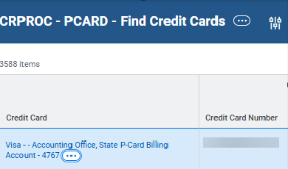
Find and Edit Credit Cards (Part 2 of 4)
INSTRUCTIONS
Click Related Actions (…) in the Credit Card column, next to the Credit Card you want to edit.

Slide 4
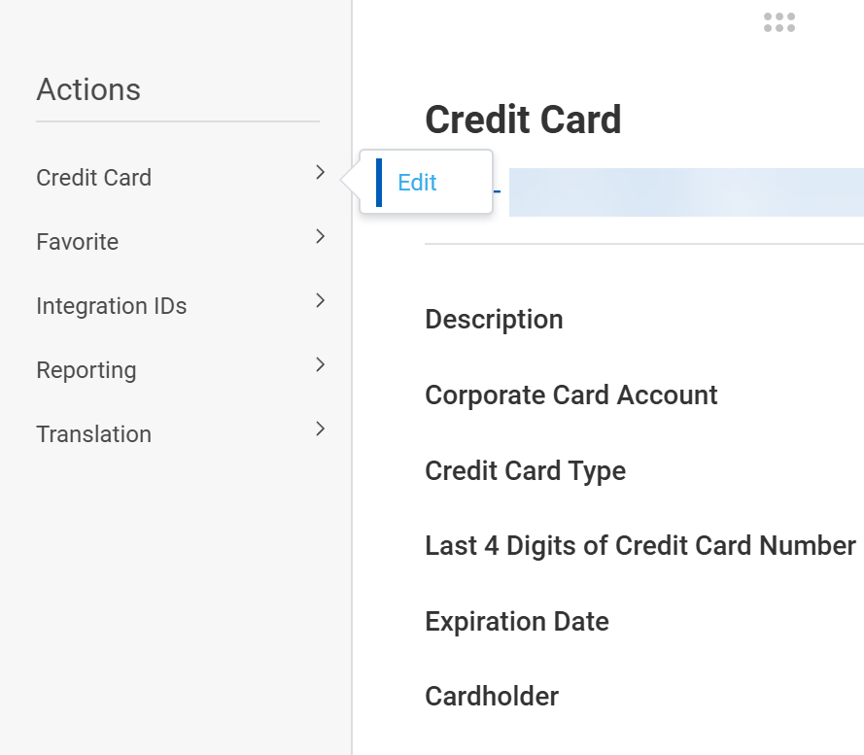
Find and Edit Credit Cards (Part 3 of 4)
INSTRUCTIONS
Hover over Credit Card and click Edit.

Slide 5
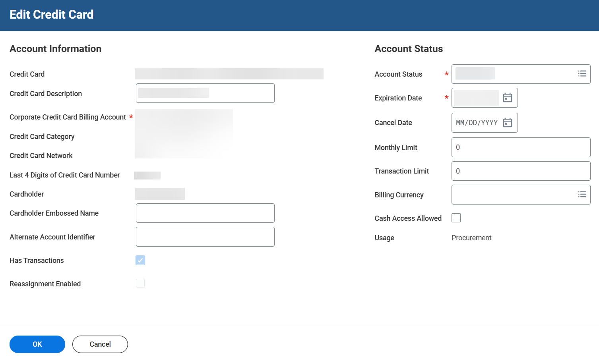

Find and Edit Credit Cards (Part 4 of 4)
INSTRUCTIONS
Review Credit Card details and make necessary updates.
Click OK.
7
8
You have successfully edited credit card details.

