Slide 1
View P-Card Administrator Training
Completion Reports in GA@WORK
This guide will show P-Card Administrators how to locate, run and view results of CRHCM-LRN-Training Completion reports in GA@WORK.
Note: Refer to the GA@WORK P-Card Administrator Reference Guide for P-Card Program information. The guide contains up-to-date report names, definitions, required training guidelines, and security requirements.
The key steps in the process are below:
Enter CRHCM in the Search field.
Click the CRHCM-LRN-Learning Enrollment report.
Select a Company and click OK.
View the report and verify Completion Status for the future cardholder.
Business Process:
Run CRHCM-LRN-Learning Enrollment Report
Set Report Parameters
Verify Training Completion Status

Slide 2
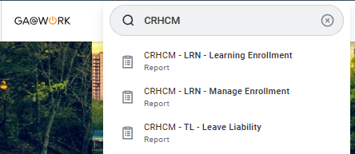
View P-Card Administrator Training Completion Reports in GA@WORK (Part 1 of 2)
Prior to issuing a card, you must confirm that the future cardholder has completed all P-Card requirements. Enter CRHCM in the Search field.
Click CRHCM-LRN-Learning Ernollment report.

Slide 3
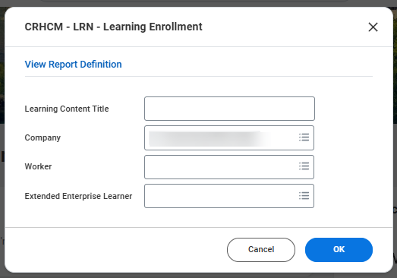
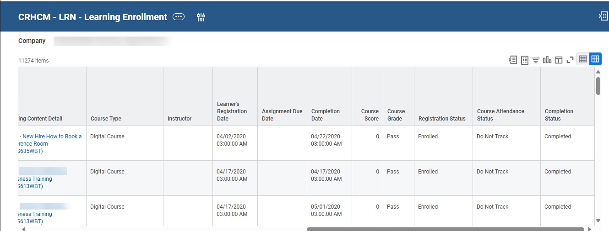

View P-Card Administrator Training Completion Reports in GA@WORK (Part 2 of 2)
Select a Company.
Note: You will only have access to view your agency report.
Click OK.
3
4
View Completion Status on the report. Verify the future cardholder has completed required training.
You have successfully verified P-Card training completion for a future cardholder.

