Slide 1
Close Purchase Order
DESCRIPTION
This guide will show PO Buyers and Procurement Operations Lead how to Close an Issued Purchase Order.
OVERVIEW
The key steps in the process are below:
Enter Find Purchase Orders in the Search field and select the report.
Locate an Issued Purchase Order and click OK.
Select Related Actions > Purchase Order > Close.
Select Accounting Date Override and Close Reason.
Locate the desired Purchase Order and click OK.
Verify Status shows Closed.
Business Process:
Locate the desired Purchase Order
Close Purchase Order
Verify Closed Status

Slide 2
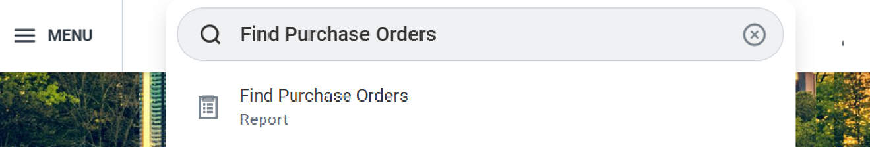
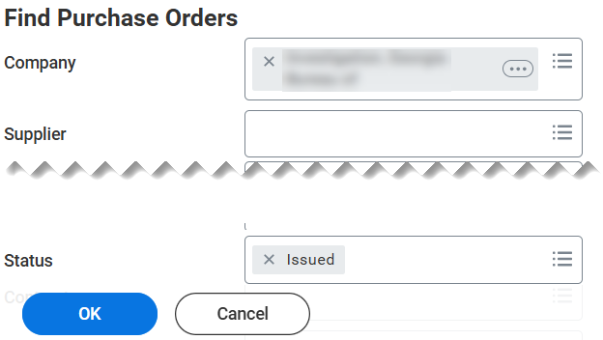
Close Purchase Order (Part 1 of 5)
INSTRUCTIONS
Enter Find Purchase Orders in the Search field.
Select Find Purchase Orders report.
1
2
Enter search parameters to locate the desired Purchase Order and click OK.
Note: Purchase Orders must have a Status of Issued with no
receipt/invoice against it, or all receipts/invoices successfully
completed the Business Processes.

Slide 3
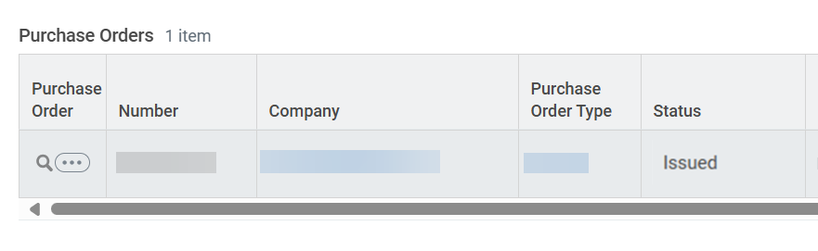
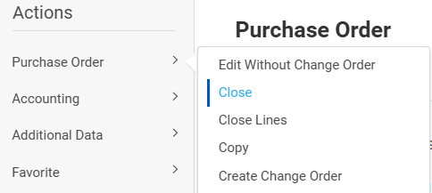
Close Purchase Order (Part 2 of 5)
INSTRUCTIONS
Click the Purchase Order Related Actions (…).
Select Purchase Order.
Select Close.
5
6

Slide 4
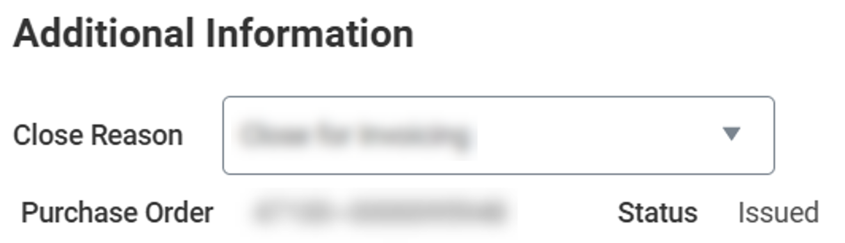
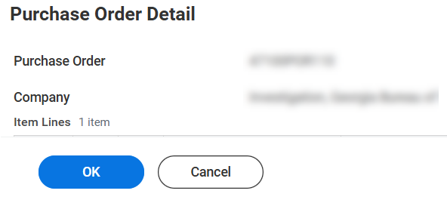
Close Purchase Order (Part 3 of 5)
INSTRUCTIONS
Select a Close Reason.
Click OK.

Slide 5
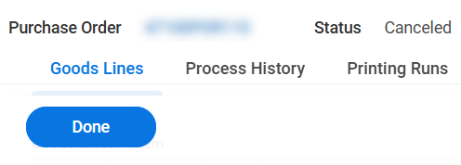
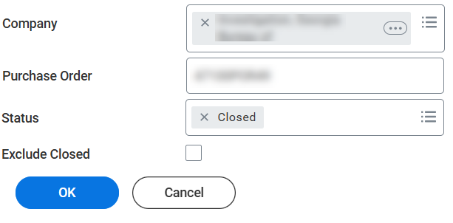
Close Purchase Order (Part 4 of 5)
INSTRUCTIONS
Click Done.
Enter search parameters to locate the desired Purchase Order and click OK.
Note: Uncheck Exclude Closed, if necessary.

Slide 6
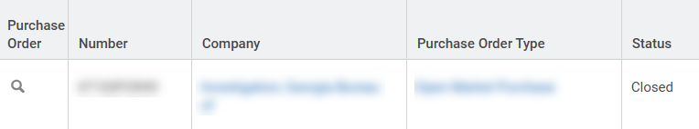

Close Purchase Order (Part 5 of 5)
INSTRUCTIONS
Verify the Status shows Closed.
You have successfully closed a purchase order.

