Slide 1
Create a Non-Requisition
Purchase Order
DESCRIPTION
This guide will show Buyers how to Create a Non-Requisition Purchase Order.
OVERVIEW
The key steps in the process are below:
Search Create Purchase Order.
Select Create Purchase Order Task.
Complete required fields.
Click Submit to route for approval.
Business Process:
Identify a need for goods or services
Create Non-Requisition Purchase Order
Submit for Approval

Slide 2
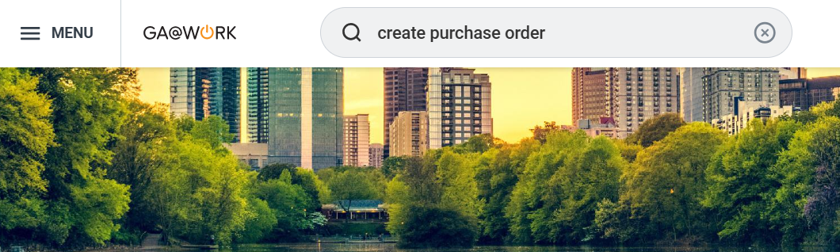
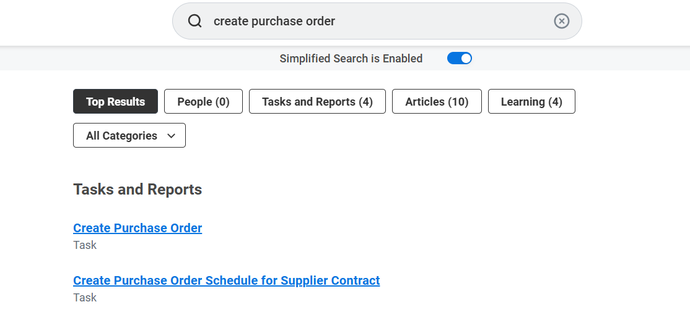
Create a Non-Requisition Purchase Order (Part 1 of 11)
INSTRUCTIONS
Enter Create Purchase Order in the Search field and press Enter.
Select the Create Purchase Order task.

Slide 3
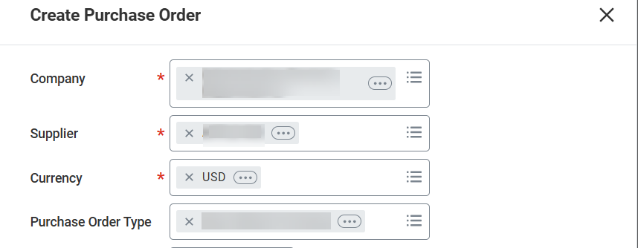
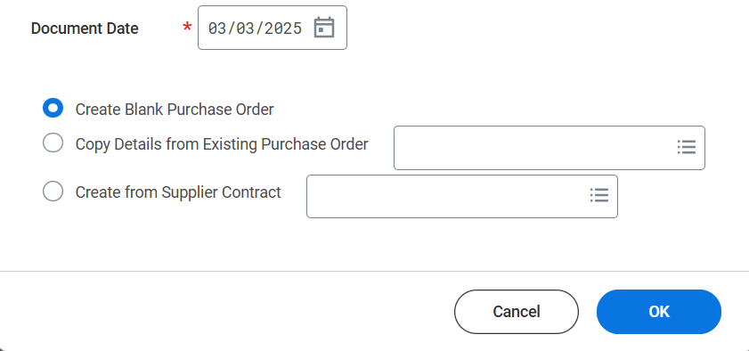
Create a Non-Requisition Purchase Order (Part 2 of 11)
INSTRUCTIONS
Confirm the default Company*, select the Supplier*, and confirm the default Currency* (USD).
Enter the applicable Purchase Order Type.
Note: Please review the PO Type Quick Reference Guide (SPD-AP016) when selecting the Purchase Order type.
3
4
Enter the Document Date*.
Select Create Blank Purchase Order.
Click OK.
5
6
7

Slide 4
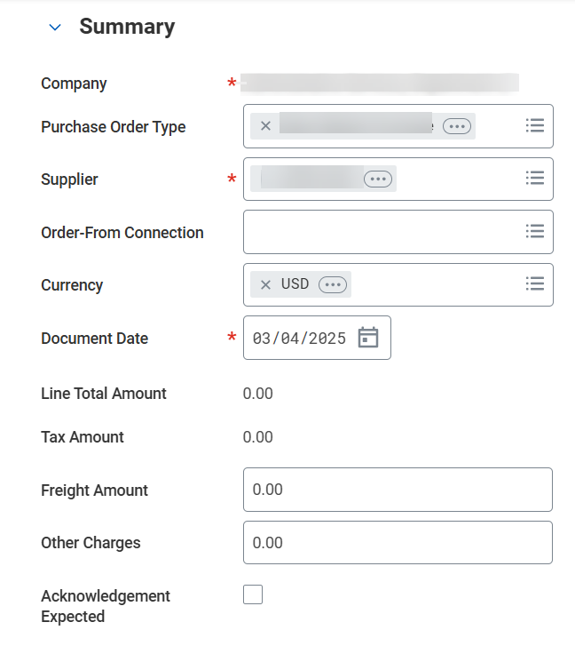
Create a Non-Requisition Purchase Order (Part 3 of 11)
INSTRUCTIONS
Review the Company*, Purchase Order Type, Supplier* and Document Date*.
Note: Update the fields as necessary and confirm that none of the required fields are blank. The Order-From Connection is helpful if a supplier has many fulfillment sites or addresses, and a buyer can pick one as needed. You may want to default ordering from address as well as issue option.
Enter Freight Amount (optional) and Other Charges (optional).
Note: You may only enter the Freight Amount or Other Charges if the order includes lines with spend categories that can allocate freight or miscellaneous charges. Alternatively, you can enter freight and miscellaneous charges as individual charges at the line level.
8
9

Slide 5
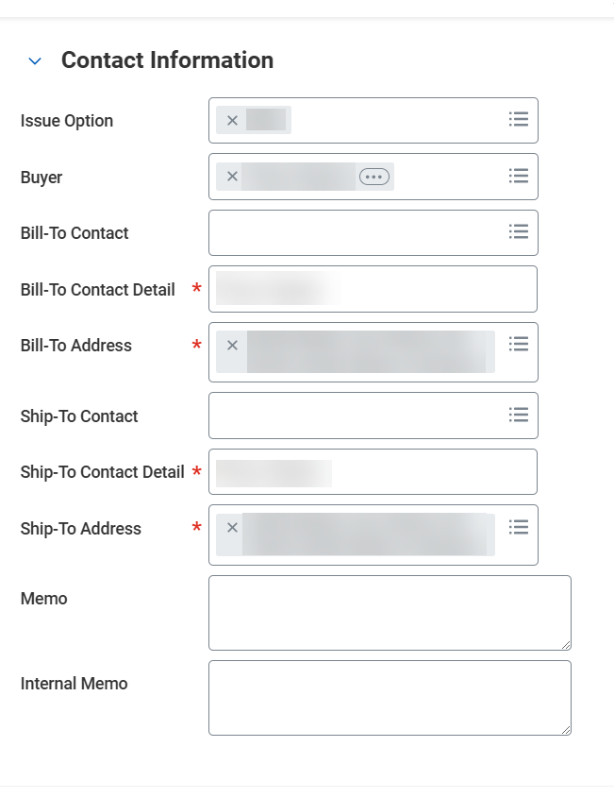
Create a Non-Requisition Purchase Order (Part 4 of 11)
INSTRUCTIONS
Enter the appropriate Issue Option.
Enter the appropriate Buyer. The field value defaults to the user that is signed on. A search can be performed to change it.
Enter the Bill-To Contact Detail*. This can also be derived from Bill To Contact.
Note: Review Bill-To Address* and Ship-To Address*. The Memo field will be printed on Purchase Order for Suppliers. The Internal Memo field will only display within the agency.
Enter the Ship-To Contact Detail*. This can also be derived from Ship To Contact.
10
11
12
13

Slide 6
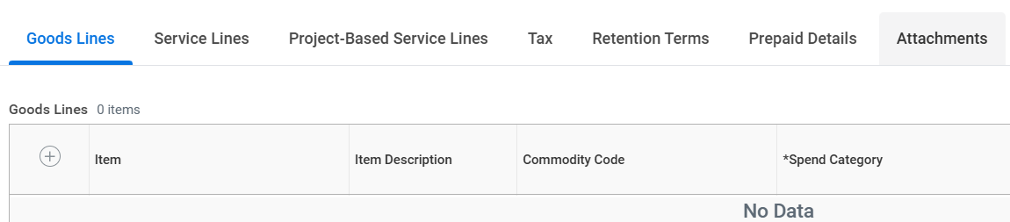
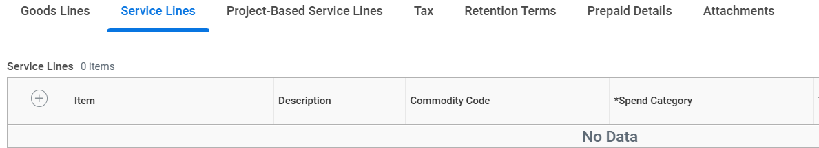
Create a Non-Requisition Purchase Order (Part 5 of 11)
INSTRUCTIONS
Select either Goods Lines or Service Lines tab based on the purchase.
For Goods Lines click Add (+).
For Service Lines click Add (+).
14
15
16

Slide 7
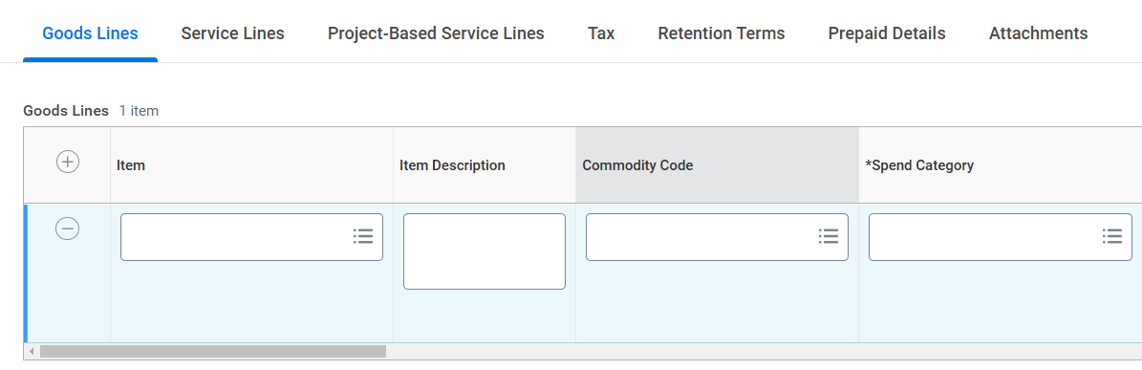
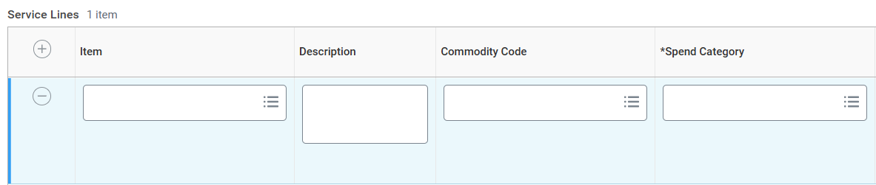
Create a Non-Requisition Purchase Order (Part 6 of 11)
INSTRUCTIONS
For Goods Lines select the Item, if known.
Note: The item search feature may not populate a result.
For Goods Lines enter the Item Description and the Commodity Code.
For Service Lines select the Item, if known.
For Services Lines, enter the Description and the Commodity Code.
17
18
19
20

Slide 8
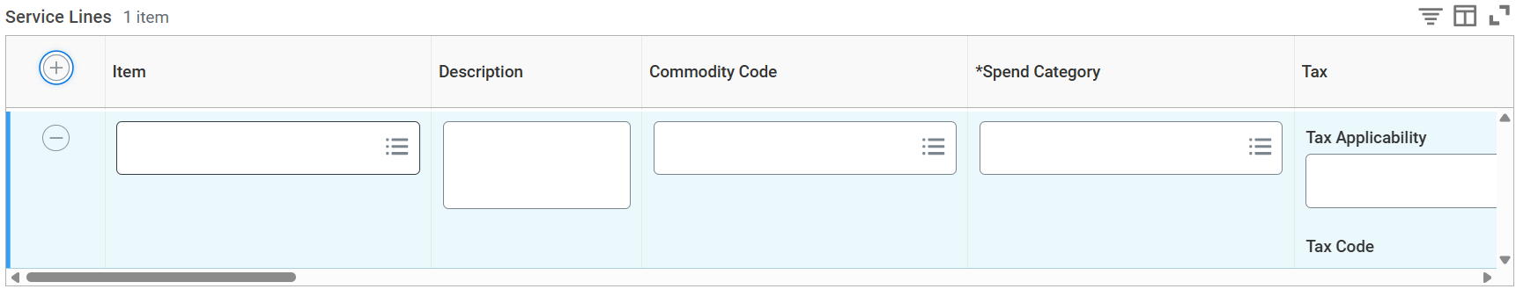
Create a Non-Requisition Purchase Order (Part 7 of 11)
INSTRUCTIONS
For Goods Lines enter or modify the *Spend Category, as necessary.
For Service Lines enter or modify the *Spend Category, as necessary.
Note: The Spend Category will auto populate based on the Commodity Code, unless there are multiple matching spend categories. If the Spend Category is a Trackable asset, a location value is required.
21
22

Slide 9
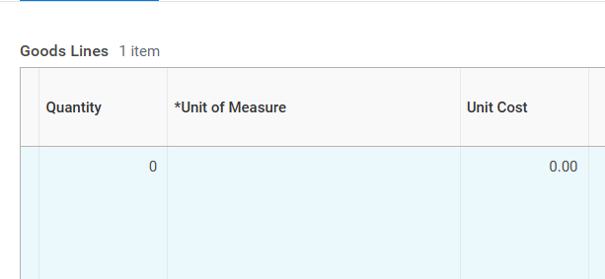
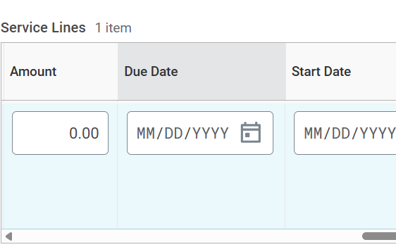
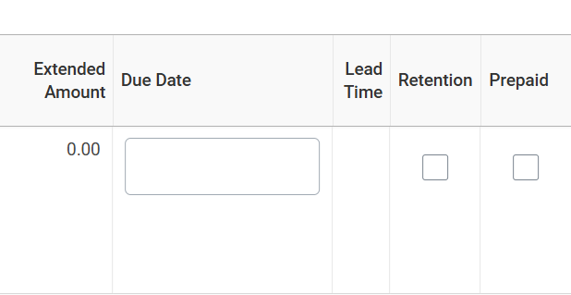
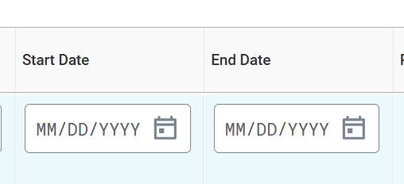
Create a Non-Requisition Purchase Order (Part 8 of 11)
INSTRUCTIONS
For Goods Lines, enter the Quantity, *Unit of Measure and the Unit Cost.
For Services Lines enter the Amount.
Note: Use the scroll bar to view all the fields.
24
23
For Goods Lines, enter the Due Date as applicable.
For Services Lines enter the Start Date and End Date.
25
26

Slide 10
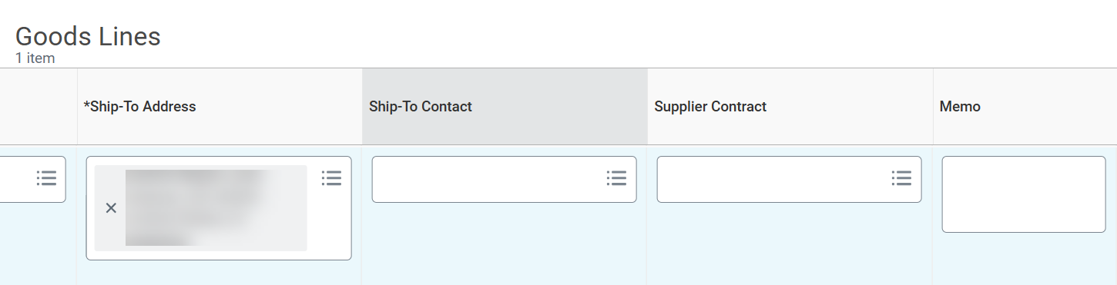
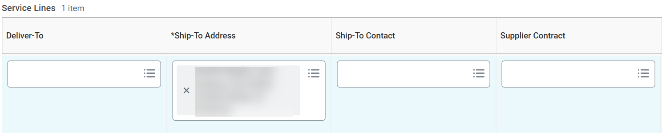
Create a Non-Requisition Purchase Order (Part 9 of 11)
INSTRUCTIONS
For Goods Lines enter the *Ship-To Address, as needed.
For Goods Lines enter the Supplier Contract, as needed.
For Service Lines enter the *Ship-To Address, as needed.
For Service Lines enter the Supplier Contract, as needed.
28
27
30
29

Slide 11
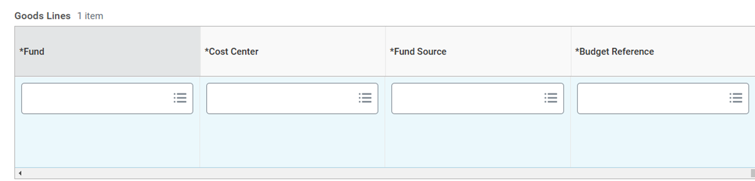
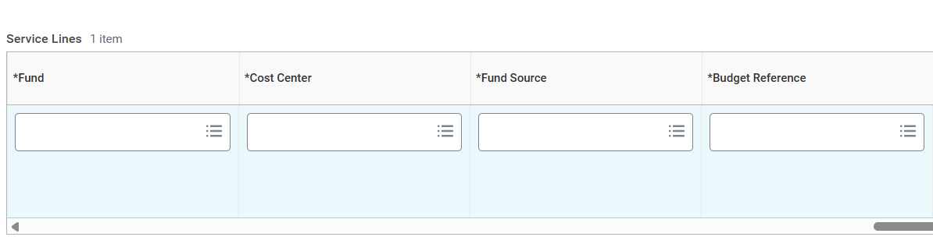
Create a Non-Requisition Purchase Order (Part 10 of 11)
INSTRUCTIONS
For Goods Lines eenter the *Fund, *Cost Center, *Fund Source and *Budget Reference.
For Service Lines enter the *Fund, *Cost Center, *Fund Source and *Budget Reference.
Note: Update any additional fields, as necessary.
31
32

Slide 12
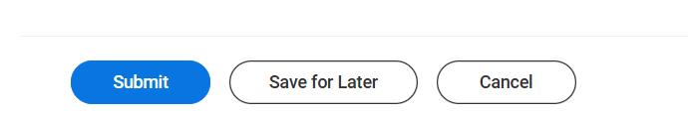
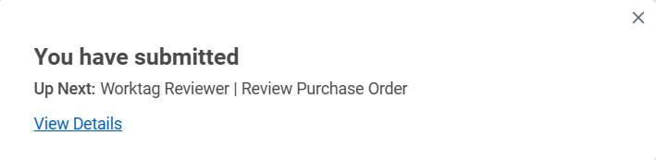

Create a Non-Requisition Purchase Order (Part 11 of 11)
INSTRUCTIONS
Click Submit.
View the confirmation of Submission.
Note: Click View Details for more information regarding your submission.
You have successfully submitted a non-requisition purchase order.

