Slide 1
Find a Requisition
DESCRIPTION
This guide will assist Buyers with the process of locating a Requisition.
OVERVIEW
The key steps in the process are below:
Navigate to the Buyer Hub.
Enter Search Criteria to locate a Requisition.
Select appropriate Requisition.
Navigate to Buyer Hub
Locate Find Requisitions
Search and Select

Slide 2
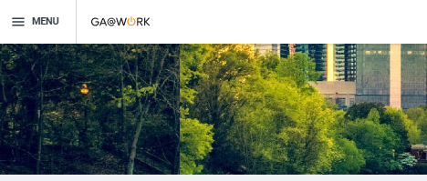
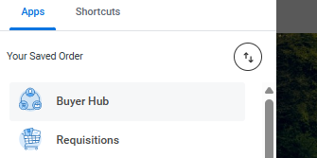
Find Requisition (Part 1 of 4)
INSTRUCTIONS
Click the Global Navigation Menu on your homepage.
Click Buyer Hub.
Note: Click Add App if you do not see the Buyer Hub application in your menu. You may also search Find Requisitions using the Search bar.

Slide 3
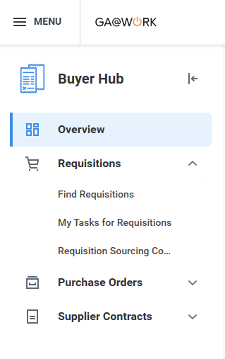
Find Requisition (Part 2 of 4)
INSTRUCTIONS
Click Requisitions.
Click Find Requisitions.
3
4

Slide 4
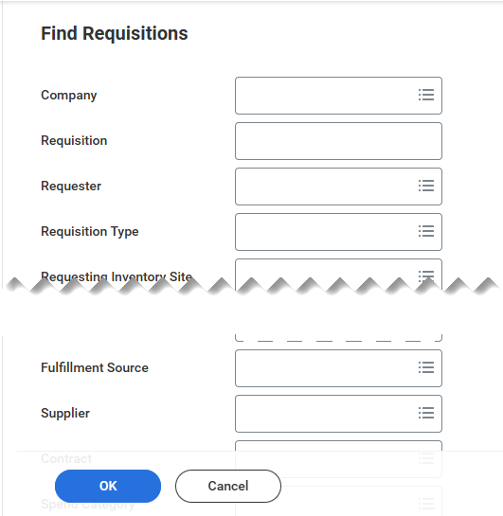
Find Requisition (Part 3 of 4)
INSTRUCTIONS
Narrow your Search Results by entering information in the relevant fields under Find Requisitions.
Note: Requisitions can also be located by selecting OK without entering search criteria.
Click OK.
5
6

Slide 5
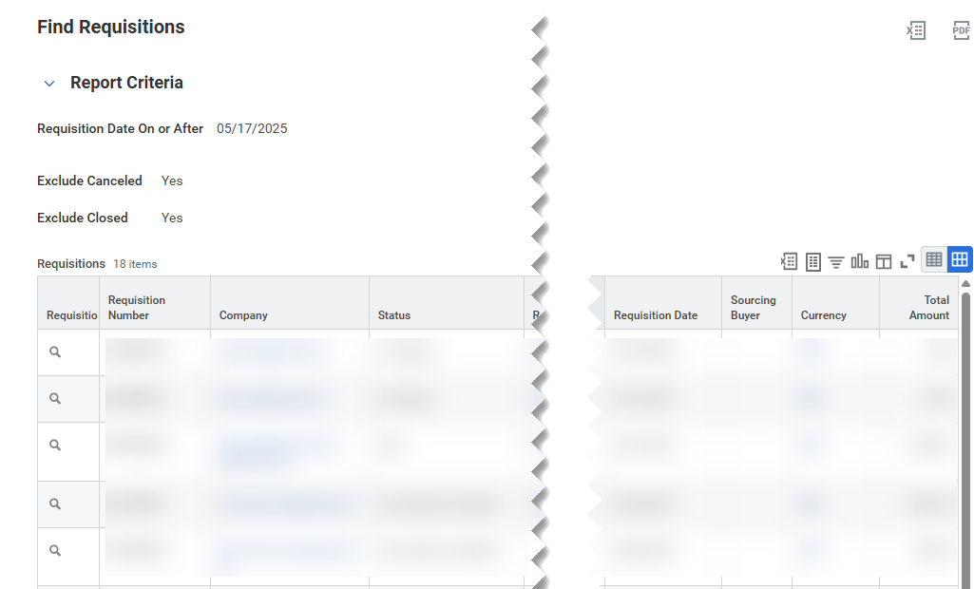
Find Requisition (Part 4 of 4)
INSTRUCTIONS
Select the appropriate requisition from the populated list.
Note: Image serves as an example and does not represent the full data set.
You have successfully located a Requisition.

