Slide 1
Source a Requisition
To Purchase Order
DESCRIPTION
This guide will show Buyers how to Source a Requisition to a Purchase Order.
Note: In addition to the sourcing method shown here, other navigation options are available. The Source Requisitions task helps Buyers source multiple requisitions into a single PO. Sourcing actions can also be accessed through a requisition’s Related Actions.
OVERVIEW
The key steps in the process are below:
Navigate to the Buyer Hub.
Search for the Requisition.
Select Source Goods/Services Lines
Enter the information in the appropriate fields.
Click OK.
Business Process:
Navigate to Buyer Hub
Locate Requisition to Source
Enter Required Information
Click OK

Slide 2
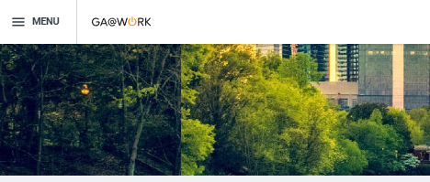
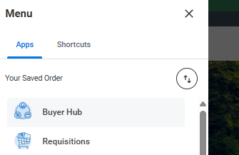
Source a Requisition To Purchase Order
(Part 1 of 6)
INSTRUCTIONS
Click the Global Navigation Menu on your homepage.
Click Buyer Hub.

Slide 3
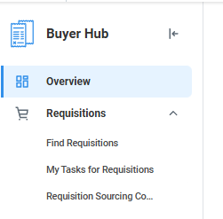
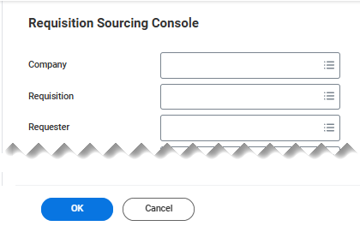
Source a Requisition To Purchase Order
(Part 2 of 6)
INSTRUCTIONS
Select Requisitions.
Select Requisition Sourcing Console.
3
4
Select the Requisition to be sourced.
Note: You may use other fields to filter the Search results and locate the applicable Requisition. Filters in this step are optional. Enter no filter values to see all requisitions available for sourcing in your agency.
Click OK.
5
6

Slide 4
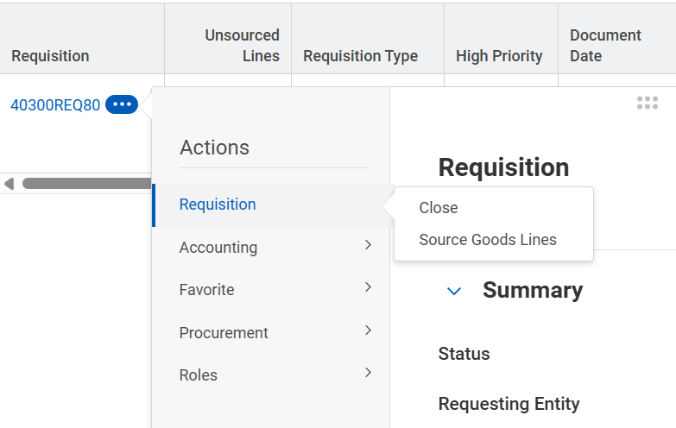
Source a Requisition To Purchase Order
(Part 3 of 6)
INSTRUCTIONS
Click Related Actions (…).
Select Requisition.
Note: Alternatively, click Open, on the right side of the page, to access the Review Goods Lines.
Select Source Goods Lines.
Note: Source Good Lines also includes Source Service Lines.
7
8
9

Slide 5
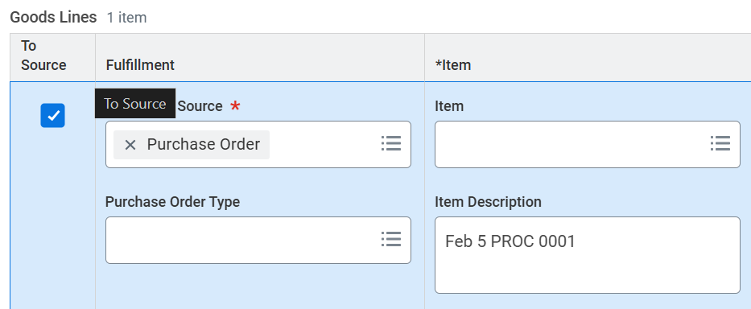
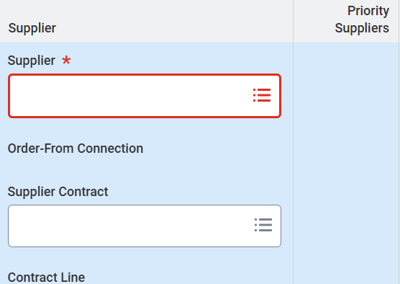
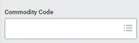
Source a Requisition To Purchase Order
(Part 4 of 6)
INSTRUCTIONS
Confirm To Source* has been checked.
Select a Supplier*.
Note: Additional fields such as Supplier Connection and Supplier Contract are optional and can be selected here if applicable.
Select or confirm the Commodity Code.

Slide 6
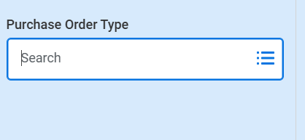
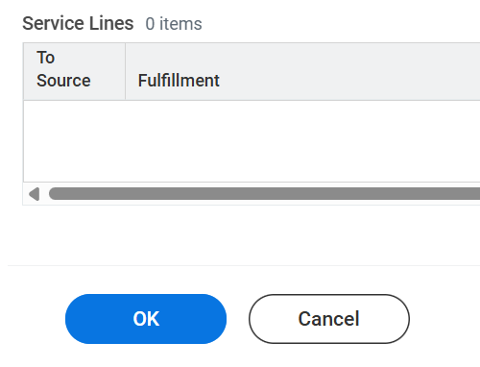
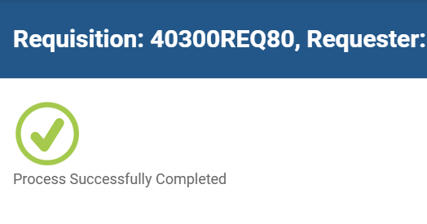
Source a Requisition To Purchase Order
(Part 5 of 6)
INSTRUCTIONS
Select a Purchase Order Type.
Note: Fields with an “X” or that appear in white during sourcing can typically be changed or edited prior to submitting.
Click OK.
View the Confirmation of Completion.

Slide 7
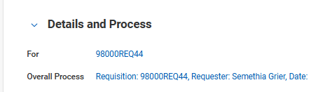
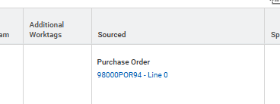

Source a Requisition To Purchase Order
(Part 6 of 6)
INSTRUCTIONS
To view the Purchase Order Number, click Details and Process.
Scroll to the line level section and find the Purchase Order Number under the Sourced column.
You have successfully sourced a requisition to a purchase order.

