Slide 1
Buyer Dashboard
DESCRIPTION
This guide will show Buyers how to access, navigate, and customize report settings on the Buyer Dashboard.
OVERVIEW
The key steps in the process are below:
Enter Buyer Dashboard in the Search field.
Click Buyer Dashboard Landing Page Group.
Review Dashboard Reports.
Update dashboard parameters, if applicable.

Slide 2
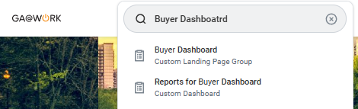
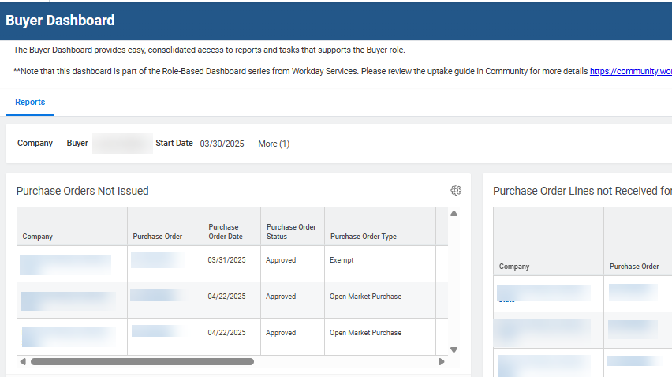
Buyer Dashboard (Part 1 of 8)
INSTRUCTIONS
Enter Buyer Dashboard in the Search field.
Click Buyer Dashboard.
1
2
View the Buyer Dashboard.

Slide 3
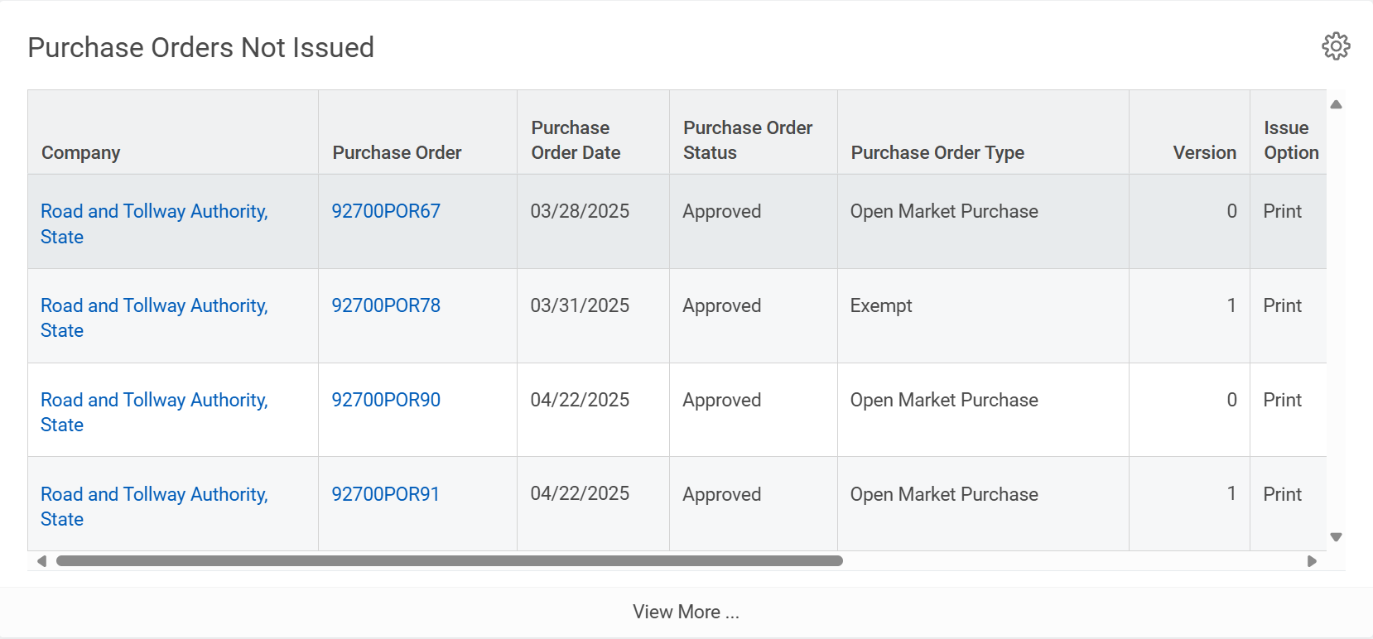
Buyer Dashboard (Part 2 of 8)
INSTRUCTIONS
Review the Purchase Orders Not Issued report. Be aware of the following fields:
  Company
  Purchase Order
  Purchase Order Date
  Purchase Order Status
  Purchase Order Type
  Version
  Issue Option
  Buyer
  Supplier
  Total PO Amount

Slide 4
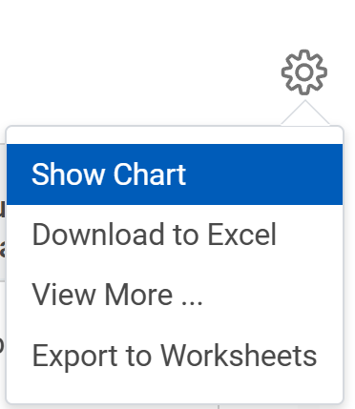
Buyer Dashboard (Part 3 of 8)
INSTRUCTIONS
Click Settings for more report viewing options. The following options are available:
  Show Chart
  Download to Excel
  View More
  Export to Worksheets
Note: Settings will have the same options for all reports on the Buyer Dashboard.

Slide 5
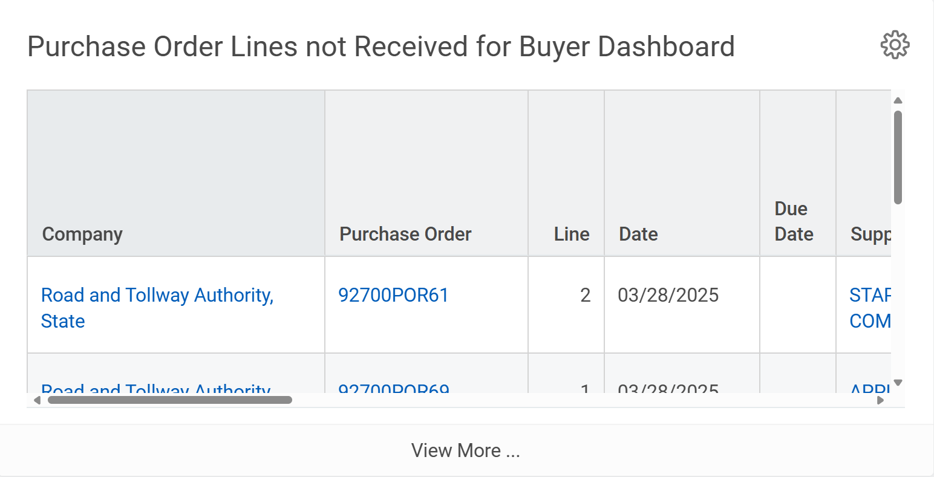
Buyer Dashboard (Part 4 of 8)
INSTRUCTIONS
Review the Purchase Order Lines not Received for Buyer Dashboard. Be aware of the following fields:
  Company
  Purchase Order
  Line
  Date & Due Date
  Supplier & Buyer
  Item & Description
  Quantity Ordered/Received
  Unit of Measurement
  Acknowledgement
  Line Memo
  Acknowledgement Status

Slide 6
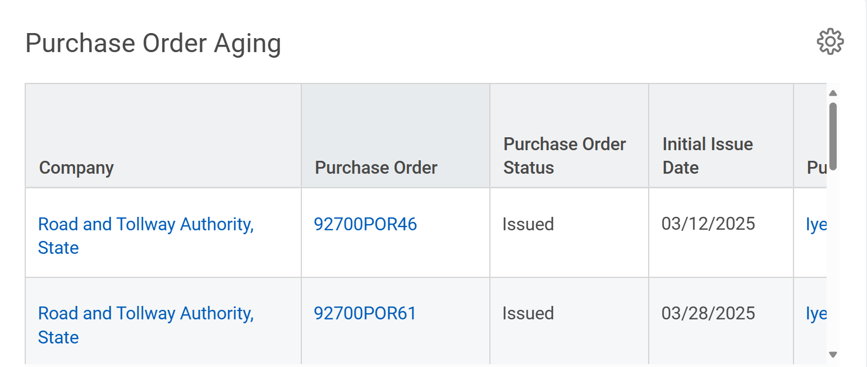
Buyer Dashboard (Part 5 of 8)
INSTRUCTIONS
Review the Purchase Order Aging report. Be aware of the following fields:
  Company
  Purchase Order & Purchase Order Status
  Initial Issue
  Purchase Order Buyer & Purchase Order Type
  Delivery Type, Supplier and Line
  Purchase Order Line Due Date
  Line-Item Description
  Unit Cost & Unit of Measure
  Quantity/Quantity Received/Invoiced/Returned
  Quantity Remaining to be Received
  1-30 Days, 31-60 Days, 61-90 Days & 90+ Days

Slide 7
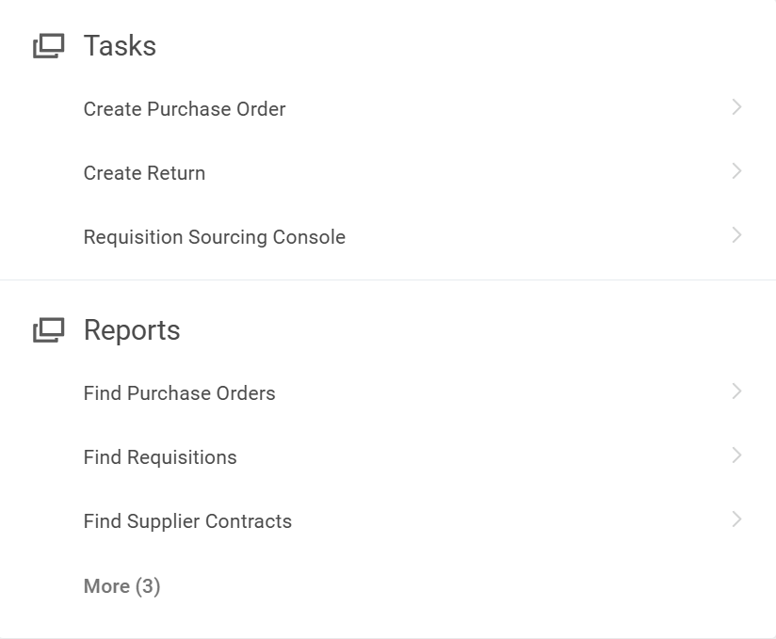
Buyer Dashboard Part (6 of 8)
INSTRUCTIONS
The Quick Links are available as Tasks and Reports.
  Tasks:
  Create Purchase Order
  Create Return
  Requisition Sourcing Console
  Reports:
  Find Purchase Orders
  Find Requisitions
  Find Supplier Contracts

Slide 8
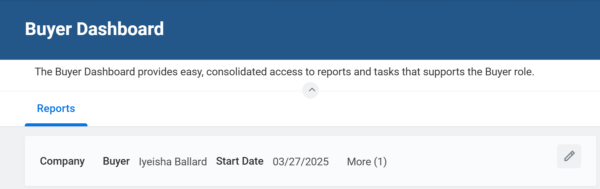
Buyer Dashboard (Part 7 of 8)
INSTRUCTIONS
Click Edit to Update Reports on the dashboard.

Slide 9
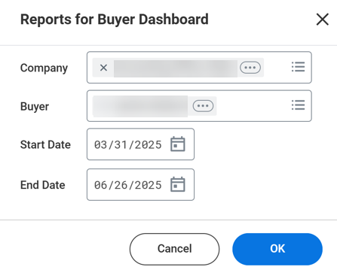

Buyer Dashboard (Part 8 of 8)
INSTRUCTIONS
Edit the Company, as applicable.
Edit the Buyer, as applicable.
Edit the Start Date and/or End Date, as applicable
Click OK.
10
11
12
13
You have successfully accessed and reviewed your buyer dashboard.

