Slide 1
Find a Purchase Order
DESCRIPTION
This guide will show the Buyer how to Find a Purchase Order.
OVERVIEW
The key steps in the process are below:
Search and select the Find Purchase Order report.
To locate the Purchase Order, verify that the correct Company is selected, then narrow your search using applicable fields.
Click OK.
View desired Purchase Order.
Business Process:
Locate Purchase Orders
Find Desired Purchase Order
Review Purchase Order

Slide 2

Find a Purchase Order (Part 1 of 3)
INSTRUCTIONS
Enter Find Purchase Order in the Search field and press Enter.
Click the Find Purchase Orders report.

Slide 3
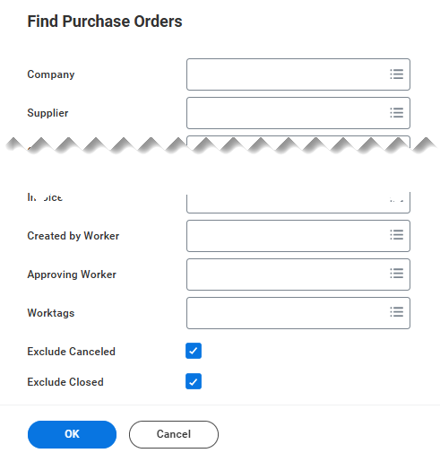
Find a Purchase Order (Part 2 of 3)
INSTRUCTIONS
Verify the Company and use available fields to filter your Search, as applicable.
Note: You can refine your search by selecting additional criteria, such as Supplier, PO Type, Issued Options, or Status. You may also choose to leave all fields blank and perform a search without entering any values.​
Check the Exclude Canceled and Excluded Closed boxes, as applicable.
Click Ok.
3
4
5

Slide 4
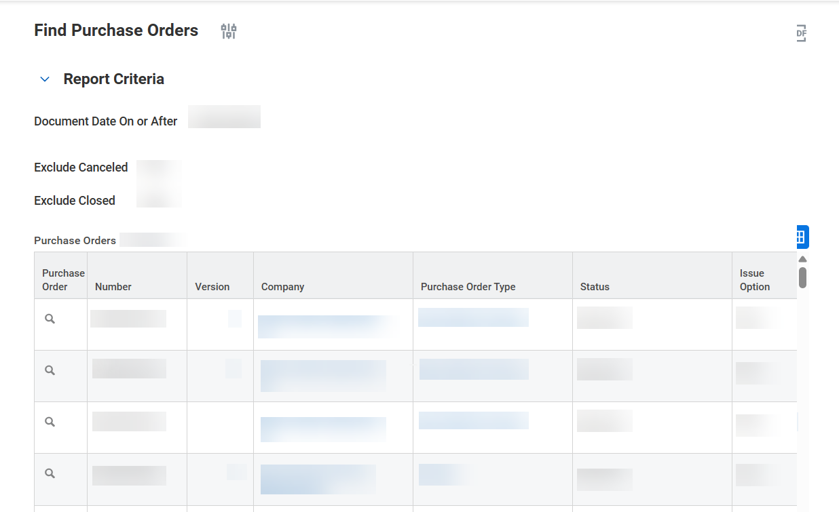

Find a Purchase Order (Part 3 of 3)
INSTRUCTIONS
Click the desired Purchase Order.
You have successfully located a Purchase Order.

