Slide 1
Requisition Sourcing Console for Requesters
DESCRIPTION
This guide will show Requesters how to locate and review the Requisition Sourcing Console.
OVERVIEW
The key steps in the process are below:
Enter Requisition Sourcing Console in the Search field.
Click Requisition Sourcing Console report.
Enter Search Parameters, if applicable.
Click OK.
Review report.
Export report to Excel or PDF, if applicable.
Business Process:
Locate Requisition Sourcing Console
Enter Search Parameters
Review Requisition Sourcing Console

Slide 2
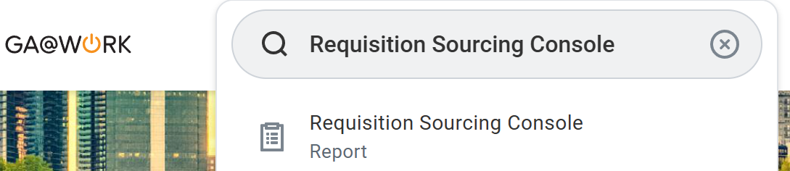
Requisition Sourcing Console for Requesters (Part 1 of 5)
INSTRUCTIONS
Enter Requisition Sourcing Console in the Search field.
Click the Requisition Sourcing Console report.
1
2

Slide 3
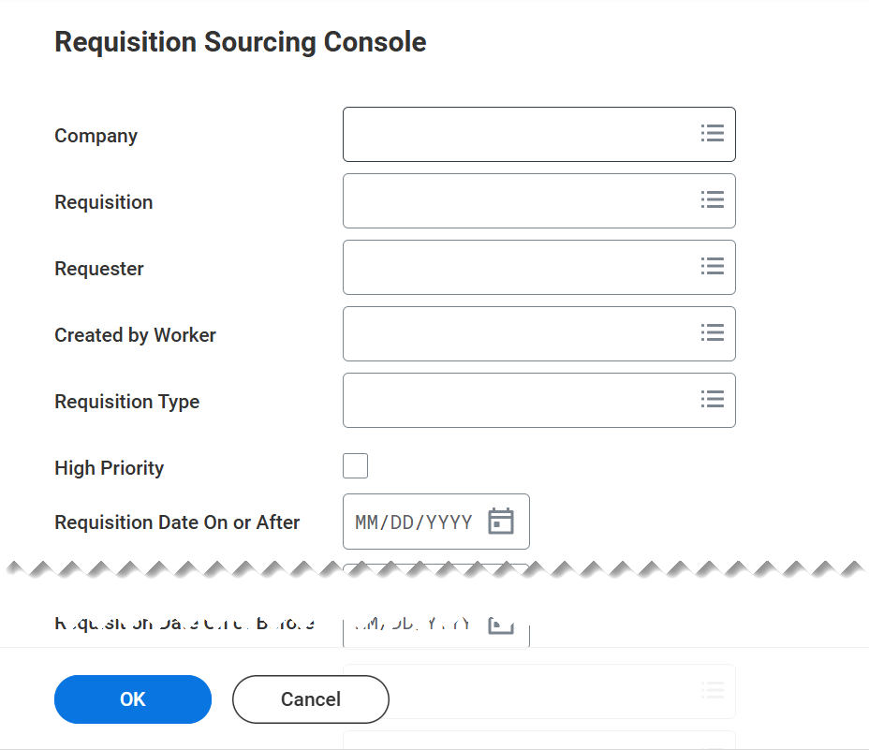
Requisition Sourcing Console for Requesters (Part 2 of 5)
INSTRUCTIONS
Enter Search Parameters, if applicable.
Click OK.
3
4

Slide 4
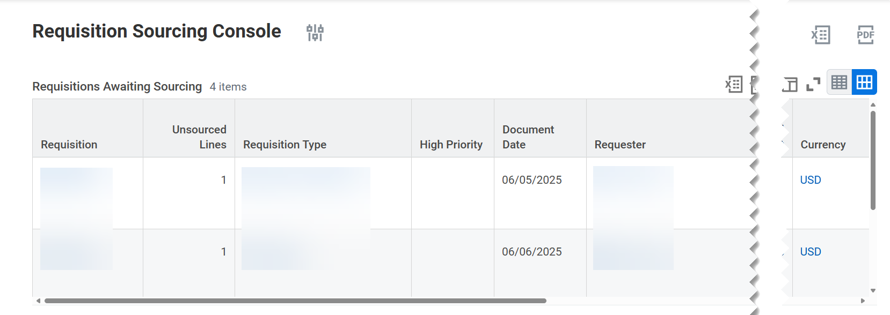
Requisition Sourcing Console for Requesters (Part 3 of 5)
INSTRUCTIONS
Review the console, be aware of the following fields:
  Requisition
    Note: You can open the Requisition by clicking on Requisition Number or Open under Actions column.
  Unsourced Lines
  Requisition Type
  High Priority
  Document Date
  Requester
  Total Amount
  Currency

Slide 5
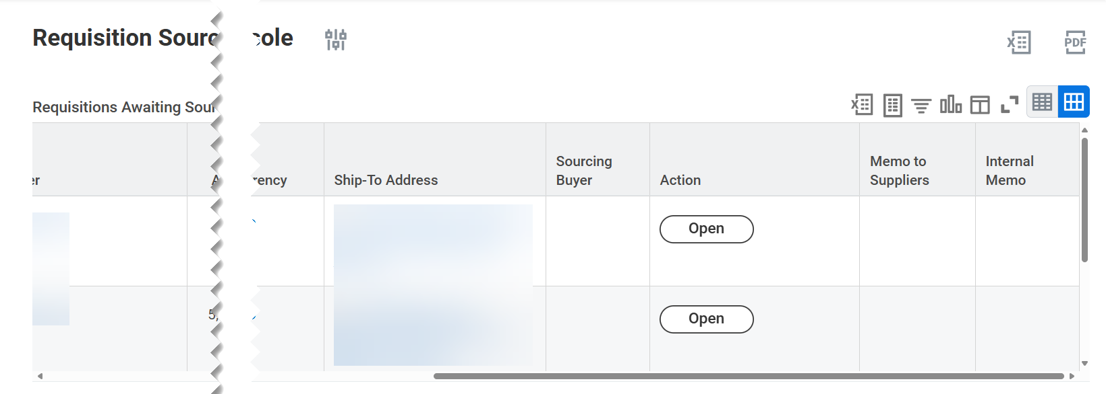
Requisition Sourcing Console for Requesters (Part 4 of 5)
INSTRUCTIONS
Review the console, be aware of the following fields:
  Ship-To Address
  Sourcing Buyer
  Action
  Memo to Suppliers
  Internal Memo

Slide 6
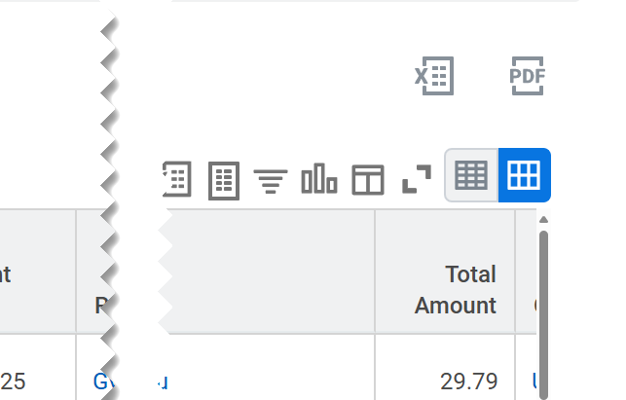

Requisition Sourcing Console for Requesters (Part 5 of 5)
INSTRUCTIONS
Click the Excel or PDF to export the report, as applicable.
You have successfully located and reviewed the Requisition Sourcing Console.

