Slide 1
Approve a Sourcing Event
DESCRIPTION
This guide will assist Award Contract Specialist Approvers with the process of reviewing and Approving a Sourcing Event.
OVERVIEW
The key steps in the process are below:
Navigate to the Sourcing, Contracts, and Supplier Management app.
Click Sign On.
Open Approvals and select the Sourcing Event Request.
Click Approve/Complete, add notes if needed, and submit.
Business Process:
Access Sourcing App
Click
Sign on
Review Event Request
Submit for Final Approval

Slide 2
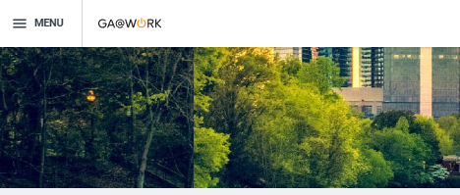
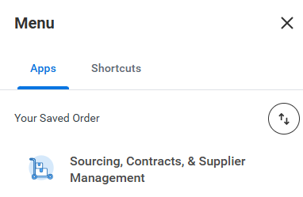
Approve a Sourcing Event (Part 1 of 5)
INSTRUCTIONS
Click the Global Navigation Menu on your homepage.
Click Sourcing, Contracts, and Supplier Management.

Slide 3
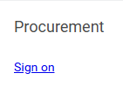

Approve a Sourcing Event (Part 2 of 5)
INSTRUCTIONS
Click Sign On.
Click Notifications to access your approval requests.
Note: You can also access your approval request on the Sourcing Menu and click Approvals.

Slide 4
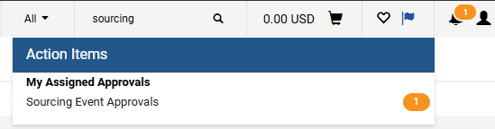
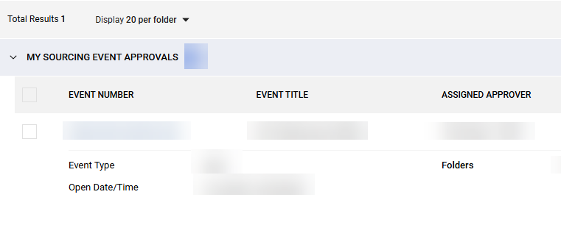
Approve a Sourcing Event (Part 3 of 5)
INSTRUCTIONS
Click My Assigned Approvals.
Under My Sourcing Event Approvals, click the Event Number.

Slide 5
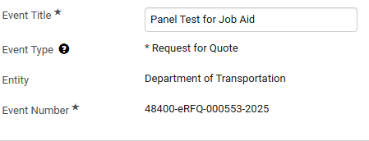
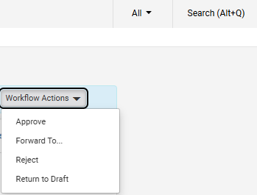
Approve a Sourcing Event (Part 4 of 5)
INSTRUCTIONS
Review all sections of the form.
Note: Fields marked with an asterisk (*) are required and must be completed before continuing. The image below is provided as an example and does not display all required fields but serves to illustrate the type of information you’ll need to enter.
Click Workflow Actions.
Click Approve.
8
9

Slide 6
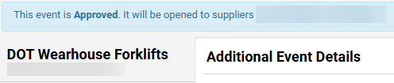

Approve a Sourcing Event (Part 5 of 5)
INSTRUCTIONS
View the completion status bar at the top of the page.
You have successfully approved a Sourcing Event.

