Slide 1
Create a Request for Quotes (RFQ)
DESCRIPTION
This guide will show Sourcing Event Buyers how to create a Request for Quotes.
OVERVIEW
The key steps in the process are below:
Navigate to Sourcing.
Select Create New Event.
Select the eRFQ Template and complete the necessary fields.
Submit the Sourcing Event.
Business Process:
Navigate to Sourcing Module
Select Create New Event
Utilize the eRFQ Template
Submit the Sourcing Event

Slide 2


Create a Request for Quotes (RFQ)
(Part 1 of 52)
INSTRUCTIONS
Click the Global Navigation Menu.
Note: University System of Georgia (USG) and GDOT users complete local logon and then proceed to Step 4.
Click Sourcing, Contracts & Supplier Management.

Slide 3

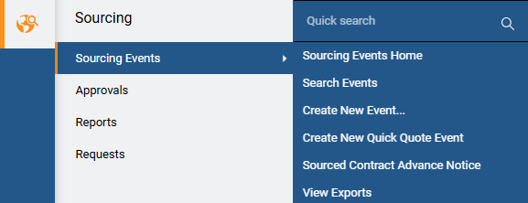
Create a Request for Quotes (RFQ)
(Part 2 of 52)
INSTRUCTIONS
Click Sign On.
Note: The system utilizes Single Sign-On (SSO) capabilities and no log in information is required.
Select Sourcing.
Select Sourcing Events.
Select Create New Event.
4
5
6

Slide 4
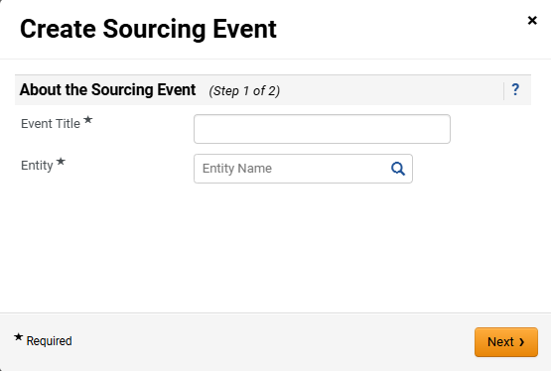
Create a Request for Quotes (RFQ)
(Part 3 of 52)
INSTRUCTIONS
Enter the Event Title*.
Note: Including the State Entity Name in Event Title will assist in Search Sourcing Events as there is no column to display state entity’s name (e.g. UGA Consulting Services).
Select Entity*.
Click Next.
7
8
9

Slide 5
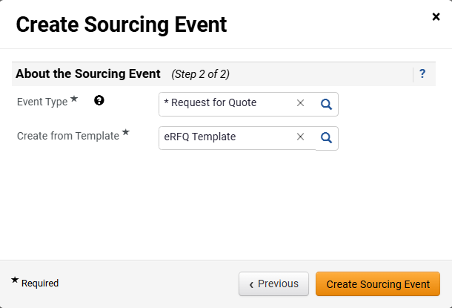
Create a Request for Quotes (RFQ)
(Part 4 of 52)
INSTRUCTIONS
Select Request for Quote as the Event Type*.
Select eRFQ Template for Create from Template*.
Note: eRFQ Template will auto-populate in the Create from Template field once Request for Quote is selected.
Click Create Sourcing Event.
10
11
12

Slide 6
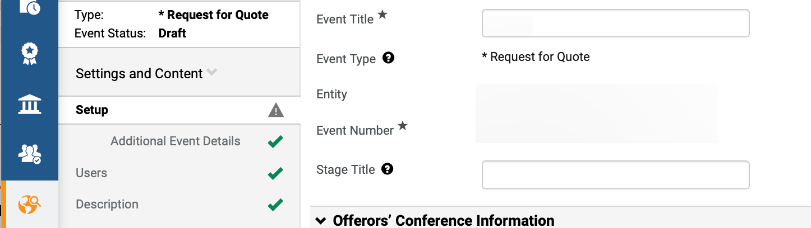
Create a Request for Quotes (RFQ)
(Part 5 of 52)
INSTRUCTIONS
Review populated Event information.
Enter Stage Title.
Note: Stage Title is used to distinguish different versions if an event goes to a second stage and beyond during the evaluation process, such as a round of cost negotiations. It is recommended to enter “Original Solicitation” as the Stage Title for all events during initial set-up. Stage Title and Event Title can be edited; however, the other fields are read-only.
13
14

Slide 7
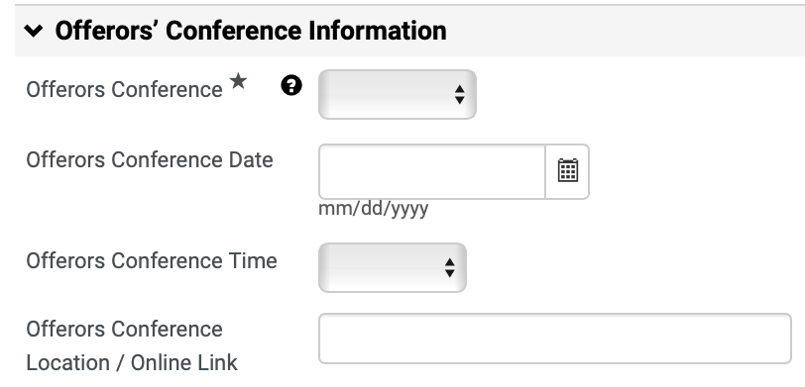
Create a Request for Quotes (RFQ)
(Part 6 of 52)
INSTRUCTIONS
Select Offerors Conference*.
Note: If Mandatory or Optional is selected, follow Steps 16 – 20 to complete the fields in this section. If Offerors Conference is N/A, skip to Step 21.
Enter Offerors Conference Date.
Select Offerors Conference Time.
Enter Offerors Conference Location / Online Link.
Note: Indicate whether the conference will be held virtually, and if so, use the link option to provide the virtual meeting information.
15
16
17
18

Slide 8
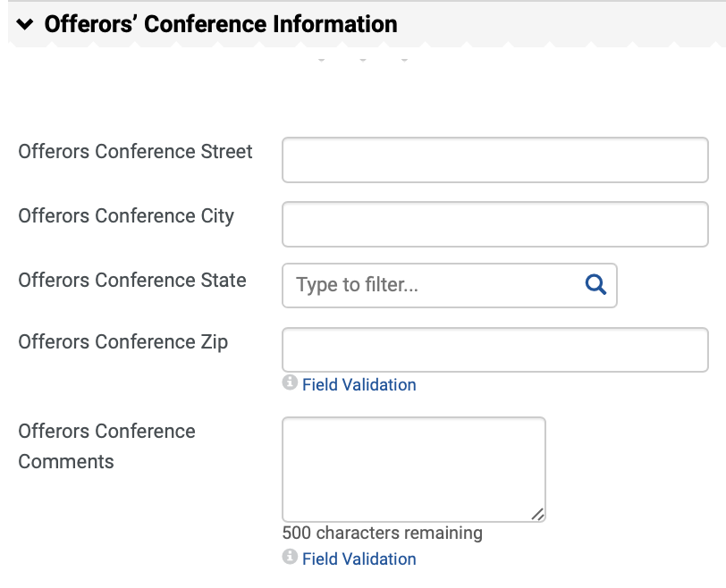
Create a Request for Quotes (RFQ)
(Part 7 of 52)
INSTRUCTIONS
Enter Offerors Conference Street, Offerors Conference City, Offerors Conference State and Offerors Conference Zip.
Enter Offerors Conference Comments.
19
20

Slide 9
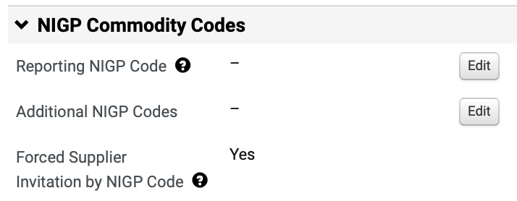
Create a Request for Quotes (RFQ)
(Part 8 of 52)
INSTRUCTIONS
Click Edit to add the Reporting NIGP Code.

Slide 10
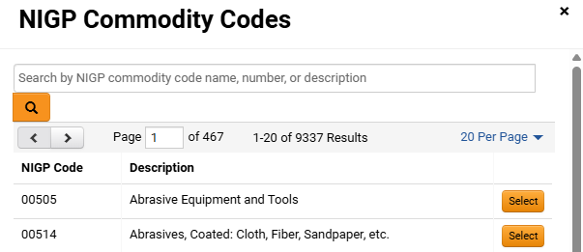
Create a Request for Quotes (RFQ)
(Part 9 of 52)
INSTRUCTIONS
Enter or search for the Commodity Code.
Note: Search by Name, Code or Description. Commodity Code can be removed by clicking Remove.
Click Select.
Note: If the event is limited to suppliers that were prequalified through an eRFQC, then do not select any NIGP Codes. Instead, add the qualified suppliers to the event to be notified manually.
22
23

Slide 11
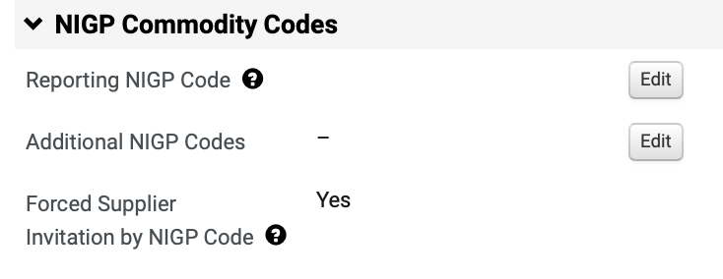
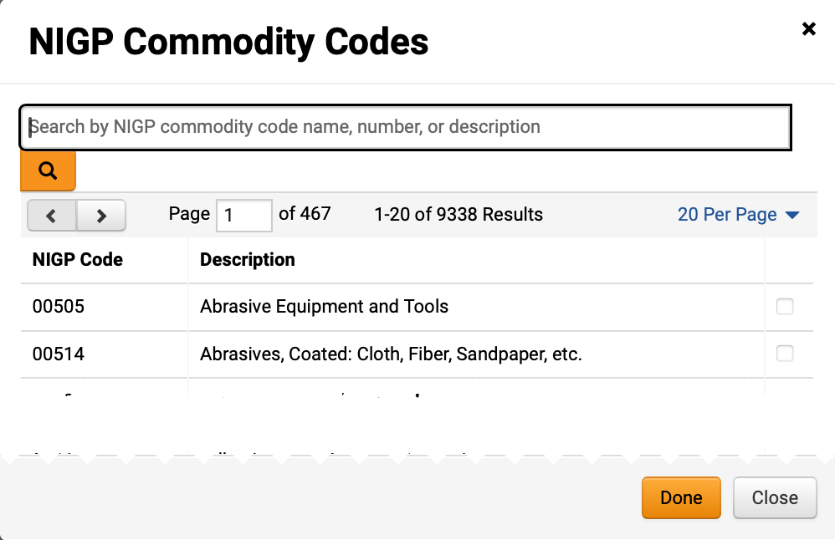
Create a Request for Quotes (RFQ)
(Part 10 of 52)
INSTRUCTIONS
Review added Reporting NIGP Code.
To add Additional NIGP Commodity Codes, click Edit.
24
25
Check the NIGP Commodity Code box.
Note: Multiple codes can be selected.
Click Done.
26
27

Slide 12
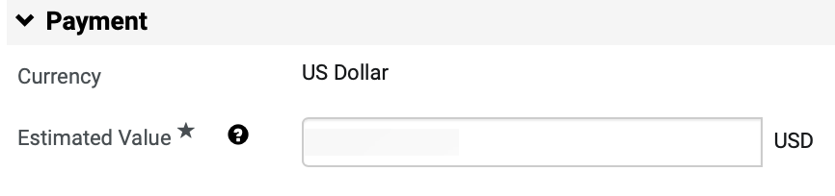
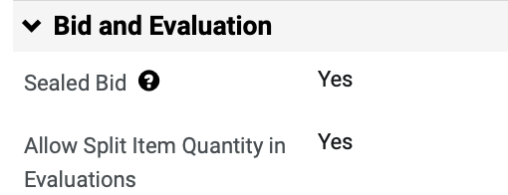
Create a Request for Quotes (RFQ)
(Part 11 of 52)
INSTRUCTIONS
Enter the Estimated Value for the event.
Note: The Estimated Value field is also used for DPA Approvals and NOIA/NOA protest period.
Review Bid and Evaluation section.
Note: The fields in this section are read-only based on the template selection. Sealed Bid ensures supplier responses remain confidential to the Sourcing Event Buyer until after the event closes.

Slide 13
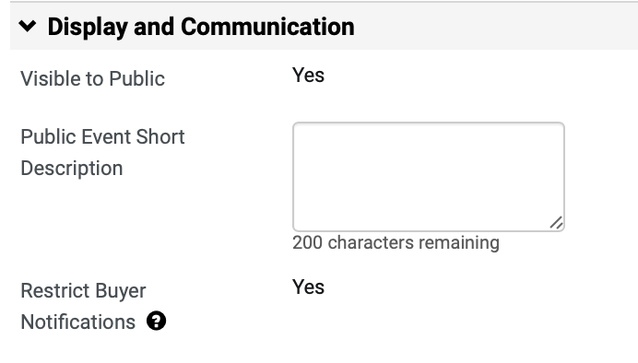
Create a Request for Quotes (RFQ)
(Part 12 of 52)
INSTRUCTIONS
Enter Public Event Short Description.
Note: The Public Event Short Description will be displayed on the G@WORK Marketplace. It is highly recommended to include the state entity’s full name in the description. Restrict Buyer Notification is set to Yes so that only the Sourcing Event Buyer will receive event related notifications.

Slide 14
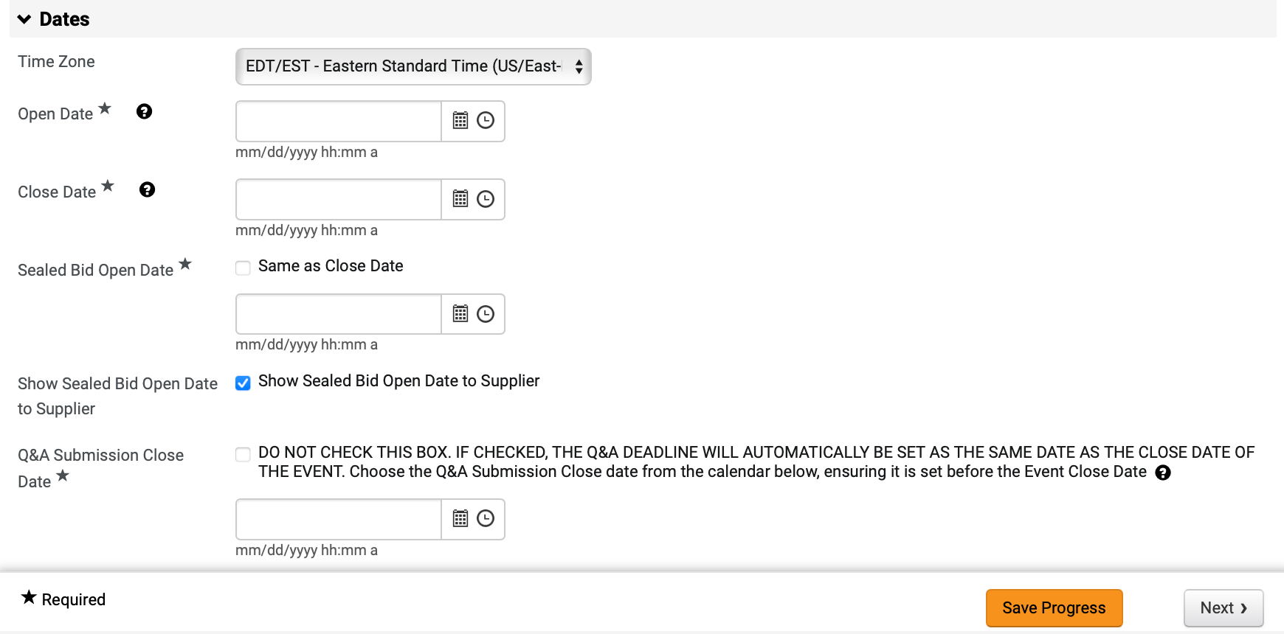
Create a Request for Quotes (RFQ)
(Part 13 of 52)
INSTRUCTIONS
Select Time Zone (Optional).
Note: Verify Time Zone is set to Eastern Standard Time.
Enter Open Date* and Close Date*.
Select Sealed Bid Open Date*.
Note: Same as Close Date is auto-checked. If you uncheck Same as Close Date box, the Sealed Bid Open Date field is visible.
Select Show Sealed Bid Open Date to Supplier.
Note: Show Sealed Bid Open Date to Supplier box is auto-checked.
Enter Q&A Submission Close Date*.
Note: If checked, the date field will automatically be set to reflect the close date of the event.
Click Save Progress and Next.
31
32
33
34
35
36

Slide 15
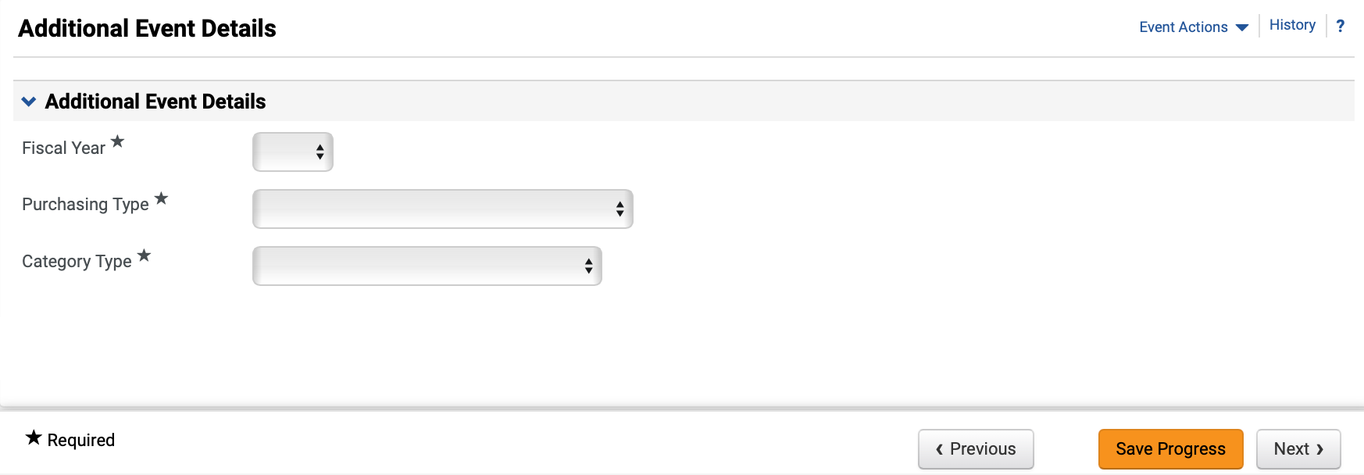
Create a Request for Quotes (RFQ)
(Part 14 of 52)
INSTRUCTIONS
Select the Fiscal Year* the event will be awarded.
Select Purchasing Type* and Category Type*.
Click Next.
37
38
39

Slide 16
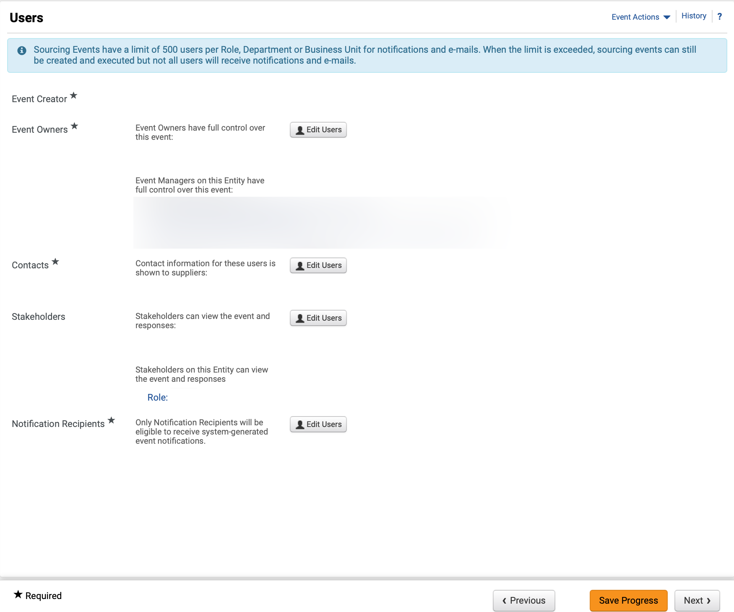
Create a Request for Quotes (RFQ)
(Part 15 of 52)
INSTRUCTIONS
Review Event Owners*, Contacts* and Notification Recipients*.
Note: Click Edit Users to update any of the editable fields. Review Managing Administrators, Stakeholders and Contract Managers Job Aid for further details.
Click Next.
40
41

Slide 17
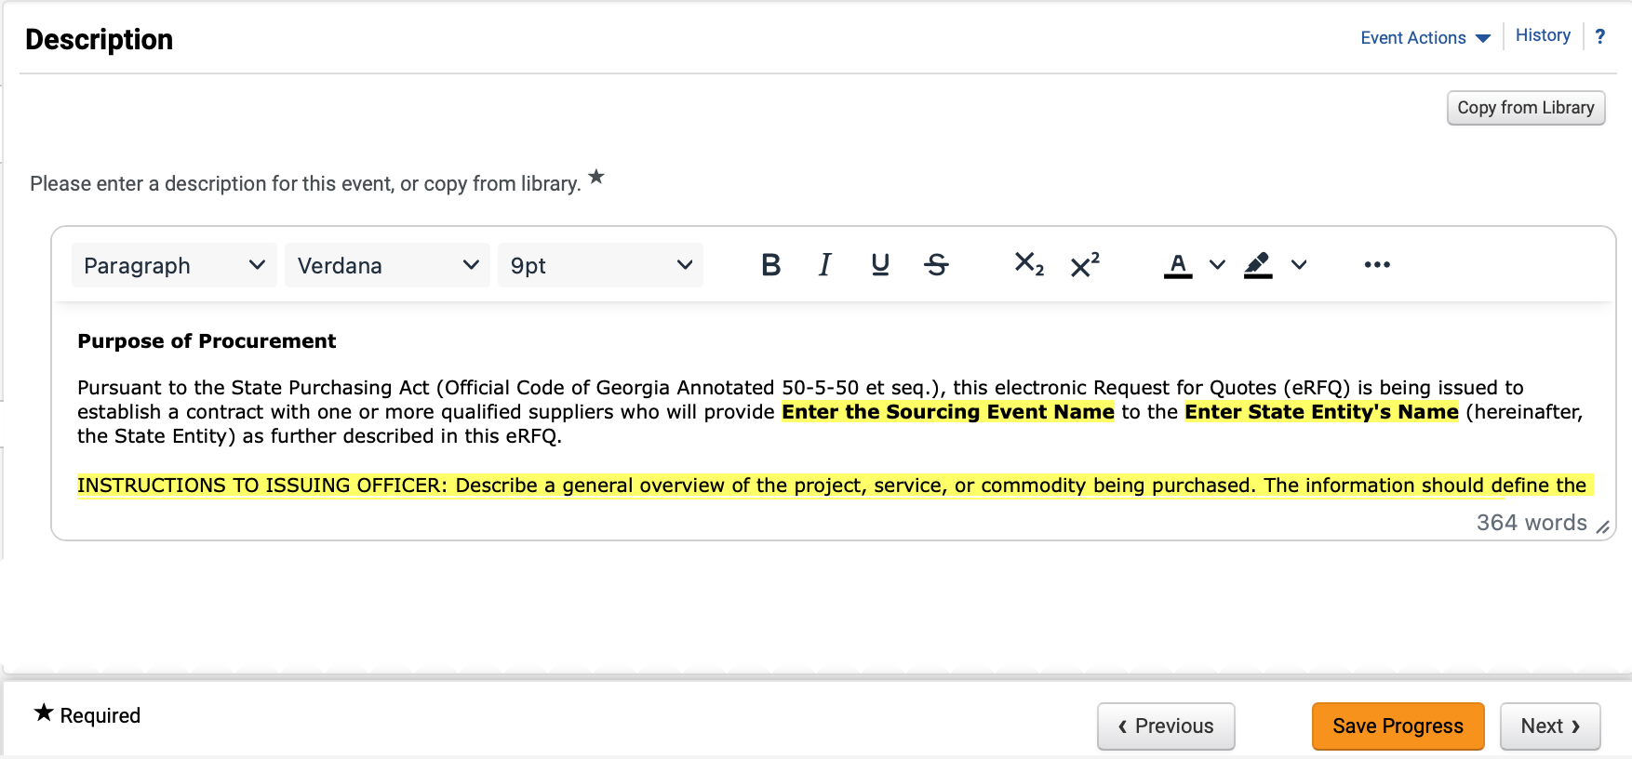
Create a Request for Quotes (RFQ)
(Part 16 of 52)
INSTRUCTIONS
Review and edit Description*.
Note: Remove instructions when editing Description. To remove yellow highlighting, select the text and click the Paint Bucket to change the background color. To Copy from Library, follow Steps 43 – 47, or skip to Step 48.
To Copy Description from Library, click Copy from Library.

Slide 18
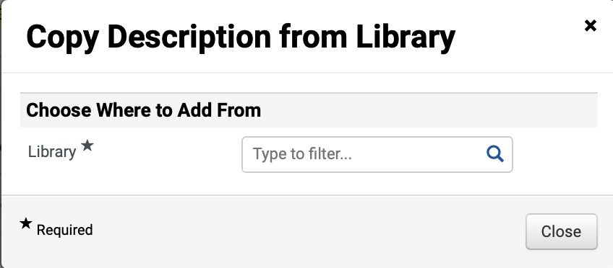
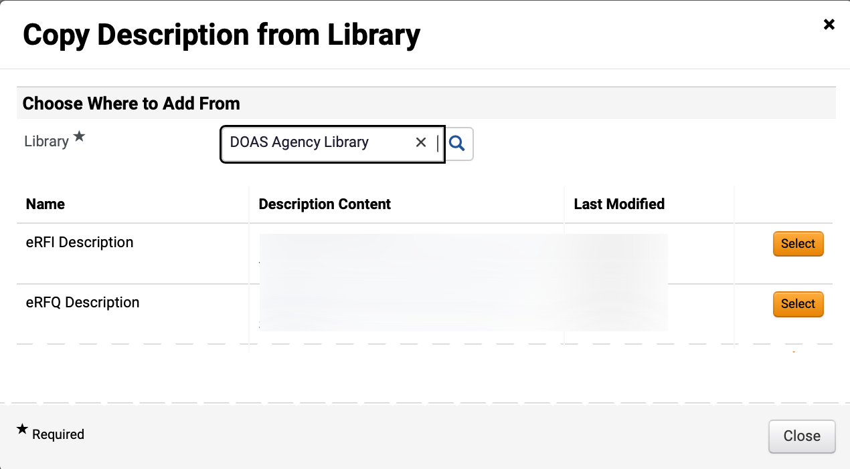
Create a Request for Quotes (RFQ)
(Part 17 of 52)
INSTRUCTIONS
Select Library*.
Note: Click magnifying glass to display more options.
Click Select to add Description Content.

Slide 19
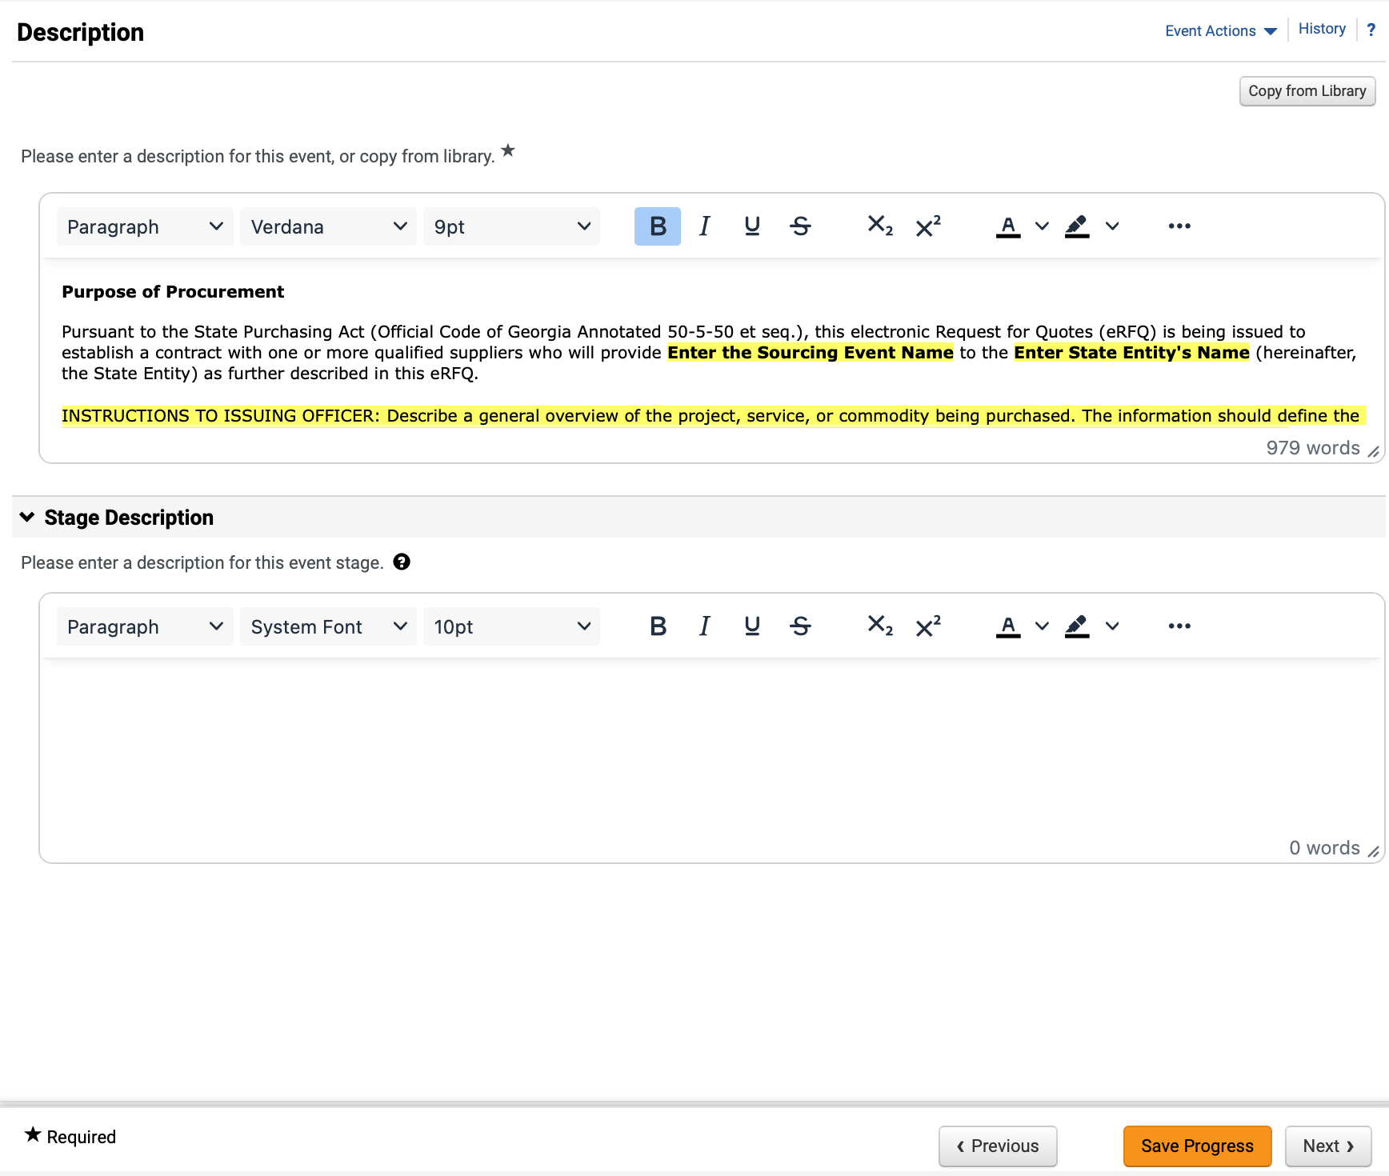
Create a Request for Quotes (RFQ)
(Part 18 of 52)
INSTRUCTIONS
Review added Description.
Enter Stage Description (Optional).
Note: Populate this field only if there is a stage included in the event.
Click Save Progress and Next.
46
47
48

Slide 20
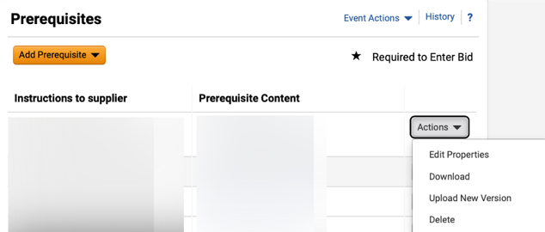
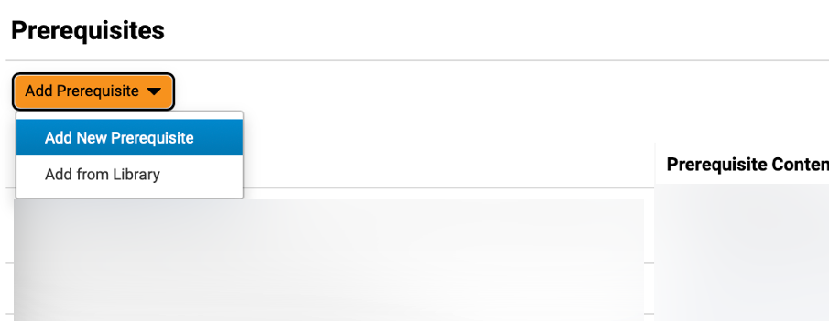
Create a Request for Quotes (RFQ)
(Part 19 of 52)
INSTRUCTIONS
Click Actions and select Edit Properties or Delete, if applicable.
Note: All template populated Prerequisites should be reviewed by Sourcing Event Buyers to ensure language and attachments are correct in accordance with what they are sourcing.
Click Add Prerequisite (Optional) and select Add New Prerequisite.
Note: If selecting Add New Prerequisite, follow Steps 50 – 63 and then skip to Step 71 to Add Buyer Attachment. If selecting Add from Library, follow Steps 64 – 70.

Slide 21
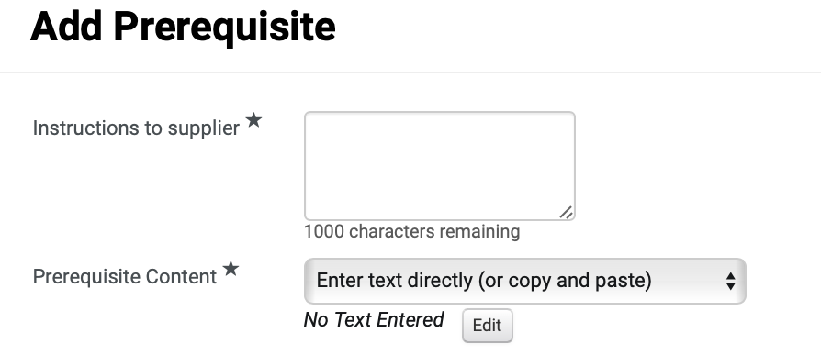
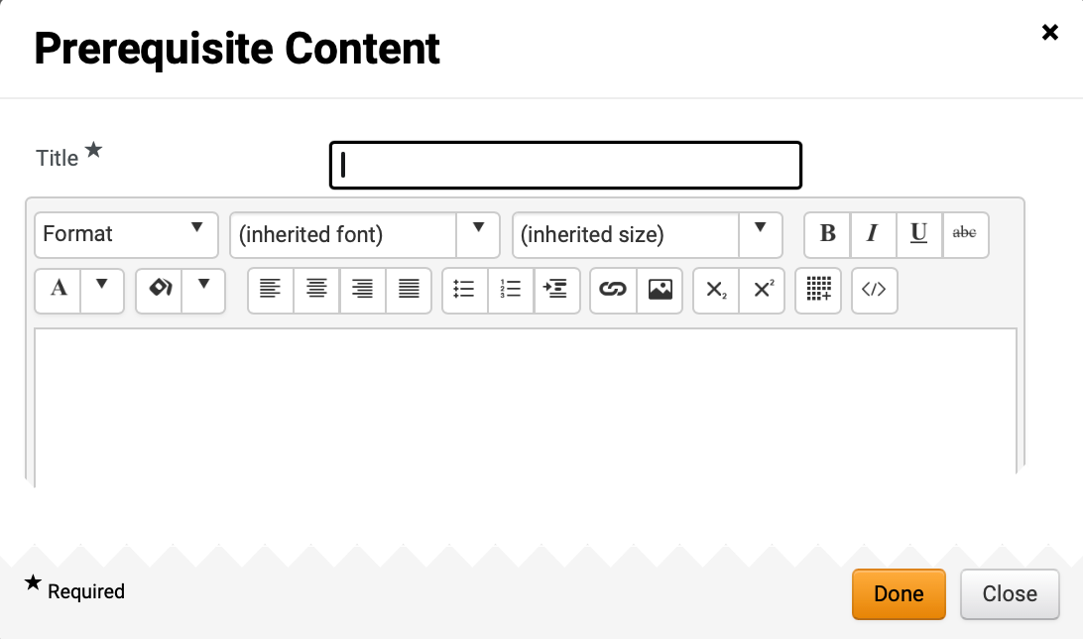
Create a Request for Quotes (RFQ)
(Part 20 of 52)
INSTRUCTIONS
Enter Instructions to supplier* and select Prerequisite Content*.
Note: If selecting Enter text directly, follow Steps 52 – 55 and skip to Step 61. To Attach File, skip to Step 56.
Click Edit.
51
52
Enter Title*.
Enter Prerequisite Content.
Click Done.
53
54
55

Slide 22
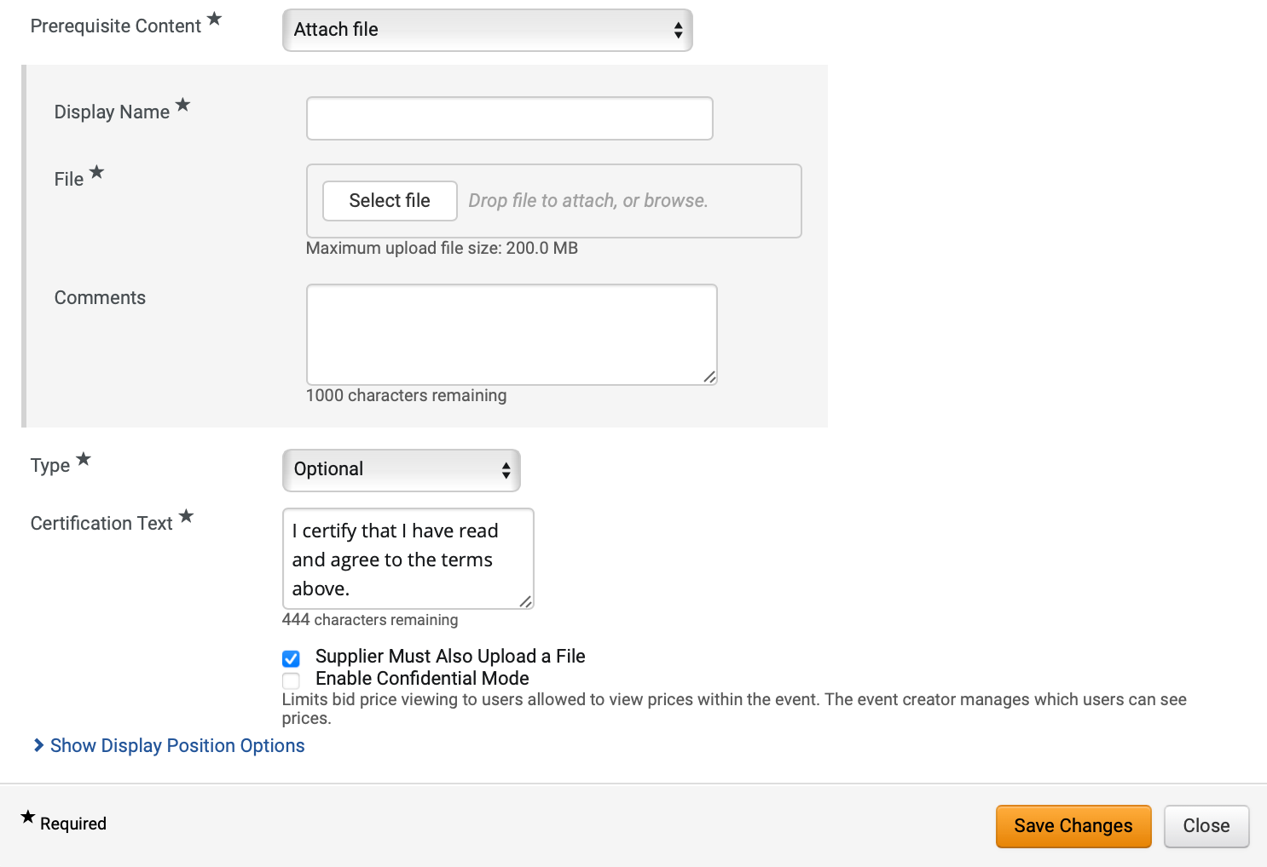
Create a Request for Quotes (RFQ)
(Part 21 of 52)
INSTRUCTIONS
If attaching file, enter Display Name*.
Click Select file to attach File*.
Enter Comments (Optional).
Select Type* and enter Certification Text*.
Note: Certification Text will auto-populate but can be edited.
Check Supplier Must Also Upload a File box (Optional).
Note: If you check this box, Enable Confidential Mode checkbox will display.
Click Show Display Position Options.
56
57
58
59
60
61

Slide 23
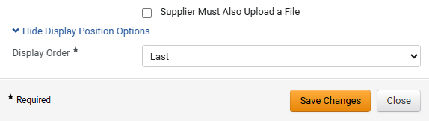
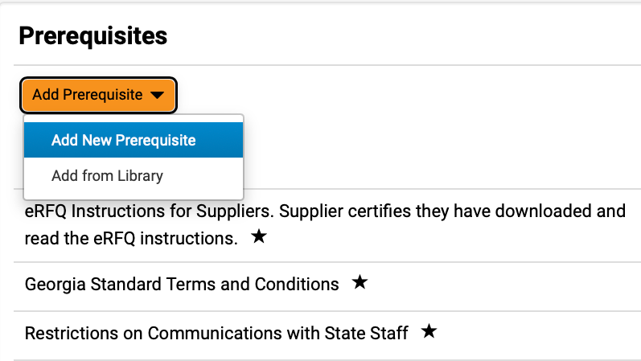
Create a Request for Quotes (RFQ)
(Part 22 of 52)
INSTRUCTIONS
Select Display Order*.
Click Save Changes.
Note: Repeat the steps above to add additional custom prerequisites.
62
63
Click Add Prerequisite.
Select Add from Library.
64
65

Slide 24
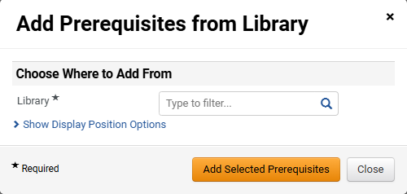
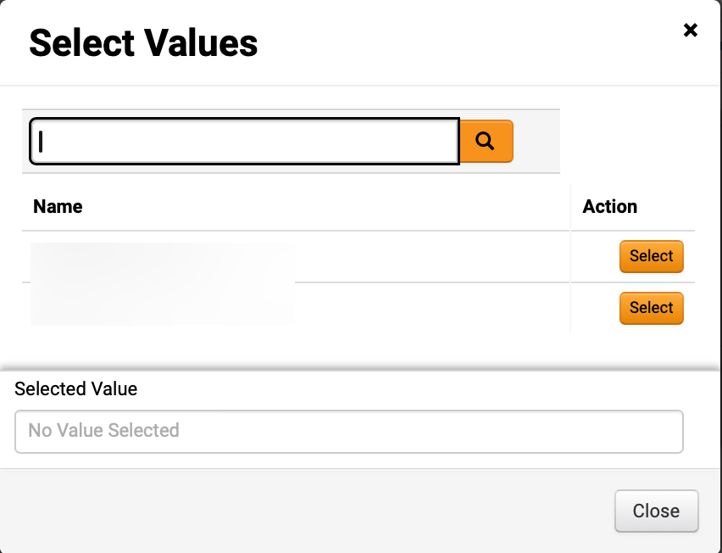
Create a Request for Quotes (RFQ)
(Part 23 of 52)
INSTRUCTIONS
Click magnifying glass to select Library*.
Note: If selecting Library, skip to Step 68.
Click Select for the desired library.

Slide 25
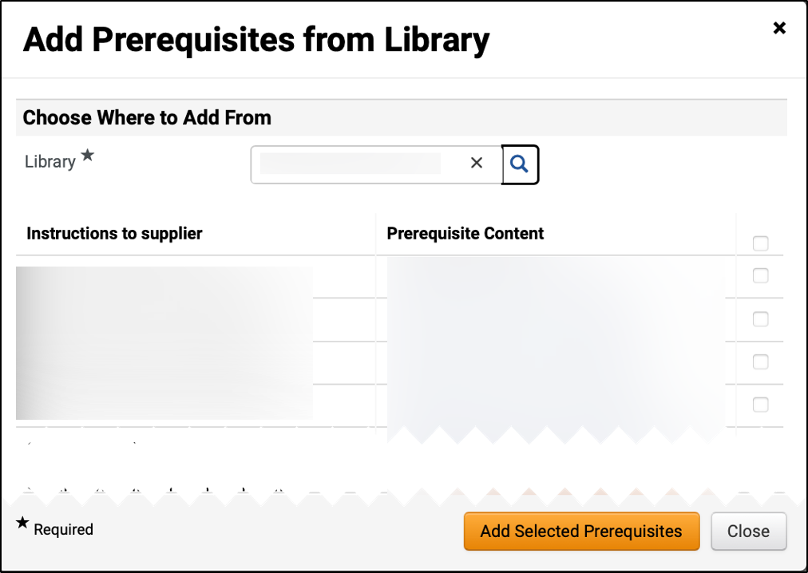
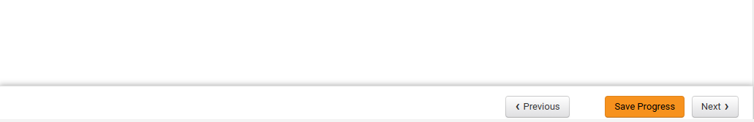
Create a Request for Quotes (RFQ)
(Part 24 of 52)
INSTRUCTIONS
Check the applicable Prerequisite Content box(s).
Click Add Selected Prerequisites.
68
69
Click Save Progress and Next.

Slide 26
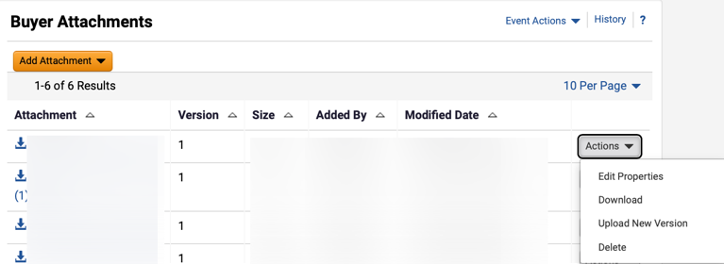
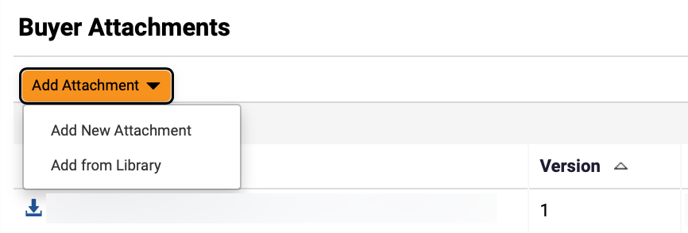
Create a Request for Quotes (RFQ)
(Part 25 of 52)
INSTRUCTIONS
Click Actions and select Edit Properties or Delete an attachment, if applicable.
Click Add Attachment.
Note: Follow Steps 72 – 86 and skip to Step 91 if adding Buyer Attachments or skip to Step 87 to Add from Library. Following your organization's guidance, upload any relevant files to the event. If no files to add, skip to Step 92.
Select Add New Attachment.
72
73

Slide 27
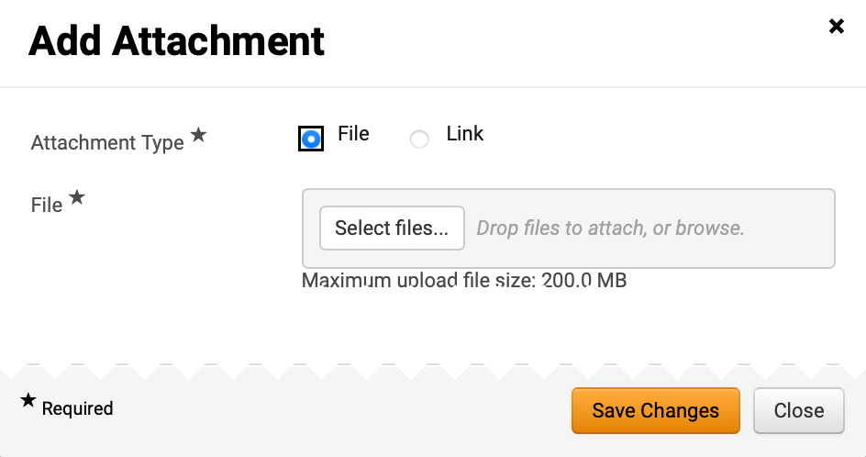

Create a Request for Quotes (RFQ)
(Part 26 of 52)
INSTRUCTIONS
Select Attachment Type*.
Note: If selecting File, follow Steps 75 – 81 then skip to Step 87. If selecting Link, skip to Step 82.
Click Select files… to upload File*.
74
75
Select the applicable File from local computer.
Click Open.
76
77

Slide 28
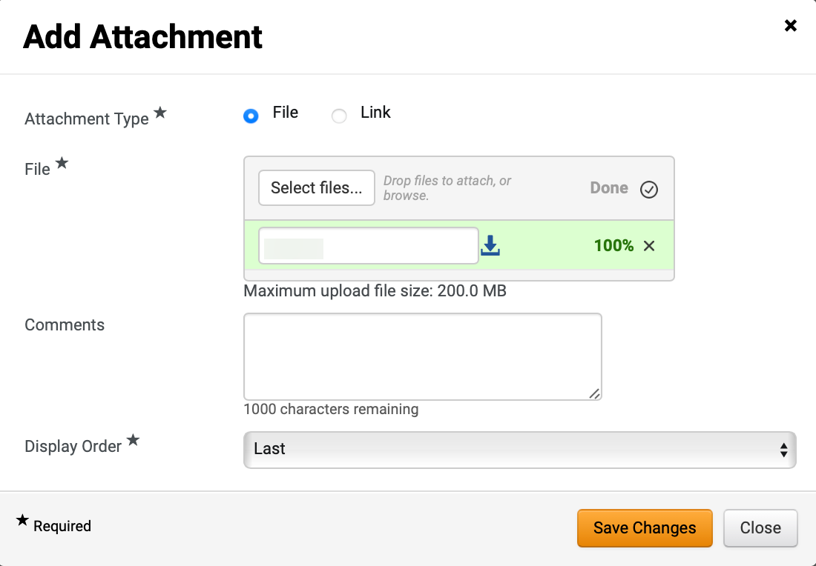
Create a Request for Quotes (RFQ)
(Part 27 of 52)
INSTRUCTIONS
Confirm that the uploaded File* was added.
Enter Comments (Optional).
Select Display Order*.
Click Save Changes.
Note: Skip to Step 96 to Add Question.
78
79
80
81

Slide 29
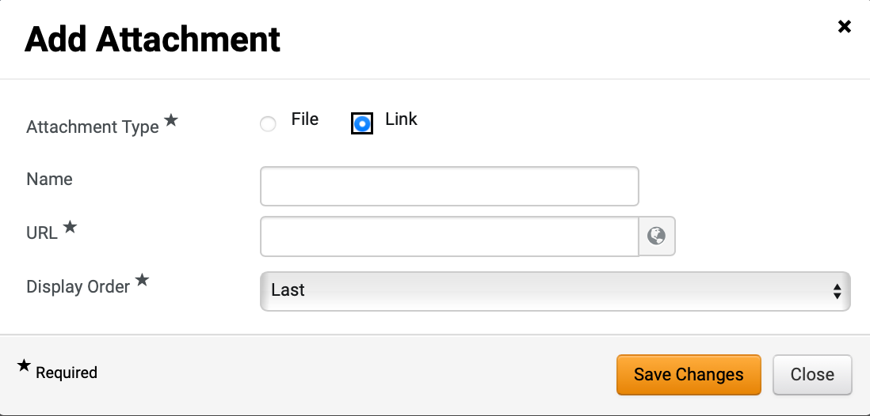
Create a Request for Quotes (RFQ)
(Part 28 of 52)
INSTRUCTIONS
Select Link as Attachment Type*.
Enter Name.
Enter URL*.
Select Display Order*.
Click Save Changes.
82
83
84
85
86
To Add Attachment from Library, select Add from Library.

Slide 30
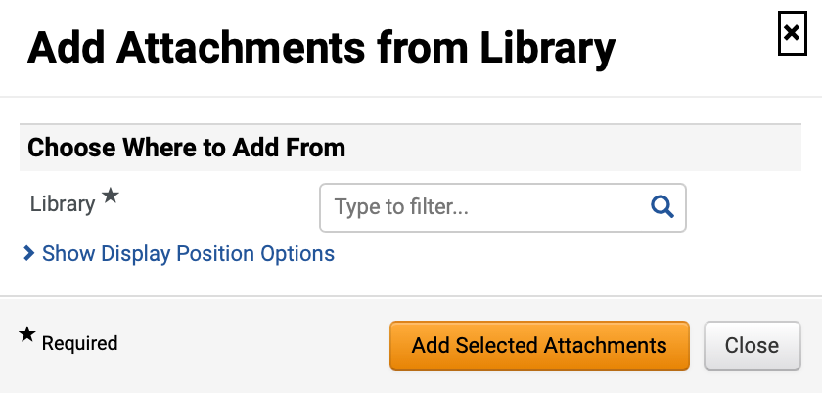
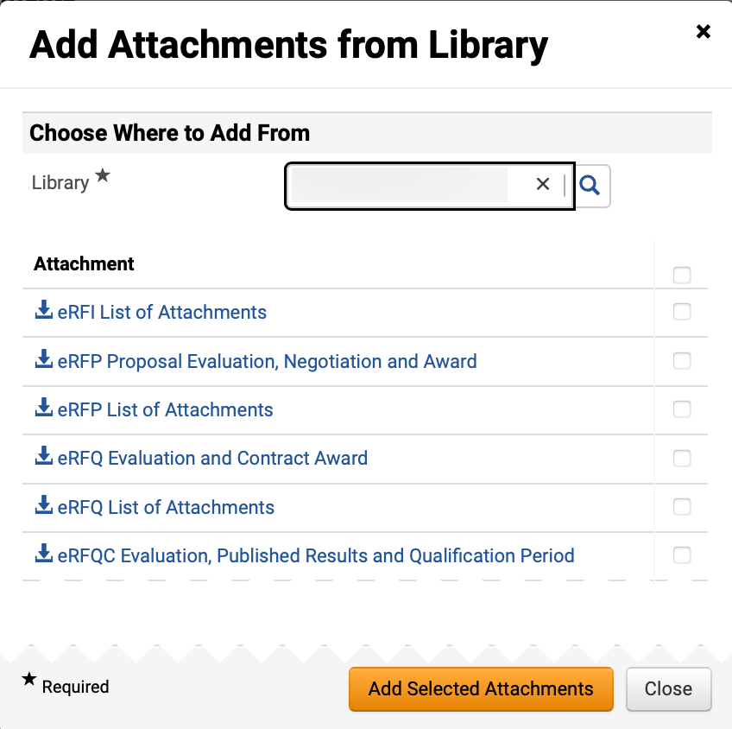
Create a Request for Quotes (RFQ)
(Part 29 of 52)
INSTRUCTIONS
Select Library*.
Note: Use magnifying glass to search for Library.
Click checkbox to Add Attachments.
Note: Multiple Attachments can be selected.
Click Add Selected Attachments.
89
90

Slide 31
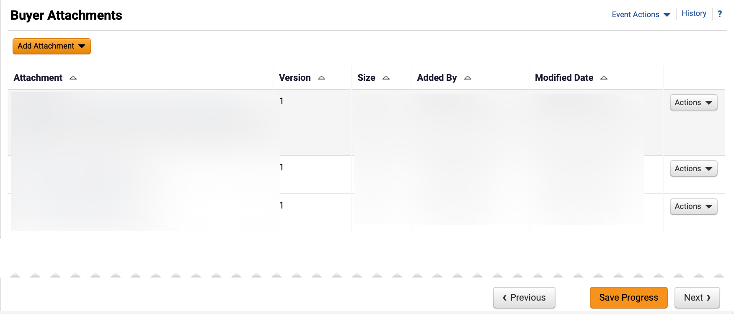
Create a Request for Quotes (RFQ)
(Part 30 of 52)
INSTRUCTIONS
Review Buyer Attachments.
Click Next.
91
92

Slide 32
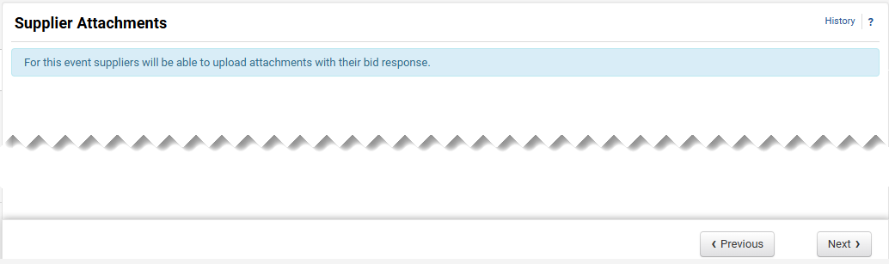
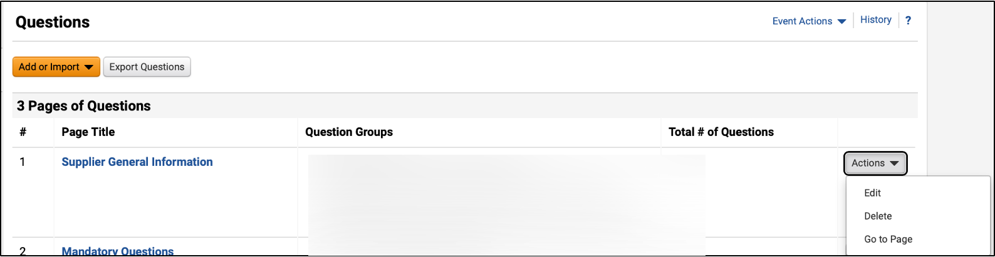
Create a Request for Quotes (RFQ)
(Part 31 of 52)
INSTRUCTIONS
Click Next.
Note: All event types are set up to allow suppliers to upload attachments.
To Edit or Delete prepopulated question groups, click Actions (Optional).
Click the Page Title hyperlink to view questions.
Note: Review the chart to learn more about Event Questions.
95
94

Slide 33
Create a Request for Quotes (RFQ)
(Part 32 of of 52)
INSTRUCTIONS
Event Questions
Description
Add New Question
Enter a custom question
Add from Library
Select standard questions
Import from File
Upload previously prepared questions
Question Page
Questions can be organized into separate pages. The RFQ Template includes three pre-populated question pages:
Supplier General Information
Mandatory Questions
Price Matching
Question Group
Within each page, questions can be further grouped into sections with titles based on user-defined criteria. Instructions for each group can also be entered.
Block Questions with Supplier Profile Content
Questions from Supplier Profile Content can be added in groups.
Note: Users can organize their questions and groups freely.
Options:
Group questions in sections under a single page.
Place each group on a separate page.
Have all questions in a single page without groups

Slide 34
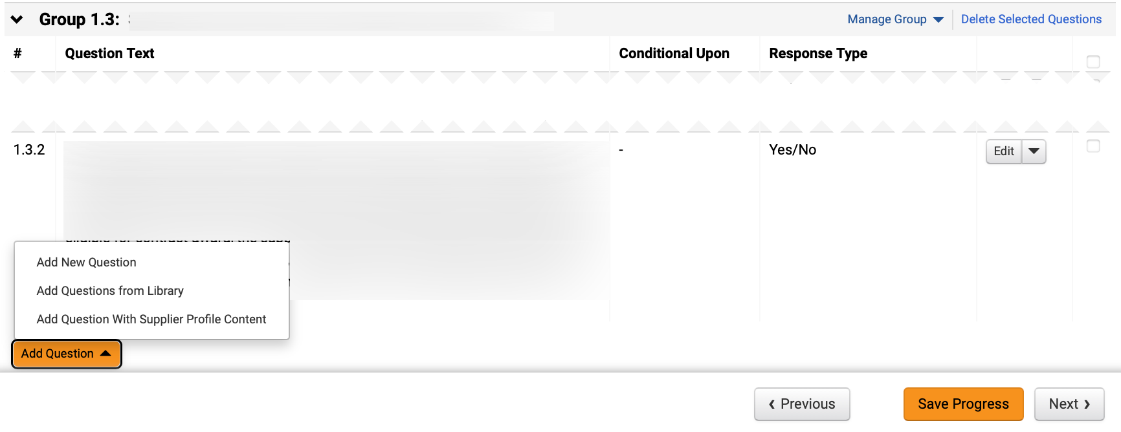
Create a Request for Quotes (RFQ)
(Part 33 of 52)
INSTRUCTIONS
Click Add Question.
To add a custom question, select Add New Question.
Note: To Add New Question, follow Steps 97 – 103 and skip to Step 110. To Add Questions from Library, follow Steps 104 – 110.
97
96

Slide 35
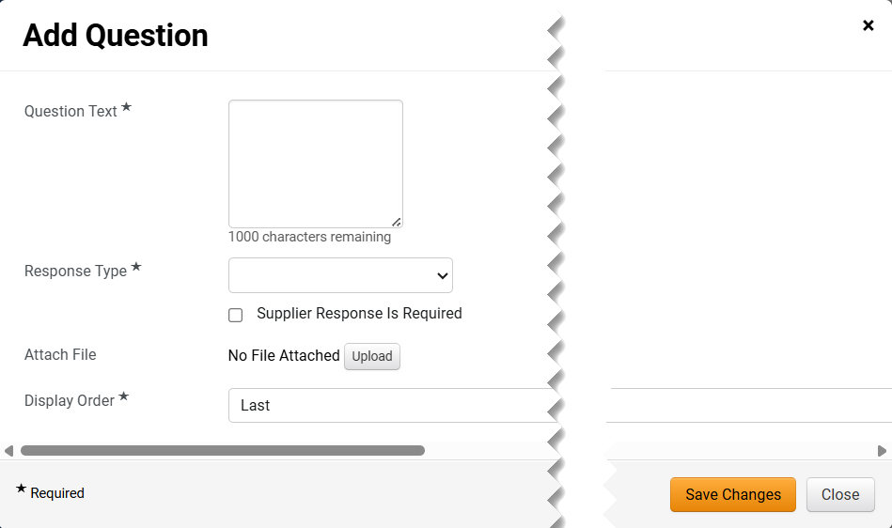
Create a Request for Quotes (RFQ)
(Part 34 of 52)
INSTRUCTIONS
Enter Question Text*.
Select Response Type*.
Note: Additional fields may display depending on Response Type selected.
Check Supplier Response is Required box (Optional).
Click Upload to Attach File (Optional).
Select Display Order*.
Click Save Changes.
98
99
100
101
102
103

Slide 36
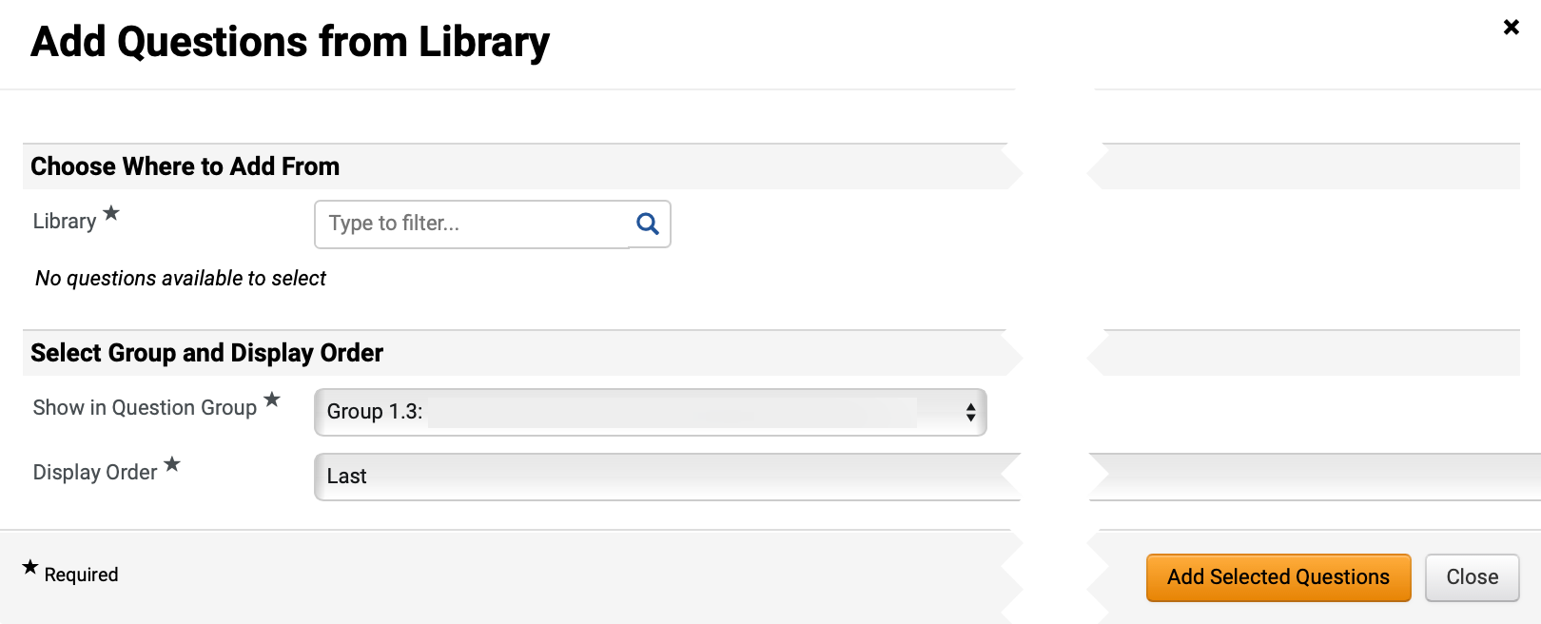
Create a Request for Quotes (RFQ)
(Part 35 of 52)
INSTRUCTIONS
Select Add Question from Library.
Note: To Add Questions from Library, follow Steps 104 – 110.
Select Library*.
Note: Use magnifying glass to search.

Slide 37
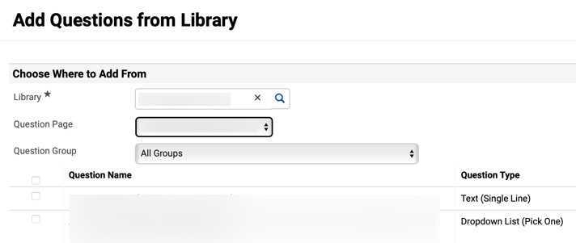
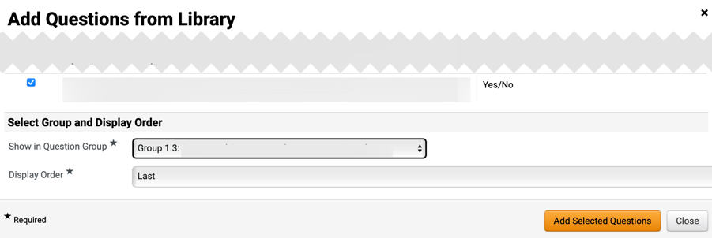
Create a Request for Quotes (RFQ)
(Part 36 of 52)
INSTRUCTIONS
Select Question Page and Question Group (Optional).
Note: Question Group can be filtered by All Groups or an individual Question Group.
Check the applicable Question Name box(s).
106
107
Select Show in Question Group* and Display Order*.
Click Add Selected Questions.
108
109

Slide 38
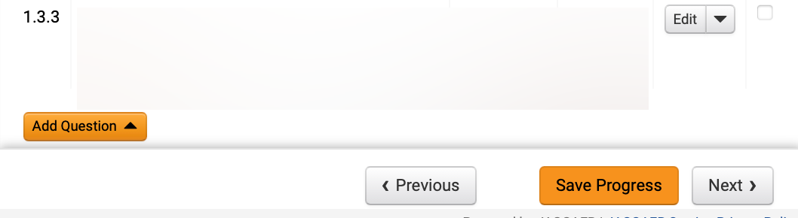
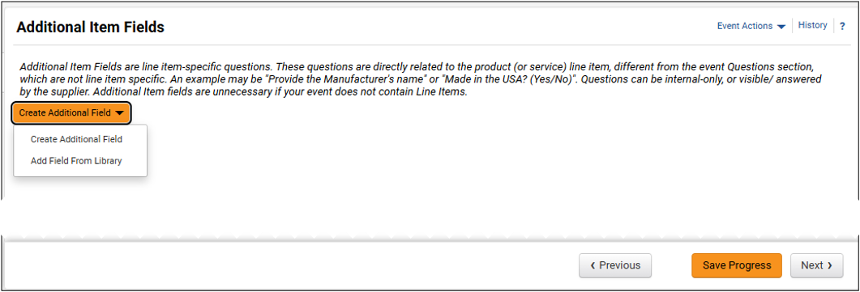
Create a Request for Quotes (RFQ)
(Part 37 of 52)
INSTRUCTIONS
Review added Question and click Next.
Click Create Additional Field and select Create Additional Field to create a custom question.
Note: If selecting Create Additional Field, follow Steps 111 – 117 and skip to Step 122. If selecting Add Field From Library, skip to Step 118.
111

Slide 39
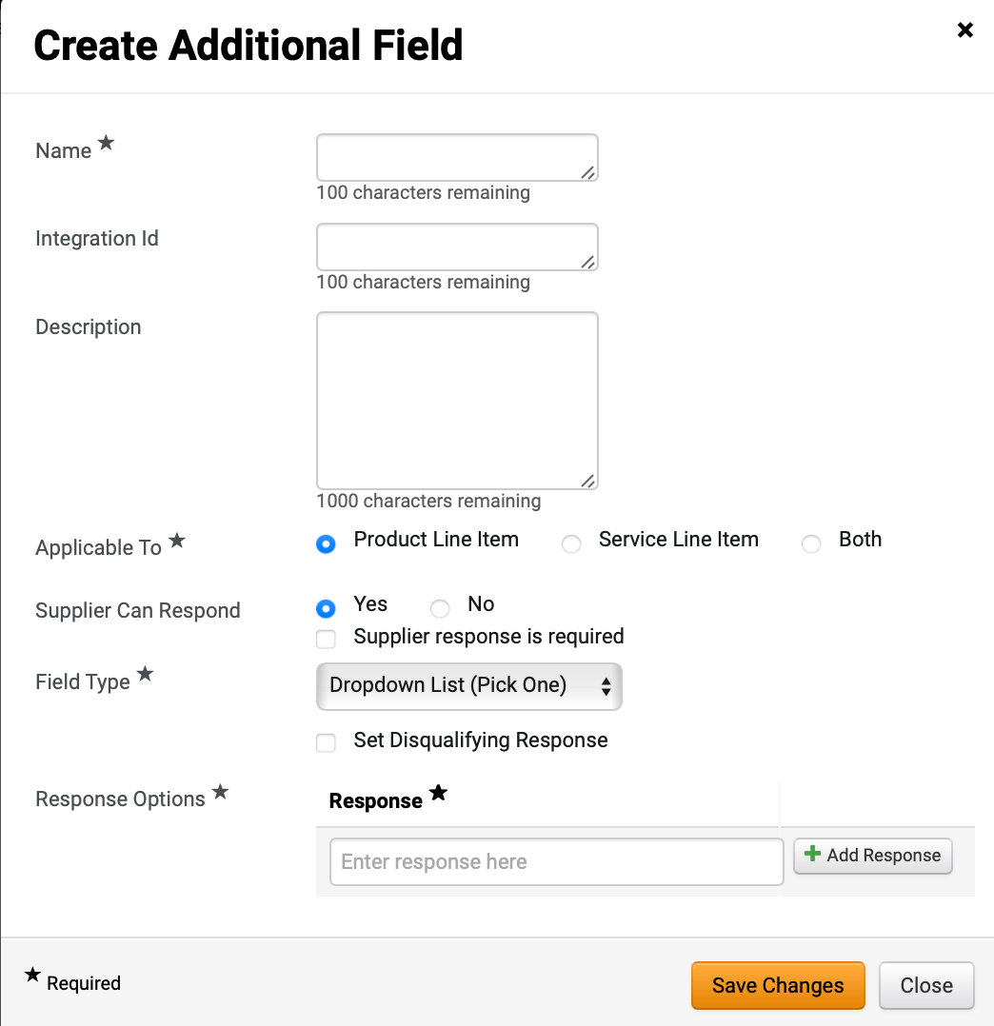
Create a Request for Quotes (RFQ)
(Part 38 of 52)
INSTRUCTIONS
Enter Name*, Integration Id, and Description (Optional).
Check Applicable To* box.
Check Supplier Can Respond box (Optional).
Note: If selecting Yes, an option to click Supplier response is required checkbox displays.
Select Field Type*.
Note: Response Option displays only based on Field Type selected. An option to Set Disqualifying Response may display.
Enter Response* and click Add Response.
Click Save Changes.
112
113
114
115
116
117

Slide 40
Create a Request for Quotes (RFQ)
(Part 39 of 52)
INSTRUCTIONS
Select Add Field from Library.

Slide 41
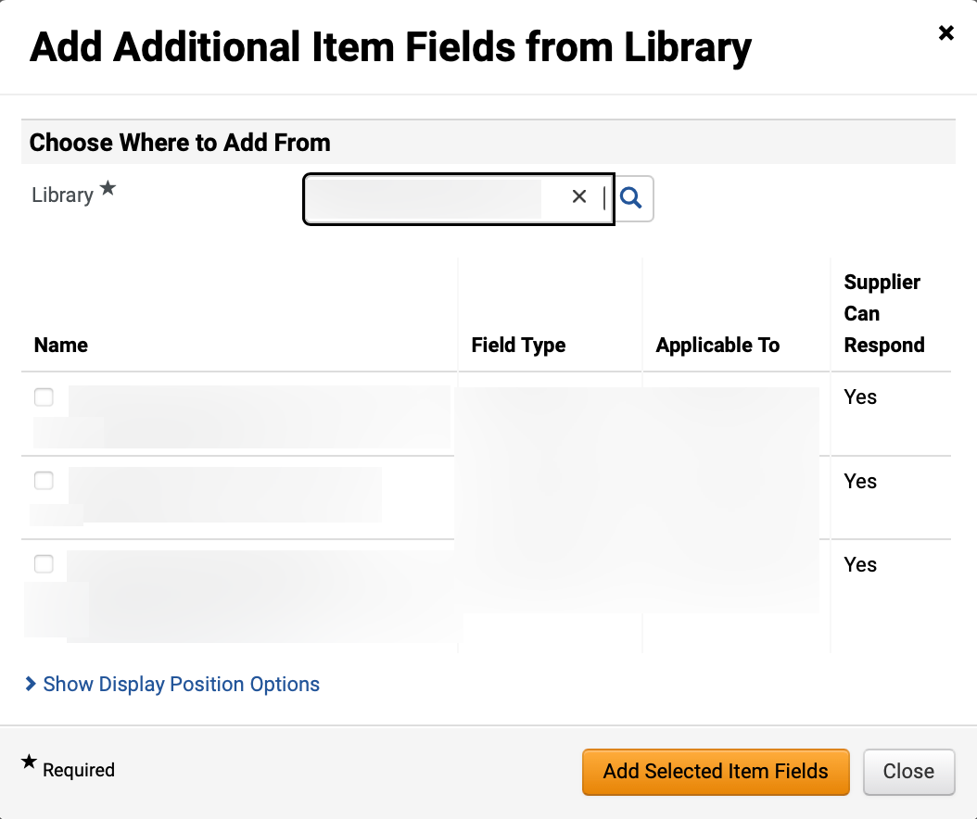
Create a Request for Quotes (RFQ)
(Part 40 of 52)
INSTRUCTIONS
Select Library*.
Note: Use magnifying glass to search. Additional Item Fields will populate once Library is selected.
Check applicable Additional Item Fields box(s).
Click Add Selected Item Fields.
119
120
121

Slide 42

Create a Request for Quotes (RFQ)
(Part 41 of 52)
INSTRUCTIONS
Review added Additional Item Fields.
Click Save Progress and Next.
122
123

Slide 43

Create a Request for Quotes (RFQ)
(Part 42 of 52)
INSTRUCTIONS
Select the applicable Items tab.
Note: If the solicitation includes both products and services, add items for both tabs following the same steps. If using a template to create the event, content will be pre-populated but can be edited or deleted.
Click Add Product Line Item and select Add New Item.
Note: To Add New Item, follow Steps 125 – 127 and skip to Step 135. If selecting Add Item from Library, skip to Step 128.
124
125

Slide 44

Create a Request for Quotes (RFQ)
(Part 43 of 52)
INSTRUCTIONS
Enter Product Line Item information.
Note: Check the Unit Price is Required box to ensure suppliers do not leave the price line blank as it will prevent contract award.
Click Save Changes.
126
127

Slide 45

Create a Request for Quotes (RFQ)
(Part 44 of 52)
INSTRUCTIONS
To Add Item from Library, click Add Product Line Item.
Select Add Item from Library.
128
129
Select Library*.
Note: Once Library is selected, additional fields will display.

Slide 46

Create a Request for Quotes (RFQ)
(Part 45 of 52)
INSTRUCTIONS
Check applicable Product Line Items box in Product Line Items Group.
Note: Multiple Product Line Items can be selected.
Select Show in Item Group*.
Select Display Order*.
Click Add Selected Items.
131
132
133
134

Slide 47

Create a Request for Quotes (RFQ)
(Part 46 of 52)
INSTRUCTIONS
Review added Items.
Click Next.
135
136

Slide 48

Create a Request for Quotes (RFQ)
(Part 47 of 52)
INSTRUCTIONS
Review added Suppliers.
Note: From the Suppliers Invited by Commodity Code tab view which registered suppliers will receive an email notification based on the NIGP Codes selected in the Setup section. If the tab is blank, return to the Setup section and select the appropriate NIGP codes.
To invite additional suppliers, select the Add Suppliers to Event tab.
138
137

Slide 49

Create a Request for Quotes (RFQ)
(Part 48 of 52)
INSTRUCTIONS
Enter Supplier Name in Quick search to search for Suppliers.
Click Add to Event.
Note: An Added confirmation icon will display
Click Manually Invite Suppliers (Optional).
Note: To Manually Invite Suppliers, follow Steps 141 – 145 or skip to Step 146.
Select Add Supplier to Event.
Note: If adding several suppliers, select Get Import Template.
141
139
142
140

Slide 50


Create a Request for Quotes (RFQ)
(Part 49 of 52)
INSTRUCTIONS
Enter Supplier Name* and enter Sales or Corporate Contact Name (Optional).
Enter Email*.
Click Save or Save and Add Another.
143
144
145
Review added Supplier.

Slide 51


Create a Request for Quotes (RFQ)
(Part 50 of 52)
INSTRUCTIONS
Click Save Progress and Next.
Review Progress for each section.
Note: Click the Section hyperlink to return to a section for editing.
Click Submit.
148
149

Slide 52


Create a Request for Quotes (RFQ)
(Part 51 of 52)
INSTRUCTIONS
Review Event Submitted summary page.
Note: If there is workflow surrounding the event, approval steps can be viewed by clicking View Approval Steps.
Click Return to My Event hyperlink.
151
150
Click Tools.
Select Approvals.
152
153

Slide 53


Create a Request for Quotes (RFQ)
(Part 52 of 52)
INSTRUCTIONS
Review Sourcing Event Approval Workflow and make changes as applicable.
You have successfully created a Request for Quotes.

