Slide 1
Create Single, Split or Multiple
Awards from Sourcing Events
DESCRIPTION
This guide will show Sourcing Event Buyers how to Create Single, Split or Multiple Awards from Sourcing Events. Refer to Create a Statewide Contract job aid for additional information.
OVERVIEW
The key steps in the process are below:
Navigate to Sourcing and review Supplier Responses.
Select Suppliers to Award, Evaluate and Finalize Award.
Upload and publish the Notice of Intent to Award (NOIA), RFQC List of Qualified Contractors and/or Notice of Award (NOA) in Award Notifications.
Approve and Award Sourcing Event.
Business Process:
Navigate to Sourcing Module
Evaluate and Finalize Award
Upload and Publish Public Notices
Approve and Award Sourcing Event

Slide 2
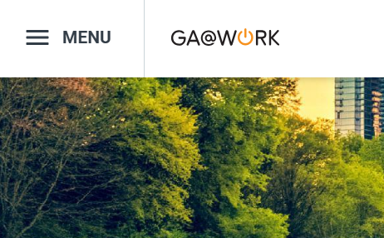

Create Single, Split or Multiple Awards from Sourcing Events (Part 1 of 13)
INSTRUCTIONS
Click the Global Navigation Menu.
Note: University System of Georgia (USG) and GDOT users complete local logon and then proceed to Step 4.
Click Sourcing, Contracts & Supplier Management.

Slide 3

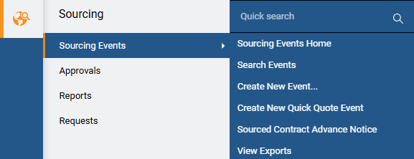
Create Single, Split or Multiple Awards from Sourcing Events (Part 2 of 13)
INSTRUCTIONS
Click Sign On.
Note: The system utilizes Single Sign-On (SSO) capabilities and no log in information is required.
Select Sourcing.
Select Sourcing Events.
Select Search Events.
4
5
6

Slide 4
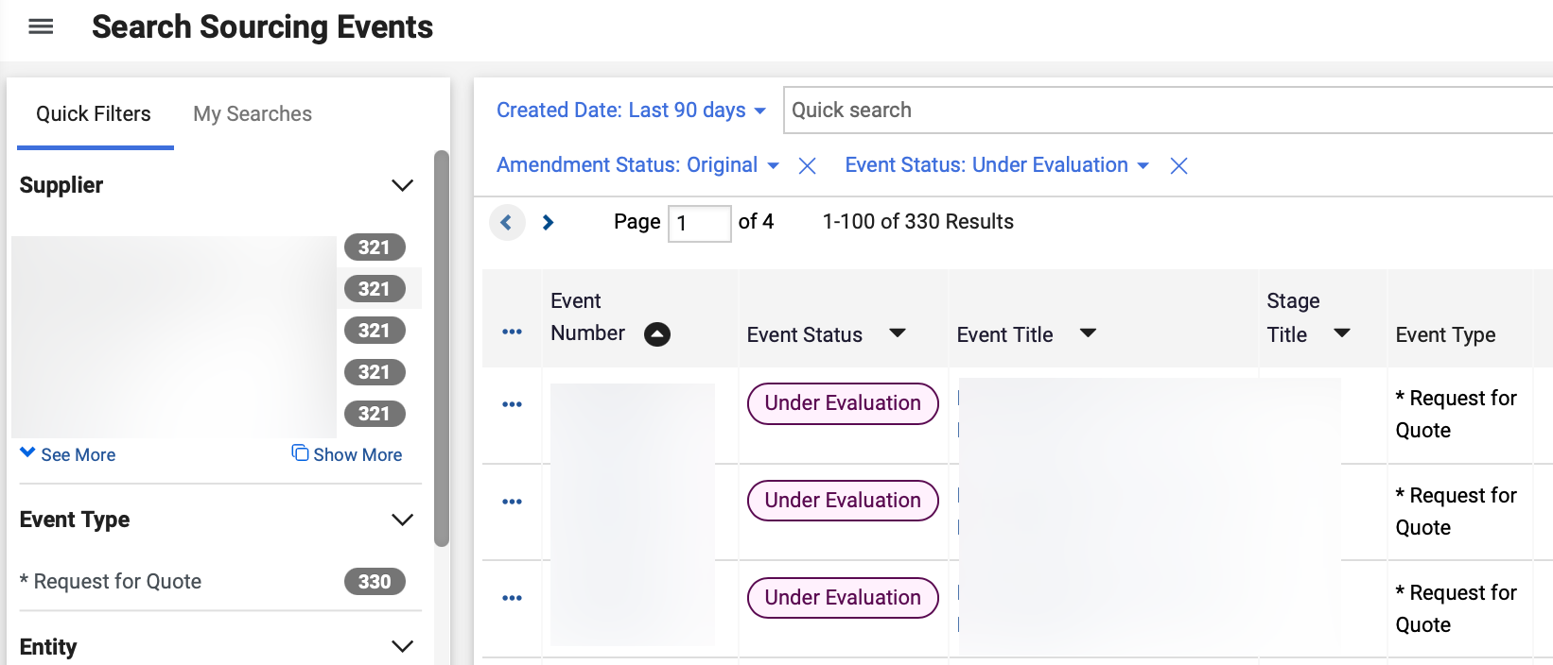
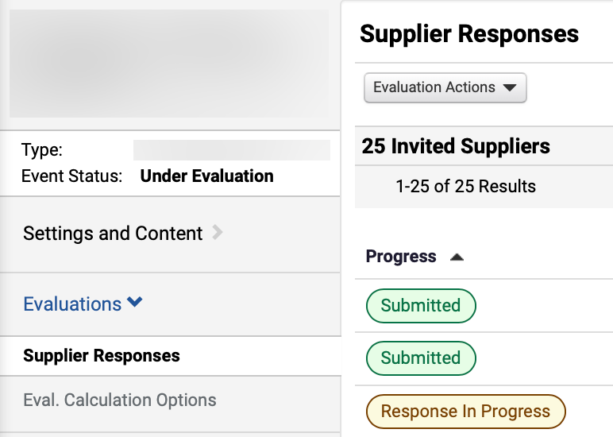
Create Single, Split or Multiple Awards from Sourcing Events (Part 3 of 13)
INSTRUCTIONS
Click the Event Number hyperlink.
Note: Select Under Evaluation as Event Status and use Filters to locate the Sourcing Event. Event can also be accessed via Sourcing Events Home.
Review Supplier Responses tab.

Slide 5
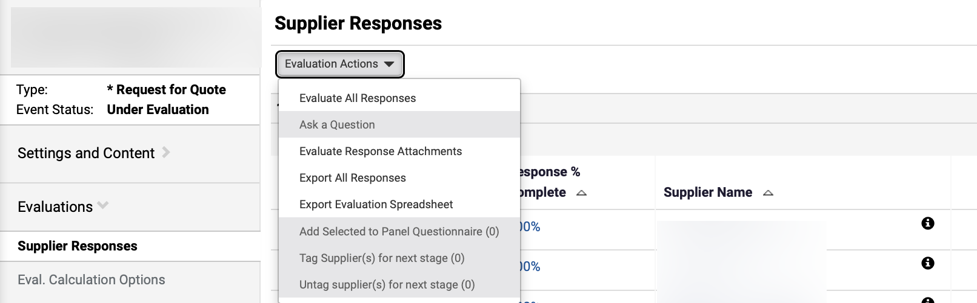
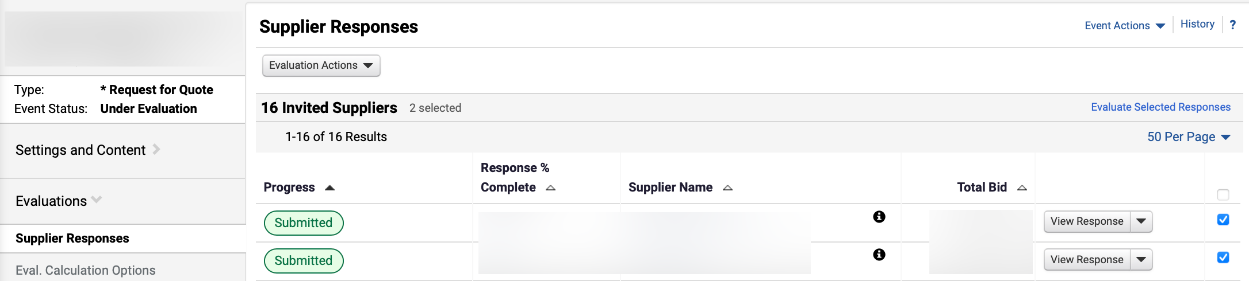
Create Single, Split or Multiple Awards from Sourcing Events (Part 4 of 13)
INSTRUCTIONS
To Evaluate All Responses, click Evaluation Actions.
Note: To Evaluate All Responses, follow Steps 9 – 10 and skip to Step 13. To Evaluate Selected Responses, skip to Step 11.
Select Evaluate All Responses.
9
10
To Evaluate Selected Responses, click checkbox to select Supplier Responses.
Click Evaluate Selected Responses.
Note: Sourcing Event Buyer may view different scenarios for award (will vary by event and award type).
12
11

Slide 6
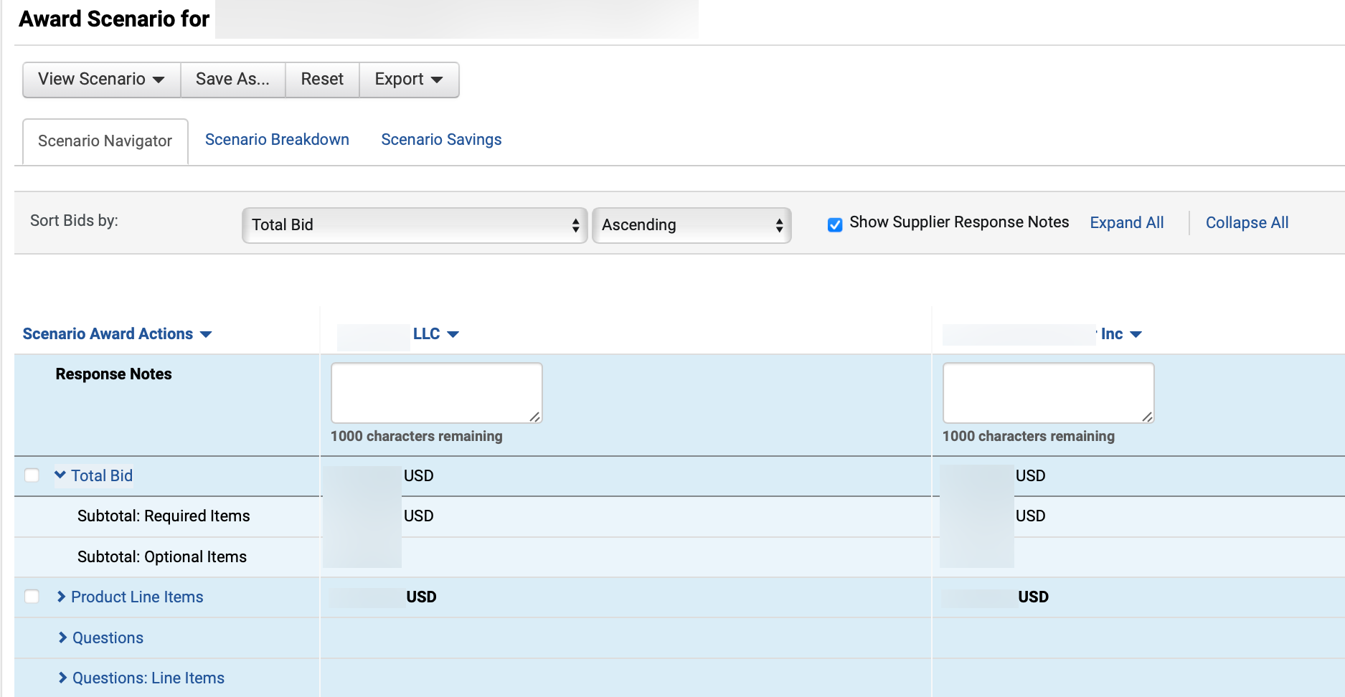
Create Single, Split or Multiple Awards from Sourcing Events (Part 5 of 13)
INSTRUCTIONS
Review Action and follow the steps in the table below to access Award actions.
Action | Description | Step Information
 |  | ​
Create a Single Award
Award to a single Supplier
Steps 14 – 18
(slides 6– 7)
Split or Multiple Award
Split Award between Suppliers and enter Assigned Quantity for each Item
Steps 19 – 24
(slides 8– 10)
Finalize Award
Finalize Award Evaluation and enter Scenario
Steps 25 – 34
(slides 10– 14)
Post Notice of Intent of Award
Publish Notice of Intent of Award or RFQC List of Qualified Contractors
Steps 1 – 26
(slides 15 – 21)
Post Notice of Award
Publish Notice of Award and review the Georgia Procurement Registry (GPR)
Steps 1 – 20
(slides 25 – 30)
To create a single Award, click Total Bid and review Items.
Check applicable Items boxes.
Note: Click arrow to expand categories.
15
14

Slide 7
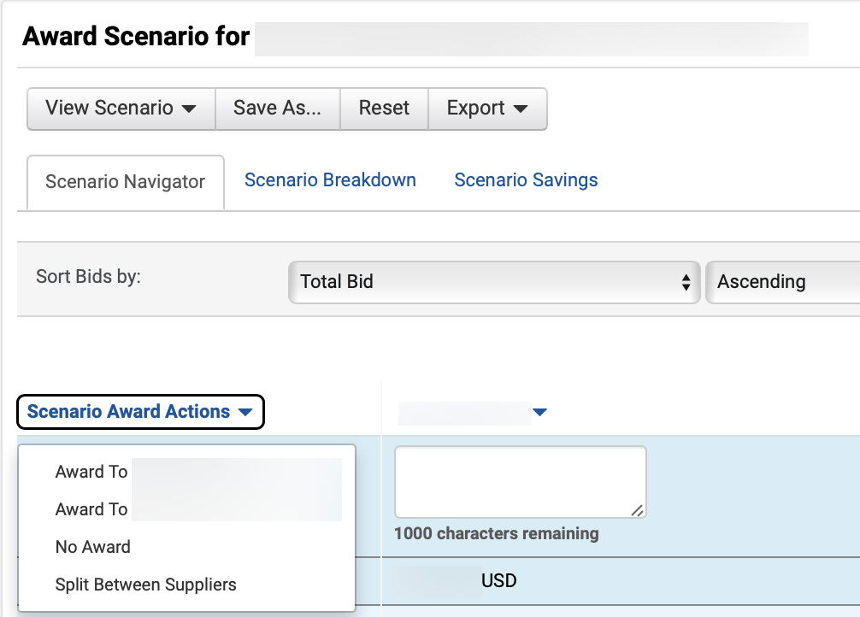
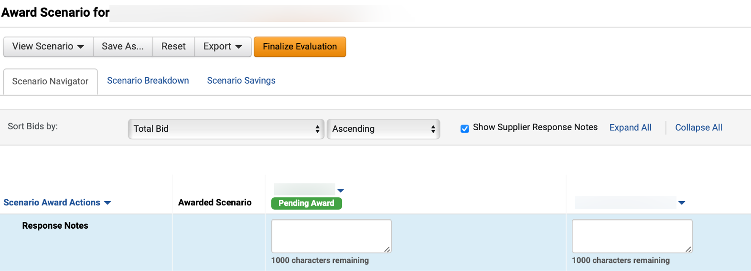
Create Single, Split or Multiple Awards from Sourcing Events (Part 6 of 13)
INSTRUCTIONS
Click Scenario Award Actions.
Select Award to Supplier.
Note: Skip to Step 25 to Finalize Award.
16
17
Review Pending Award notification.
Note: Sourcing Event Buyer can click the drop down next to the Supplier name to Remove Award From Supplier.

Slide 8
Create Single, Split or Multiple Awards from Sourcing Events (Part 7 of 13)
INSTRUCTIONS
To split an Award, click Scenario Award Actions.
Select Split Between Suppliers.
19
20

Slide 9
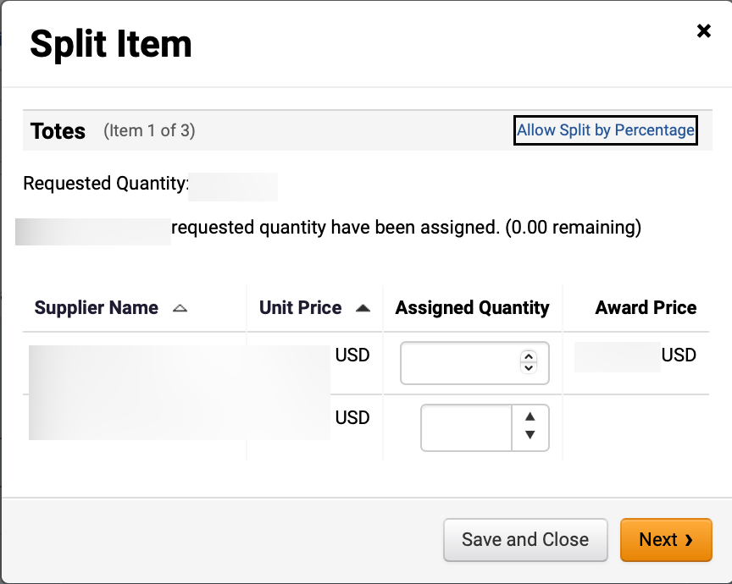
Create Single, Split or Multiple Awards from Sourcing Events (Part 8 of 13)
INSTRUCTIONS
Enter Assigned Quantity.
Note: Enter Assigned Quantity for each selected Item. Selecting Split Between Suppliers gives Sourcing Event Buyer the ability to allocate awards to multiple suppliers or allow the system to automatically split the award. Click Allow Split by Percentage to enter Assigned Percentage.
Click Next.
21
22

Slide 10
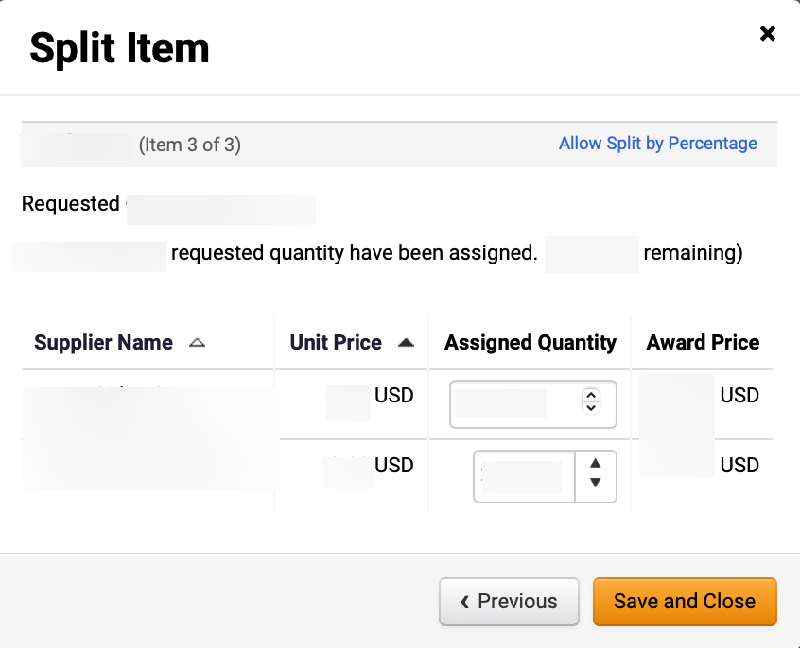
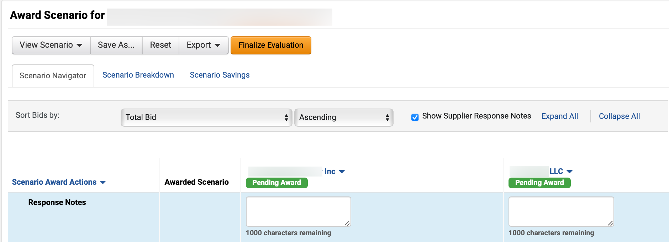
Create Single, Split or Multiple Awards from Sourcing Events (Part 9 of 13)
INSTRUCTIONS
Click Save and Close.
Review Pending Award notifications.
To finalize an Award, click Finalize Evaluation.
25
24

Slide 11
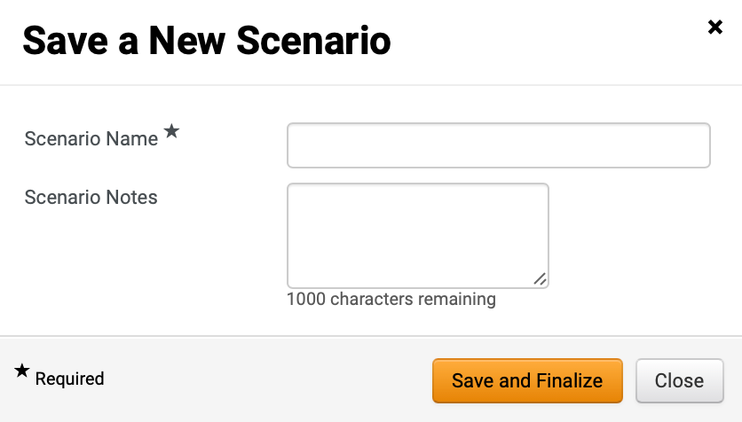
Create Single, Split or Multiple Awards from Sourcing Events (Part 10 of 13)
INSTRUCTIONS
Enter Scenario Name*.
Note: Include reason for award details, such as Award Type and Supplier Name, for easier identification.
Enter Scenario Notes (Optional).
Note: Sourcing Event Buyers can add notes detailing events that impacted the award decision which may be valuable in the future.
Click Save and Finalize.
26
27
28

Slide 12
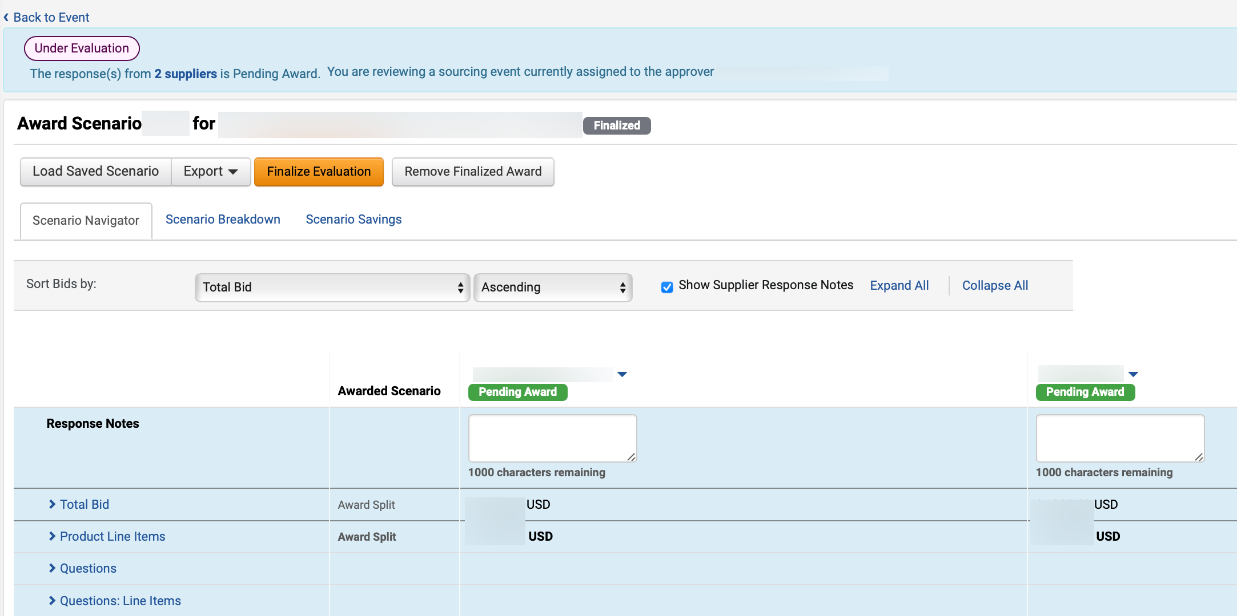
Create Single, Split or Multiple Awards from Sourcing Events (Part 11 of 13)
INSTRUCTIONS
Review Award Scenario Title and Finalized icon.
Note: The event status will remain Under Evaluation until the Sourcing Event Buyer completes all necessary public notice steps. If any changes are needed, click Remove Finalized Award. Follow Steps 31 – 34 if there is a protest.
Click Back to Event.
30
29

Slide 13
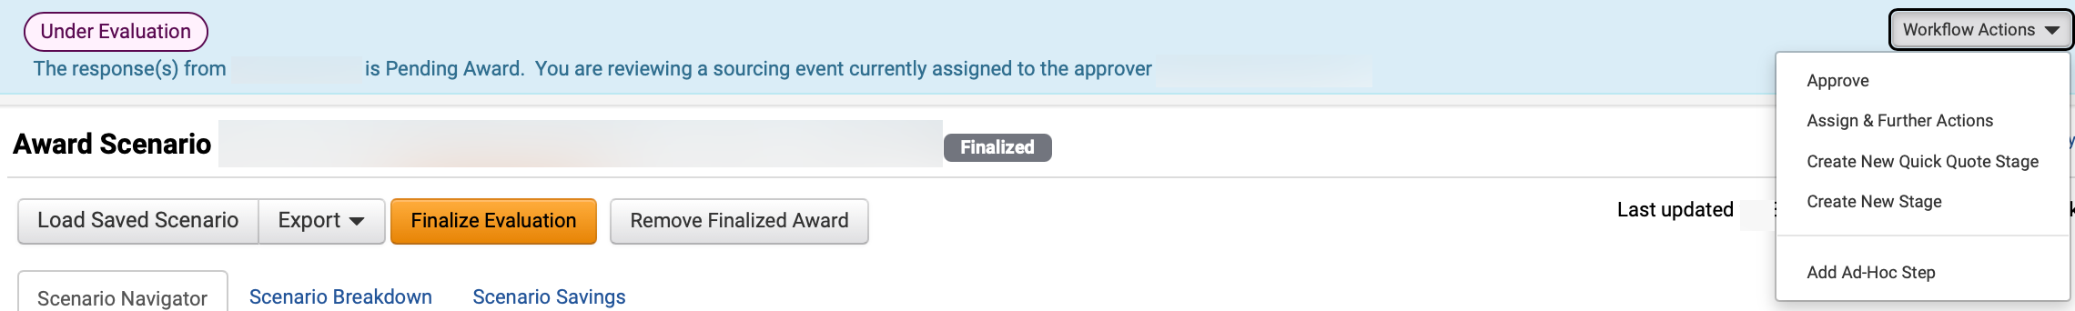
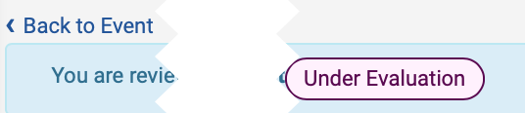
Create Single, Split or Multiple Awards from Sourcing Events (Part 12 of 13)
INSTRUCTIONS
Click Workflow Actions and select Approve.
Review Status.
Note: Sourcing Event status will remain as Under Evaluation.

Slide 14
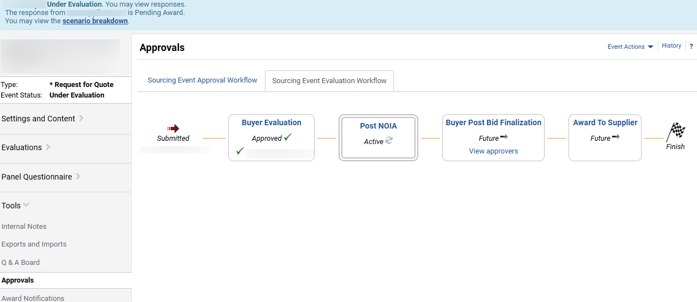
Create Single, Split or Multiple Awards from Sourcing Events (Part 13 of 13)
INSTRUCTIONS
Click Tools and select Approvals.
Review Sourcing Event Evaluation Workflow.
Note: The Post NOIA workflow step is active but the Workflow Actions button will not be visible until the NOIA protest period ends.
34
33

Slide 15
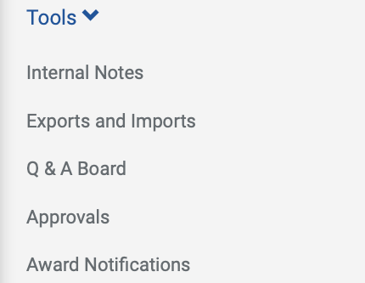
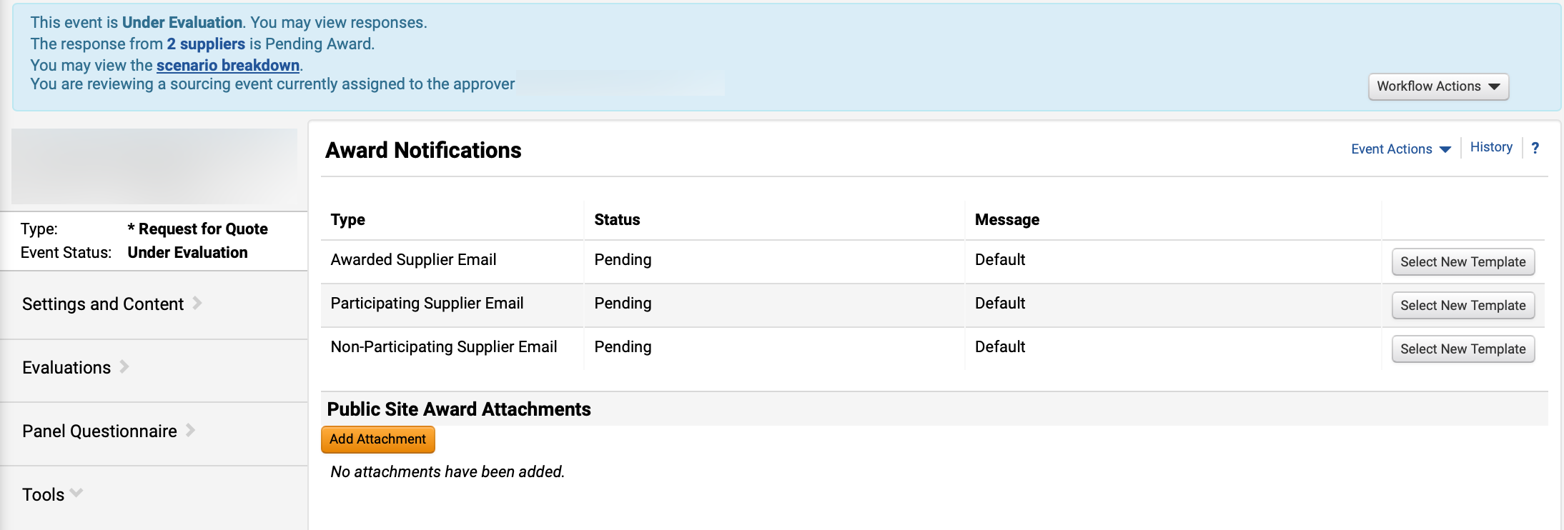
Publish Notice of Intent of Award
(Part 1 of 7)
INSTRUCTIONS
Prior to the protest period, to post the Notice of Intent of Award (NOIA), click Tools.
Select Award Notifications.
Note: Sourcing Event Buyer must follow the rules and timeline in the Georgia Procurement Manual when posting Notice of Intent of Award.
1
2
Click Add Attachment.

Slide 16
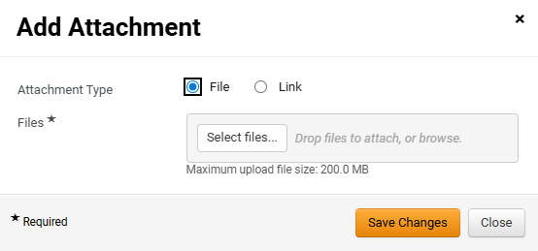

Publish Notice of Intent of Award
(Part 2 of 7)
INSTRUCTIONS
Select Attachment Type.
Note: If selecting File, follow Steps 5 – 9 then skip to Step 15. If selecting Link, skip to Step 10.
Click Select files… to upload File*.
4
5
Select the applicable File from local computer.
Click Open.
6
7

Slide 17
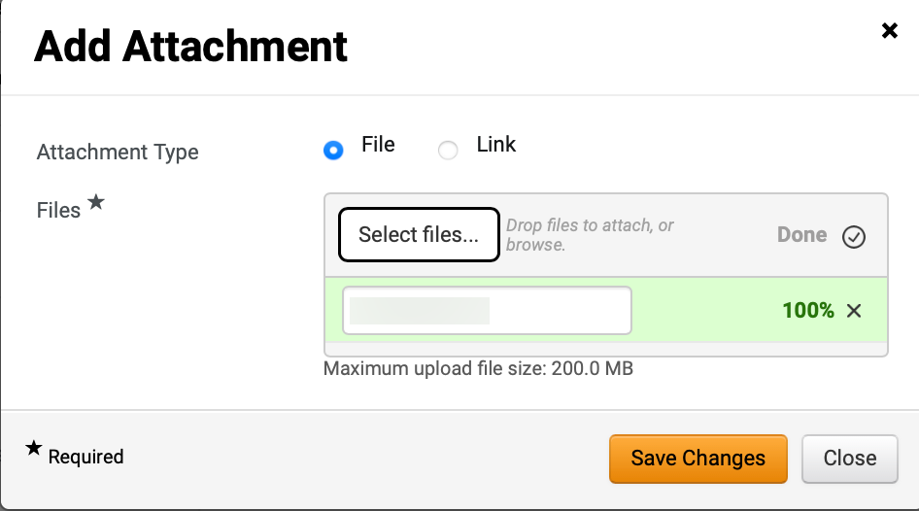
Publish Notice of Intent of Award
(Part 3 of 7)
INSTRUCTIONS
Confirm that the uploaded File* was added.
Click Save Changes.
Note: Skip to Step 15 to review Success confirmation.
8
9

Slide 18
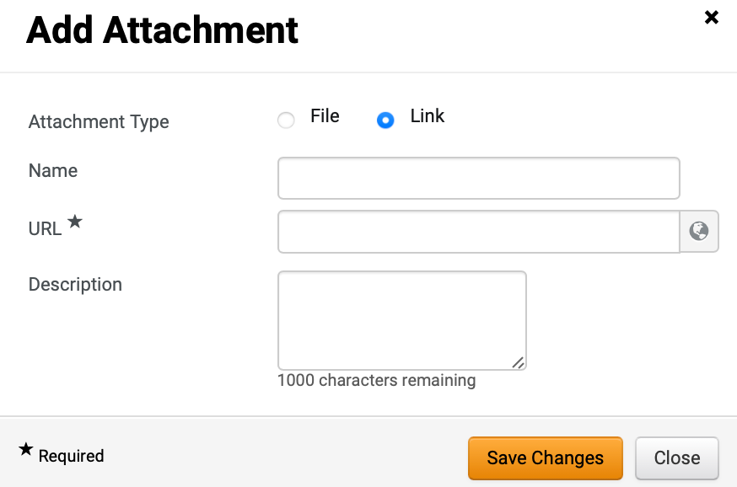
Publish Notice of Intent of Award
(Part 4 of 7)
INSTRUCTIONS
Select Link as Attachment Type.
Enter Name.
Enter URL*.
Enter Description (Optional).
Click Save Changes.
10
11
12
13
14

Slide 19
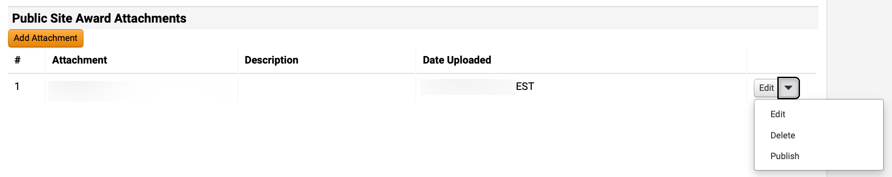
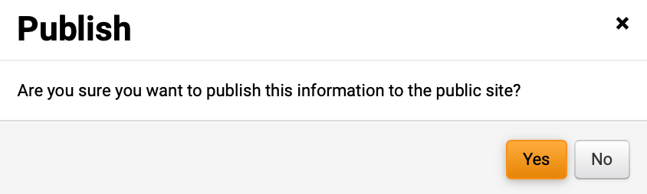
Publish Notice of Intent of Award
(Part 5 of 7)
INSTRUCTIONS
Review uploaded Attachment.
Click Edit
Select Publish.
Note: Click to Edit or Delete to make changes to the attachment.
15
16
17
Click Yes.

Slide 20
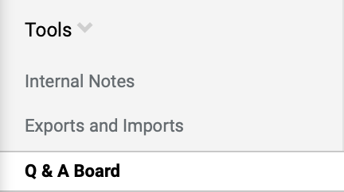
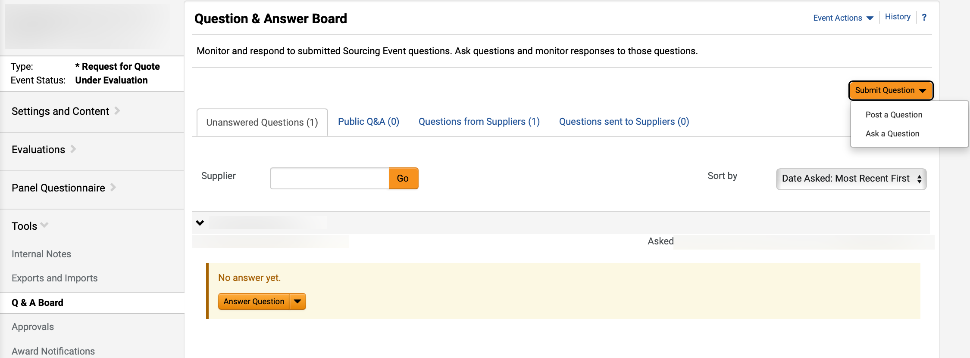
Publish Notice of Intent of Award
(Part 6 of 7)
INSTRUCTIONS
To communicate with the Supplier about NOIA/RFQC List of Qualified Contractors, click Tools.
Select Q&A Board.
19
20
Click Submit Question and select Post a Question.
Note: If further information about Q&A is required, follow Manage Sourcing Event Question and Answer (Q&A) Board job aid.

Slide 21
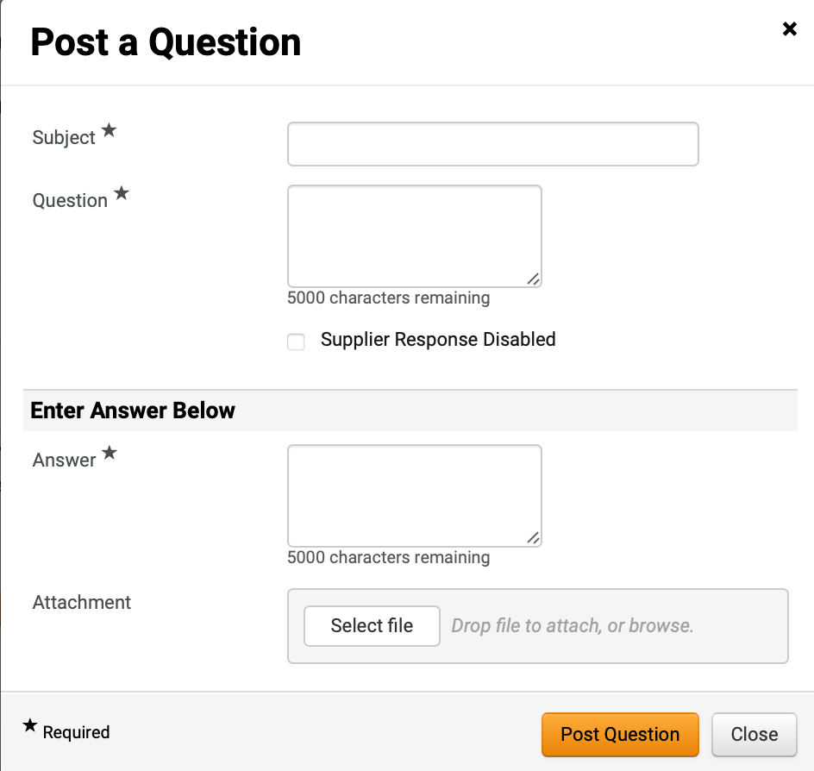
Publish Notice of Intent of Award
(Part 7 of 7)
INSTRUCTIONS
Enter Subject* and Question*.
Click Supplier Response Disabled checkbox (Recommended).
Enter Answer*.
Click Select file to add Attachment.
Note: Add the NOIA or RFQC List of Qualified Contractors as an Attachment.
Click Post Question.
22
23
24
25
26

Slide 22

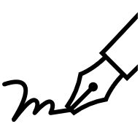




Sourcing Award Process (Part 1 of 3)
PROCESS
Review the following steps before moving to step 2.
Finalize Evaluation
The Sourcing Event Buyer evaluates supplier responses and finalizes the evaluation.
Save Award Scenario
The Sourcing Event Buyer saves and finalizes the Award Scenario.
Post Notice of Intent to Award (NOIA) or RFQC List of Qualified Contractors
The Sourcing Event Buyer approves the Award Scenario and publishes the Notice of Intent to Award.
Note: If amount is over 100k, the post NOIA workflow steps apply.
Communicate with Supplier via the Q&A Board
The Sourcing Event Buyer uploads and publishes the NOIA Attachment via the Q&A Board to inform the supplier.

Slide 23



Sourcing Award Process (Part 2 of 3)
PROCESS
Review the following steps before moving to step 3.
5. Review NOIA Status on GPR
The Sourcing Event Buyer reviews the Georgia Procurement Registry (GPR) NOIA countdown.
Note: The Sourcing Event will stay under evaluation until protest concludes. Refer to Georgia Procurement Registry (GPR) for additional details.
In case of Protest
If there is a protest period, the Sourcing Event Buyer will follow the steps to update and create a new award scenario. If no applicable protest period, follow steps 31 – 34.
Approval
The Sourcing Event Buyer approves the Sourcing Event status of the event changes to Awarded.
8. Upload and Publish Notice of Award Attachment
The Sourcing Event Buyer uploads and publishes the NOA Attachment.
Note: Communicate through Award Notifications.

Slide 24

Sourcing Award Process (Part 3 of 3)
PROCESS
Review the following steps before moving to Publish Notice of Award.
Review Awarded Event
The Sourcing Event Buyer reviews the event has been awarded on the GPR

Slide 25
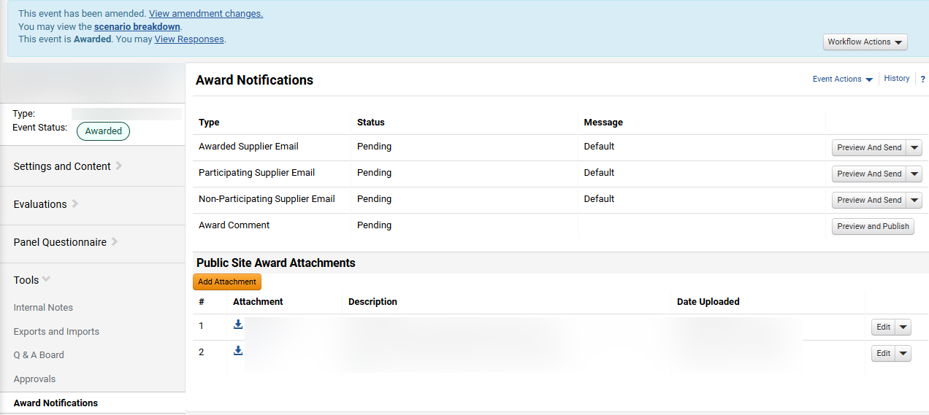
Publish Notice of Award (Part 1 of 6)
INSTRUCTIONS
To post Notice of Award (NOA), click Tools.
Select Award Notifications.
Note: Sourcing Event Buyer must follow the rules and timeline in the State Procurement Policy when posting Notice of Award.
1
2
Click Add Attachment.
Note: Click Select New Template to edit default template for each Award Type.

Slide 26
Publish Notice of Award (Part 2 of 6)
INSTRUCTIONS
Select Attachment Type.
Note: If selecting File, follow Steps 5 – 9 then skip to Step 15. If selecting Link, skip to Step 10.
Click Select files… to upload File*.
4
5
Select the applicable File from local computer.
Click Open.
6
7

Slide 27
Publish Notice of Award (Part 3 of 6)
INSTRUCTIONS
Confirm that the uploaded File* was added.
Click Save Changes.
Note: Skip to Step 15 to review Success confirmation.
.
8
9

Slide 28
Publish Notice of Award (Part 4 of 6)
INSTRUCTIONS
Select Link as Attachment Type.
Enter Name.
Enter URL*.
Enter Description (Optional).
Click Save Changes.
10
11
12
13
14

Slide 29
Publish Notice of Award (Part 5 of 6)
INSTRUCTIONS
Review uploaded Attachment.
Click Edit
Select Publish.
Note: Click to Edit or Delete to make changes to the attachment.
15
16
17
Click Yes.

Slide 30
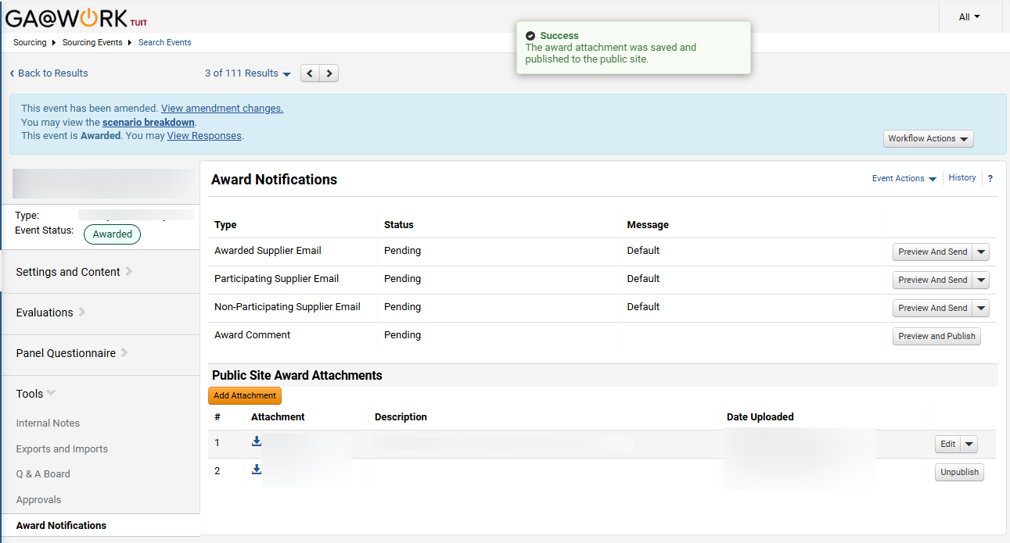

Publish Notice of Award (Part 6 of 6)
INSTRUCTIONS
Review Success confirmation.
Note: The Edit button changes to Unpublish when the posting is successful and Sourcing Event Buyers have the option to Unpublish the event. Sourcing Event Buyer should confirm the Notice of Award was posted to the Georgia Procurement Registry
To send email to Supplier, click Preview and Send.
Note: Sourcing Event Buyers can send Notice of Award notifications to suppliers via email after the event has been awarded.
19
20
You have successfully created a single, split or multiple award for a sourcing event.

