Slide 1
Create and Manage Sourcing
Event Templates
DESCRIPTION
This guide will show Librarians how to Create and Manage Templates.
OVERVIEW
The key steps in the process are below:
Navigate to Sourcing, Contracts, & Supplier Management.
Click Sourcing > Templates and Libraries > Event Templates.
Edit available templates or click Add Template.
Complete the appropriate fields and Publish the template.
Business Process:
Navigate to Sourcing, Contracts, & Supplier Mgmt..
Access the Event Templates menu.
Edit templates or click Add Template.
Complete fields and Publish the template.

Slide 2
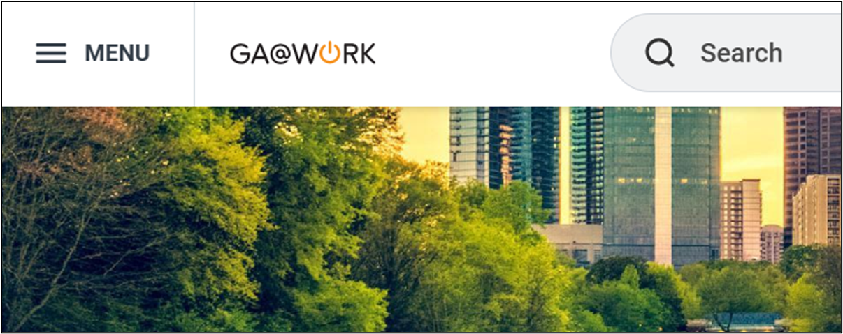
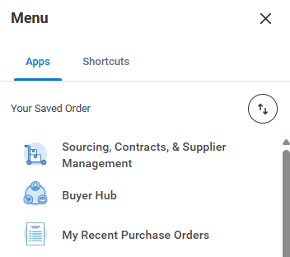
Create and Manage Sourcing Event Templates (Part 1 of 21)
INSTRUCTIONS
Click the Global Navigation Menu.
Select Sourcing, Contracts, & Supplier Management.

Slide 3
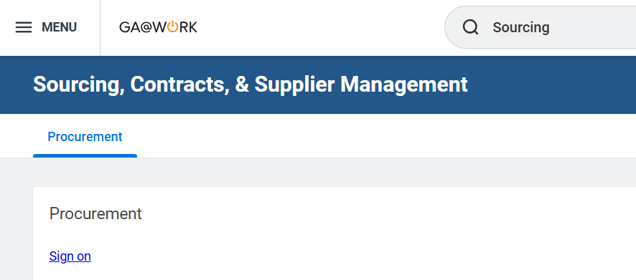
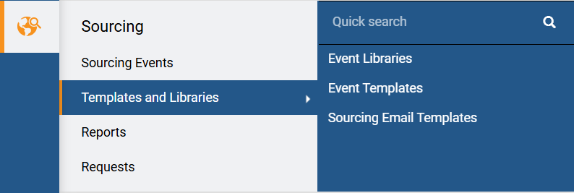
Create and Manage Sourcing Event Templates (Part 2 of 21)
INSTRUCTIONS
Click Sign On.
Click Sourcing.
Select Templates and Libraries.
Select Event Templates.
4
5
6

Slide 4
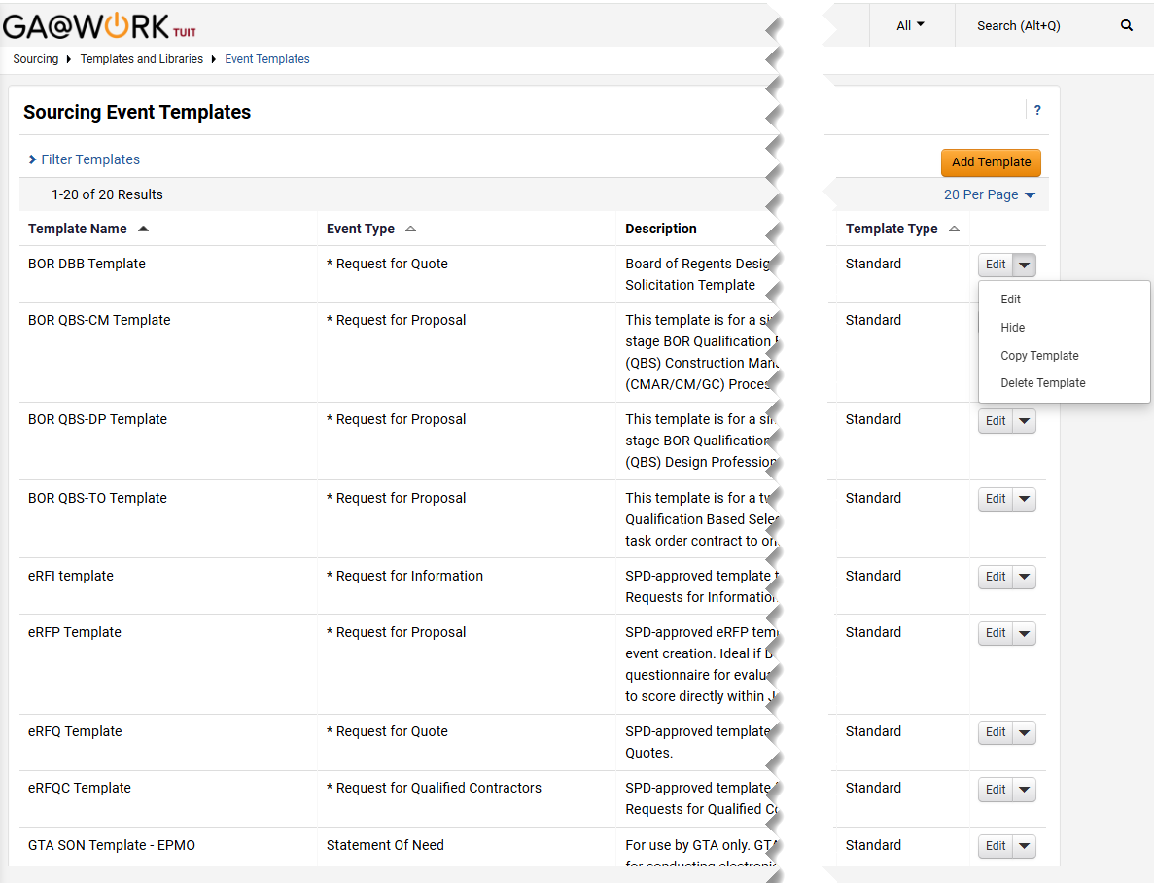
Create and Manage Sourcing Event Templates (Part 3 of 21)
INSTRUCTIONS
To create a new template click Add Template.
Note: To edit, delete or copy a previously created template click Edit.

Slide 5
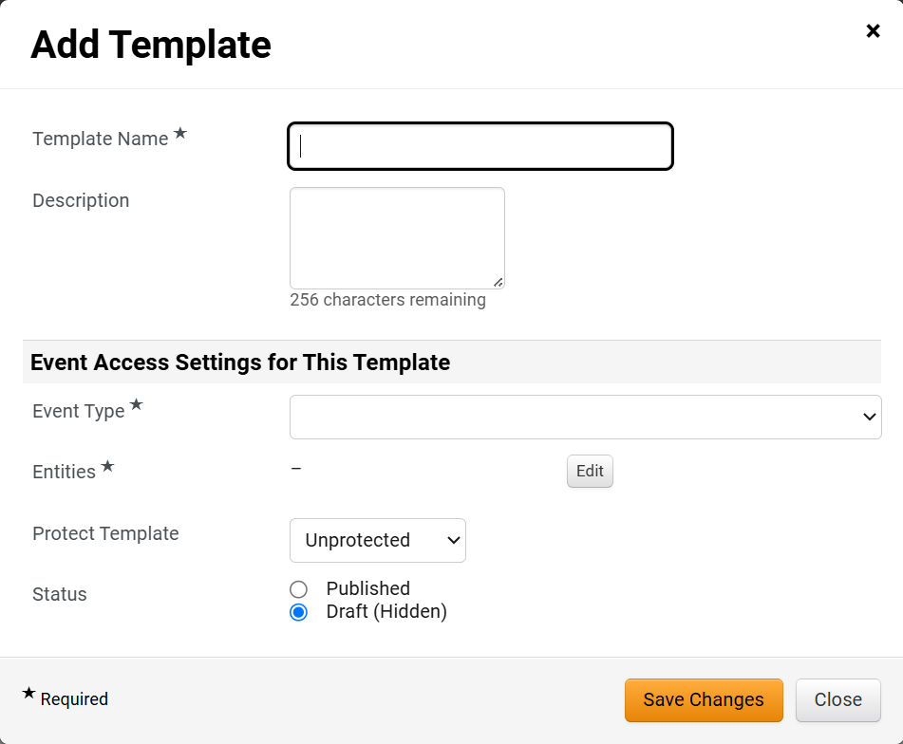
Create and Manage Sourcing Event Templates (Part 4 of 21)
INSTRUCTIONS
Enter the Template Name*.
Enter the Description for the template.
Select the Event Type* for which this template will be available.
Click Edit to select the Entities* for which this template will be available to.
Select if you would like to Protect Template.
Select the Status.
Note: Published templates can immediately be used on the designated event type and work groups. Draft is hidden until you have finalized the template.
Click Save Changes.
8
9
10
11
12
13
14

Slide 6
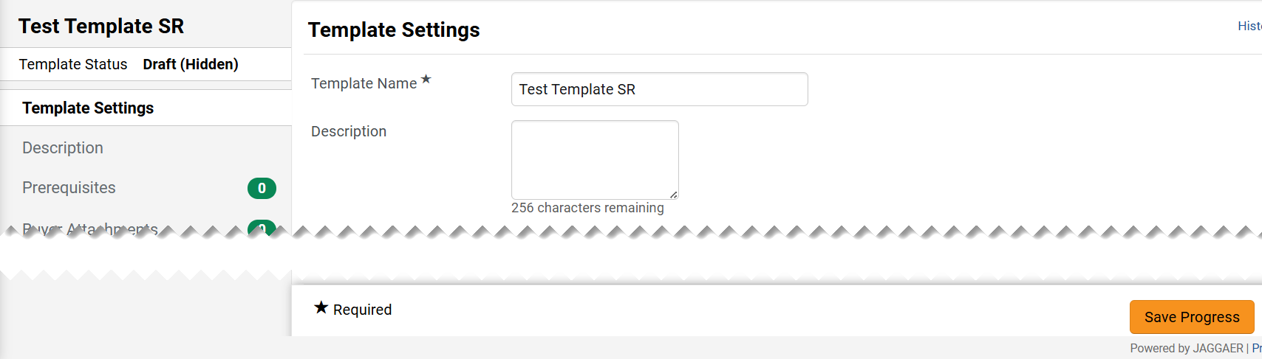
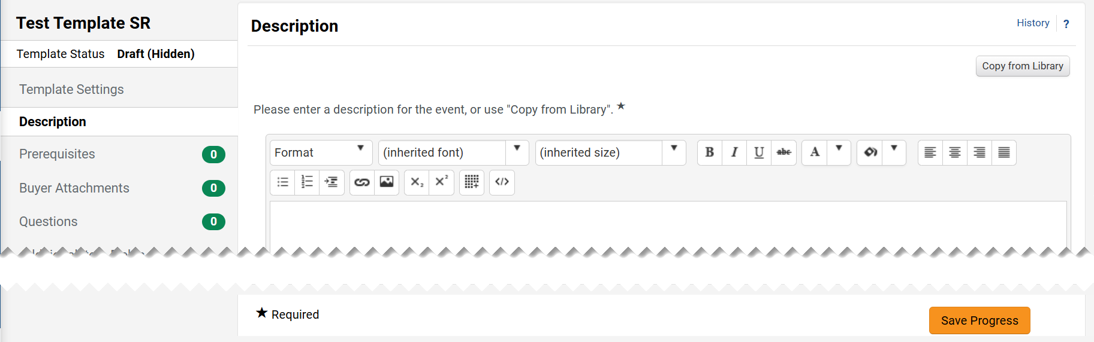
Create and Manage Sourcing Event Templates (Part 5 of 21)
INSTRUCTIONS
Edit the Template Settings page, as necessary.
Note: This page contains the information you entered in the previous section.
If any edits are made, click Save Progress.
16
Select the Description page.
Enter a Description for the template.
Click Save Progress.
17
18
19

Slide 7
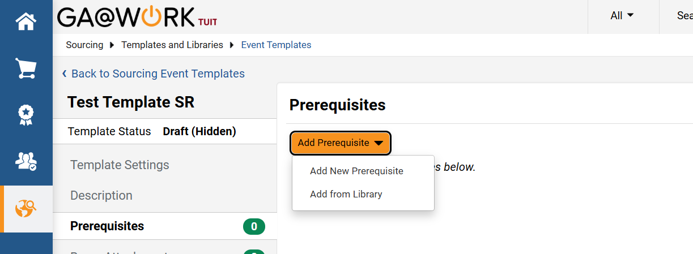
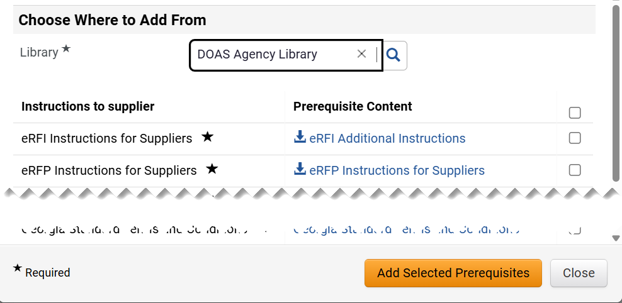
Create and Manage Sourcing Event Templates (Part 6 of 21)
INSTRUCTIONS
Select the Prerequisites page.
Click Add Prerequisite and then select Add New Prerequisite or Add from Library.
21
20
To Add from Library, select the Library*.
Check the desired Prerequisite(s) Content box.
Click Add Selected Prerequisites.
22
23
24

Slide 8
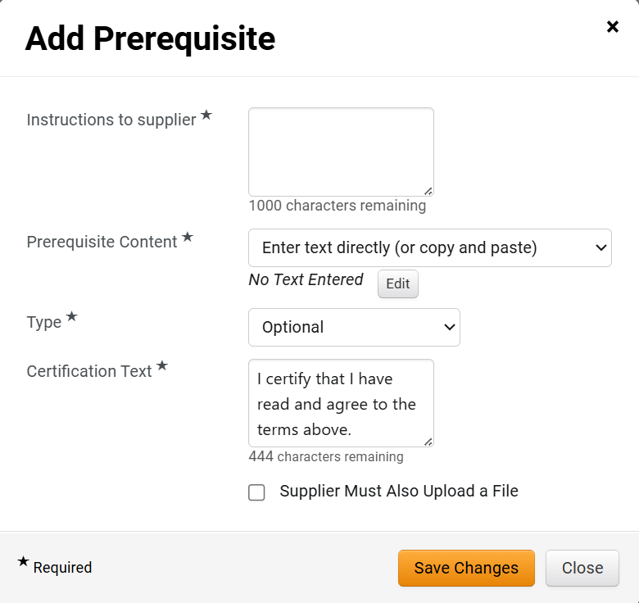
Create and Manage Sourcing Event Templates (Part 7 of 21)
INSTRUCTIONS
Enter Instructions to supplier*.
Select how the Prerequisite Content* should be entered.
Select the Type* of prerequisite.
Edit the Certification Text*, if appropriate.
Check the Supplier Must Also Upload a File box if applicable.
Click Save Changes.
25
26
27
28
29
30

Slide 9
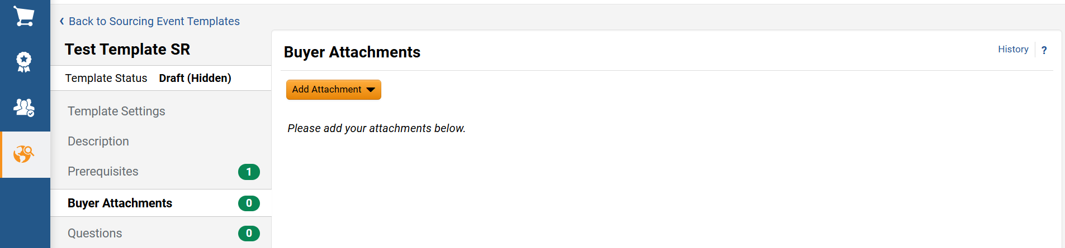
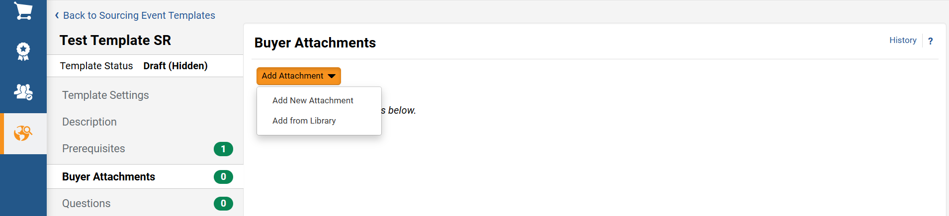
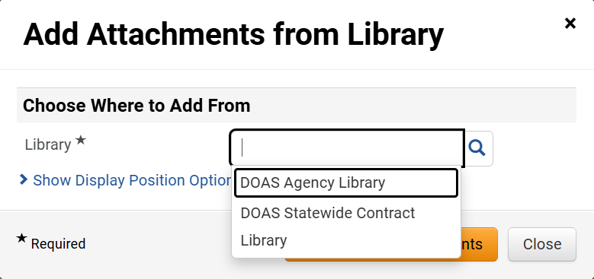
Create and Manage Sourcing Event Templates (Part 8 of 21)
INSTRUCTIONS
Select the Buyer Attachments page.
Click Add Attachment.
31
32
Select Add New Attachment or Add from Library.
Select the Library*.

Slide 10
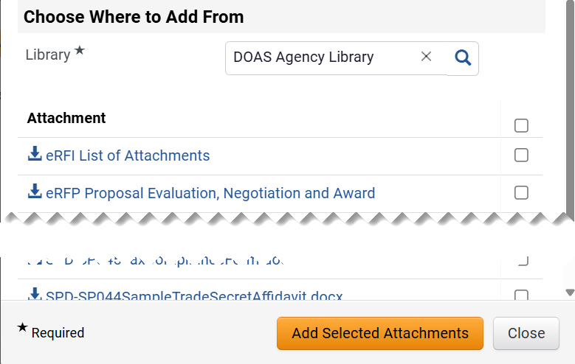
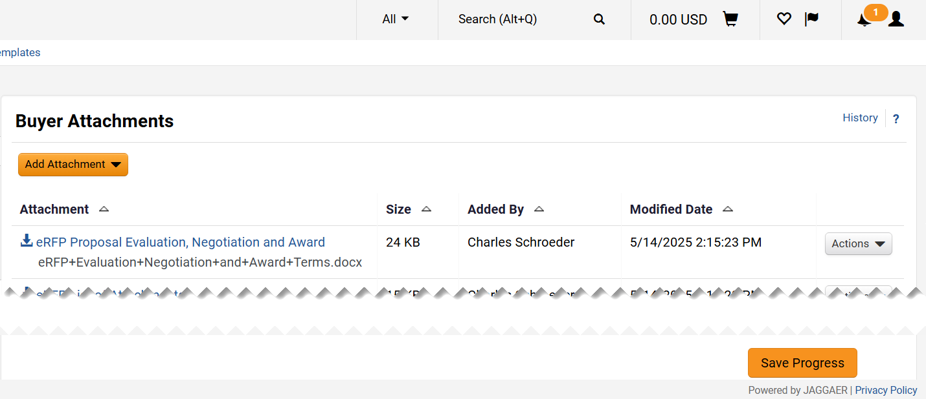
Create and Manage Sourcing Event Templates (Part 9 of 21)
INSTRUCTIONS
Check the Attachment box you desire to add.
Click Add Selected Attachments.
35
36
Click Save Progress.

Slide 11
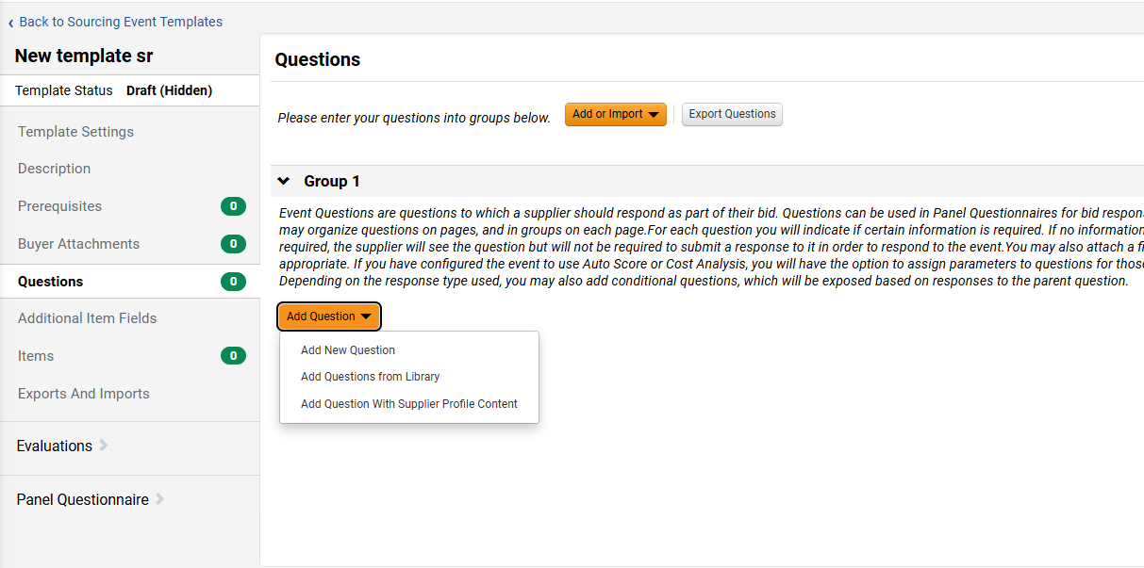
Create and Manage Sourcing Event Templates (Part 10 of 21)
INSTRUCTIONS
Select the Questions page.
Click Add Question.
Select one of the Add Question options.
38
39
40

Slide 12
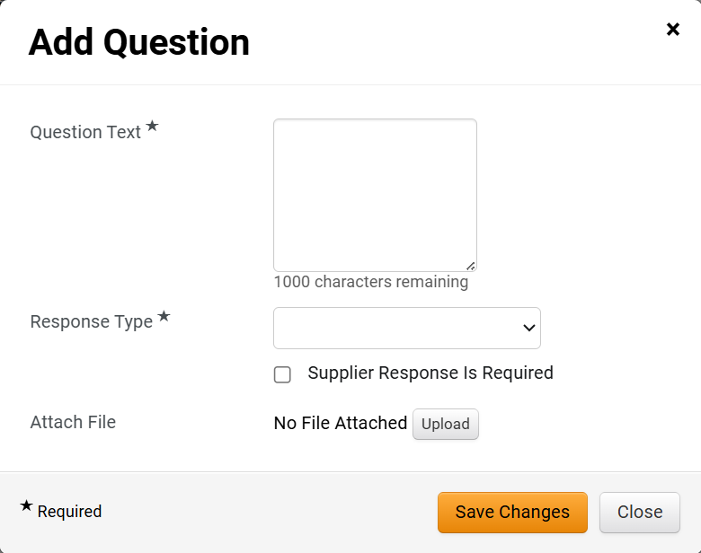
Create and Manage Sourcing Event Templates (Part 11 of 21)
INSTRUCTIONS
To Add New Question enter the Question Text*.
Select a Response Type* for the question
Check the Supplier Response is Required box if applicable.
Click the Upload button if you would like to attach a file to the question.
Note: Once more than one question is added you will need to indicate the Display Order.
Click Save Changes.
41
42
43
44
45

Slide 13
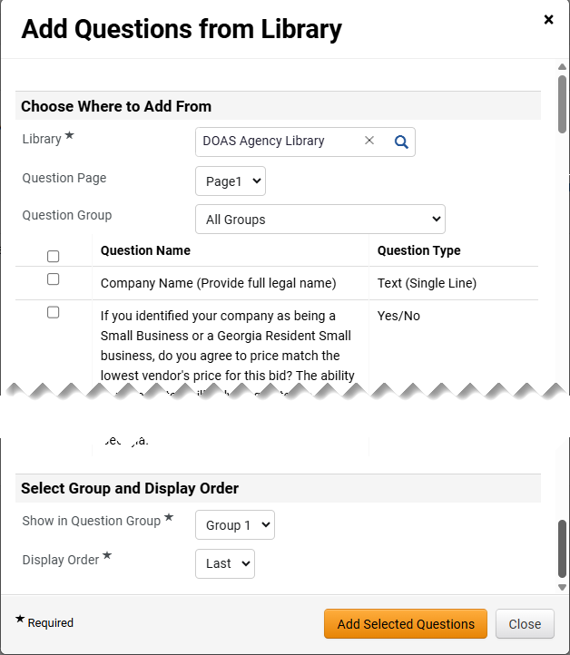
Create and Manage Sourcing Event Templates (Part 12 of 21)
INSTRUCTIONS
To Add From Library, select the Library*.
Check the box for the question you want to add.
Select the Show in Item Group*.
Note: You will need to scroll down to see this option on the screen.
Select the Display Order*.
Click Add Selected Questions.
46
47
48
49
50

Slide 14
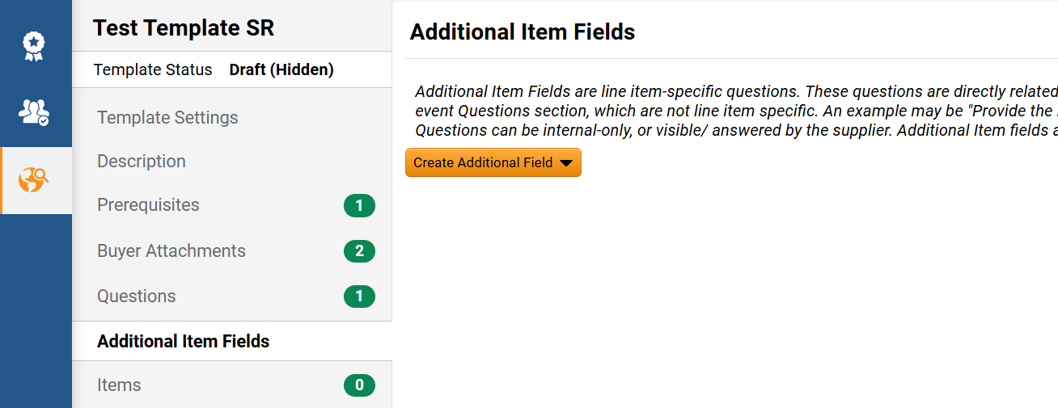
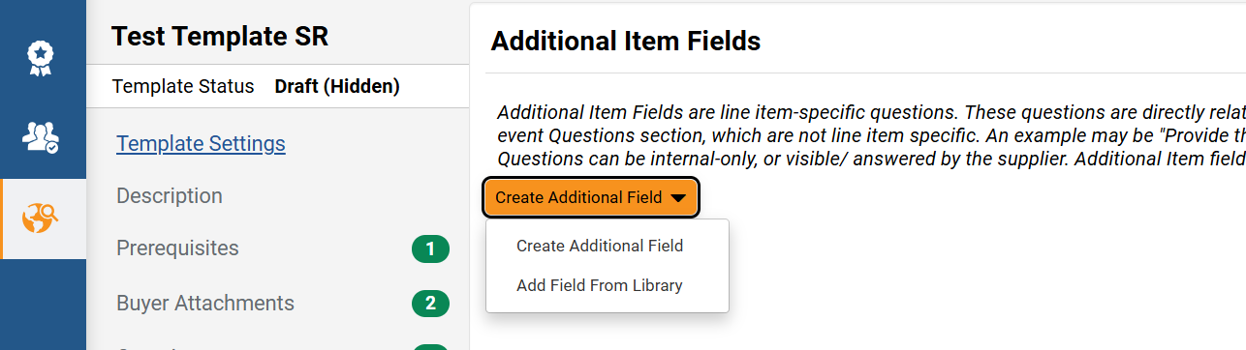
Create and Manage Sourcing Event Templates (Part 13 of 21)
INSTRUCTIONS
Select the Additional Item Fields page.
Click Create Additional Field.
52
51
Select Create Additional Field or Add Field From Library.

Slide 15
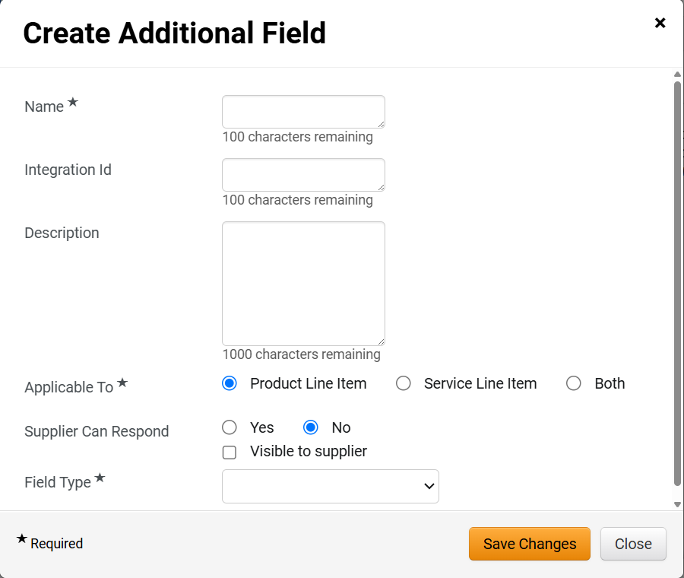
Create and Manage Sourcing Event Templates (Part 14 of 21)
INSTRUCTIONS
To Create Additional Field enter the Name*
Enter a Description for the field.
Indicate whether the field is Applicable To* product line items, service line items, or both.
Note: Additional checkboxes are displayed depending on your selection in the following fields.
Indicate whether or not the Supplier Can Respond.
Check the Visible to supplier box if applicable
Select the Field Type*
Click Save Changes.
54
55
56
58
57
59
60

Slide 16
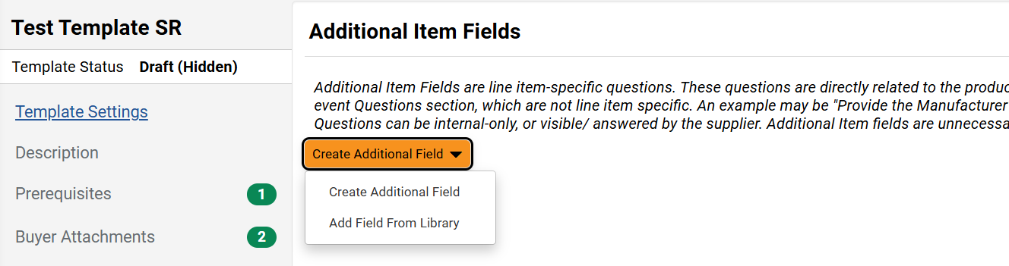
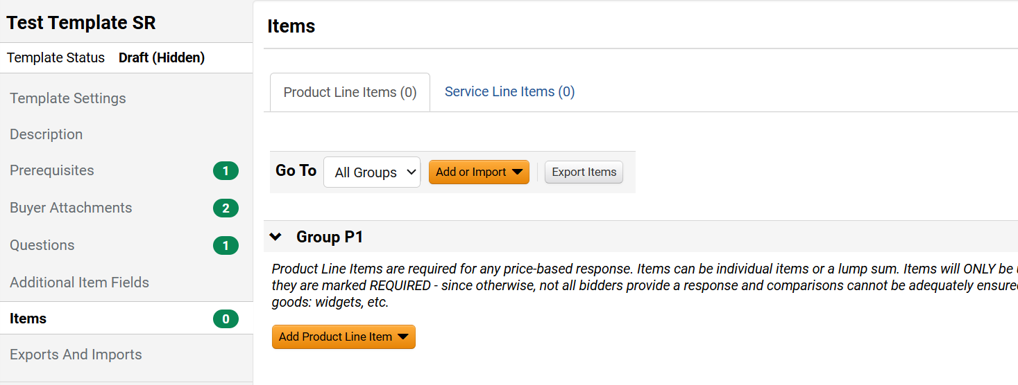
Create and Manage Sourcing Event Templates (Part 15 of 21)
INSTRUCTIONS
To Add From Library select Add Field From Library and follow previously listed steps #46-50.
Select the Items page

Slide 17
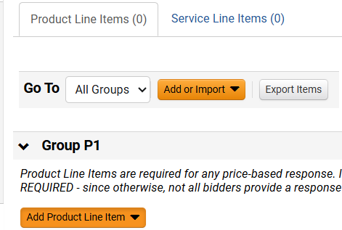
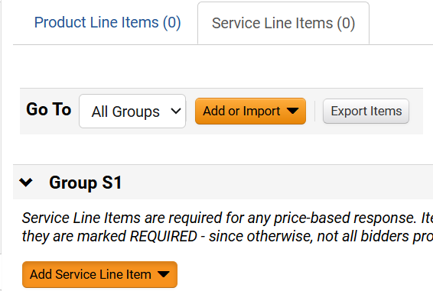
Create and Manage Sourcing Event Templates (Part 16 of 21)
INSTRUCTIONS
For Product Lines select the Product Line Items tab.
Click Add Product Line Item.
For Service Lines select the Service Line Items tab.
Click Add Service Line Item.
63
64
65
66

Slide 18
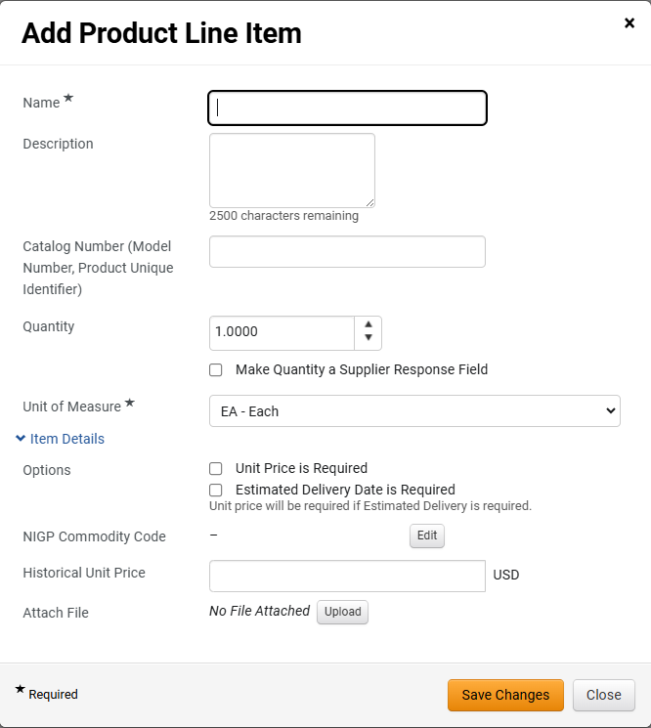
Create and Manage Sourcing Event Templates (Part 17 of 21)
INSTRUCTIONS
For Product Line Items enter a Name* for the item.
Select a Unit of Measure*.
Note: Product descriptions are generally very specific therefore it is recommended to only complete the required fields.
Click Save Changes.
67
68
69

Slide 19
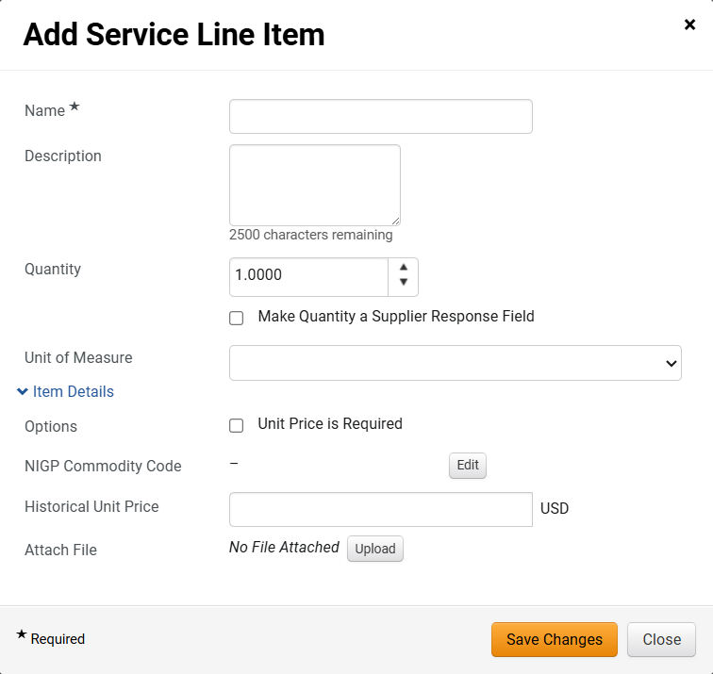
Create and Manage Sourcing Event Templates (Part 18 of 21)
INSTRUCTIONS
For Service Line Items enter a Name* for the item.
Note: Service descriptions are generally very specific therefore it is recommended to only complete the required fields.
Click Save Changes.
70
71

Slide 20
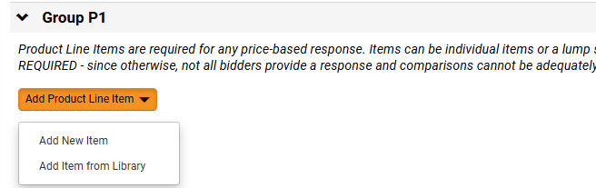
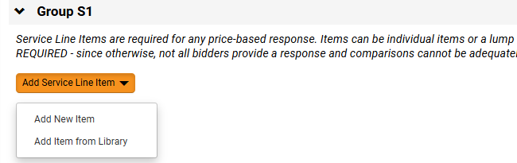
Create and Manage Sourcing Event Templates (Part 19 of 21)
INSTRUCTIONS
To add a product line item from library select Add Item From Library and select the library as previously shown.
To add a service line item from the library select Add Item from Library and select the library as previously shown.
72
73

Slide 21
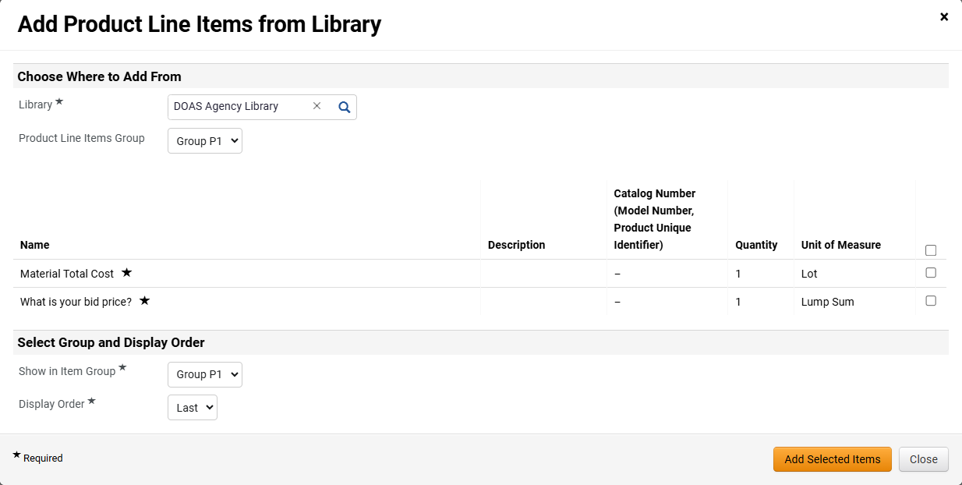
Create and Manage Sourcing Event Templates (Part 20 of 21)
INSTRUCTIONS
Check the box for the item you want to add.
Select the Show in Item Group*.
Select the Display Order*.
Click Add Selected Items.
74
75
76
77

Slide 22
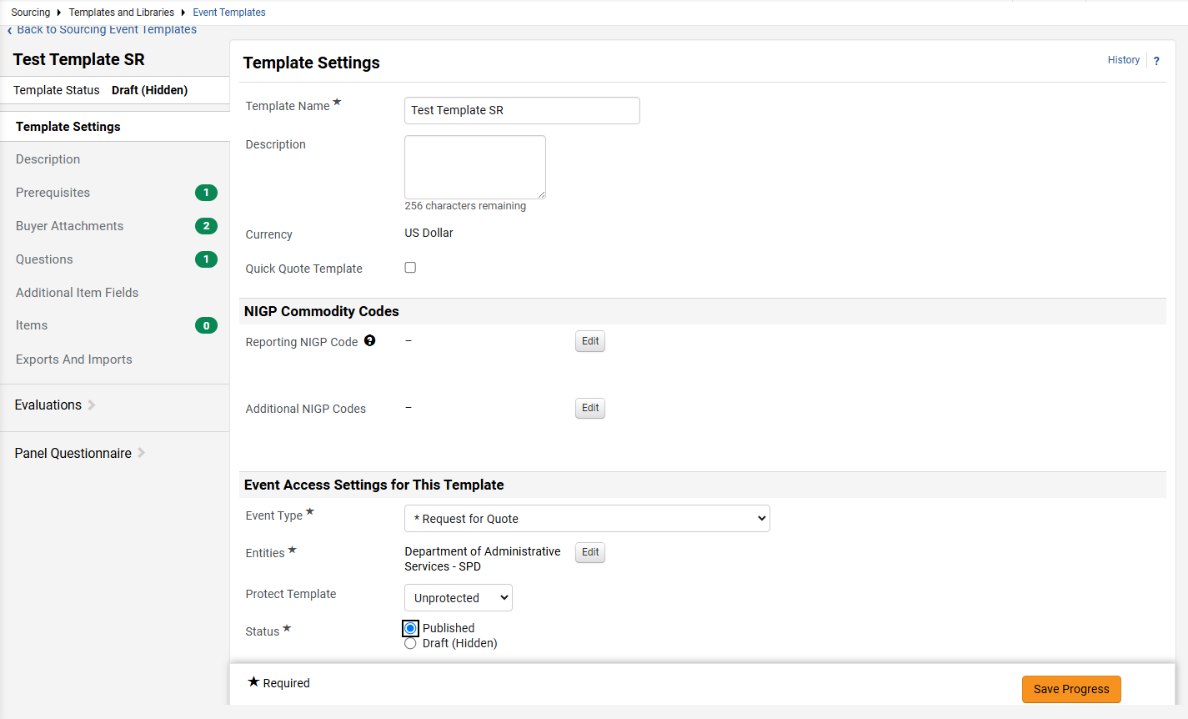

Create and Manage Sourcing Event Templates (Part 21 of 21)
INSTRUCTIONS
Once you have completed the template. Return to the Template Settings Page.
Update the Status* to Published.
Click Save Progress.
78
79
80
You have successfully created and published a template.

