Slide 1
Create and Publish Panel
Questionnaire (Technical Scoring)
DESCRIPTION
This guide will show the Sourcing Event Buyer how to Create and Manage a Panel Questionnaire for either RFP or RFQC with a Technical Scoring Requirement.
OVERVIEW
The key steps in the process are below:
Locate the Sourcing Event.
Add the Panel Questionnaire and Panelists.
Select Questions and assign relevant Weight.
Add Suppliers.
Publish the Panel Questionnaire.
Business Process:
Add Questionnaire & Panelists
Assign Question Weight & Add Suppliers
Locate Sourcing Event
Publish Panel Questionnaire

Slide 2


Create and Publish Panel Questionnaire - Technical Scoring (Part 1 of 11)
INSTRUCTIONS
Click the Global Navigation Menu.
Note: University System of Georgia (USG) users complete local logon and then proceed to Step 4.
Click Sourcing, Contracts & Supplier Management.

Slide 3

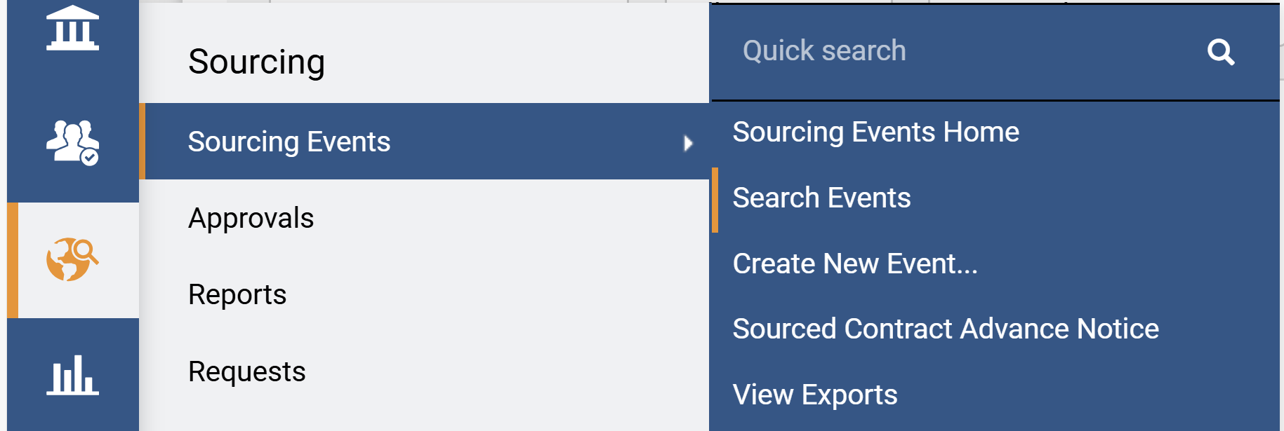
Create and Publish Panel Questionnaire - Technical Scoring (Part 2 of 11)
INSTRUCTIONS
Click Sign On.
Note: The system utilizes Single Sign-On (SSO) capabilities
and no log in information is required.
Access the Sourcing module.
Click Sourcing Events.
Click Search Events and locate the event.
5
6
4

Slide 4
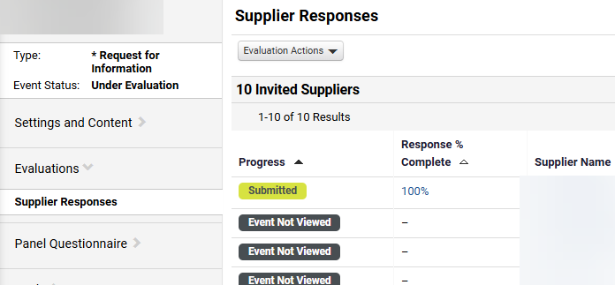
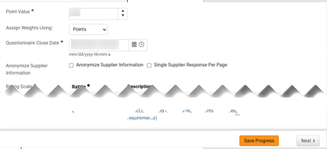
Create and Publish Panel Questionnaire - Technical Scoring (Part 3 of 11)
Select Panel Questionnaire.
Note: The Panel Questionnaire can be set-up while the event is in “draft”, “open” or “under evaluation” status.
2
Under Setup, enter Point Value* and Questionnaire Close Date and Time*.
Note: Select Points for Assign Weights Using. Don’t check Anonymize Supplier Information or Single Supplier Response Per Page. Point Value should match Best Value.
Click Save Progress, then click Next.
8
9

Slide 5
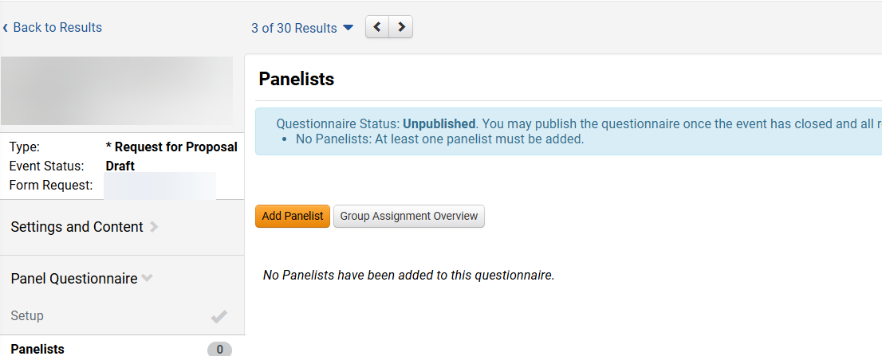
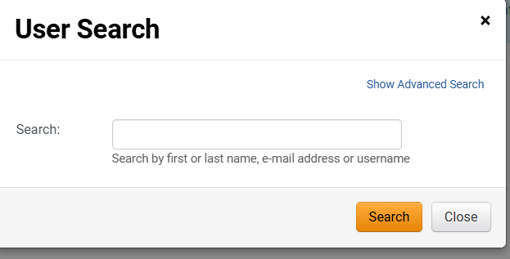
Create and Publish Panel Questionnaire - Technical Scoring (Part 4 of 11)
INSTRUCTIONS
Click Panelists.
Note: After the event has closed and all requirements have been met, the questionnaire can be published.
Click Add Panelist.
Note: See job aid Create Local Panelist Account.
10
11
Enter the panelist full name, email address or username.
Click Search.
12
13

Slide 6
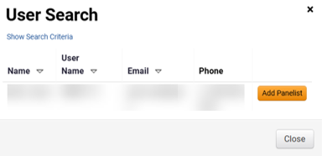
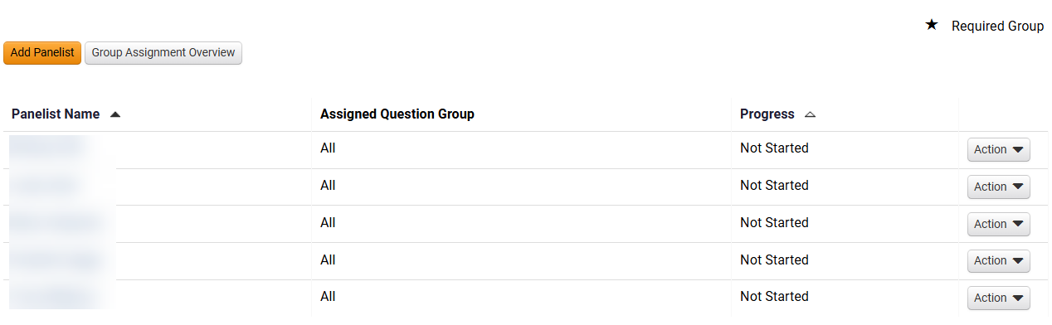
Create and Publish Panel Questionnaire - Technical Scoring (Part 5 of 11)
INSTRUCTIONS
Once the Panelist is located, click Add Panelist.
Note: This can be repeated for as many Panelists as necessary. To add a panelist, reference the Create Technical Evaluator (Panelists) Role job aid.
Click Close.
14
15
Review and confirm that all panelists were added successfully.

Slide 7
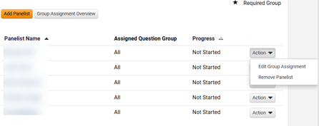
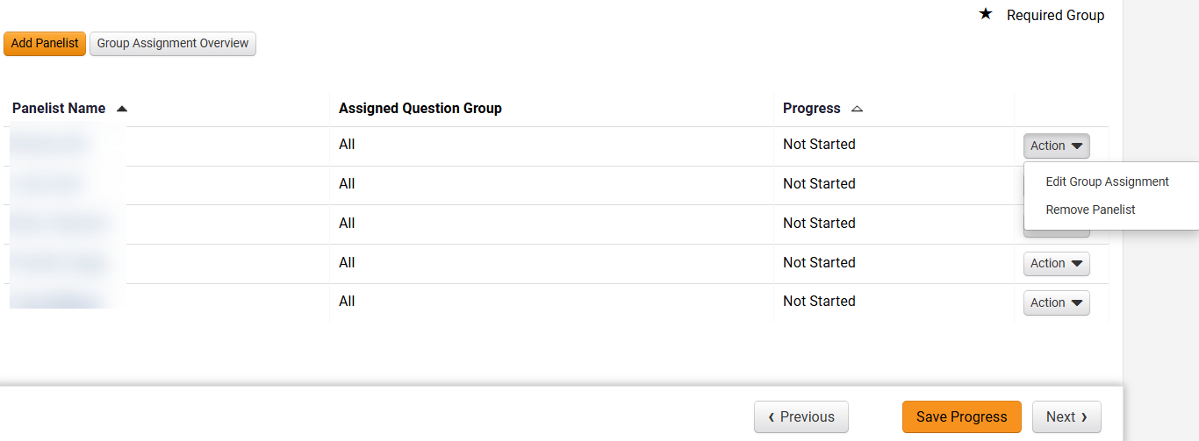
Create and Publish Panel Questionnaire - Technical Scoring (Part 6 of 11)
INSTRUCTIONS
Click Action, then select Remove Panelist, as applicable.
Note: Use Edit Group Assignment to assign specific questions to a panelist.
Click Save Progress, then click Next.

Slide 8
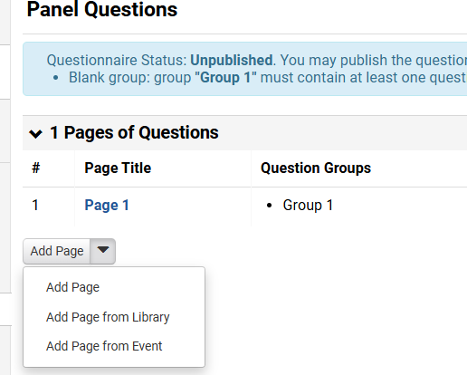
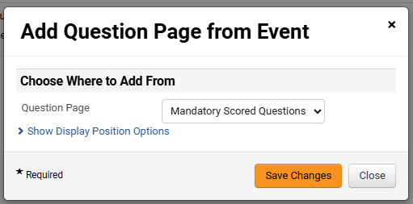
Create and Publish Panel Questionnaire - Technical Scoring (Part 7 of 11)
INSTRUCTIONS
Click Add Page.
Click Add Page from Event.
19
20
Select Mandatory Scored Questions or Additional Scored Questions, as applicable.
Click Save Changes.
Note: Repeat the process to add all scored questions. For this guide, we selected Mandatory Scored Questions. You may also select Additional Scored Questions.
21
22

Slide 9
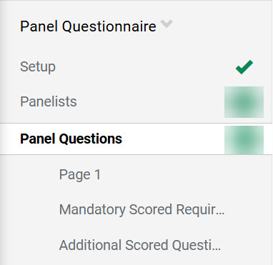
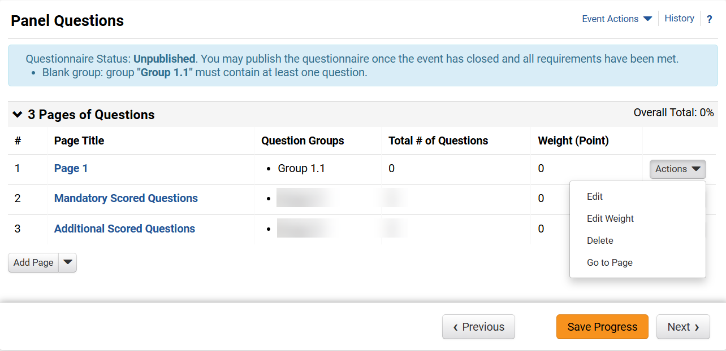
Create and Publish Panel Questionnaire - Technical Scoring ( Part 8 of 11)
INSTRUCTIONS
Select Panel Questions.
Click Actions, then select Delete to remove the now empty Page 1.
Click Save Progress, then click Next.
24
25

Slide 10
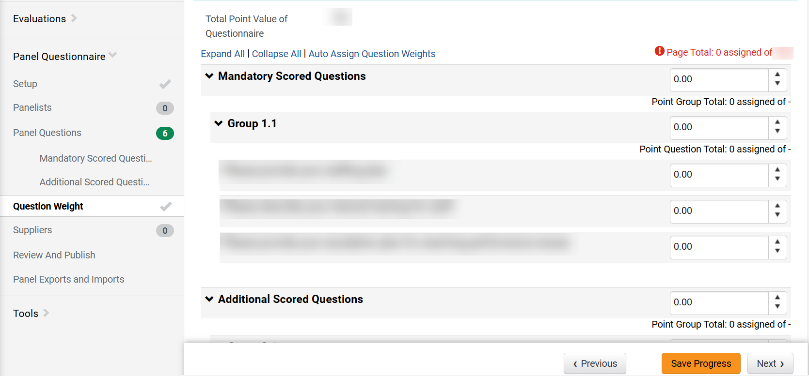
Create and Publish Panel Questionnaire - Technical Scoring (Part 9 of 11)
INSTRUCTIONS
From the Panel Questionnaire, click Question Weight.
Click Expand All or Collapse All as applicable to view the pages, groups and questions.
Assign points to each Page and then distribute amongst the Group(s) within that page.
Assign points to all Questions within each Group.
Note: Repeat steps until all points are assigned.
Click Save Progress and Next.
27
28
26
29
30

Slide 11
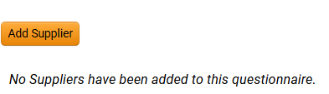
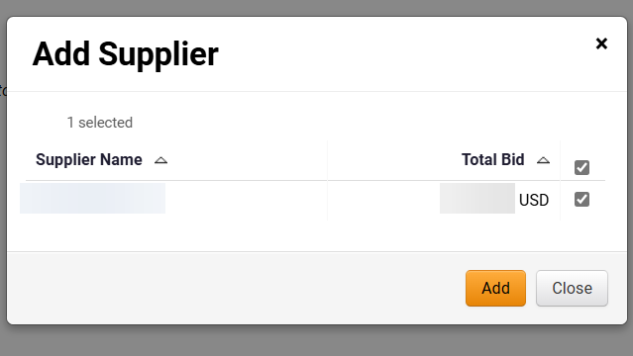
Create and Publish Panel Questionnaire - Technical Scoring (Part 10 of 11)
INSTRUCTIONS
Click Add Supplier.
Note: Each Supplier responding to the event and passing the administrative review needs to be added.
Click Add for each Supplier, as applicable.

Slide 12
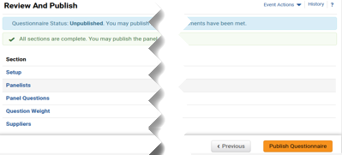
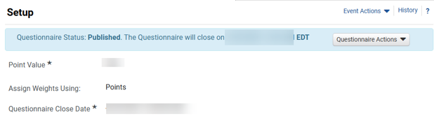

Create and Publish Panel Questionnaire - Technical Scoring (Part 11 of 11)
INSTRUCTIONS
Verify all information and click Publish Questionnaire.
The Questionnaire Status shows Published with the closing Date and Time.
You have successfully created and published a Panel Questionnaire for Technical Scoring.

