Slide 1
View Supplier Activity for
Open Sourcing Events
DESCRIPTION
This guide will show Sourcing Event Buyers and Agency Procurement Officers how to View Supplier Activity for Open Sourcing Events.
OVERVIEW
The key steps in the process are below:
Navigate to the Sourcing Menu.
Locate the required Sourcing Event.
Select Evaluations.
Select Supplier Responses.
View Supplier Progress.
Business Process:
Locate Sourcing Event
Select Supplier Responses
View Supplier Progress

Slide 2
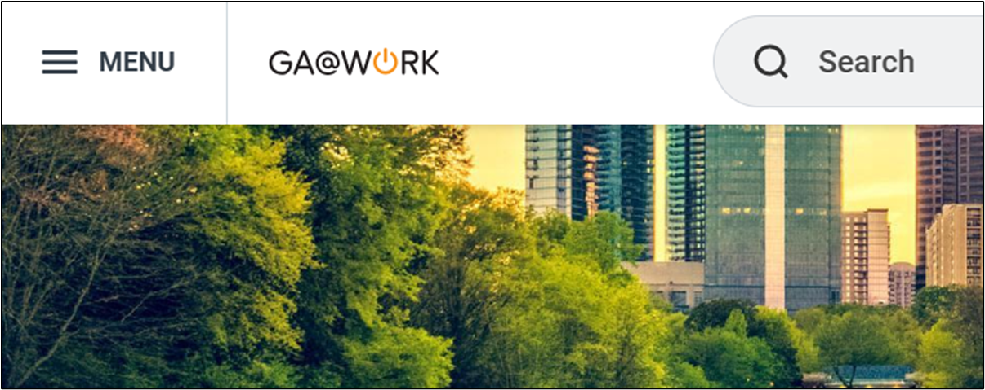
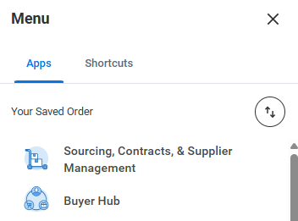
View Supplier Activity for Open Sourcing Events (Part 1 of 4)
INSTRUCTIONS
Click the Global Navigation Menu.
Note: University System of Georgia (USG) follow your logon process. Proceed to Step 4.
Click Sourcing, Contracts, & Supplier Management.
Note: Click Add Apps to add additional apps.

Slide 3
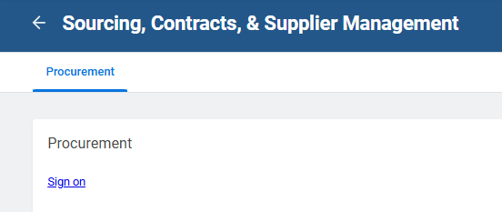
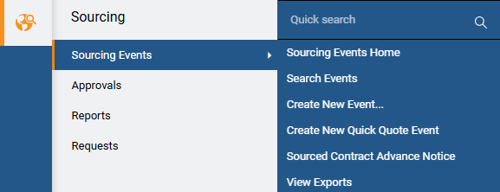
View Supplier Activity for Open Sourcing Events (Part 2 of 4)
INSTRUCTIONS
Click Sign On.
Click Sourcing.
Click Sourcing Events.
Click Search Events.
4
5
6

Slide 4
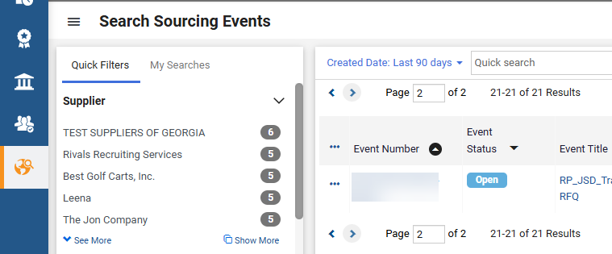
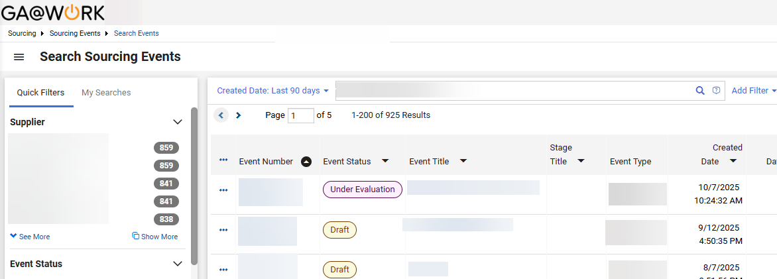
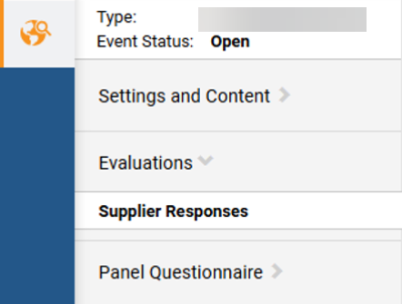
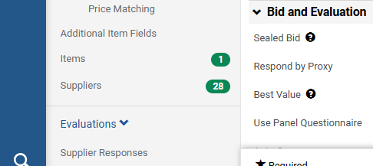
View Supplier Activity for Open Sourcing Events (Part 3 of 4)
INSTRUCTIONS
Locate the Sourcing Event. Select the Event Number to view event.
Click Evaluations.
Click Supplier Responses.
8
9

Slide 5
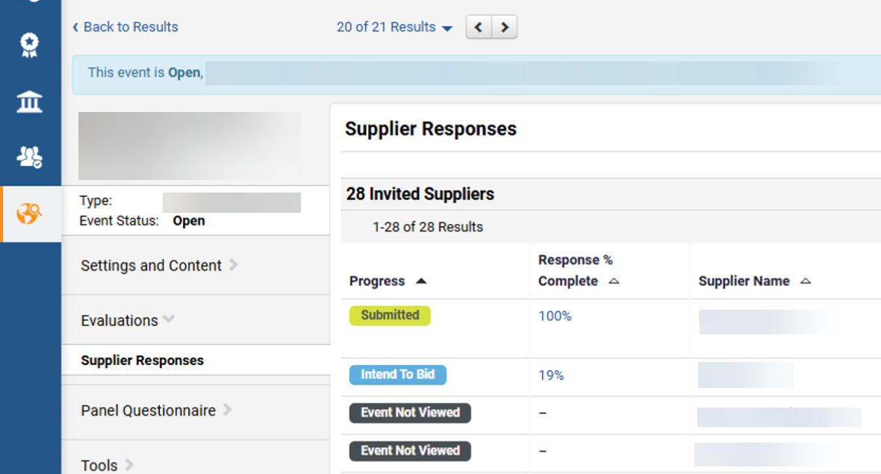
View Supplier Activity for Open Sourcing Events (Part 4 of 4)
INSTRUCTIONS
View supplier Progress for open solicitation.
Note: The contents of suppliers' responses will not be visible to the buyer until the event closes and is under evaluation.
You have successfully viewed supplier activity for an open sourcing event.

