Slide 1
Cancel Purchase Order
DESCRIPTION
This guide will show PO Buyers and Procurement Operations Lead how to Cancel Purchase Order.
OVERVIEW
The key steps in the process are below:
Enter Find Purchase Orders in the Search field and select the report.
Locate the desired Purchase Order and click OK.
Click Related Actions > Purchase Order > Cancel
Locate the desired Purchase Order and click OK.
Verify Status shows Canceled.
Business Process:
Locate the desired Purchase Order
Cancel Purchase Order
Verify Canceled Status

Slide 2
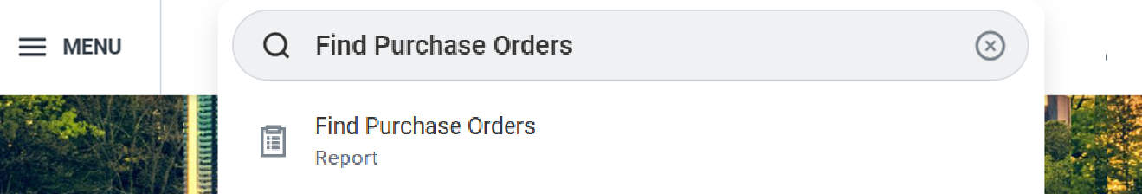
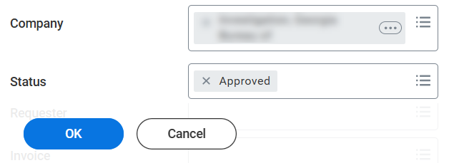
Cancel Purchase Order (Part 1 of 4)
INSTRUCTIONS
Enter Find Purchase Orders in the Search field.
Select Find Purchase Orders report.
1
2
Enter search parameters to locate the desired Purchase Order and click OK.
Note: Purchase Orders must have a Status of Approved, In Progress, Draft or Issued, if a Purchase Order is not received or invoiced.

Slide 3
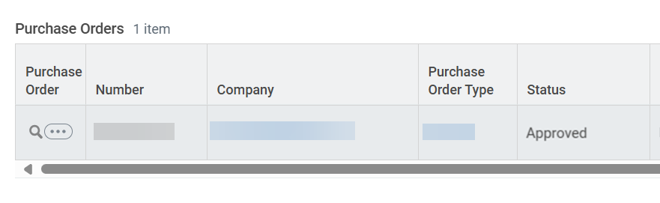
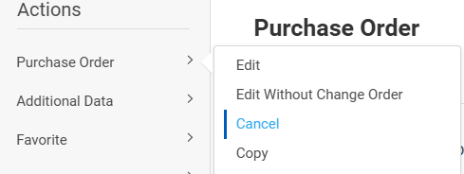
Cancel Purchase Order (Part 2 of 4)
INSTRUCTIONS
Click the Purchase Order Related Actions (…).
Select Purchase Order.
Select Cancel.
5
6

Slide 4
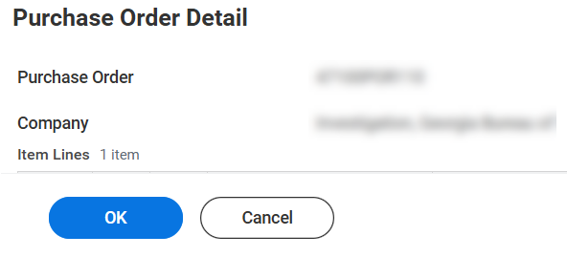
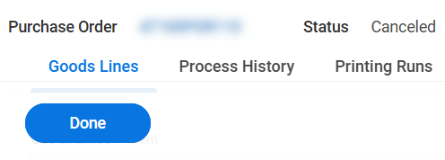
Cancel Purchase Order (Part 3 of 4)
INSTRUCTIONS
Click OK.
Click Done.

Slide 5
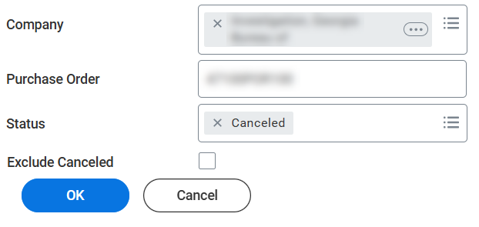
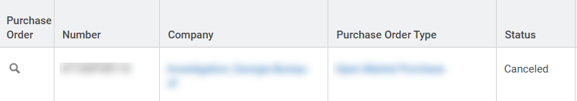

Cancel Purchase Order (Part 4 of 4)
INSTRUCTIONS
Return to Find Purchase Orders Report.
Enter search parameters to locate the desired Purchase Order and click OK.
Note: Uncheck Exclude Canceled, if necessary.
Verify the Status shows Canceled.
You have successfully canceled a purchase order.

