Slide 1
Cancel Requisition
DESCRIPTION
This guide will show Requesters how to Cancel Requisition.
OVERVIEW
The key steps in the process are below:
Enter Find Requisitions in the Search field and select the report.
Locate the desired Requisition and click OK.
Click Related Actions > Requisition > Cancel
Select a Reason and enter Comments, if desired.
Click OK and verify Status shows Canceled.
Business Process:
Locate the desired Requisition
Cancel Requisition
Verify Canceled Status

Slide 2
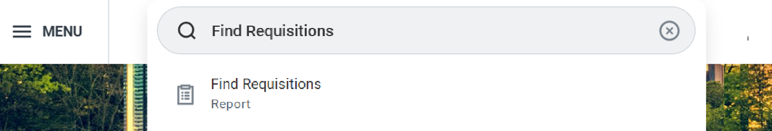
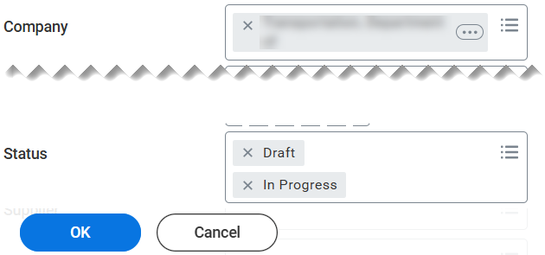
Cancel Requisition (Part 1 of 4)
INSTRUCTIONS
Enter Find Requisitions in the Search field.
Select Find Requisitions report.
1
2
Enter search parameters to locate the desired Requisition and click OK.
Note: Requisitions must have a Status of Draft or In
Progress.

Slide 3
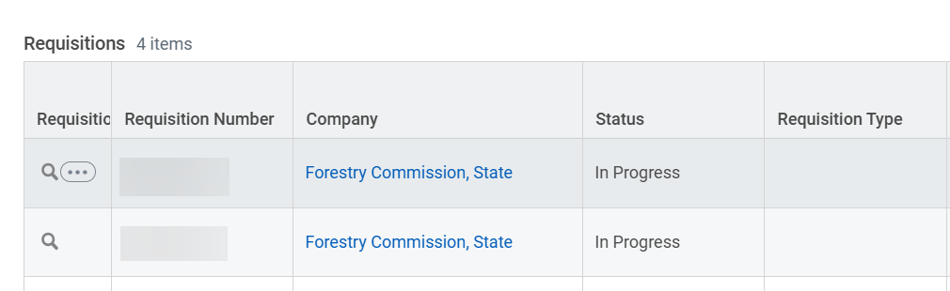
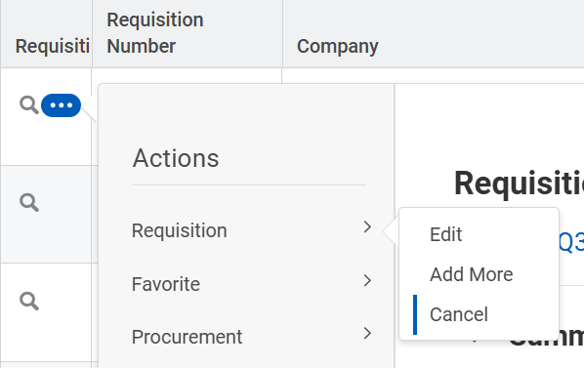
Cancel Requisition (Part 2 of 4)
INSTRUCTIONS
Click the Requisition Related Actions (…).
Select Requisition.
Select Cancel.
5
6

Slide 4
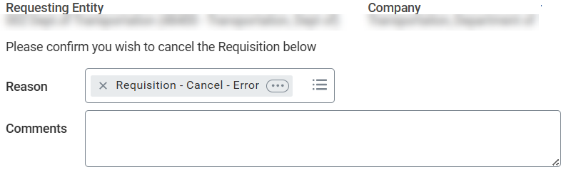
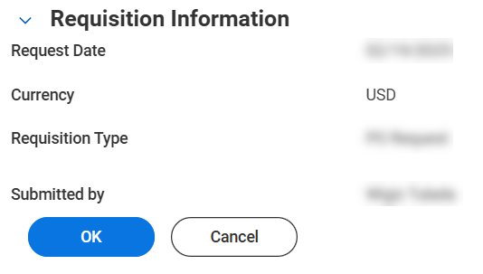
Cancel Requisition (Part 3 of 4)
INSTRUCTIONS
Select a Reason.
Enter Comments, if desired.
7
8
Click OK.

Slide 5
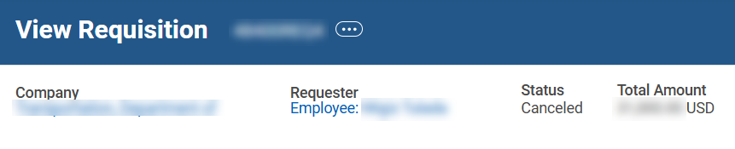

Cancel Requisition (Part 4 of 4)
INSTRUCTIONS
Verify Status shows Canceled.
You have successfully canceled a requisition.

