Slide 1
Close Requisition
DESCRIPTION
This guide will show Requesters how to Close a Requisition.
OVERVIEW
The key steps in the process are below:
Enter Find Requisitions in the Search field and select the report.
Locate desired Requisition by Date, Successfully Completed status, and click OK.
Click Related Actions > Requisition > Close.
Select a Date, Reason and enter Comments, if desired.
Click OK and validate Closed Status.
Business Process:
Locate the desired Requisition
Close Requisition
Validate Closed Status

Slide 2

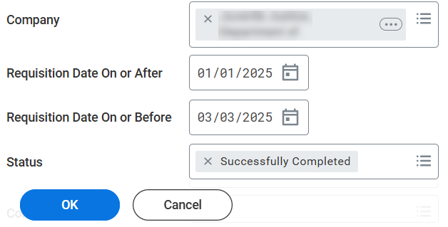
Close Requisition (Part 1 of 4)
INSTRUCTIONS
Enter Find Requisitions in the Search field.
Select Find Requisitions report.
1
2
Enter search parameters to locate the desired Requisition and click OK.
Note: Requisitions must have a Successfully Completed
status, which means the Requisition is fully approved.

Slide 3
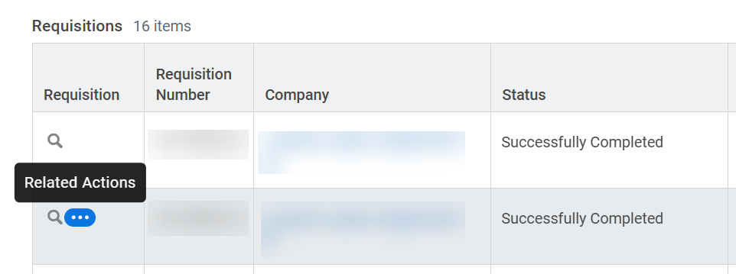
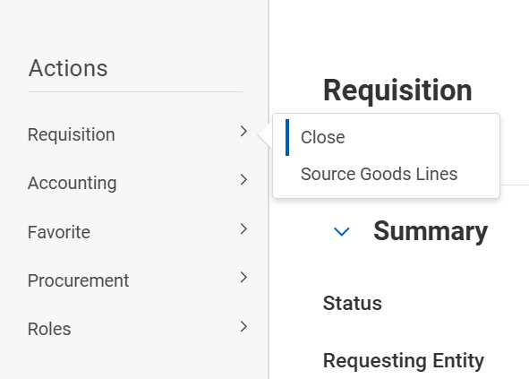
Close Requisition (Part 2 of 4)
INSTRUCTIONS
Click the Related Actions (…) for the desired Requisition.
Select Requisition.
Select Close.
5
6

Slide 4
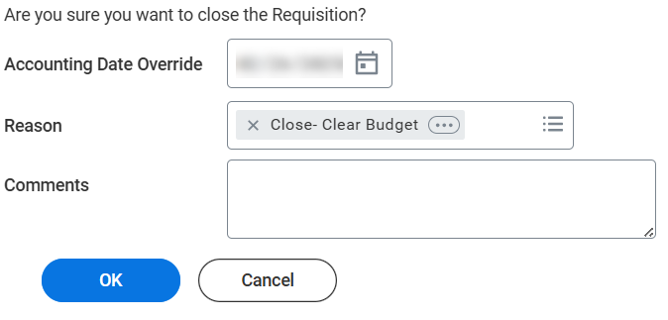
Close Requisition (Part 3 of 4)
INSTRUCTIONS
Enter the Accounting Date Override if this is an older requisition in an accounting period that is closed.
Select a Reason.
7
8
Enter Comments, if desired
Click OK.
9
10

Slide 5
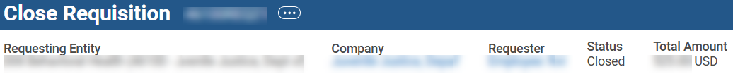

Close Requisition (Part 4 of 4)
INSTRUCTIONS
Validate Status shows Closed.
You have successfully closed a requisition.

