Slide 1
P-Card Prior Approval
Request for Cardholders
DESCRIPTION
This guide will show P-Card Holders how to create, submit, and take appropriate action on a P-Card Prior Approval Request.
OVERVIEW
The key steps in the process are below:
Enter Create Request in the Search field.
Click Create Request task.
Select Request | P-Card Prior Approval for Request Type.
Complete Request Form and click Submit.
Select Request and review entries from My Tasks and take appropriate action.
Request routes for approval(s) and closure.
Business Process:
Create P-Card Prior Approval Request
Submit and Approve Request
Cardholder Manager Approves & Closes Request

Slide 2

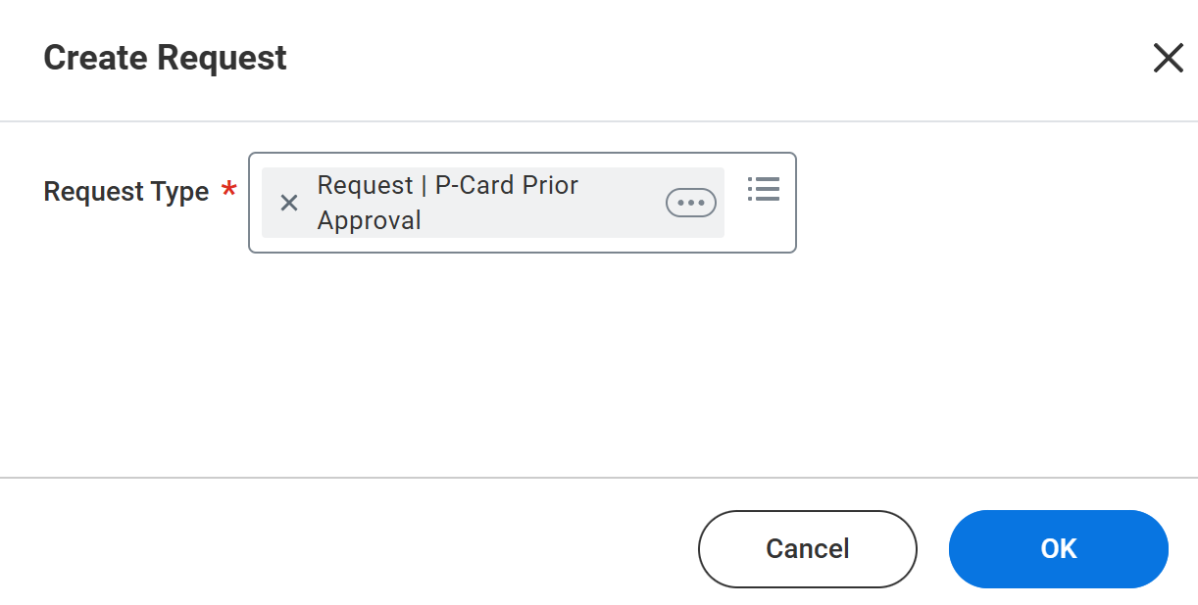
P-Card Prior Approval Request for Cardholders (Part 1 of 7)
INSTRUCTIONS
Enter Create Request in the Search field.
Click Create Request task.
1
2
Select Request | P-Card Prior Approval for Request Type*.
Click OK.
3
4

Slide 3
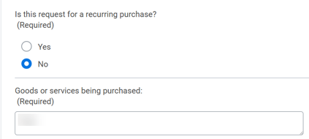
P-Card Prior Approval Request for Cardholders (Part 2 of 7)
INSTRUCTIONS
Select Yes or No to Is this request for a recurring purchase? (Required).
  Note: If Yes is selected, an additional (Required) question relevant to the recurring purchase must be populated.
Enter details for Goods or services being requested: (Required)
5
6

Slide 4
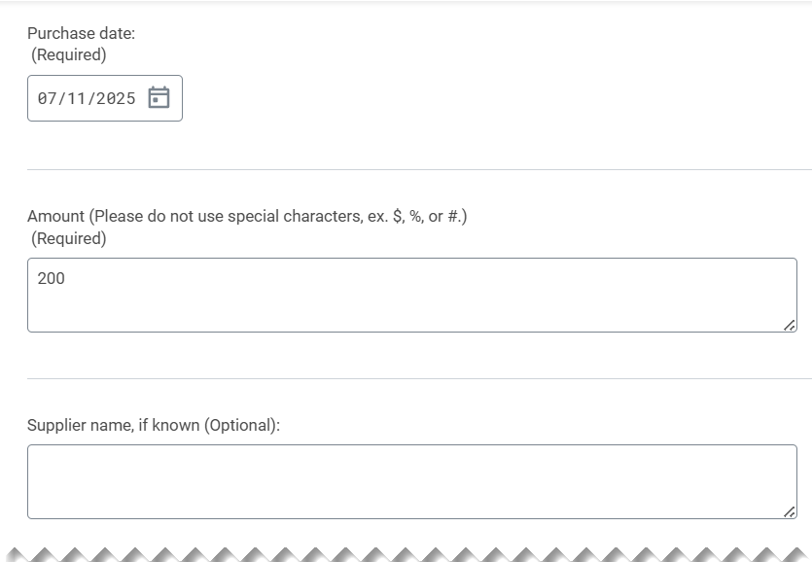
P-Card Prior Approval Request for Cardholders (Part 3 of 7)
INSTRUCTIONS
Enter a Purchase date (Required).
Enter an Amount, estimated or actual (Required).
Enter the Supplier Name, if known (Optional).
7
8
9

Slide 5
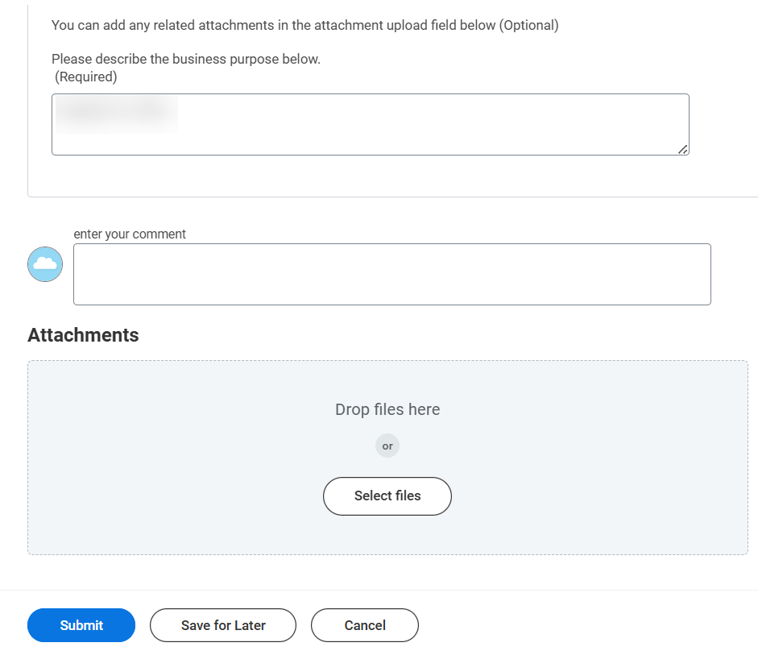
P-Card Prior Approval Request for Cardholders (Part 4 of 7)
INSTRUCTIONS
Describe the Business Purpose (Required).
You enter your comment, if applicable.
Click Select files or drag and drop files to add Attachments, if applicable.
Click Submit.
10
11
12
13

Slide 6
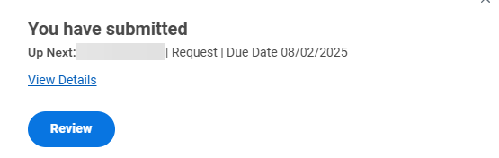

P-Card Prior Approval Request for Cardholders (Part 5 of 7)
INSTRUCTIONS
Click Review from the message button to directly review the P-Card Prior Approval Request.
Note: If you are not ready to review and submit the request, close the message. The request will remain in your My Tasks list pending action. As an alternative, this message could be closed and the request accessed via My Tasks.
Click My Tasks, in the top right corner of your Homepage.

Slide 7
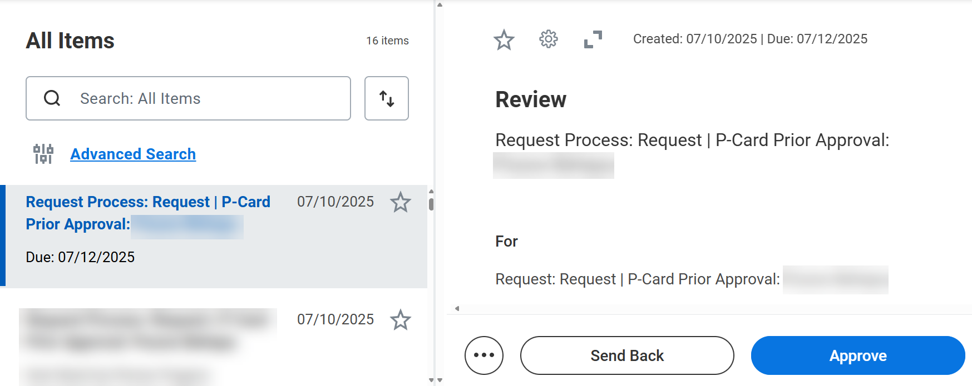
P-Card Prior Approval Request for Cardholders (Part 6 of 7)
INSTRUCTIONS
Review all responses for completeness and accuracy.
  Note: This is a Review step only. Click Send Back to route request back to cardholder (as initiator) for ability to Revise Request. Other action options available prior to Approve, include: Click Add Approvers to insert an approver(s) prior to manager approval. Click Deny to refuse to use your card to pay for goods or services. Click Save for Later to take no action at this time. The request will remain in your inbox pending action. Click Cancel to take no action and simply exit the cardholder from the request form.
Click Approve.
16
17

Slide 8
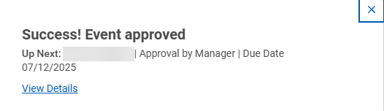

P-Card Prior Approval Request for Cardholders (Part 7 of 7)
INSTRUCTIONS
The P-Card Approval Request is then sent to the Manager for final approval and closure.
Note: If additional Approvers were added by the Cardholder, the Request will be routed to those approvers prior to routing for manager approval and closure.
You have successfully located and submitted the p-card prior approval request for cardholders.

