Slide 1
P-Card Prior Approval Request – Create a Request on Behalf of Cardholder
DESCRIPTION
This guide will show how any Employee can Create a P-Card Prior Approval Request On Behalf of a Cardholder to obtain approval to pay for a purchase using their card.
OVERVIEW
The key steps in the process are below:
Enter Create Request in the Search field.
Click Create Request task.
Select Request | P-Card Prior Approval for Request Type.
Complete Request Form and click Submit.
Request routes to Cardholder for their review and approval.
Request is sent to Manager for final approval and closure.
Business Process:
Locate Prior Approval Request
Submit Prior Approval Request
Send for Manager Approval and Closure
Notes:
Tier1 provide:
Request ID
Detail of customer's question or request
Security:
Access provided to all GA@WORK users through the Employee as Self security group.
No security role required.

Slide 2

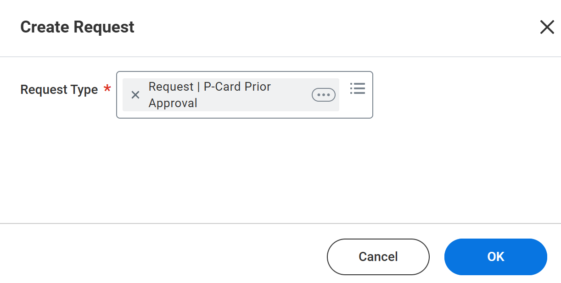
P-Card Prior Approval Request – Employee Requests on Behalf of Cardholder (Part 1 of 7)
INSTRUCTIONS
Enter Create Request in the Search field.
Click Create Request task.
1
2
Select Request | P-Card Prior Approval for Request Type.
Click OK.
3
4

Slide 3
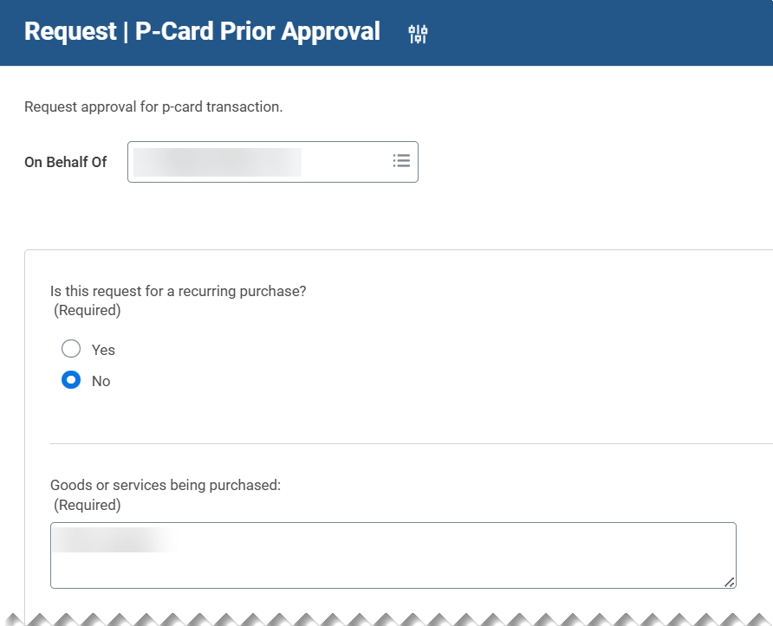
P-Card Prior Approval Request – Employee Requests on Behalf of Cardholder (Part 2 of 7)
INSTRUCTIONS
Select the Cardholder’s Name in the On Behalf Of field.
  Note: When there are multiple cardholders with the same name, the Initiator should use the Related Actions icon to preview the first 3 digits of each Cardholder's (Worker) Organization or Location to confirm they are selecting the correct cardholder associated with their company.
Select Yes or No to Is this request for a recurring purchase? (Required).
  Note: If Yes is selected, an additional (required) question relevant to the recurring purchase appears and must be populated.
Enter details for Goods or services being purchased: (Required).
5
6
7

Slide 4
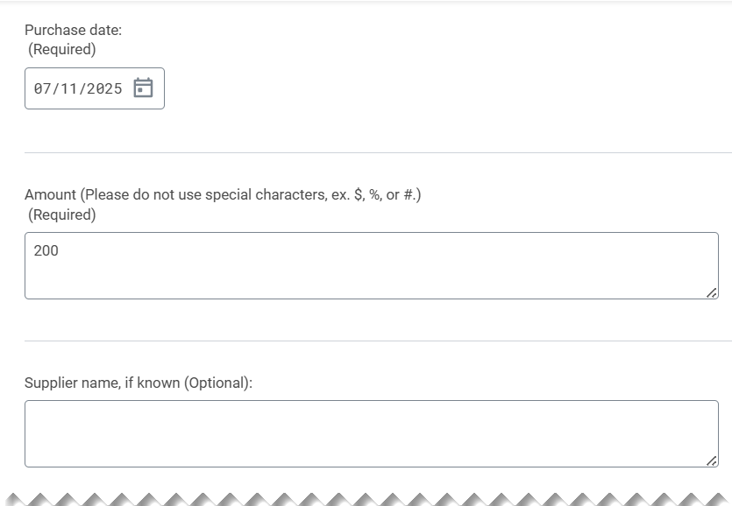
P-Card Prior Approval Request – Employee Requests on Behalf of Cardholder (Part 3 of 7)
INSTRUCTIONS
Enter a Purchase date (Required).
Enter an Amount, estimated or actual (Required).
Enter the Supplier Name, if known (Optional).
8
9
10

Slide 5
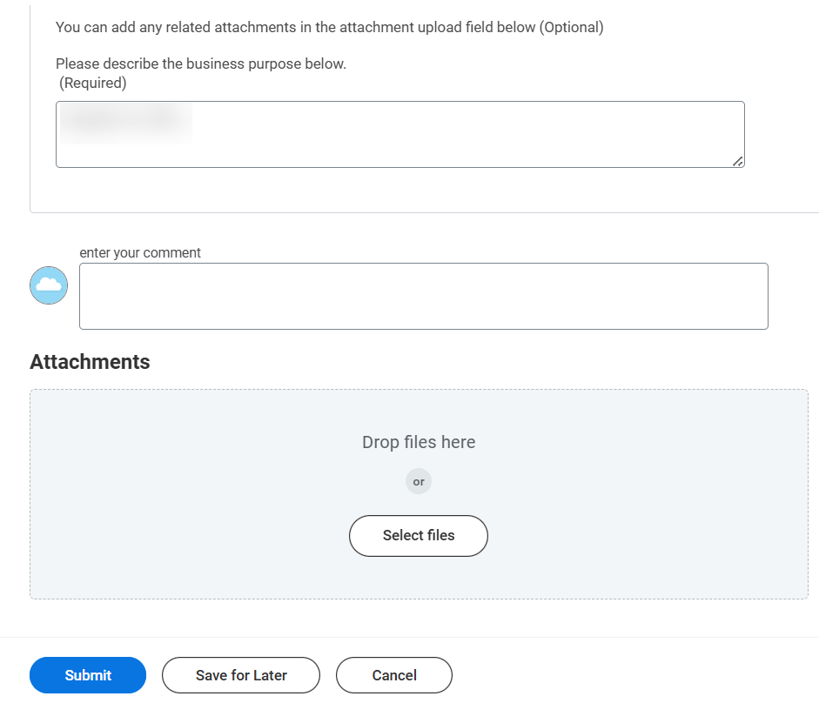
P-Card Prior Approval Request – Employee Requests on Behalf of Cardholder (Part 4 of 7)
INSTRUCTIONS
Describe the Business Purpose (Required).
You enter your comment, if applicable.
Click Select files or drag and drop files to add Attachments (Optional).
Click Submit.
11
12
13
14

Slide 6
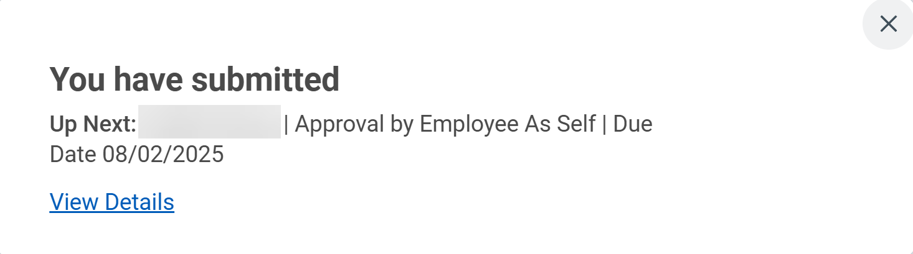
P-Card Prior Approval Request – Employee Requests on Behalf of Cardholder (Part 5 of 7)
INSTRUCTIONS
The cardholder that the request was submitted On Behalf Of is required to review the request and approve the form entries.

Slide 7
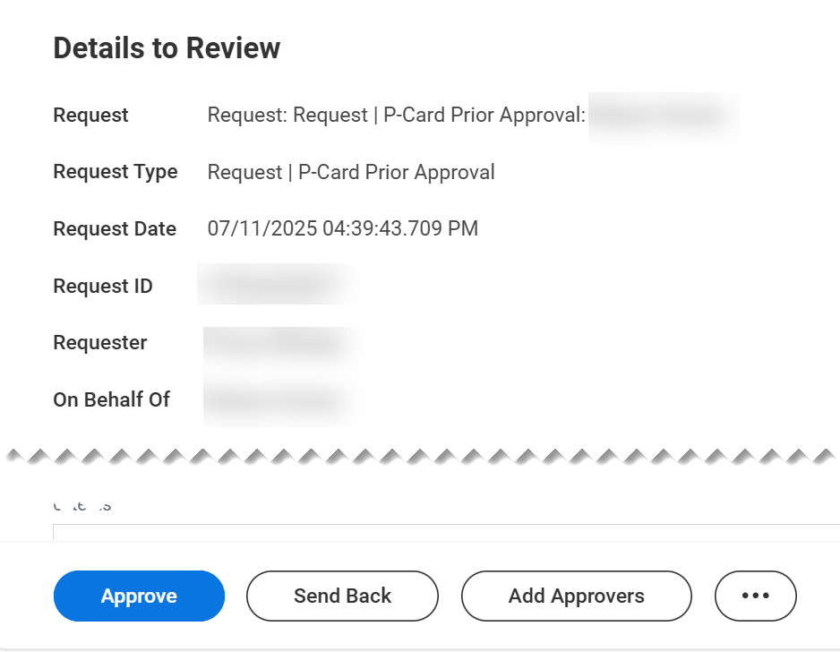
P-Card Prior Approval Request – Employee Requests on Behalf of Cardholder (Part 6 of 7)
INSTRUCTIONS
Review details of the Request.
Click Approve to accept the request as is and route it for approval.
Note: Click Add Approvers to insert an approver(s) prior to manager approval. Click Deny to refuse to use your card to pay for goods or services. Click Save for Later to take no action at this time. The request will remain in your inbox pending action. Click Cancel to take no action and simply exit the cardholder from the request form. The cardholder who the request is created On Behalf Of will not have the ability to edit details of the request, therefore, click Send Back to return it to the initiator for making any necessary changes prior to applying cardholder approval.
16
17

Slide 8
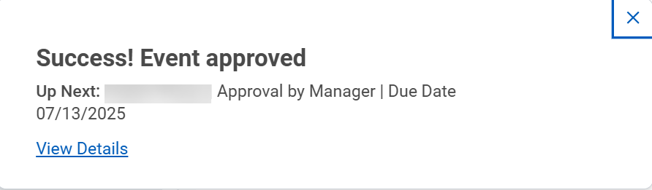

P-Card Prior Approval Request – Employee Requests on Behalf of Cardholder (Part 7 of 7)
INSTRUCTIONS
Once approved by the Cardholder, the P-Card Approval Request is sent to the Cardholder Manager for final approval and closure.
Note: If additional Approvers were added by the Cardholder, the Request will be routed to those approvers prior to routing for manager approval and closure.
You have successfully submitted the p-card prior approval request on behalf of a cardholder.

