Slide 1
Drop Learning Enrollment
This guide will show Learners, External Learners the steps to Drop a Learning Enrollment.
Click Learning on the Menu.
Click My Learning on the Learning menu.
Select a Drop Reason to Drop Learning Enrollment.
Submit the Drop Learning Enrollment.
Click Learning on Menu
Click My Learning
Select a Drop Reason
Submit Drop Learning Enrollment

Slide 2

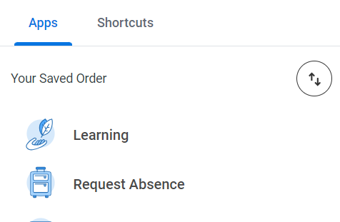
Drop Learning Enrollment (Part 1 of 4)
Click the Global Navigation Menu.
Click Learning to access your Learning Dashboard.

Slide 3
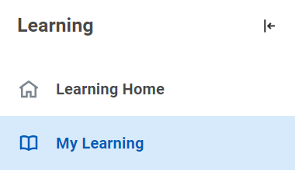
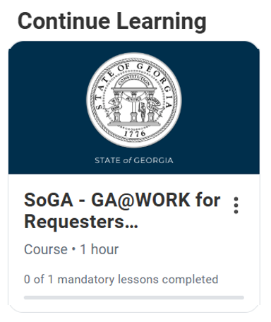
Drop Learning Enrollment (Part 2 of 4)
Click My Learning to access your My Learning Dashboard.
Select the desired course in the Continue Learning section.
Note: The course can also be accessed by clicking Need to Drop an Enrollment?

Slide 4
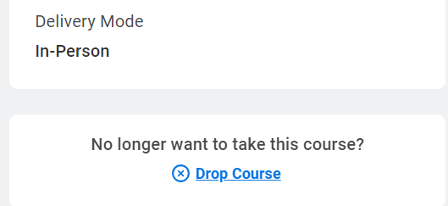
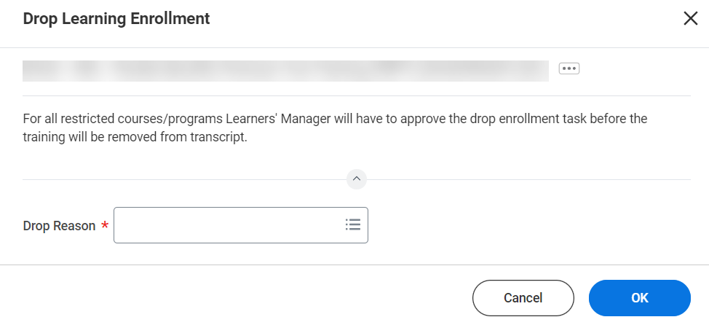
Drop Learning Enrollment (Part 3 of 4)
The course page will display. Click Drop Course on the lower right corner of the page.
Select the Drop Reason*.
Click OK.
V
6
7

Slide 5
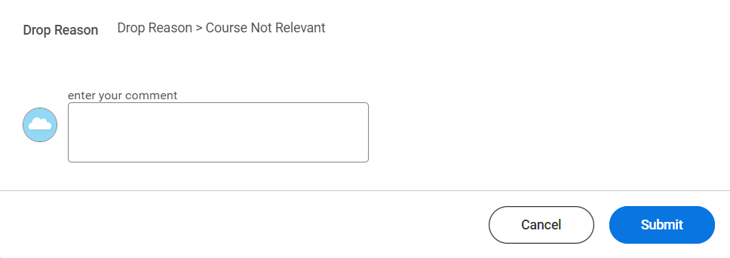
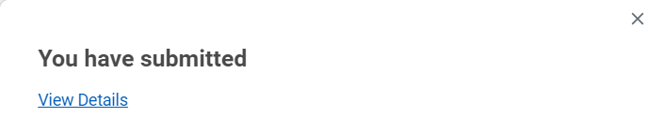
Drop Learning Enrollment (Part 4 of 4)
The Drop Reason will display. Click Submit.
Note: Restricted Courses require approval. For Internal Learners, their manager must approve the Drop Learning Enrollment. For External Learners, the Instructor for the Blended course must approve the Drop Learning Enrollment.
You have successfully submitted the Drop Learning Enrollment.
Note: You may select View Details for more information regarding the Drop Learning Enrollment.
You have successfully created the drop learning enrollment.

