Slide 1
Enroll in Digital Course/Blended Course/Program
This guide will assist Learners and External Learners with the steps to Enroll in Course/Program.
Click Learning to access your Learning Dashboard. ​
Click Browse Learning.
Click Enroll.
​Click Submit.
Browse Learning Catalog
Enroll in Course/ Program
Click Submit

Slide 2

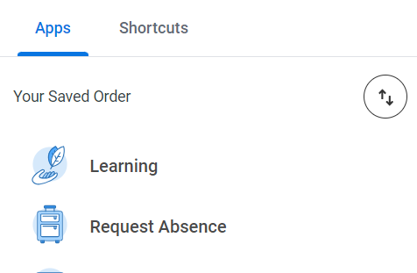
Enroll in Digital Course/Blended Course/Program (Part 1 of 4)
Click the Global Navigation Menu.
Click Learning to access your Learning Dashboard.

Slide 3
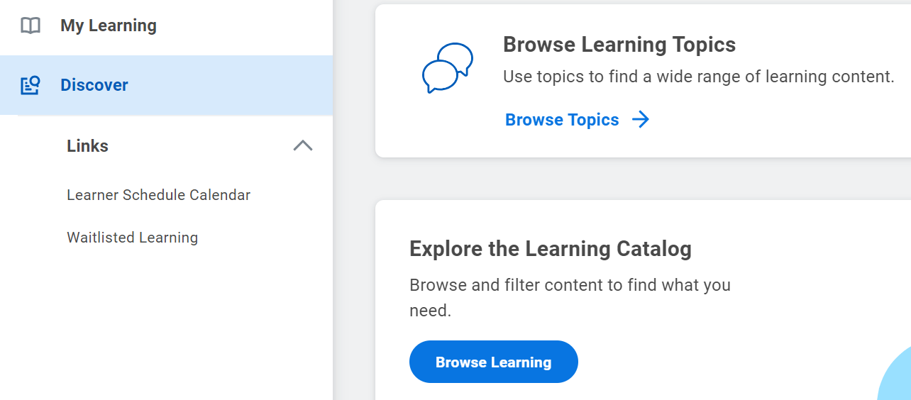
Enroll in Digital Course/Blended Course/Program (Part 2 of 4)
INSTRUCTIONS
Click Discover.
Click Browse Learning.
3
4

Slide 4
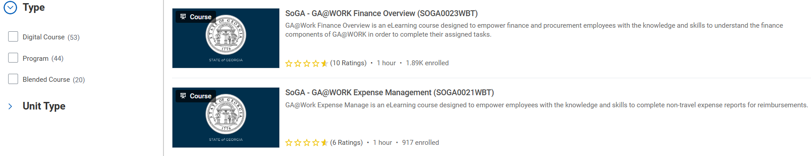
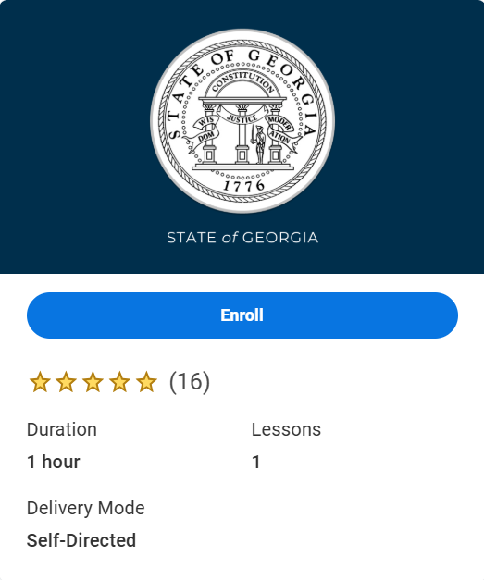
Enroll in Digital Course/Blended Course/Program (Part 3 of 4)
INSTRUCTIONS
Select desired course.
  Note: You can search for a specific course by entering key words in the Search field and pressing Enter, or by using the filter options to narrow down your search by selecting digital, blended and/or program.
Click Enroll.

Slide 5
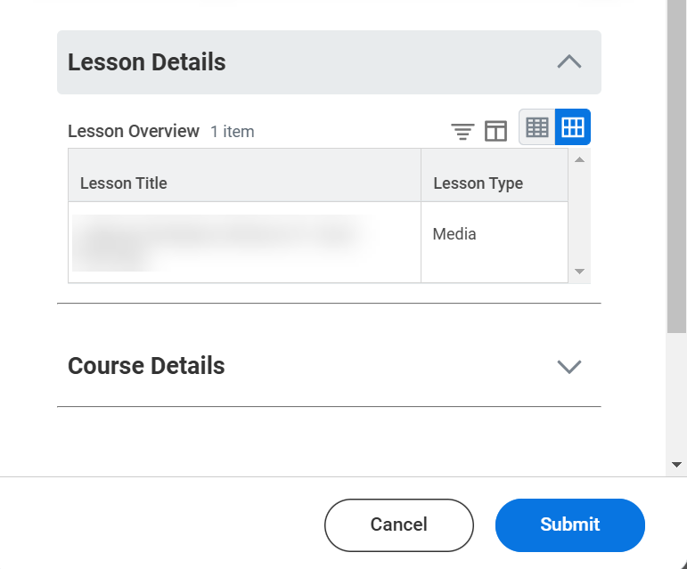
Enroll in Digital Course/Blended Course/Program (Part 4 of 4)
INSTRUCTIONS
Click Submit.
  Note: Restricted Digital Courses require manager approval for internal learners, but no approval is needed for external learners.
  Blended Courses require approval from the instructor for both internal and external learners.
  Program Courses require manager approval for internal learners, but no approval is needed for external learners.
You have successfully enrolled in a course/program.

