Slide 1
Enroll Learner in Course
This guide will assist Managers with the steps to Enroll a Learner in Course.
Click Learning to access your Learning Dashboard. ​
Click Browse Learning.
Click Enroll My Team.
​Select learners ​to enroll in the course.
Click Submit.
Enrolling a Learner to a Course is Needed
Enroll Learner in Course
Click Submit

Slide 2

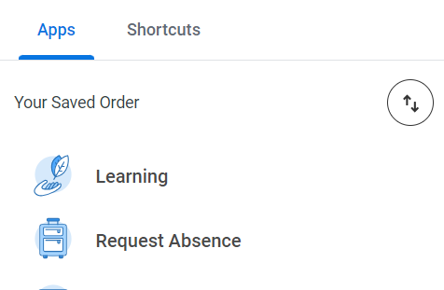
Enroll Learner in Course (Part 1 of 5)
Click the Global Navigation Menu.
Click Learning to access your Learning Dashboard.

Slide 3
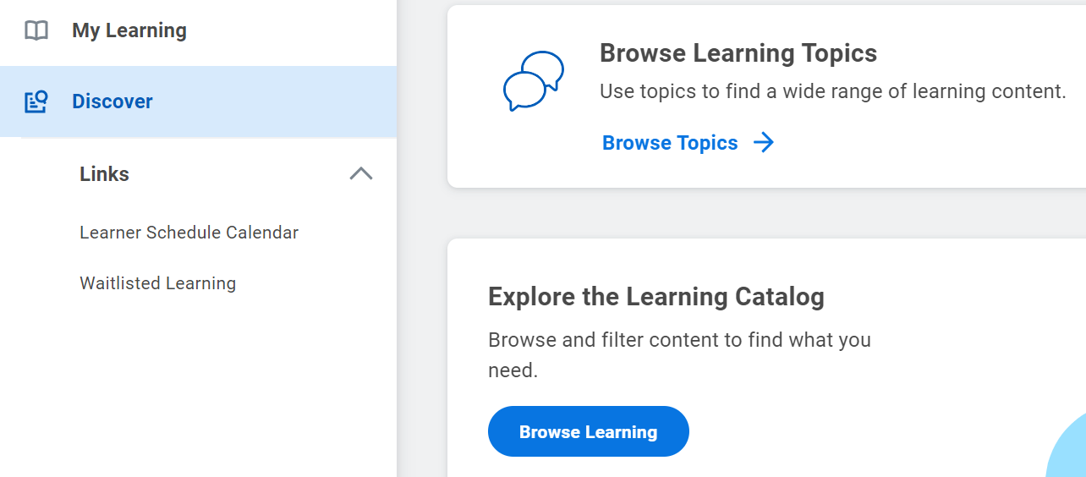
Enroll Learner in Course (Part 2 of 5)
INSTRUCTIONS
Click Discover.
Click Browse Learning.
3
4

Slide 4
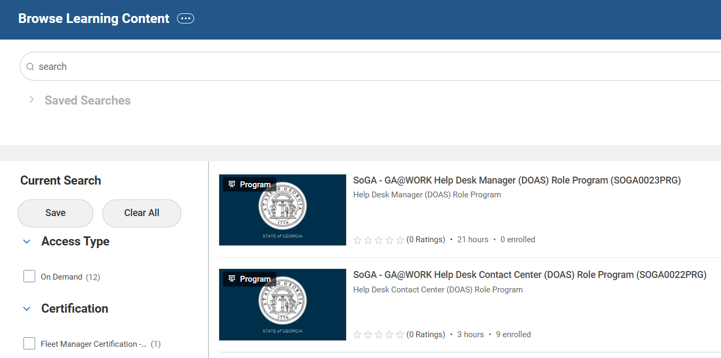
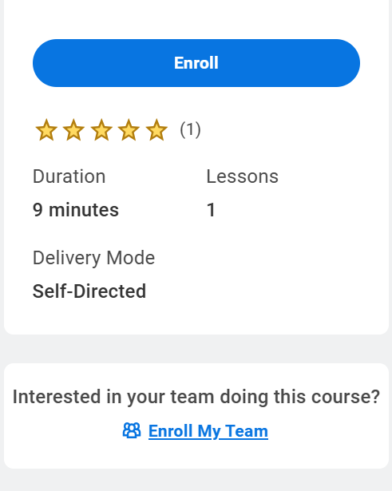
Enroll Learner in Course (Part 3 of 5)
INSTRUCTIONS
Select desired course.
  Note: You can also search for a specific course by entering key words in the search field and pressing Enter.
Click Enroll My Team.

Slide 5
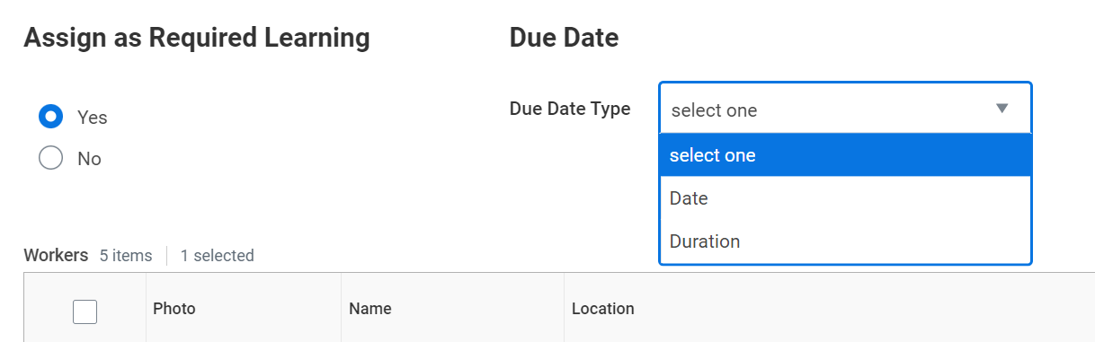
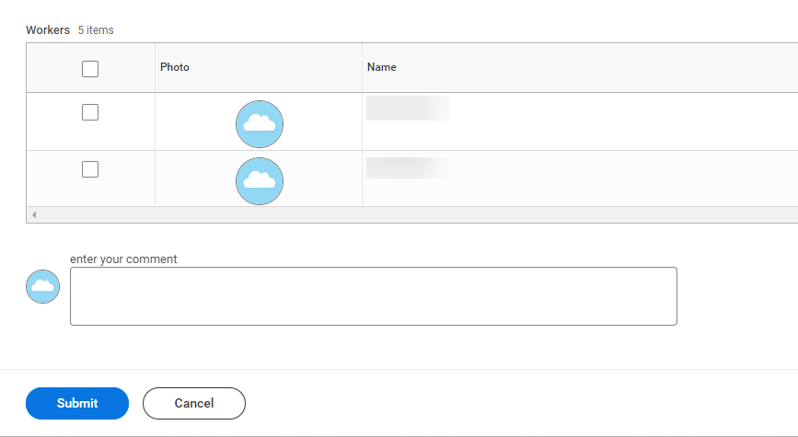
Enroll Learner in Course (Part 4 of 5)
INSTRUCTIONS
Select Yes or No to assign as a Required Learning.
  Select Due Date Type.
  Note: Due Date Type field will only display if Yes was selected.
7
8
Select learners to enroll in the course.
  Note: To select all learners, check the box in the header of the table.
͏͏Enter your Comment, as applicable.
9
10

Slide 6
Enroll Learner in Course (Part 5 of 5)
INSTRUCTIONS
Click Submit.
You have successfully enrolled a learner in course.

