Slide 1
Learner Dashboard Overview for Learners
This guide will show Learners the steps to navigate the Learning Dashboard in GA@WORK.
Access the Learner Dashboard.
​Enroll Courses to your Learning Home page.
View Courses in Progress, view Learning History, manage Course Enrollment and manage Learning Preferences.
Discover Learning Topics in the Learning Catalog.
View the Learner Schedule Calendar and other helpful Links.
Access Learner Dashboard
Explore Learning Home Page
Discover Learning Topics
View Learner Schedule Calendar

Slide 2
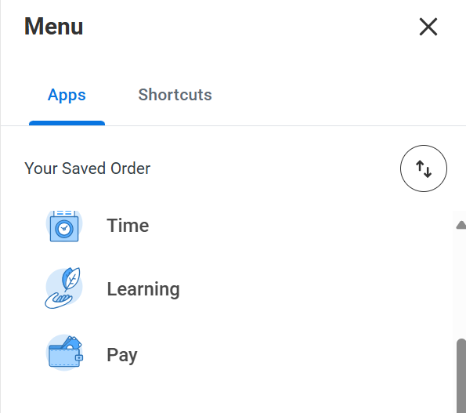
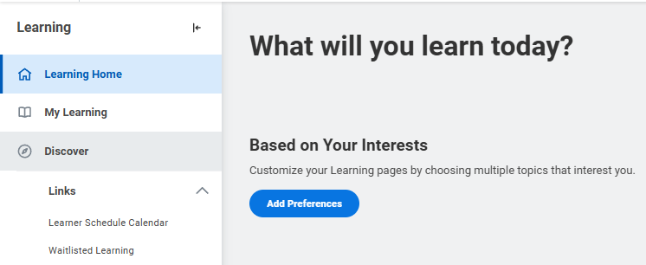
Learning Dashboard Overview
(Part 1 of 12)
Click Learning in the Global Navigation Menu.
The Learning Dashboard provides you with a list of courses Based on Your Interests. Click Add Preferences to customize this page.
Note: After you Add Preferences initially, your slider will be updated to show courses Based on Your Interest.

Slide 3
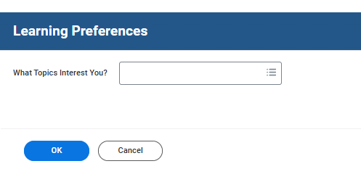
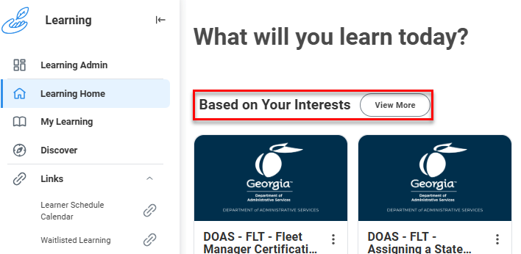
Learning Dashboard Overview
(Part 2 of 12)
Select What Topics Interest You?, as applicable.
Click OK.
3
4
Courses will display on your Learning Home page aligned to your learning preferences.
Note: Click View More to access additional courses Based on Your Interests.

Slide 4
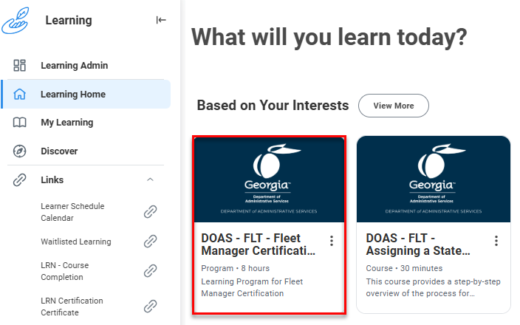
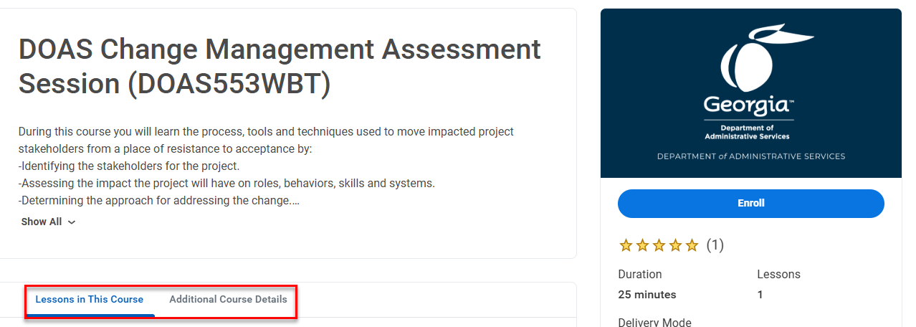
Learning Dashboard Overview
(Part 3 of 12)
Click any course tile to view the details of each recommended course.
Review the Lessons in This Course/Program and Additional Course/Program Details.
Note: The process of enrolling in a course is covered in the job aid titled Enroll in Course/Program.

Slide 5
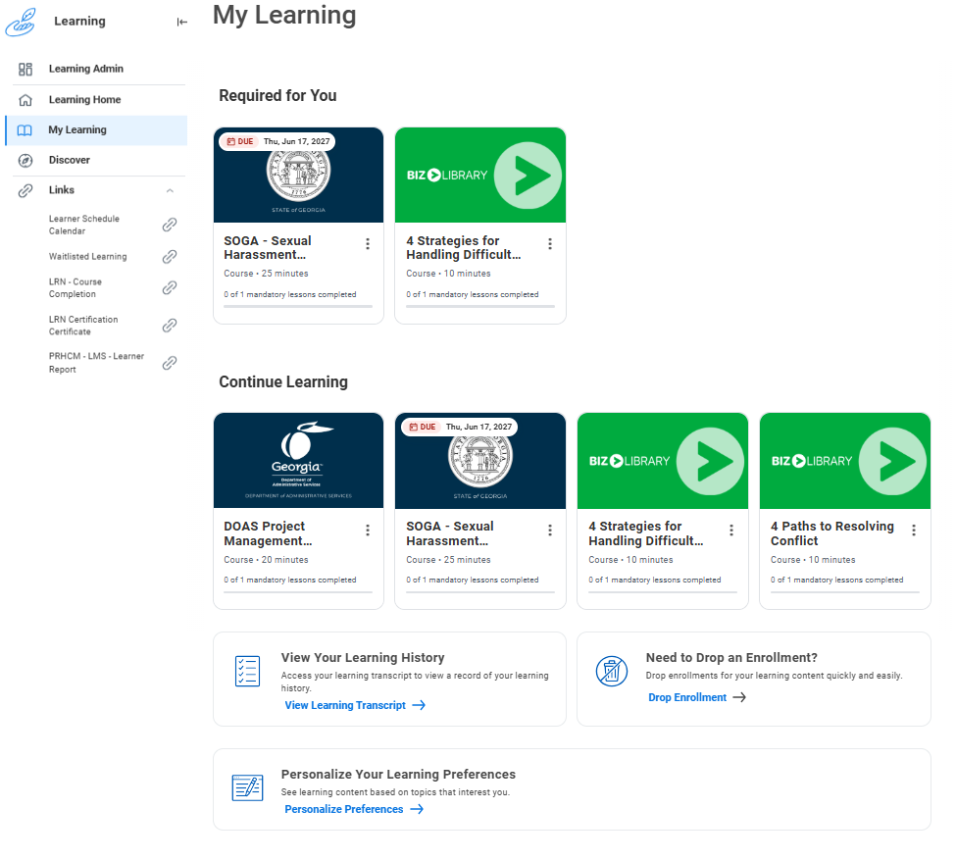
Learning Dashboard Overview
(Part 4 of 12)
Click My Learning on the Learning dashboard to access your My Learning page.
Your My Learning page gives you access to Required Learning Slider, Continue Learning, and View Learning History. You may also Drop an Enrollment or Personalize your Preferences.
8
9

Slide 6
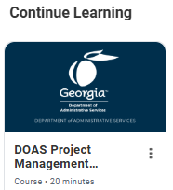
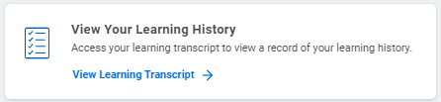
Learning Dashboard Overview
(Part 5 of 12)
Click any course in the Continue Learning section to proceed with taking the course.
Click View Your Learning Transcript to access your learning transcripts and view a record of your learning history.

Slide 7
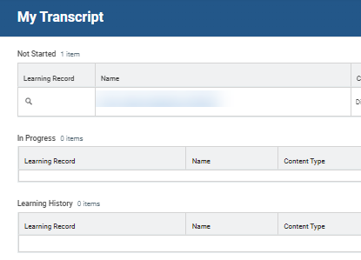
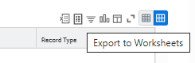
Learning Dashboard Overview
(Part 6 of 12)
​My Transcript display details for Courses that are Not Started, In Progress, and your Learning History [completed learning].
To export your full Transcript Report, click Export to Worksheets next to Learning History.
Note: The Transcript Report contains Learning History including Name, Course Type, Registration Status, Date Enrolled, Completion Status, Attendance Status, Grade, Score, Record Type and Expiration Date if the learner has completed a course with expiration.

Slide 8
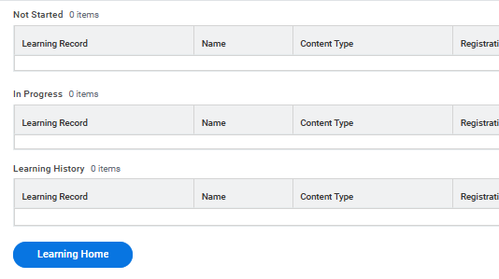
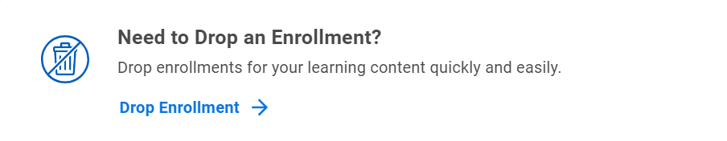
Learning Dashboard Overview
(Part 7 of 12)
When you have finished reviewing your transcript, click Learning Home.
Return to your My Learning page. The Need to Drop an Enrollment? worklet will allow you to remove yourself from a Course activity. Click Drop Enrollment to begin.
Note: This process is covered in the job aid Drop Learning Enrollment.

Slide 9
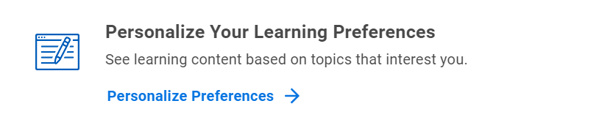
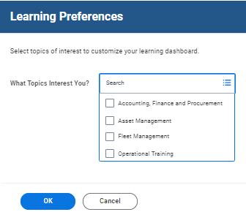
Learning Dashboard Overview
(Part 8 of 12)
Return to your My Learning page. You may Personalize Your Learning Preferences to see learning content based on topics that interest you. Click Personalize Preferences to begin.
Search and select What Topics Interest You?.
Click OK.
17
18

Slide 10
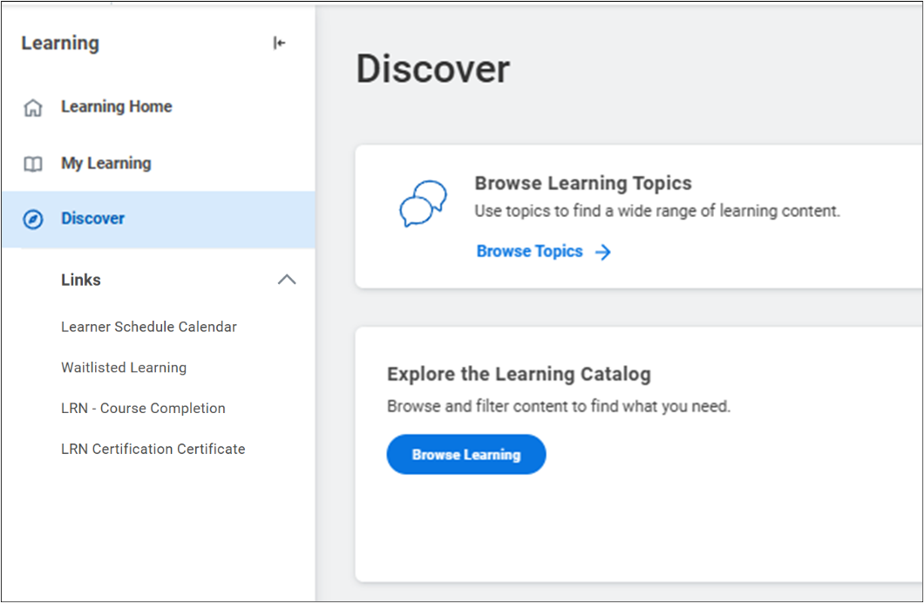
Learning Dashboard Overview
(Part 9 of 12)
Select Discover from the Learning menu to browse for Learning Content.
Click Browse Topics on the Browse Learning topics worklet.
19
20

Slide 11
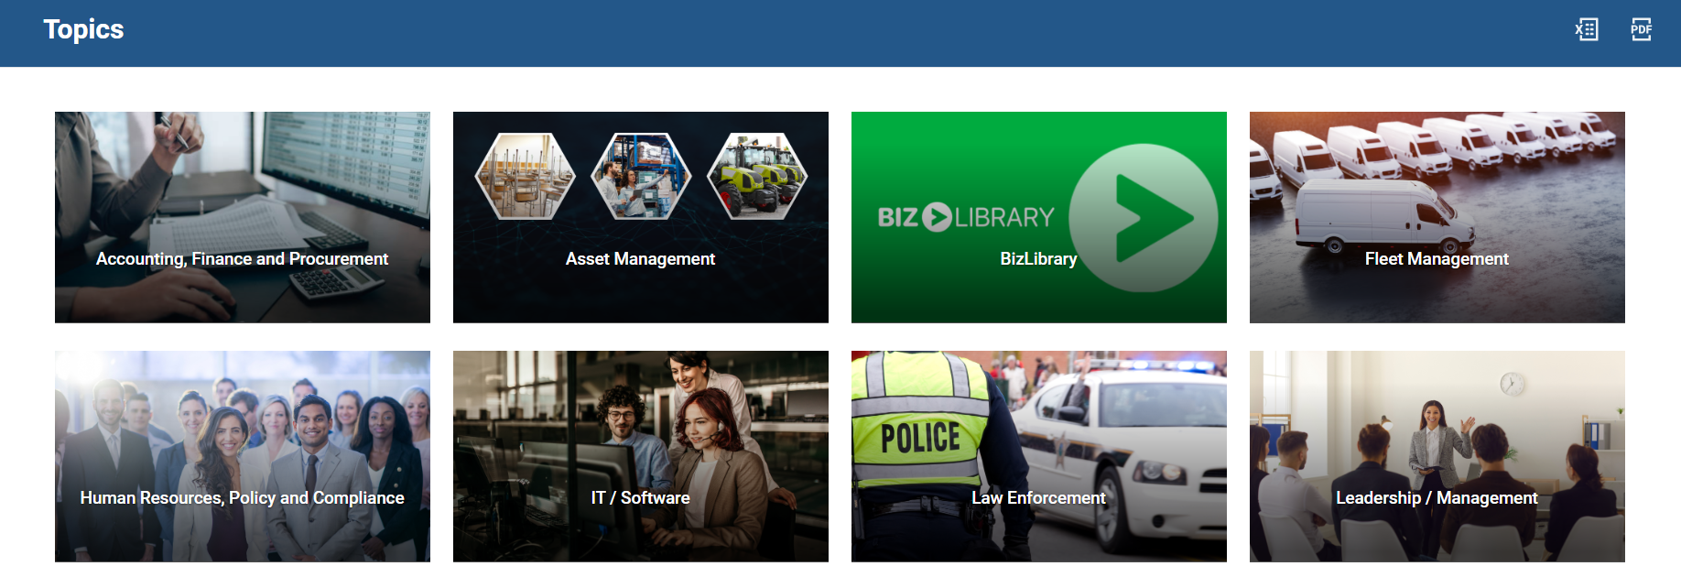
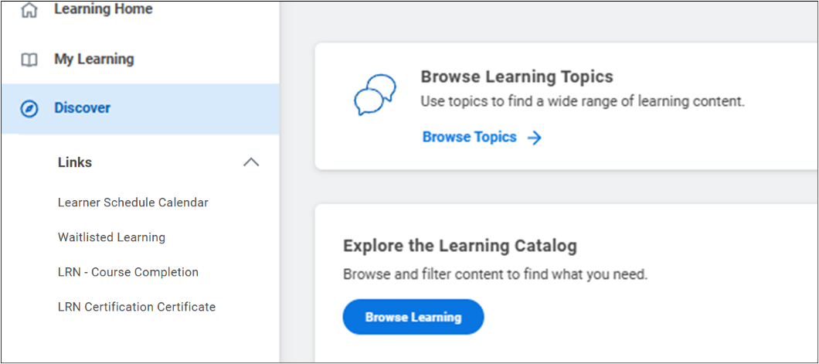
Learning Dashboard Overview
(Part 10 of 12)
Click any tile on the Topics page to view the associated Courses.
Note: The topics that you see will vary depending on your agency. External Learners will have access to the External Enterprise Library and will not see this Topic page.
Return to the Discover page. You may Explore the Learning Catalog to browse available content. Click Browse Learning.

Slide 12
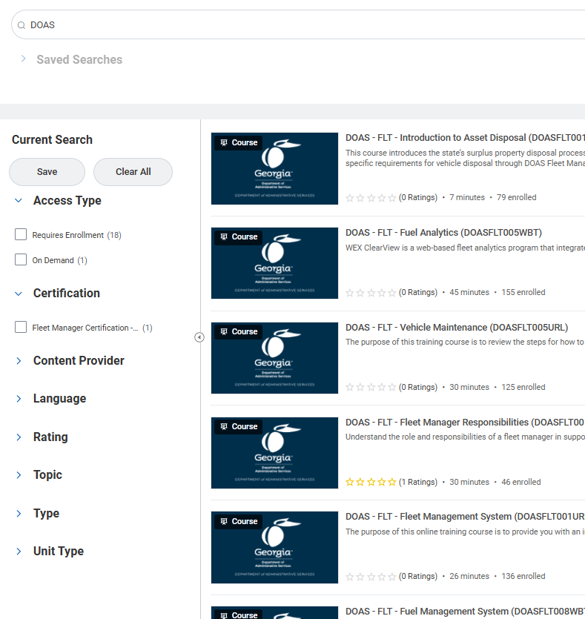
Learning Dashboard Overview
(Part 11 of 12)
Enter key terms in the Search bar to filter content.
Filter Courses by Access Type, Certification, Content Provider, Created by Worker, Language, Skill Level, Topic, Type and Unit Type.
Note: You may save your Search parameters.
23
24

Slide 13
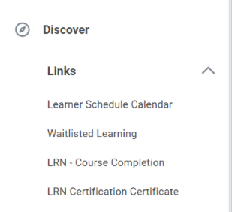
Learning Dashboard Overview
(Part 12 of 12)
Under Links in the Learning menu, select Learner Schedule Calendar to view and manage your instructor-led training schedule.
Note: The calendar will only display blended courses where you have enrolled in a scheduled course offering.
Select Waitlisted Learning to view and manage courses or programs for which you have been waitlisted.
Select LRN – Course Completion to view and print course completion certificates.
25
26
27
You have successfully navigated your Learning dashboard.

