Slide 1
Request Extended Enterprise
Learner – Activate Account
DESCRIPTION
This guide will assist External Learners with the steps to Request Activation of their Extended Enterprise Learner Account.
OVERVIEW
The key steps in the process are below:
Click Activate Account.
Enter your Email Address.
Enter your Username and Verification Code.
Click Update and Activate Account.
Note: If an external learner has not logged in for over 90 days, their account becomes inactive and will show as blocked when logging in via ELRA. However, if their certification is set to expire within 60 days, the account will be automatically reactivated. Otherwise, to regain access, they must follow the account activation steps.
Business Process:
Click Activate Account
Enter Username and Verification Code from Email
Click Update and Activate Account

Slide 2
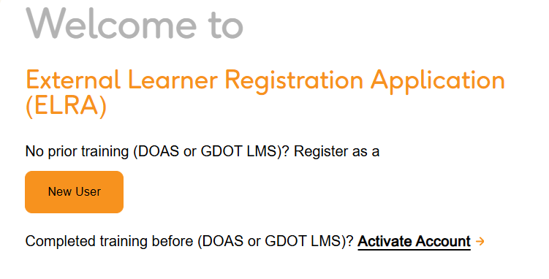
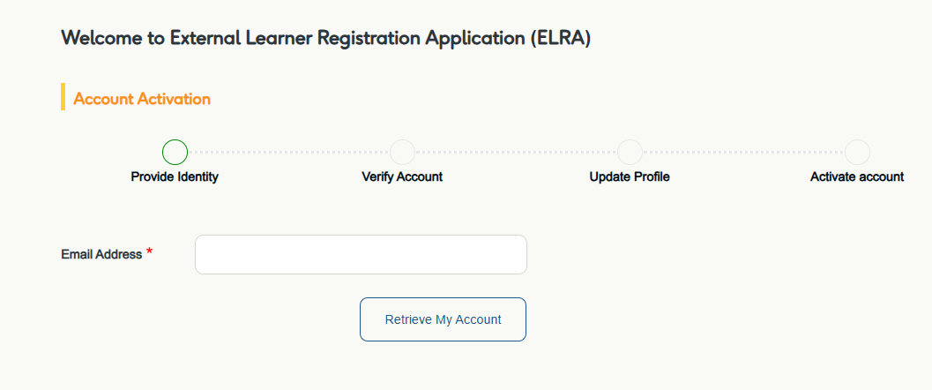
Request Extended Enterprise Learner –
Activate Account (Part 1 of 7)
INSTRUCTIONS
Click Activate Account.
Note: If you received the activation link in your email, you may skip Step 1.
Enter the Email Address* you previously used in the Legacy LMS.
Click Retrieve My Account.
2
3

Slide 3
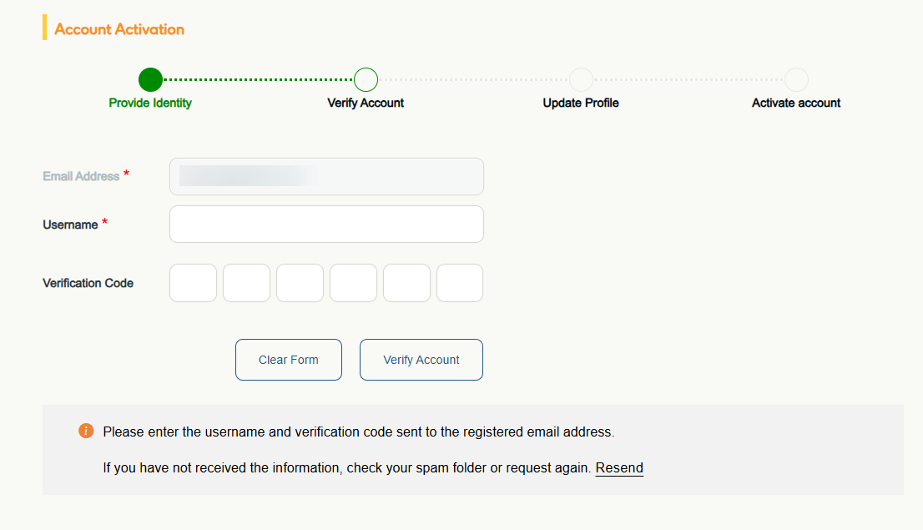
Request Extended Enterprise Learner –
Activate Account (Part 2 of 7)
Enter your Username* and Verification Code.
  Note: Your Email Address* will appear automatically. Use the Username* and Verification Code sent to the registered email address. The verification code is only valid for 15 minutes.
Click Verify Account.
4
5

Slide 4
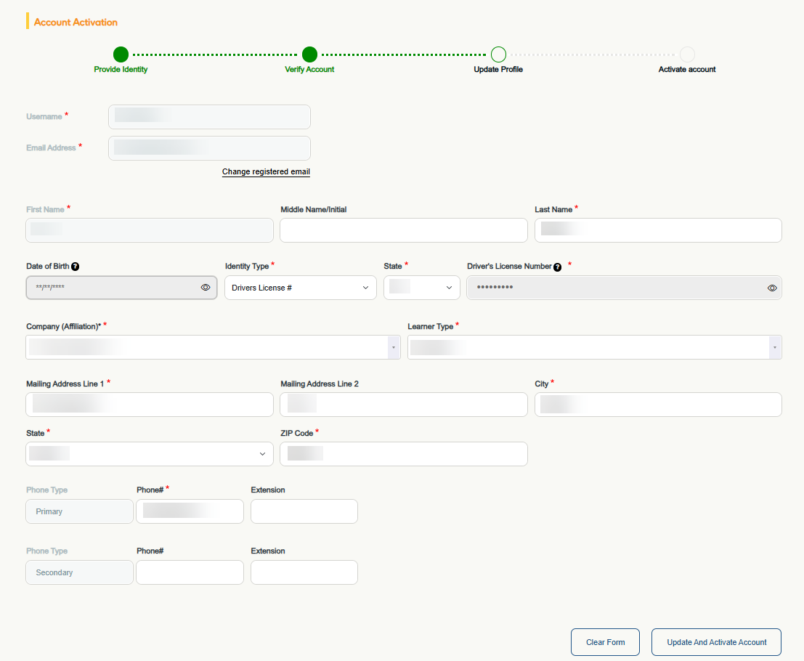
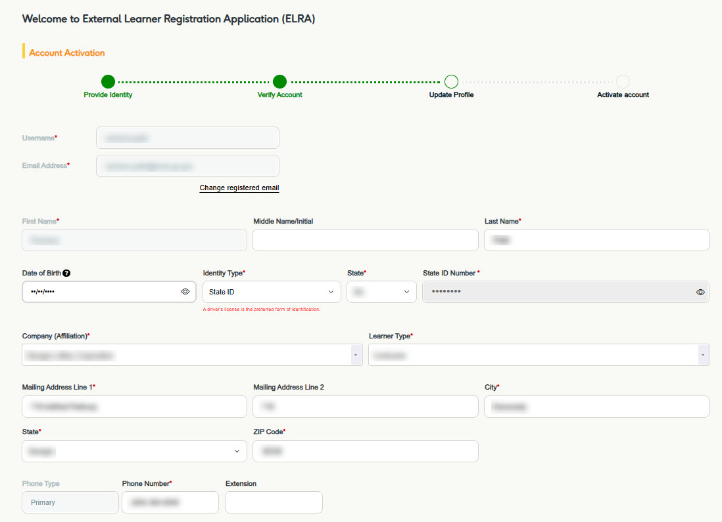
Request Extended Enterprise Learner –
Activate Account (Part 3 of 7)
Update your profile, if applicable.
Click Update And Activate Account.

Slide 5
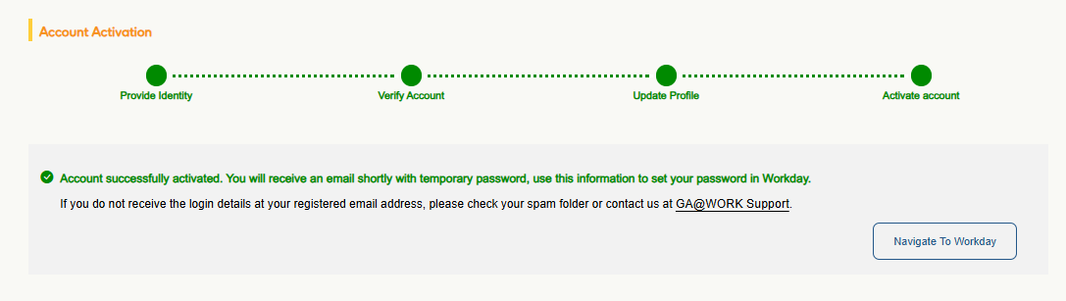
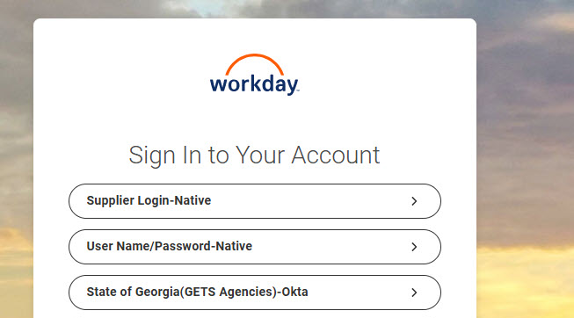
Request Extended Enterprise Learner –
Activate Account (Part 4 of 7)
View confirmation of Activation, then click Navigate to Workday.
  Note: You will receive temporary login details via email.
Click User Name/Password-Native.

Slide 6
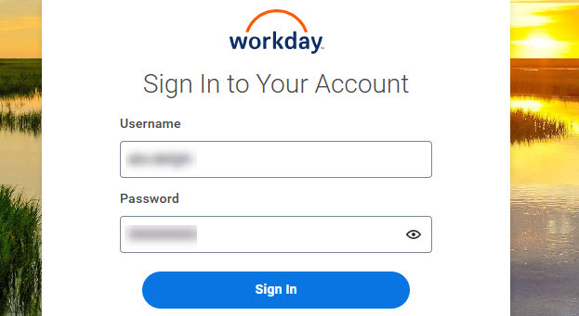
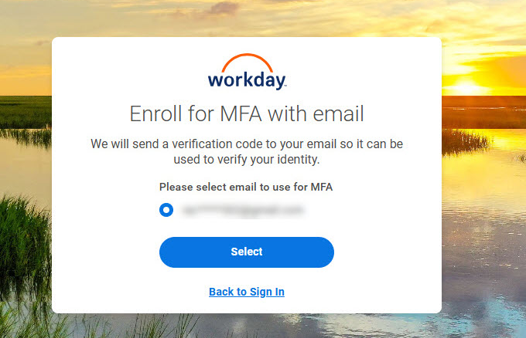
Request Extended Enterprise Learner –
Activate Account (Part 5 of 7)
Enter the User Name and Password received in your email.
Click Sign In.
10
10
11
Click Select.

Slide 7
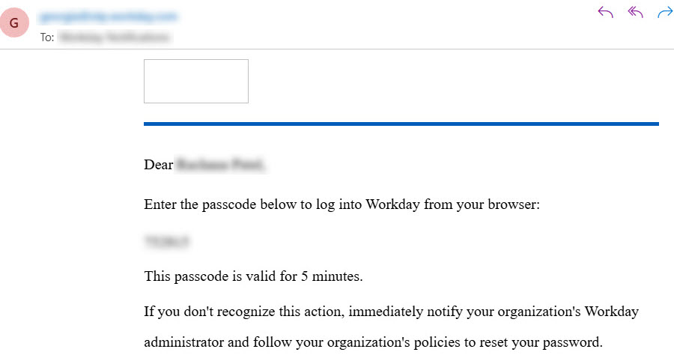
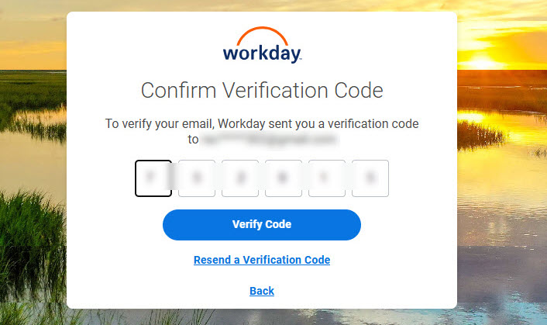
Request Extended Enterprise Learner –
Activate Account (Part 6 of 7)
Open the email to view the Verification Code.
Enter the Verification Code.
Click Verify Code.
14
15

Slide 8
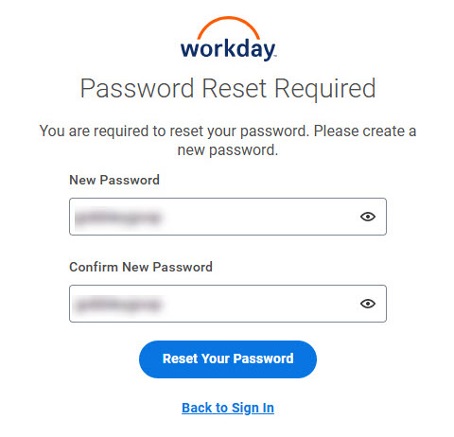
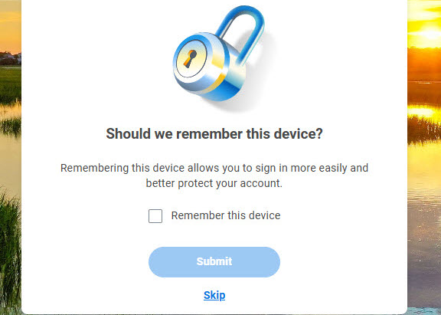
Request Extended Enterprise Learner –
Activate Account (Part 7 of 7)
Enter and confirm your New Password.
Click Reset Your Password.
16
16
17
Check the box to Remember this device, if desired. Otherwise, click Skip to complete.
You have now successfully Requested Extended Enterprise Learner to Activate your Account.

