Slide 1
Request Extended Enterprise
Learner – Active User
This guide will assist External Learners with the steps to Request Extended Enterprise Learner as an Active User.
OVERVIEW
The key steps in the process are below:
Verify your Username in Extended Learner Registration Application (ELRA).
Login to GA@WORK.
Complete Multifactor Authentication.
Business Process:
Verify Username
Login to GA@WORK
Complete Multifactor Authentication

Slide 2
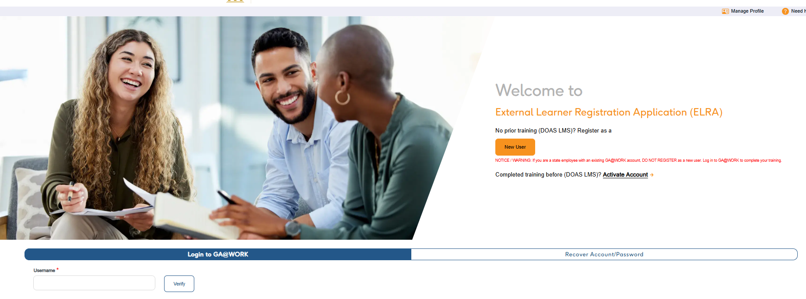
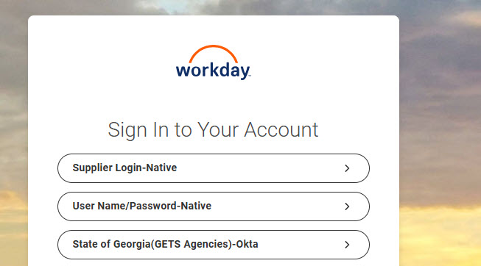
Request Extended Enterprise Learner –
Active User (Part 1 of 3)
Enter your Username* in ELRA.
Click Verify.
1
2
In GA@WORK (Workday), select Supplier Login-Native.

Slide 3
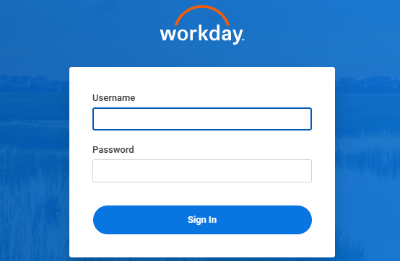
Request Extended Enterprise Learner –
Active User (Part 2 of 3)
Enter your Username and Password.
Click Sign In.
4
5

Slide 4
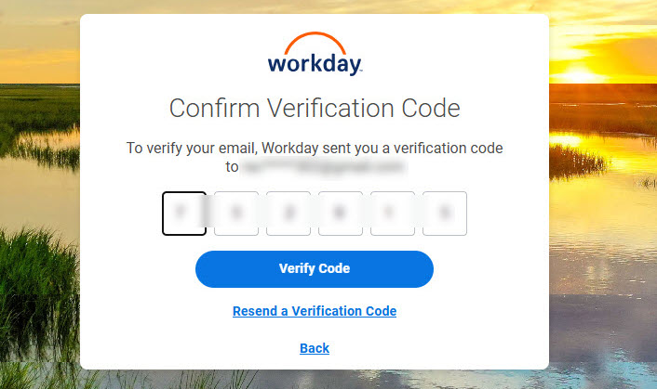
Request Extended Enterprise Learner –
Active User (Part 3 of 3)
Enter Verification Code.
Click Verify Code.
7
8
You have now successfully Requested Extended Enterprise Learner as an Active User.

