Slide 1
Request Extended Enterprise
Learner – New User
DESCRIPTION
This guide will assist External Learners with the steps to Request Extended Enterprise Learner as a New User, as well as how to Manage Profile, Recover Account, and Reset Password if forgotten.
OVERVIEW
The key steps in the process are below:
Click New User.
Enter your Name and Email Address.
Enter Verification Code.
Complete required fields.
Click Complete Verification.
Business Process:
Click New User
Register as a New User
Click Complete Verification

Slide 2
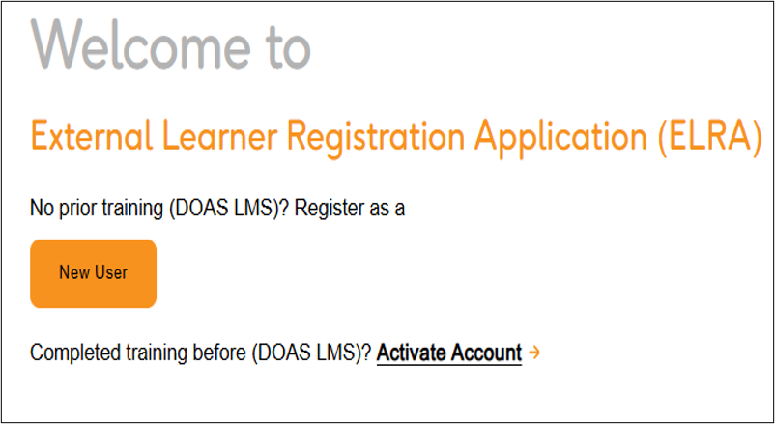
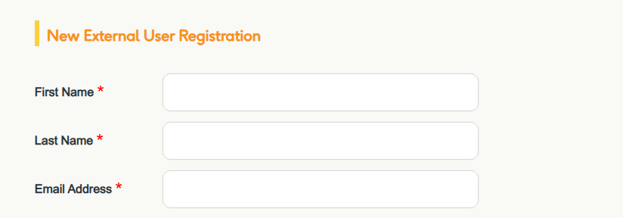
Request Extended Enterprise Learner –
New User (Part 1 of 8)
INSTRUCTIONS
Click New User.
Enter your First Name*, Last Name*, and Email Address*.
  Note: A verification code will be sent to your email address to continue with the registration process. The verification code is only valid for 15 minutes.

Slide 3
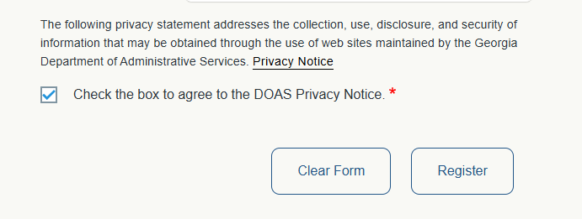
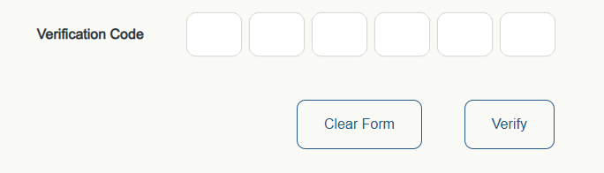
Request Extended Enterprise Learner –
New User (Part 2 of 8)
INSTRUCTIONS
Select Check the box to agree to the DOAS Privacy Notice*.
Click Register.
3
4
Enter your Verification Code.
  Note: Use the verification code sent to the email address you provided.
Click Verify.
5
6

Slide 4
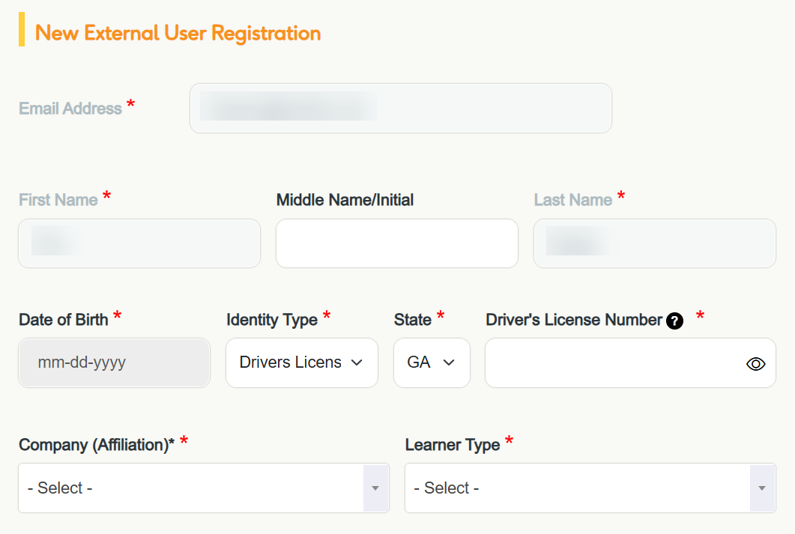
Request Extended Enterprise Learner –
New User (Part 3 of 8)
Enter your Middle Name/Initial, if desired.
  Note: Email Address*, First Name*, and Last Name* will appear automatically.
Enter your Date of Birth*, Identity Type*, State*, and Driver’s License Number*.
  Note: Select Drivers License# as the Identity Type*.
Select your Company (Affiliation)* and Learner Type*.
7
8
9

Slide 5
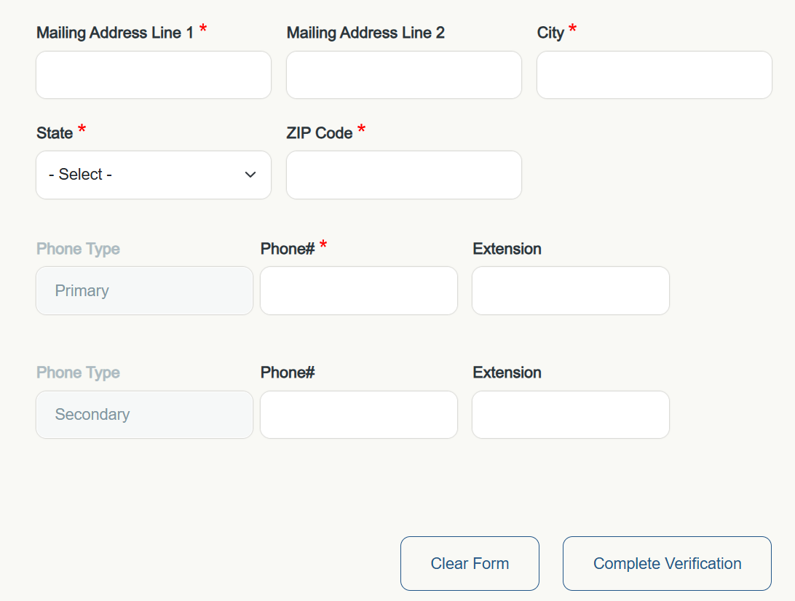
Request Extended Enterprise Learner –
New User (Part 4 of 8)
Enter your Mailing Address Line 1*, City*, State*, and ZIP Code*.
  Note: Enter Mailing Address Line 2, if applicable.
Enter your Phone#*.
  Note: You may also enter an Extension and Secondary Phone#, if applicable.
Click Complete Verification.
10
11
12

Slide 6
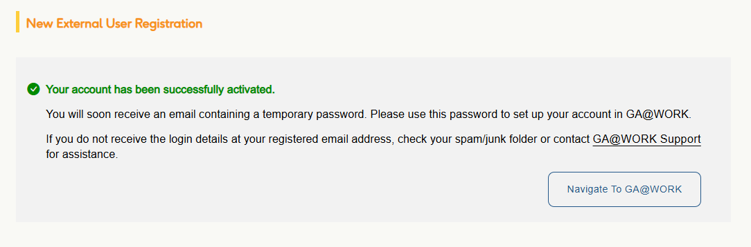
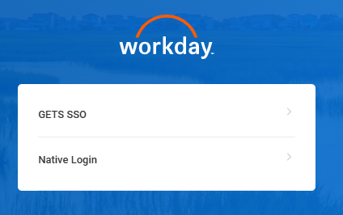
Request Extended Enterprise Learner –
New User (Part 5 of 8)
INSTRUCTIONS
View confirmation of Registration, then click Navigate to GA@WORK.
  Note: You will receive temporary login details via email.
Click Native Login.

Slide 7
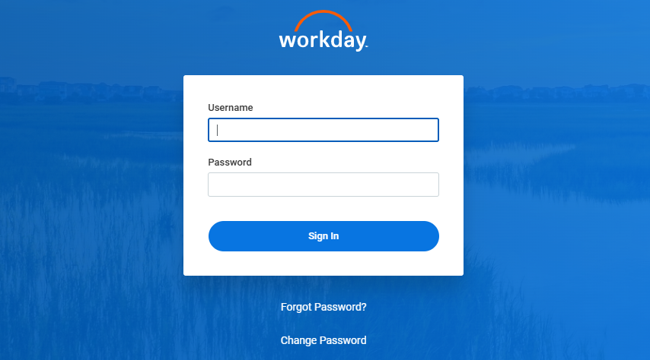
Request Extended Enterprise Learner –
New User (Part 6 of 8)
Enter the Username and Temporary Password provided in your email.
  Note: This will be sent in two separate emails.
Click Sign In.
15
16

Slide 8
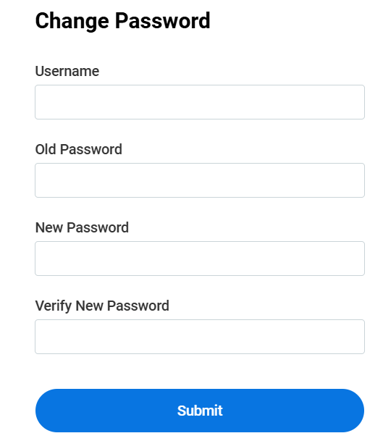
Request Extended Enterprise Learner –
New User (Part 7 of 8)
To change your password, enter your Username and Old Password.
Enter your New Password and Verify New Password.
Click Submit.
17
18
19

Slide 9
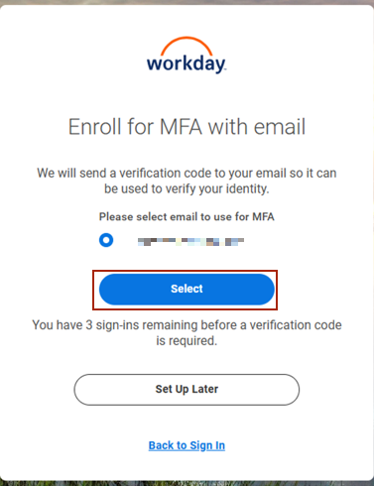
Request Extended Enterprise Learner –
New User (Part 8 of 8)
Click Select to complete the Multifactor Authentication setup.
  Note: Choose Email to complete your identity verification.

Slide 10
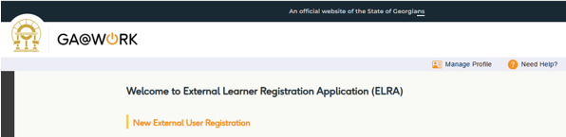
Request Extended Enterprise Learner –
Manage Profile (Part 1 of 3)
͏͏To manage your profile, click Manage Profile.

Slide 11
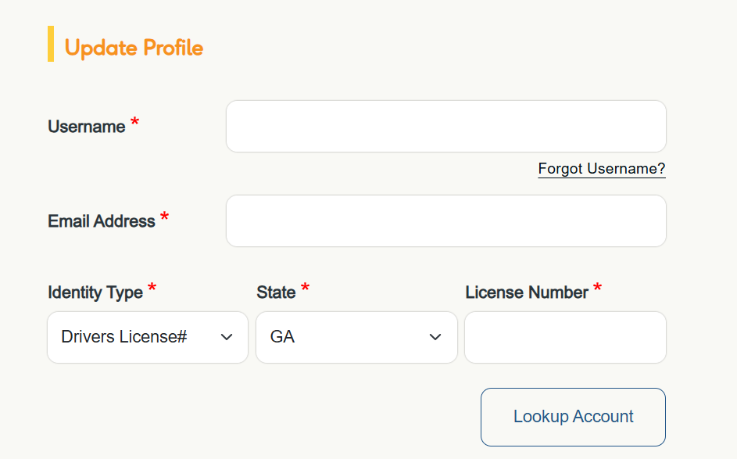
Request Extended Enterprise Learner –
Manage Profile (Part 2 of 3)
͏͏Enter your Username* and Email Address*.
Enter the Identity Type*, State*, and License Number*.
  Note: Select Drivers License# as the Identity Type*.
Click Lookup Account.
2
3
4

Slide 12
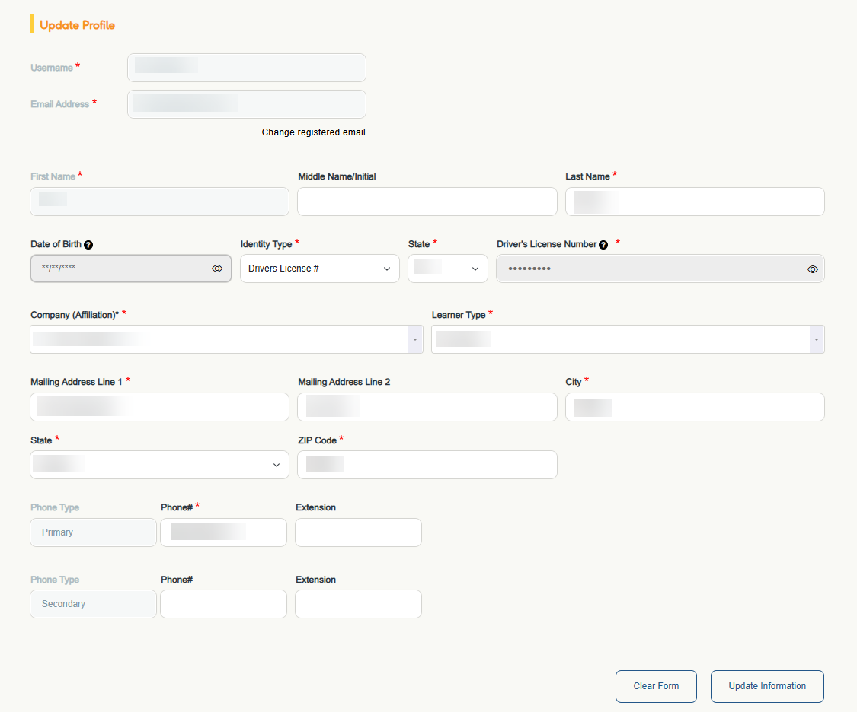
Request Extended Enterprise Learner –
Manage Profile (Part 3 of 3)
͏͏Edit information, if applicable, then click Update Information.

Slide 13
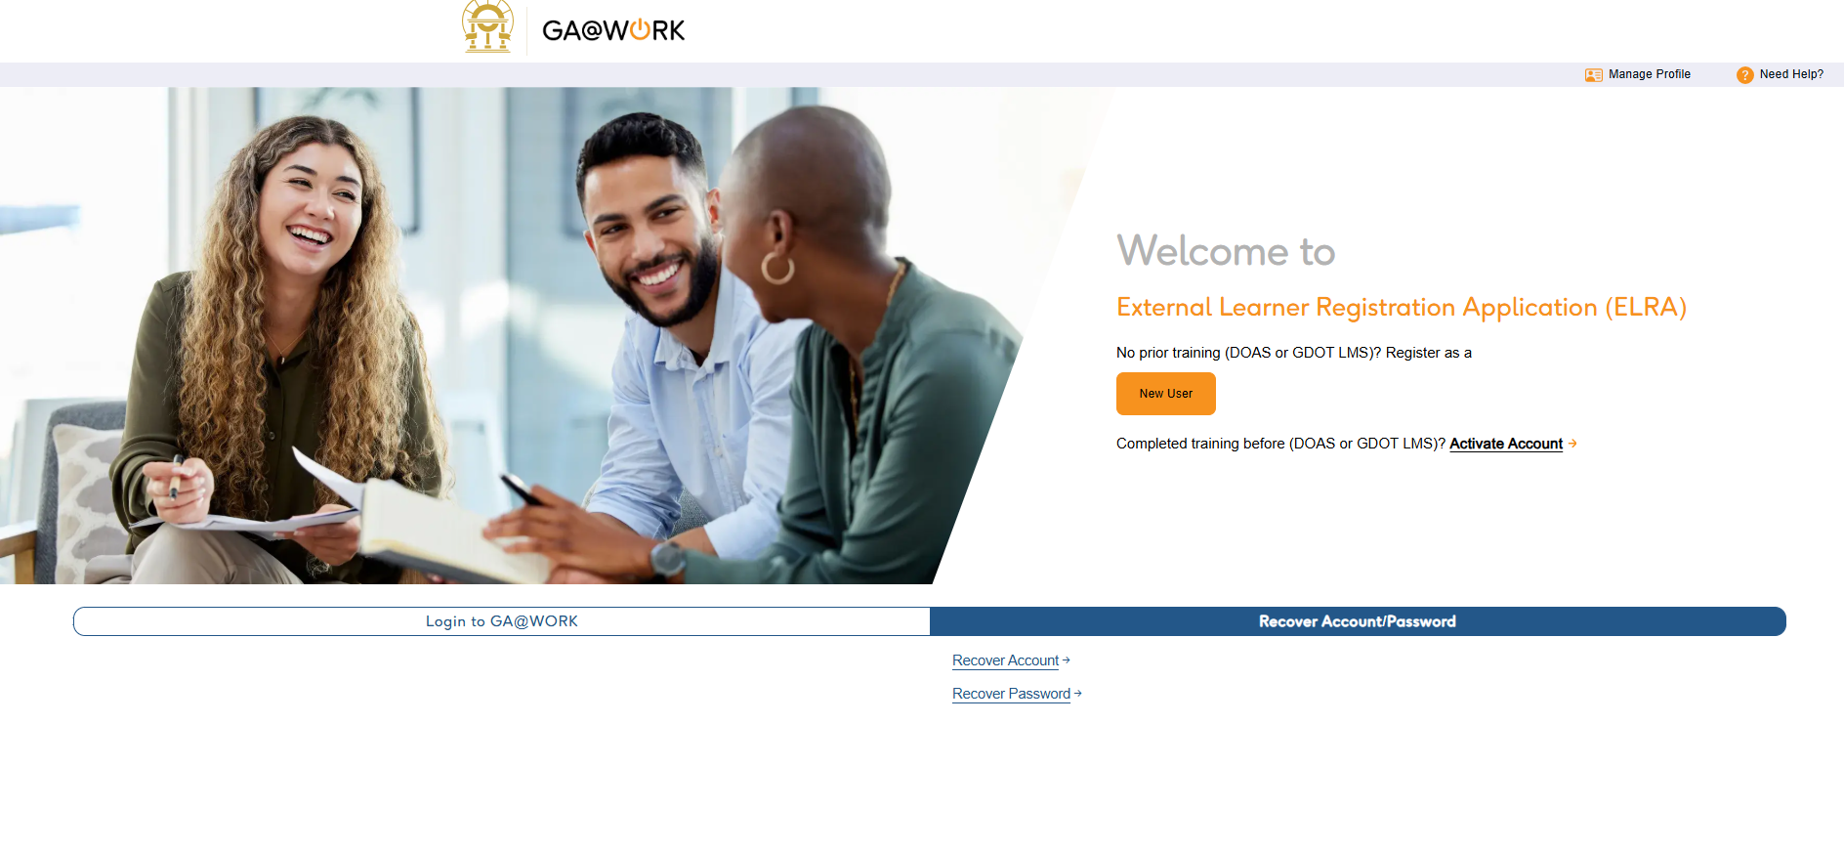
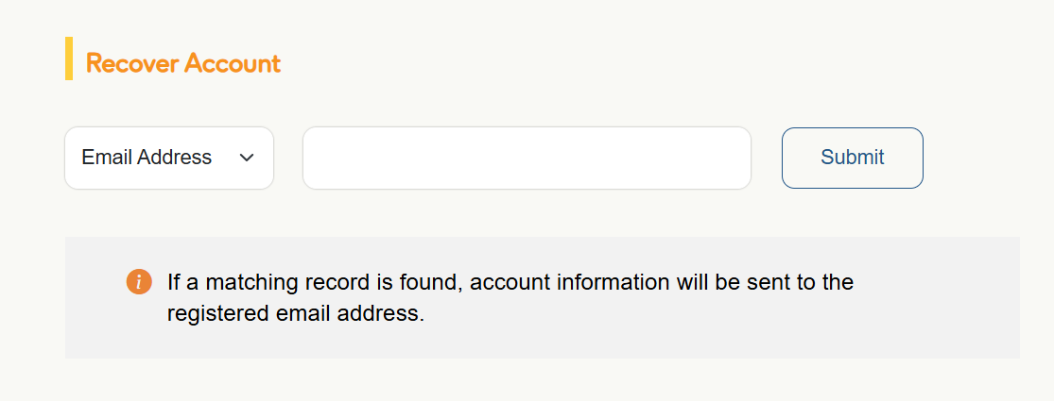
Request Extended Enterprise Learner –
Recover Account/Password (Part 1 of 4)
INSTRUCTIONS
͏͏To recover your account, click Recover Account/Password.
Click Recover Account.
1
2
Select a method to recover your account.
  Note: You can select either email address or username.
Enter either your email address or username.
Click Submit.
4
5
3

Slide 14
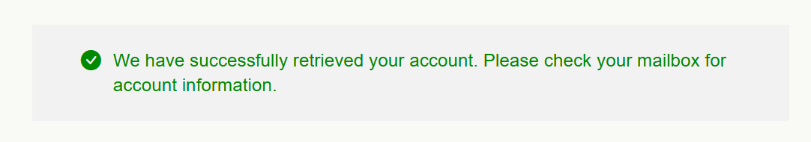
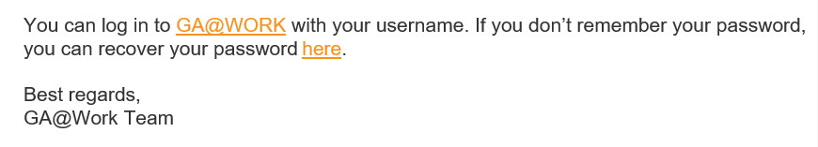
Request Extended Enterprise Learner –
Recover Account/Password (Part 2 of 4)
INSTRUCTIONS
͏Access your email to view account information.
  Note: You can also recover your password using the link provided in your email.
In the body of the email you receive, click the link to recover your password.

Slide 15
Request Extended Enterprise Learner –
Recover Account/Password (Part 3 of 4)
INSTRUCTIONS
͏Click Native Login.
Click Forgot Password.

Slide 16
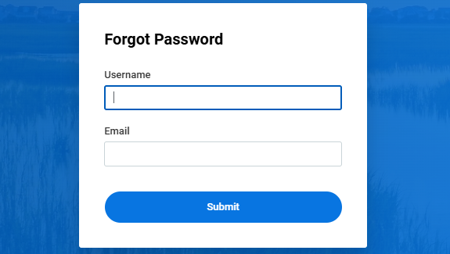
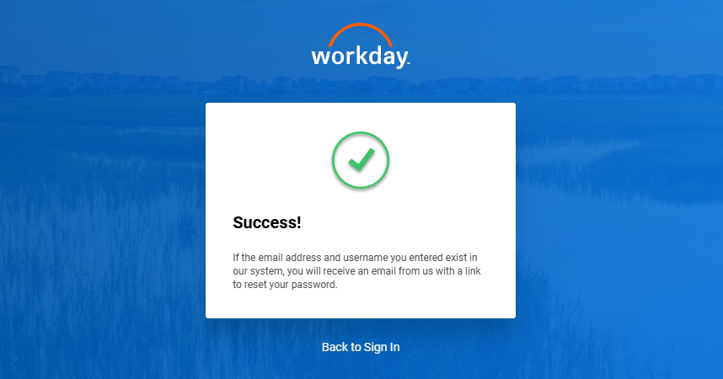
Request Extended Enterprise Learner –
Recover Account/Password (Part 4 of 4)
INSTRUCTIONS
͏Enter your Username and Email.
Click Submit.
10
11
View confirmation of Submission.
  Note: You will receive an email with the link to reset your password. The link will be valid for 1 hour.
You have now successfully Requested Extended Enterprise Learner as a New User.

