Slide 1
Talent Review: Manage Certifications
This guide will assist Employees with the steps to Manage Certifications from their Profile.
Click Profile.
Select Career.
Edit Certifications.
Complete required fields.
Click Close.
Employee certification is Needed
Complete Talent Review: Manage Certifications
Click Close

Slide 2
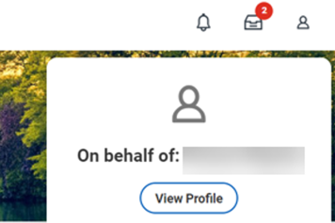
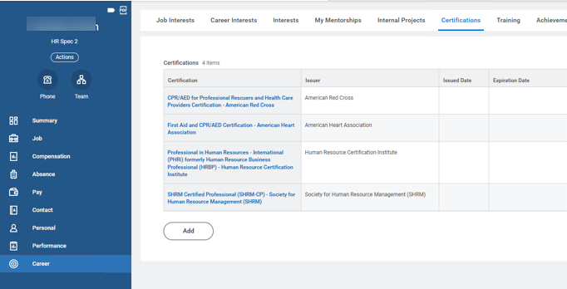
Talent Review: Manage Certifications
(Part 1 of 5)
Click Profile.
Click View Profile.
1
2
Click Career.
Select Certifications to review or add certifications.
4
3

Slide 3
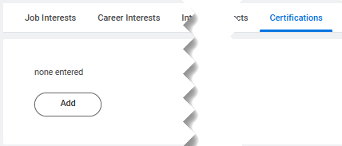
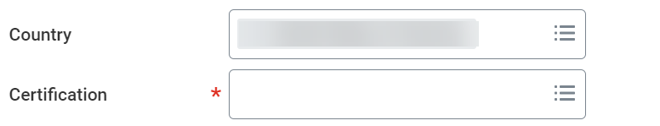
Talent Review: Manage Certifications
(Part 2 of 5)
Click Add (+).
Select the Country.
Select the Certification*.
6
7

Slide 4
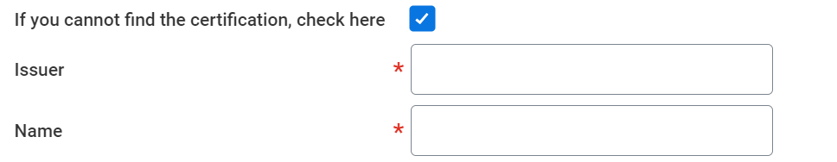
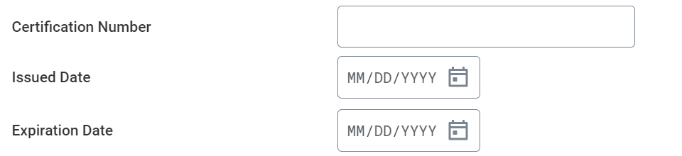
Talent Review: Manage Certifications
(Part 3 of 5)
Select the If you cannot find the certification, check here box, if applicable.
Note: Please reach out to the Help Desk to have the certification added.
Enter the Issuer* of the certification.
Enter the Name* of the certification.
8
9
10
Enter the Certification Number.
Select the Issued Date and the Expiration Date.
11
12

Slide 5
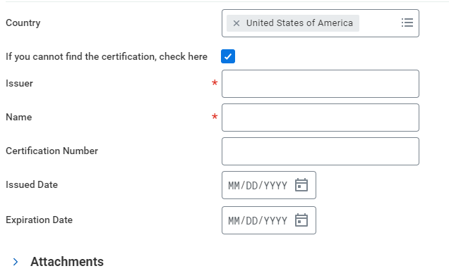
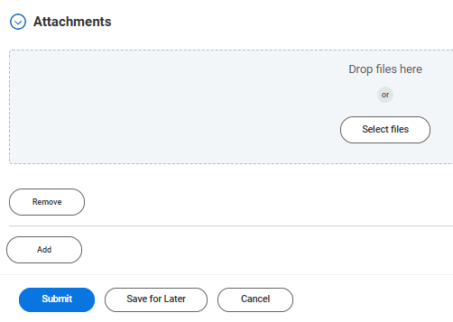
Talent Review: Manage Certifications
(Part 4 of 5)
Click Attachments.
Note: Attachments are required for Certifications. If an Attachment is not added, you will receive an error message.
Click Select Files to attach documents as applicable.

Slide 6

Talent Review: Manage Certifications
(Part 5 of 5)
Click Submit.
You have successfully managed your certifications from your profile.

