Slide 1
Procurement Huddle
August 26, 2026
Notes:
Carrie– Welcome

Slide 2
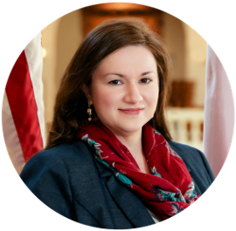

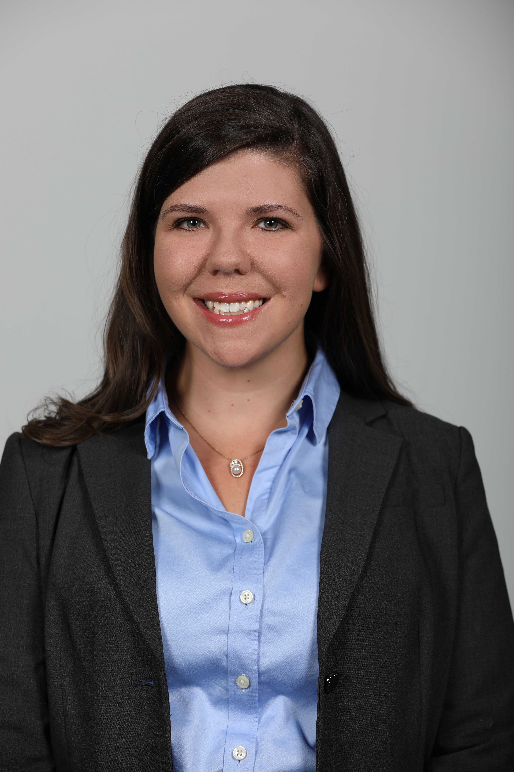
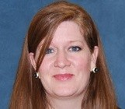
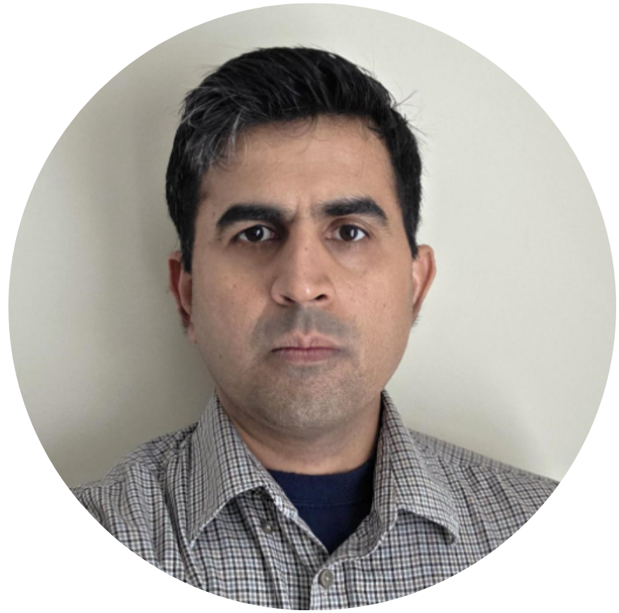
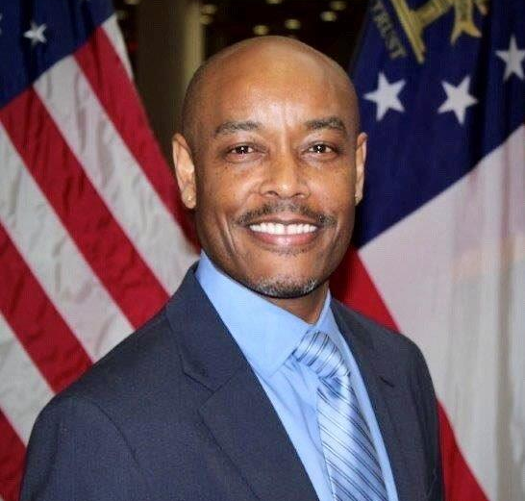
Presenters and Support Team
Mary Chapman
Sheree Reddick
Diana Tiernan
Deputy Division Director,
State Purchasing Division
Senior Training Manager,
State Purchasing Division
Organizational Change
Management Lead, Deloitte
Becky Alexander
Vinod Kalpathi
Osborne Johnson
State Purchasing Card
Program Manager,
SPD – Purchasing Audits
Sr. TeamWorks TGM Consultant,
Information Technology
Sourcing Manager,
SPD – Agency Sourcing
Notes:
All presenters to introduce themselves

Slide 3
Agenda
Welcome and Support
Reminders
Agency Readiness
Training
Requisition and Purchase Order
GA@WORK Release Highlights
P-Card Hot Topics
Notes:
Mary

Slide 4
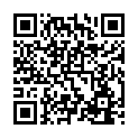
How are we doing?
Your feedback helps us continue to improve.
SCAN ME
Scan to share your feedback
It only takes a few minutes.
Notes:
Please give us 10 out of 10!!

Slide 5
REMINDER: Get help with GA@WORK
Start with Self-Service Options | Before using the below options, contact your agency’s internal support team or visit the GA@WORK Support Portal
Be prepared | When reaching out for assistance, have your employee ID and description of the issue available
I NEED HELP WITH ...
Absence Management
Time Tracking
Payroll
Financials
HCM Core
Benefits
Compensation
Learning
GA@WORK Training
Payroll Shared Services
Travel & Expense
Recruiting
Talent Management
Procurement
Suppliers
Security
P-Card
GA@WORK Marketplace
Contact SAO support teams using one of the below options
Contact DOAS support teams using one of the below options
Submit a GA@WORK Ticket
Submit a GA@WORK Ticket
770-357-5555
770-357-5555
Live Chat
Live Chat
July: M-F 7 a.m. – 7 p.m. | August: M-F 8 a.m. – 6 p.m.
September: M-F 8 a.m. – 5 p.m.
M-F 8 a.m. – 5 p.m.
Didn’t find what you need? Click here for more support options.
Notes:
Mary

Slide 6
System Metrics​
Mary Chapman and Osborn Johnson

Slide 7
System Activity
Procurement by the numbers
22,255
17,253
1,999
5,657
Requisitions
Created
Purchase Orders Created
Learning Lab Attendees
P-Card
Transactions Imported
All metrics are cumulative totals since GA@WORK go-live (July 1, 2026 – August 21, 2026)
CONTRACTS
SUPPLIERS
SOURCING
884
New Contracts Created
394
Contracts Renewed/Amended
1,010
Suppliers Trained on Registration and Bidding
278
Statewide Contract Suppliers Trained
130
Sourcing Events Created
96
Sourcing Events Posted

Slide 8
1 Month in GA@WORK
By the Numbers
July 1 - 31, 2026
15,000+
Average daily GA@WORK logins
814
New hires added
to the system
1,449
Inter/Intra-Agency Transfers
50,000+
Average number of reports run each day
125,000+
Bidders and suppliers successfully migrated
124,000+
Direct deposit transactions over two successful payroll runs
5,000+
Contracts successfully integrated into GA@WORK

Slide 9
What we heard - Contracts
End-user feedback on Contracts
The screenshots are extremely helpful
Great guidance on termination reviews
Excellent and valuable information
Informative and practical training
Demonstrations made the process easier to understand
Notes:
Os

Slide 10
What we heard – Sourcing and Learning Labs
End-user feedback on Sourcing Module and Procurement Learning Labs
The new system feels easier to use
The scenario examples are a great help
Learning Labs are impactful and informative
Love the tips, tricks and integrated job aids
Searching feels intuitive, almost like Google
Notes:
Os

Slide 11
What’s Next
2026
1
Continued Training
2026
2
System Update Releases
2027
3
Mobile App roll out
2027
4
Continued education at annual HR, Finance, Procurement conferences
2027
5
Continued Optimization
Notes:
GA@WORK is our system for the future! We can expect periodic updates to the system from the software publisher. Workday Releases 2x a year – there may be new trainings, etc. to watch out for, so stay tuned. The next release is September
GA@WORK User Community
Highlight some items from optimization list
GA@WORK mobile functionality

Slide 12
Agency Readiness
Diana Tiernan
Notes:
Diana

Slide 13
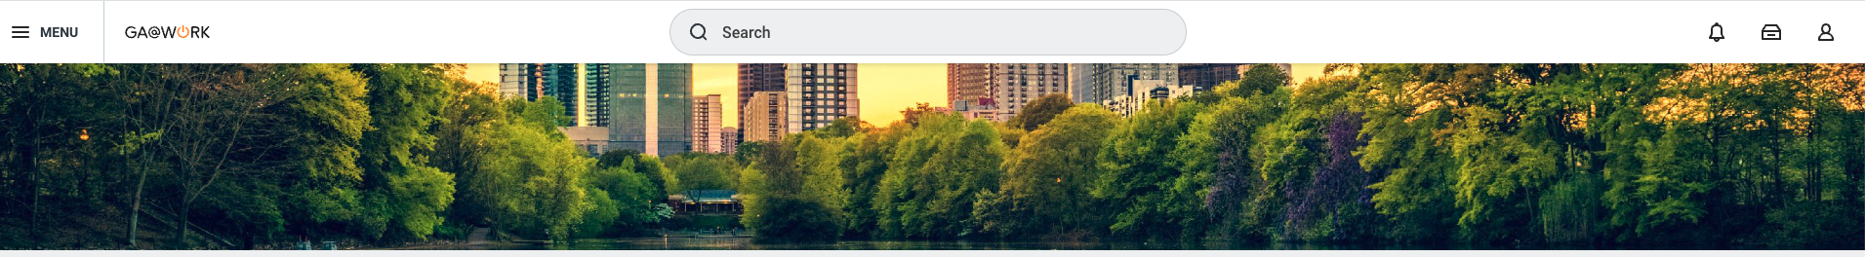
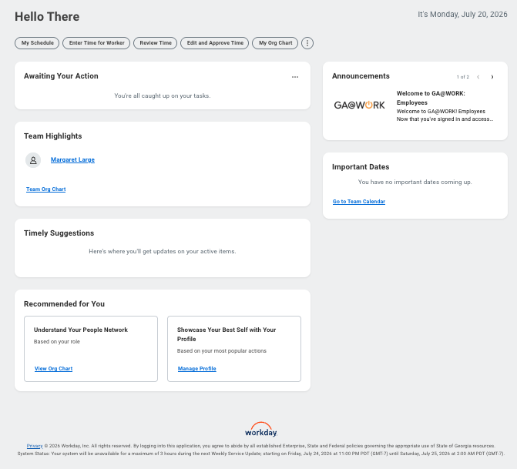
GA@WORK system availability
Where to look for system outage information
1
System maintenance information will be available in the Announcements panel on the upper-right corner of the homepage, and as a banner on the GA@WORK Support Portal.
Regularly scheduled Workday outages will be listed in the Footer of your home page.
You can expect additional occurrences when the system will be unavailable for short periods for data conversions, system maintenance and updates over the next month.
1
2
2
Notes:
As a reminder, just like in TeamWorks, GA@WORK will have system outages for maintenance.
There will be outages due to system configuration changes, managed by the state, and outages deployed by Workday.
In fact, there was one last weekend.
We are communicating state maintenance in a few ways – Within the GA@WORK system announcements, (you can see the example here in #1)
In Stakeholder meetings (the one for last weekend was shared in the Friday Change Network Halftime Report) and as a banner at the top of the home page on the GA@WORK Support Portal
You can find Workday planned system outage information at the very bottom of the GA@WORK homepage, as indicated here in #2.
If you go there now, you can see the System Status. Note this is provided in Pacific time, which is 3 hours later than our Easter time.
As a reminder:
Over the next month, you can expect additional occurrences when the system will be unavailable for short periods for data conversions, system maintenance and updates.

Slide 14
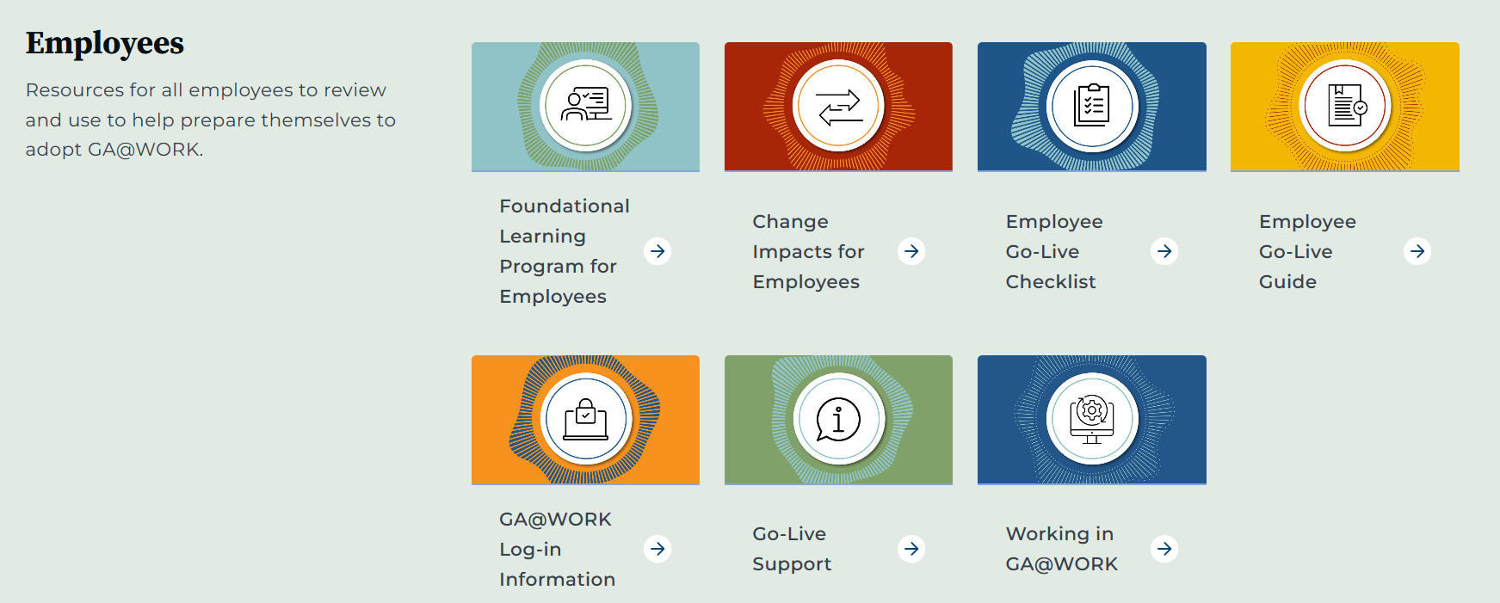
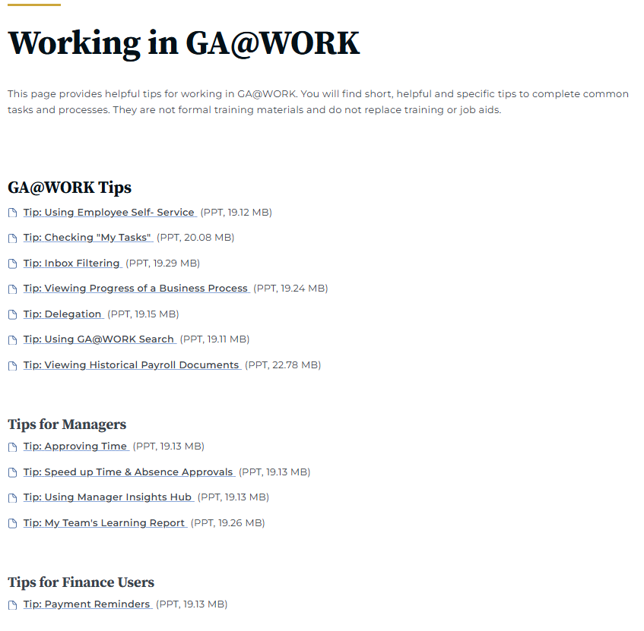
Tips for working in GA@WORK
Tips to build GA@WORK muscle and increase efficiency are available on both the Support Portal and the GA@WORK Resource Library.
Review these tips and share them with your colleagues.

Slide 15


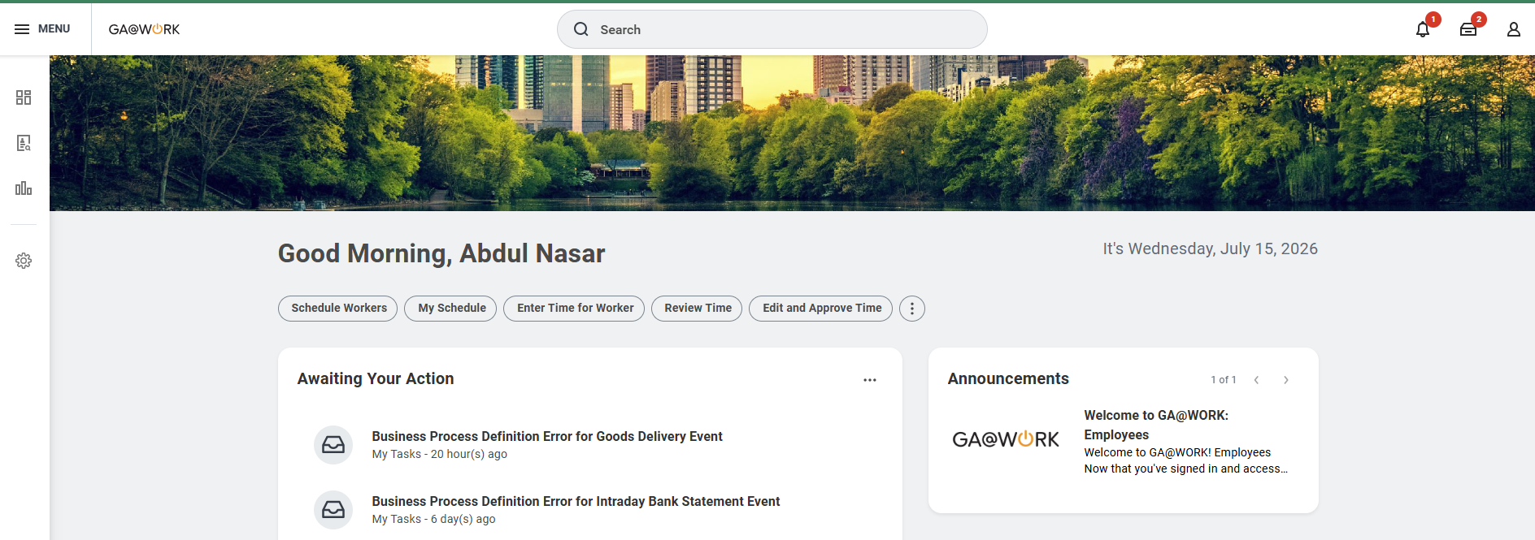
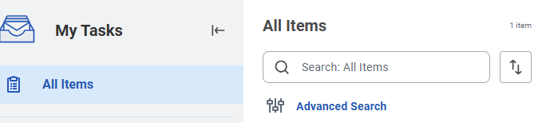
Tip: Check “My Tasks” Daily
Delivered by The NextGen Project
“My Tasks” Today. No Delays Tomorrow.
“My Tasks” is for everyone. Managers and task approvers should check their “My Tasks” daily at minimum to avoid delays.
Check “My Tasks” in a variety of ways, including:
1
Open “My Tasks” anytime from the top navigation.
2
Review tasks awaiting your approval from the homepage.
John Doe
3
Open and complete items ready for action in “My Tasks.”

Slide 16
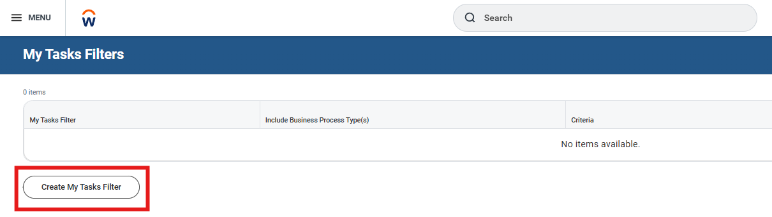
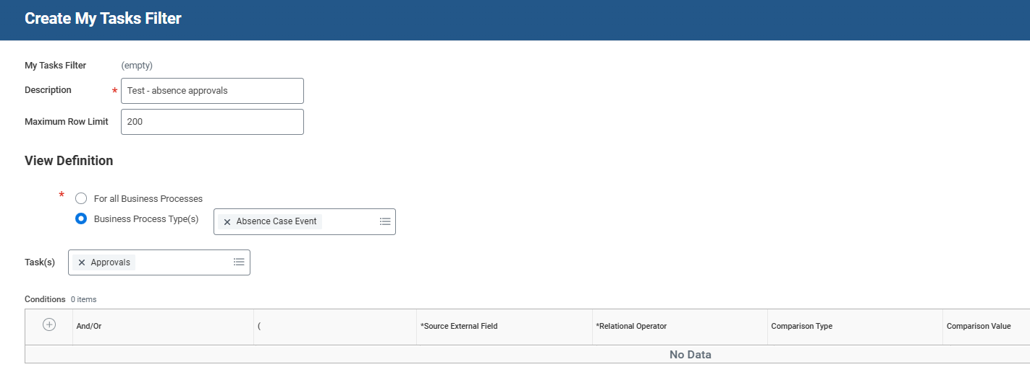
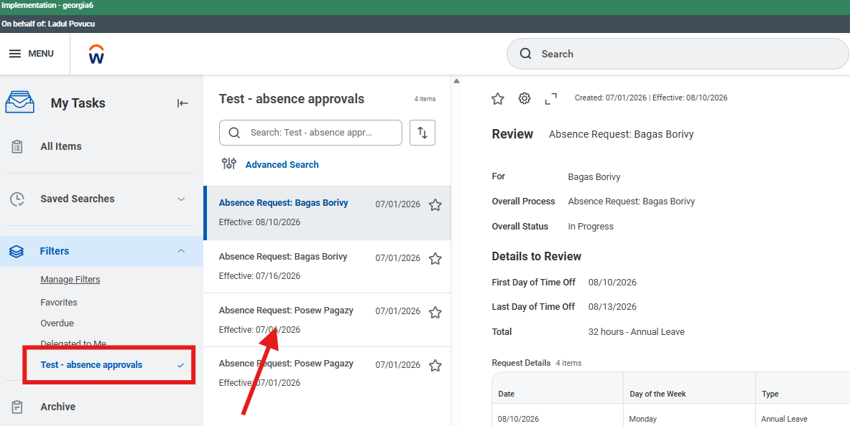
Tip: Set Up a Filter in Your Inbox
Use inbox filters to focus on the tasks you want to review first.
Navigate to your “My Tasks” inbox.
1
3
In the left panel, select “Filters,” then select “Manage Filters.”
2
4
Select “Create My Tasks Filter.”
3
Create a filter for the business processes and tasks you want to track (e.g., Absence Case Event).
4
Return to your inbox and select your new filter to see those specific transactions.
5
5

Slide 17
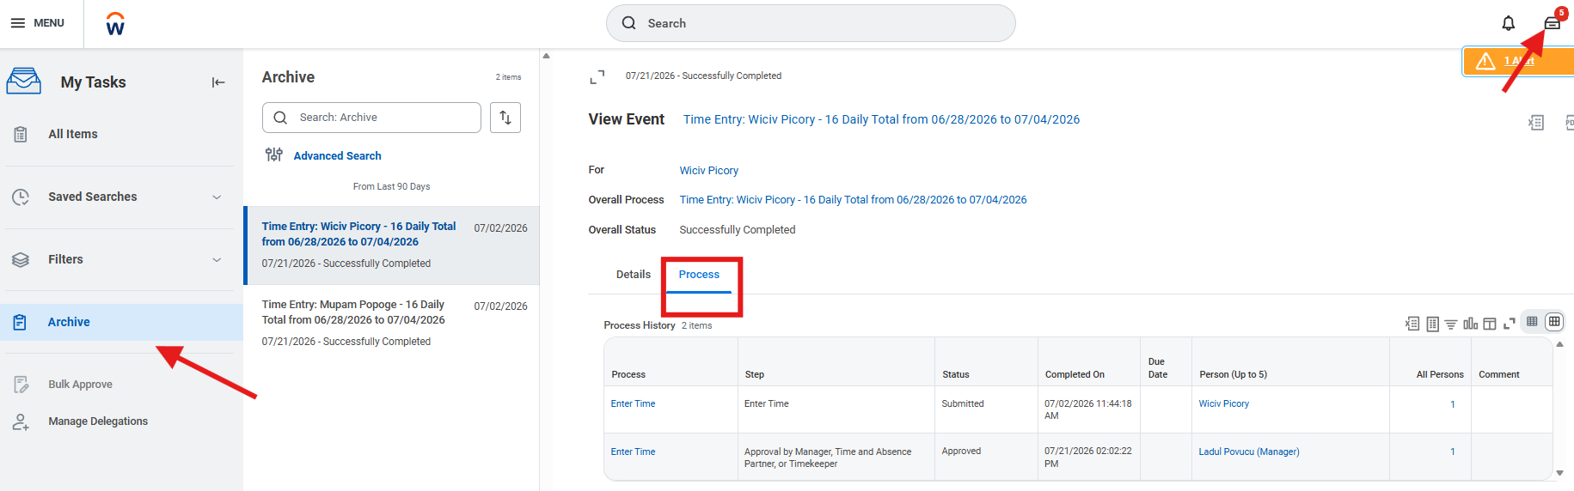
Tip: View In-Progress Business Processes
Follow the steps to view the next step for a business process requiring approval.
1
3
3a
2
Navigate to your “My Tasks” inbox.
1
In the left panel, select “Archive.”
2
You can now select the “Process” tab on any of your recently submitted or approved transactions.
3
“Step” will show you what step your business process is in.
3a

Slide 18
Training​
Sheree Reddick

Slide 19
Job Aid Downloads
7,710
Job Aids Downloaded
GA@WORK Procurement Web page
Most Downloaded Job Aids
Downloaded by Topic
Export Event Reports
Create P-Card
Purchase Order
Register as a
Prospective Supplier
P-Card
Strategic Sourcing
Supplier
Requisition to
Purchase Order
2,134
2,675
2,113
2,307
1,460
793
774
Notes:
I’m extremely excited about our GA@WORK Procurement Web Page and the great training resources that are available there.
We’ve had 7,710 job aid downloads from the GA@WORK Procurement webpage. When we look at the individual resources, Export Event Reports, Create P-Card Purchase Order and Register as a Prospective Supplier are our three most downloaded job aids.
Looking at downloads by topic, P-Card leads with 2,675 downloads, followed closely by Strategic Sourcing with 2,307. We’re also seeing significant interest in Supplier resources.
So, please continue to take advantage of the job aids available on the Procurement webpage—and let us know if there are areas where additional guidance would be helpful.

Slide 20
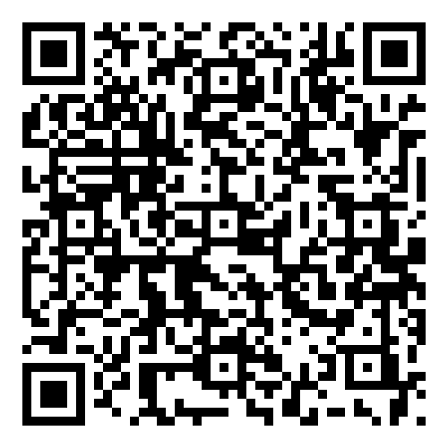
Additional Learning Lab Topics and Dates
Learning Labs Resources
Scan To Access
Additional Topics Available
View upcoming Learning Labs topics and dates.
Register and Review
Register for Learning Labs and review previously recorded sessions.
Learning Lab topics, registration and recordings.
Notes:
Also on our GA@WORK Procurement webpage, you can register for Learning Labs.
We have additional topics and dates available, so I encourage you to take a look at what’s coming up and register for the sessions that are most relevant to your work.
We’re also making the recordings from previous Learning Labs available, so if you missed a session—or want to revisit a demonstration—you can go back and watch it.
You can scan the QR code here to access the Learning Lab page, where you’ll find upcoming topics, registration links, and recordings all in one place.
These labs are a great way to continue building your GA@WORK knowledge beyond Office Hours.

Slide 21
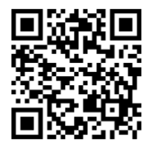
External Learners
Learners who do not have a worker account inside of GA@WORK but are associated with certain Affiliations
ACCESS ELRA
CREATE
ACTIVATE
No training history in the DOAS legacy Learning Management System (LMS), Team Georgia Learning? Create an External Learner Registration Application (ELRA) account.
Training history exists in the DOAS legacy LMS. Team Georgia Learning? Activate your existing account.
Scan to access the External Learner Registration Application.
Notes:
I also want to highlight an important update for our external learners.
External learners are individuals who do not have a worker account in GA@WORK but are associated with certain affiliations and need access to GA@WORK Learning.
The key thing to remember is that there are now two paths: Create or Activate.
If you do not have training history in our previous DOAS Learning Management System, Team Georgia Learning, you’ll select Create to establish a new external learner account.
If you do have training history in the legacy LMS, you’ll select Activate. This allows you to activate your existing learner record rather than creating a new one, which is important for maintaining your training history.
If you’re an external learner—or you’re helping someone who is—you can scan the QR code to access the External Learner Registration Application, or ELRA, and select the option that applies to you

Slide 22
Register for Procurement Instructor Led Training
GA@WORK and non-system course offerings are now available.
  Available for All users
  Offered Virtual
  Registration Deadline
  Registration closes two days before each class.
Notes:
I’m also excited to share that our instructor-led procurement training is officially underway. We kicked off our first Fundamentals of State Purchasing course today. The class is full, and we’re off to a great start!
We have additional instructor-led course offerings already scheduled through December, including both GA@WORK system training and our non-system procurement courses.
These courses are available to both internal and external learners, and our current offerings are being delivered virtually.
As you’re looking ahead at your training needs, I encourage you to check GA@WORK Learning and register early. Registration closes two days before each class, and as we’re already seeing with Fundamentals, classes can fill up.
So, if there’s a course you’ve been waiting to take, log in to GA@WORK Learning and reserve your spot.
Demo then proceed to the next slide?

Slide 23
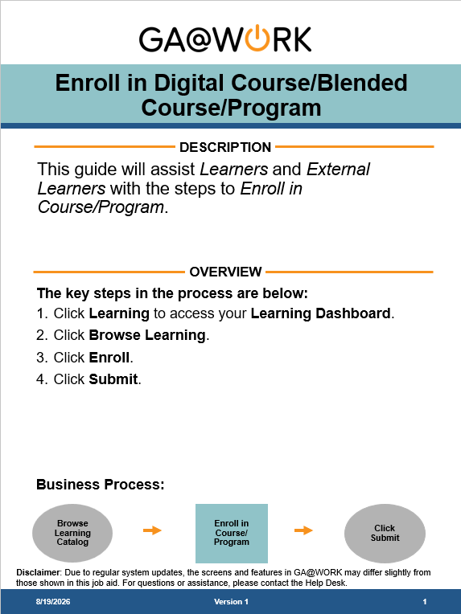
Enroll in Digital Course/Blended Course/Program
Available in GA@WORK
Type “enroll in digital course” in the global navigation bar
Sort by Articles in search results
Click to download job aid

Slide 24
Requisition and Purchase Order
Vinod Kalpathi
Notes:
Vinod

Slide 25
Requisitions and Purchase Orders
Converted
Not Converted
Applicable purchase orders and associated un-invoiced receipts were converted.
Lines with less than $1 remaining
Employees or inactive suppliers
Very Few issues reported with converted PO amounts.
Need Help?
Submit an SAO service request for budget or worktag questions related to converted POs.
NEXT: Workday 2026R2 UI and requisition/PO changes.

Slide 26
GA@WORK Release Highlights
GA@WORK (Workday) 2026R2 Item Summary
Notes:
Vinod

Slide 27
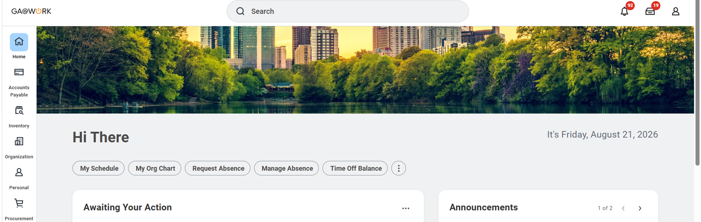

GA@WORK (Workday) 2026R2 Release
Release will be effective as of Monday September 21
528 Release items, out of which, we have identified approximately 10 in scope for procurement.
Important! Homepage UI / UX change: homepage looks different and the menu items are arranged under folders.
  Create Requisitions is moving to the Requisitions App
  Searching for "Create Requisitions" will also direct users to the Requisitions App.

Slide 28
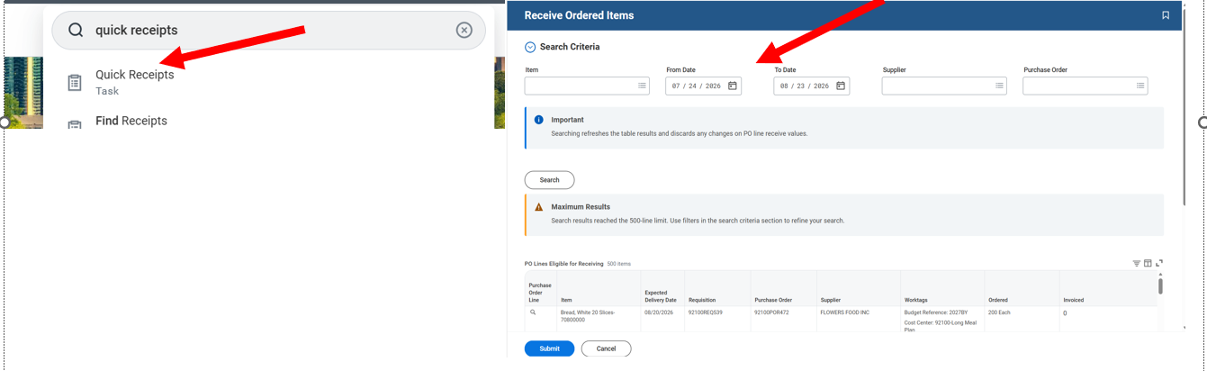
GA@WORK (Workday) 2026R2 Release
PO receipt efficiency: "Quick Receipt" task in release enables receiving multiple PO lines, from different POs on the same page. The POs can be searched by supplier, PO and/or date range.
  There is also a "Manage My Receipts" task that will help users in maintaining all their initiated receipts in one page.
This will be available only after a change request approval by leadership as this feature is not "automatically available". A security configuration, to enable this feature for buyer and receiving specialist roles need to be performed. We recommend this to be performed but will wait for leadership approval.

Slide 29
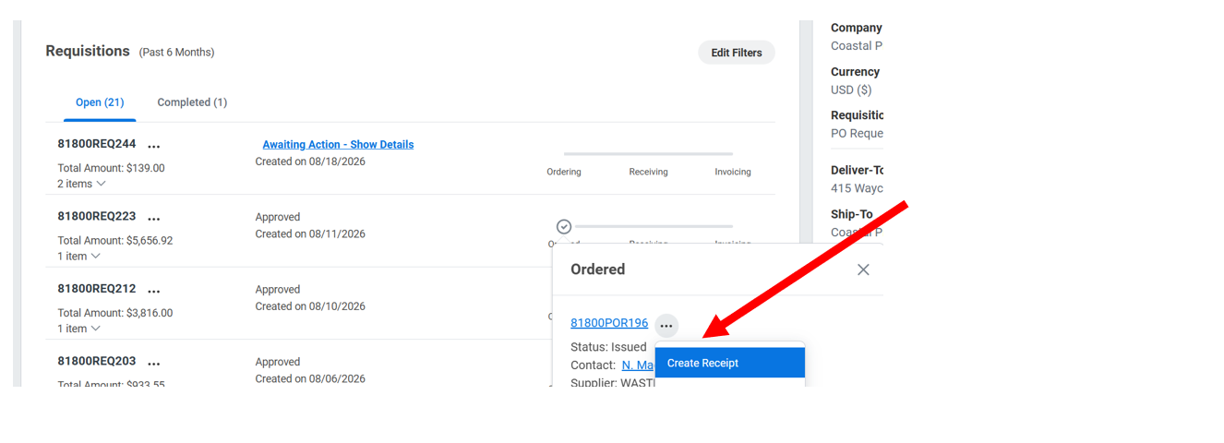
GA@WORK (Workday) 2026R2 Release
Related Actions From Requisitions App: Requisitions app will be enhanced and related actions will be available on the purchase orders, receipts, and supplier invoices associated with your requisitions on the Requisitions app. This will be automatically available.

Slide 30
P-Card Hot Topics
Becky Alexander
Notes:
Becky

Slide 31
P-Card Hot Topics
Common questions from administrators, cardholders, and agencies
Q: Does a P-Card Prior Approval Request encumber funds?
A: No. P-Card Prior Approval Requests do not encumber funds. To encumber, use the REQ/PO process instead.
Q: We don't use POs for P-Card purchases. Do we still need a non-PO requisition?
A: No. The P-Card Prior Approval Request serves as the authorization to purchase, REQ-to-PO is only used on an as-needed basis. Either can be used for approval.
Q: When creating a delegate, does the P-Card Administrator need to be the alternate?
A: Yes. For both cardholder verification delegations and manager/approver delegations, the Alternate Delegate should be set to the P-Card Administrator, with "Use Default Alternate" unchecked.

Slide 32
P-Card Hot Topics
Q: Is the cardholder required to attach the finalized approved request to their P-Card reconciliation?
A: They are required to reference the PCPA (P-Card Prior Approval Request) when doing verification, in the memo field. It's good practice to attach the request as well, but the memo field reference is what's required.
Delegation setup differs by role:
Cardholder
Managers / Approvers
Delegate Verification only.
Select "Start On My Behalf" for the business process "Procurement Card Transaction Verification
Do not delegate request initiation; anyone may create a P-Card Prior Approval Request.
Create two separate delegation rows:
Prior Approval Requests – Do My Task On My Behalf
Verification – Do My Task on My Behalf
Submit both rows for complete coverage.
Set the Alternate Delegate to the P-Card Administrator, leave Use Default Alternate unchecked, and enter an end date.

Slide 33
Reminders
Mary Chapman

Slide 34
Save the Date
Upcoming procurement events
GFMC
September 20-23
Sunday – Wednesday
Georgia Fiscal Management Council
Procurement Huddle
September 30
1:00 – 2:00 PM
Wednesday

Slide 35

GA@WORK stay in the know!
Check out the
GA@WORK Procurement website:
GA@WORK Procurement | Georgia Department of Administrative Services - DOAS
Follow us on LinkedIn:
@ GA State Accounting Office
@ Georgia DOAS State Purchasing Division
Notes:
Mary
As we close out, it is important to note that we have several items in the works:
In a follow up email, we will send you this presentation. We will share with you video links to the virtual agency preview sessions (not training), a link to our website with FAQs, and our one-page procurement flyer.
If you have questions and want to stay up to date on the project, we have several options:
Questions can be sent to the NextGen email box – nextgen@sao.ga.gov
You can visit our website at sao.georgia.gov/NextGen
Connect with your point of contact for agency specific updates
Subscribe to our NextGen newsletters. You can subscribe on the website.
Follow the State Accounting Office on LinkedIn for brief project announcements.

Slide 36
SPD stay in the know!
Please use the following mailboxes to submit questions and requests:
procurementhelp@doas.ga.gov | Technical issues with the Georgia Procurement Registry, JAGGAER Sourcing Director or Team Georgia Marketplace™
spdpolicy@doas.ga.gov | Questions regarding the Georgia Procurement Manual, special approvals, etc.
cardprograms@doas.ga.gov | Questions regarding the Statewide Purchasing Card (PCard) program, plan amendments, and special approvals
Georgia.learning@doas.ga.gov | Questions about training, requests for access, issues with Learning Management System (LMS)
Doas.audits@doas.ga.gov | Questions about audits, etc.
Agency.sourcing@doas.ga.gov | Requests for assistance with solicitations, requests to exceed DPA, approval of sole sources more than $500,000, etc.
Notes:
Mary

Slide 37
Notes:
Mary

