Slide 1
GA@WORK: New Navigation Menu
DESCRIPTION
This job aid walks employees through the 7 new features introduced in the redesigned GA@WORK navigation menu.
OVERVIEW
The 7 new features covered in this guide:
Easy Access to Home – the Home button is now located in the navigation sidebar.
Categorized Navigation – hover over a category to preview and select items in one click.
Saved Items – access saved shortcuts directly from the sidebar.
Customize Your Navigation – personalize your navigation to fit how you work.
Optimize Your Screen Space – show or hide the sidebar to maximize screen space.
Reorder Categories – customize the order of your categories.
Pin Menu Items – pin your most-used items to the top of the sidebar.
At a Glance:
Explore the Sidebar
Customize Menu
Reorder & Optimize
Pin Your Favorites

Slide 2
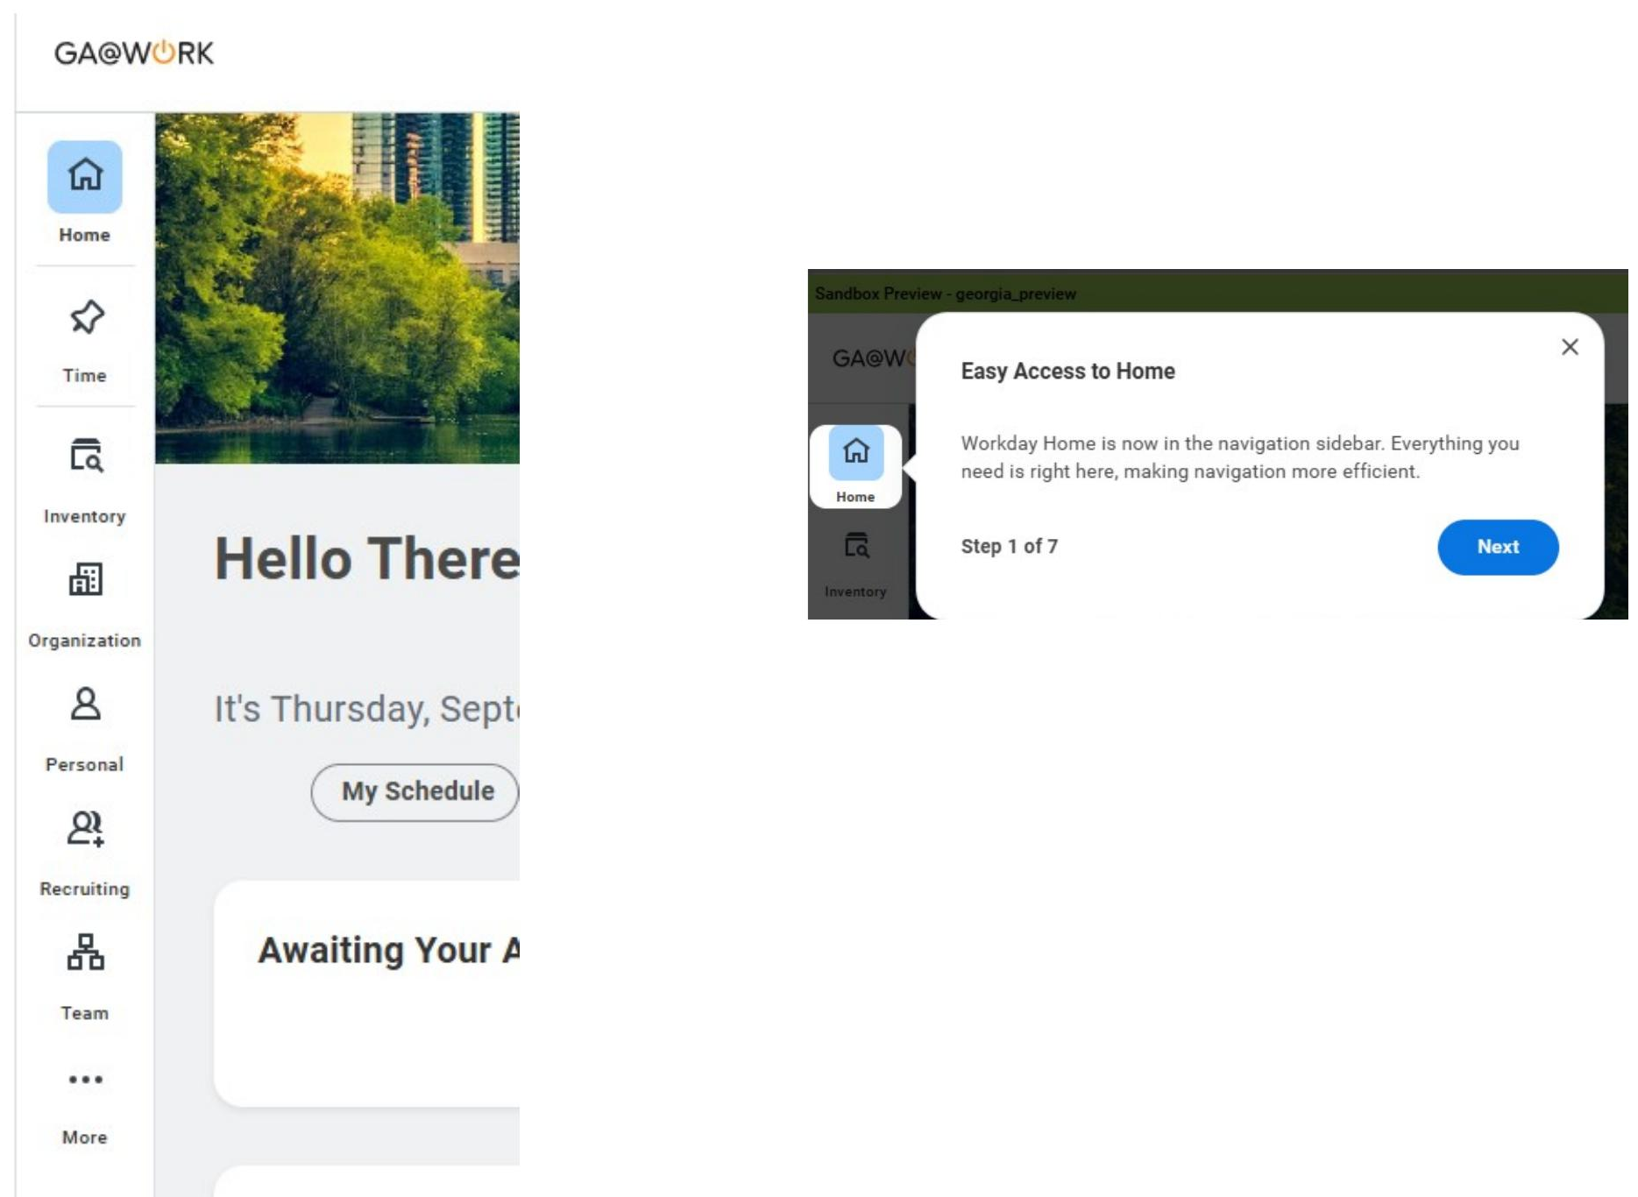
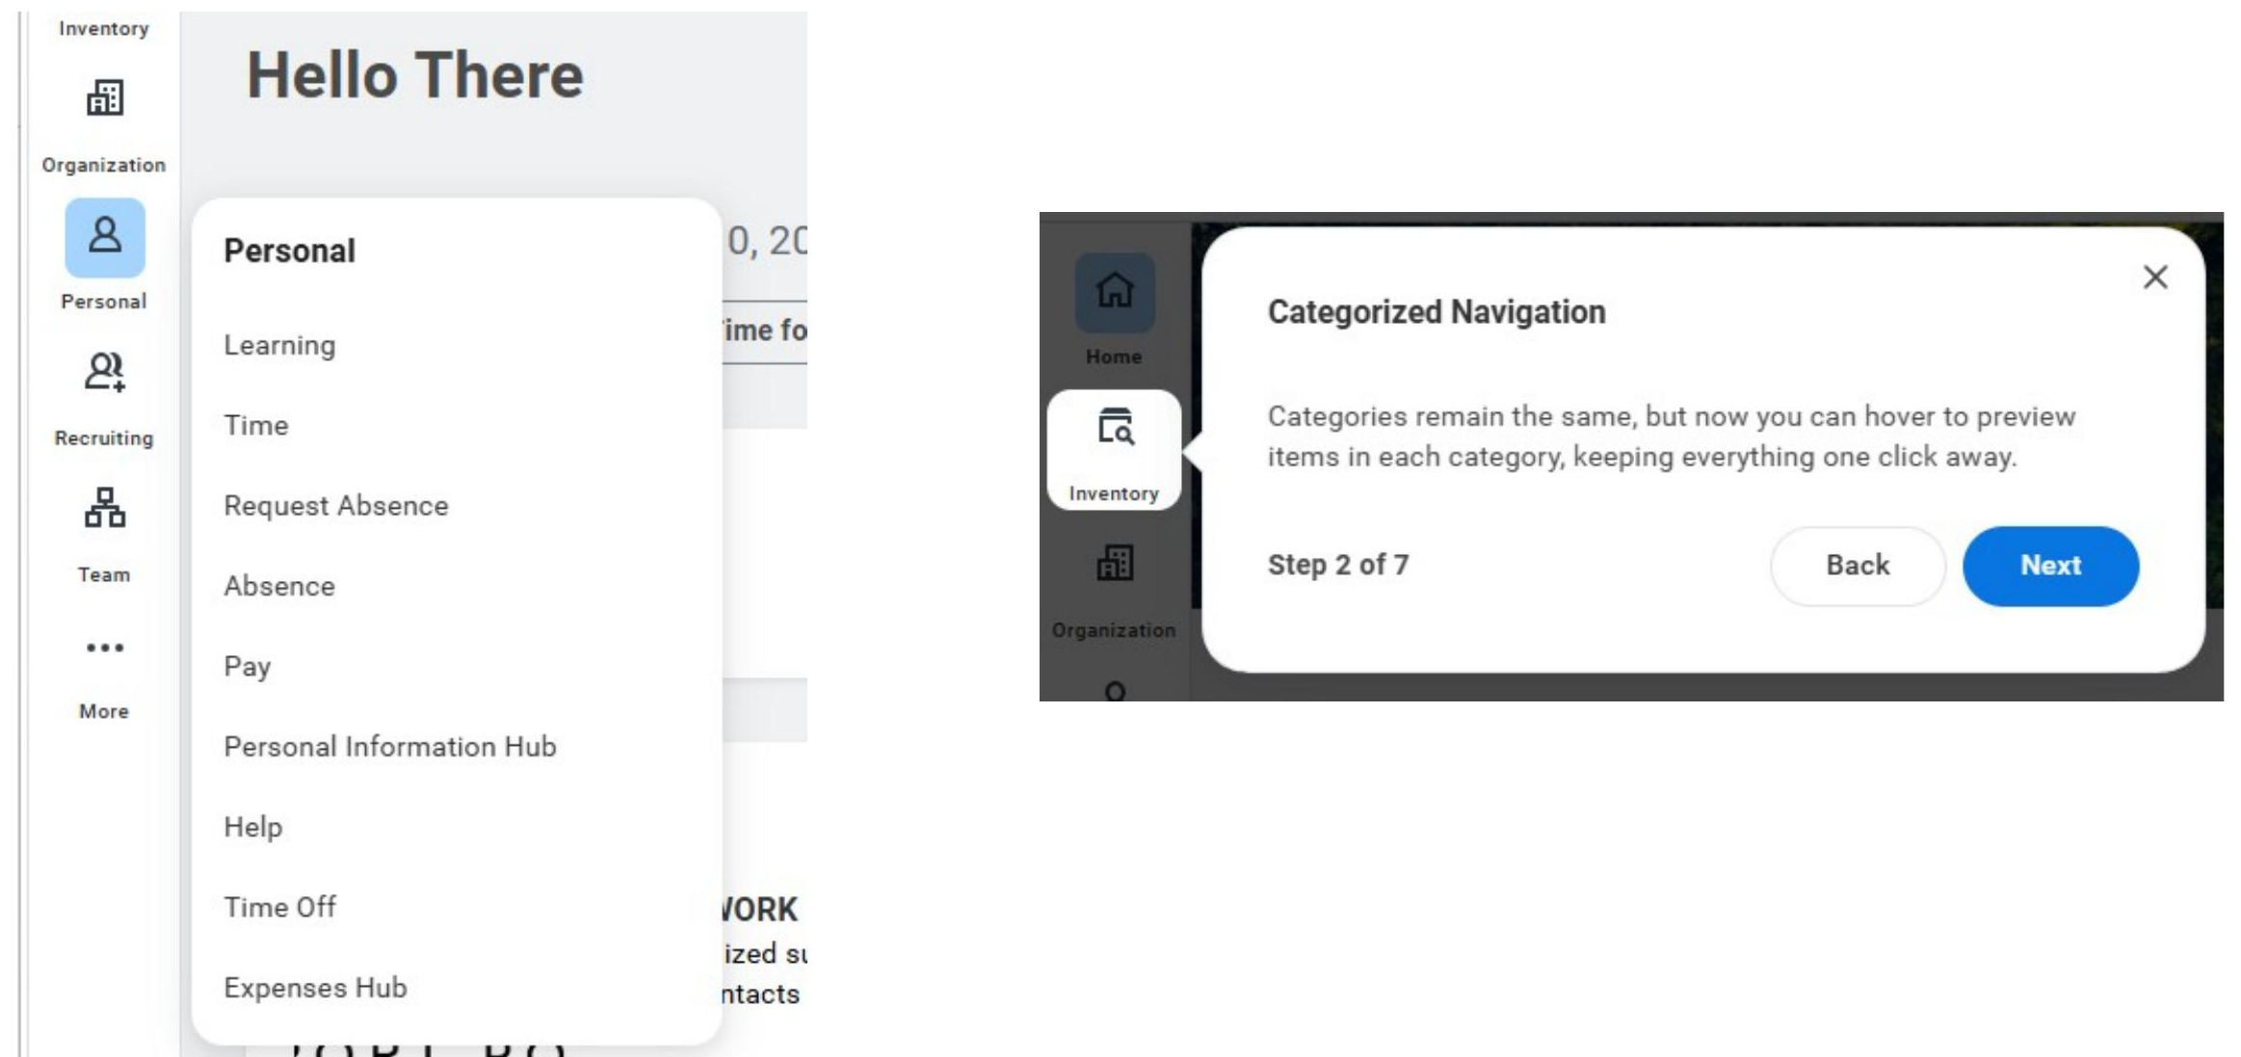
New Navigation Menu (Part 1 of 4)
INSTRUCTIONS
Select the Home button.
  Note: The Home button is now in the navigation sidebar.
1
Hover over a category to preview.
  Note: Categories remain the same, but you can now hover to preview items in each category, keeping everything one click away.
2

Slide 3
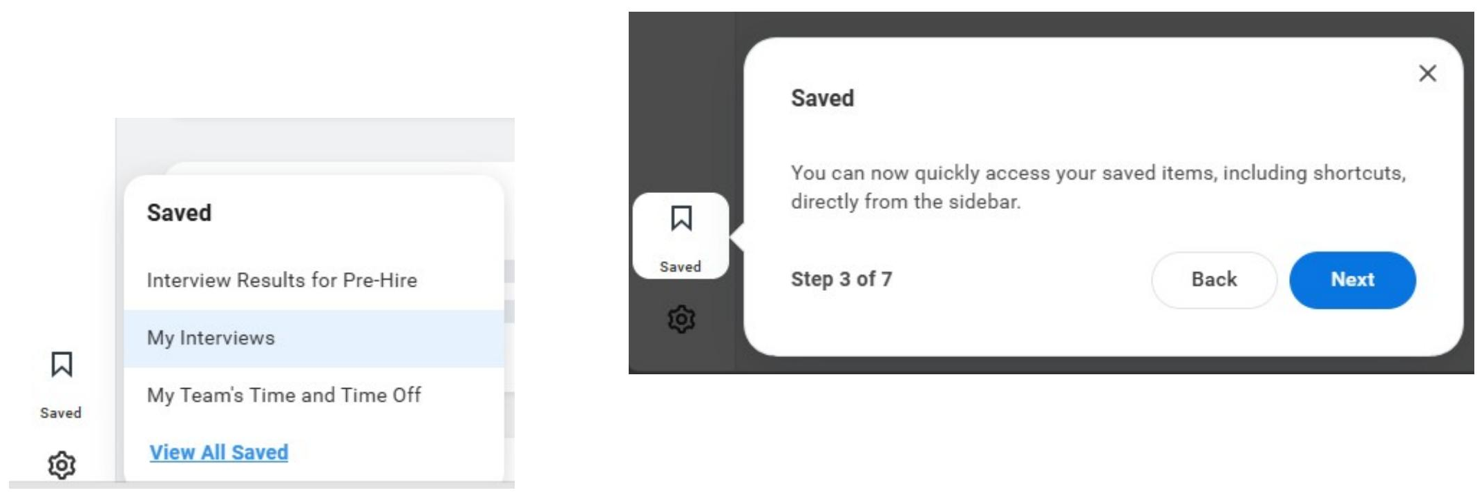
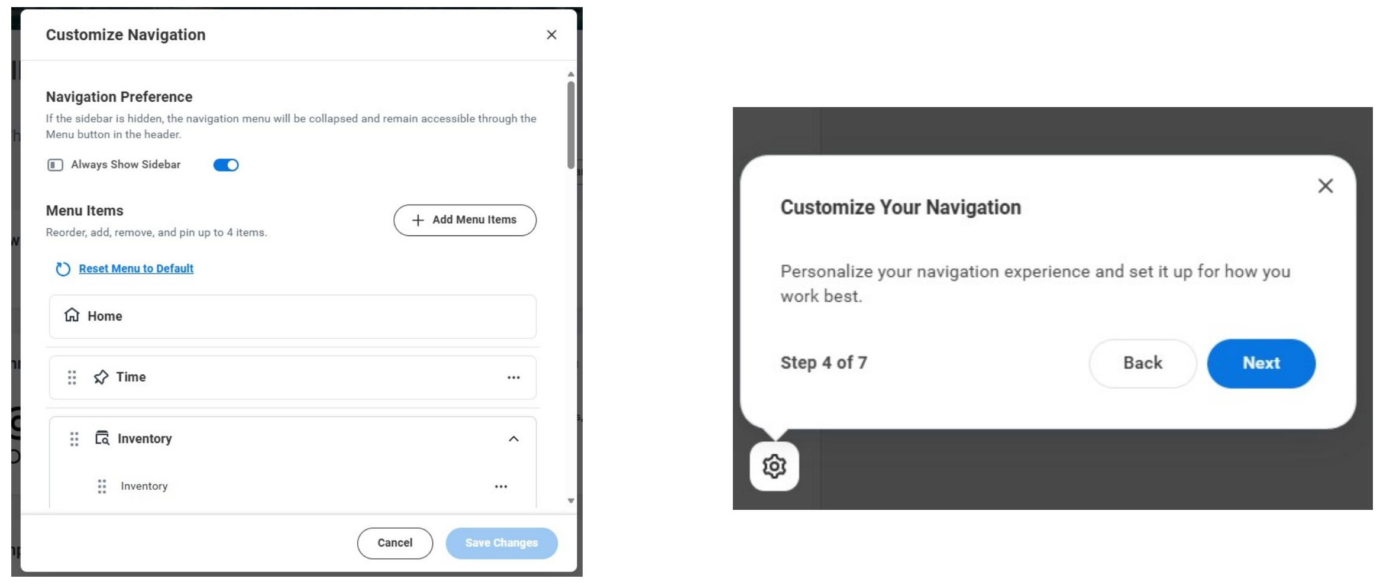
New Navigation Menu (Part 2 of 4)
Select items from the Saved menu on the sidebar.
  Note: Quickly access your saved items, including shortcuts, directly from the sidebar.
3
Select items from the Customize Navigation menu.
  Note: Set up your navigation the way that works best for you.
4

Slide 4
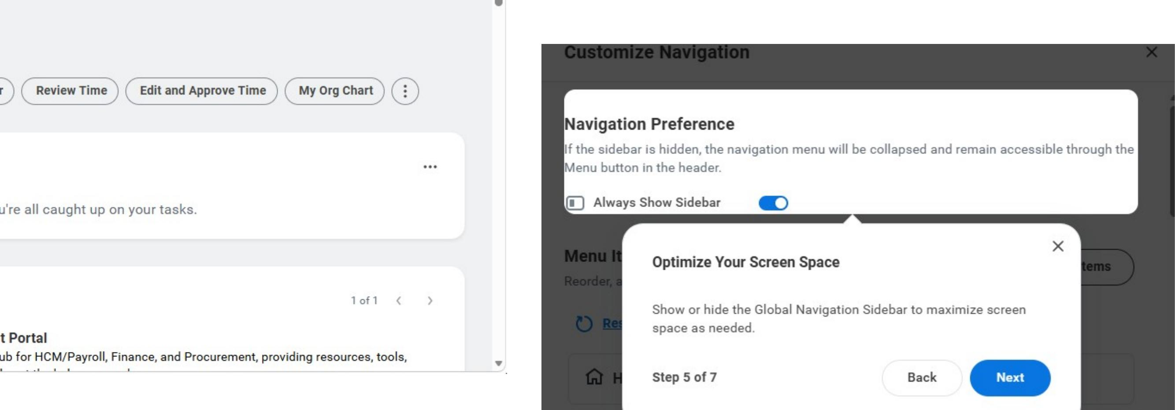
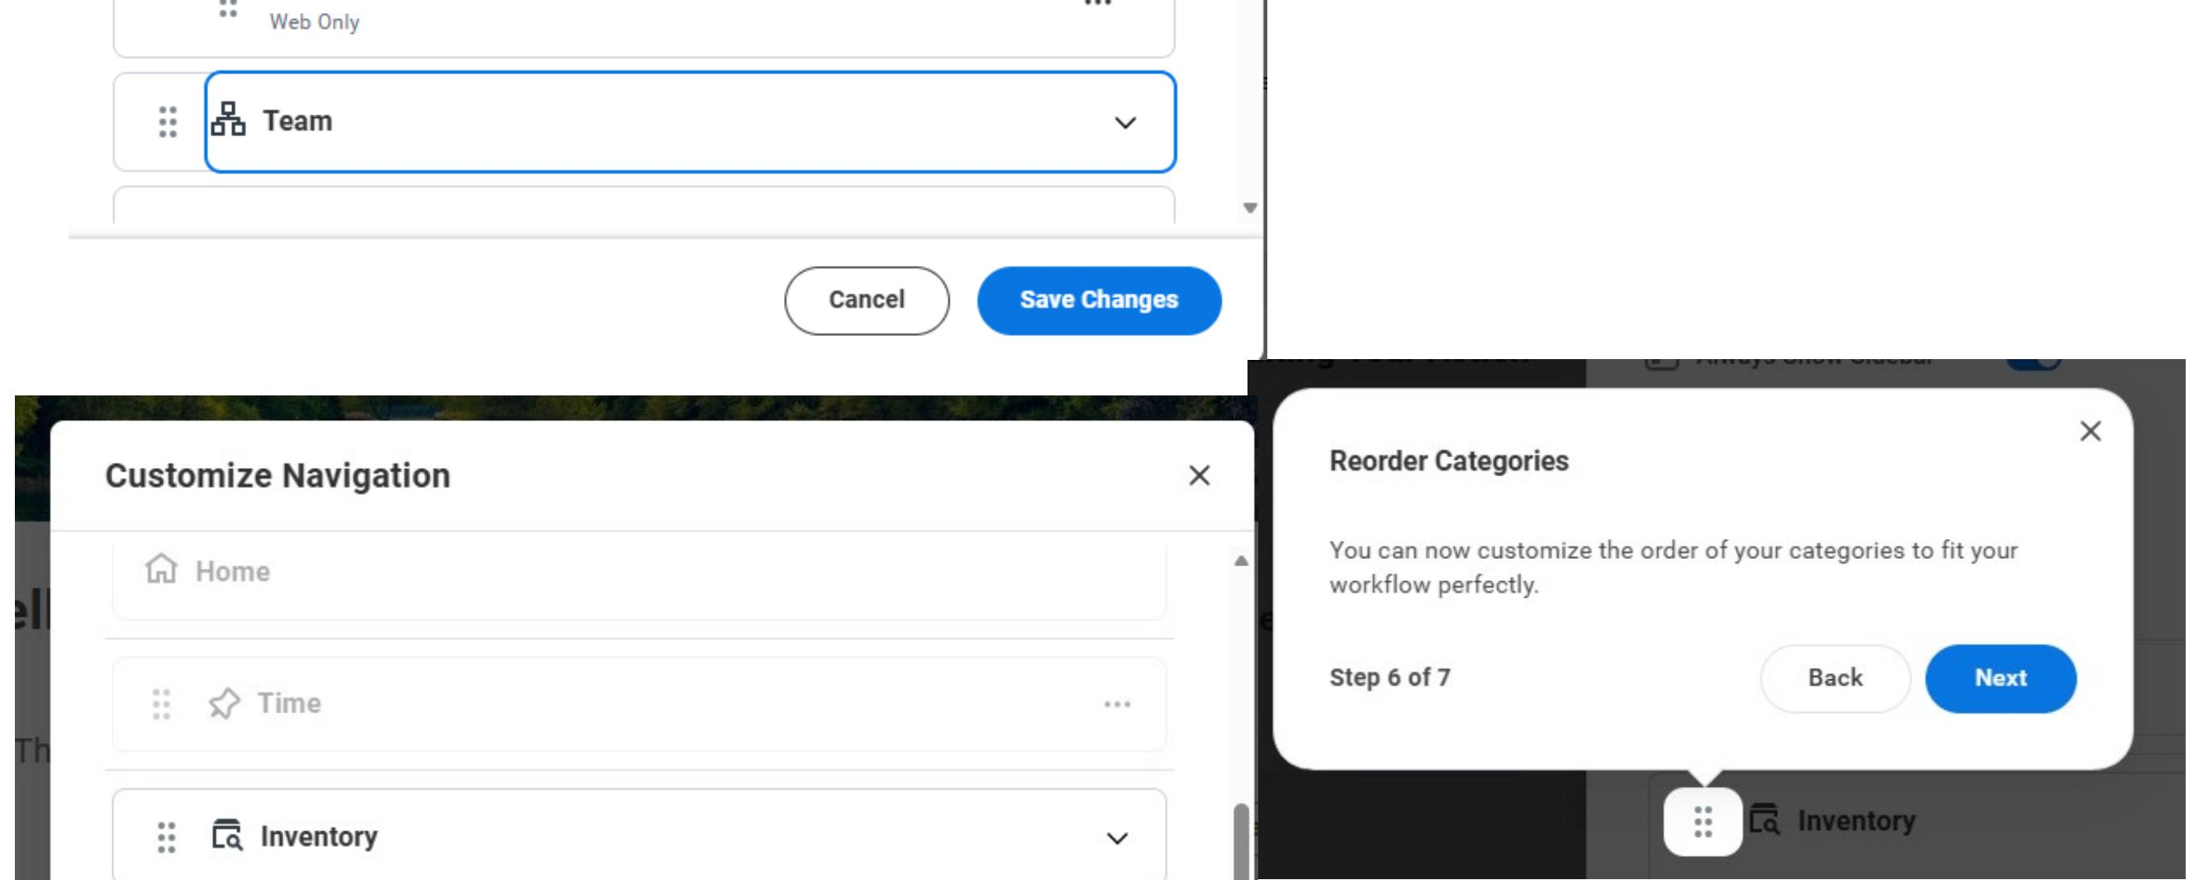
New Navigation Menu (Part 3 of 4)
Maximize your screen by showing or hiding the Navigation sidebar.
  Note: Show or hide the Global Navigation Sidebar to maximize screen space as needed.
5
Select items under Customize Navigation to Reorder Categories.
  Note: Customize the order of your categories to fit your workflow.
6

Slide 5
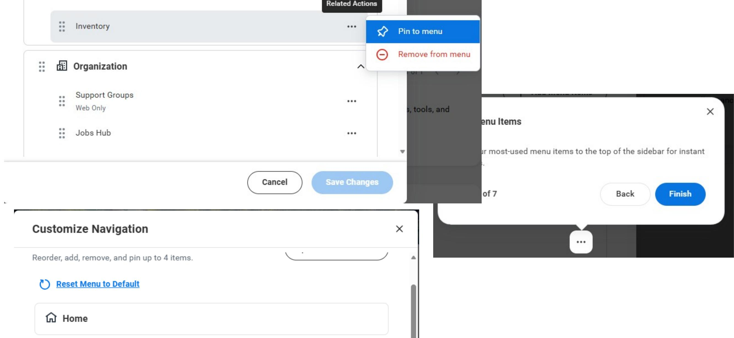
New Navigation Menu (Part 4 of 4)
Pin menu items.
Note: Pin your most-used menu items to the top of the sidebar for instant access.
7
You have successfully reviewed the new GA@WORK navigation menu.

